Slide 1

Metallurgical changes of Cryogenically treated Coated Carbide (KC9225) and its performance while wet machining (turning) of Austenitic Stainless Steel - 310
ICEC27-ICMC2018
Meghna Das Chaudhury, Raju, Anbarasu S
Department of Mechanical Engineering National Institute of Technology, Rourkela, India.
Presenters: Meghna Das Chaudhury, Raju.

Slide 2
MAJOR HIGHLIGHTS
Introduction to Cryogenic treatment.
Significance of Cryogenic Treatment on Tungsten Carbide.
Literature Study of the previous work.
Objective of the present experimental work.
Phases present in the coated carbide.
Outline of the Experimental Procedure.
Results and Discussions.
a. Microstructural Analysis using SEM and XRD.
b. Micro Hardness.
c. Machining Analysis.
d. Wear resistance analysis using FESEM and SEM.
8. Inferences.
9. Future scope of this work.
10. References.

Slide 3
1. INTRODUCTION TO CRYOGENICS TREATMENT.
‘Cryogenics’ is the branch of physics and engineering that involves the study of very low temperature, its production, application and how materials respond at those temperatures ranges.
Cryogenic Treatment started in 1930’s and 1940’s when scientists found that by dipping some metals in liquid Nitrogen, they could enhance the material properties such as hardness, thermal conductivity, toughness etc.
Classification (on the basis of temperature range) :
Shallow Cryogenic Treatment : -80 °C to -140 °C.
Deep Cryogenic Treatment : -140 °C to -196 °C.
Both the treatments are beneficial for different types of material and material respond differently to different Cryogenic treatments.

Slide 4
2. SIGNIFICANCE OF CRYOGENIC TREATMENT ON TUNGSTEN CARBIDE.
Tungsten carbide is prepared by Sintering process in which a secondary hard and brittle phase (i.e. η-phase) is produced as a result of Decarburizing reactions during sintering.
Also, this phase is generated during high temperature Chemical Vapour Deposition (CVD) coating on the substrate (WC).
Its distribution depends on the carbon content and other factors like compacting pressure, sintering temperature etc.
Cryogenic Treatment is done in order to ensure approximate uniformity in the η-phase distribution throughout the microstructure of the sample.
Uniform distribution of above will ensure the enhancement in mechanical properties of the material i.e. hardness etc.

Slide 5
The properties of Cemented Tungsten Carbide grades are generally determined by:
Binder content.
Grain size.
Secondary Carbides.
Wear Resistance
Wear Resistance
Ultra fine 0.5
<4 %
4 % - 10 %
Sub micron 0.8
10 % -16 %
Medium 1-2
>16 %
Coarse>3
Toughness
Toughness
Fig 1. Effect of Binder Content.
Fig 2. Effect of Grain Size.
Picture Source- www.tappi.org/content/events/10PLACE/papers/lemaistre.pdf

Slide 6
3. LITERATURE STUDY OF THE PREVIOUS WORK
Sr.No. | Author | Year | Work
1. | P Baldessera and C Delprete | 2008 | Cryogenic treatment led to Re-alignment of grains which relieved the internal stresses present in the material. Increased precipitation of η-phase was observed.
2. | J Yong and C Ding | 2011 | Bending resistance and toughness was found by them to be unresponsive (WC-Co).
3. | S Akinsioglu, H Gokkaya and I Uyugur | 2015 | Improvement in properties of the treated tool such as resistance to chipping and plastic deformation. Better heat dissipation .

Slide 7
4. | A N Ozbek, A Cicek, M Gulesin and Ozbek O | 2016 | An experimental study that concluded that the amount of η-phase and flank wear improved by 5.4 % and 34 % respectively in the treated sample as compared to the untreated one. Built-up-edges was also found to be significantly more in the untreated sample (WC-Co).
5. | R.G. Deshpande and K.A. Venugopal. | 2018 | Observed the wear pattern on both the treated and the untreated tool. Concluded that the wear pattern was both regular and less in number in the treated tool (WC-Co).

Slide 8
4. OBJECTIVE OF THE EXPERIMENTAL WORK
To experimentally investigate and compare the metallurgical behaviour of the Untreated and Deep Cryogenically Treated coated Tungsten Carbide.
To compare the change in distribution of η-phase and its effect on the coated carbide after Deep Cryogenic Treatment.
To analyse its machining performance while turning Austenitic Stainless steel -310.

Slide 9
5. PHASES PRESENT IN THE COATED CARBIDE
Phase | Definition of Phase
α | Tungsten carbide (WC)-Grey uneven angular shaped
β | Cobalt Binder (Co)-white region
η | Complex Carbide (Co₃W₁₀C_{3.4}, Co₃W₃C)-dark region

Slide 10
6. OUTLINE OF THE EXPERIMENTAL PROCEDURE
CUTTING TOOL
(KC-9225)

Slide 11
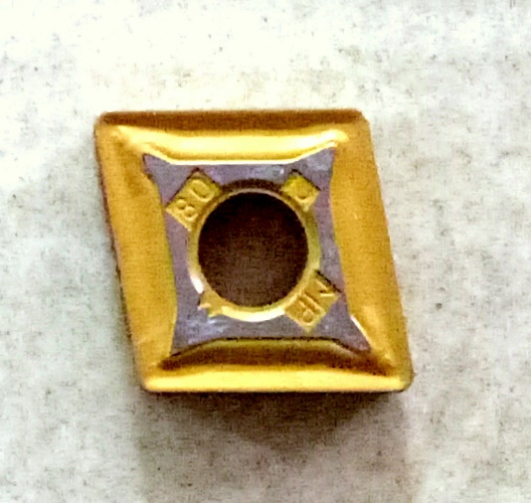
Coating Sequence | Role
TiN | BUE resistance, effective at lower speed.
TiCN | Harder than TiN coatings, Abrasive resistance.
Al2O3 | Crater resistance, effective at high speeds and high heat condition.
TiN | Effective on high temperature alloys, effective on stainless steel.
Fig 2. CVD Coated Tungsten Carbide KC-9225 (Cutting Tool).

Slide 12
CUTTING TOOL
(KC-9225)
Cryogenic TREATMENT
(DIP STICK)
LIQUID NITROGEN

Slide 13
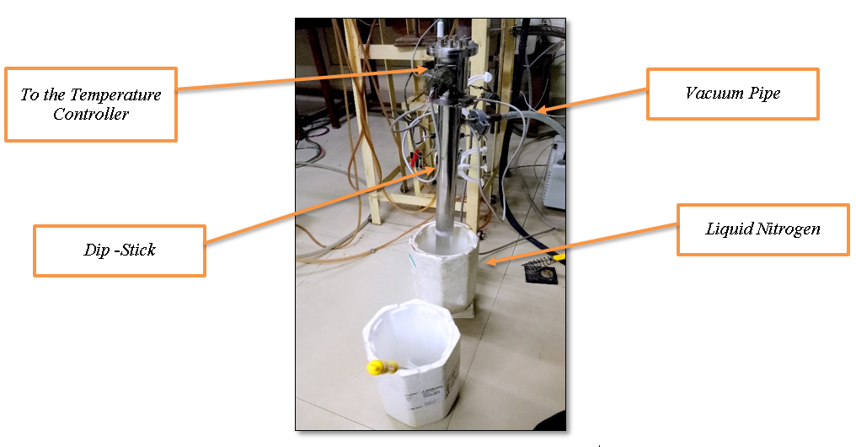
Fig 3. Dip Stick Arrangement.

Slide 14
CUTTING TOOL
(KC-9225)
Cryogenic TREATMENT
(DIP STICK)
HEAT TREATMENT
LIQUID NITROGEN
DILATOMETER

Slide 15
Fig 4. Deep Cryogenic Treatment and Tempering Cycle.

Slide 16
CUTTING TOOL
(KC-9225)
Cryogenic TREATMENT
(DIP STICK)
HEAT TREATMENT
LIQUID NITROGEN
DILATOMETER
XRD AND SEM
TURNING OF SS-310
MICRO HARDNESS TESTER
MICRO
STRUCTURAL ANALYSIS
M/C PARAMETRES
HARDNESS

Slide 17
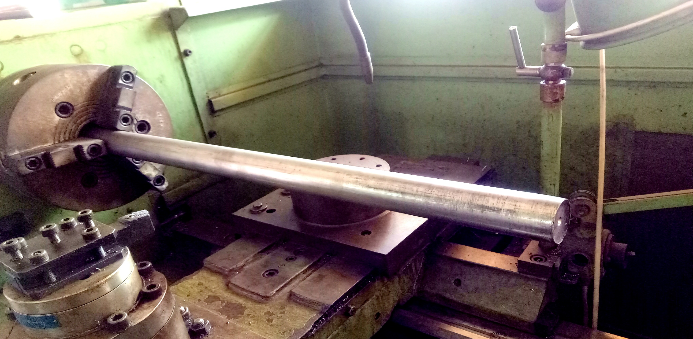
Fig 5. Stainless Steel 310 (work-piece with diameter = 45 mm and length = 615 mm).

Slide 18
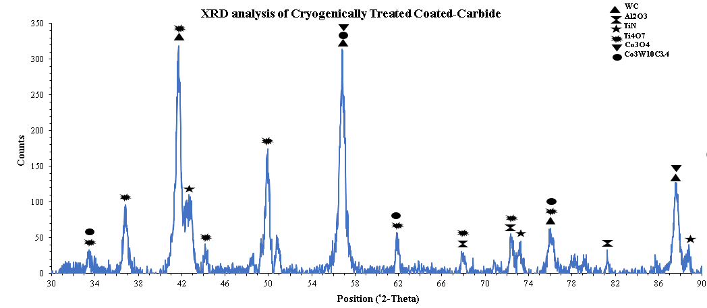
7. RESULTS AND DISCUSSIONS
a. Microstructural Analysis:
XRD (X-Ray Diffraction)
Fig 6. XRD Analysis of Cryogenically Treated Coated Carbide.

Slide 19
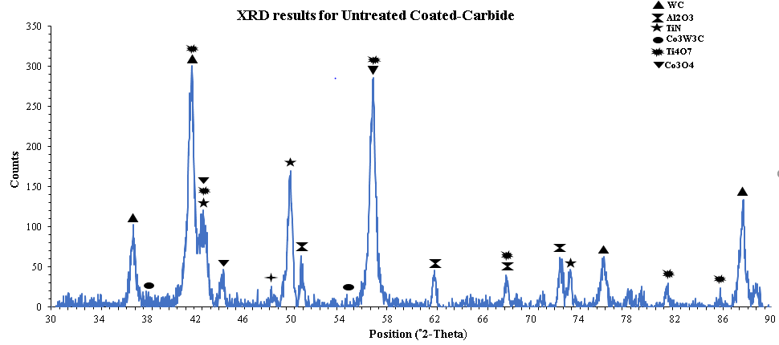
Fig 7. XRD Analysis of Cryogenically Treated Coated Carbide.

Slide 20
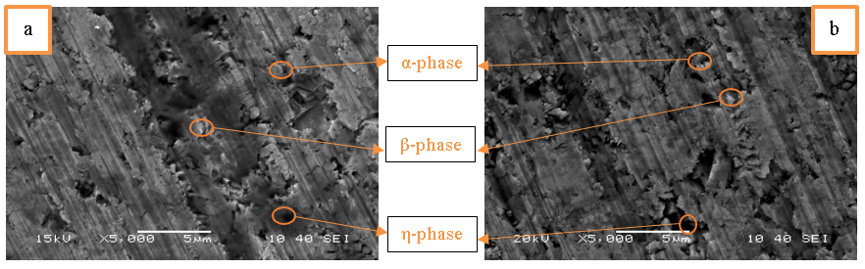
SEM (Scanning Electron Microscope) – The phases identified in the microstructure of the cutting tool insert was as per ASTM-B657-92.
Fig 8. SEM images of a)Untreated Coated Carbide, b)Deep Cryogenically Treated Coated Carbide.

Slide 21
b. Micro Hardness
Appreciable Increment in the micro hardness of the Treated Tool as compared to Untreated Tool was observed which was approximately 21.75%.
Sr.No. | Treated Tool | Untreated Tool
1. | 1935 | 1862
2. | 2250 | 1745.9
3. | 2271.2 Average = 2152.22 | 1834.8 Average = 1814.23
Table 2. Micro Hardness Results.

Slide 22
c. Machining Analysis
Sr.No. | Depth of Cut (mm) | Feed (mm/rev) | Cutting Velocity (m/min) | Cutting Force for Treated Sample (N) | Cutting Force for Untreated Sample (N)
1. | 0.5 | 0.1 | 44.86 | 148.333 | 154
2. |  | 0.14 |  | 181 | 227.6667
3. |  | 0.2 |  | 153 | 245
4. |  | 0.24 |  | 213.6667 | 250
5. | 0.5 | 0.1 | 58.43 | 96.6667 | 146
6. |  | 0.14 |  | 116 | 181.6667
7. |  | 0.2 |  | 121 | 203.33
8. |  | 0.24 |  | 135.33 | 229
9. | 0.5 | 0.1 | 76.02 | 156.6667 | 192.6667
10. |  | 0.14 |  | 160.6667 | 172.6667
11. |  | 0.2 |  | 174.33 | 191.6667
12. |  | 0.24 |  | 179.6667 | 199.33
13. | 0.5 | 0.1 | 98.89 | 150.6667 | 160.6667
14. |  | 0.14 |  | 171 | 182.3333
15. |  | 0.2 |  | 201 | 223.33
16. |  | 0.24 |  | 198.6667 | 221.6667
Table 3. Machining Parameters considered.

Slide 23
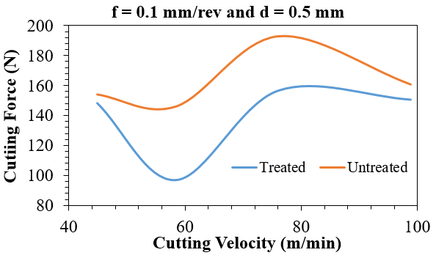
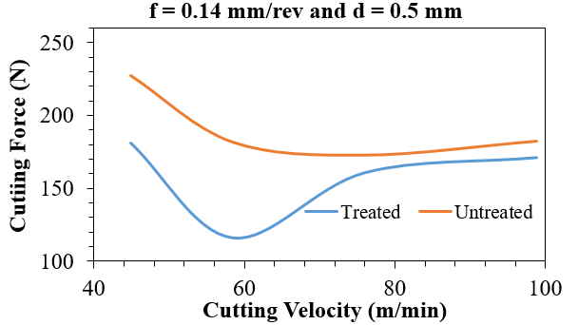
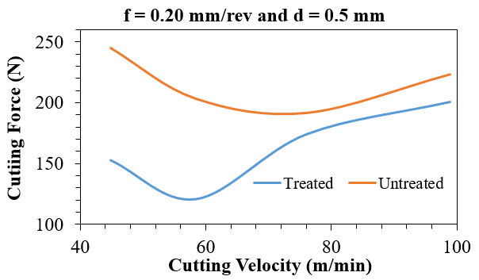
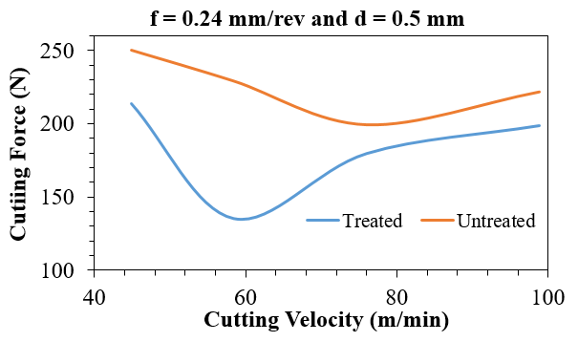
Fig 9. Cutting Force (N) vs Cutting Velocity (m/min) graphs.

Slide 24
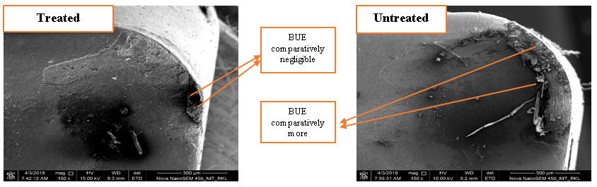
d. Wear resistance analysis using FESEM and SEM
In order to better understand the changes in surface topology especially in terms of Flank-Wear, Crater-Wear and BUE (Built Up Edges); FESEM and SEM were conducted.
Fig 13. Comparison of BUE formation from images obtained by FESEM test.

Slide 25
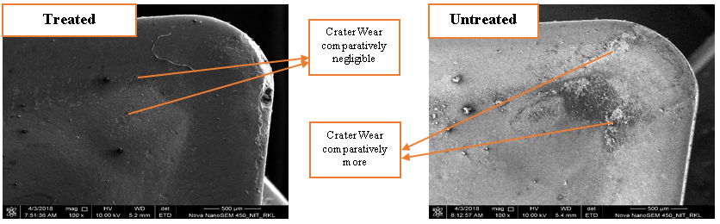
Fig 14. Comparison of Crater-Wear from images obtained by FESEM test

Slide 26
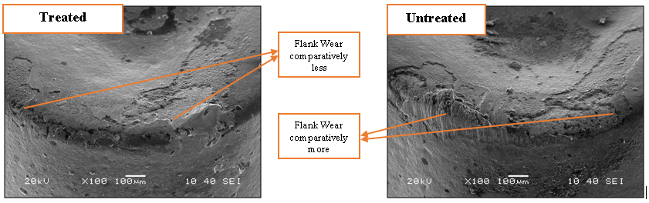
Fig 15. Comparison of Flank-Wear from images obtained by SEM test

Slide 27
8. INFERENCES
In order to enhance the cutting tool performance and to reduce the manufacturing cost, Cryogenic Treatment is an effective way which can be applied to various types of cutting tools.
Parameters like Soaking time, Soaking Temperature, Tempering Cycles and the duration plays an important role in order to obtain favourable outcomes out of Cryogenic Treatment. These factors can be further optimized to get maximum benefit out of the process.
Both XRD and SEM results confirmed the increased precipitation of η-phase and densification of the binder phase.
The hardness of the treated sample increased by 21.75 % as compared to the untreated one.

Slide 28
The cutting force reduced by 3 to 70 % in case of Cryogenically treated insert.
FESEM and SEM analysis revealed that the reduction in tool wear and Built-up-edge formation is relatively more prominent in the treated sample.

Slide 29
9. FUTURE SCOPE OF WORK
Analysis of the results obtained from the current work suggests several feasible extensions to the research. Some of them are listed below:
Minimum possible soaking temperature may be beneficial to improve the properties of the materials. Application of other cooling media like Hydrogen and Helium which can further reduce the soaking temperature also needs to be investigated.
Combined effect of surface coatings and Cryogenic treatment may further enhance the tool life.
Also the optimized thickness of the surface coating coupled with Cryogenic treatment can improve turning performance.

Slide 30
Microstructural studies at higher magnifications, which can be done by using equipment such as Transmission Electron Microscopes (TEM), could be done to provide insights into changes in the microstructure at an intra-granular level.

Slide 31
10. REFERENCES.
[1] Baldessera P and Delprete C Deep Cryogenic treatment: A Bibliographic Review 2008 The Open Mechanical Engineering Journal 2 1-11.
[2] Chopra A and Swamini Sargade V G Metallurgy behind the Cryogenic treatment of Cutting Tools: An Overview 2015 Materials Today: Proceedings 2 Issues 4-5 1814-24.
[3] Mukkoti V V, Sankaraiah G and Yohan M. Effect of Cryogenic treatment of Tungsten carbide tools on cutting force and power consumption in CNC milling process 2018 Production and Manufacturing Research 6 149-170.
[4] Deshpande R G and Venugopal K A Machining with Cryogenically treated carbide cutting tool inserts 2018 Materials Today Proceedings 5 1872-1878.

Slide 32
[5] Akinsioglu S, Gokkaya H and Uyugur I A review of Cryogenic treatment of cutting tools 2015 Int. J. Adv. Manuf. Technol. 78 Issues 9-12 1609-27.
[6] Yong J and Ding C Effect of Cryogenic treatment on WC–Co cemented carbides 2011 Material Science and Engineering: A 528 Issue 3 1735-39.
[7] Ozbek A N, Cicek A, Gulesin M and Ozbek O Effect of cutting conditions on wear performance of Cryogenically treated Tungsten carbide inserts in dry turning of stainless steel 2016 Tribology International 94 223-33.
[8] Zhang H, Chen L, Sun J, Wang W and Wang Q An investigation of cobalt phase structure in WC–Co cemented carbides before and after Deep Cryogenic Treatment 2015 International Journal of Refractory Metals and Hard Materials 51 201-06.
[9] Reddy Sreeram T V, Sornakumar T, Reddy Venkataraman M and Venkatram R Machinability of C45 steel with Deep Cryogenic treated Tungsten carbide cutting tool inserts 2009 International Journal of Refractory Metals and Hard Materials 27 Issue 1 181.85.

Slide 33
[10] Reddy Sreeram T V, Sornakumar T, Reddy Venkataraman M and Senthilkumar A Turning studies of Deep Cryogenic treated p-40 Tungsten carbide cutting tool inserts 2009 Machining Science and Technology 13 Issue 2 269-81.
[11] Gill Singh S, Singh J, Singh H and Singh R Metallurgical and mechanical characteristics of Cryogenically treated Tungsten carbide (WC–Co) 2012 The International Journal of Advanced Manufacturing Technology 58 Issues 1-4 119-131.

Slide 34
Thank You For
Your Time… r.bhatia2194@gmail.com meghc2007@gmail.com

