Slide 1
Enhanced Jc at both self and high field of MgB₂ superconductor
through co-doping route
M. Ranot¹, Y. S. Oh¹, S. H. Kang¹, S. H. Jang², D. Y. Hwang², and K. C. Chung¹
¹Korea Institute of Materials Science, Changwon, Korea
²Kiswire Advanced Technology Ltd, Daejeon, Korea

Slide 2
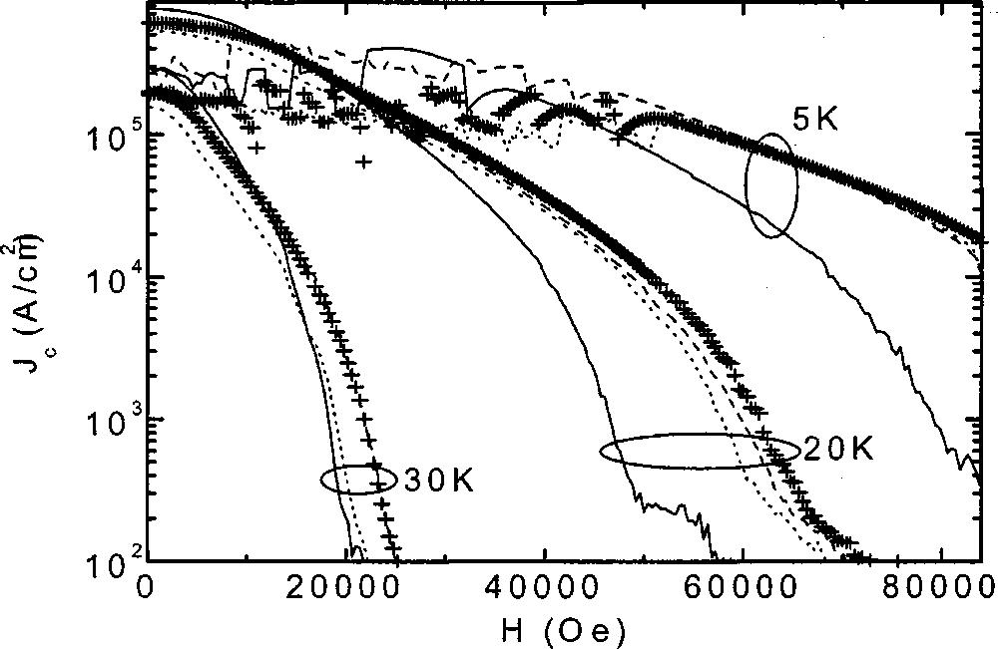
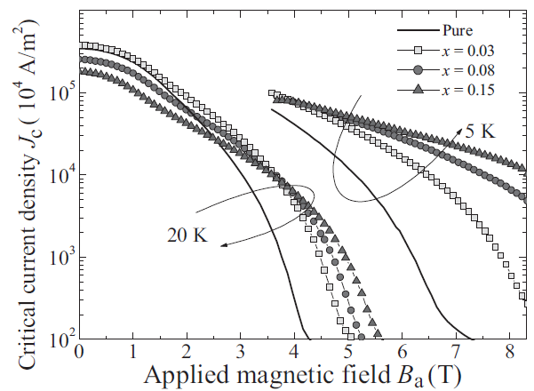
Carbon : Best dopant for MgB₂
Solid-state mixing
Agglomeration of nano additives
Issue: homogeneous distribution
Nano additives are expensive
Wet-mixing process
Sugar coating of B powder
Reduction in self-field, J_{c}(H)
High MgO and high resistivity
nano SiC-doped
Sugar (C₆H₁₂O₆)-doped
S. X. Dou et al., APL 81, 3419 (2002)
S. Zhou et al., Adv. Mater. 19, 1373 (2007)

Slide 3
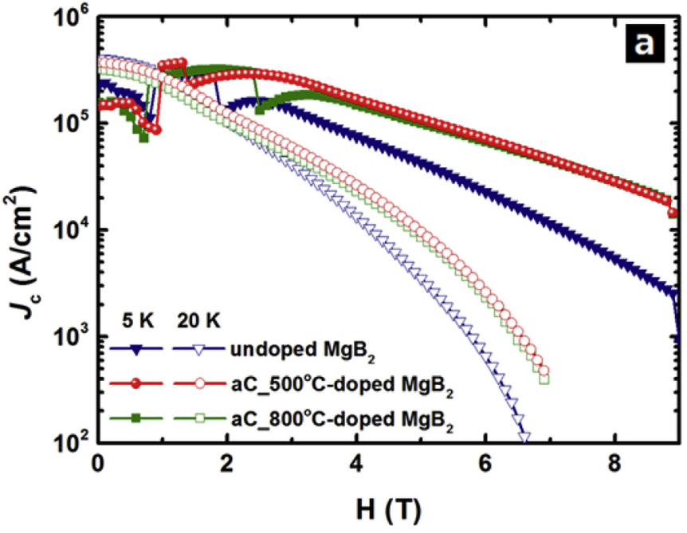
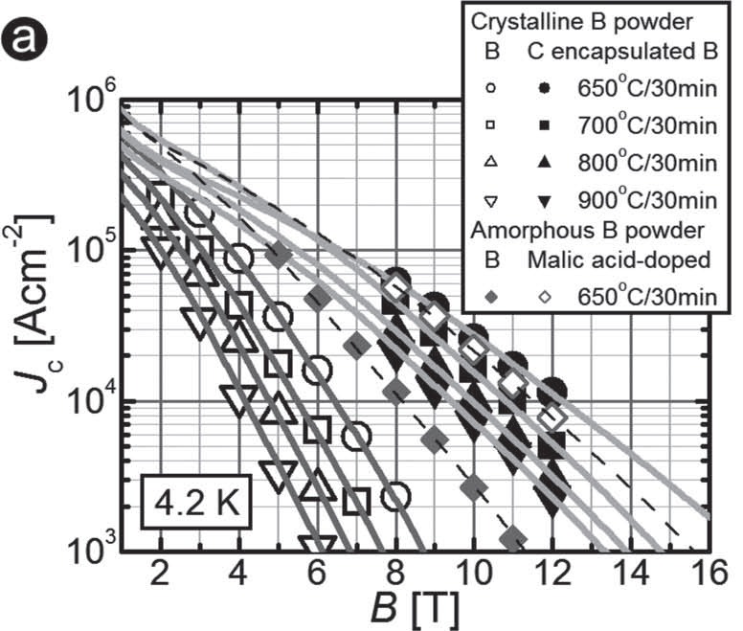
Carbon : Best dopant for MgB₂
C-encapsulated Boron
RF plasma technique
Gaseous source of C
Good J_{c}(H) performance
Solution process
C coating on B by pyrolysis of PMMA
J_{c}(H) and J_{c}(0). Little reduction in T_{c}
J.H. Kim et al., Adv. Mater. 23, 4942 (2011)
Ranot et al., JALCOM 724 (2017) 507

Slide 4
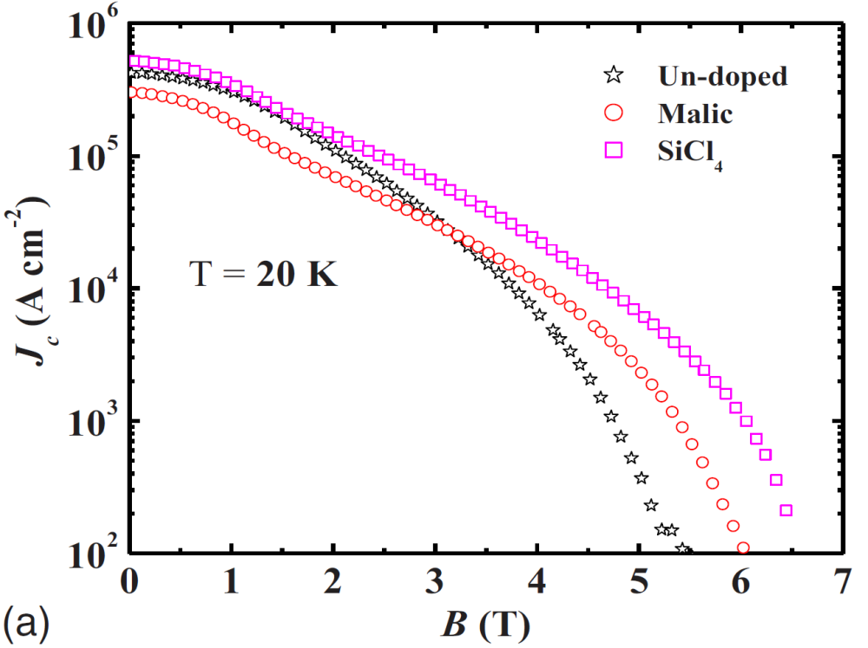
Motivation for this work
Why Chloroform (CHCl₃) ?
Liquid source
(i) easy for uniform mixing of powders
(ii) no solvent required
Can be coat on B at R.T.
Free of oxygen (O)
Cl and C co-doping effect
Molar mass of each element in CHCl₃
M(Cl) = 89.095 %
M(C) = 10.061 %
M(H) = 0.844 %
Wang et al., Phy. Rev. B 81, 224514 (2010)
Liquid doping source
Liquid SiCl₄ free of Carbon
Better J_{c}, little reduction in T_{c}

Slide 5
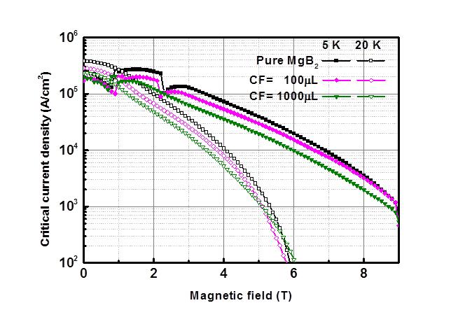
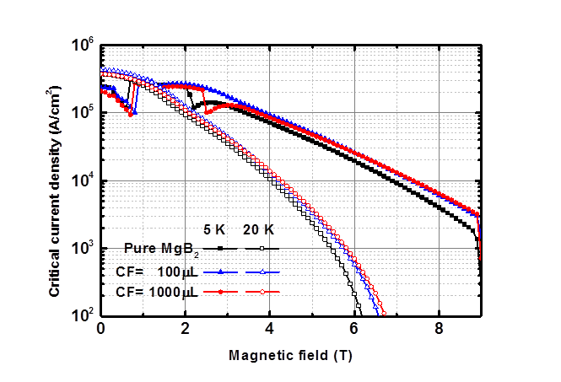
Preliminary study
Addition approach
Coating approach
(Mg + B) + CHCl₃
Mg + (B + CHCl₃)
Coating approach more favorable for J_{c} enhancement
as compared to addition approach.

Slide 6
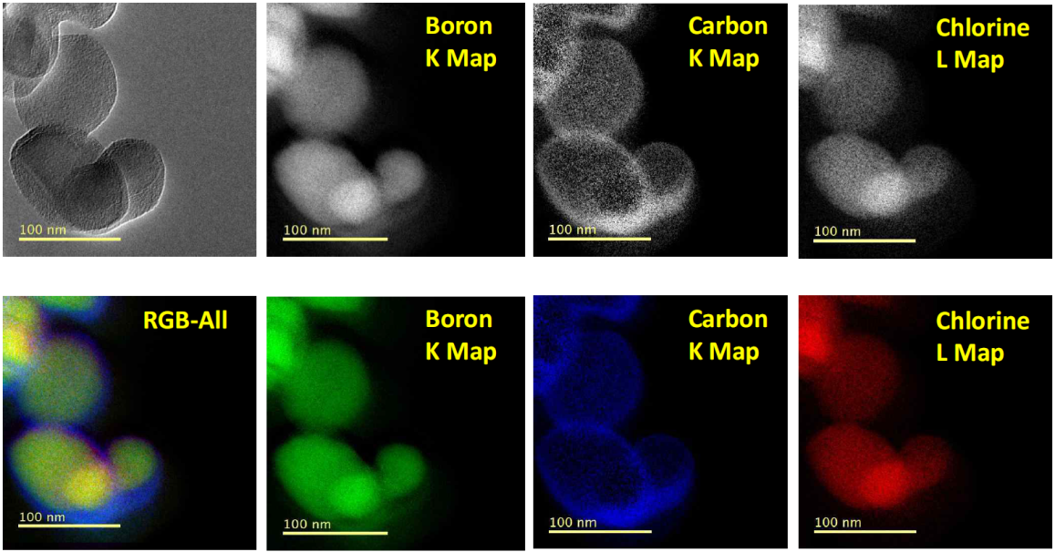
TEM for doped Boron
TEM for CHCl₃ treated Boron
Amorphous
carbon
~3 nm
TEM, Elemental Mapping Analysis
~6 nm
Amorphous carbon layer formed on the surface of Boron powder
Chlorine element also found inside the Boron

Slide 7
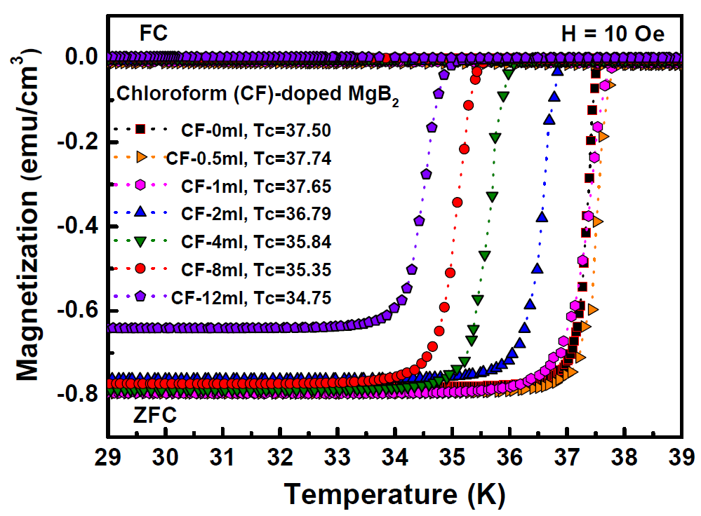
M-T curves of MgB₂ with CHCl₃
CHCl₃ | Tc (K)
Pure | 37.50
0.5 ml | 37.74
1 ml | 37.65
2 ml | 36.79
4 ml | 35.84
8 ml | 35.35
12 ml | 34.75
No noticeable change in T_{c} with chloroform less than 1ml
T_{c} decreased when chloroform used more than 2 ml (Carbon substitution)

Slide 8
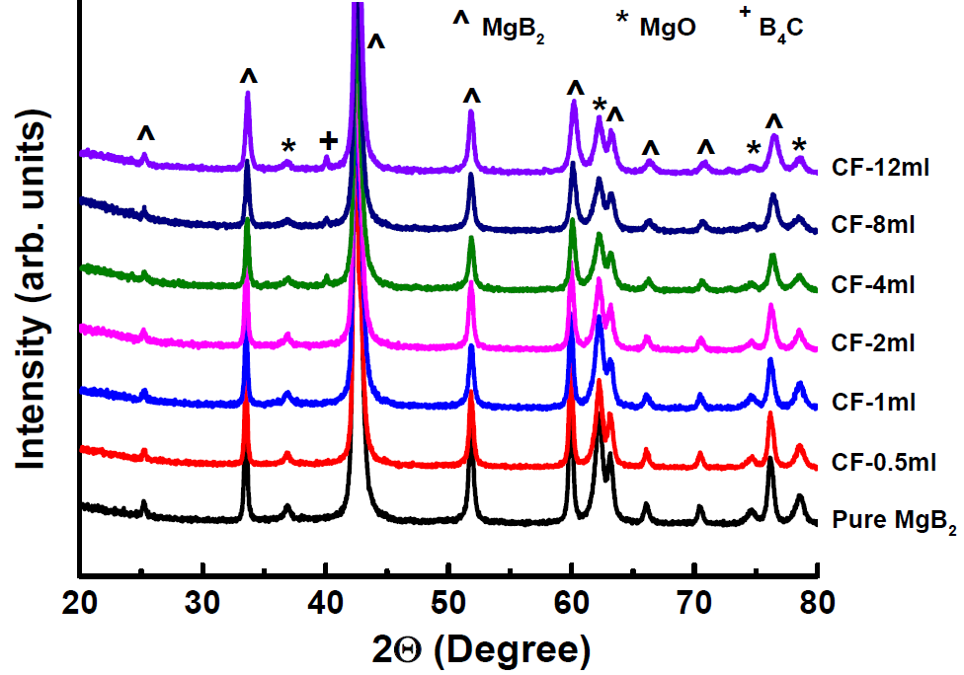
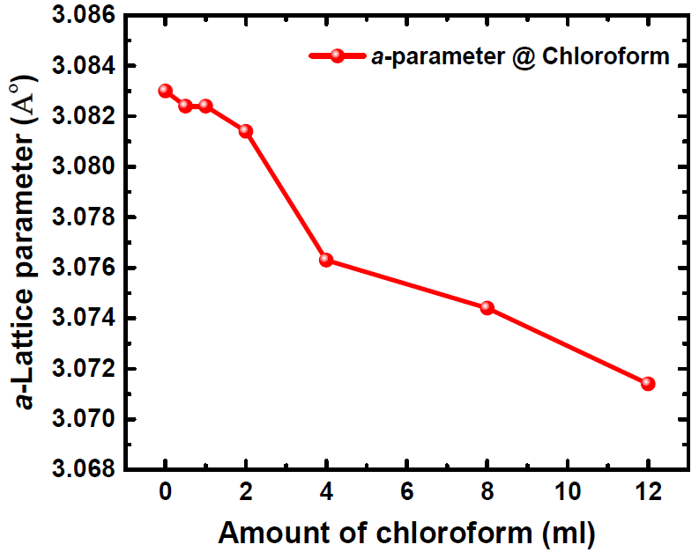
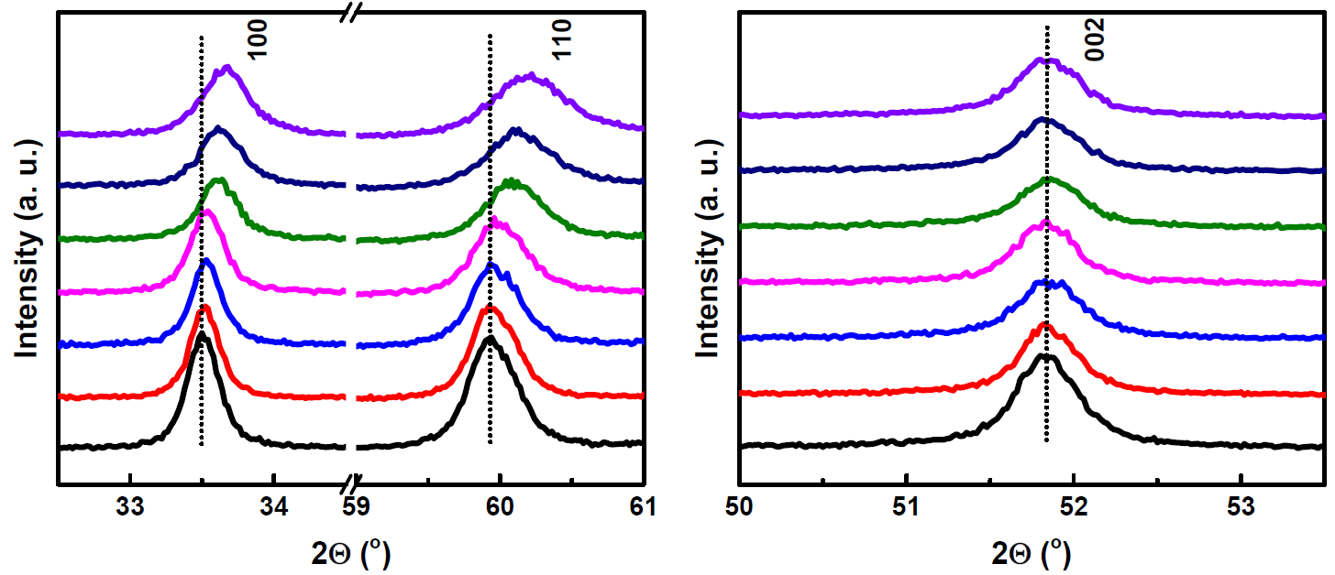
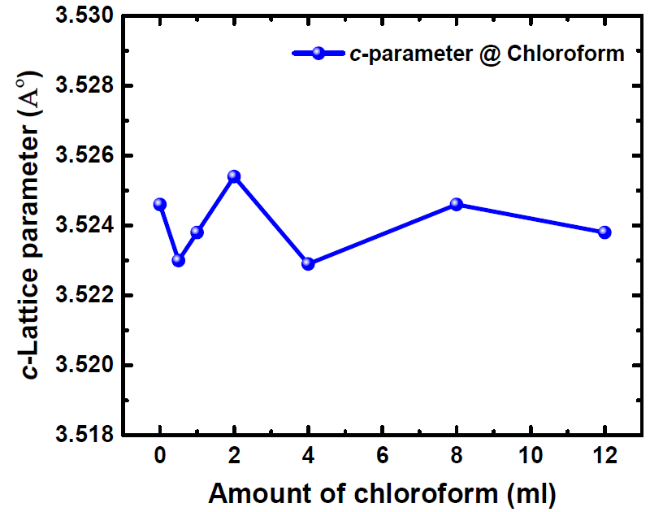
XRD patterns of MgB₂ with CHCl₃
a-axis
c-axis
Shift in (100) and (110) reflections towards higher angles, no shift in (002)

Slide 9
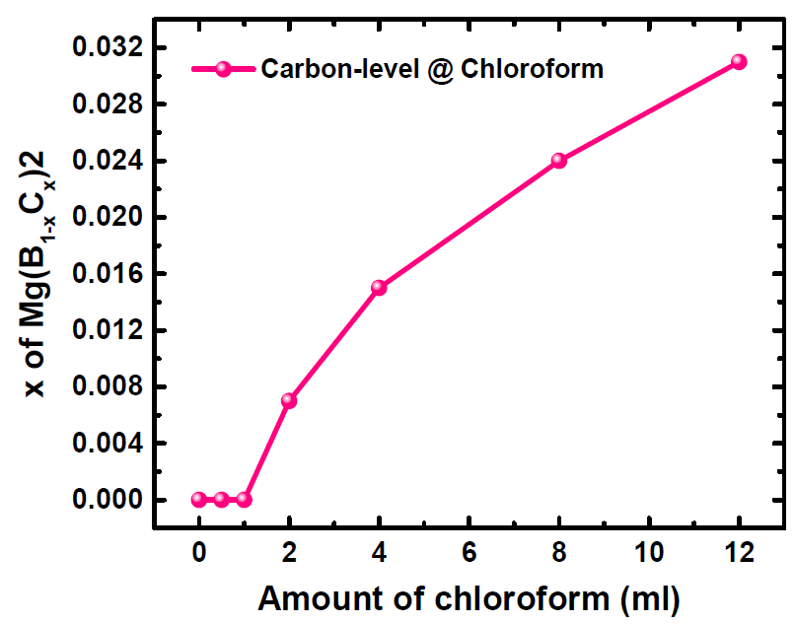
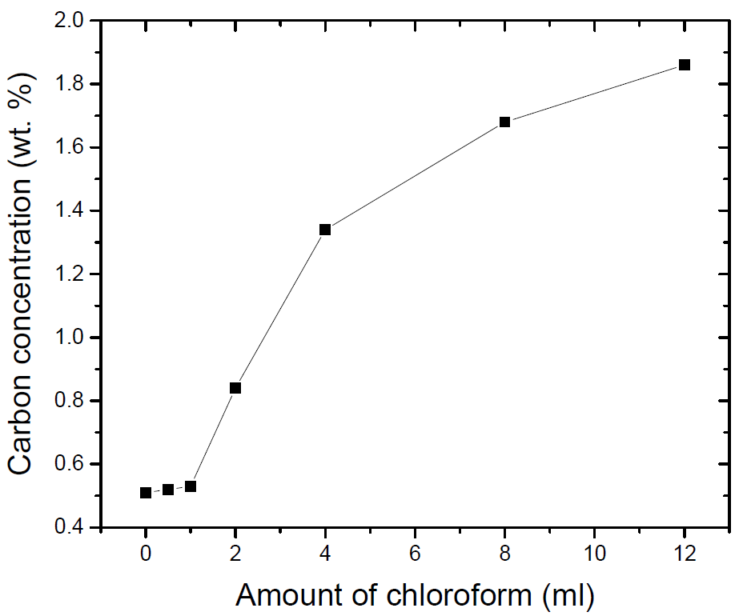
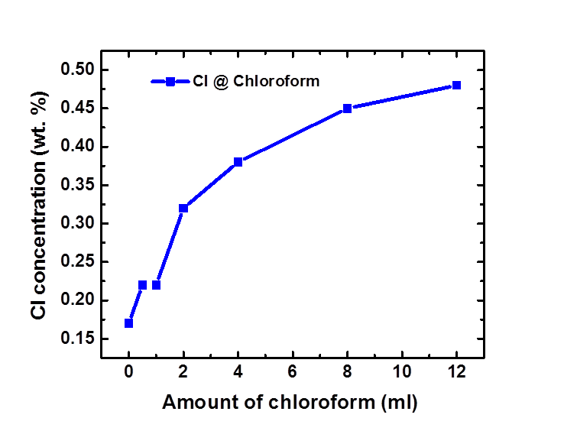
C & Cl element analysis of MgB₂
Calculated from XRD
CS Analyzer (CS744, LECO)
EDS analysis
Carbon content
(calculated, at. %)
Carbon content
(measured, wt. %)
Chlorine content
(measured, wt. %)
Both C and Cl amount was found to be increased
upon increasing the doping level of chloroform.

Slide 10
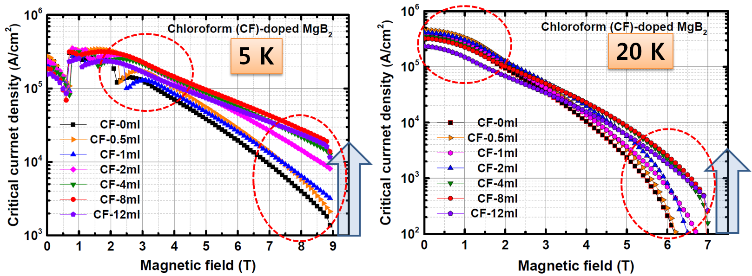
J_{c}(H) properties of MgB₂
Systematic enhancement in J_{c} upon with the doping level of chloroform
Improvement of J_{c} both at low & high fields and 5 & 20 K

Slide 11
Conclusions
Chloroform-doped MgB₂ bulk samples were prepared
using coating approach.
TEM elemental mapping confirms the presence of C and Cl
on B powder.
Enhancement in J_{c}(H) was observed with CHCl₃ doping
as compared to un-doped MgB₂.
Enhancement could be attributed to the combined effect
of C and Cl.

Slide 12
Acknowledgements
This work was supported by industrial Technology Innovation Program (Grant No. 10053590) funded by the Ministry of Trade, Industry and Energy (MOTIE), Korea
Thank you very much
for your kind attentions

Slide 13
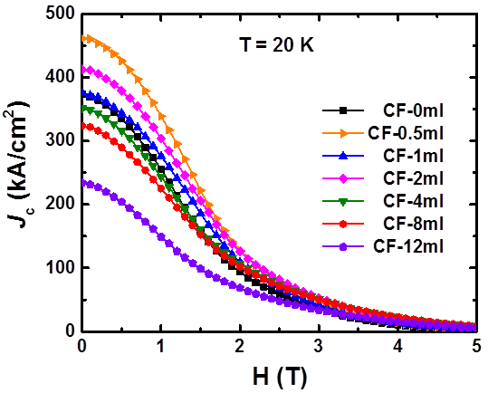
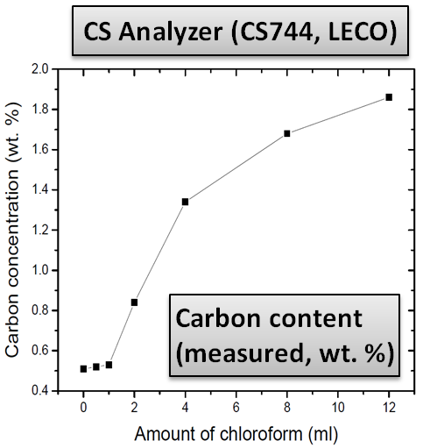
Jc-B property of MgB₂ at 20 K
Jc at low-fields increased
up to 2 ml of CHCl₃ possibly due to the only Cl doping(?)

Slide 14
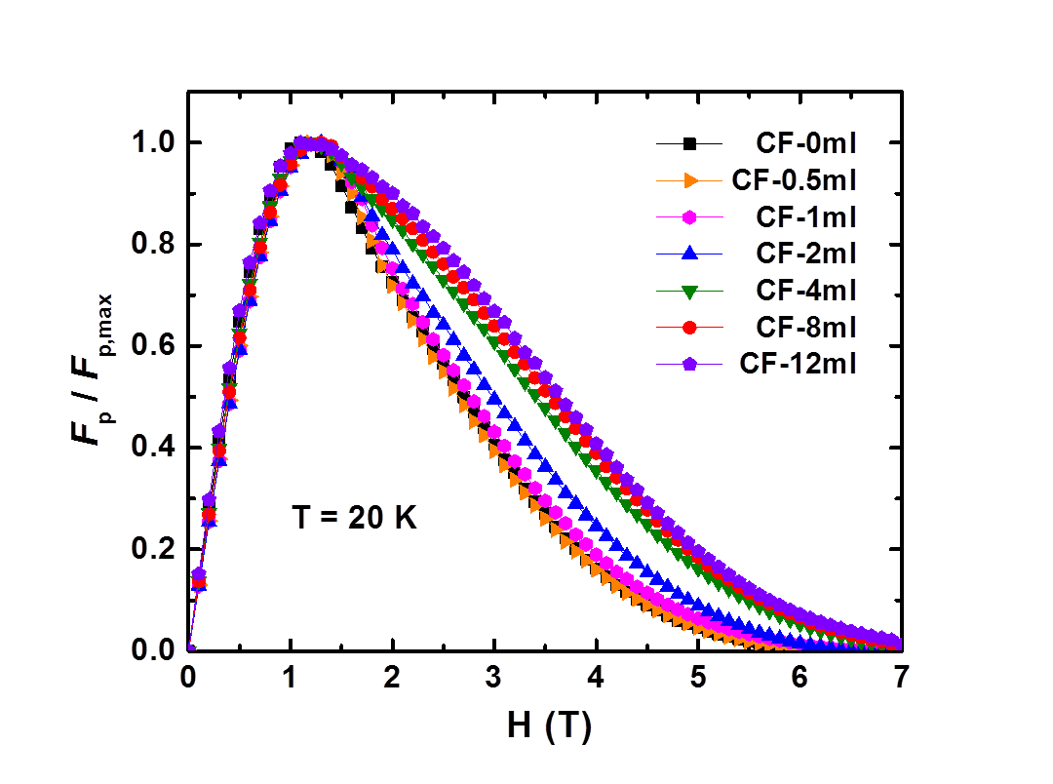
Flux pinning property
Doped samples showed much higher flux pinning force than that of un-doped MgB₂.

