Slide 1
Turbulent velocity
measurements in high
Reynolds cryogenic
helium facilities at SBT
S. Kharche¹, J.P. Moro², C. Baudet³, B. Rousset¹, A. Fuchs⁴, J. Peinke⁴ and A. Girard¹
¹ SBT, CEA-UGA Grenoble, France
² STMF , CEA Grenoble, France
³ LEGI UGA Grenoble, France
⁴ Oldenburg University, Germany

Slide 2
OUTLINE
Introduction
  Challenges in Turbulence
  Interest of Helium
Hot wire anemometry
    Principle
    Calibration and time constant
    3. Experimental results
    4 Prospects.

Slide 3
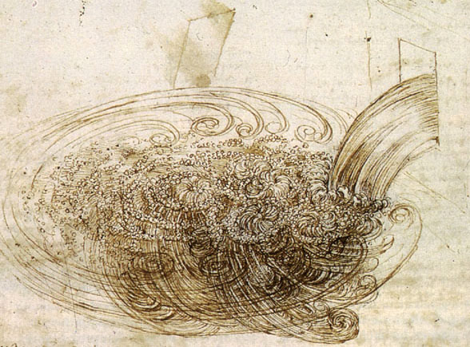
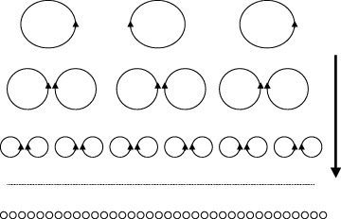
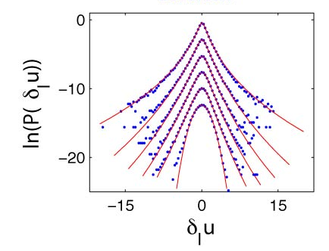
Introduction: research on turbulence
Description of the cascade process
still under discussion :
intermittency (at small scales) not yet
understood.
Models assume infinite Reynolds
=> interest of HELIUM

Slide 4
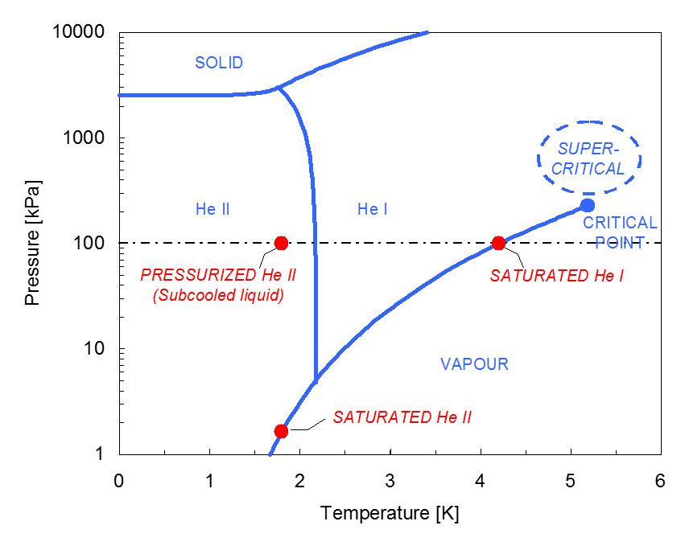
Helium properties make it the ideal fluid for fundamental studies

Slide 5
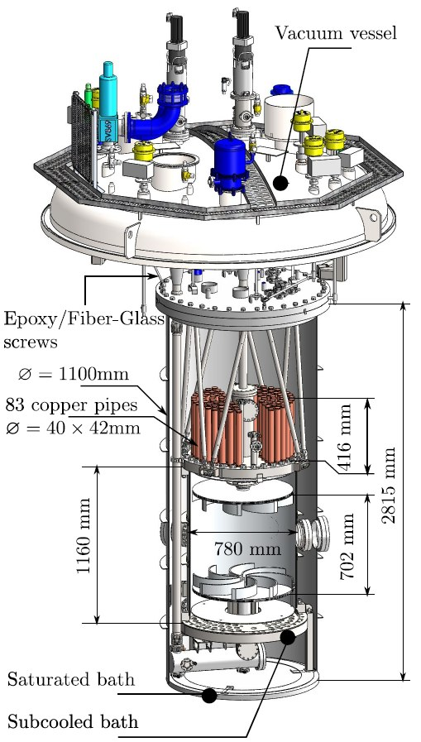
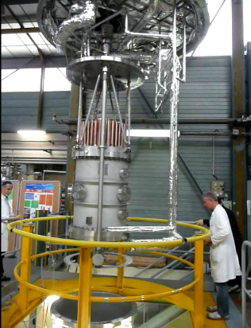
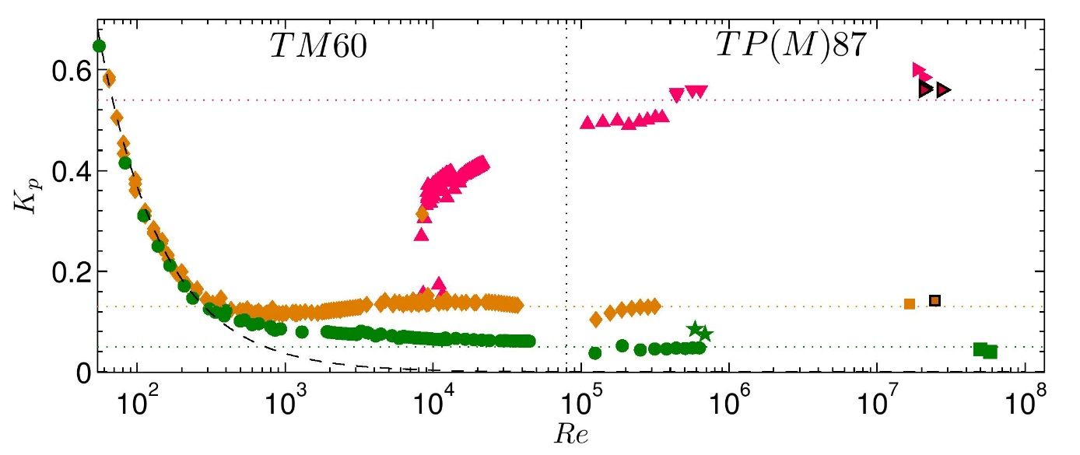
Example : the SHREK experiment

Slide 6
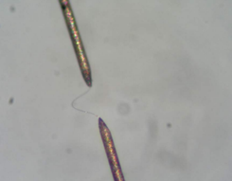
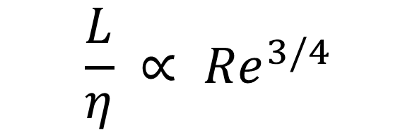
Measuring velocity fluctuations: Hot Wire Anemometry
$$\frac{L}{η} ∝ {Re}^{3/4}$$
=> Need for very small sensors ( η ~ few µm)
Hot wires are the most widespread (and efficient) sensors for turbulence
(principle: convective flux cools the wire & changes its resistance)
But : small hot wires are not available commercially
Developments at CEA Grenoble for:
      Small (micron size) sensors
    Reliable sensors.
    technique of Wollastone hot wires
    Application to Cryogenic Helium ?

Slide 7
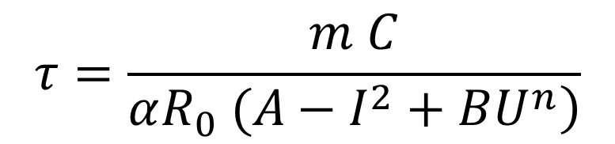
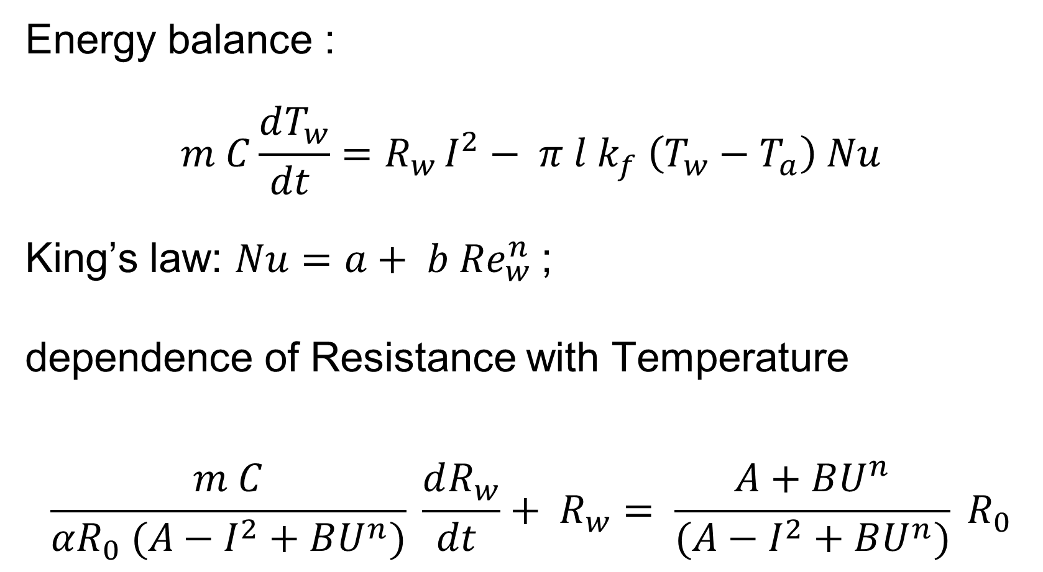
A few equations…
Energy balance :
$$m C\frac{dT_{w}}{dt }=R_{w }I^{2}− {π l k}_{f} \left(T_{w}−T_{a}\right) Nu$$
King’s law: $Nu=a+ b {Re}_{w}^{n}$;
dependence of Resistance with Temperature
$$\frac{m C}{αR_{0} (A−I^{2}+BU^{n})} \frac{dR_{w}}{dt }+ R_{w}= \frac{A+BU^{n}}{(A−I^{2}+BU^{n})} R_{0}$$
Need for calibration
    Determination of the time constant :
$$τ=\frac{m C}{\left.αR_{0} (A−I^{2}+BU^{n}\right)}$$

Slide 8
Calibration
SHREK is cooled via a high power refrigerator,
providing up to 400 W at 1.8 K, and 120 W at
1.6 K
Calibration is performed by rotating
both (upper and lower) propellers
in the same direction (instead of opposite)
Quasi solid rotation of the fluid,
at the speed of propellers
Calibration performed in HeI ( T=2.5 K)
and in HeII (T=2 K)

Slide 9
Calibration (continued)
In HeI : fit with
King’s law very good
In HeII: King’s law not
Satisfactory & calibration
curve depends on the
temperature
However, even in HeII,
hot wires are sensitive
to the Velocity (above
a certain threshhold)

Slide 10
Time constant measurement (CCA operation)
As expected, the time constant decreases as the velocity increases. This
dependence is however different in normal and in superfluid helium

Slide 11
First Conclusions
Wollastone hot wires 1 µm in diameter are reliable at low temperature,
and for HeI show the same behavior as in normal fluids
(Thermal) Time constant provides accurate measurements up to 8 kHz
Hot wires exhibit a different behavior in HeII
Need for a higher current in HeII to get the same resistance
Calibration curve does not fit King’s law, but is sensitive to velocity
Time constant dependence on velocity is different in HeII
Heat transfer in He II is totally different from what happens in HeI
The operation of hot wires in HeII need to be studied and clarified

Slide 12
Examples of velocity spectra

Slide 13
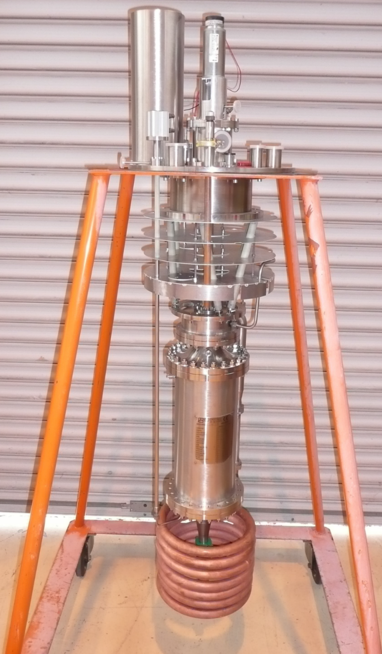
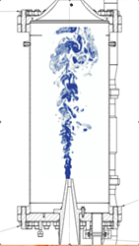
The HeJet/HeCal experiment
Hejet (bottom left) is a smaller size experiment dedicated to sensor
development and test.
HeCal (bottom right) is based on Hejet and is dedicated to the
calibration of HWs.

Slide 14
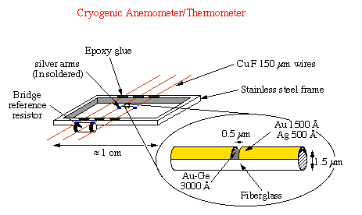
Further developments
Wollastone hot wires work at cryogenic temperature and are reliable;
Our short term goal: Wollastone hot wires of diameter 0.6 µm, length < 100 µm
Other techniques (based on Castaing’s pioneering work @CNRS
using microfabrication techniques ( similar to Princeton developments)

