Slide 1

Flow behavior of LN2 in helically corrugated pipes with insertion of HTS power transmission cables
ICEC27-ICMC2018, Sep. 3-7, Oxford, UK
Zhongqi Zuo; Wenbing Jiang; Zhiguang Yu; Yonghua Huang *
* Correspondence: huangyh@sjtu.edu.cn
800 Dongchuan Rd., Shanghai, China

Slide 2
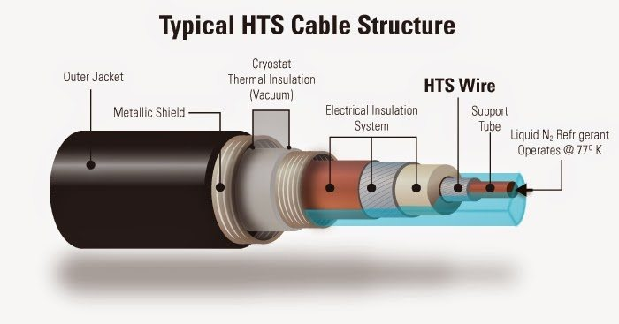
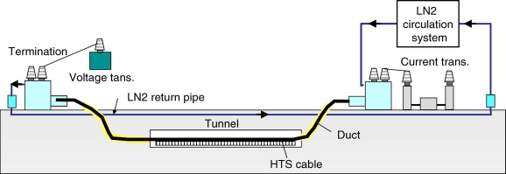
Introduction
Insertion of cables significantly changes the LN₂ flow in vacuum-jacked pipes.
Flow is spiral when twisted cables are inserted in helically corrugated pipes.
Pressure drop and temperature rise are key parameters for deployment of HTS transmission lines.
Flow behavior of LN2 in helically corrugated pipes with insertion of HTS cables
A typical HTS cable structure
https://www.quora.com/Can-superconductors-be-used-to-reduce-transmission-losses-in-power-lines

Slide 3
Introduction
Summary of typical research on flow in pipes
Author | Year | Method | Fluid | Re
Kauder et al. | 1974 | Exp. | H₂O | 0~1000
Weisend et al. | 1990 | Exp. | He | 8000~150000
Bernhard et al. | 1996 | Exp. | H₂O | 2000~3000
Fuchino et al. | 2001 | Exp. | N₂ | 5000~20000
Lee et al. | 2003 | Sim. | N₂ | 10000~800000
Koh et al. | 2004 | Exp. | N₂ | 10000~40000
Jaiman et al. | 2010 | Sim. | H₂O | 10000~8E7
Ivanov et al. | 2011 | Exp. | N₂ | 6000~20000
Sasaki et al. | 2011 | Sim. | N₂ | 2000~30000
Popiel et al. | 2013 | Sim. | H₂O | 2000~30000
Calomio et al. | 2015 | E&S | H₂O | 2000~30000
Li et al. | 2017 | Sim. | N₂ | 1000~100000
Lack of study on pressure drop in helically corrugated pipes with multiple cable insertion.
Even lower Re region should be covered for the LN₂ correlations.
In addition to friction factor, Nusselt number regarding heat transfer will be concerned as well.

Slide 4
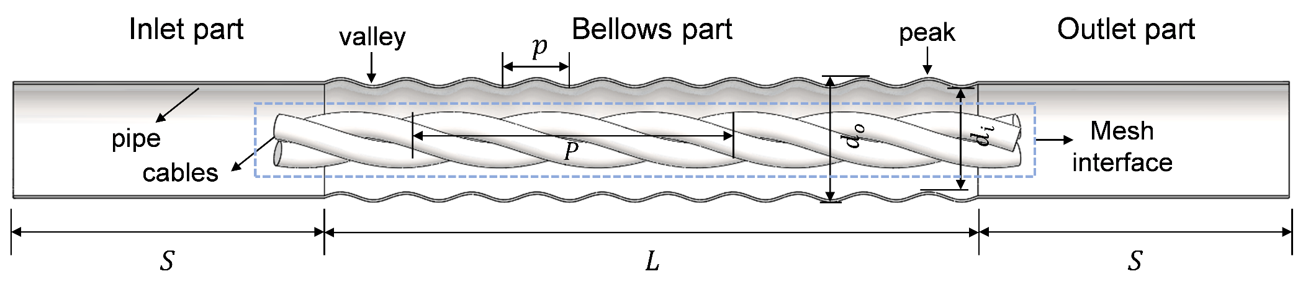
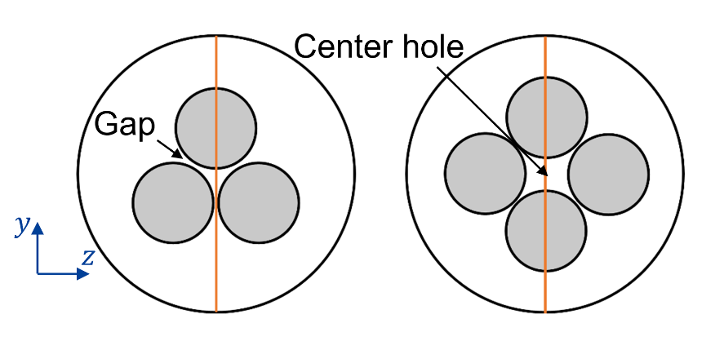
Geometry Model
Schematic diagram of the corrugated pipe
Plain parts (inlet and outlet part) are designed to get fully developed flow.
LN₂ flow is helical because of the geometry of the pipe and the cables.
Cable are loosely entangled, and little gaps and center hole exist between the cables.
Cross section of the corrugated pipe, with 3 or 4 cables inserted

Slide 5


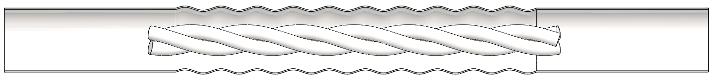

Physical Model
k–ω Shear Stress Transport (SST) model is adopted (for spin turbulence flow).
Hybrid mesh: Tetra mesh inside the interface, and hex mesh outside.
Mesh size near the corrugation is carefully tuned to improve mesh quality.
Kinematic Eddy Viscosity
Turbulence Kinetic Energy
Residual：$1×{10}^{−4}$.
Specific Dissipation Rate
interface
Tetra mesh
Hex mesh

Slide 6
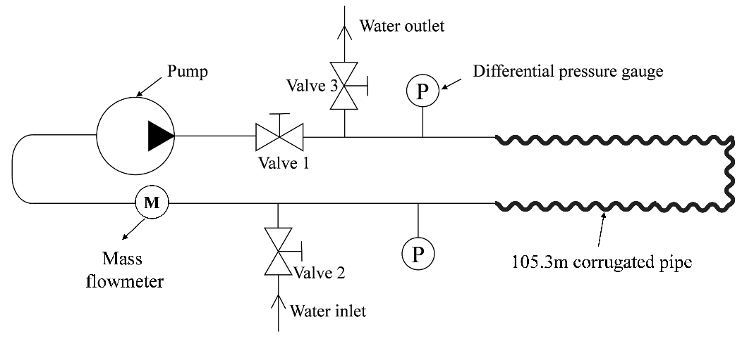
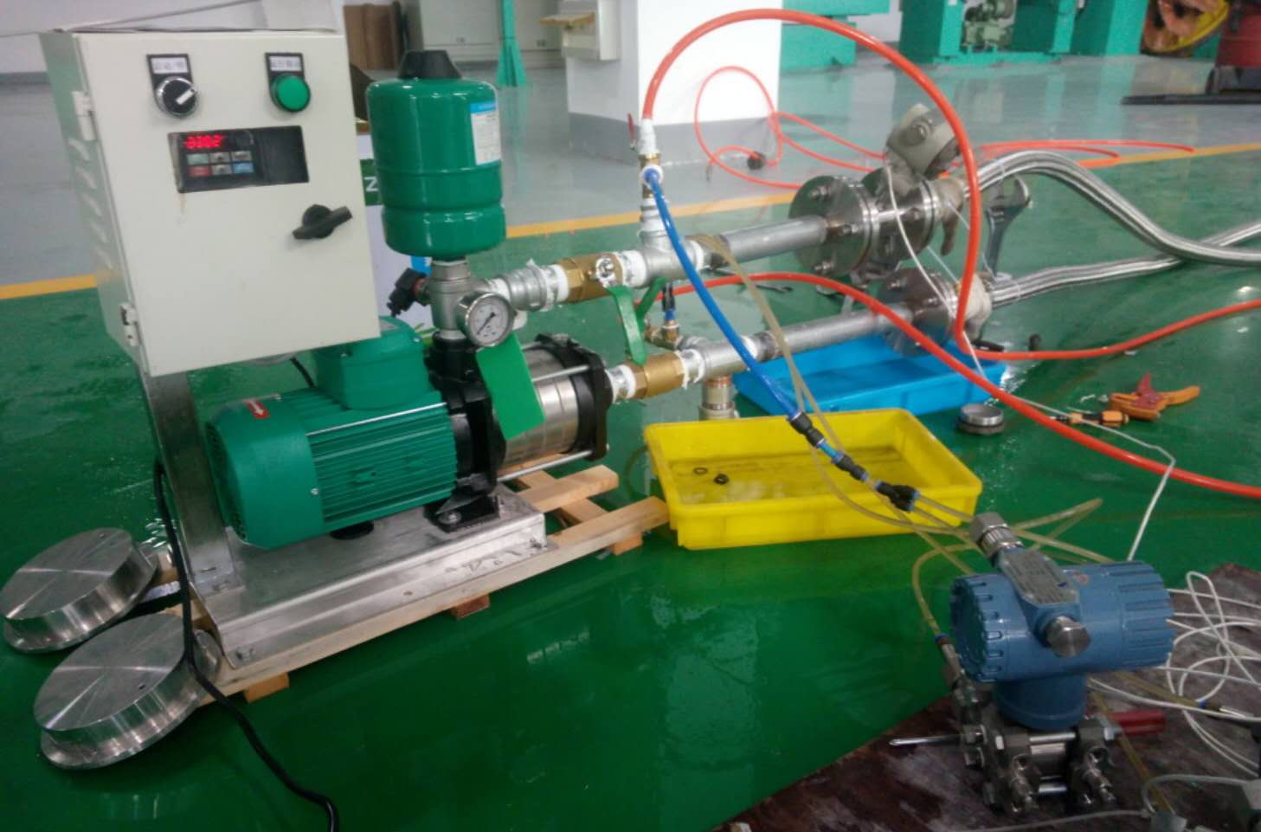
Validation-Water experiment
Schematic of the water experimental setup
pipe
Comparison of pressure drop of water in sim. & exp.
Mass flowmeter
pump
Re<700: Relative standard deviation within 7.5%
Re>2000: Measurement uncertainty enlarges
Differential Pressure gauge

Slide 7
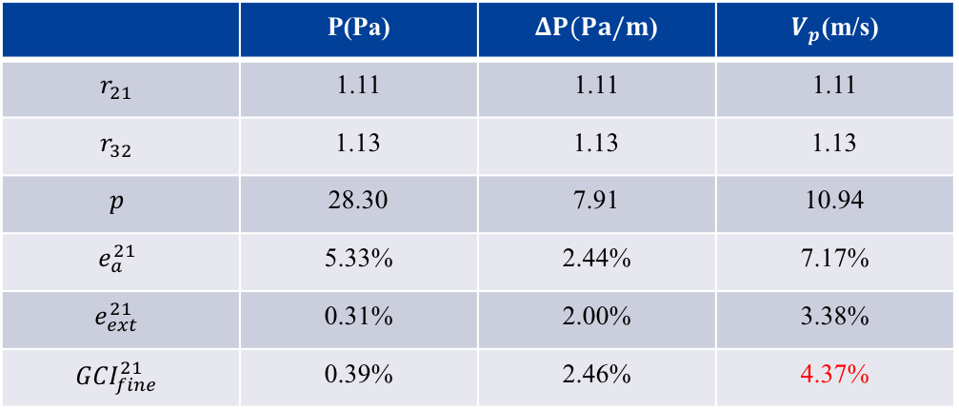
Validation-GCI method
Grid Convergence Method (GCI): check discretization error of mesh with LN₂ flow.
Calculation of discretization error using GCI
 | P(Pa) | $ΔP(Pa/m$) | $V_{p}$(m/s)
$$r_{21}$$ | 1.11 | 1.11 | 1.11
$$r_{32}$$ | 1.13 | 1.13 | 1.13
$$p$$ | 28.30 | 7.91 | 10.94
$$e_{a}^{21}$$ | 5.33% | 2.44% | 7.17%
$$e_{ext}^{21}$$ | 0.31% | 2.00% | 3.38%
$$GCI_{fine}^{21}$$ | 0.39% | 2.46% | 4.37%
Mesh and algorithm: bring in error < 3% for both pressure and pressure drop.
Error of the velocity at the peak of corrugations is relatively larger but within 5% , due to the skewness of mesh in this region.

Slide 8
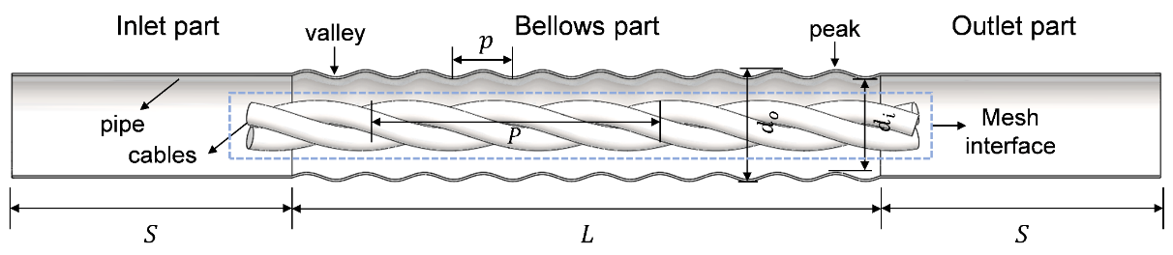
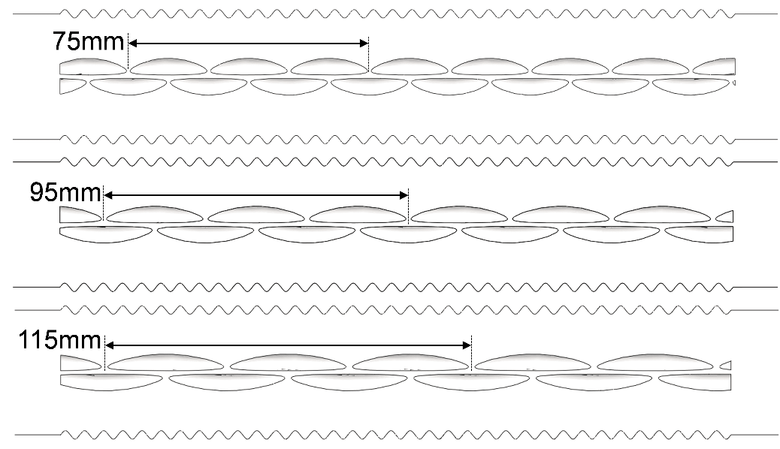
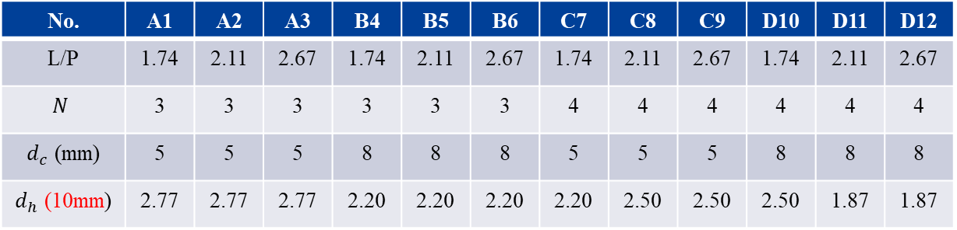
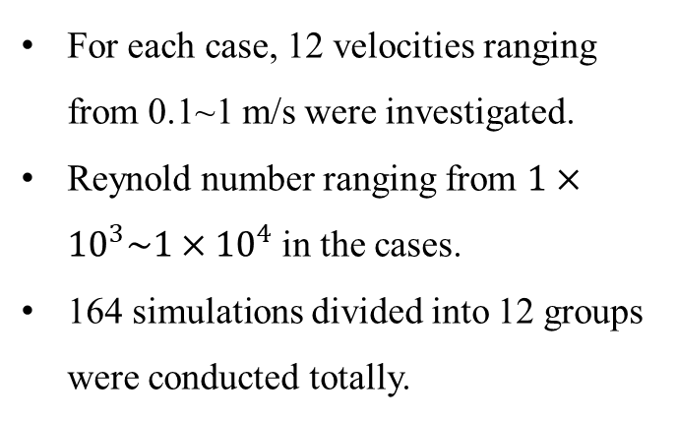
Case definition
For each case, 12 velocities ranging from 0.1~1 m/s were investigated.
Reynold number ranging from $1×{10}^{3}\sim 1×{10}^{4}$ in the cases.
164 simulations divided into 12 groups were conducted totally.
A1
A2
A3
All geometries used in the simulations
No. | A1 | A2 | A3 | B4 | B5 | B6 | C7 | C8 | C9 | D10 | D11 | D12
L/P | 1.74 | 2.11 | 2.67 | 1.74 | 2.11 | 2.67 | 1.74 | 2.11 | 2.67 | 1.74 | 2.11 | 2.67
$$N$$ | 3 | 3 | 3 | 3 | 3 | 3 | 4 | 4 | 4 | 4 | 4 | 4
$d_{c}$ (mm) | 5 | 5 | 5 | 8 | 8 | 8 | 5 | 5 | 5 | 8 | 8 | 8
$d_{h}$ (10mm) | 2.77 | 2.77 | 2.77 | 2.20 | 2.20 | 2.20 | 2.20 | 2.50 | 2.50 | 2.50 | 1.87 | 1.87

Slide 9
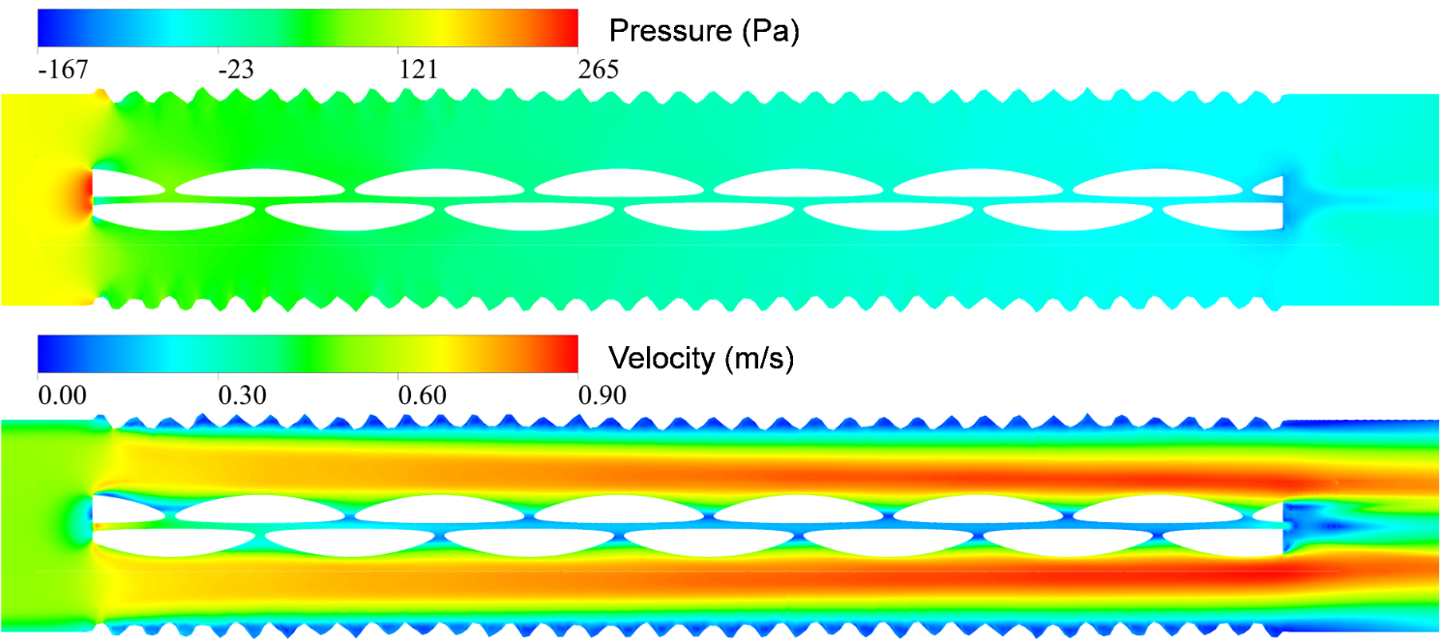
Results-Distribution of $u$ and $P$
Pressure and velocity distribution in the pipe (u=0.5m/s)
Pressure drop rate is larger in bellows section than in plain section.
Pressure distributions with different geometry of inserted cables are similar.
Velocity is not zero in the gaps and the center hole.

Slide 10
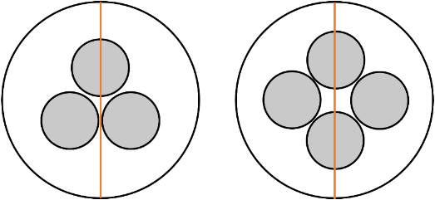


Results-Velocity profiles
Velocity peak
Velocity peak
$$y$$
$$z$$
$$y$$
$$z$$
Comparison of velocity alone the vertical line with 3 and 4 inserted cables (u=0.5 m/s).
2 velocity peaks appear between the cables and the pipe wall.
Velocity changes more rapidly with 4 inserted cables.
The pitch of the twisted cables has significant influence on velocity profiles.
Difference of velocity mainly appears near the gaps and the center hole.

Slide 11


Results-Relation between Re and $f$
Group A (3 cables, $d_{h}=5$ mm)
Group D (4 cables, $d_{h}=8$ mm)
The friction factor gradually goes to plain as Reynold number increases.
Geometry determines how the friction factor changes with Reynold number.
As pitch of cables decreases, the friction factor increases.
Friction factor increases at first in Group A, but decreases in Group D.

Slide 12
Results-the friction factor
Changing the diameter of cables from 5 mm to 8 mm brings a 28% increase in friction factor.
Highest friction factor is in Case D12, where the flow area is smallest, and the turbulence intensity is high.
Gaps between cables each other and the total crossing sectional area of cables directly influence the effect of the pitches of cables on friction factor.
Friction factor for all cases with Re$≃4100$

Slide 13
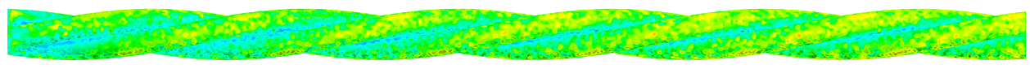
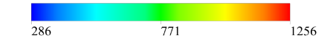
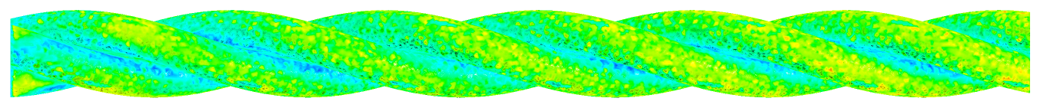
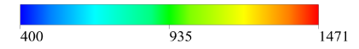
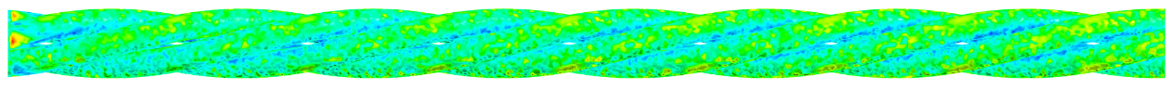
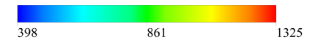
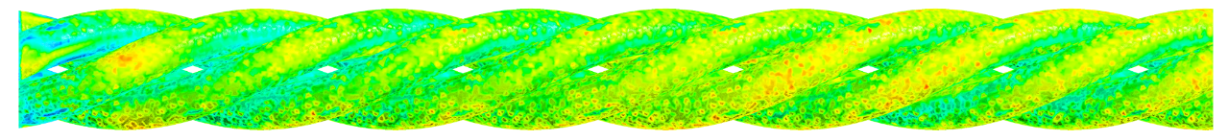
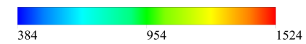
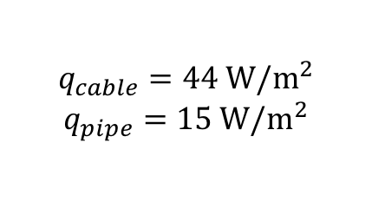
Results-Distribution of $h$
A2
B5
C8
$$q_{cable}=44 W/m^{2}$$
$$q_{pipe}=15 W/m^{2}$$
D11
Heat transfer coefficient values in corresponding case (u=0.7m/s).
The heat transfer coefficient increases with the increase of the cable size.
Heat transfer is stronger at heaved part on the cables, and is weak at depressed part.
Distributions of heat transfer coefficient are similar with different cable geometries.
Averaged HTC is suggested for heat transfer calculation in such corrugated pipes.

Slide 14
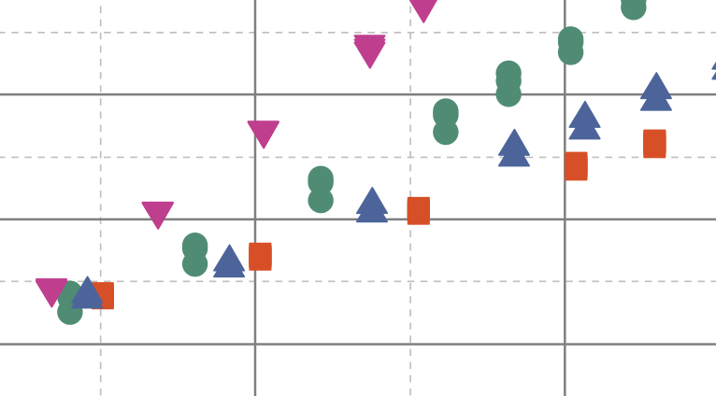
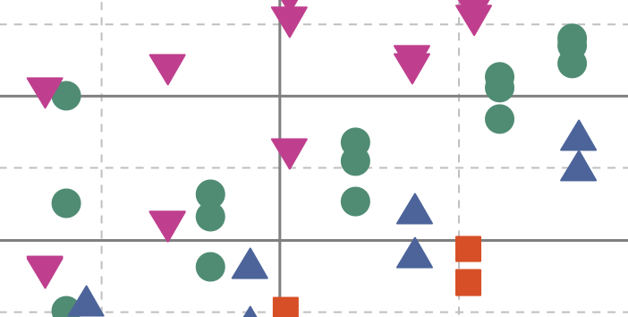
Results-averaged $h$ on cables and pipe wall
Average heat transfer coefficient on cable surfaces
Average heat transfer coefficient on pipe wall
Apparent divergence in growth rate of the HTC can be observed on cable surfaces, in contrast, the growth rates are similar on the pipe wall side.
When changing the pitch of the cables, the HTC changes little on cable surfaces, however, the values vary a lot on the pipe wall, especially in cases with large cables inserted.

Slide 15
Results-Correlations
Related to the cable size
On cables surface
On pipe wall
Equivalent diameter

Slide 16
Conclusion
At the beginning and the ending of the cables, high and low pressure region exists.
The pressure decrease rate in the bellows part is significantly larger than that in the plain part.
Changing the diameter of inserted cables from 5 mm to 8 mm will bring a 28% increase in friction factor in average.
The gaps between cables and overall cable size will influence friction factor greatly.
Increase in cable size will enhance heat transfer in the pipe.
Correlations between cable size, Reynold number and Nusselt number are proposed both for cable surfaces and pipe wall. The predicted Nu agree well with the simulation data.

Slide 17
Thank you for your attention!
This work is supported by the Shanghai Science and Technology Committee Project (STCSM No. 16DZ2291500).
Correspondence email: huangyh@sjtu.edu.cn

