Slide 1
Presenter: Rafael Domenikos
A Different Approach at Solid and Supersolid Helium 4
National Technical University of Athens
Authors: Domenikos Rafael¹ and Rogdakis Emmanouil²
¹ Mechanical Engineer, Ph.D. Candidate NTUA, Laboratory of Applied Thermodynamics, School of Mechanical Engineering, Thermal Engineering Section, National Technical University of Athens, Heroon Polytechniou 9, Zografou Campus, 15780, Athens, Greece
² Professor NTUA, Mechanical Engineer, Ph.D. , Laboratory of Applied Thermodynamics, School of Mechanical Engineering, Thermal Engineering Section, National Technical University of Athens, Heroon Polytechniou 9, Zografou Campus, 15780, Athens, Greece
E-mail: rdomenikos@gmail.com

Slide 2
Current Approaches - Problems
Physics point of view:
  Shadow Wavefunctions – More math intensive, impractical from an engineering perspective
  Multi-Particle Coded Solutions for the quantum equations of the particles at each position – too time consuming, too many phenomena might be hidden from the code.
Macroscopic Point of view:
  Focused at the production of the results using thermodynamics, cannot really provide a microscopical explanation
No theory is yet universally accepted
There is too much knowledge in superfluidity to not draw from it

Slide 3
The Proposed Approach
The assumption that supersolidity is caused by the superflow of the vacancies formed within the lattice.
Superflow Superfluid Bose – Einstein Condensate
Problem: The Vacuum does not have a wavefunction in order to calculate for BE condensation.
London’s Approach

Slide 4
Explaining the Approach
The vacuum is interpreted as a sum of two opposite wavefunctions
  One being the Helium’s atom
  The second being a hypothetical particle with the exact opposite wave-function
A crystal with no imperfections is assumed at this point
The hypothetical particles have the opposite wave-function of the helium particles, therefore:
Bosons + Known Wavefunction + Known Potential
=
Derivation of the Bose-Einstein Condensation Temperature

Slide 5
Helium as a Quantum Solid
To follow the prior method the exact potential at each point of the lattice needs to be known
To find this we make use of the known [1] Lenard-Jones Potential for the helium 4 atom and find the overall potential at each point of the crystal
Knowing the potential we calculate the interatomic distance as a function of Temperature, Pressure, and Number of Atoms
r (Å)

Slide 6
Finding the Vacancies in the Lattice
By finding the vacancies in the crystal we find the number of the aforementioned hypothetical particles that must be assumed.
A Vacancy formation can be due to:
  Thermal Excitation
  Quantum Tunneling
r (Å)

Slide 7
Thermodynamic Properties
It is important at this stage to derive some thermodynamic relations for the quantum solid with the vacancies, for later to be able to derive the thermodynamic properties of the Supersolid.
Heat Capacity
Depending on Temperature, Volume and interatomic distance
Integrated in the equation is the number of vacancies

Slide 8
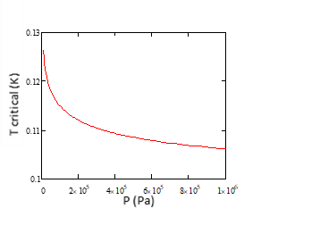
Bose – Einstein Condensation Temperature
To find the Bose – Einstein Condensation temperature we use the exact method used in the superfluid [2].
P (Pa)

Slide 9
Finding the Number of Condensed Particles
Given the width of the wavefunctions and the scaling of the crystal it is safe to assume that each particle can only condense with a neighboring one.
Using the BE Distribution we find the number of particles at the ground state – using the temperature we want and the ground state energy for this temperature and pressure:
Tc
T (K)

Slide 10
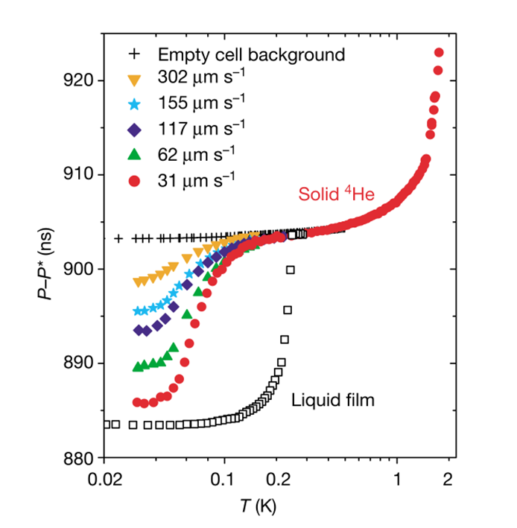
Checking the Results
To have an idea if our calculations point towards the correct phenomena and results we compare the to Kim’s et al. experiment, replicating in a mathematical form and adding our model:
Results:
ex. ΔΤ=~ 1223ns for T=0.1 and ΔΤ=~1239ns
for T=0.2K at the same P
                We find that the final result is within a reasonable margin of error for our initial generalizations and input.
Figure from Ref [3]

Slide 11
Conclusions
Mathematically sound method to describe supersolidity at a perfect helium 4 crystal
Uses similar methods with the approach used in the study of superfluids
The results when compared to the experiment seems very promising and within reasonable margin of error given that this is a very early estimate and application of this research

Slide 12
Next Steps
Full Replication of Kim’s et al. experiment and test of the absolute accuracy of the method given finely tuned inputs and working assumptions
Tune the method to work with imperfections within the crystal
Derive a full representation of the thermodynamical equations of supersolid helium

Slide 13
References
[1] R Aziz & V Nain & J Carley & W Taylor & G McConville, An accurate intermolecular potential for helium, J. Chern. Phys., Vol. 70, No.9, 1 May 1979
[2] R Domenikos & E Rogdakis, An Improved Equations of State for Superfluid Helium 4, Procedings ICEC27-ICMC 18
[3] E Kim & M Chan, Probable observation of a supersolid helium phase, NATURE, VOL 427, 15 JANUARY 2004

Slide 14
THANK YOU FOR YOU ATTENTION
QUESTIONS
?

