Slide 1
Manufacture and Characterisation of Bulk MgB₂ Superconductor with High Trapped Field for Biomedical Applications
Susie Speller
ICEC-ICMC, 4th September 2018, Oxford

Slide 2





Acknowledgements
Oxford Materials (CfAS)
Sajjad Amirkhanlou
Guillaume Matthews
Tim Davies
Chris Grovenor
Element Six
Edwin Eardley
Chris Wort
Cambridge Engineering
John Durrell
Difan Zhou
David Cardwell
STFC (RAL)
Matthew Hills
Tom Bradshaw
Simeon Greenwood
Martin Crook

Slide 3
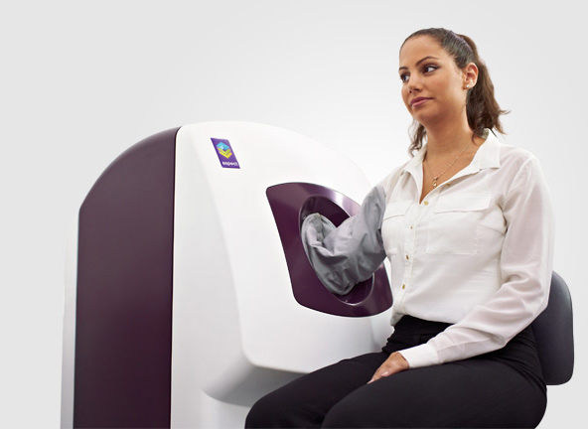


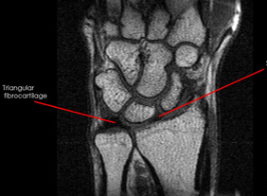
Magnets for Biomedical Applications
Magnets for MRI body scanners are the main commercial application of superconductors.
Large expensive systems
Use NbTi superconducting electromagnets.
Cheaper limb-scale MRI machines are entering the market place.
Use 1 T permanent magnets.

Slide 4



Magnetic Drug Targeting
Magnetic Force$∝\left(B∙∇\right)B$
Drug
Polymer shell
Magnetite
Increasing magnetic force enables:
→ blood vessels deeper inside body to be targeted
→ effective trapping of drug carrier in larger diameter blood vessels with faster blood flow.
Blood vessel
Tissue
Magnet

Slide 5
Bulk superconductor magnets
Advantages
Stronger than permanent ferromagnets (3-5 T for MgB₂, 17 T for REBCO compared to ~1.6 T for Nd-Fe-B)
More compact than electromagnets
Challenges
Bulk superconductors need to be magnetised using an external magnetic field.
Cheap, compact, reliable cryogenic solutions are needed.
Demonstrators are needed to show these can be achieved in practical devices.
To obtain high trapped fields:
→ large sample diameter
→ high critical current density

Slide 6
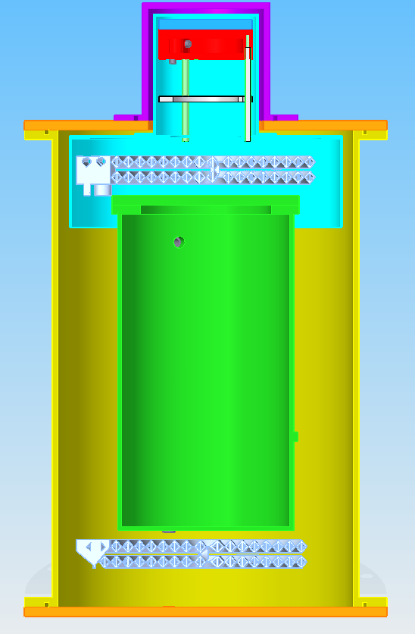
Bulk MgB₂ magnet demonstrator
MgB₂ puck
OVC top hat
3 year EPSRC grant to build a compact demonstrator magnet using bulk MgB₂ superconductor
MgB₂ bulk development (Dec 2017)
  Oxford
  Element Six
Cryogenics (Sep 2017)
  STFC
Pulsed field magnetisation (Sep 2018)
  Cambridge
27K
Neon pot
JT Heat Exchanger
Radiation Shield
Main outer vacuum can
LN2 bath
High Temp. HX
For details of cryogenics – see poster E-15:065 on Thursday

Slide 7
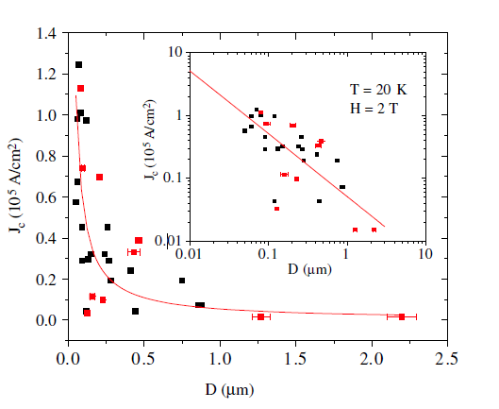
Advantages of MgB₂
Effect of grain size on J_{c}
Cheap.
Polycrystalline – grain boundaries are good pinning sites.
Can be processed by scalable techniques.
Relatively high T_{c} of 39 K.
Larger magnetic fields than permanent magnets (3-5 T).
Mikheenko et al, SUST. 20 (2007) S264

Slide 8
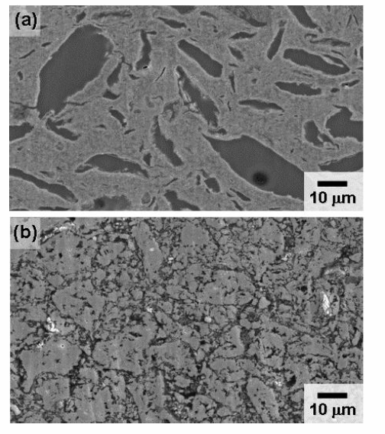

MgB₂ Processing
In-situ
In-situ processing
T <900 ºC
Inherent porosity
Good grain connectivity
$$Mg+B →MgB_{2}$$
Porosity
Ex-situ processing
T >900ºC
High density (if processed under pressure)
Poor grain connectivity
Ex-situ
Poor sintering
Yamamoto et al 2012 Jpn. J. Appl. Phys. 51 010105

Slide 9
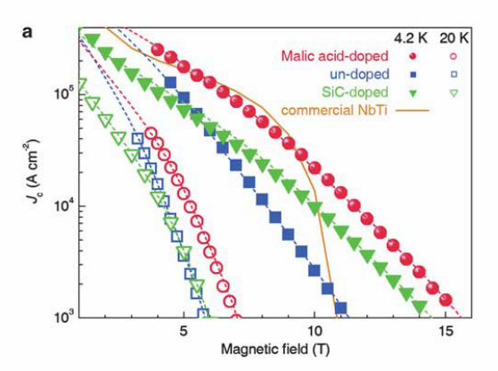
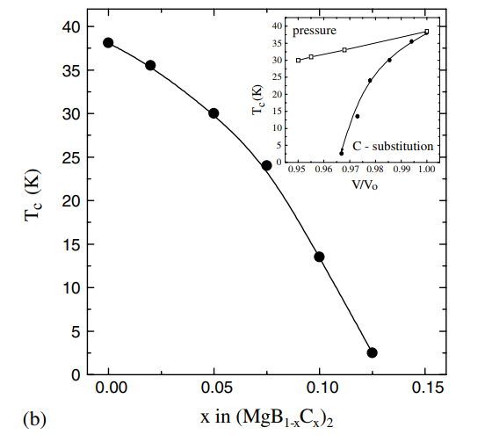
Carbon doping
Carbon doping increases J_{c} at high fields - but reduces T_{c}.
Kim et al, NPG Asia Materials (2012) 4, e3
Lee et al, Physica C 397 (2003) 7

Slide 10
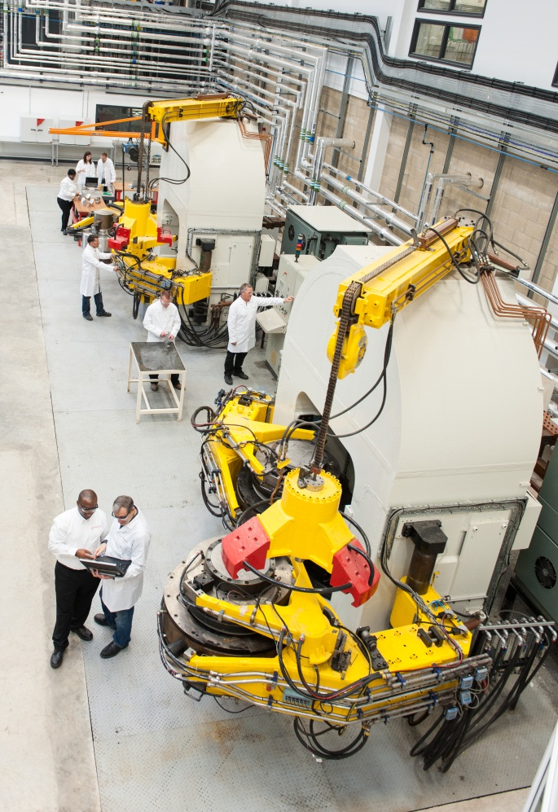
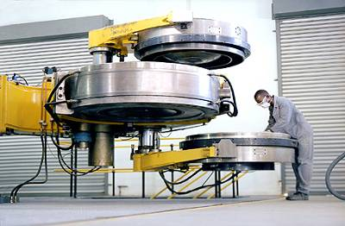
Hot Pressing at Element Six
Industrial scale R & D presses at E6 Global Innovation Centre, Harwell.
High Pressure - High Temperature (HPHT) processing of large bulk samples under extreme conditions.
Processing Conditions
Temperature | 900-1500 ºC (T1<T2<T3)
Pressure | 4-8 GPa
Time | 5-25 mins
R&D presses at E6 GIC, Harwell UK
Notes:
High pressure: 55,000 atmospheres ( = tower of 5000 family-sized saloon cars stacked on a jar of peanut butter)

Slide 11
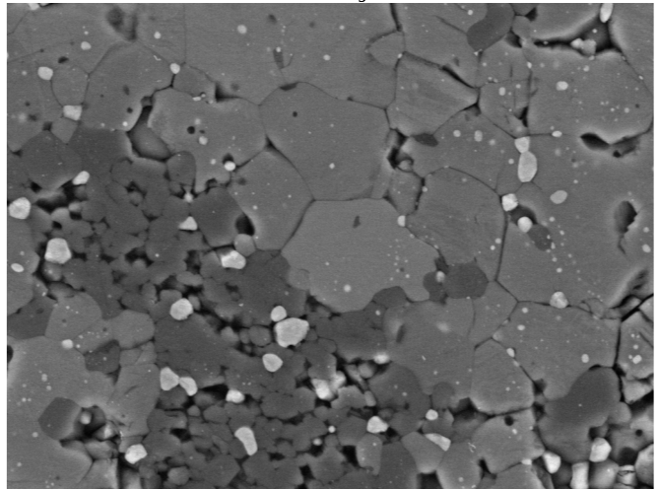
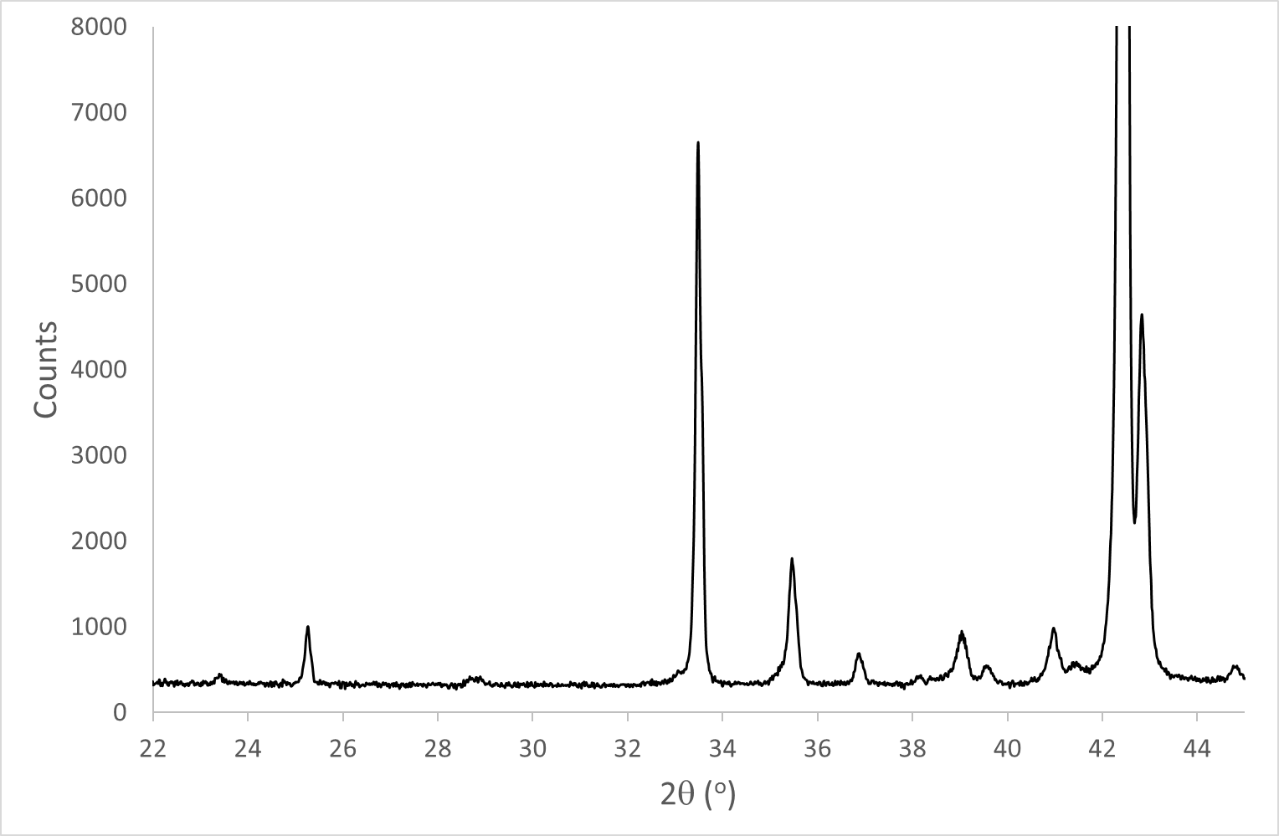
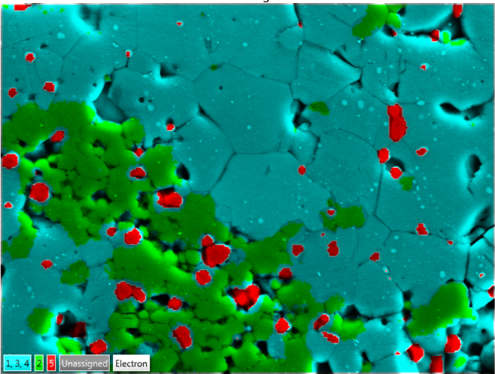
Typical Microstructure
BSE image
MgB₂
X-ray Diffraction (XRD)
●
MgB₄
●
MgB₂
*
MgB₄
●
o
MgO
MgO
EDX phase map
*
MgB₂
●
o
*
*
MgB₄
MgO
5 μm

Slide 12
Microstructural Refinement
Backscattered Electron Micrographs of Element Six HPHT for 15 mins.
5 μm
5 μm
5 μm
5 μm
Increasing Pressing Temperature
Increasing Grain Size

Slide 13
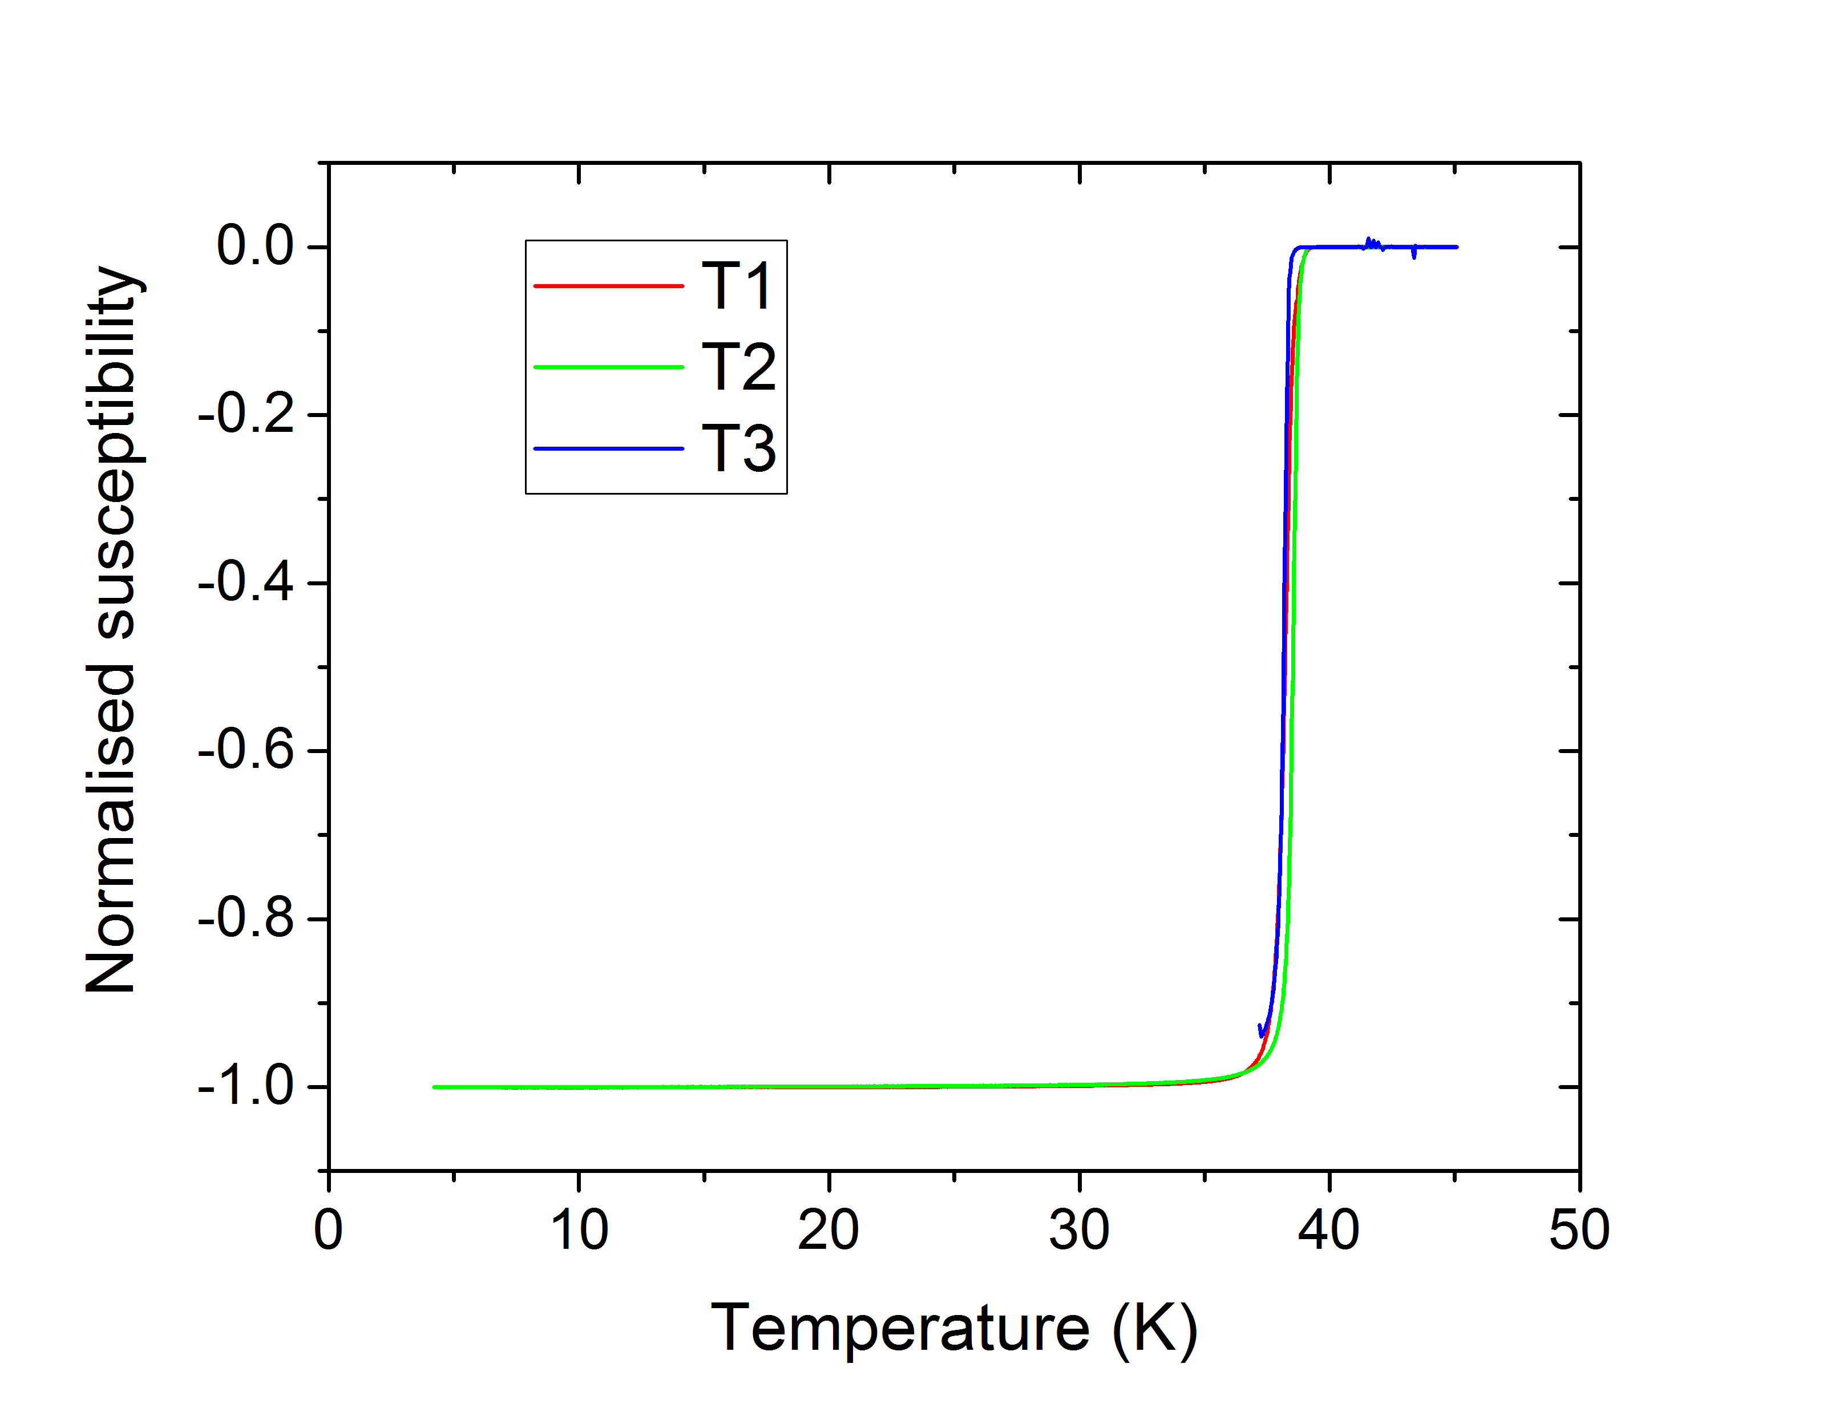
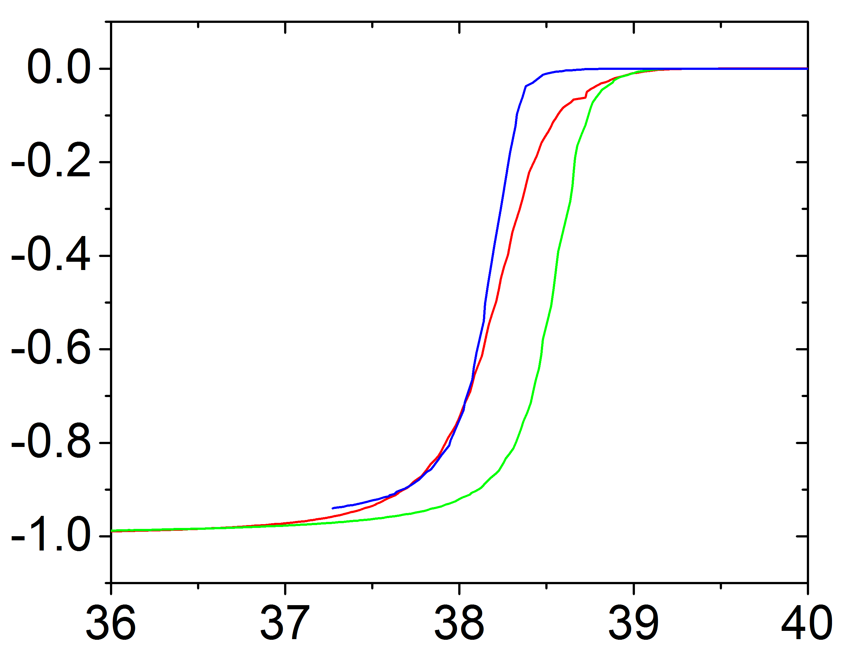
T_{c} Measurements
T1 < T2 < T3
T_{c} very close to optimum value of 39 K.
5 mT

Slide 14
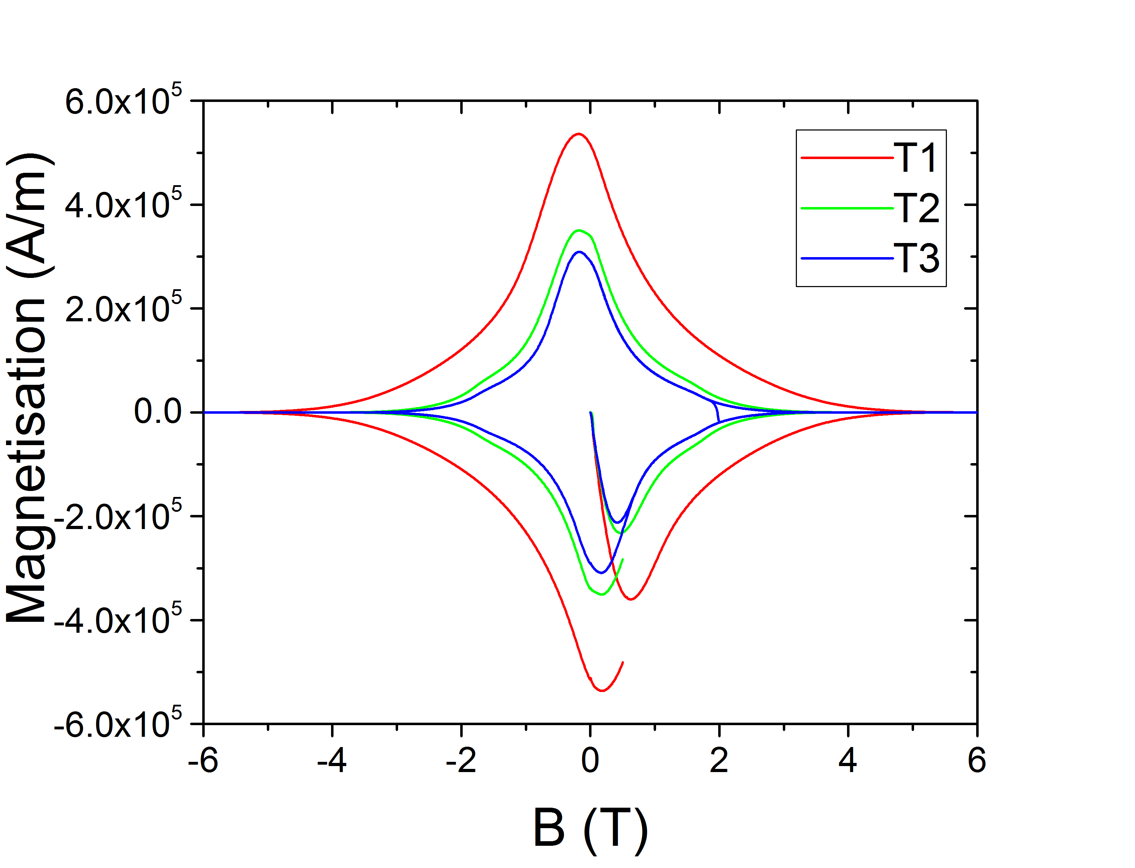
Hysteresis Loops
All samples show hysteresis loops typical of polycrystalline type II superconductors with bulk pinning and well-connected grains.
Decreasing processing temperature increases size of hysteresis loop
20 K

Slide 15
J_{c}(B) performance
At 20 K
At 27 K
T1<T2<T3
Lower processing temperatures → smaller grains → better J_{c}(B) performance

Slide 16
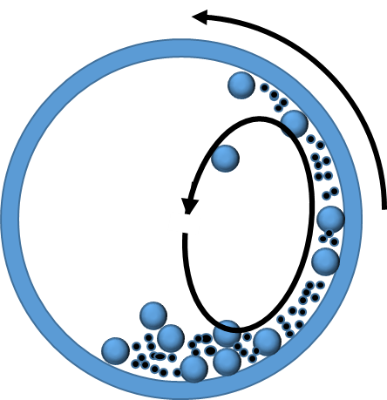
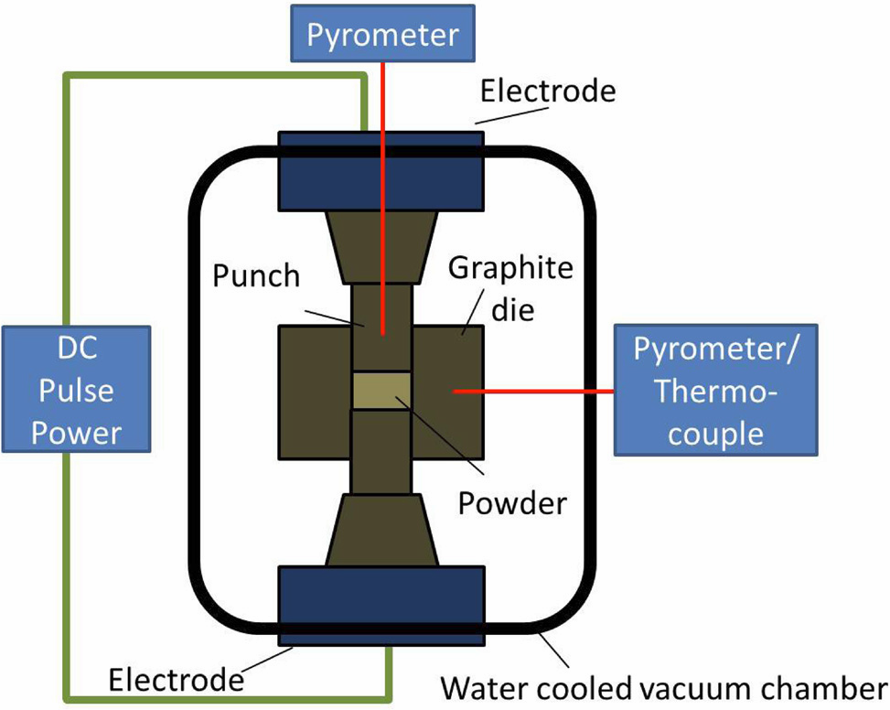
Powder Modifications
Field-Assisted Sintering Technology (FAST)*
High energy Ball Milling
(BM)
Commercial MgB₂ Powder
50 MPa
0.5-10 wt %
Y₂O₃ powder
additions
0-12 hours
5, 30 mins, 950-1150 ºC
* Guillon et al, Adv. Eng. Mat. 2014, 16, 830

Slide 17
Effect of Milling on Powders
Particle Size
XRD of 2 wt% Y₂O₃ sample
10²
Median particle size (μm)
MgB₂
Counts
10¹
Y₂O₃
10⁰
0
15
20
5
10
Milling Time (h)
2θ (º)

Slide 18
XRD peak broadening analysis
As milling time increases:
→ lattice strain increases
→ crystallite size decreases

Slide 19
Effect on T_{c}
Samples consolidated into bulks using FAST (1100 ºC, 50 MPa, 5 mins)
Normalised Susceptibility
Ball milling for 12 hours results in a small degradation in T_{c}.
Addition of Y₂O₃ results in two discernible transitions, with the first onset at a similar temperature to the sample made from as-received MgB₂ powder.
5 mT
35
36
37
38
39
40
41
Temperature (K)

Slide 20
Effect on J_{c}
Samples consolidated into bulks (density >90%) using FAST (1100 ºC, 50 MPa, 5 mins)
10⁹
4 K
10⁹
20 K
10⁸
10⁸
J_{c} (A/m²)
J_{c} (A/m²)
10⁷
10⁷
10⁶
10⁶
10⁵
10⁵
0
1
2
3
4
5
6
7
8
9
10
0
1
2
3
4
5
6
Applied magnetic field (T)
Applied magnetic field (T)

Slide 21
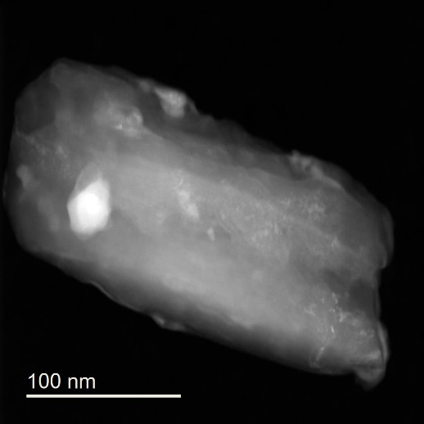
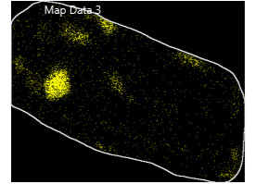
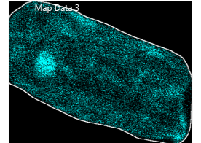
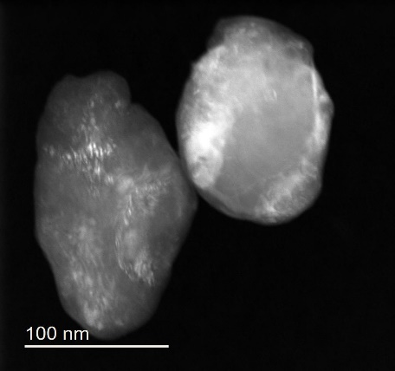
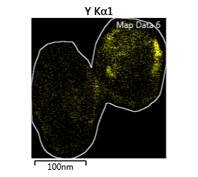
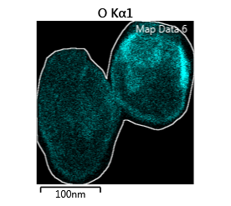
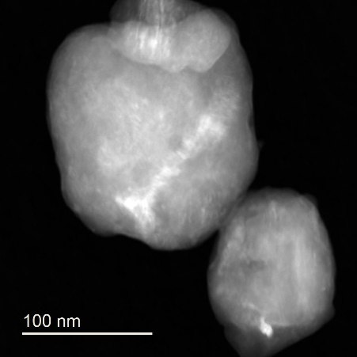
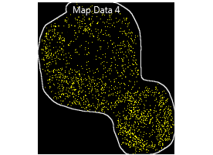
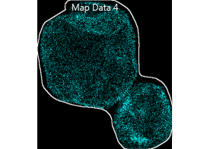
Y₂O₃ Distribution
2 wt % Y₂O₃
O
STEM EDX mapping of individual powder particles.
Increasing milling time results in finer scale mixing of Yttrium.
After milling for 12 hours, Y dispersed homogeneously within MgB₂ particles.
Y
BM 10 minutes
Y
O
BM 1 hr
Y
O
BM 12 hr

Slide 22
Effect of Heat Treatment
MgB₂ + 10 wt% Y₂O₃
XRD shows YB₄ forms at the expense of MgB₄ during sintering.
Higher processing temperature
→ increases YB₄ fraction
→ restores crystallinity of MgB₂
2θ (º)

Slide 23
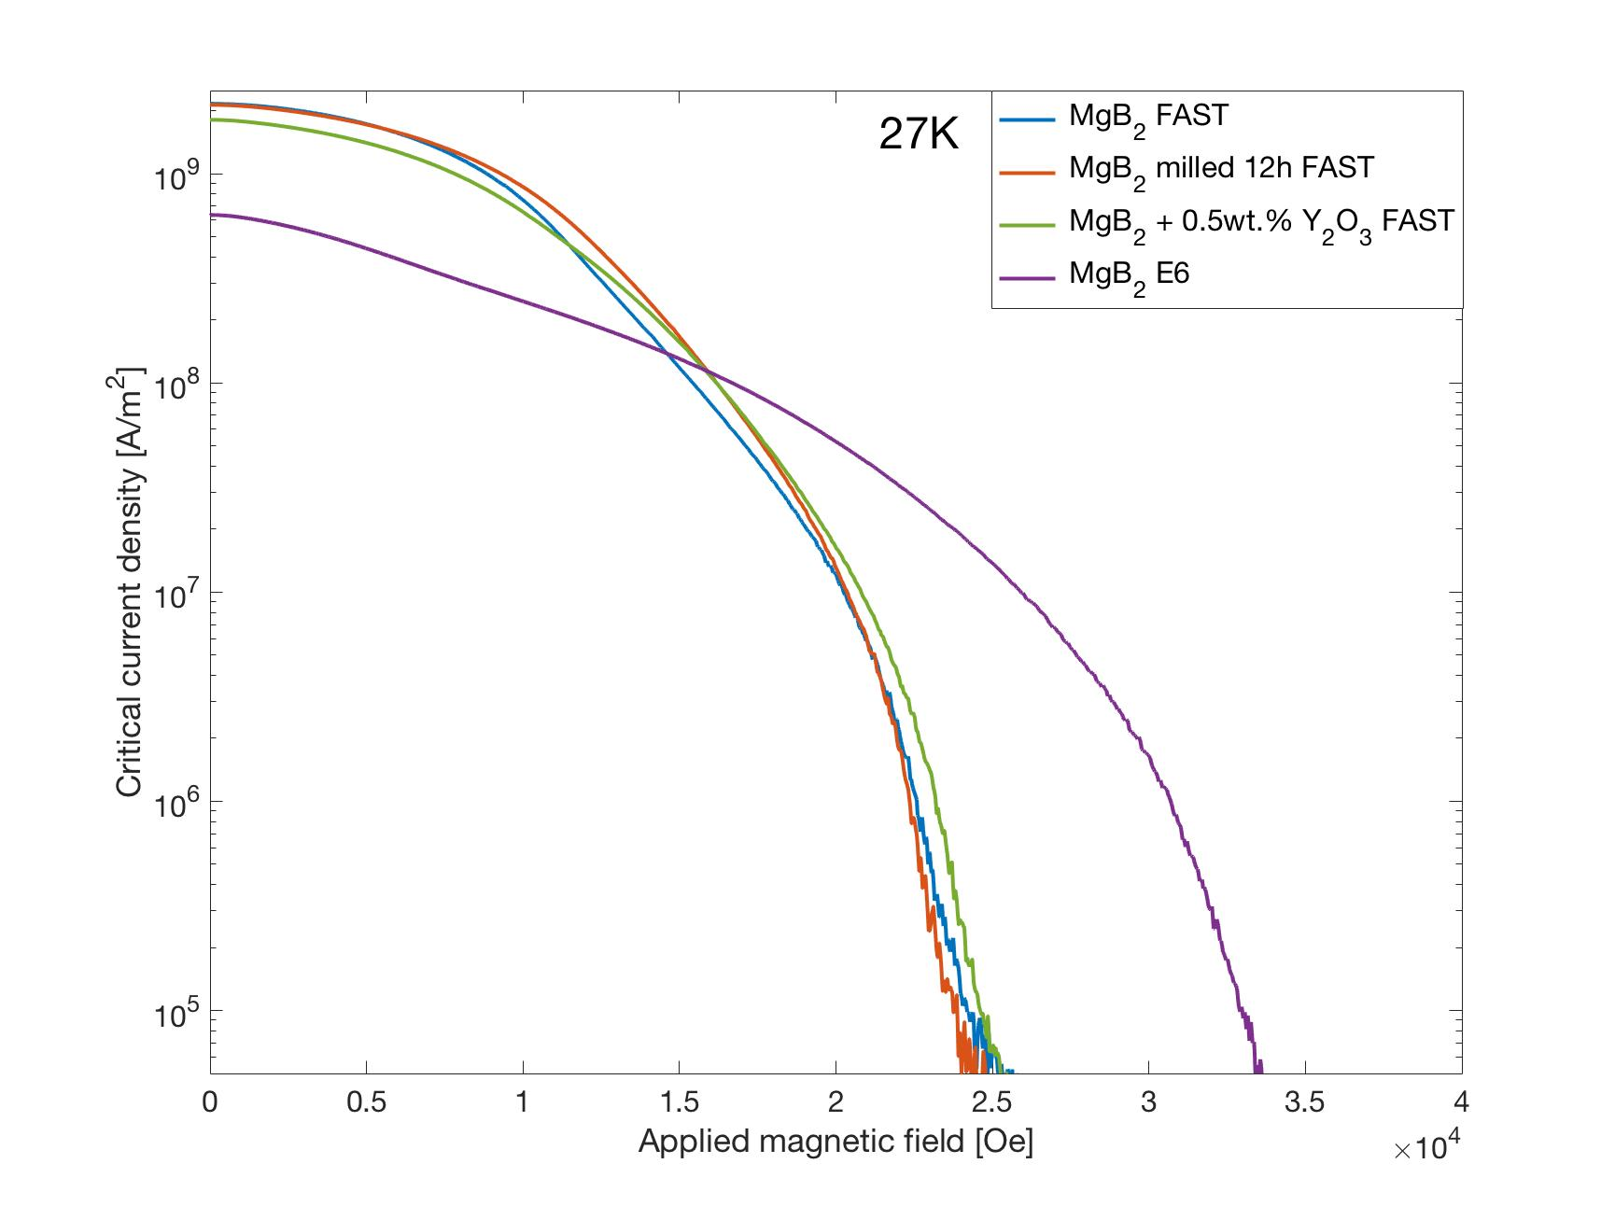
Summary of Bulk Performance at 27 K
FAST samples have highest J_{c} at low fields
Y₂O₃ additions make a small improvement in J_{c}(B)
Ultra HP synthesis at lower temperatures dramatically improves irreversibility field at 27 K.
J_{c} (A/m²)
Element Six HPHT sample
FAST samples
Applied Field (T)

Slide 24
Conclusions
Large diameter bulks have been made at E6 using HPHT process.
Ultra high pressure obtainable in E6 bulks allows densification at low temperature. The resulting small grain size leads to significant field enhancement at 27 K.
Initial work on Y₂O₃ additions have produced slight improvement in performance.
Future work includes more detailed microstructural studies, measuring trapped field performance, using the E6 HPHT process with our in-house modified powders, investigating other nanoparticle additions and scaling up to larger diameter bulks.

Slide 25
B_{irr} comparison
B_{irr} (at J_{c}=10⁶ A/m²) | 4 K | 20 K | 27 K
E6 (T1) HPHT | 9.5 T | 5.6 T | 3.1 T
0.5 wt% Y₂O₃ FAST | 7.5 T | 4.1 T | 2.3 T
As-received MgB₂ FAST | 6.6 T | 3.8 T | 2.2 T

Slide 26
E6 samples at 4.2 K

