Slide 1
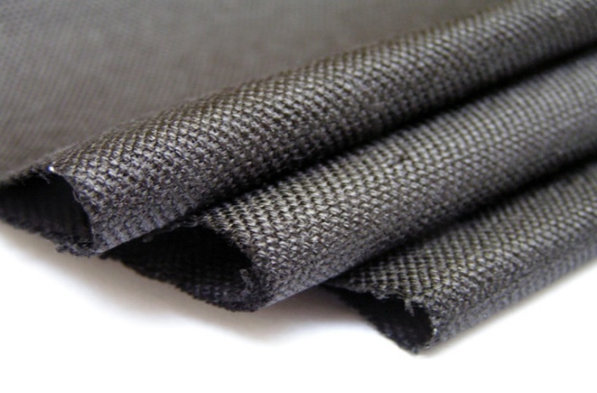


Enhancing high vacuum performance of multi-layer insulation systems with activated charcoal fabric
W. O. S. Bailey, J. Pelegrin, C. Beduz

Slide 2

Motivation
Multi-layer insulation (MLI) is an important component of any cryogenic system.
The configuration of MLI can influence the quality and speed to achieve a good vacuum.
Some materials, like glass fibre paper, normally used as a spacer are difficult to handle and wrap.
New fabrics containing woven activated charcoal fibres (ACF) could potentially replace the glass fibre paper while enhancing cryopumping performance.
Adding activated charcoal into the MLI would significantly increase the distribution of the “getter” throughout the system making it work more effectively and efficiently.
Several new combinations of MLI were prepared and liquid nitrogen boil off rates were measured using a calorimeter.

Slide 3
Summary
Activated charcoal cloth
Experimental setup
Wrapping methodology
Test methodology
Results
Summary of results
Conclusions
Further work

Slide 4
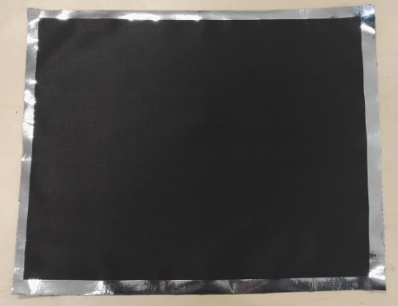
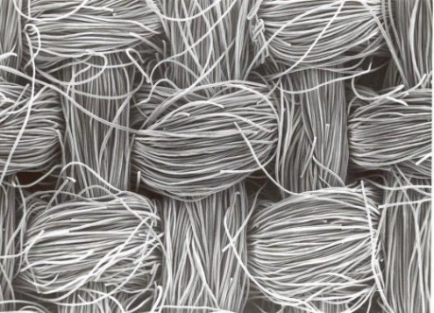
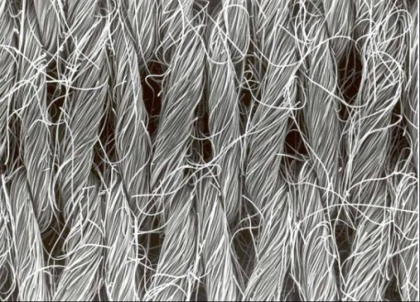
Activated charcoal cloth
Activated charcoal is considered a more effective “getter” material than zeolite for cryosorption of gases like helium and hydrogen.
The activated charcoal cloth (ACC) is composed by 100 % activated charcoal fibres.
The cloth has an extremely large surface area of 1000 – 2000 m²/g, compared to activated charcoal in granular form of 889 m²/g).
It has a nominal thickness of 500 microns and nominal density of 240 g/m³, (compacted activated charcoal has a density of 460 g/m³).
The cloth is easy to handle and can be baked at high temperatures.
Layers can be easily removed and reused.
The edges of the woven cloth tend to fray when cut. This is not expected to be a problem for the knitted cloth.
Woven cloth
Knitted cloth

Slide 5
Experimental setup
The dimensions of each test vessel (3 off):
  Diameter: 108 mm
  Height: 300 mm
The middle vessel (measurement) was wrapped with the new MLI configurations
Only 5 m² of the ACC was available for testing
The top and bottom vessels (guards) were wrapped with Nylon-Mylar blankets

Slide 6
Wrapping methodology
The reflecting and insulating layers are wrapped one layer at a time.
10 layers of reflecting material and 9 layers of insulation are wrapped for each test.
Thermocouples are placed on layers 2, 3, 5, 7, 9 and 10 with the reference placed on the measurement vessel at 77 K.
Insulating layers are made longer to avoid contact between reflecting layers.
Insulating
Material | Thickness [µm] | Thermal conductivity at 77 K [W/m K]
Aluminium foil (Al) | 15 | 300
Mylar | 12 | 0.15
Glass fibre paper (GFP) | 100 | 0.008
Activated charcoal cloth (ACC) | 500 | 0.25 - 2
Reflecting

Slide 7
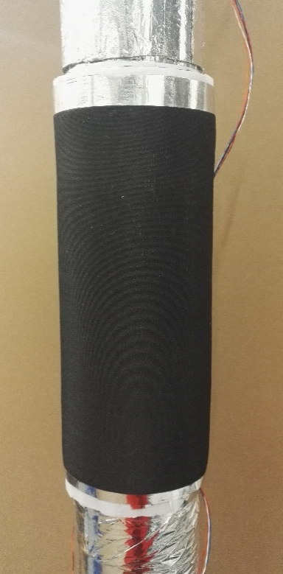
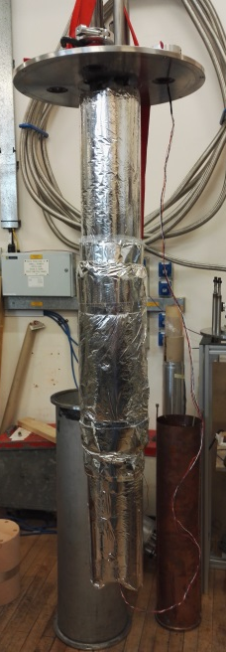
Test methodology
Test procedure:
Wrap the middle vessel.
Insert calorimeter into outer vacuum jacket.
Pump vacuum space (typically for 1 week).
Cool down of guards and measurement vessels.
Isolate vacuum pump.
Measure liquid nitrogen boil off as a function of time when system settles.
Record the vacuum pressure and temperature profile over a period of 1-3 days.

Slide 8
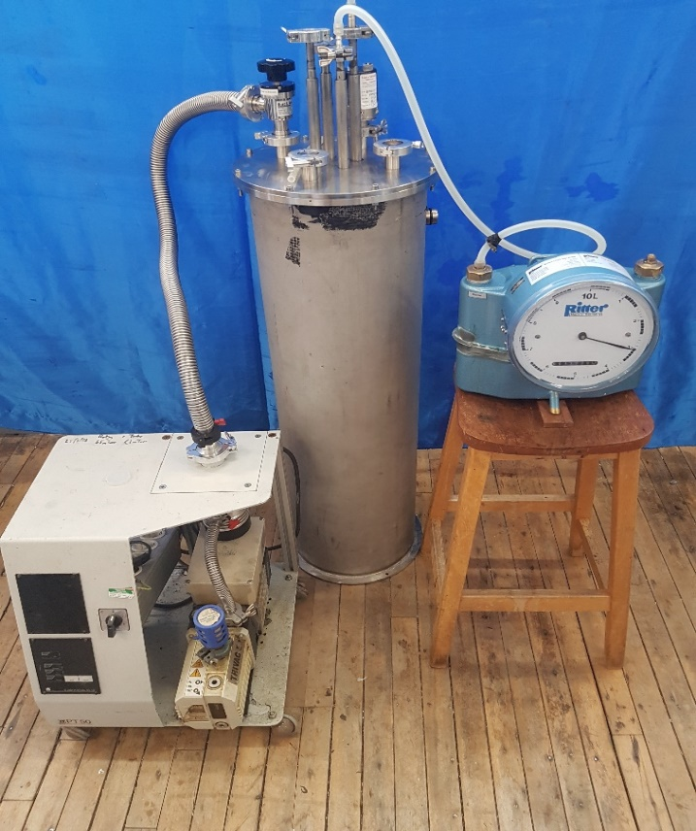
Test methodology
Vacuum gauge
Test procedure:
Wrap the middle vessel.
Insert calorimeter into outer vacuum jacket.
Pump vacuum space (typically for 1 week).
Cool down of guards and measurement vessels.
Isolate vacuum pump.
Measure liquid nitrogen boil off as a function of time when system settles.
Record the vacuum pressure and temperature profile over a period of 1-3 days.
Instrumentation port
Isolation valve
Flow meter
Vacuum pump

Slide 9
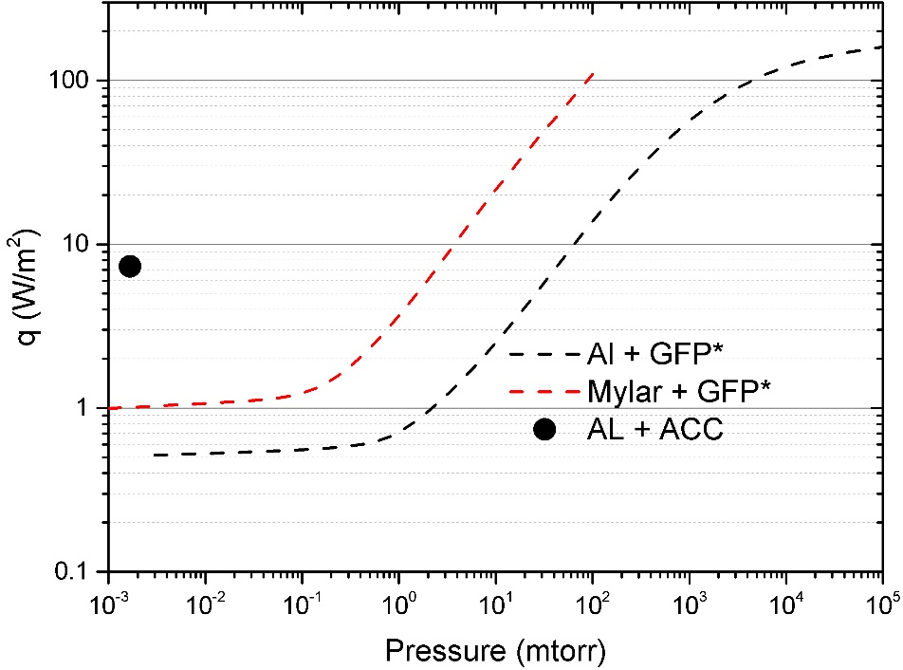
Results
Al + ACC:
The first test used Al foil as the reflecting material and ACC as the spacer material.
*J. E. Fesmire Phys Procedia 2015;67:1089-97
The measured boil off rate was much higher than expected.
Very good vacuum pressure achieved thanks to the ACC.
Since the ACC can have a relatively high thermal conductivity, the Al (reflecting material) was substituted with Mylar to reduce the thermal conduction between sequential layers.

Slide 10
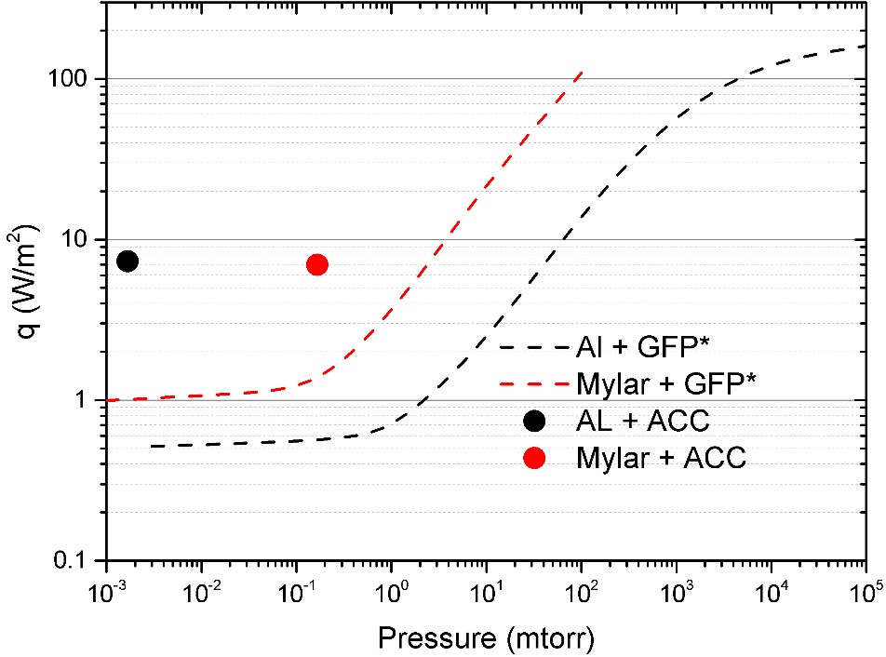
Results
Mylar + ACC:
The second test replaced the Al foil with Mylar as the reflecting material and retained the ACC as the spacer material.
The boil off rate did not reduced significantly.
The vacuum pressure was higher due to a leak in the system, but still between the optimum limit for MLI to be effective.
The vacuum pressure was expected to be similar without the leak (or slightly higher due to higher outgassing).
The thermal profile could be checked to explain the poor performance of the MLI.
*J. E. Fesmire Phys Procedia 2015;67:1089-97

Slide 11
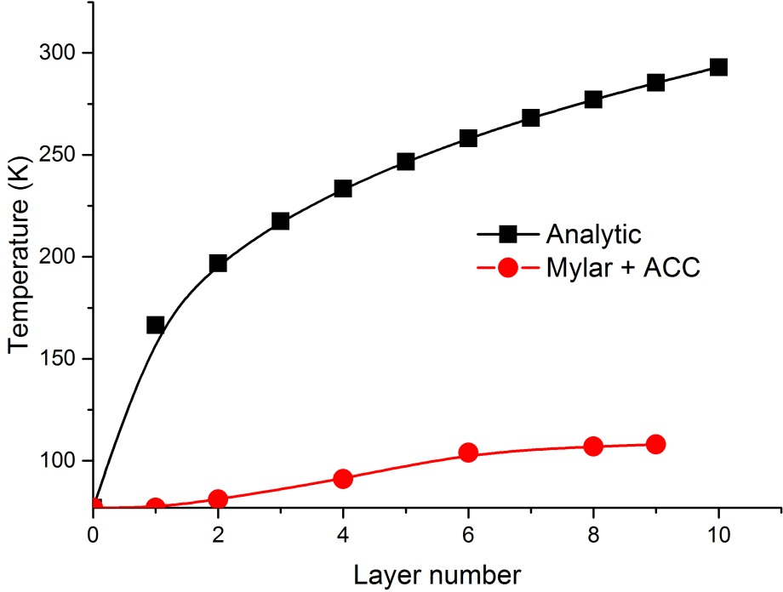

Results
Mylar + ACC:
The second test replaced the Al foil with Mylar as the reflecting material and retained the ACC as the spacer material.
Comparing the temperature distribution at each layer with the analytical solution for 10 layers obtained from:
It appears that the heat transfer by conduction is significant across the MLI.
It might be due to some contact points in the ACC due the extra length of the spacing layers.
$$T_{n}=[{77}^{4}+\frac{n}{N+1}{\left({300}^{4}+{77}^{4}\right)]}^{1/4}$$

Slide 12
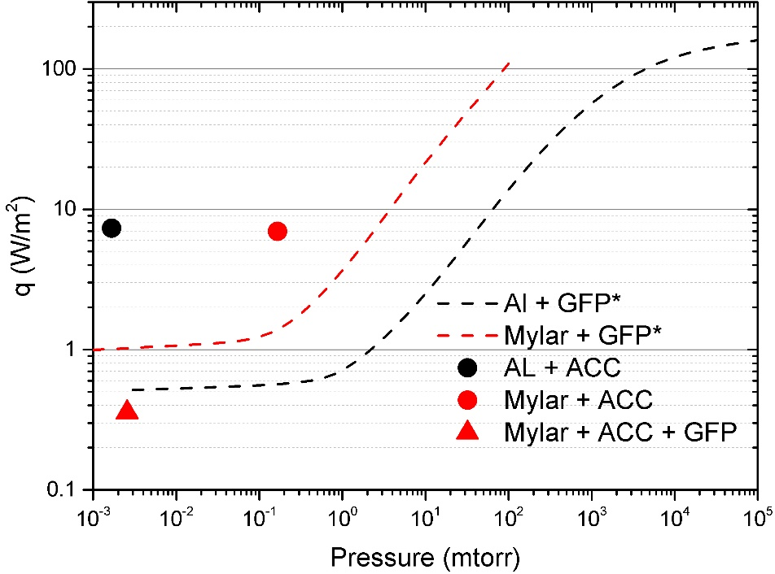
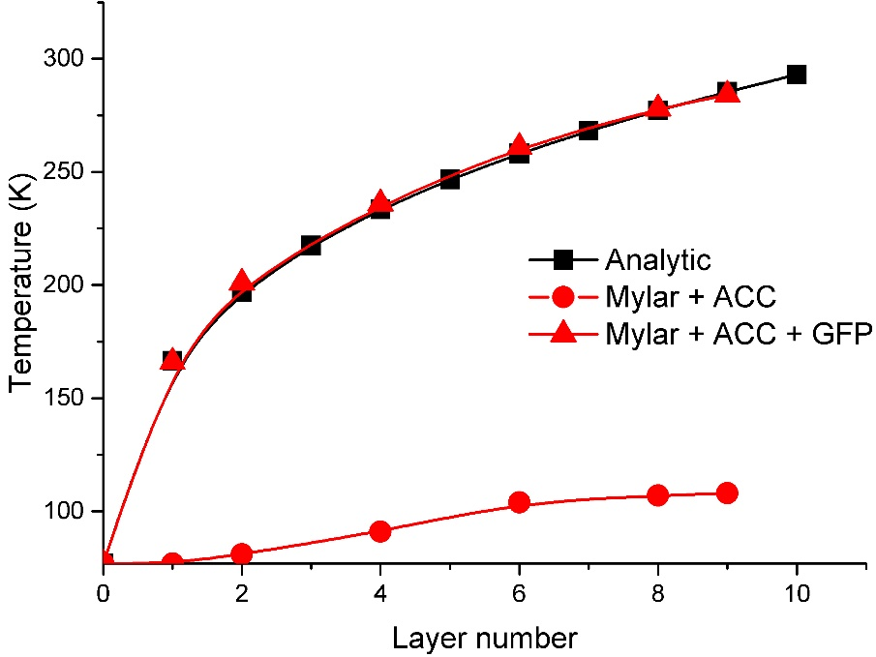
Results
Mylar + ACC + GFP:
Glass fibre paper (GFP) was added as an additional spacer material after the ACC.
Very low boil off rates and low vacuum pressures were achieved.
The temperature distribution fits well the analytical model.
*J. E. Fesmire Phys Procedia 2015;67:1089-97

Slide 13
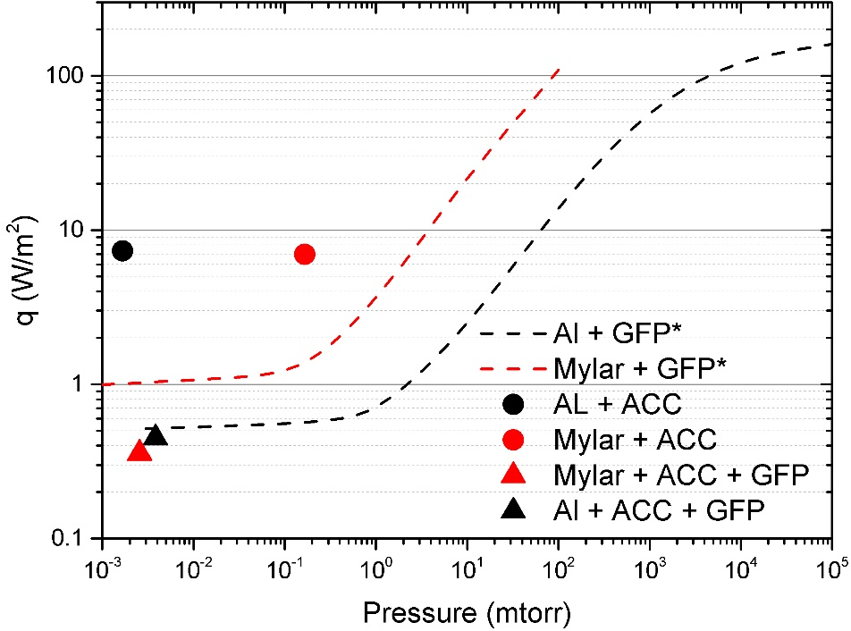
Results
Al + ACC + GFP:
Al foil replaced the Mylar to check if lower vacuum pressure could be achieved
*J. E. Fesmire Phys Procedia 2015;67:1089-97
Similar values to those measured when using Mylar+ACC+GFP were obtained.
The vacuum pressure was 50 % higher, however this particular test was pumped for half the time (3 days) and this is likely to have had an affect on the results.

Slide 14
Summary of results
Material | Thickness [m x 10⁻³] | Heat flux (q) [W/m²] | Apparent thermal conductvity (k_{e}) [W/m K] | Vacuum pressure [millitorr]
Al + ACC | 5.145 | 7.34 | 3.04 x 10⁻⁴ | 0.0017
Mylar + ACC | 3.850 | 6.95 | 2.87 x 10⁻⁴ | 0.1667
Al + ACC + GFP | 8.765 | 0.45 | 1.77 x 10⁻⁵ | 0.0038
Mylar + ACC + GFP | 9.250 | 0.36 | 1.48 x 10⁻⁵ | 0.0026
Mylar + carbon loaded paper* | 3.240 | 1.76 | 2.63 x 10⁻⁵ | 0.0400
Al + GFP* | 2.850 | 2.13 | 2.81 x 10⁻⁵ | 0.2000
Mylar + GFP* | 2.670 | 3.40 | 4.17 x 10⁻⁵ | 1.0000
*R. G. Scurlock and B. Saull Sixth International Cryogenic Engineering Conference

Slide 15
Conclusions
The activated charcoal cloth has potential to replace getters used in solid/powder form.
Activated charcoal cloth is easy to integrate into an MLI system and is quick to wrap.
It appears the thermal conductivity of the cloth is too high to use solely as a spacer material, hence, a spacer material like the GFP has to be used.
When a spacing material was added to the system, heat flux values similar to those of the standard curves were obtained with low vacuum pressures, equivalent to when using solid getters.
Future work:
In line with our initial motivation to remove the GFP spacer (difficult to handle and wrap) we intend to investigate some alternative MLI systems:
ACC + Nylon net
ACC + Crinkled/dimpled Al sheet
Experimental validation of the optimised number of ACC layers required to enhanced vacuum performance obtained when using getters.

Slide 16
Conclusions
Thank you for your attention.

