Slide 1
Extraction of Instrumentation Wires through the High-Voltage Insulation of the ITER Magnet Feeder System
N Clayton¹, D Evans¹, C-Y Gung¹, O Pastor¹, R Piccin¹,
S Cerignat², X Huang³, G Li³ and M Crouchen⁴
¹ITER Organization, Route de Vinon-sur-Verdon, CS 90046, 13067 St. Paul Lez Durance Cedex, France.
²CEA, IRFM, 13108 St. Paul Lez Durance Cedex, France.
³Institute of Plasma Physics (ASIPP), Chinese Academy of Sciences, P.O. Box 1126, Hefei, Anhui, 230031, People’s Republic of China.
⁴Rockwood Composites Ltd. 8 Venture Court, Bradley Lane, Newton Abbot, Devon TQ12 1NB, United Kingdom.

Slide 2
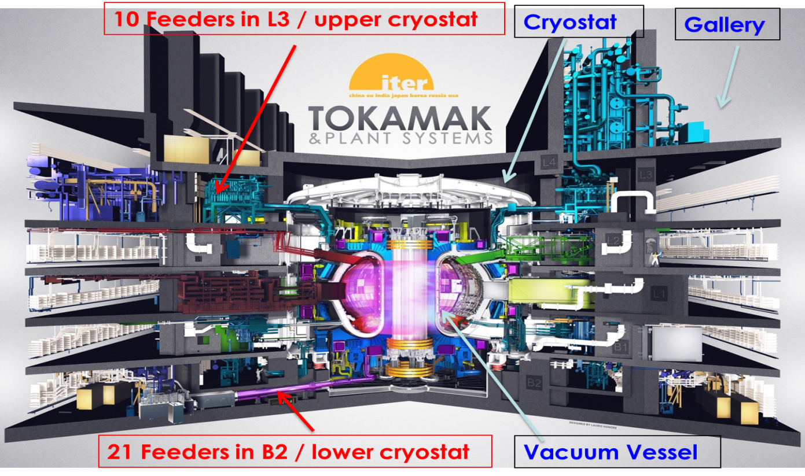
Overview of ITER
ITER superconducting magnets contain the plasma within the vacuum vessel
The feeders supply these magnets with helium coolant and electrical current
They also carry the instrumentation signals from the magnets

Slide 3
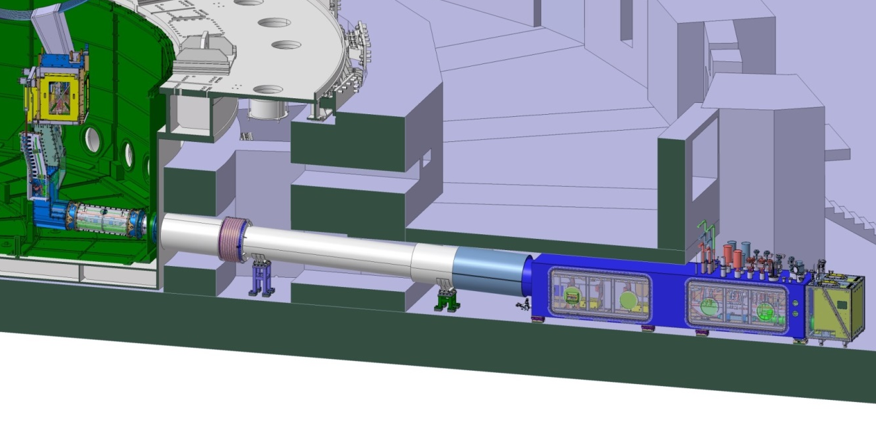
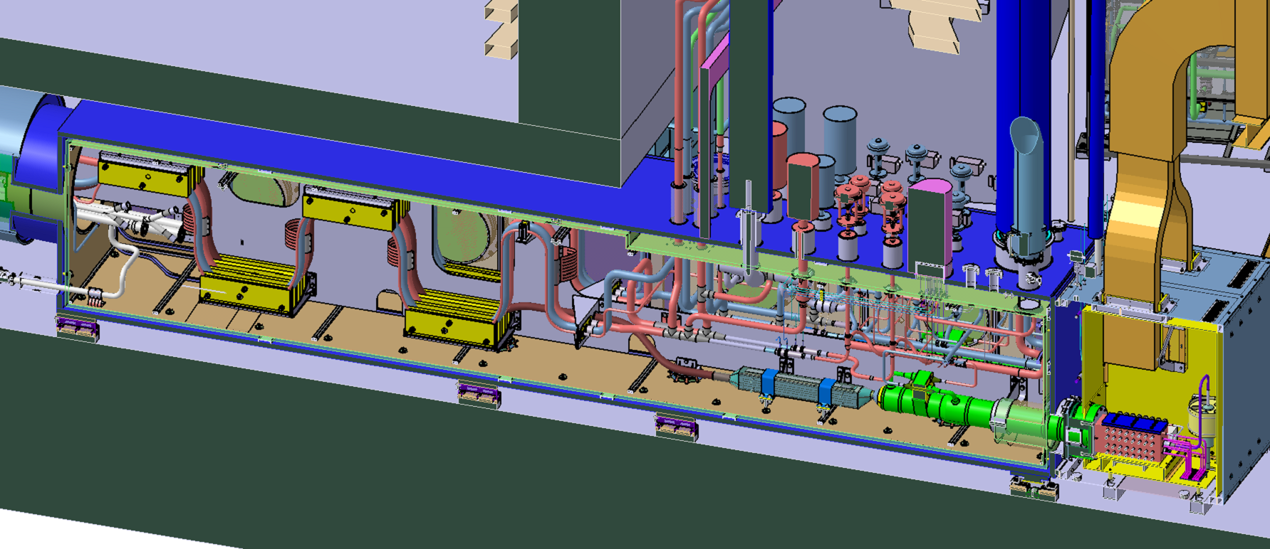
Overview of a Feeder
Superconducting busbar, joint and current lead are enveloped in high voltage insulation
Instrumentation wires to be extracted through this insulation
~30 m

Slide 4
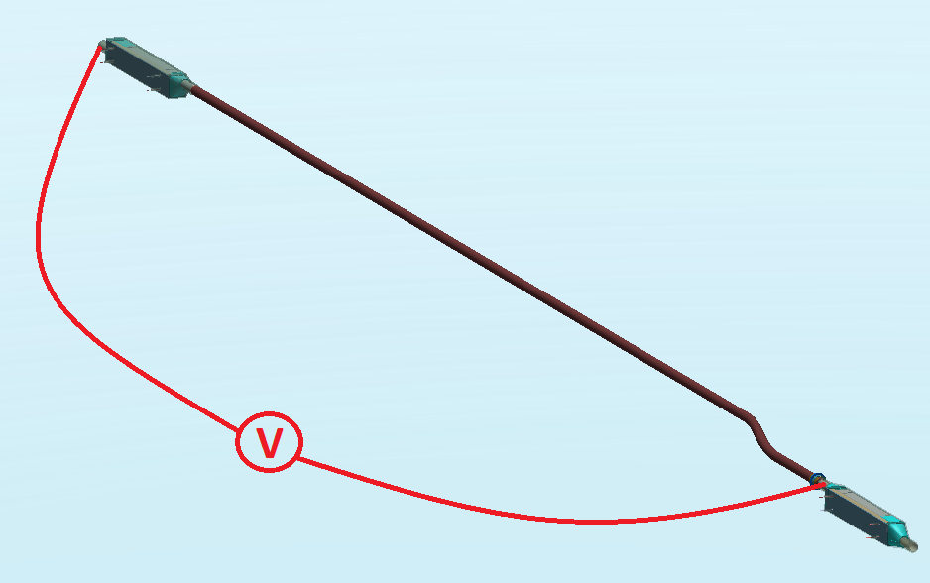
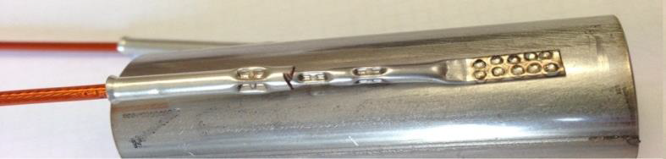
Purpose of the Instrumentation Wires
Purpose is to allow the detection of resistive voltages in the event of superconducting busbar quench
Instrumentation wires: 1 mm diameter multifilament copper core, encapsulated by 1 mm thick polyimide – a.k.a HV wire
They terminate in a crimp which is spot welded to the busbar
~1000 HV wires to be extracted from the feeders

Slide 5
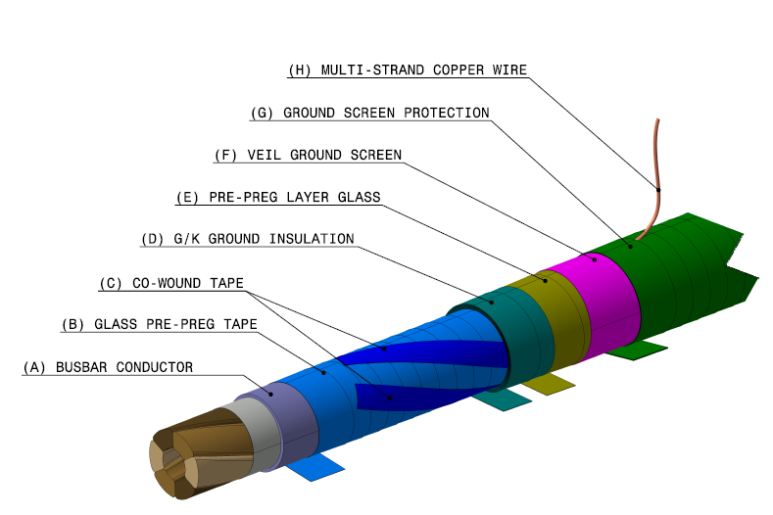
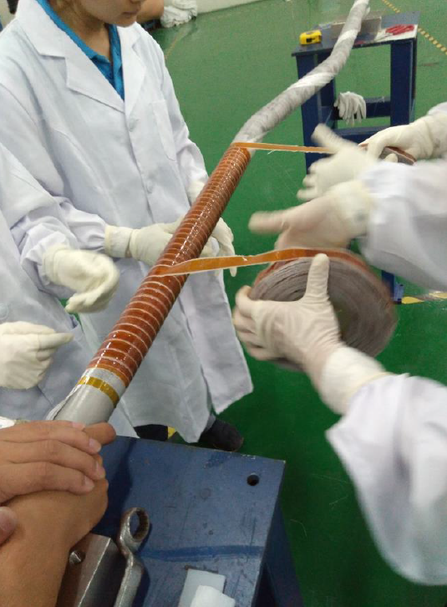
Feeder High Voltage Insulation
ITER magnets and feeders may be at high voltage (HV) during operation » need HV insulation
HV insulation consists of 7 half-lapped layers of glass pre-preg/Kapton tapes (G/K tapes)
Materials and processing documented in Clayton et al. Cryogenics 83 (2017) 64-70

Slide 6
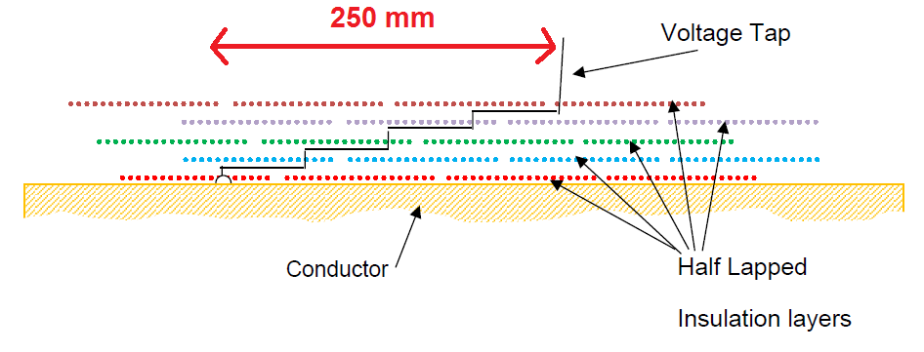
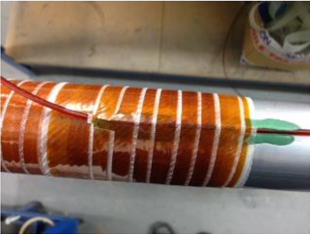
Preliminary HV Wire Extraction Trials
Single HV wire (3 mm outer diameter) extracted through 6 mm thick HV insulation » significant perturbation
‘Step’ the wire after ~ every 3rd G/K wrap.
An epoxy putty (Huntsman AV/HV 1580) was used as the filler on the sides of the wire to eliminate voids.
Advantage is that the putty is malleable so can flow to fill the volume
The extracted wire must not degrade the electrical performance of feeder HV insulation

Slide 7
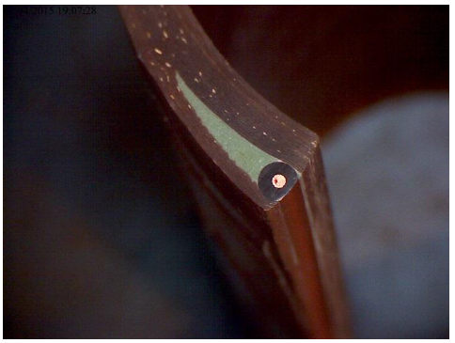
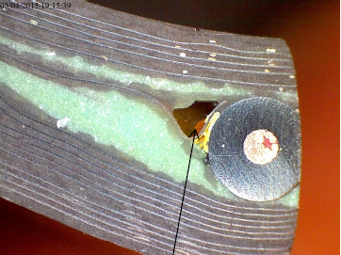
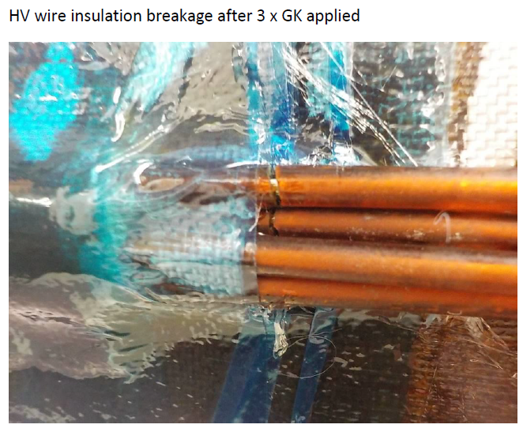
Preliminary HV Wire Extraction Trials (2)
Section cuts indicated that the putty flowed quite well, although some local voids are present.
However, cracks were observed in the HV wire insulation in a later specimen trialing the extraction of 4 wires (as required in the feeder).
Mismatch in thermal contraction of putty and wire?
Repeated bending of wires which is required as filler is applied?

Slide 8
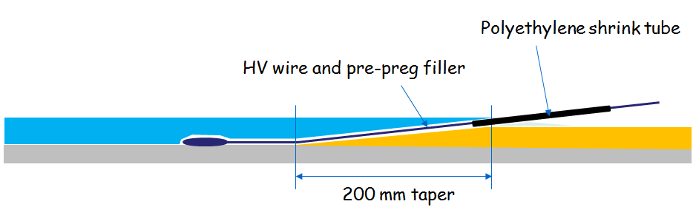
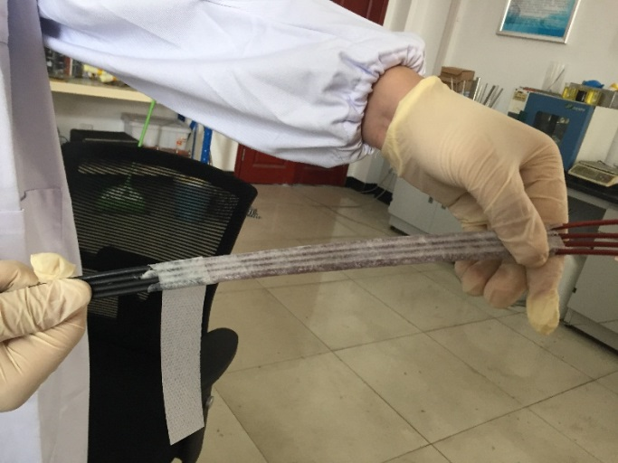
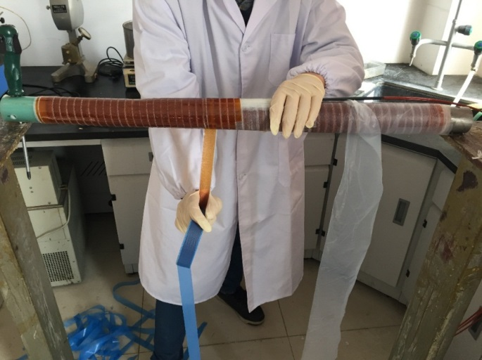
Revised HV Wire Extraction Strategy
Two main strategies adopted to overcome the limitations of using putty
Use pre-preg as the filler between wires and insulation
Prepare the taper in the insulation and lay the wires on to minimise handling
Wrap each wire and the 4 wire bundle in one half-lapped layer of pre-preg.
Use PE shrink tube to locally reinforce the wire at the break-out point
Lay the 4 wires up the cured taper and fill in with G/K insulation

Slide 9
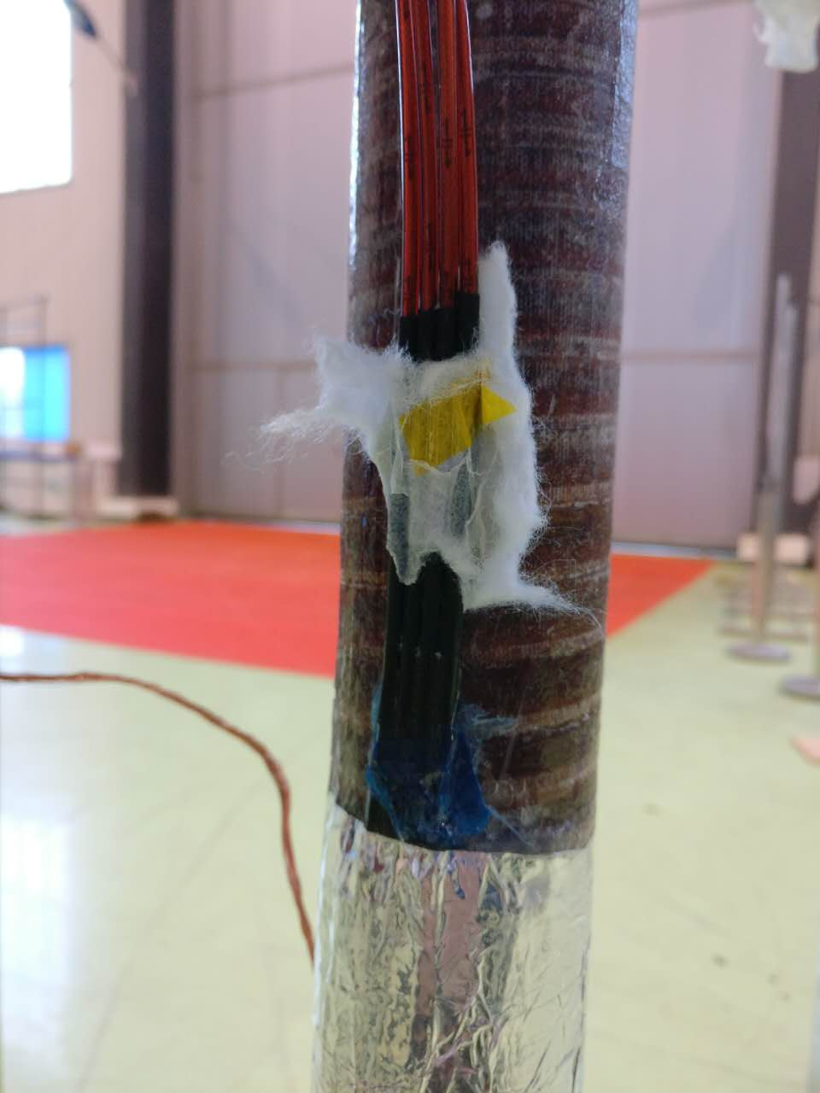
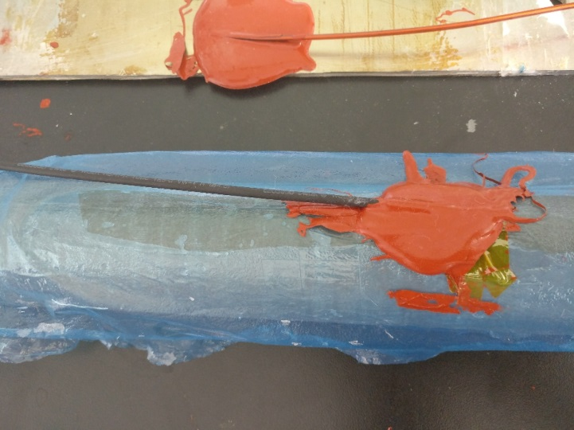
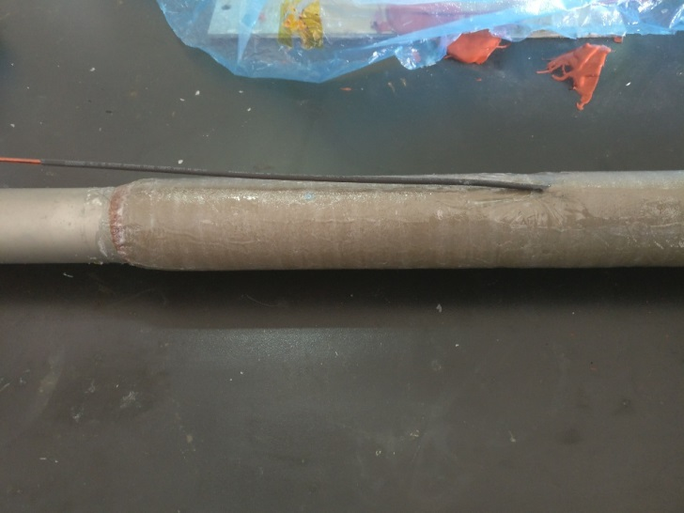
Revised HV Wire Extraction Strategy (2)
Excess resin has flowed and cured on the wire.
Critical to avoid this as it makes a sharp ‘edge’ on the wire which can lead to HV wire insulation breakage
Solution is to use a temporary barrier material (Silcoset 101) which does not bond to the insulation

Slide 10
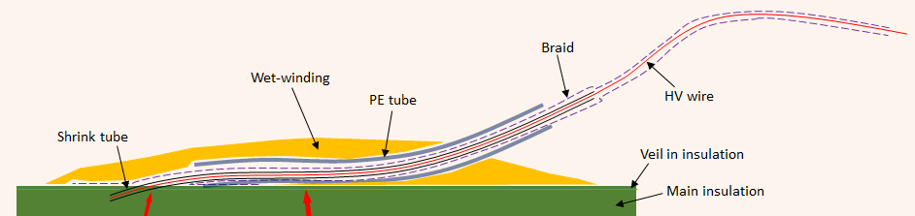
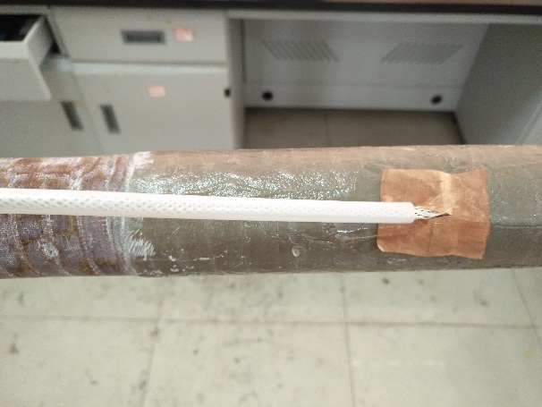
Revised HV Wire Extraction Strategy (3)
A second wire reinforcement is applied after the insulation has been cured » loose fitting ‘outer’ PE tube with 1 mm wall thickness.
The root of the outer PE tube is secured onto the underlying structure using wet-winding resin.

Slide 11
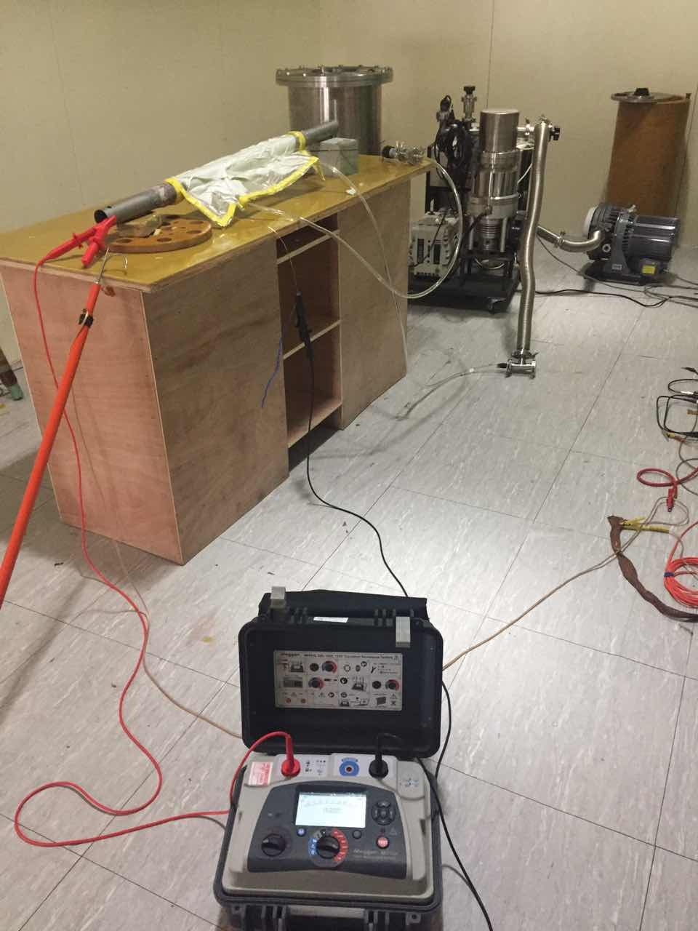
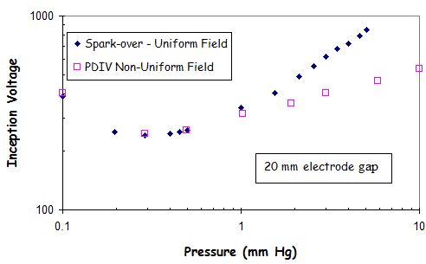
Qualification Tests
Multiple specimens have been prepared by the feeder manufacturer (ASIPP, China) and at the ITER Organization workshop.
Specimens subjected to 30 kV DC hi-pot test, followed by a 15 kV Paschen test (a DC hi-pot test with the specimen in a partial pressure atmosphere).
If there is a gas path through the insulation (e.g. along the HV wire) this would lead to breakdown at only ~200 V in low partial pressure atmosphere (Paschen minimum).
Paschen test is particularly severe, as a successful test shows that the insulation is hermetically sealed.
Specimens thermally cycled to 77 K and HV tests repeated.
Specimens now routinely made which pass these tests (including Paschen) after thermal cycle.

Slide 12
Summary
The ITER magnet feeders contain many HV wires which are used to detect quenches of the superconducting busbar. These HV wires need to be extracted through the busbar HV insulation.
Initial trials using an epoxy putty to fill the void between HV wires and HV insulation were unsuccessful, and were abandoned.
The selected solution uses pre-preg as the filler, and employs HV wire reinforcement at the break-out position.
Specimens are now routinely made which pass HV tests (including under Paschen conditions), after thermal cycle to 77K. The solution is qualified for use on the feeders.

