Slide 1



This work is performed in the Framework Collaboration Agreement KN3573/GEN between CERN and CEA and its Addendum n°2 KE3800

Slide 2
Contents
1- Introduction - context
2- HeII heat transport and transfer
3- Heat exchanger design
4- D2 Heat exchanger selection
4- Conclusion

Slide 3
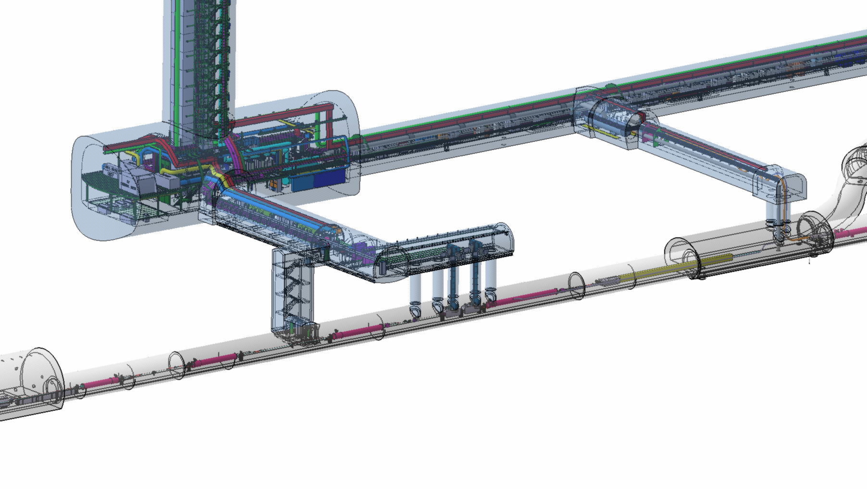
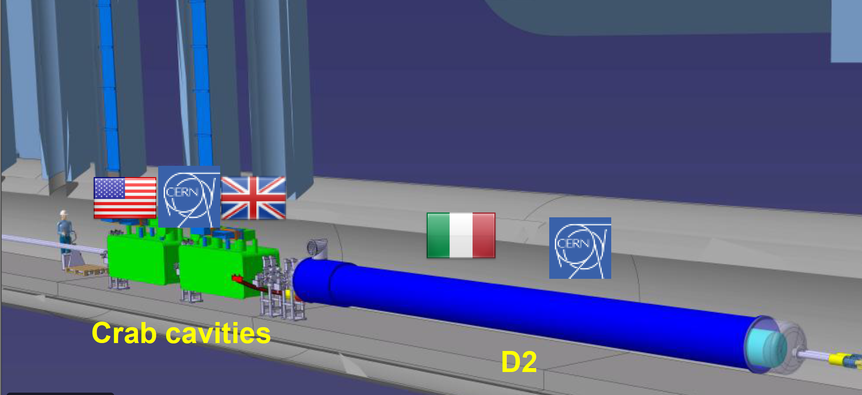
Example for 5R
HL-LHC layout
D2
Q4
Q5
Q6
Criteria for a good heat exchanger :
HL-LHC
LHC
@ Efficiency : release maximum heat with minimum ΔT
@ Ability to cope with transient
@ Compactness : minimum dedicated overall volume
@ Reliability
@ Cost
limit

Slide 4
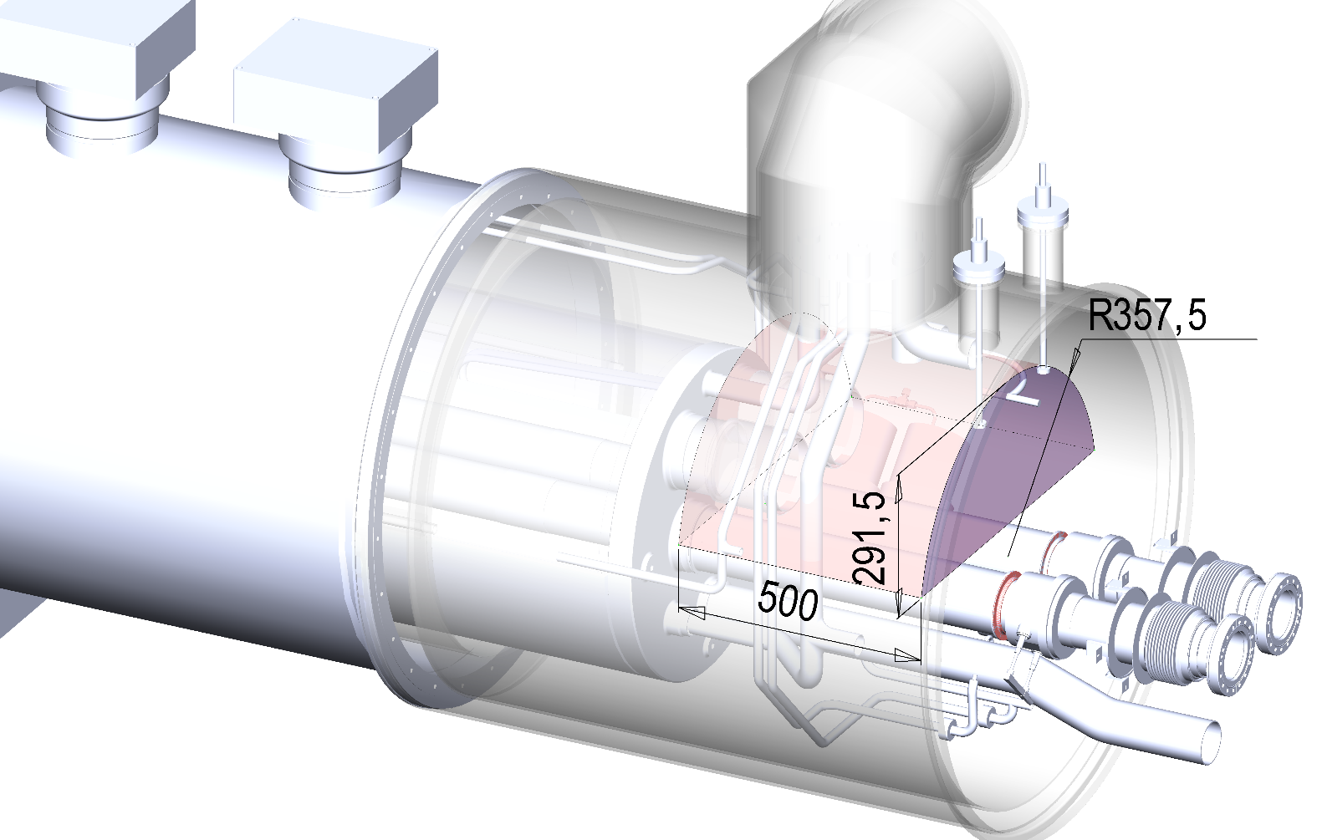
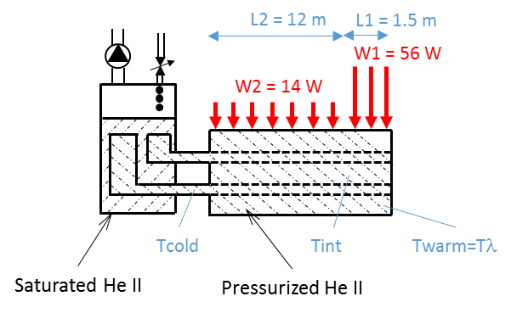
D2 layout and heat loads

Slide 5
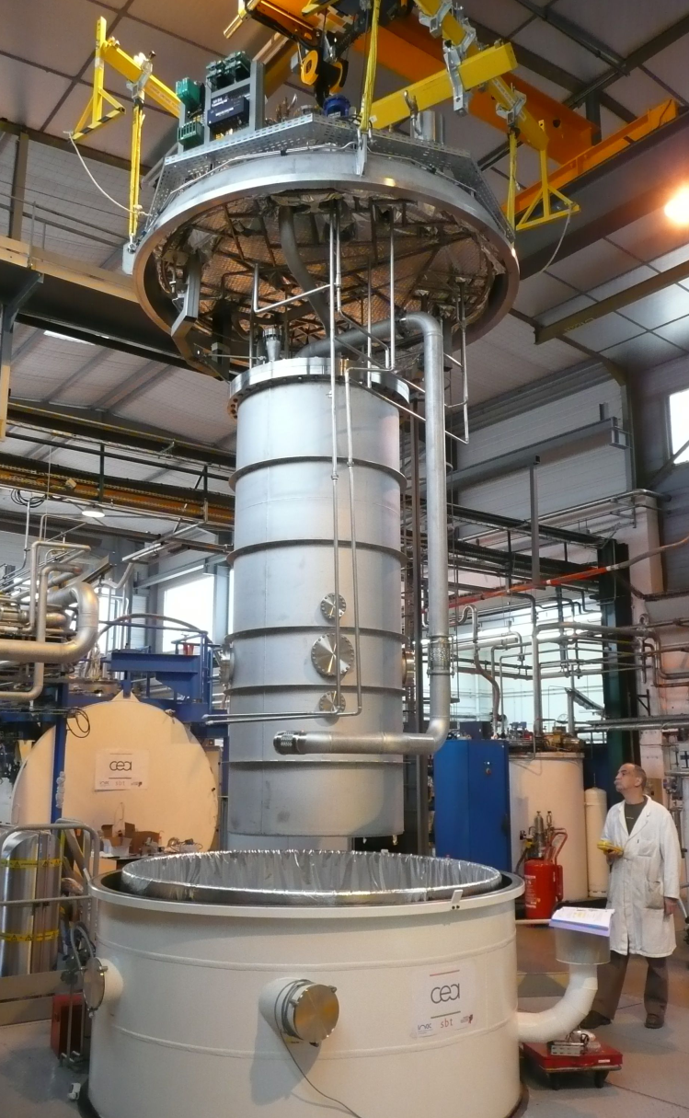
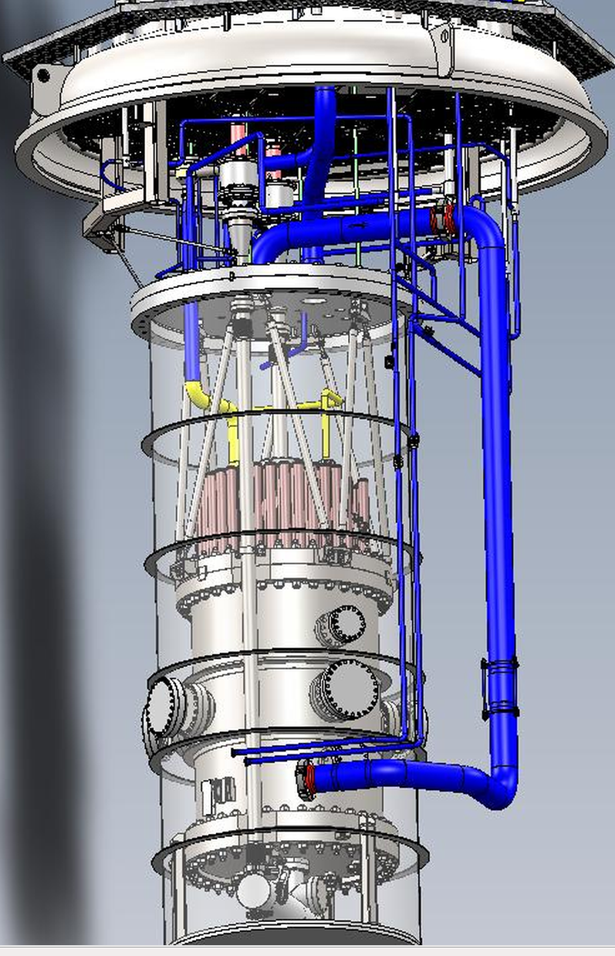
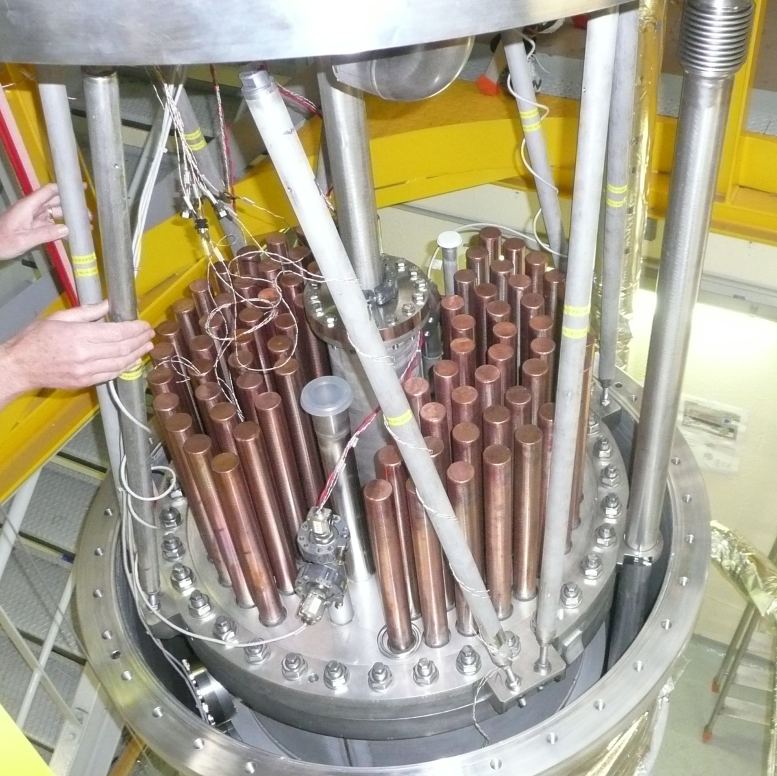
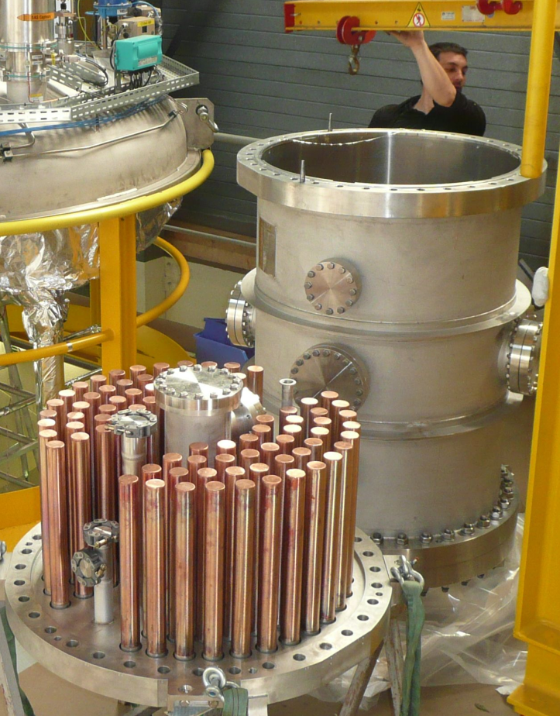
Example of a pressurized HeII/saturated He heat exchanger :
Here some pipes filled with pressurized liquid are immersed in a saturated bath (a “Tore-Supra” like solution)
A simple (and false) idea consists to believe that increasing the pipe length will systematically improve the heat exchanger efficiency

Slide 6
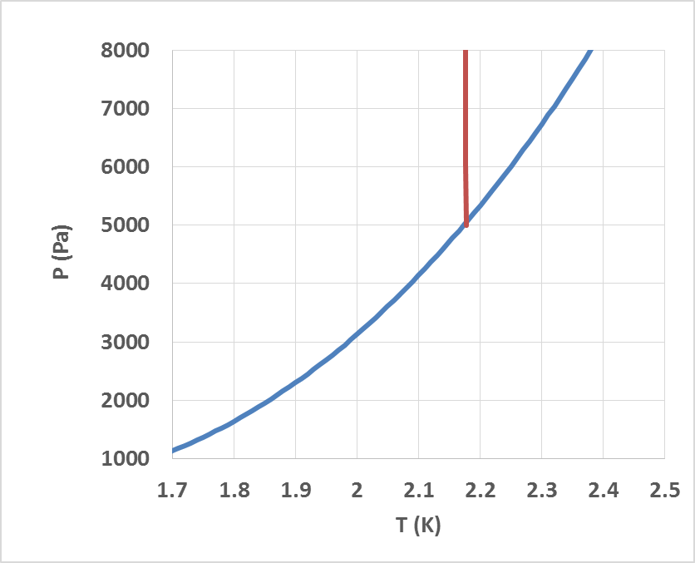
Heat exchanger consists in a periodic arrangements of channels in parallel:
let’s consider here only one period
HeII
HeI
C
Tmin at liquid-vapor interface
Temperature
margin
ΔT4 large cross section HeII bath, small ΔT
A
B
ΔP (immersion depth)
Sub cooling
« Saturated » HeII channel
A
Liquid
Pressurized HeII channel
Vapor
ΔT3 inside saturated HeII pipe
ΔT1 inside pressurized HeII
Bath level
B
ΔP
(immersion
depth)
A
Tmax at heat exchanger inlet
ΔT2 due to wall heat transfer (Kapitza+copper)
B
ΔTtot=ΔT1+ΔT2(outlet)+ΔT4=ΔT2(inlet)+ΔT3+ΔT4

Slide 7
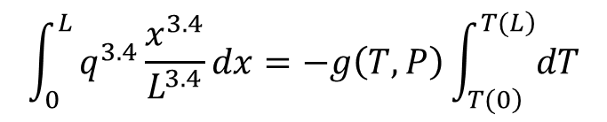
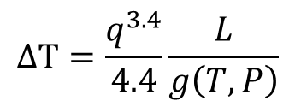
ΔTtot=ΔT1+ΔT2(outlet)+ΔT4=ΔT2(inlet)+ΔT3+ΔT4
Usually the liquid height above the heat exchanger is quite small (as compared to the heat exchanger length) and the cross section for heat flux higher than those allocated for the HeII in channels, so ΔT4 is almost negligible as compared to the other terms of previous equation.
ΔTtot ≈ ΔT1+ΔT2(outlet) ≈ ΔT2(inlet)+ΔT3
Longitudinal ΔT due to heat transport in HeII (ΔT1 and ΔT3) only depends on overall cross section, heat exchanger length and heat amplitude and repartition along the whole heat exchanger length.
To optimize ΔTtot we assume ΔT1= ΔT3 and consequently the heat flux is evenly deposited along the heat exchanger so ΔT2=cte
Inside HeII (ΔT1 or ΔT3) the heat transport is given by:
$$\int_{0}^{L}{q^{3.4}\frac{x^{3.4}}{L^{3.4}}dx}=−g\left(T,P\right)\int_{\left.T(0\right)}^{\left.T(L\right)}{dT}$$
Bath level
ΔT1
ΔP
ΔT2
$$∆T=\frac{q^{3.4}}{4.4}\frac{L}{g\left(T,P\right)}$$
ΔT3

Slide 8

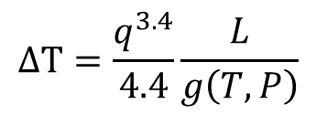
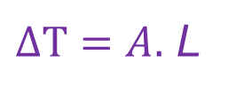
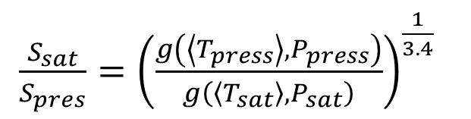
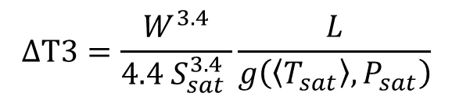
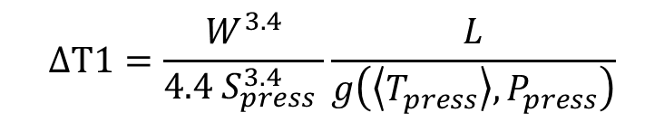

$$∆T1=\frac{W^{3.4}}{{4.4 S}_{press}^{3.4} }\frac{L}{g\left(\left\langle T_{press}\right\rangle ,P_{press}\right)}$$
$∆T1=$ $∆T3$
$$∆T=\frac{q^{3.4}}{4.4}\frac{L}{g\left(T,P\right)}$$
$$∆T3=\frac{W^{3.4}}{{4.4 S}_{sat}^{3.4} }\frac{L}{g\left(\left\langle T_{sat}\right\rangle ,P_{sat}\right)}$$
$\frac{S_{sat}}{S_{pres}}={\left(\frac{g\left(\left\langle T_{press}\right\rangle ,P_{press}\right)}{g\left(\left\langle T_{sat}\right\rangle ,P_{sat}\right)}\right)}^{\frac{1}{3.4}}$
$$A$$
Bath level
So longitudinal ΔT is in the form
ΔT1
$∆T=A.$ L
ΔP
ΔT2
ΔT3
L

Slide 9
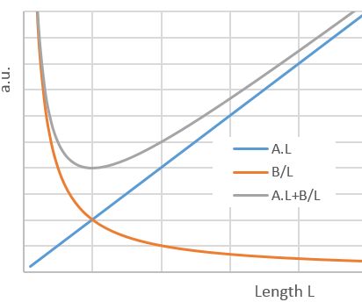
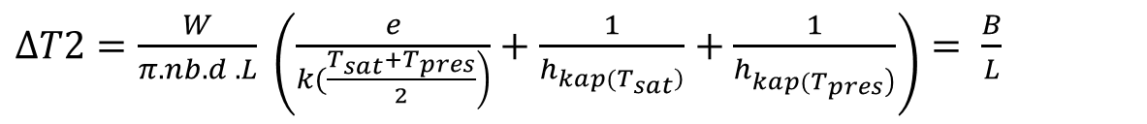




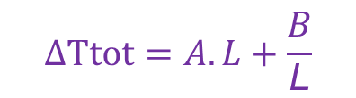
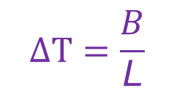

$∆T2=\frac{W}{π.nb.d .L} \left(\frac{e}{\left.k(\frac{T_{sat}+T_{pres}}{2}\right)}+\frac{1}{h_{\left.kap(T_{sat}\right)}}+\frac{1}{h_{\left.kap(T_{pres}\right)}}\right)$ $= \frac{B}{L}$
So transverse ΔT is in the form
$$∆T=\frac{B}{\text{L}}$$
$$B$$
Which results in :
$$∆Ttot=A.L+\frac{B}{\text{L}}$$
This expression has a minimum equal at
$$2\sqrt{AB}$$
$L=\sqrt{\frac{B}{A}}$
$$∆Ttot=\sqrt{AB}+\sqrt{AB}$$
for
$\sqrt{\frac{B}{A}}$
Bath level
Which also leads to
ΔT1
ΔP
ΔT1 (= ΔT3) = ΔT2 !
ΔT2
ΔT3

Slide 10
ΔT1 (= ΔT3) = ΔT2 !
The way step by step to proceed to optimize a HeII/HeII heat exchanger design :
1. Assume an overall cross section for the heat exchanger. Calculate the corresponding overall cross section for the saturated HeII only using ΔT1 =ΔT3
2. Increase the number of pipes while keeping the overall cross section (i.e. decreasing accordingly the pipe diameter) increases the heat transfer area and decrease ΔT2 while keeping ΔT1 (and ΔT3) almost constant : the number of pipes should be increased until pipe diameter becomes to small and space occupied by pipe walls matters too.
3. Calculate the optimum pipe length L to obtain ΔT3 (or ΔT1) =ΔT2
Bath level
ΔT1
ΔP
ΔT2
ΔT3
L

Slide 11
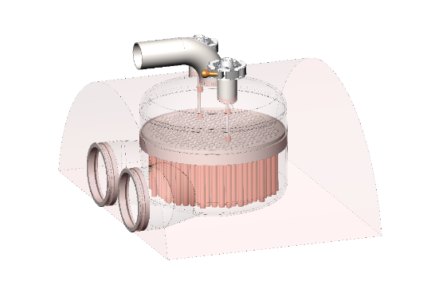
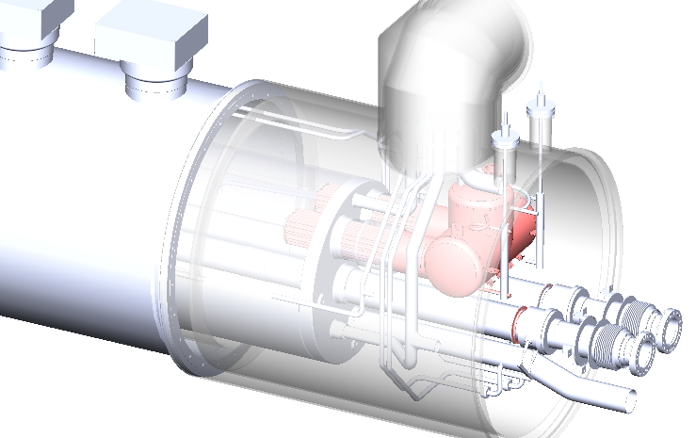
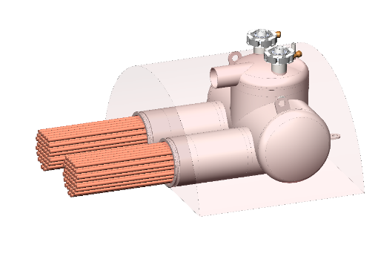
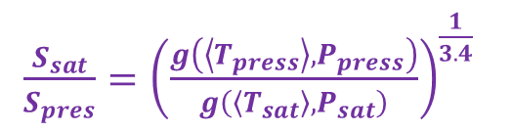
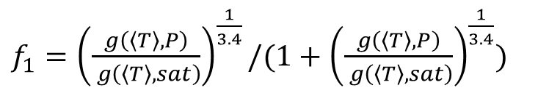
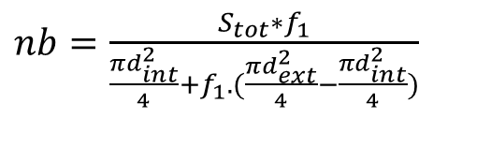

Application to the future D2 HL-LHC dipole
Design criteria :
W=70W
Tpress max=2.044K
Ppress =4bar
Tsat =2.K
Diameter of the two connecting holes to D2 magnet : 0.136m I.D.
Considering pressure to be sustained by pipes (20bar in case of quench), and minimum thickness/ space access for welding the copper pipes to the end plate, pipes of 12X10mm appears to be the best choice.
$\frac{S_{sat}}{S_{pres}}={\left(\frac{g\left(\left\langle T_{press}\right\rangle ,P_{press}\right)}{g\left(\left\langle T_{sat}\right\rangle ,P_{sat}\right)}\right)}^{\frac{1}{3.4}}$
Previous relation ΔT1 = ΔT3 ( resulting in )
allows to calculate the number of pipes knowing the total cross section
$f_{1}={\left(\frac{g\left(〈T〉,P\right)}{ g\left(〈T〉,sat\right)}\right)}^{\frac{1}{3.4}}/(1+{\left(\frac{g\left(〈T〉,P\right)}{ g\left(〈T〉,sat\right)}\right)}^{\frac{1}{3.4}})$
$nb=\frac{S_{tot}∗f_{1}}{\frac{πd_{int}^{2}}{4}+f_{1}.(\frac{πd_{ext}^{2}}{4}−\frac{πd_{int}^{2}}{4})}$
with
gives
$nb=130$

Slide 12

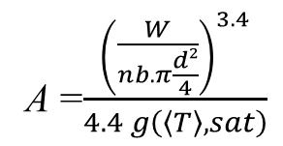


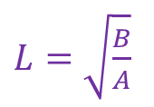
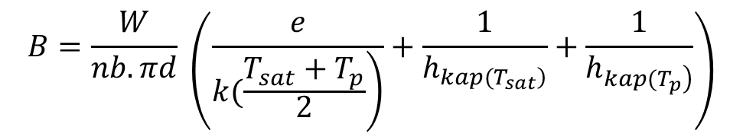
Application to the future D2 HL-LHC dipole (continuing…)
$L=\sqrt{\frac{B}{A}}$
Previous relation ΔT1 (or ΔT3) = ΔT2 allows to calculate the optimal length
And the overall ΔT
$$∆Ttot=2\sqrt{AB}$$
with
A =$\frac{{\left(\frac{W}{nb.π\frac{d²}{4}}\right)}^{3.4}}{4.4 g\left(〈T〉,sat\right)}$
$$B=\frac{W}{nb.πd} \left(\frac{e}{\left.k(\frac{T_{sat}+T_{p}}{2}\right)}+\frac{1}{h_{\left.kap(T_{sat}\right)}}+\frac{1}{h_{\left.kap(T_{p}\right)}}\right)$$
gives :
$L=$1.2m
and
$$∆Ttot=13mK$$
Using hkap=600T³ and k=6T
The objective was a maximal ΔTtot =44mK so there is a lot of margin. It will be used to :
1) To decrease down to 104 the number of pipes to take into account the presence of the inner diameter wall of the two connecting holes
2) To decrease down to 0.5m the pipe length L so the heat exchanger fits in the magnet cryostat
This will results in a transversal ΔT2 =20mK and a longitudinal ΔT3=5mK, this latter one being very small, it avoid to need a high level to keep subcooling (only a few cm is enough). This validates the former assumption of ΔT4 negligible (<1mK)

Slide 13
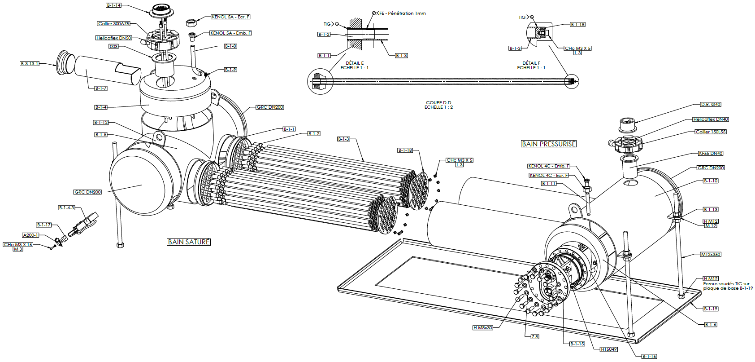
Conclusion
A procedure to design step by step a HeII/HeII heat exchanger has been described and applied to the future D2 HL-LHC dipole at CERN.
A prototype of this heat exchanger is under construction and will be tested at CEA/SBT during 2019
Thank you for your attention !

