Slide 1
Experimental and numerical study of the different quench acceleration phenomena in the JT-60SA Toroidal Field coils
Yawei HUANG¹, Walid ABDEL MAKSOUD¹, Bertrand BAUDOUY¹, Daniel CIAZYNSKI², Patrick DECOOL², Laurent GENINI¹, Benoît LACROIX², Sylvie NICOLLET², François NUNIO¹, Alexandre TORRE², Roser VALLCORBA¹, Louis ZANI²
¹CEA, IRFU, 91191 Gif-sur-Yvette Cedex, France
²CEA, IRFM, 13108 Saint-Paul-lez-Durance, France
E-mail: ywhuang90@gmail.com, yawei.huang@cea.fr

Slide 2
Outline
Outline
Context and introduction
Context of the project JT-60SA
Characteristics of the Toroidal Field coil
Quench test protocol
Experimental analysis of the different quench acceleration dynamics
Quench resistance evolution
Testing temperature conditions
Numerical analysis of the temperature oscillation effect on the quench acceleration
Numerical model
Oscillation amplitude
Phase shift
Conclusions

Slide 3
Context and introduction
Outline
Context and introduction
Context of the project JT-60SA
Characteristics of the Toroidal Field coil
Quench test protocol
Experimental analysis of the different quench acceleration dynamics
Quench resistance evolution
Testing temperature conditions
Numerical analysis of the temperature oscillation effect on the quench acceleration
Numerical model
Oscillation amplitude
Phase shift
Conclusions

Slide 4
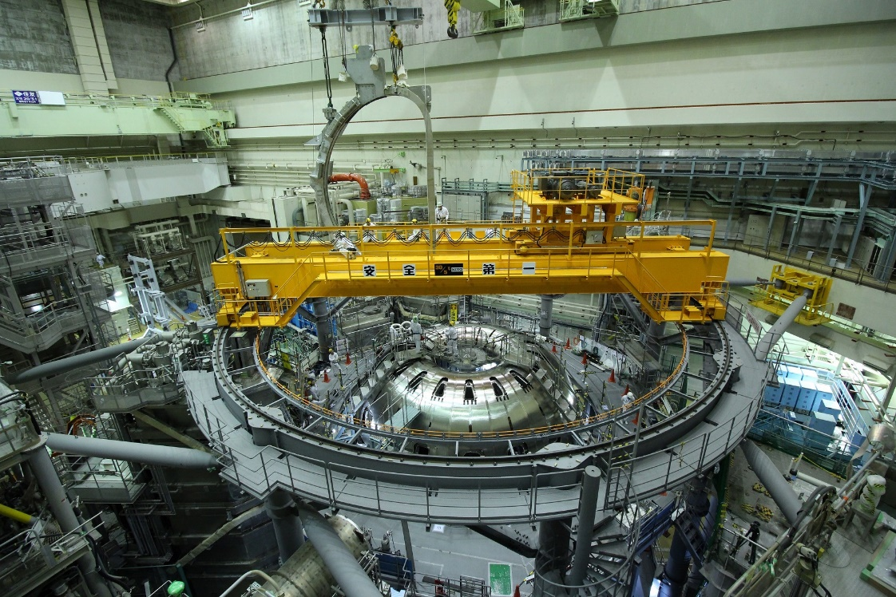
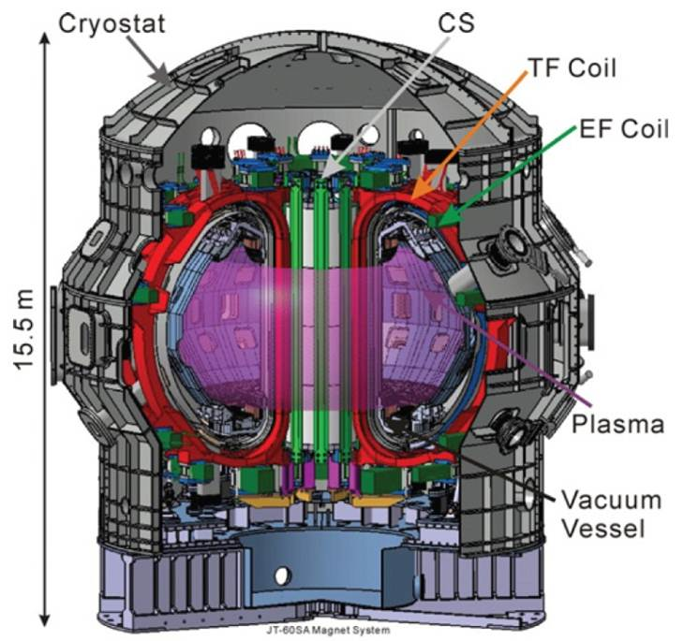
I. Context and introduction
Context of the project JT-60SA
Characteristics of the Toroidal Field coil
Quench test protocol
Why JT-60SA?
$E_{fusion}→E_{electric}$ (Tokamak machine)
ITER “Broader Approach”:
Superconducting Tokamak JT-60SA (Naka Japan) by Japan and Europe
Operation experiences and key physics issues for ITER and DEMO reactors
Why quench test?
18 (+2 spare coils) superconducting Toroidal Field (TF) coils manufactured in France and in Italy, tested at CEA in France
To check the coils performance and mitigate the fabrication risks
To ensure the magnet security and Tokamak operations

Slide 5
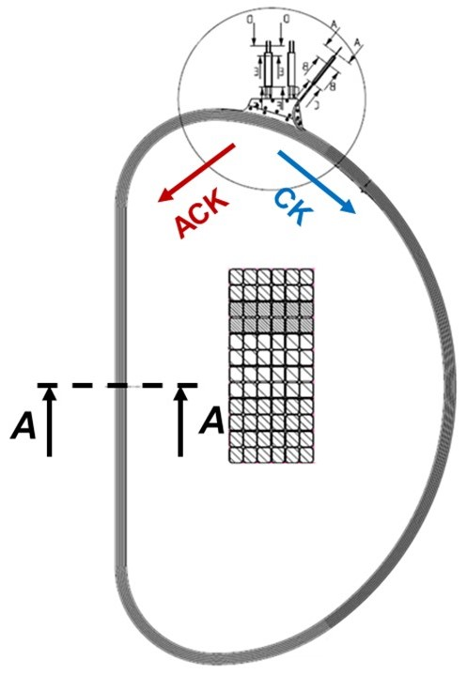
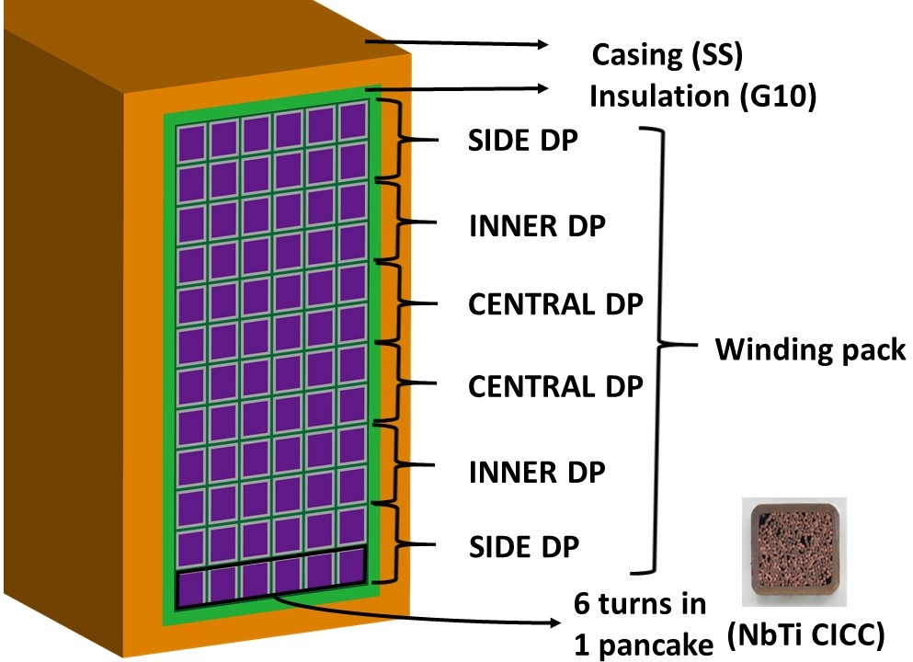
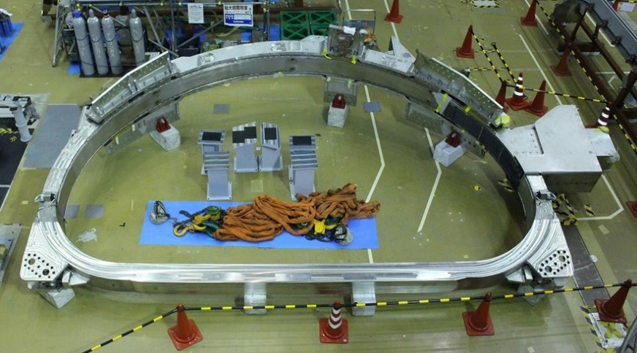
I. Context and introduction
Context of the project JT-60SA
Characteristics of the Toroidal Field coil
Quench test protocol
TF coil = casing + winding pack + insulation
Winding pack = 6 double-pancakes (DPs)
= 12 pancakes ($L_{pancake}=113.28 m$)
Cable In Conduit Conductor (CICC):
Cable section = 1/3 NbTi + 2/3 Cu
Void fraction = 32% (Helium)
4.5 m
7.5 m

Slide 6
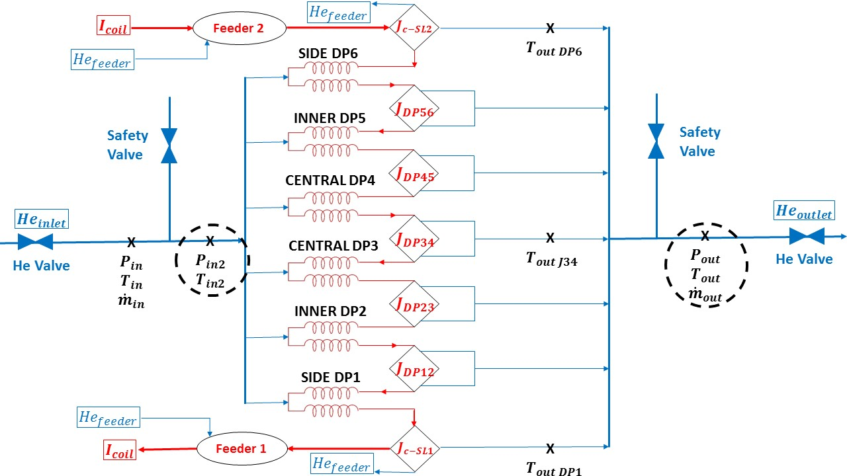
I. Context and introduction
Context of the project JT-60SA
Characteristics of the Toroidal Field coil
Quench test protocol
Instrumentation hydraulic
Pressure
Temperature
Mass flow rate
Instrumentation electric
Voltage: DP + joints + feeders
Current

Slide 7
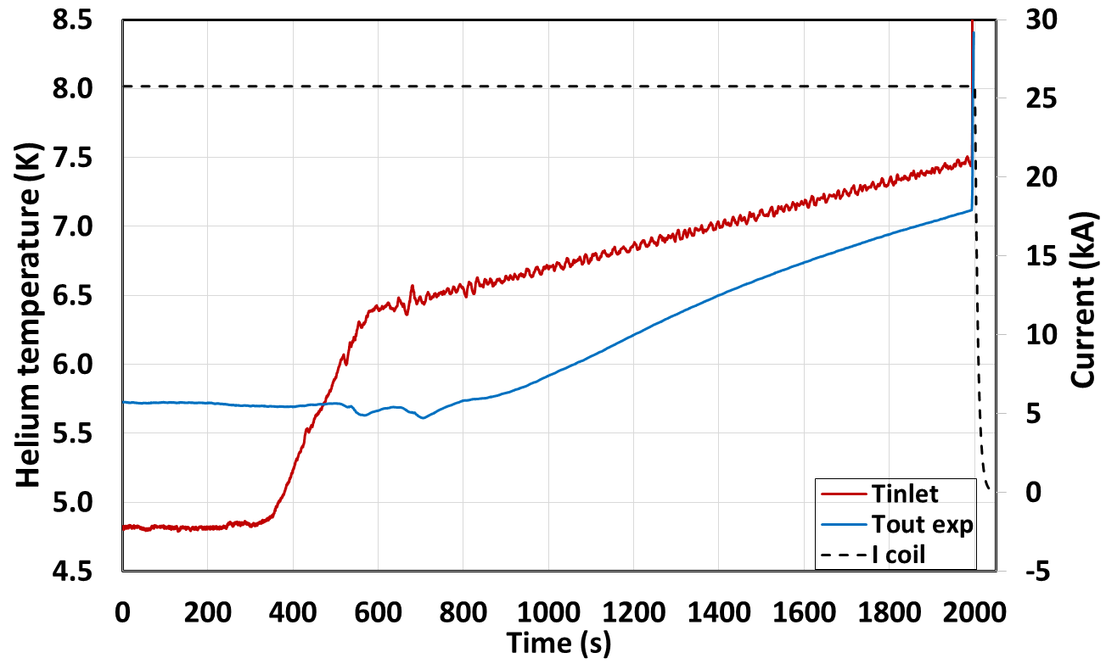
I. Context and introduction
Context of the project JT-60SA
Characteristics of the Toroidal Field coil
Quench test protocol
0.05 K/min
0.4 K/min
$$T_{outlet}$$
Quench moment
$$1K$$
$$T_{inlet}$$
$$I_{nominal}=25.7 kA$$
Quench test protocol
1st step: nominal conditions
$$I_{nominal}=25.7 kA$$
$$T_{inlet}=4.8 K$$
$${\dot{m}}_{av}=2 g/s$$
2nd step: temperature-increasing phase
$$∆T_{inlet 1}=0.4 K/min$$
$$∆T_{inlet 2}=0.05 K/min$$

Slide 8
Experimental analysis
Outline
Context and introduction
Context of the project JT-60SA
Characteristics of the Toroidal Field coil
Quench test protocol
Experimental analysis of the different quench acceleration dynamics
Quench resistance evolution
Testing temperature conditions
Numerical analysis of the temperature oscillation effect on the quench acceleration
Numerical model
Oscillation amplitude
Phase shift
Conclusions

Slide 9
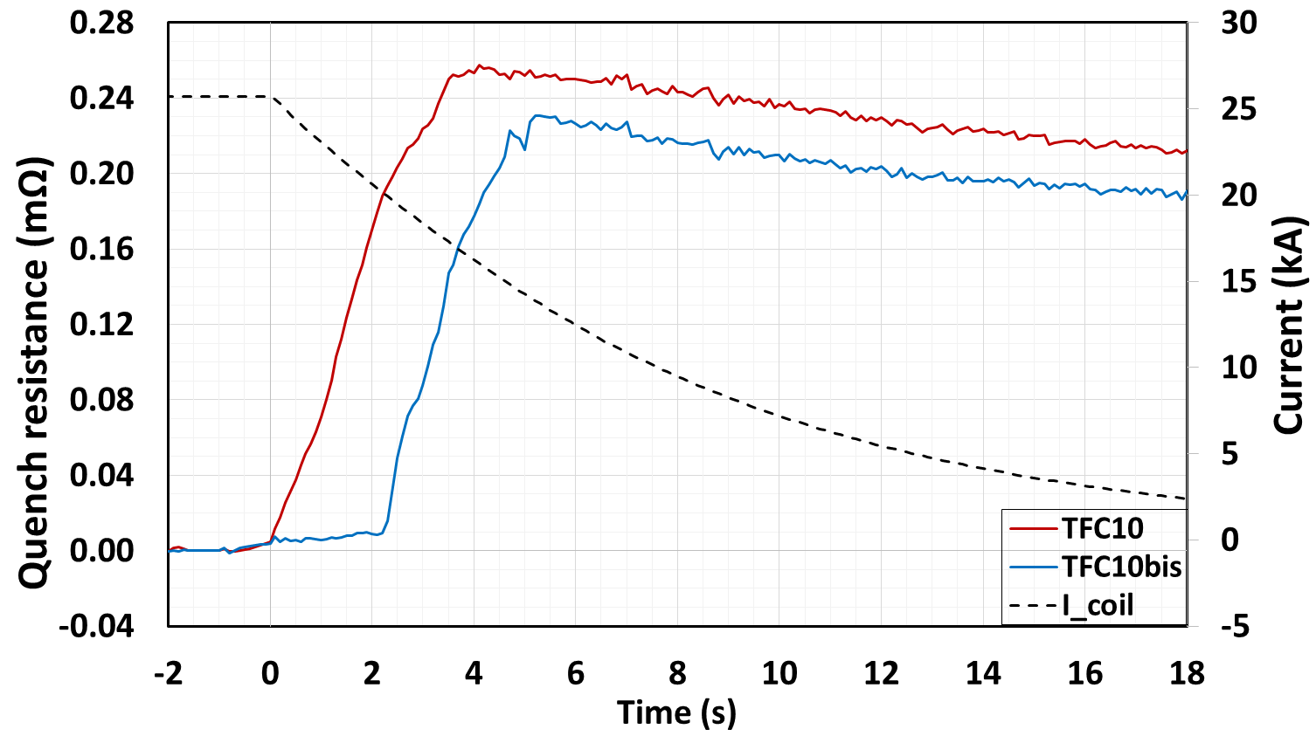
II. Experimental analysis
Quench resistance evolution
Testing temperature conditions
TFC10: “early” quench acceleration ~68%
➔ thermo-hydraulic quench-back [1,2]
TFC10bis: “delayed” quench acceleration ~26% ➔ ???
Quench resistance evolution of the side DP in the coil number 10
Acceleration:
$$v_{q}=3m/s→30 m/s$$
2s delay
Fast Discharge
[1] Huang Y, Abdel Maksoud W, et al 2017 Fusion Eng. Des. 124 147-152
[2] Lue J W and Dresner L 1994 Adv. Cryog. Eng. 39 437-444

Slide 10
II. Experimental analysis
Quench resistance evolution
Testing temperature conditions
Before quench

Slide 11
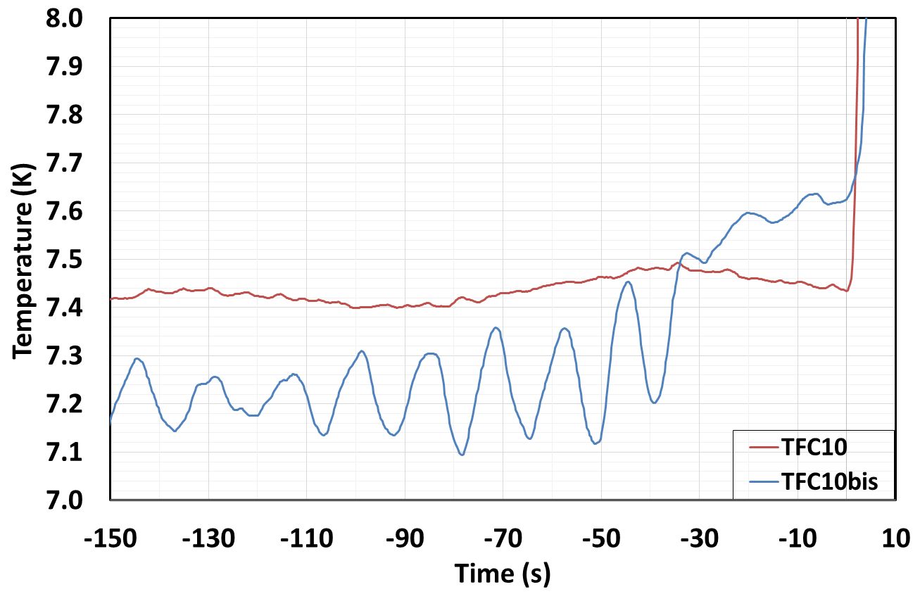
II. Experimental analysis
Quench resistance evolution
Testing temperature conditions
TFC10: “early” quench acceleration
$$v_{q}\sim \frac{1}{\sqrt{∆T}}$$
With $∆T≈T_{cs}−T_{He}$
$${∆T}_{TFC10}\sim 10mK$$
$${∆T}_{TFC10bis}\sim 100mK$$
TFC10bis: “delayed” quench acceleration

Slide 12
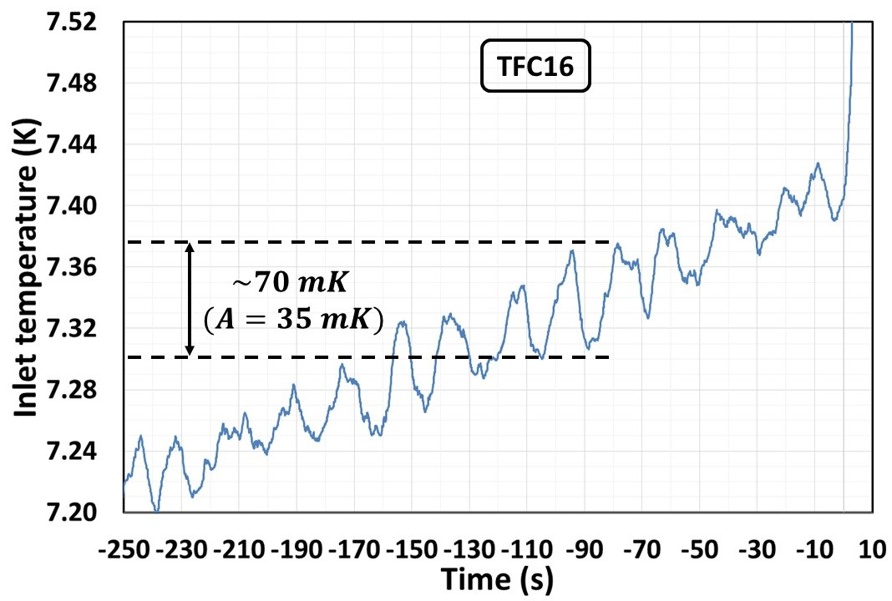
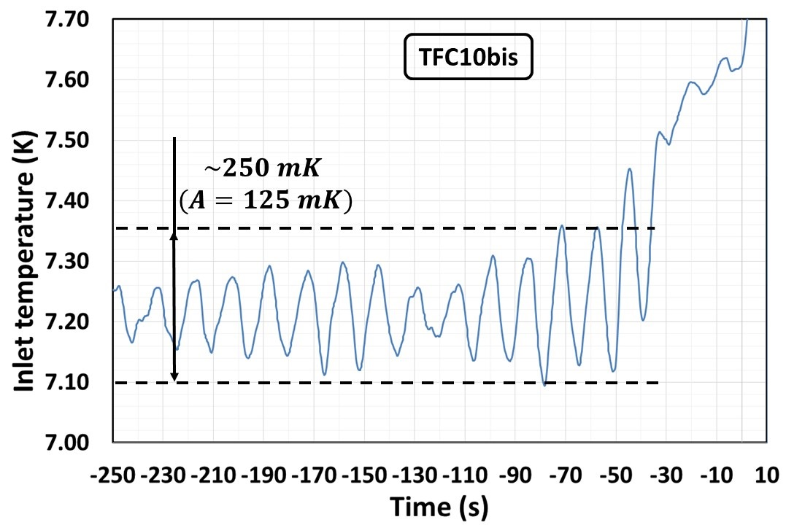
II. Experimental analysis
Quench resistance evolution
Testing temperature conditions
Quench test TFC16
$$A_{min}=35 mK$$
$T_{per}=20$s
Quench test TFC10bis
$$A_{max}=125 mK$$
$T_{per}=20$s

Slide 13
Numerical analysis
Outline
Context and introduction
Context of the project JT-60SA
Characteristics of the Toroidal Field coil
Quench test protocol
Experimental analysis of the different quench acceleration dynamics
Quench resistance evolution
Testing temperature conditions
Numerical analysis of the temperature oscillation effect on the quench acceleration
Numerical model
Oscillation amplitude
Phase shift
Conclusions

Slide 14
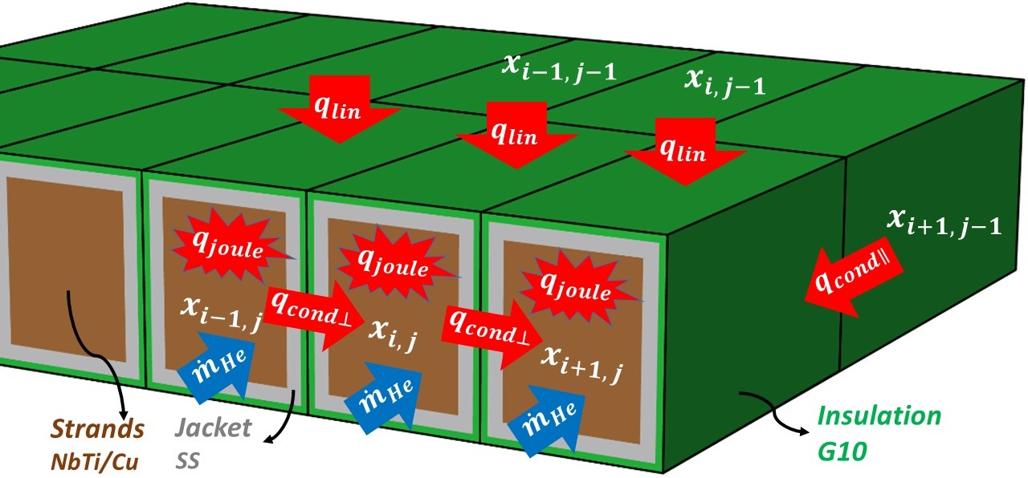
III. Numerical analysis
Numerical model
Oscillation amplitude
Phase shift
$$h_{it}$$
Inter-turn thermal coupling model (in THEA)
Heating flux terms
$q_{cond∥}$ Longitudinal thermal conduction
$q_{Joule}$ Joule heat of the cable in case of quench
$q_{conv}$ Heat exchange by forced convection of supercritical helium flow
$q_{lin}$ External heat load per unit length on the insulation
$q_{cond⊥}$ Transversal thermal conduction between conductors
Thermal balance
$$ρC_{p}\frac{∂T}{∂t}S=q_{cond∥}+q_{Joule}+q_{conv}+q_{lin}+q_{cond⊥}$$
with $q_{cond⊥}=\frac{h_{it}}{{(e/λ)}_{i−1}}⋅\left(T_{i−1}−T_{i}\right)+\frac{h_{it}}{{(e/λ)}_{i+1}}⋅(T_{i+1}−T_{i})$
Ref: Y. Huang et al., “Numerical Modeling of the Quench Propagation
Phase in the JT-60SA TF Coils”, 2018 IEEE Trans. Appl. Supercond. 28 4204205.

Slide 15
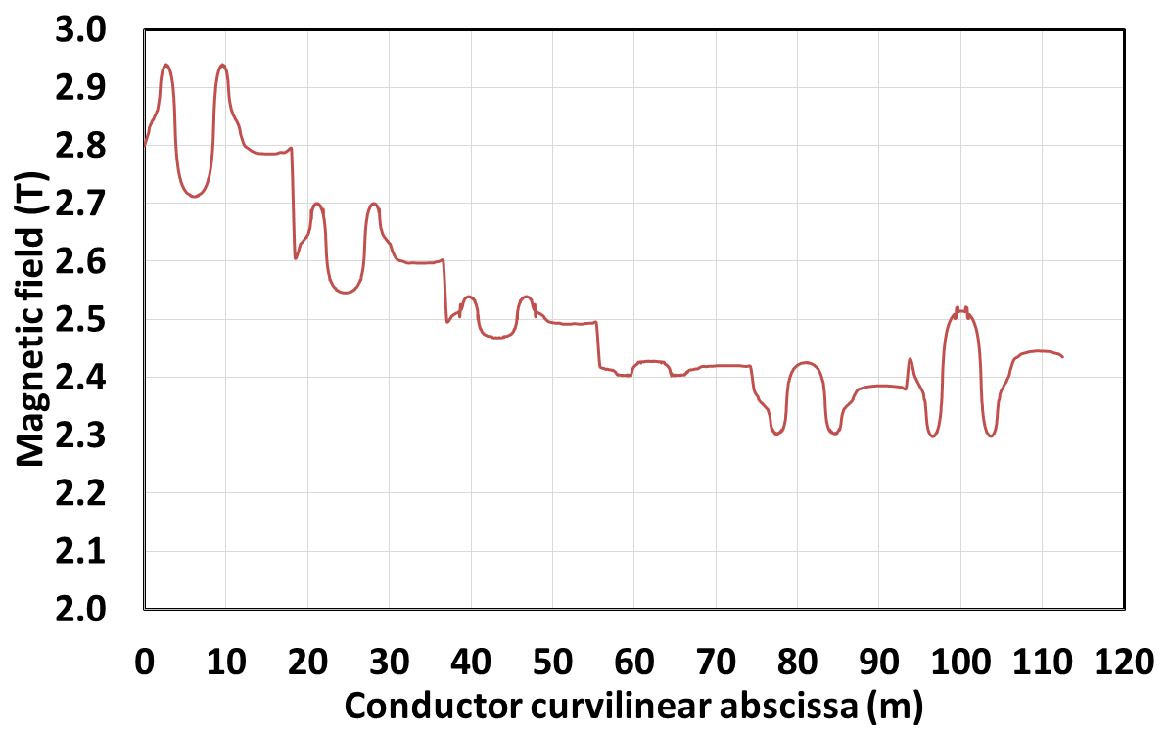
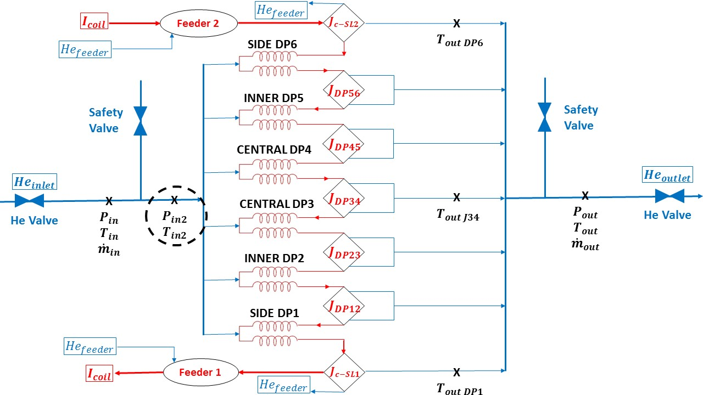
III. Numerical analysis
Numerical model
Oscillation amplitude
Phase shift
Boundary conditions:
Inlet temperature with oscillation (in sinusoidal function):
$$T_{in}\left(t\right)=T_{fit}(t)+T_{oscill}(t)=T_{fit}(t)+A sin(\frac{2π}{T_{per}}t−φ)$$
Mass flow rate of helium per pancake ~2 g/s
Magnetic field map B(x) in the side DP
Friction factor f, forced flow convection coefficient $h_{cv}$
0.05 K/min
0.4 K/min

Slide 16
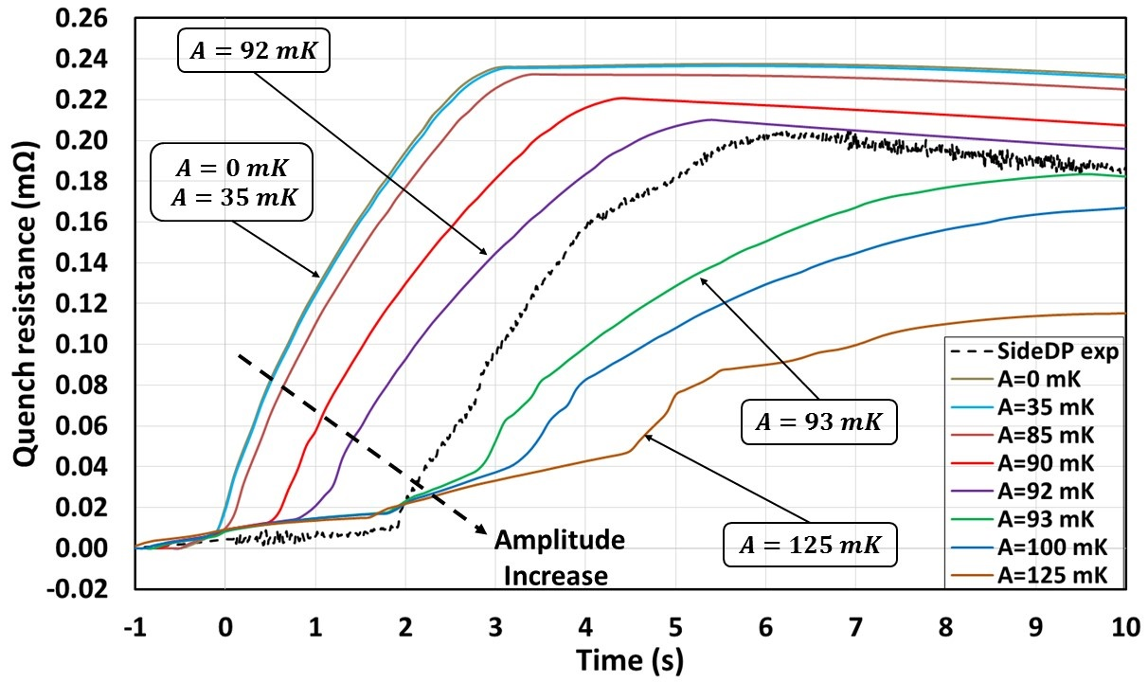
III. Numerical analysis
Numerical model
Oscillation amplitude
Phase shift
Effect of oscillation amplitude on the quench acceleration dynamics (case of TFC16):
$A=35 \sim 125 mK$; $T_{per}=20 s$; $φ=0$
Case $A=125 mK$:
“delayed” quench acceleration
Case $A=35 mK$:
“early” quench acceleration

Slide 17
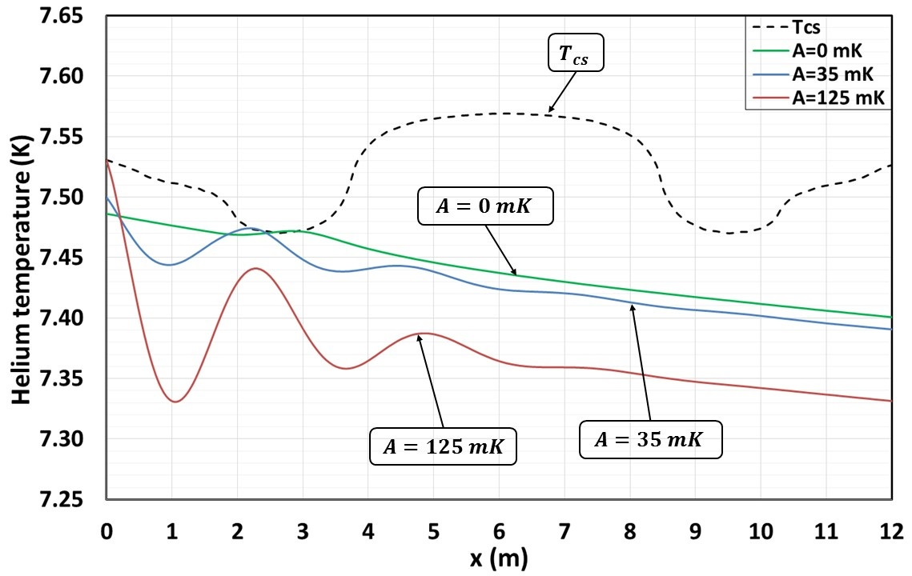
III. Numerical analysis
Numerical model
Oscillation amplitude
Phase shift
Temperature profiles at the quench initiation moment
Case $A=125 mK$ (delayed):
quench initiation at the coil’s inlet (x=0 m);
higher $∆T≈170 mK$
➔ lower $v_{q}$
Case $A=35 mK$ (early):
quench initiation at the peak field region (x=2.5 m)
lower $∆T≈50 mK$
➔ higher $v_{q}$
Conclusion: quench initiation location + temperature profile
➔ quench propagation
➔ normal zone length
$$170 mK$$
(delayed)
$$∆T$$
$$∆T$$
$$50 mK$$
(early)

Slide 18
III. Numerical analysis
Numerical model
Oscillation amplitude
Phase shift
Special value of oscillation amplitude: $A=92 mK$
Why ?
Second parameter:
Phase shift
$$T_{oscill}\left(t\right)=A sin(\frac{2π}{T_{per}}t−φ)$$

Slide 19
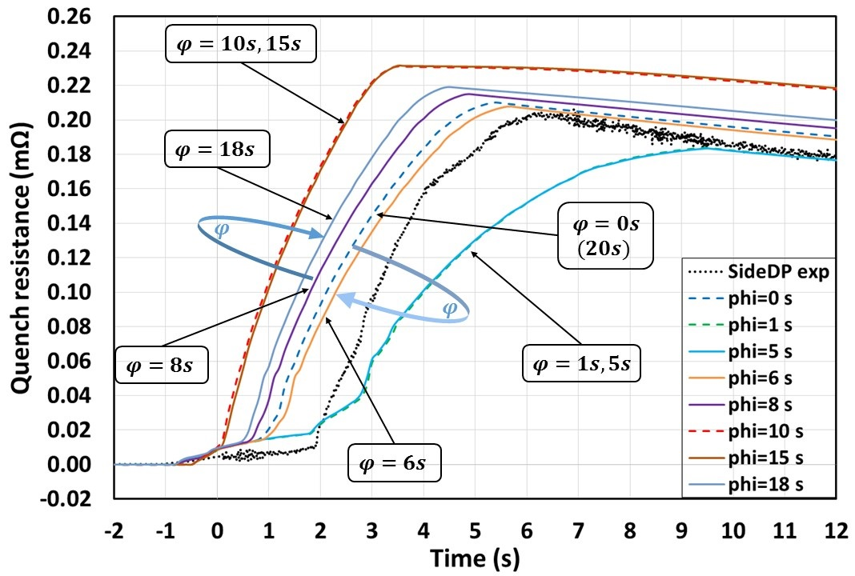
III. Numerical analysis
Numerical model
Oscillation amplitude
Phase shift
Effect of phase shift on the quench acceleration dynamics:
$A=92 mK$;
$T_{per}=20 s$;
$$φ=0\sim 2π$$
➔ Change the quench initiation position as well as the local $∆T$ between Tcs and helium (same reason to oscillation amplitude)

Slide 20
Conclusions
Outline
Context and introduction
Context of the project JT-60SA
Characteristics of the Toroidal Field coil
Quench test protocol
Experimental analysis of the different quench acceleration dynamics
Quench resistance evolution
Testing temperature conditions
Numerical analysis of the temperature oscillation effect on the quench acceleration
Numerical model
Oscillation amplitude
Phase shift
Conclusions

Slide 21
Conclusions
Issue: « delayed » quench acceleration phenomenon
Experimental analysis
Observation : two quench tests in the same coil TFC10
two different quench acceleration dynamics
Assumption: effect of the testing temperature oscillations
Numerical analysis
Single pancake model in THEA code
➔ Representative delayed case: TFC16
Oscillation amplitude and phase shift: predominant effect on the quench acceleration dynamics.
When the temperature oscillation is strong enough to initiate a quench far away from the peak field region and to lead to a globally high temperature difference between Tcs and helium, the “delayed" quench acceleration will be easier to take place. Otherwise, it will be an “early" one.

Slide 22
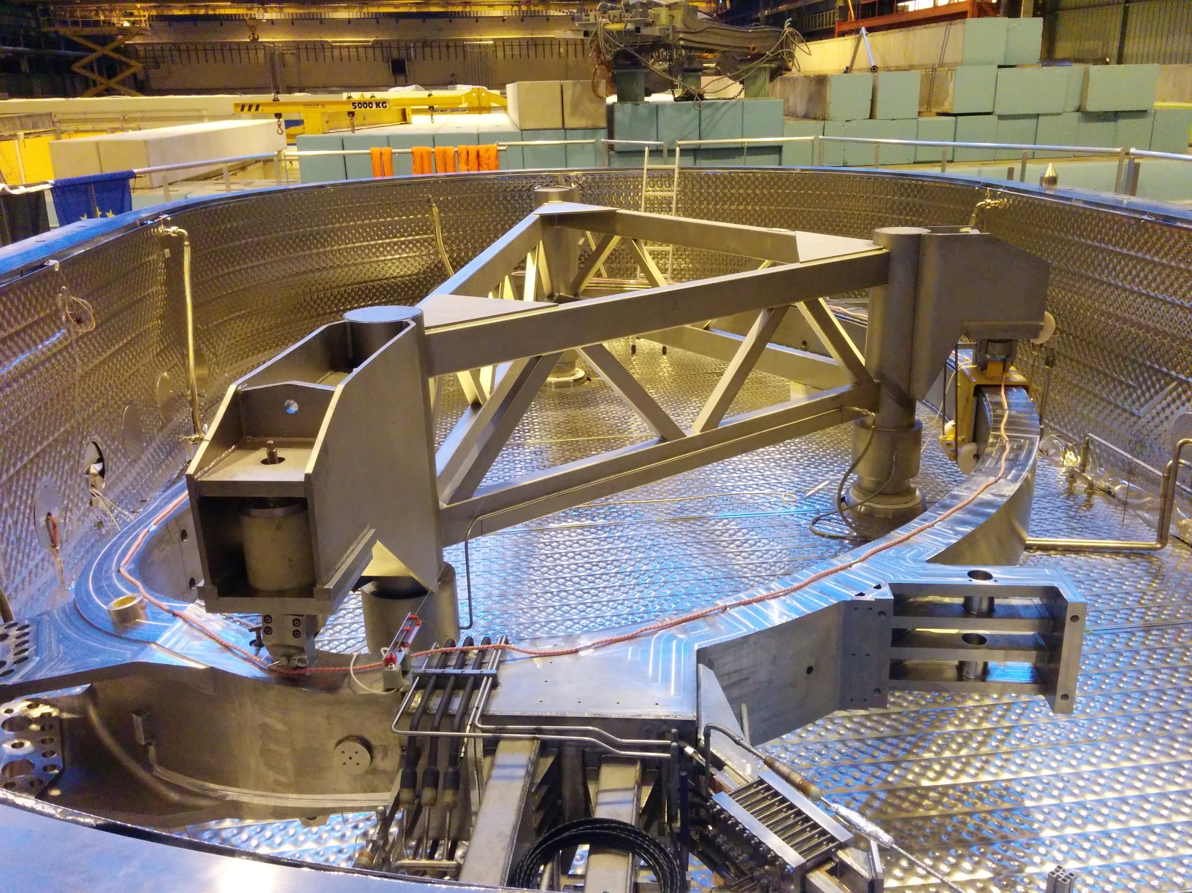
THANK YOU

