Slide 1

Performance test and analysis of the developed emergency release system for liquefied hydrogen installed in loading systems
2018 CEC conference
5th September, 2018
*Akihiko Inomata (Kawasaki Heavy Industries Ltd. and Kobe University)
Tomoaki Umemura, Jun Kawaguchi (Kawasaki Heavy Industries Ltd.)
Tsutomu Kawai (Tokyo-Boeki engineering Co., Ltd.)
Yoshihiro Naruo, Yusuke Maru (Japan Aerospace Exploration Agency, JAXA)
Tetsuya Senda (Japan Ship Technology Research Association, JSTRA)
Minoru Takeda (Kobe University)

Slide 2
Outline
Background
Pressure drop analysis for ERS
Measurement of atmospheric hydrogen concentration at disconnection of ERS
Simulation of hydrogen diffusion at ERS disconnection
Summary

Slide 3
Outline
Background
Pressure drop analysis for ERS
Measurement of atmospheric hydrogen concentration at disconnection of ERS
Simulation of hydrogen diffusion at ERS disconnection
Summary

Slide 4
COP21 (Paris Agreement)
1. Background
Dec. 2015
De-carbonation society
- shifted from Low-carbon -
Global temperature rise less than 1.5℃ at most effort, as well as２℃ target
Became effective after 4th, Nov. 2016
170 nations and countries signed
(as of 1st, Dec. 2017)
Target of CO₂ Reduction:
・Japan： “26% by 2030”
・Advanced Nations including Japan：
“80% by 2050”

Slide 5
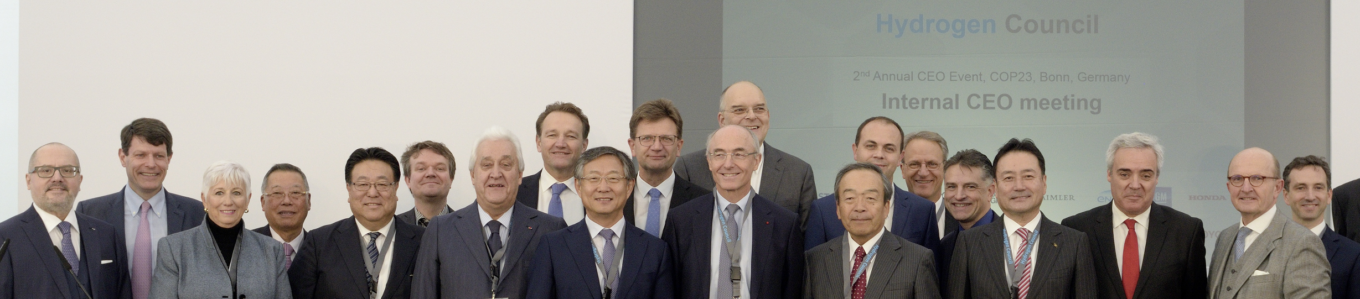












1. Background
Initiative by Global Companies
Hydrogen Council
Composed of 39 leading companies from energy, transportation, manufacturing industry and trading sectors: 24 steering members (above photo + 3M, Bosch, China Energy, Great Wall Motor, JXTG and Weichai) and 15 associate members.
A global initiative advocates long term target to move to hydrogen utilizing new energy economy
With understanding of importance of hydrogen on energy transition, Hydrogen Council aims to create effective action plan with Governments and other stakeholders

Slide 6
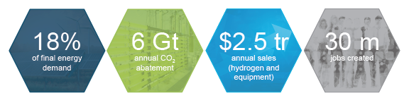
1. Background
Hydrogen Introduction Vision 2050
Hydrogen Council & McKinsey
Hydrogen market, 2.5 trillion dollars, creates 30 million employment allover the world
Responsible for 18% of energy and 20% of CO₂ reduction
CO₂ reduction of 6 billion t/year（50 billion t/year as of 2010 including feed stock)
Hydrogen power generation of 1,500TWh/year（recent 10 years Japan：about 1,000TWh/year,
the world：about 22,000TWh/year）
Excessive renewable energy of 500TWh/year will be stored and utilized

Slide 7

1. Background
Basic Hydrogen Strategy
(Ministries cooperation Common scenario)
On December 26, 2017, the Ministerial Council on Renewable Energy, Hydrogen and Related Issues held its second meeting and decided on a Basic Hydrogen Strategy to accomplish a world-leading hydrogen-based society
From HP. of Prime Minister's Office
Hydrogen is an option as important as renewable energies (R.E.)
Mass production from low cost sources: utilizing brown coal and foreign R.E. (Develop international liquefied hydrogen supply chain）
Promotion of fuel cell vehicles and hydrogen refueling stations
Commercialization of hydrogen power generation and mass consumption of hydrogen (hydrogen consumption 10 mill. t/year, Power generation capacity 30GW)
Leading to growth strategy to leveraged Tokyo Olympic Paralympic Games

Slide 8
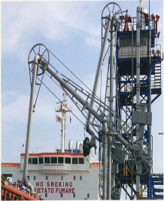





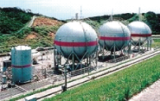



1. Background
The Concept of CO₂-free Hydrogen Chains
Stably supplying energy while suppressing CO₂ emissions
Emergency Release System (ERS)
Resourcing country (Australia)
Utilizing country (Japan)
Production of hydrogen at low costs from unutilized resources (brown coal) and/or abundant recyclable energy
Process uses
Semiconductor and solar battery manufacture
Oil refinement, desulfurization, etc.
Affordable renewable energy
Loading arms
Transport equipment
Hydrogen stations
Fuel cell vehicles, etc.
Liquefied hydrogen containers
Transport equipment
Hydrogen gas turbines
Fuel cells, etc.
Liquefaction/ loading
Liquefied hydrogen carrier
JAXA
Brown coal
CO₂-free hydrogen
Liquefied hydrogen storage tanks
Electrical power plants
Combined cycle power generators etc.
CCS
(CO₂ capture/storage)
Hydrogen transport/storage
Hydrogen production
Hydrogen use
Fig.1 LH2 supply chain

Slide 9
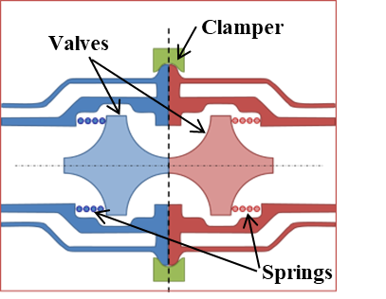
1. Background
World-first ERS for LH2
Fig.2 Concept of ERS for LH2
Operation: 1) Open of the clamper, 2) Two valve bodies are separated, and 3) Springs at each side push each valve to shut the flow path.
Advantages: 1) It has no shaft to operate valves, which leads low heat ingress from the shaft. 2) Stable operation because of its simple structure. It is important when ERS is required to operate at the emergency case.
Disadvantage: 1) Relatively high pressure drop because of its narrow flow path. 2) Amount of diffused LH2 is relatively high at disconnection.

Slide 10
1. Background
Purpose of this study
Performance of Developed ERS
・It is important to assess the world-first ERS for LH2.
Especially,
- Pressure drop performance of check type valve
- performance of hydrogen diffusion at disconnection operation
This Study
Simulation on distribution of pressure drop and flow rate by CFD (Computational Fluid Dynamics).
Disconnection test of ERS prototype and measurement of diffused hydrogen concentration.
Simulation of hydrogen diffusion and comparison with experimental data.

Slide 11
Outline
Background
Pressure drop analysis for ERS
Measurement of atmospheric hydrogen concentration at disconnection of ERS
Simulation of hydrogen diffusion at ERS disconnection
Summary

Slide 12
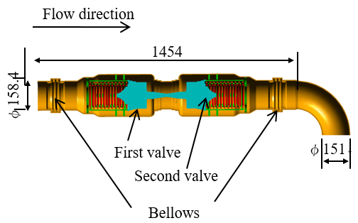
2. Pressure drop analysis
1) Simulation model for ERS
Table. Analysis conditions.
Application | FLUENT (version 17.2)
Steady/unsteady | Steady state
Adopted turbulence flow model | Realizable k-e model
Property of LH2 | Density: 70.8 [kg/m3] Viscosity coefficient: 1.33E-5 [Pa･s]
Flow rate at Inlet | 5.64 [m/s]
Pressure at outlet | 0 [PaG]
Fig.3 CFD Simulation model

Slide 13
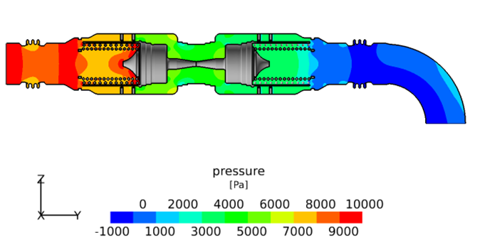
2. Pressure drop analysis
2) Calculation result of distribution of pressure drop
Fig.4 Pressure distribution
Overall pressure drop is 9.89E+3 Pa.
→ Not serious value, because of physical property of LH2.
Some area are seemed to affect mainly.

Slide 14
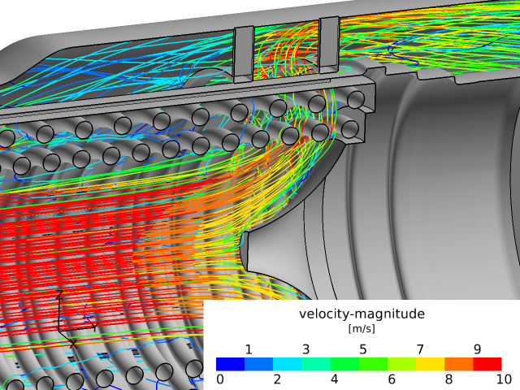
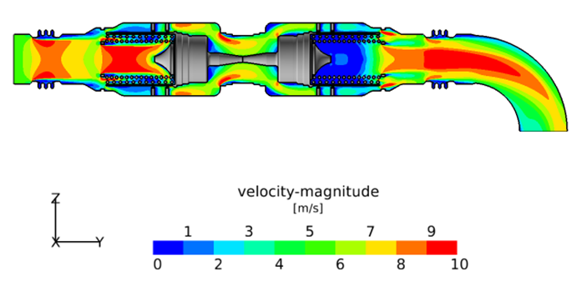
2. Pressure drop analysis
3) Calculation result of flow rate distribution
Fig.5 Flow rate distribution
High speed area colored red affects large pressure drop.
→ Shape, size, and location of springs and valve should be improved.

Slide 15
Outline
The Concept of CO₂-free Hydrogen Chains
Pressure drop analysis for ERS
Measurement of atmospheric hydrogen concentration at disconnection of ERS
Simulation of hydrogen diffusion at ERS disconnection
Summary

Slide 16
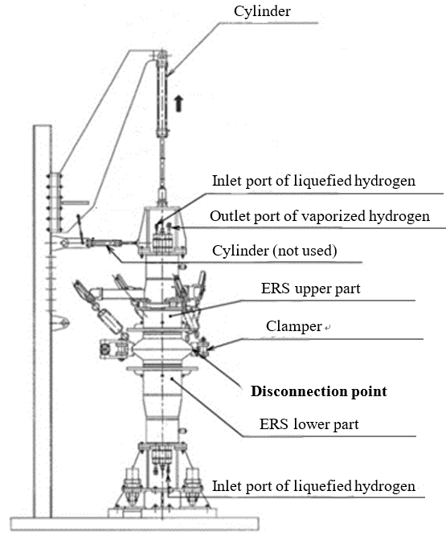
3. Measurement for diffusion
1) Layout of the test apparatus measuring diffused hydrogen concentration after disconnection
Test was conducted at JAXA (Japan Aerospace Exploration Agency) rocket test facility in Noshiro city in Japan.
ERS prototype was located vertically.
LH2 was supplied from top and bottom piping.
Boil off gas is disposed at vent stack through the piping.
After disconnection, ERS upper part goes up by cylinder vertically
Fig.6 Test apparatus

Slide 17
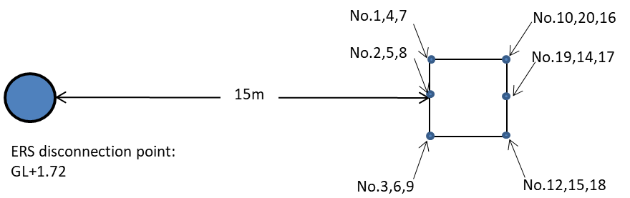
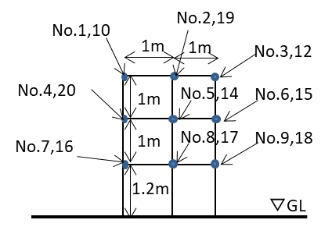
3. Measurement for diffusion
2) Location of the tower of hydrogen concentration sensors
Sensors are contact burning type. Range: 0 to 40000 ppm
The three axis ultra-sonic vane anemometer near the ERS
Direction from ERS to the tower was 230 degrees clockwise from the north.
Fig.7 Location of sensors

Slide 18
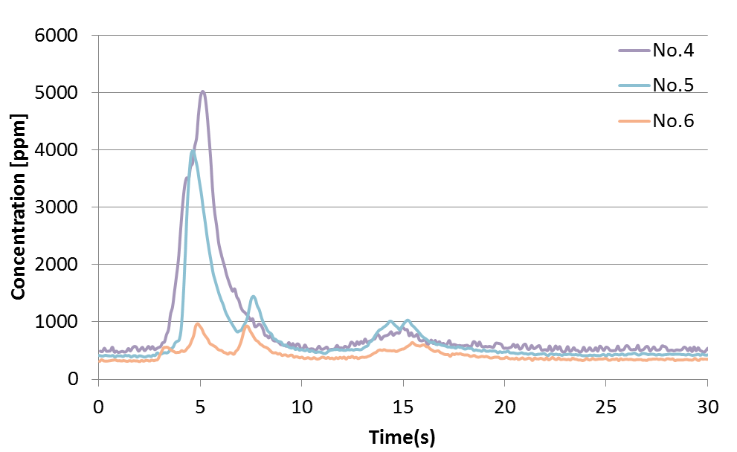
3. Measurement for diffusion
3) Test results of concentration
Time recorded peak concentration is 4.5 to 5s at each sensor.
There are some small peaks after 5s.
Peak value of No.4 is the biggest and No.6 is the smallest of the three.
Fig.8 Measurement result for sensor No.4, 5, and 6.

Slide 19
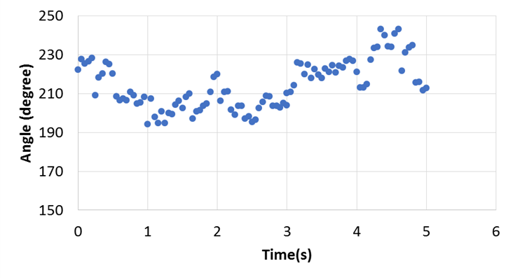
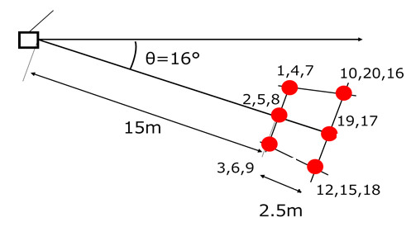
3. Measurement for diffusion
4) Measured wind direction value
Mean value was 214 degrees from the north, therefore wind direction was 16 degrees anticlockwise of the sensor tower from ERS.
It is reasonable that peak value of No.4 is the biggest and No.6 is the smallest of the three.
ERS Prototype
Wind direction
Fig.9 Measurement result on wind’s clockwise angle from the north.

Slide 20
Outline
The Concept of CO₂-free Hydrogen Chains
Pressure drop analysis for ERS
Measurement of atmospheric hydrogen concentration at disconnection of ERS
Simulation of hydrogen diffusion at ERS disconnection
Summary

Slide 21
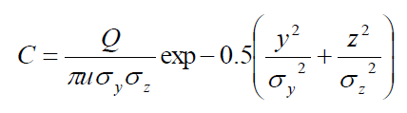
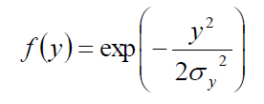
4. Simulation of hydrogen diffusion
1) Outline of the software “Phast”
Developed by DNV, improved for 30 years, and has validated for hydrogen.
Basically based on Pasquill’s equation that concentration distribution is expressed by Gaussian distribution as below.
The model of dispersion of the plume is included movement and vaporization of drops of liquefied gas.
Heat exchange between atmosphere and plume considering change of temperature and phase.
Atmospheric stability proposed by Pasquill and the density of the plume also affect values on distribution.
Where C is gas concentration at any x point [volume fraction], Q is flow rate of dispersed fluid [m³/s], u is wind speed along x axis [m/s], σ_{y}, σ_{z} [m] are standard deviation for gas concentration at y and z axis direction respectively.
f(z) can be expressed as well.

Slide 22
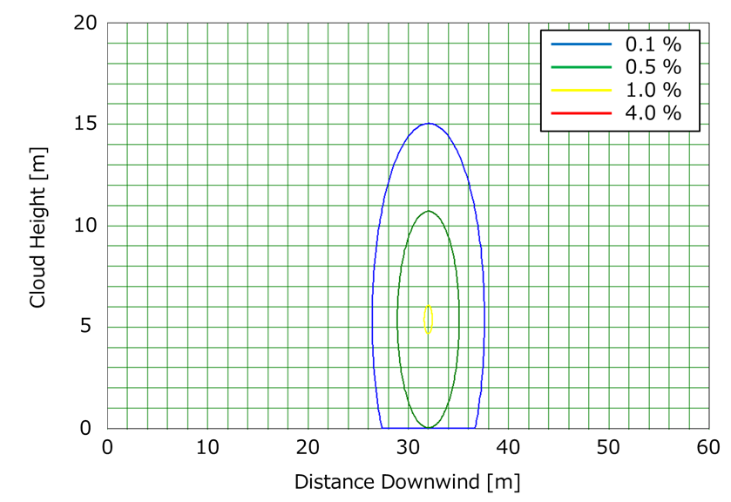
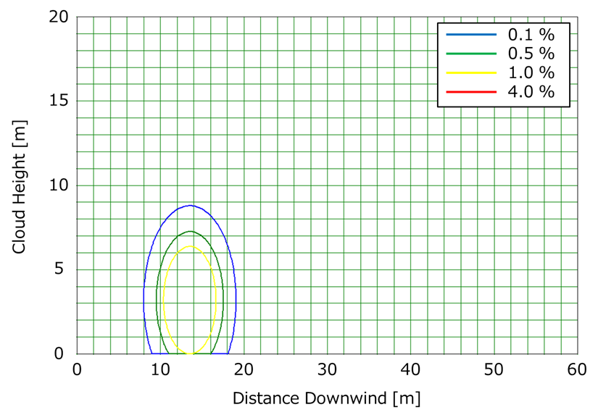
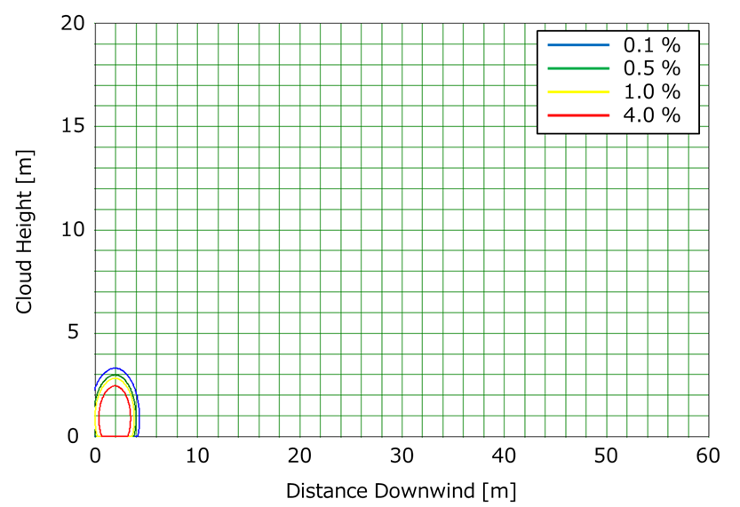
4. Simulation of hydrogen diffusion
2) Calculated concentration contour figure
10s after the dispersion
5s after the dispersion
1s after the dispersion
Fig.10 Hydrogen concentration contour
With the lapse of time, gas plume is diffusing moving to the downstream.
1s after the dispersion, the area within explosion range is observed, while 5s after the dispersion, explosion concentration is disappeared.

Slide 23
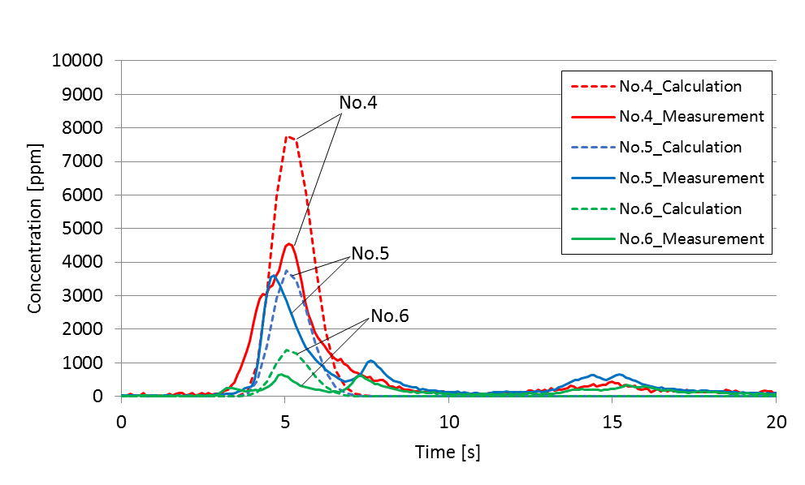
4. Simulation of hydrogen diffusion
3) Comparison simulation with experiment
ERS Prototype
Wind direction
Fig.11 Measured and calculated concentration
Measured peak mountain is broader than calculated one. → Supposed effect of change of wind speed and maintained liquid on ERS lower part.
Measured peak value is more uniform than calculated one. → Supposed effect of change of wind direction

Slide 24
Outline
Background
Pressure drop analysis for ERS
Measurement of atmospheric hydrogen concentration at disconnection of ERS
Simulation of hydrogen diffusion at ERS disconnection
Summary

Slide 25

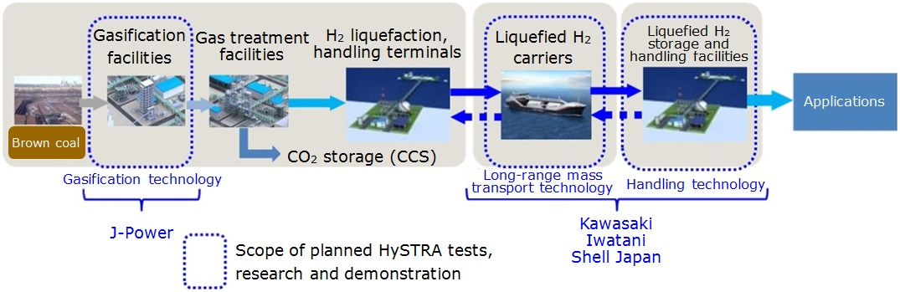
5. Summary
Established Technical Research Association
Name of TRA: CO₂-free Hydrogen Energy Supply-chain Technical Research Association (Abbreviation: HySTRA)
Established date: February 2016
Member: KHI, Iwatani Corporation, Shell Japan, J-Power (as of established date)
NEDO “Demonstration project for establishment of mass hydrogen marine transportation supply chain derived from unused brown coal”
New Energy and Industrial Technology Development Organization (NEDO);
Development of Technologies for Realizing a Hydrogen Society, Development of Technologies for Large-Scale Hydrogen Systems,
Demonstration project for establishment of mass hydrogen marine transportation supply chain derived from unused brown coal
Fig.12 Demonstration project conducted from 2015 to 2020

Slide 26
5. Summary
5. Summary
Performance of world-first ERS for LH2 was simulated and measured. We obtained knowledge as follows;
Pressure drop is estimated practical value, abt. 10kPa.
Flow rate distribution is also simulated and obtained data to be improved for the future ERS.
Diffusion of hydrogen at disconnection of ERS is measured and obtained the reasonable data.
Simulation can predict the concentration distribution of hydrogen very well
These method shall contribute future commercialization of LH2 supply chain and de-carbonation society.

Slide 27
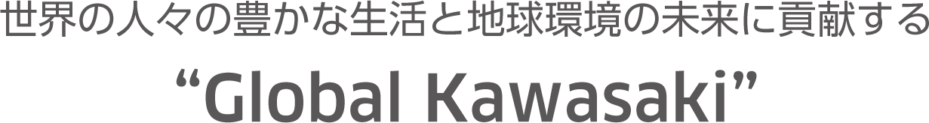
Thank you for listening
Kawasaki, working as one for the good of the planet
Acknowledgments:
A part of this work was supported by Council for Science, Technology and Innovation (CSTI), Cross-ministerial Strategic Innovation Promotion Program (SIP), “Energy Carriers” (Funding agency: JST).

