Slide 1
4.5K Refrigerator Cold Box for the Facility for Rare Isotope Beams (FRIB). Michigan State University (MSU).
Nikolay Kolev
ICEC27-ICMC 2018, 4th September 2018

Slide 2
Agenda
1. | Location and purpose of the plant
2. | Cold boxes layout and design
3. | Process and flow diagram
4. | Performance data
5. | Summary
Authors:
M. Ressel Linde Kryotechnik AG, Switzerland
Y. Jia Linde Cryogenics, OK, USA
F. Casagrande FRIB, MI, USA

Slide 3
Agenda
1. | Location and purpose of the plant
2. | Cold boxes layout and design
3. | Process and flow diagram
4. | Performance data
5. | Summary

Slide 4
Location and purpose of the plant Facility for Rare Isotope Beams (FRIB) at MSU
East Lansing, MI

Slide 5
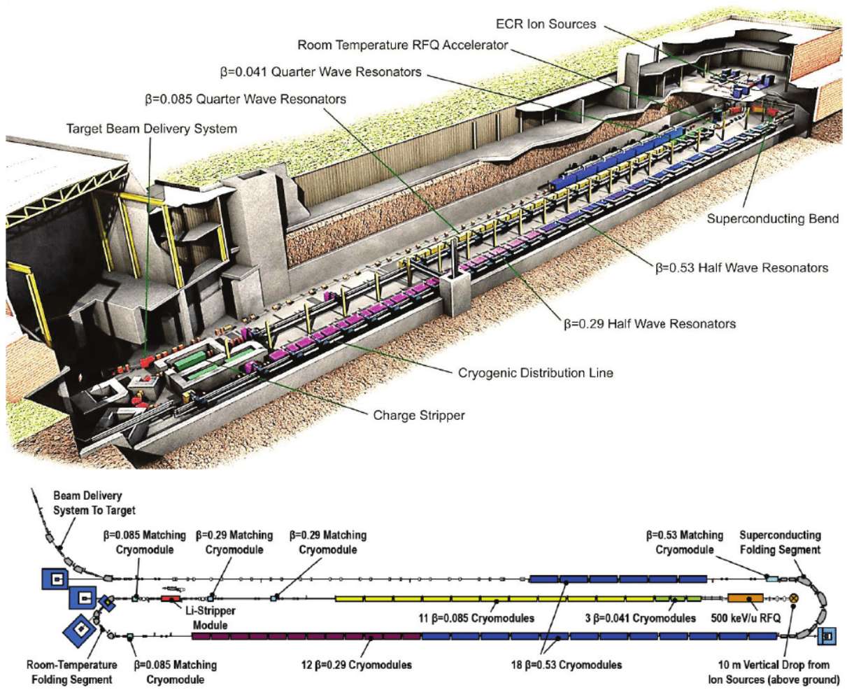
Location and purpose of the plant Facility for Rare Isotope Beams (FRIB) at MSU
ion beams from protons to uranium up to energies of >200 MeV/u
beam power of up to 400 kW
Leitner M. et al. The FRIB project at MSU,
Proceedings of SRF2013, Paris, France

Slide 6
Agenda
1. | Location and purpose of the plant
2. | Cold boxes layout and design
3. | Process and flow diagram
4. | Performance data
5. | Summary

Slide 7
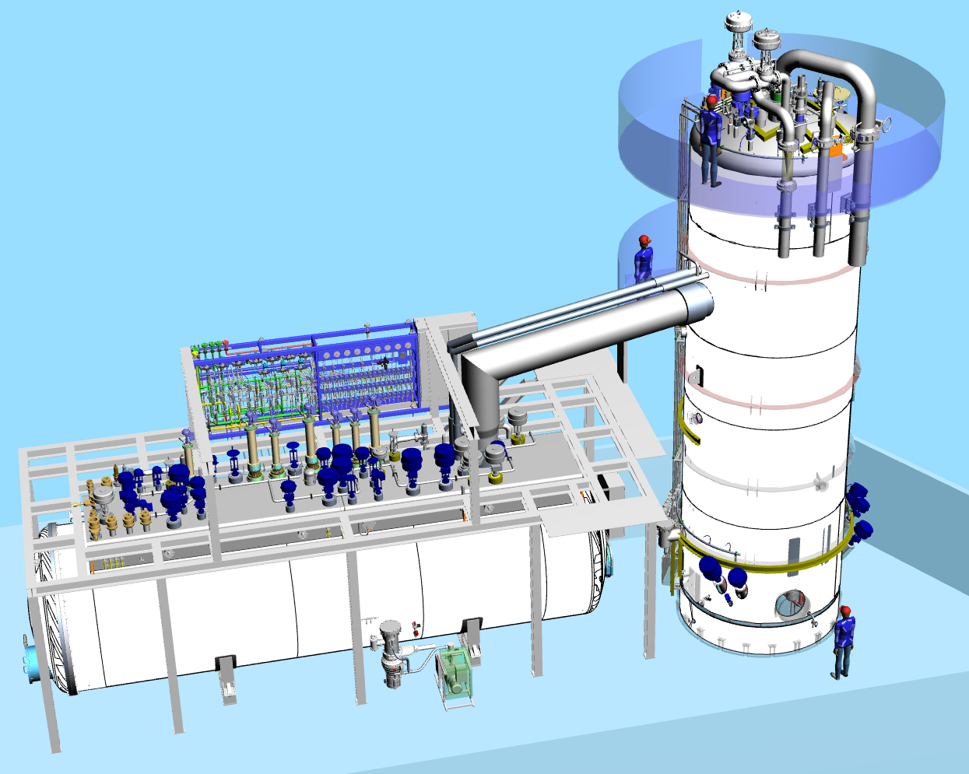
Selected features Cold box layout and design
Linde scope of supply (main components):
Vertical (upper) cold box
Horizontal (lower) cold box
Interconnecting transfer lines
Adsorber regeneration skids
Purge and instruments panels

Slide 8
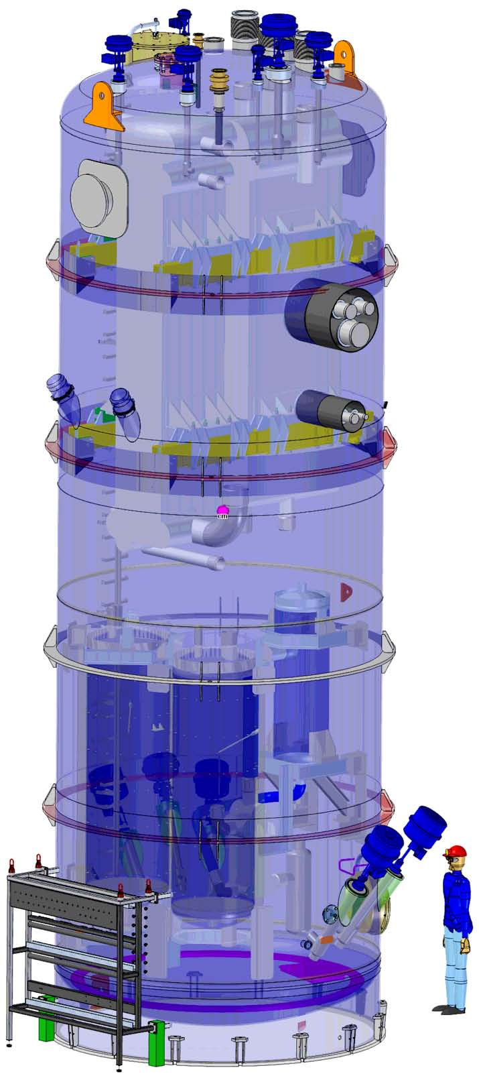
Selected features Cold box layout and design – vertical box
Features, specifications and modifications applied in the cryogenic plant:
Improved heat exchanger configuration 300K to 80 K
Temperature split at 60 K
Dual 80-K adsorber beds can be independently isolated, regenerated and then brought back on-line
Both beds can be bypassed if necessary
Refrigerator can continue to operate, although at a reduced capacity, if there is a LN2 utility failure
LN2 pre-cooler can utilize the nitrogen vapor from
other parts of the facility
Three thermal shield operational configurations
Upper cold box
300K-60K range

Slide 9
Selected features Cold box layout and design – horizontal box
Each of the four turbine strings can be independently shut-down, isolated, maintenance performed and then brought back on-line
JT expander can be bypassed by any amount with minimal disturbance to the supply with the incorporation of an upstream HX
20-K adsorber bed can be bypassed while being
isolated, regenerated and then brought
back on-line
Lower cold box 60K-4.5K range

Slide 10
Agenda
1. | Location and purpose of the plant
2. | Cold boxes layout and design
3. | Process and flow diagram
4. | Performance data
5. | Summary

Slide 11
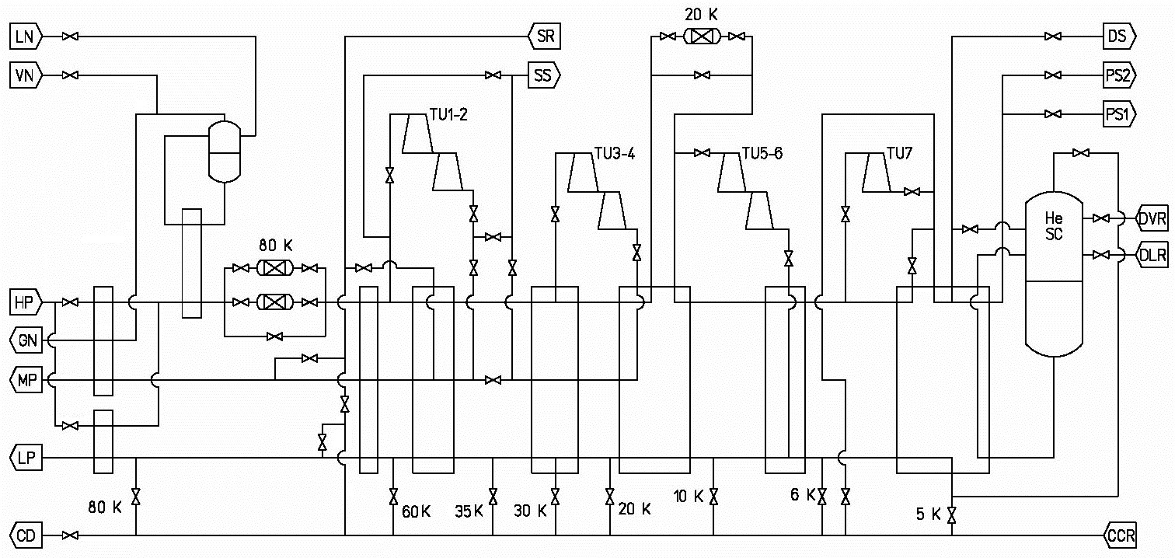
Performance data and flow diagram Flow diagram

Slide 12
Agenda
1. | Location and purpose of the plant
2. | Cold boxes layout and design
3. | Process and flow diagram
4. | Performance data
5. | Summary

Slide 13
Performance data Load table of measured values
Performance | Unit | Maximum capacity | Maximum liquefaction | Maximum refrigeration
Shield capacity (60K Load) | [kW] | 20.2 | 13.4 | 20.1
Refrigeration (4.5K Load) | [kW] | 4.3 | - | 11.7
Liquefaction (@ ca.1.3 bar) | [g/s] | 23.3 | 165 | -
2K Load Supply (@ 3.25 bar) | [g/s] | 184* | - | -
* return temperature of 30K
All values measured at constant liquid helium levels. LN2 consumption below design.

Slide 14
Agenda
1. | Location and purpose of the plant
2. | Cold boxes layout and design
3. | Process and flow diagram
4. | Performance data
5. | Summary

Slide 15
Summary
Design for very flexible operation regarding
2K / cold compressor load
Liquefaction
Refrigeration at 4.5K
Shield load
Design for high load variations
Floating pressure – Ganni cycle
Dynamic gas bearing turbines
Plant capacity variation 20 to 100% (6.5 to 20 bar)
Six major modes of operation
Design for very high availability
Three shield operation modes
Redundant 80K adsorbers plus adsorber bypass valves
Internal liquid helium vessel with heaters
Nine load return valves
Four turbine strings

Slide 16
Thank you for your attention.
Linde Kryotechnik AG
Nikolay Kolev, Process Engineering
Tel +41 52 304 05 09
nikolay.kolev@linde-kryotechnik.ch, www.linde-kryotechnik.ch
Authors: M. Ressel Linde Kryotechnik AG, Switzerland Y. Jia Linde Cryogenics, OK, USA F. Casagrande FRIB, MI, USA

