Slide 1
Refrigerator and liquefaction system for IHEP’s PAPS SRF Facility
A. Lange, S. Li
ICEC27 – ICMC 2018 Oxford, UK, September 4, 2018

Slide 2
Agenda
1. | IHEP & PAPS
2. | Requirements & challenges
3. | Solutions
4. | Process flow diagram and performance
5. | Summary

Slide 3
Agenda
1. | IHEP & PAPS
2. | Requirements & challenges
3. | Solutions
4. | Process flow diagram and performance
5. | Summary

Slide 4
IHEP & PAPS Institute of High Energy Physics (IHEP)
Chinas biggest laboratory for the study of particle physics
Research on several topics
theoretical and experimental research into particle and astroparticle physics
accelerator technologies
nuclear analysis techniques
Facilities
Accelerator based facilities such as Beijing Electron-Positron Collider, Beijing spectrometer and Beijing Synchroton Radiation Facility
Non accelerator facilities such as Yangbajing Cosmic Ray Observatory and Daya Bay Reactor Neutrino Experiment
China Spallation Neutron Source (CSNS) at the Dongguan campus, which has been successfully constructed and passed its national acceptance on August 23, 2018
Under construction are Jiangmen Underground Neutrino Observatory, and the Large High-Altitude Air Shower Observatory

Slide 5
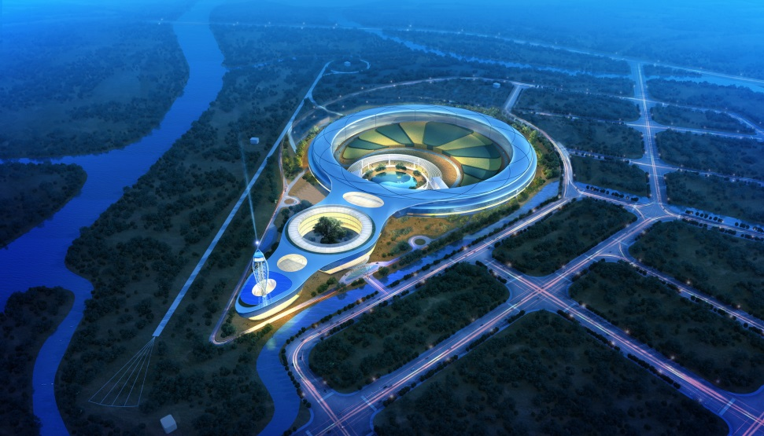
IHEP & PAPS High Energy Photon Source (HEPS)
High Energy Photon Source (HEPS)
Proposed in 2008, it is designed as an ultra-low emittance ring-based synchroton radiation light source
HEPS will serve as a platform to promote multi-disciplinary R&D in the fields of materials science, chemical engineering science, energy and environment science, and biomedicine
Facts
The beam energy of the HEPS storage ring is 6 GeV
the emittance is less than 0.06 nm ·Rad and the capacity of the high
performance beam-line station is not less than 90
Total HEPS project investment is 5 billion RMB
The kick off of the project is scheduled for November, 2018
Image by IHEP
Notes:
To realize these projects, as well as many other future large superconducting accelerator projects in China and worldwide, it is mandatory to build a large-scale and well-functioned production and SRF R&D facility in an early stage; such a facility would also help to train the new generation of scientists, as well as to serve as a link between industry and project management
The construction of the PAPS SRF facility has just started, and it is planned to complete before June 2020biggest laboratory for the study of particle physics
The PAPS SRF facility is aimed at processing and testing of several hundreds of SRF cavities and couplers
assembly and testing of about 20 cryomodules per year for different users
It is also planned to cover the requirement of new SRF material and technology development

Slide 6
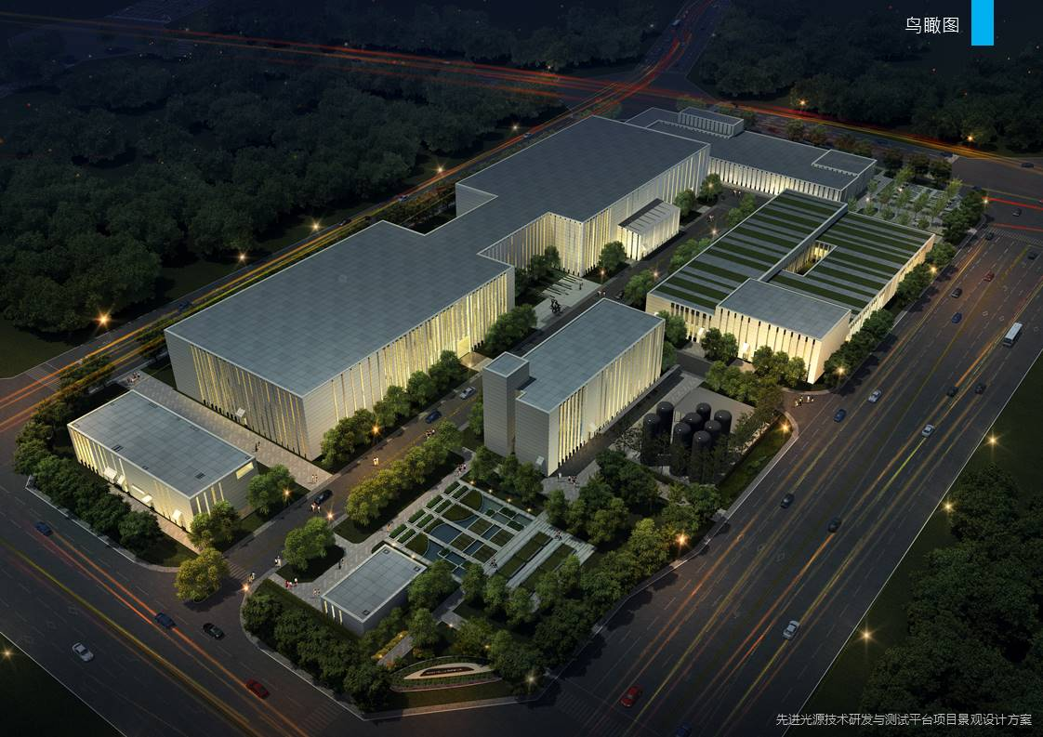
IHEP & PAPS Platform of Advance Photon Source Technology R&D (PAPS)
Platform of Advance Photon Source Technology R&D (PAPS)
PAPS shall provide a solid foundation and condition for R&D, engineering testing and verification for the (HEPS) project, to be completed on schedule and to achieve the expected design target
The construction of the PAPS SRF facility has just started, and it is planned to be completed before June 2020
Facts
Officially launched in February 2017
The total project investment is 0.5 million RMB
The PAPS SRF facility is aimed at processing and testing of
several hundreds of SRF cavities and couplers
assembly and testing of about 20 cryomodules per year
for different users
It is also planned to cover the requirement of new SRF material and technology development
Image by IHEP

Slide 7
Agenda
1. | IHEP & PAPS
2. | Requirements & challenges
3. | Solutions
4. | Process flow diagram and performance
5. | Summary

Slide 8
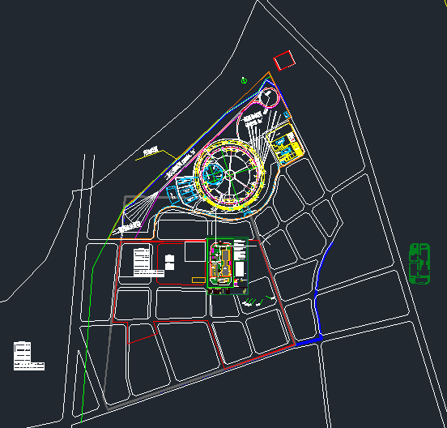
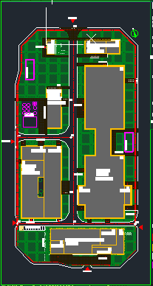
Requirements & challenges Platform of Advance Photon Source Technology R&D (PAPS)
Project goals
Construct a 2.5KW@4.5K or 300W@2K superfluid helium cryogenic system with three vertical test stands, two horizontal test stands and a beam test stand for superconducting cavities
Construct an impure helium recovery and purification system with the capacity of 210 m³/h He recovery and 100 m³/h He purification
Support the performance test of various type of superconducting cavities
HEPS
SC lab
Cryogenics
Construction site
Huairou district of Beijing
About 60 Km from IHEP

Slide 9
Requirements & challenges Helium refrigeration plant
Requirements
Solutions
Three operation modes: liquefaction, refrigeration and mixed operation
Operation with and without LN2 precooling
Supply cooling power at three temperature levels:
5 – 8 K thermal shield
50- 80K thermal shield
4.5K GHe for liquefaction
Ability to receive and integrate returning cold Helium gas into the process
High flexibility to operate efficiently at all modes
Controlled fluctuation of the compressor’s suction pressure
High reliability
“standardized customization”
Use of the standard engineered LR700 refrigerator
Compressor concept based on standardized modular design
Proven control concept to regulate suction pressure
Efficiency
3 turbo expander to assure efficient operation at all modes
Use of variable frequency drives to adapt the mass flow to the cooling power demand
Support
Local and remote after sale service support to provide short reaction times

Slide 10
Agenda
1. | IHEP & PAPS
2. | Requirements & challenges
3. | Solutions
4. | Process flow diagram and performance
5. | Summary

Slide 11
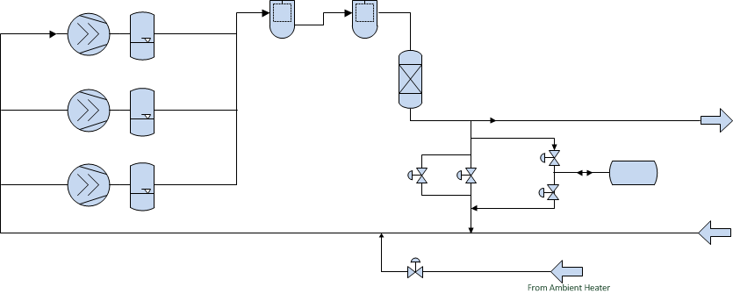
Solutions Helium refrigeration plant - Setup
Compressor System
Two large compressors with variable frequency drive
One small compressor to boost mass flow and serve as a back up compressor during break downs or shut downs
Oil separation system consisting on 2 coalescer stages and one oil adsorber downstream the compressor

Slide 12
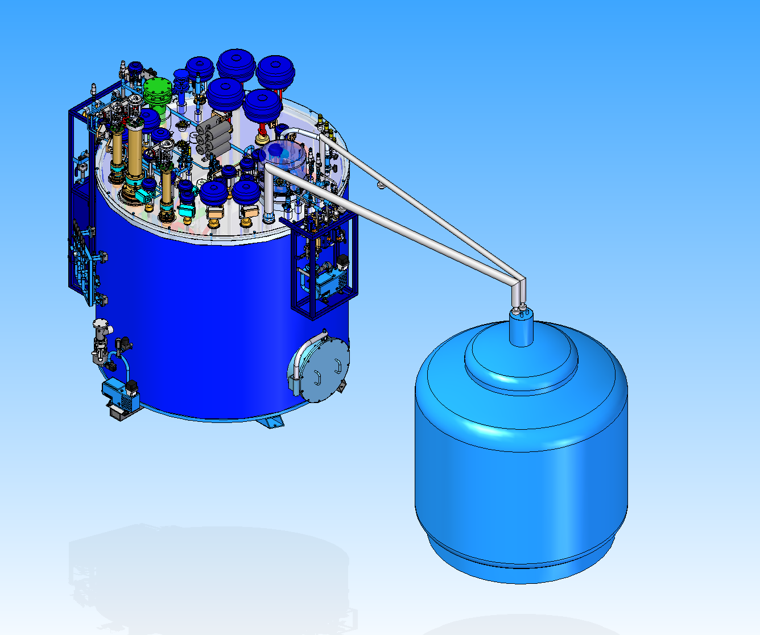
Solutions Helium refrigeration plant - Setup
Refrigerator Cold box & Dewar
Standard engineered LR700 concept
Three turbo-expanders with dynamic gas bearings
Cold helium supply for two thermal shields at different temperature levels
Low pressure cold helium gas return
4 ports to supply and for the return of helium at different boundary conditions
Two thermal shields: at 40K (HTTS) and 5K (LTTS)
Supply and return to main Dewar
Cold down supply and return
5’000l main Helium dewar
Local after sales service either through Beijing Cryosource or by a Linde engineer located at Linde Engineering in Hangzhou
Remote service support from Switzerland
After sales

Slide 13
Solutions Cooling power at a wide range of temperatures
4.5K GHe supply
Thermal shields (TS)
Cool down features
Helium liquefaction at a 5’000l Dewar
Cooling power for refrigeration mode
Cold helium supply for mixed mode
40K HTTS supply downstream 2nd HEX
(High Temperature Thermal Shield)
80K HTTS return upstream 1st TED
5K LTTS supply upstream JT valve
(Low Temperature Thermal Shield)
8K return to LP line downstream
JT HEX
300 – 40 K
cooldown mass flow via the dedicated cooldown supply port
Supply and return flow T control
Integration of the returning flow
40 – 5 K
40K/5K flow via dedicated ports
Flow T control
Integration of the returning flow
Helium refrigeration plant

Slide 14
Agenda
1. | IHEP & PAPS
2. | Requirements & challenges
3. | Solutions
4. | Process flow diagram and performance
5. | Summary

Slide 15
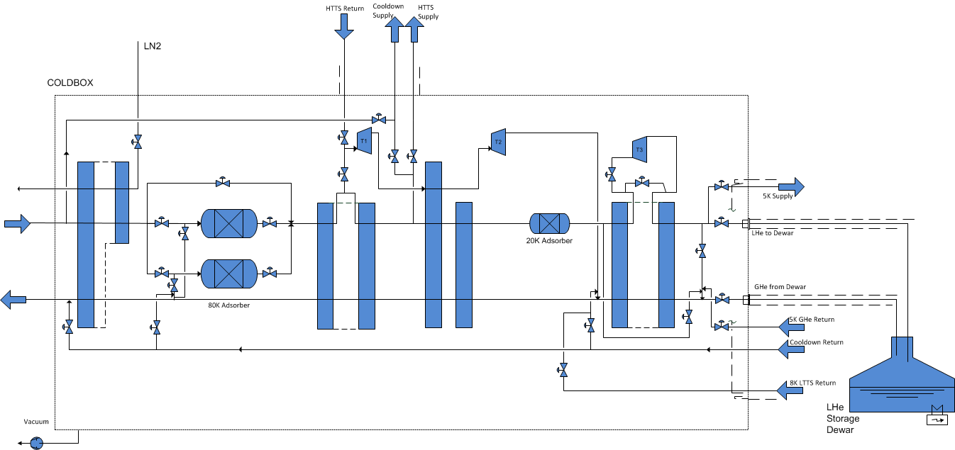
Process flow diagram and performance Cold box & Dewar

Slide 16
Process flow diagram and performance Performance data
Plant performance guaranteed
Liquefaction rate @ level rise ⁽¹⁾ | L/h LHe | ≥ 800
Cooling power @ 4.5K | W | ≥ 2’500
Mixed mode
Liquefaction rate @ level rise ⁽¹⁾ | L/h LHe | ≥ 650
Cooling power at 4.5K | W | 500
Thermal shields⁽²⁾
Cooling power @ 40 K – HTTS | W | 1’000
Cooling power @ 5 K - LTTS | W | 500
During operation with LN2 pre-cooling
1.3 bara dewar pressure
Expected values

Slide 17
Agenda
1. | IHEP & PAPS
2. | Requirements & challenges
3. | Solutions
4. | Process flow diagram and performance
5. | Summary

Slide 18
Summary
PAPS facility will enable the construction and R&D of super conducting cavities for the HEPS project. Linde Kryotechnik was awarded the contract to design, build and put into operation a highly flexible cryogenic system for the PAPS project
The helium refrigeration plant is designed to provide flexibility while operating with maximum efficiency at a wide range of loads. Its main features are
Automatic load adaptation via compressor system, variable frequency drives, adaptation of HP and a third turbine with bypass
Cost efficient solution by using standard engineered modules
Proven control concept to regulate suction pressure
The challenging requirements are covered by a combination of a tailor made concept with standard engineered modules, providing a customized, reliable, low cost solution
Chinese customer’s can rely on Linde’s support either from the headquarters in Switzerland or its local partners

Slide 19
Thank you for your attention.
Linde Kryotechnik AG
A. Lange, Linde Kryotechnik AG
S. Li, IHEP
adolfo.lange@linde-kryotechnik.ch
www.linde-kryotechnik.ch

