Slide 1
Conceptual design of the Cryogenic System of Comprehensive Research Facility for Key Fusion Reactor Core Systems
Liangbing Hu
huliangbing@ipp.ac.cn
Sep.4. 2018

Slide 2
Outline
Background
Cryogenic facility
Conclusion and Perspective
Cryogenic supported system
Research Platform of Key technology for helium cryogenic

Slide 3
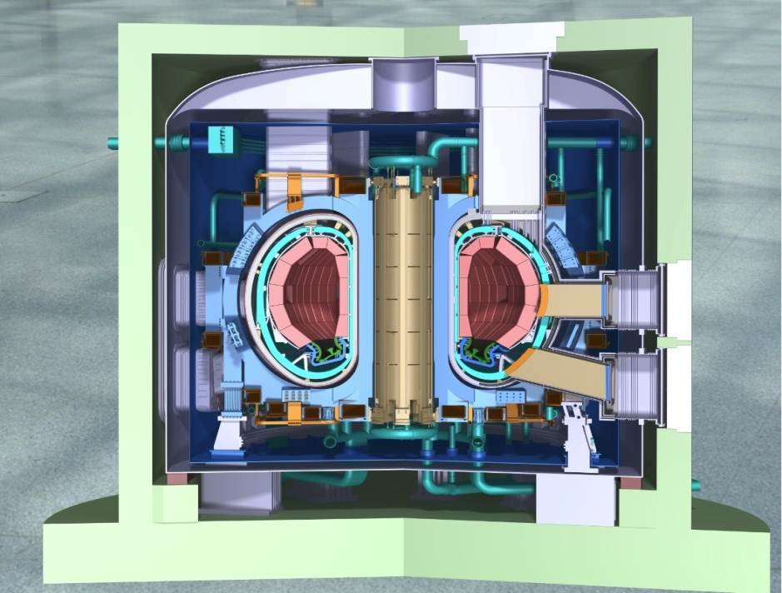
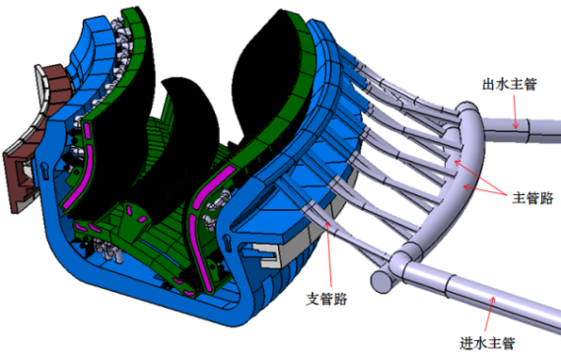
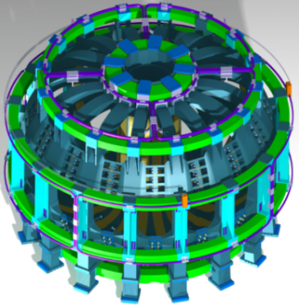

Key components: magnets and divertor
“Comprehensive Research Facility for Key Fusion Reactor Core System” in National Grand Project by Chinese government will be build to ensure their overall performance, reliability and safety in CFETR.
To break through the bottlenecks of magnets and divertor for experimental research and engineering development.
Divertor
Magnets
CFETR
( Chinese Fusion Engineering Test Reactor)
The facility encompasses two synergistic research systems for :
1. Superconductor and magnets capable of max. field of 16.7T
2. Divertor physics and engineering capable of a max.plasma flux of 10²⁴/m²s.

Slide 4
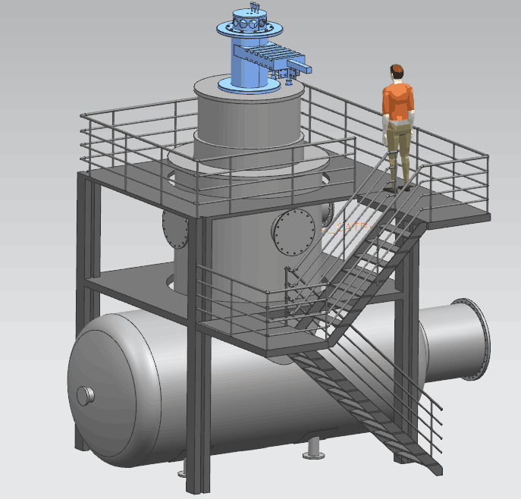
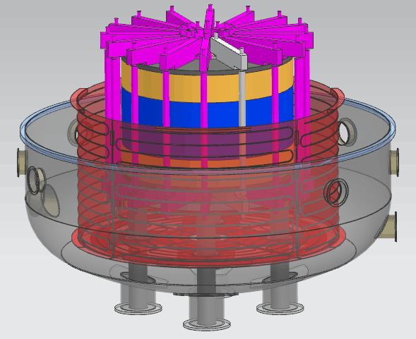
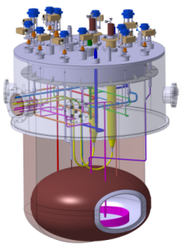
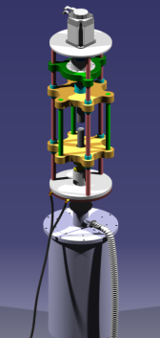
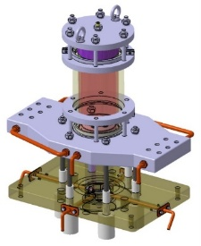
Configuration of magnets system
Parameters
Magnet dimension: | 10m x 15m
Max field | 16.7T
Cool Capacity | 7.2kW@4.5K
Max current | 120kA
Magnets system
Magnet research platform
Cryogenic research platform
Material research platform
Conductor research platform
Power research platform
Research of superconductor and high magnet characteristic, ensure the safety and reliability of superconducting magnets for fusion reactor

Slide 5
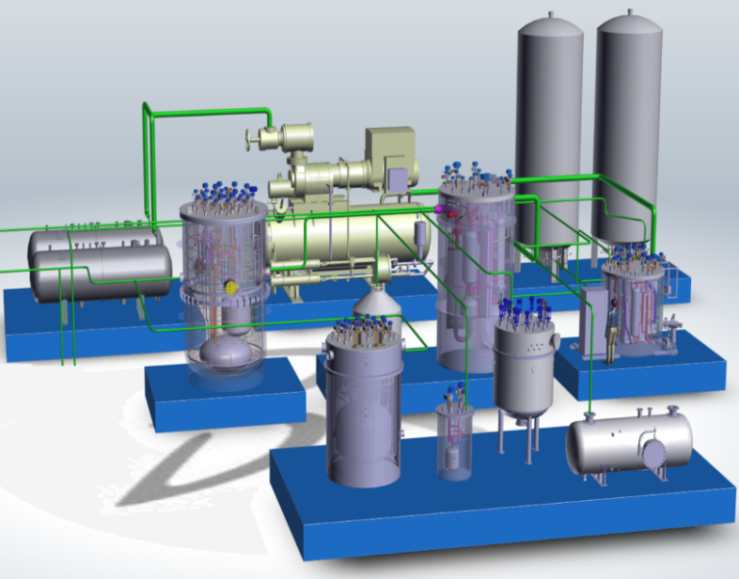
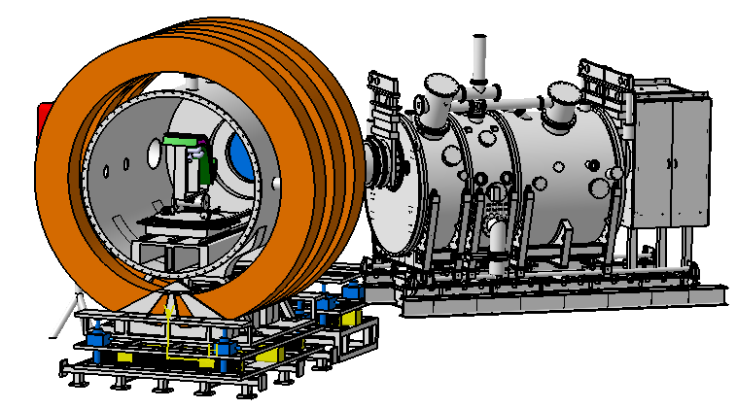

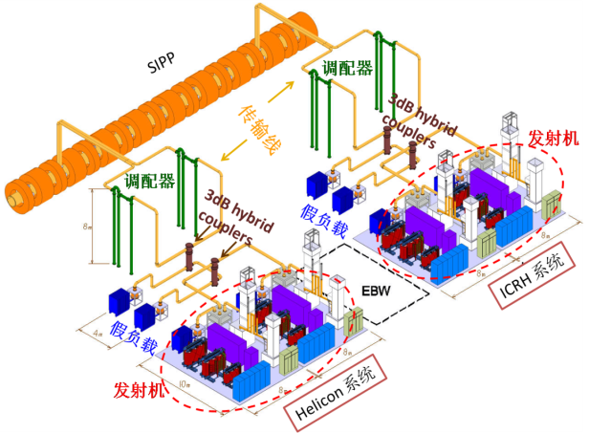
Scope of cryogenic system
Cryogenic users
Cryogenic research platform
Cryogenic public service platform
Superconducting magnets test device
Divertor test device
Cryogenic research platform
Cryogenic public service platform
Compressor station
Storage system
Superconducting magnets test
Item | parameters
Capacity | 7.2kW@4.5K
Temperature | 1.8K，3K，4.5K
Pressure | 1600Pa~2MPa
Mass flow rate | >500g/s
Cold box
Superconductor performance
Distribution system
material performance
Divertor system
NBI system
ICRH system

Slide 6
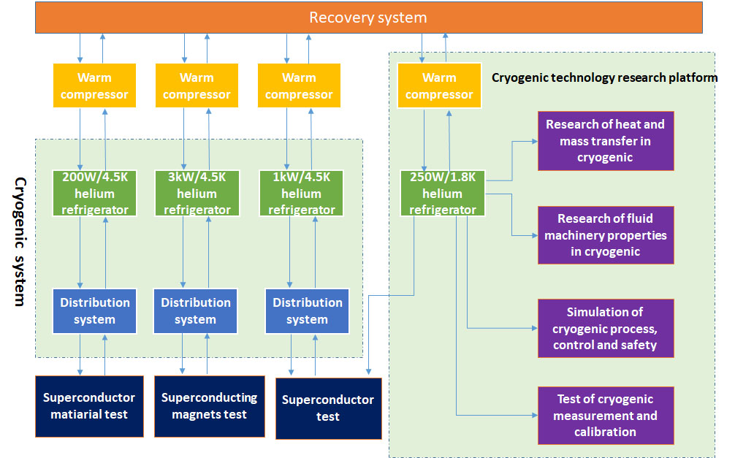
Cryogenic system

Slide 7
3kW/4.5K refrigerator
The refrigerator is based on Claude cycle with LN2 precooling and two turbine in series. The 3K stage is obtained by two cold compressors in series.
The Capacity is 3kW/4.5K（1kW/3K） . FOM is 20%.
TYPE | refrigerating mode(4K) | refrigerating mode(3K) | 50K-80K thermal shield | Mass flow rate of SHe
HRL 3000 | 3000W/4.5K | 1.2kW/4.5K+1.0kW/3K | 15.5kW/50K | 200g/s

Slide 8
1kW/4.5K refrigerator
The refrigerator is based on Claude cycle with LN2 precooling and two turbine in series.
The Capacity is 1050W/4.5K on pure refrigeration mode. Liquid rate is 300L/hr, FOM is 21.5%.
TYPE | LN2 precool |  | No LN2 precool
HRL 1000 | Capacity | Liquid rate | Capacity | Liquid rate
 | 1000W/4.5K | 300L/h | 600W/4.5K | 150L/h

Slide 9
200W/4.5K refrigerator
The refrigerator is based on Claude cycle with LN2 precooling and two turbine in series.
The Capacity is 210W/4.5K on pure refrigeration mode. Liquid rate is 60L/hr, FOM is 12.6%.
TYPE | LN2 precool |  | No LN2 precool
HRL 200 | Capacity | Liquid rate | Capacity | Liquid rate
 | 200W/4.5K | 60L/h | 100W/4.5K | 30L/h

Slide 10
250W/1.8K refrigerator
1.8K cycle is obtained by cold compressor and warm vacuum compressor mixed mode.
It will provide the 110K, 80K, 20K, 4.5K interface for the research platform of heat mass and transfer in cryogenic.
ITEM | Temperature | Capacity | Pressure | Mass flow rate
Parameters | 1.8K~300K | 250W/1.8K 500W/2K | 1600Pa~2MPa | 10~25g/s

Slide 11
Cryogenic research platform
Key technology of helium cryogenic
Research of heat and mass transfer in cryogenic
Research of fluid machinery properties in cryogenic
Simulation of cryogenic process, control and safety
Test of cryogenic measurement and calibration
Major function:
Develop and make research on cryogenic system for CFETR and future fusion reactor and promote its application in industry.

Slide 12
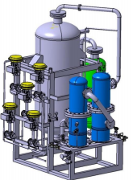
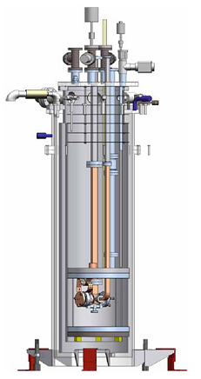
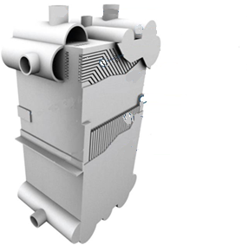
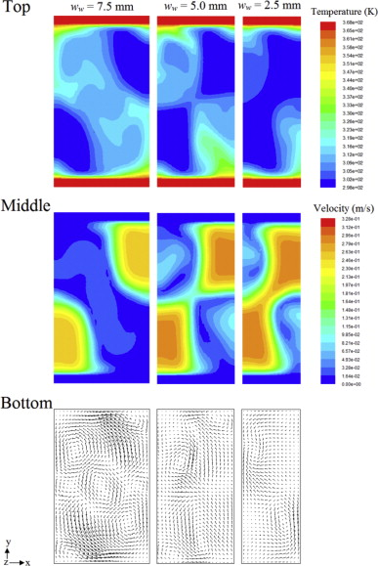
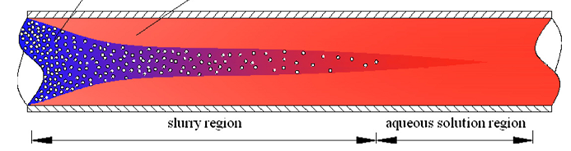
Heat and mass transfer in cryogenic
Cryogenic fluid and heat transfer
He II&He I Phase change mechanism
Cryogenic heat exchanger
Oil removal system experiment facility
Separation of impurities gas from He
Oil removal system experiment facility
Separation of impurities gas from He
Cryogenic flow & heat transfer research platform
Cryogenic heat exchanger
He II & He I Phase change mechanism
Cryogenic fluid flow and heat transfer
Mechanism study of He II phase change heat transfer in superconducting magnets and transient thermal response under pulsed heat load

Slide 13
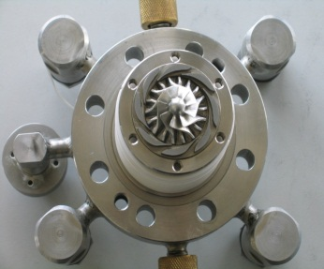
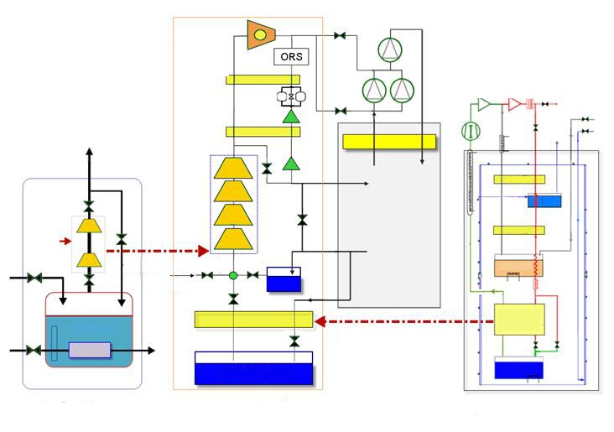
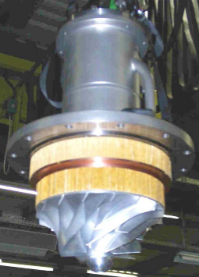
Fluid machinery properties in cryogenic
Turbine expander
4.5K helium refrigerator
Cold compressor
Test cryostat for Cold compressor
1.8 K refrigeration
unit
Test cryostat for
subcool heat exchanger
The cryogenic fluid machinery properties in cryogenic will be to develop the large-flow turbine expander, cold compressor and helium circulator, and realize the in-house production of key components in large scale helium cryogenic system.
Helium circulator

Slide 14
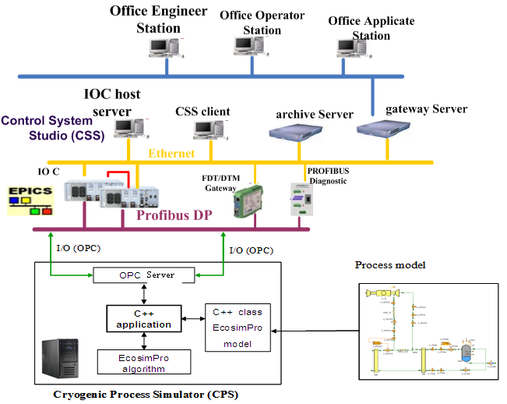
Simulation of cryogenic process, control and safety
Refrigeration Process Design
Thermodynamic calculation, Equipment parameters
Control Strategies Design
Control sequences , Controller Parameter Tuning,
Virtual commissioning
Performance Optimization
Operational optimization in Off-design condition
Management under abnormal conditions
Fault diagnosis, Smooth for heat-load
System Commissioning
Operator training, Refrigeration cycle re- optimization
It will be an efficient platform to realize rapid design and stable operation of cryogenic system, and have guiding significance during the life-cycle of cryogenic system .
Dynamic simulation of transient characteristics of pulse heat load on cryogenic system and collaborative control to smooth the influence of the load.

Slide 15
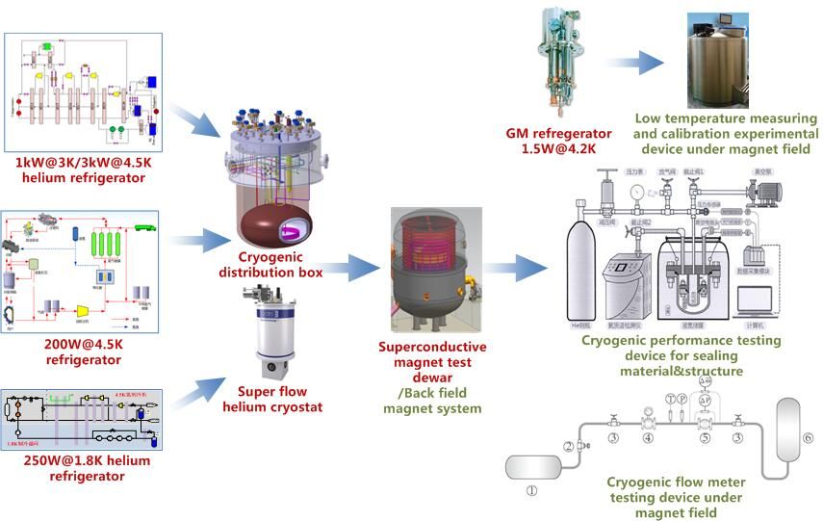
Test of cryogenic measurement and calibration
Cryogenic measuring and calibration experiment device under magnet field
Cryogenic performance test device for sealing material and structure
Cryogenic flow meter test device under magnet field
The service platform is established for calibration and test of cryogenic precision measurement instruments, high-voltage insulation performance, insulating materials under 1.8K, and cryogenic performance test of sealing materials and sealing structures, flow characteristics, heat leakage characteristics of cryogenic valve.

Slide 16
Time table
Project | 2018 |  |  |  | 2019 |  |  |  | 2020 |  |  |  | 2021 |  |  |  | 2022
 | 1 | 2 | 3 | 4 | 1 | 2 | 3 | 4 | 1 | 2 | 3 | 4 | 1 | 2 | 3 | 4 | 1 | 2 | 3 | 4
Cryogenic system
Engineering design of helium refrigeration
Manufacture of cold box and distribution valve box
Assemble of helium refrigerator
Commission and assemble of helium refrigerator
Commission and system integration of cryogenic system with load
Engineering design of cryogenic research platform
Manufacture of sub system
Assemble of sub system
Commission and test of sub system
Optimization and acceptance of project

Slide 17
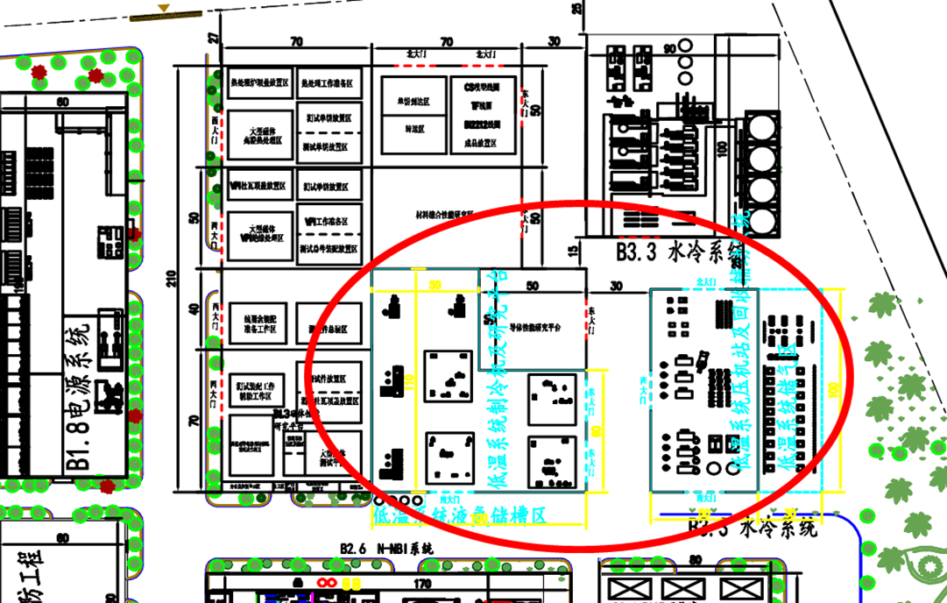
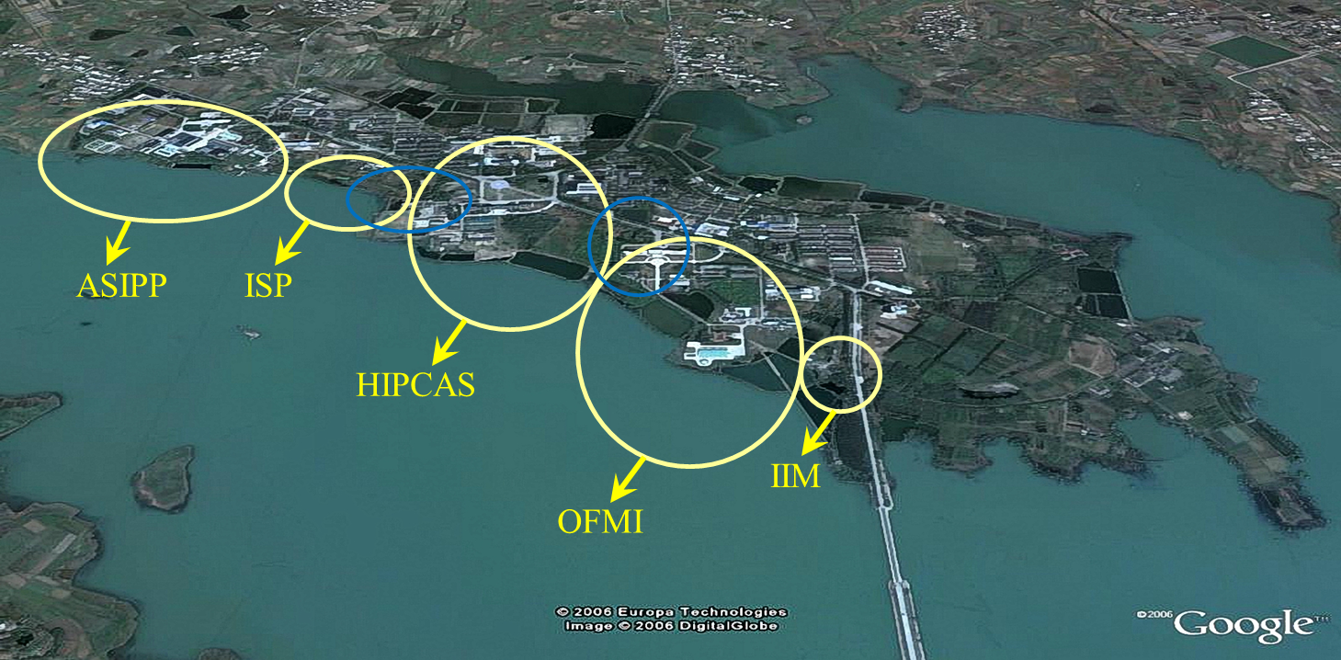
Location of the facility
New Facility
Cryogenic system
16,500 m²
Science island
Hefei Comprehensive National Science Center, Anhui ,China

Slide 18
Conclusion and perspective
Conceptual design of the project have been finished and the proposal has been submitted to be review.
The preliminary engineering design will be evaluated.
A large-scale Cryogenic Technology and Engineering center will be built in 5 years which can provide the cryogenic technology and test for fusion reactor and other users.
Collaboration and technical supports will be welcome.

Slide 19


Thanks for your attention！

