Slide 1
Hydraulic adjustment of the two-phase helium forced flow cooled superconducting magnets of the SIS100 heavy ion synchrotron for FAIR
Alexander Bleile
GSI, Darmstadt

Slide 2
Outline
Introduction: FAIR / SIS100
Fast ramped superconducting magnets
Operating modes of SIS100 synchrotron and
dynamic heat load in sc magnets
Hydraulic adjustment of parallel cooling cannels
Conclusions

Slide 3
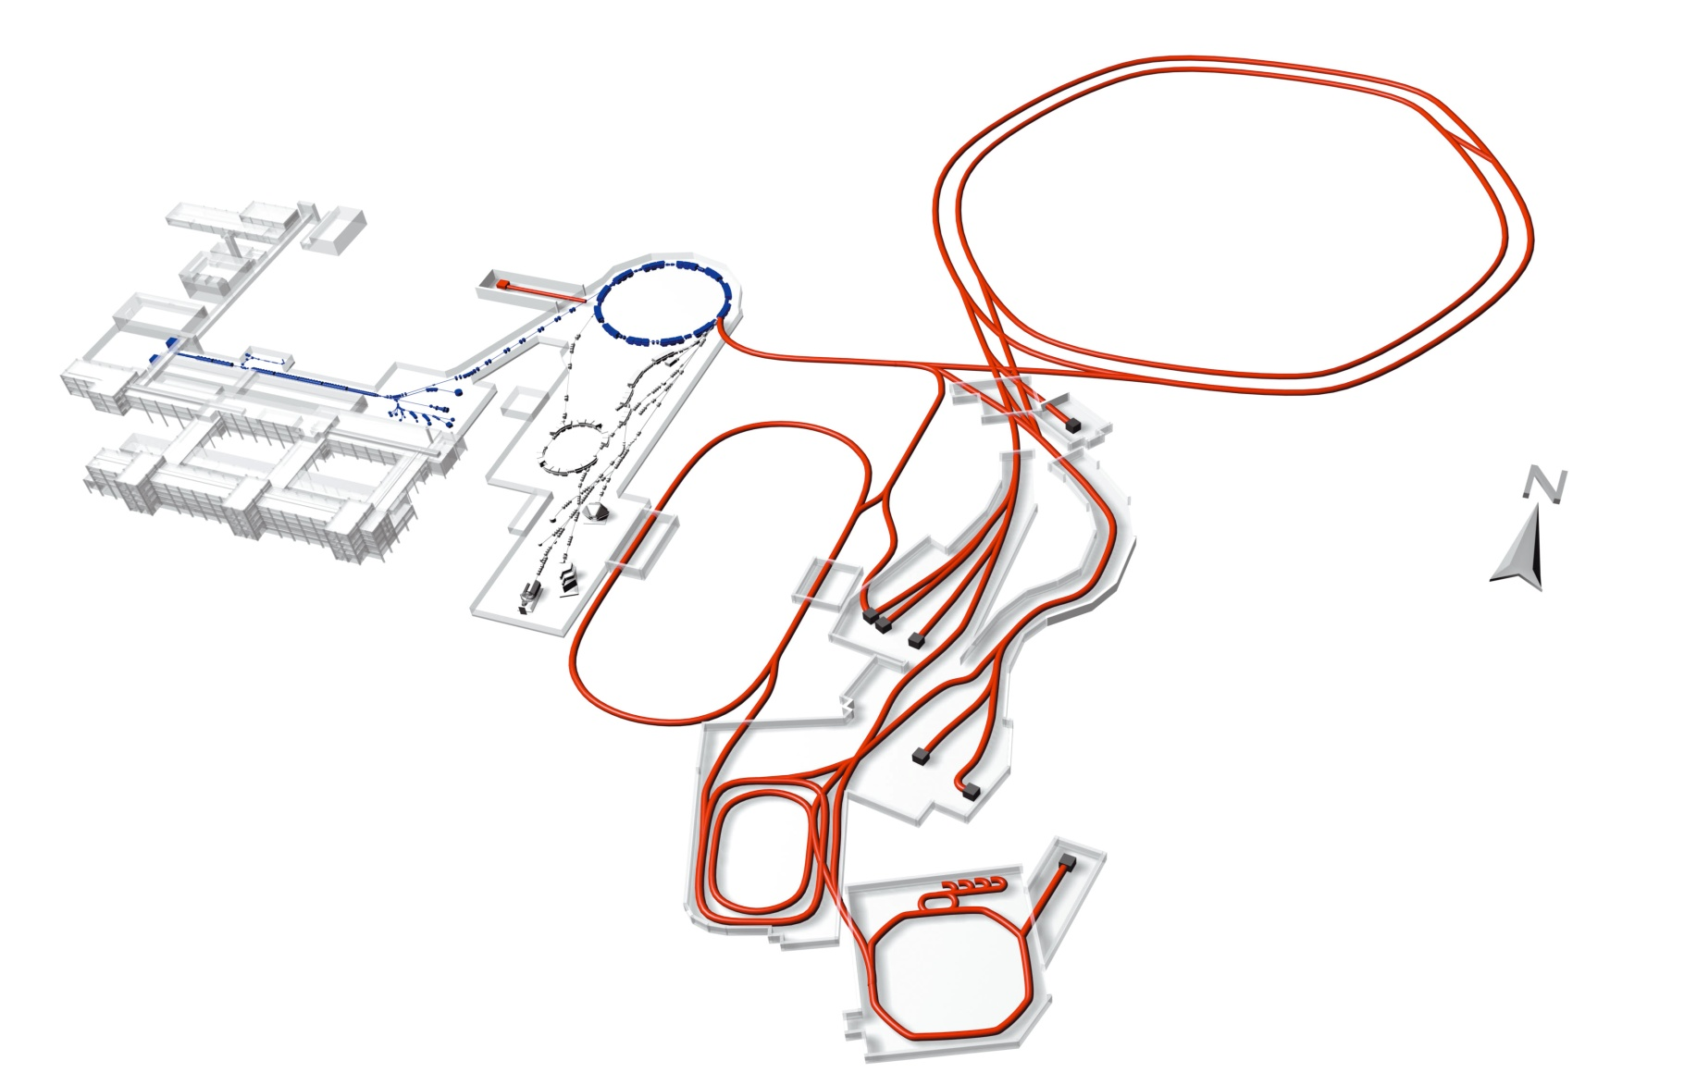
FAIR Project
GSI
SIS18
SIS 100/ SIS 300
HESR
Super-FRS
100 m
SIS100:
protons: 29 GeV 4∙10¹³
U²⁸⁺ 2.7 GeV/u 4∙10¹¹
RESR/CR
NESR

Slide 4
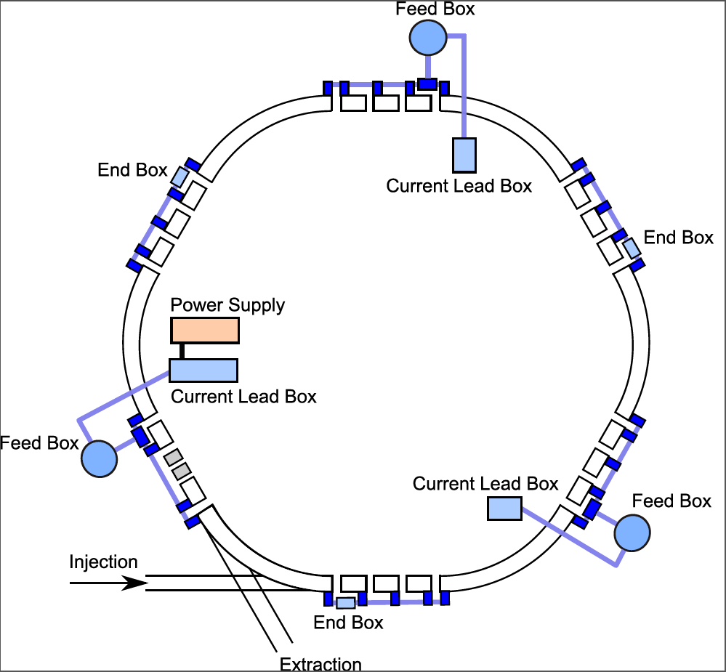
SIS100 synchrotron
SIS100 ring:
6 independently cooled sectors
18 dipole modules per sector
14 quadrupole doublets per sector
acceleration cycles up to 1 Hz

Slide 5
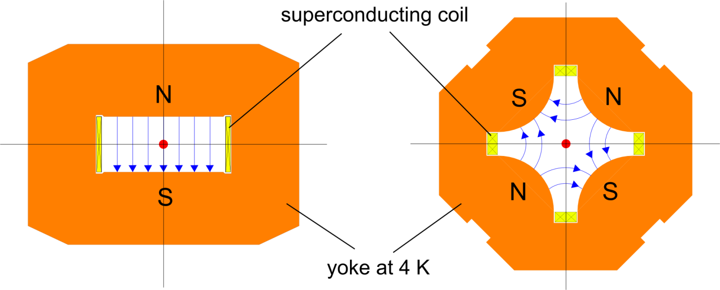

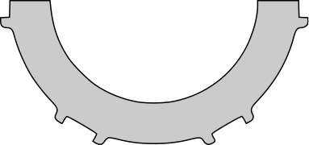
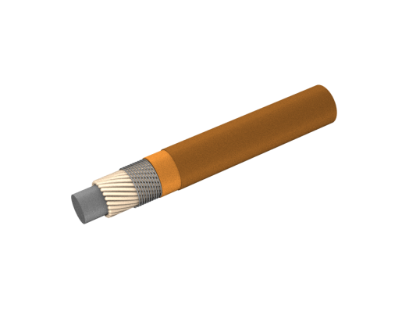
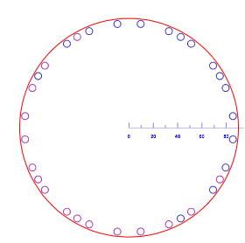
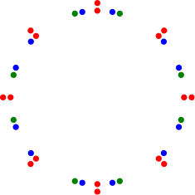
Fast Ramped Super-ferric Magnets
Main dipole: B_{max} = 1.9 T, dB/dt = 4 T/s, 1 Hz
108 dipole magnets
166 quadrupole magnets
149 corrector magnets
Nuclotron type cable
steering
magnet
sextupole
multipoe
corrector
NbTi wires
CuNi cooling tube
Di = 4.7 mm / 4.0 mm

Slide 6
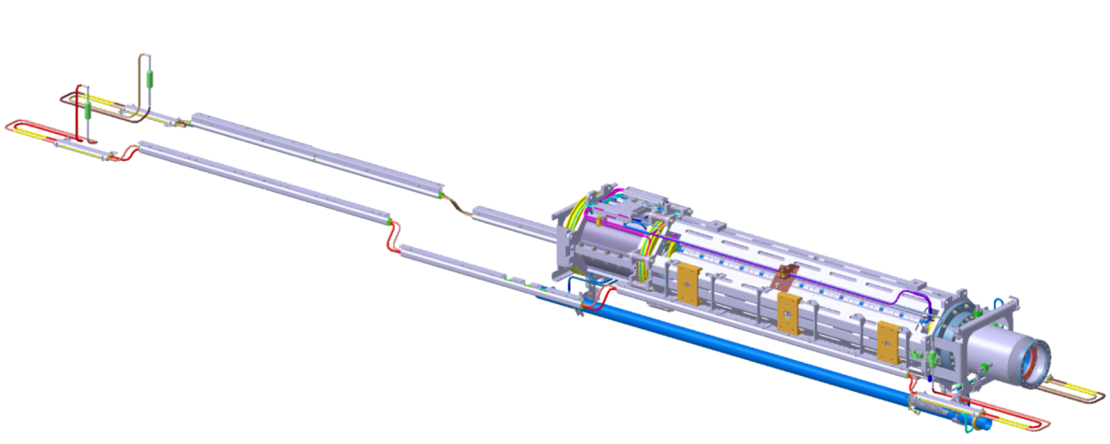
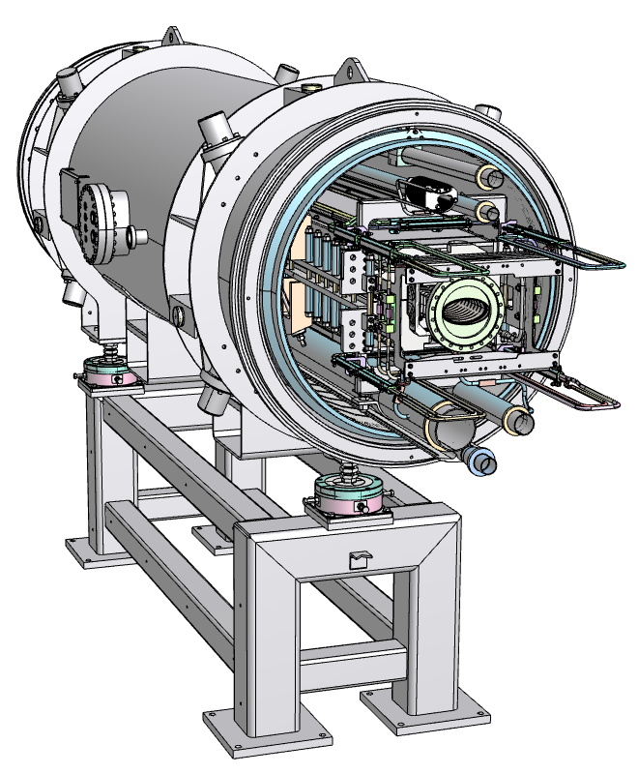
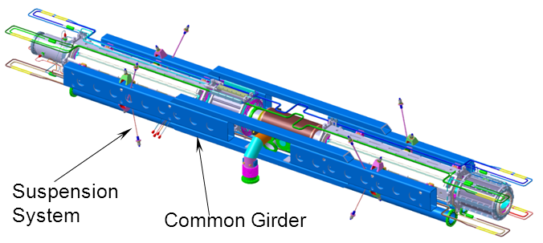
SIS100 Magnet Modules
SIS100 dipole magnet
quadrupole unit SF2B:
quadrupole, steerer, Beam Position Monitor
cold mass of the quadrupole doublet

Slide 7
Status of the SIS100 Magnet Modules
Dipole Magnet Modules:
series production and testing
started in 2017
Quadrupole Units:
2 first-of-series units produced and tested in 2017
series production will start in autumn 2018
Quadrupole Doublet Modules:
integration of the first-of-series doublet will start
in September 2018
start of the series production in 2019

Slide 8
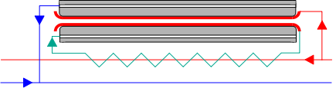
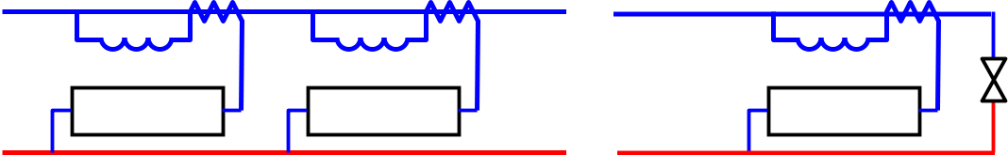
SIS100 Magnet Cooling
3
point 1: – sub-cooled helium
P_{in} = 1.5 – 1.8 bar, T_{in} = 4.5 K
P_{out} = 1.25 bar
1
P_{in}
2
2‘
Heat load:
static: 7 W
dynamic: up to 40 W
P_{out}
P_{in}
ΔP = P_{in} - P_{out}
P_{out}
Required mass flow rate: depends on the total heat load, static and dynamic
hydraulic resistance of cooling channels is defined by the coil and bus bars:
yoke cooling tube: d = 10 mm
dipole coil and bus bars: d = 4.7 mm , L = 108 m
quadrupole coils and bus bars: d = 4.7 mm, L = 63 – 67 m
corrector coils and bus bas d = 4.0 mm, L = 17 – 45 m
flow restrictor d = 2.0 mm, L - to be adapted

Slide 9
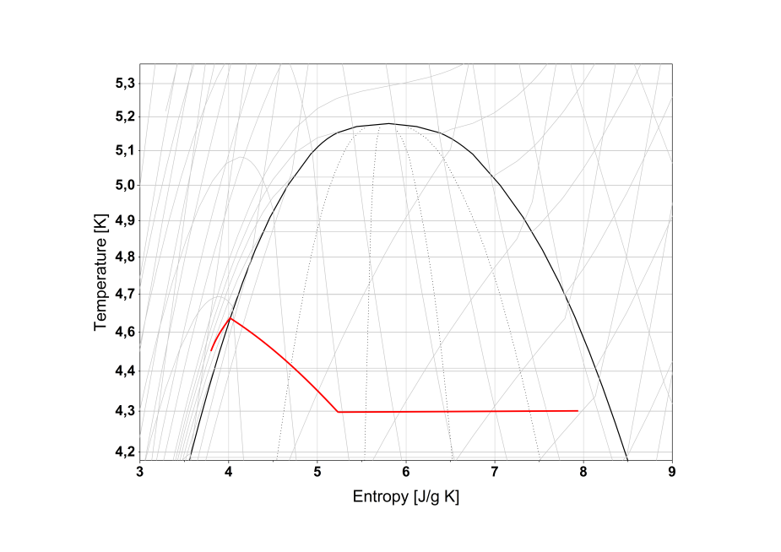
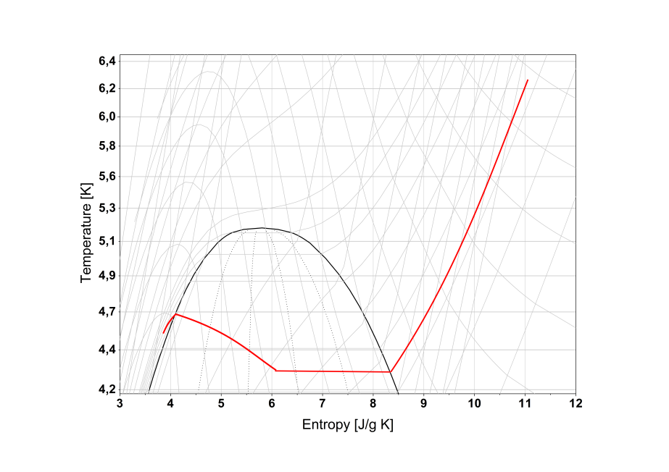
SIS100 Magnet Cooling
3
point 1: – sub-cooled helium
P_{in} = 1.5 – 1.8 bar, T_{in} = 4.5 K
P_{out} = 1.25 bar
1
P_{out}
2
2‘
Heat load:
static: 7 W
dynamic: up to 40 W
P_{in}
3
1
3
1
2, 2‘
2, 2‘
ΔP = 0.37 bar
ΔP = 0.23 bar
Pressure difference can be set up to 0.55 bar → add flow restrictor on the inlet

Slide 10
SIS100 Operating Modes
injection from SIS18
ramp up at 4 T/s
I_{max} = 13 kA for dipoles
extraction (slow or fast)
ramp down at 3.5 T/s
Quadrupoles:
I_{max} = 10.5 kA (proton cycle)
only for F1
ref. cycle = Triangular RIB
with I_{max} = 7.7 kA
reference cycle for dipoles and for quadrupoles:
1 Hz triangular RIB cycle 2.7 GeV

Slide 11
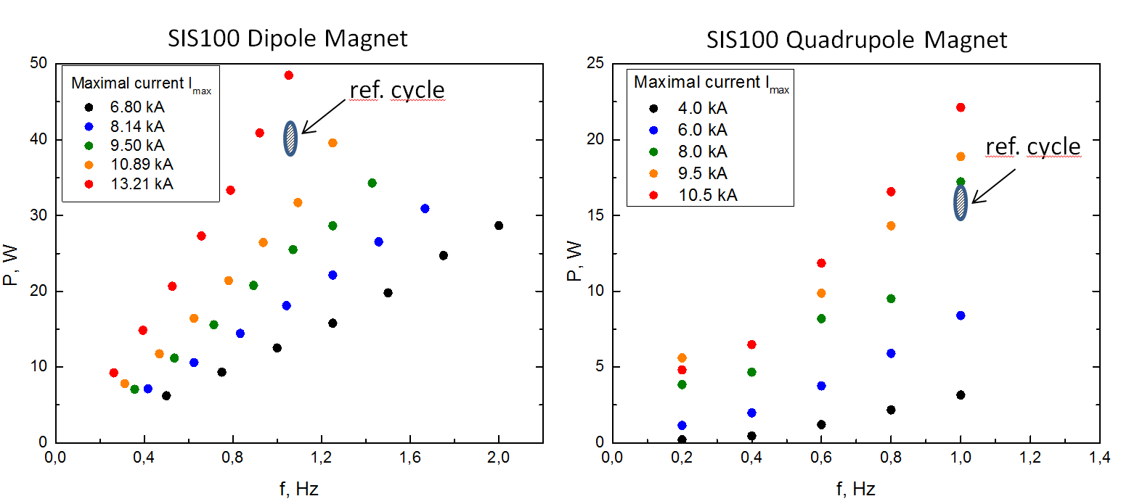

Dynamic heat load
triangular cycle:
$$f=2I_{max}/\dot{I}$$
reference cycle: 1 Hz triangular RIB cycle 2.7 GeV

Slide 12
Corrector Cycle
corrector magnets:
coils are connected in series with quadrupole coils
specified for bipolar operaion ± 250A
specified for 3 Hz operation
sextupole and steerer succesfully tested at 3 Hz
worst case scenario for SIS100: 1 Hz

Slide 13
Quadrupole units
15 types of QP units
7 main configurations of cooling channels
Configuration | Arc | Straight | Arc Term | Total
no corrector magnets (QP only) | 36 | 17 | 6 | 59
sextupole + QP | 18 |  |  | 18
steerer + QP | 18 | 17 | 12 | 59
steerer + sextupole + QP | 24 |  |  | 24
steerer + gt- jump + QP | 12 |  |  | 12
Multipole corrector + QP |  |  | 6 | 6
Multipole corrector only |  |  | 6 | 6
injection/extraction quadrupoles
missing dipole modules
bypass line sections
Length of the capillary – to be defined for each configuration

Slide 14
Conclusions
the hydraulic resistances of the parallel cooling channels will be adjusted
by adding additional flow restrictors - a capillary with 2 mm inner diameter
The reference cycle for the hydraulic adjustment represents the
“worst case” scenario of SIS100 operation with respect to the head load
the length of the flow restrictor must be adapted to assure a reliable
operation for the reference cycle
each adjusted dipole magnet and quadrupole unit will be tested at
cryogenic conditions

Slide 15
Quadrupole unit SF2H
SF2H

