Slide 1
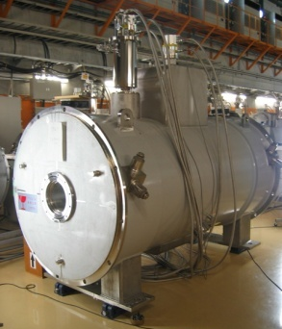
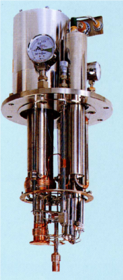
Long-term Operation of the Superconducting Triplet Quadrupoles (STQ) with Cryocoolers for BigRIPS In-flight Separator at RIKEN
Contents
KUSAKA Kensuke
RIKEN Nishina Center, BigRIPS Team
Introduction
BigRIPS & BI-beam Delivery line
STQ with cryocoolers
Operational Experiences
Maintenance
Long-term Operation of Cryocoolers
Troubles

Slide 2
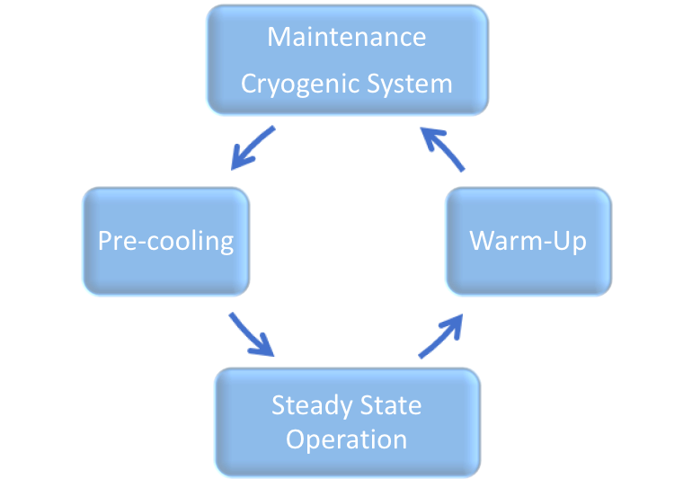
Introduction
Standard Operation of
SC Magnets
Fabrication
Thermal Cycle Operation
Operation of SC Magnets with Cryocoolers
Excitation
Excitation
Cold Maintenance
Cold Maintenance
Repeat . . . .
Never warm up SC magnet
Continuous operation of cryocoolers
longer than 10 years

Slide 3
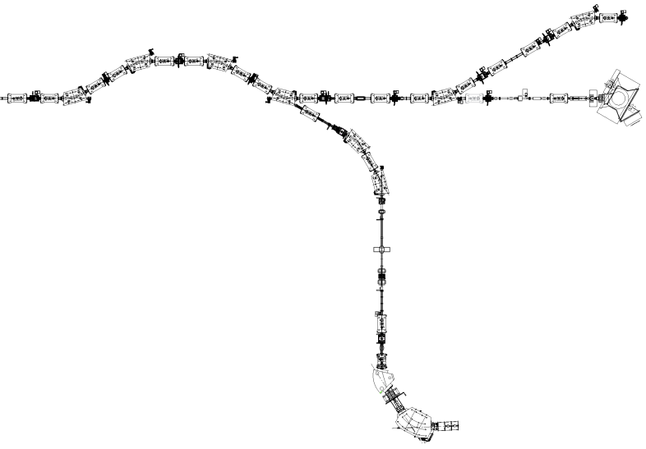
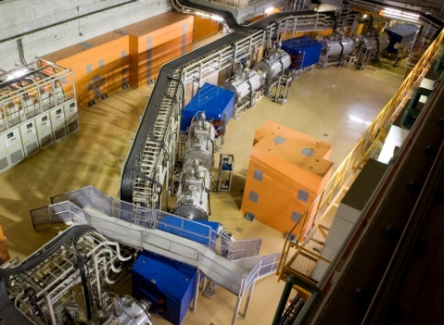
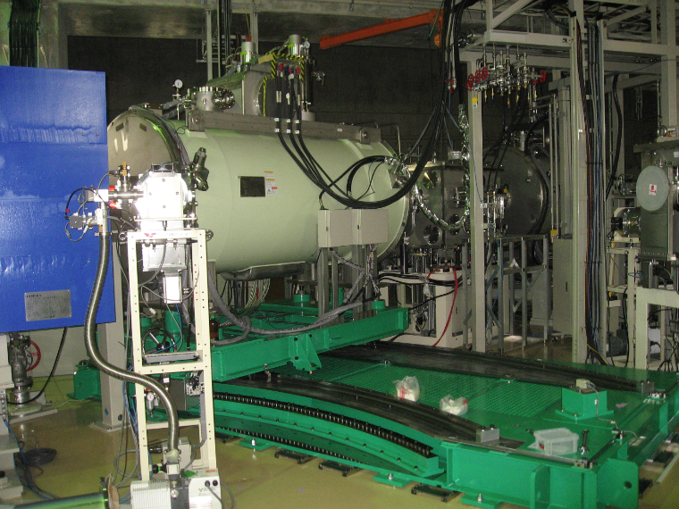
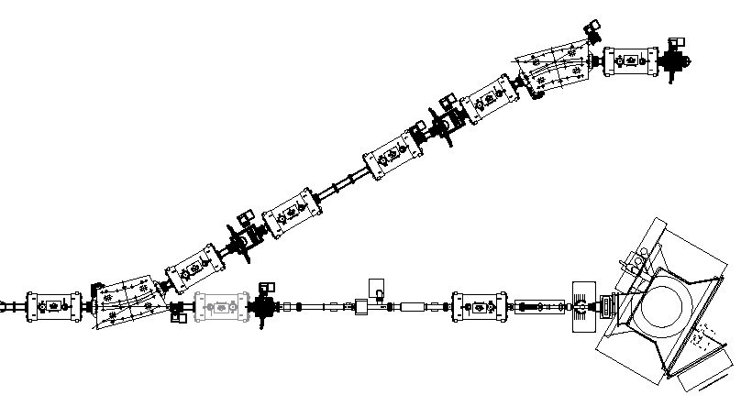
BigRIPS and RI-beam Delivery Lines
Unique large aperture (ID 240mm) 100m-long Beam Lines
consists of 22 “Stand-alone”
Superconducting Triplet Quadrapoles
STQ with Cryocoolers
No Transfer Line needed
Flexible in beam-line design
STQ18 on circular motion stage
STQ18 is used in 2 beam lines

Slide 4
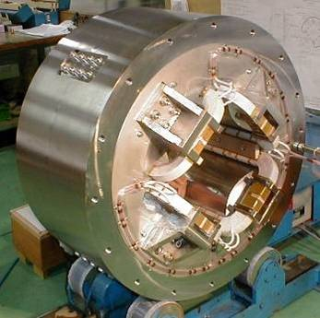
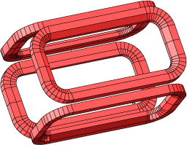
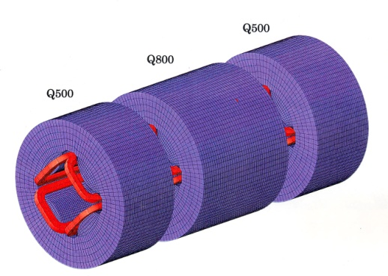
STQ Magnet Specification
 | Q500/Q800/Q100
Field gradient [T/m] | 14.1
Conductor size [mm] | φ1.15
Cu/super ratio | 6.5
# of turns | 1405
Ic/Iop | 3.5
Nominal current [A] | 142 / 137 / 135
Current density [A/ mm²] | 115 / 110 / 109
Stored energy [MJ] | 0.13 / 0.19 / 0.27
NbTi
Superferric
Flat Racetrack Coil
 | Q500/Q800/Q100
Effective length [m] | ~ 0.54 / ~0.84 / ~1.04
Pole-tip dia. [mm] | 340
Warm bore dia. [mm] | 240
Length of iron [mm] | 440 / 740 / 940
OD of yoke [mm] | 960
Q500
Q800/Q1000
Q500
Triplet in single cryostat
LHe bath cooling
Total Cold mass ~ 9.4/10.2 tons
Conservative LTS Quads

Slide 5
STQ with Cryocoolers
Shield & PL Cooler
4K Cooler
Single-stage GM cooler
90W@80K
GM/JT cooler
2.5W@4.3K
SHI CG110
SHI CG308
HTSC PLs
Cryocooler with Gas Driven Displacer
Key of Cold Maintenance
room-temp. displacer can be put
in cold cylinder
He Vessel
LHe ~500 L
Small Heat Load < 2W
Large Cold Mass ~10 ton
Unique Thermal Cycle operation

Slide 6
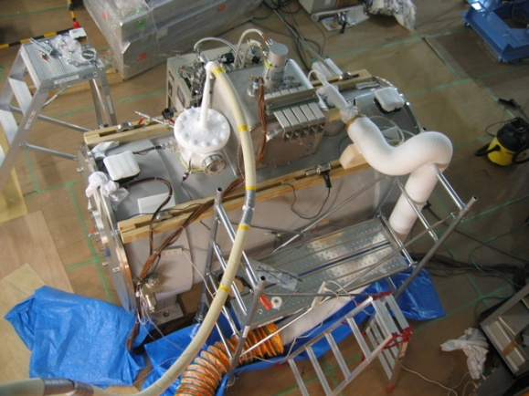
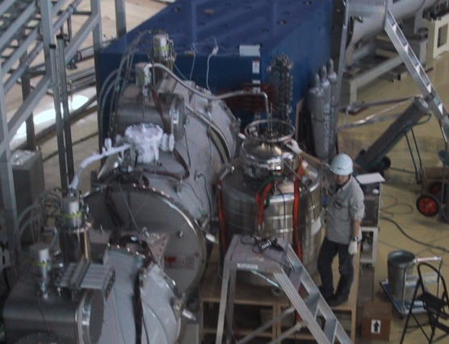
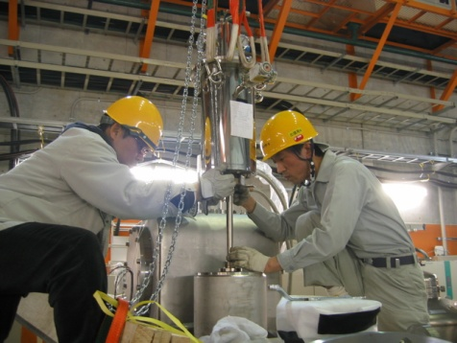
Precooling
2005 ~ 2006
Room T (~300K) to 80 K
80 K to 4.5 K
Continuous
Operation
of
Cryocoolers
Transferring liquid N
from CE tank
Transferring liquid He
from Dewar
GM/JT Cooler
Mounting
after precooling
3000 ~ 4000 L
~ 2000 L

Slide 7
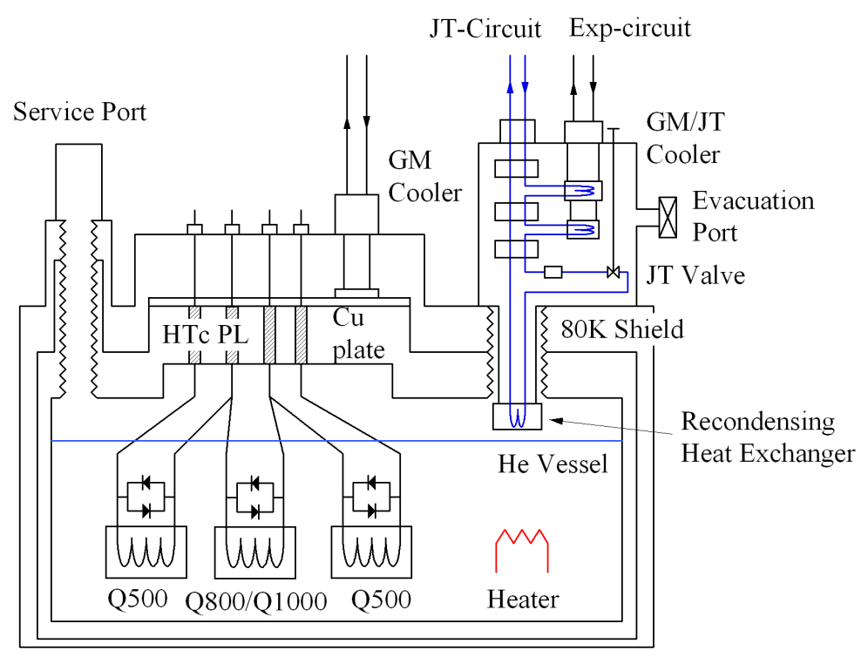
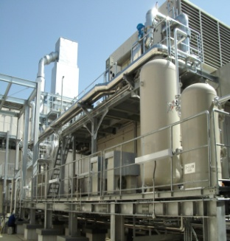
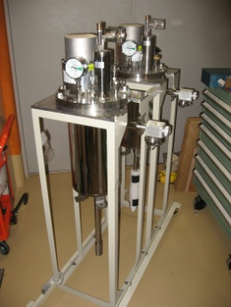
Operation of Cryocoolers & STQ
2007 ~ Present
Pressure of He vessel
Kept in 7 ~8 kPaG
> P atmospheric
Heater in vessel（2W) ON/OFF control
P
Heater Output
Cooling capacity of GM/JT cooler (2.5W)
Fine tuning by JT valve (once ~ twice /year)
Excitation of Magnets
PL temp. interlock < 70K
He loss occurs when P > 20 kPaG
LHe level interlock > 80%
Cracking Pressure of safety check valve
Spare Cryocoolers
& Compressors
Back-Up of Electric Power & Cooling Water
6500 kW- Power Class
Gas Turbine Cogeneration
Electric Power -> RIBF CGS & TEPCO
2 independent Cooling Water Systems
Regular maintenance of Cryocoolers (yearly)

Slide 8
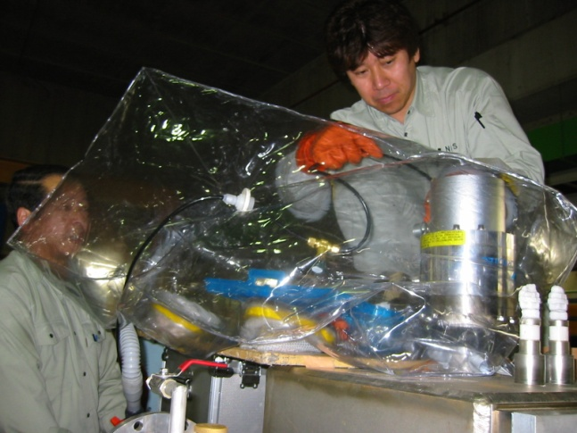
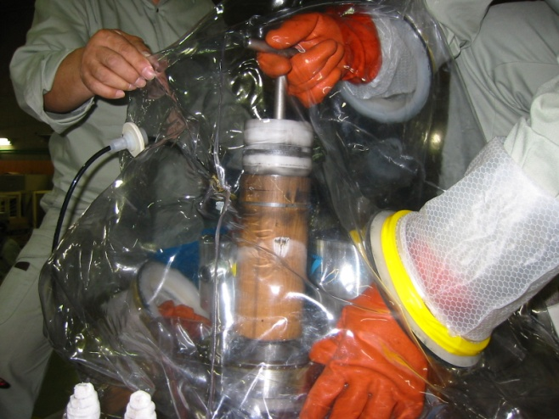
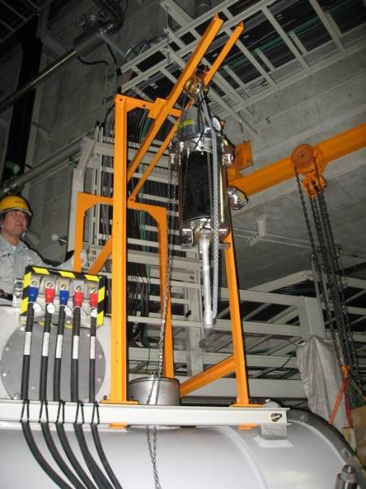
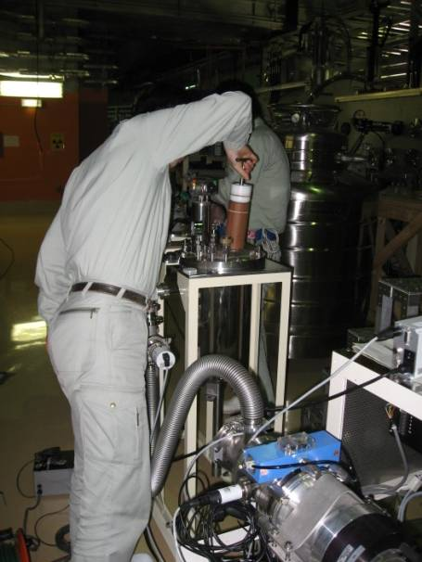
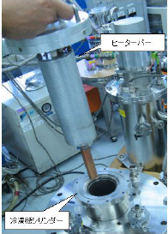
Cryocooler Maintenance
Magnets in Cold State
GM Cooler Maintenance（Cold Maintenance）
Well-established by
Cryocooler maintainers
helium-purged gas bag
Exchange displacers
GM/JT Cooler Maintenance
Displacer Replacement
JT-circuit flushing
Heater-bar maintenance
without dismount GM/JT cooler from cryostat
1. Take out cold displacer
2. JT-flushing with heater
in Exp. displacer cylinder
3. Insert new displacer
Till 2008 warm maintenance
From 2009 to present
70~80 L of He loss
less than 10 L of He loss

Slide 9
A Long-term Trend of Temperatures, LHe levels, etc.
e.g. STQ7 (from Jan. 2008 to Jul. 2018)
PL & GM head Temperature
Discharge & Suction Pressures of GM comp.
GM cooler degradation
by blocked gas flow in displacer
Scheduled (yearly) Maintenances
Rise of GM head, PLs & Shield Temp.
LHe Level, Shield Temp., excess cooling capacity (ave. heater output P)
Constant LHe Level & well-cooled (< 70K) PL Temp.
Safe excitation of Magnets

Slide 10
A Long-term Trend of Temperatures, LHe levels, etc.
e.g. STQ17 (from Jan. 2008 to Jul. 2018)
Unexpected rapid rises of GM head Temp.
Rapid Increase
Scheduled (yearly) Maintenances
Unscheduled maintenances
flushing comp.
Degradation of cooling capacity of GM/JT cooler
JT-circuit blockage
T_{4K} ~ 4.75K (4.3~4.5K)
Temp. of Expander Head
T_{exp} ~ 16 K (<14K)
He loss, p_{vessel} > 20 kpaG
GM/JT cooler replaced
Cooling capacity recovered after warm-up

Slide 11
Unscheduled Maintenance of GM coolers & replaced GM/JT coolers
Unscheduled Maintenances
of GM coolers
Replaced (deteriorated) GM/JT coolers
Year | STQ system
2008
2009 | STQ8
2010 | STQ8, STQ11
2011 | STQ9
2012 | STQ6, STQ8, STQ9, STQ14, STQ18
2013 | STQ16
2014
2015 | STQ17
2016 | STQ9, STQ10, STQ25
2017 | STQ21
 | Date of Stop | Operation time from maintenance (total) | Reason
STQ17 | May 2011 | 6,476 (38,773) h | T_{JT} ~ 4.8K
STQ17 | Jun 2012 | 6,719 (47,913) h | T_{exp} ~ 16K
STQ13 | Mar 2013 | 5,113 (69,439) h | T_{exp} ~ 23K
STQ15 | Nov 2014 | 1,518 (82,003) h | T_{exp} ~ 18K
STQ10 | Nov 2014 | 1,855 (83,017) h | T_{exp} ~ 17K
STQ11 | Jun 2017 | 5,983 (106,985) h | T_{JT} ~ 4.6K
T_{exp} < 14K
Normal temp. of GM/JT cooler
T_{JT} 4.3 ~ 4.5 K
operation time
from last maintenance
1,200~6,700 h
Few hours beam time stops

Slide 12
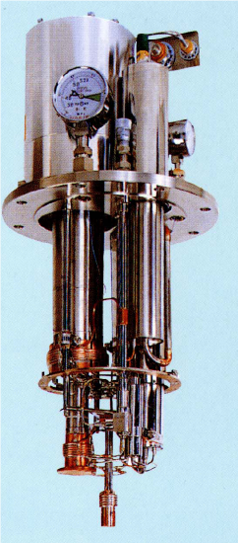
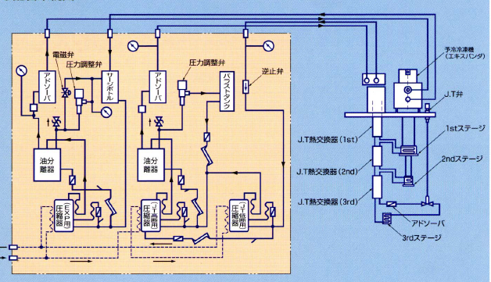
Hardware failures
GM/JT compressor (STQ24) t_{op} 17,245 h
Exp. Comp
Replaced
Malfunction of Exp. Rotary Comp. (foreign substance)
GM compressor (STQ14) t_{op} 60,086 h
Whole Unit
Replaced
Gass flow decreased 20%, (Oil SP, P-control valve )
GM/JT compressor (STQ11) t_{op} 71,775 h
PLC Replaced
Many sudden Stops (PLC error)
JT valve of GM/JT cooler
STQ18 t_{op} 69,190 h
STQ19 t_{op} 78,737 h
JT valve Replaced
cold head T didn’t change
Schematic Diagram of GM/JT cooler system
Aging deterioration of sensors
sudden stop of comp.
(P-sensor in HP line)
Expander
P-cntrl
valve
P-cntrl
valve
check
valve
GM/JT comp.
Surge Tank
ADS
ADS
Ballast Tank
JT Tuner
(Micrometer)
STQ16 t_{op} 70,087 h
STQ11 t_{op} 82,448 h
STQ20 t_{op} 100,023 h
STQ21 t_{op} 100,563 h
1st Stage
JT EX (1st)
Oil
SP
Oil
SP
2nd Stage
JT EX (2nd)
GM comp.
JT EX (3rd )
JT valve
STQ23 t_{op} 89,603 h
STQ6 t_{op} 103,855 h
Comp
Comp
Comp
Adsorber
Re-condensing
Exchanger

Slide 13
Summary & Conclusion
We have developed STQ with Cryocoolers
We improved the maintenance of GM/JT coolers
Heater bar maintenance to reduces He loss
We operate 22 STQ systems for more than 10 years without warming up magnets.
Yearly maintenance is essential to avoid degradation of cooling capacity.
Unexpected rise of GM head temperature is under investigation. (impurity of coolant gas He)
Hardware failures by aging are becoming noticeable.
Preparing spare coolers & compressors are essential.
Solid infrastructure (electric power & cooling water) is important for long-term operation.

Slide 14
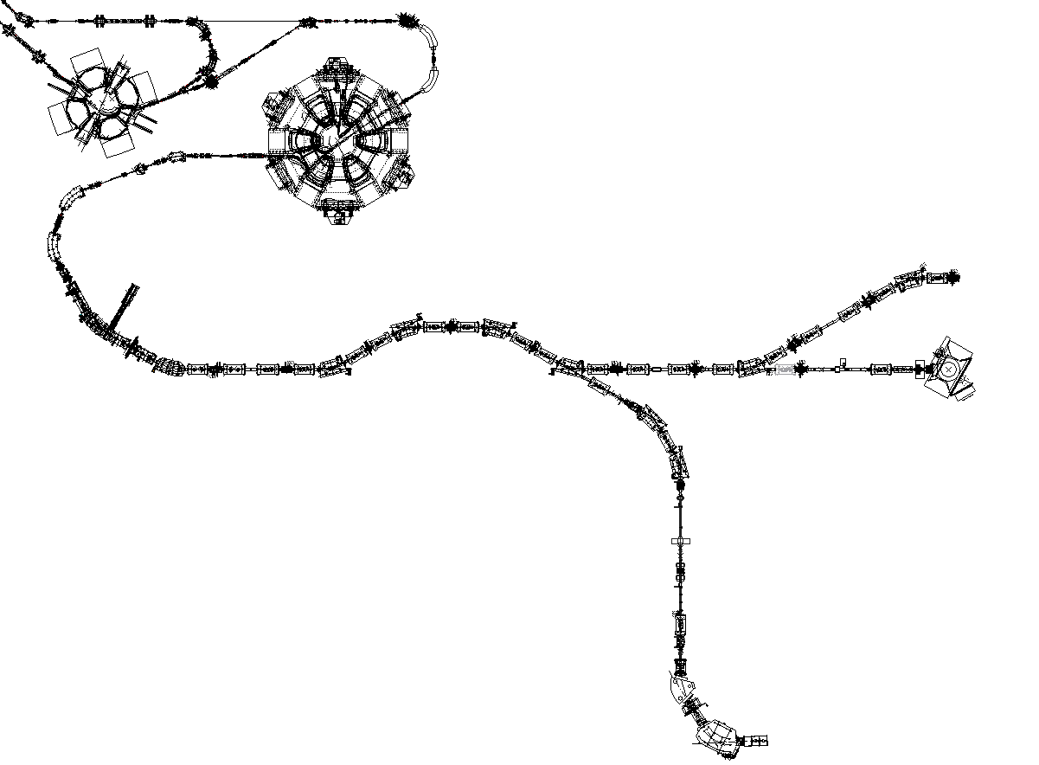
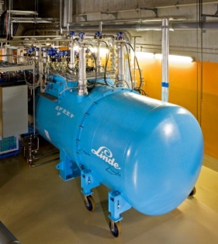
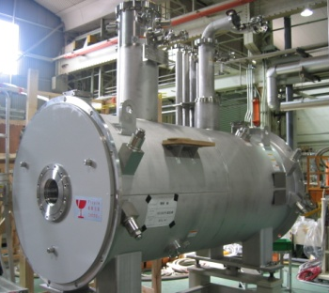
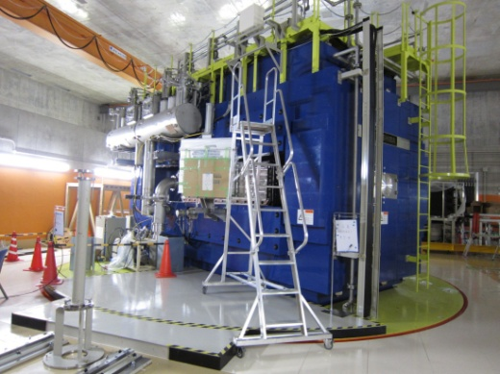
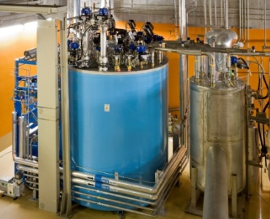
RIBF Cryogenics
100m-long beam lines formed by
Stand-alone Superconducting Quads
22 STQ’s
Cooled by Cryocoolers
IRC
Linde TCF200
BigRIPS
1st Stage
SRC
SAMURAI
SHI CG308
5 STQ cooled by
Cryogenic Plant
Charactorized by
Beam Heat load
to Cryogenic System
Large Heat Load Fluctuation!
3T 880mm-gap
Superconducting Dipole
Cooled by Cryocoolers
Linde TCF50S

Slide 15
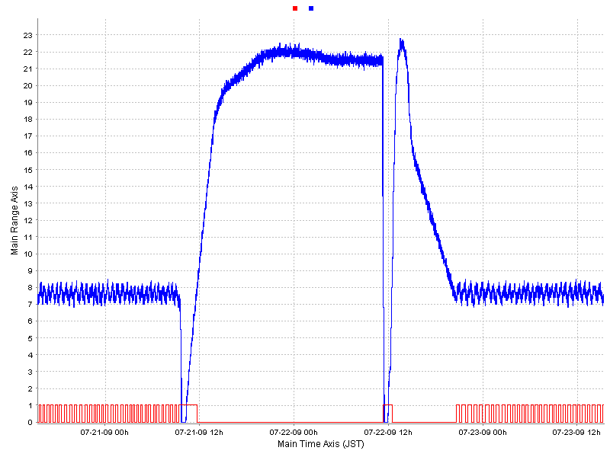
He Loss during maintenance
STQ14 4K ref.
Check valve
P Relief =3psi
P [kPaG]
24h warm-up for JT flushing
LHe Loss
Level 82% -> 59%
~60L
1.5day
Compressor Stop
& Dismount cryocooler
Mount &
Restart compressor
Blow to reduce P of He vessel
Stop of compressor longer than 30h
70~100L of LHe transfer / 1 STQ

Slide 16
Improvement of GM/JT Cooler Maintenance II
Heater-bar maintenance
JT flushing without dismounting
cryocooler from cryostat
He vessel Pressure during maintenance
Warm-up JT circuit by heater-bar
in Expander Cylinder
Level 87% -> 85%
LHe Loss
~ Few L
Compressor
Stop
~5h
P [kPaG]
STQ17
Restart
50~70L of LHe transfer / STQ in 2~3 years
Save ~ 1000L of LHe / year !

