Slide 1
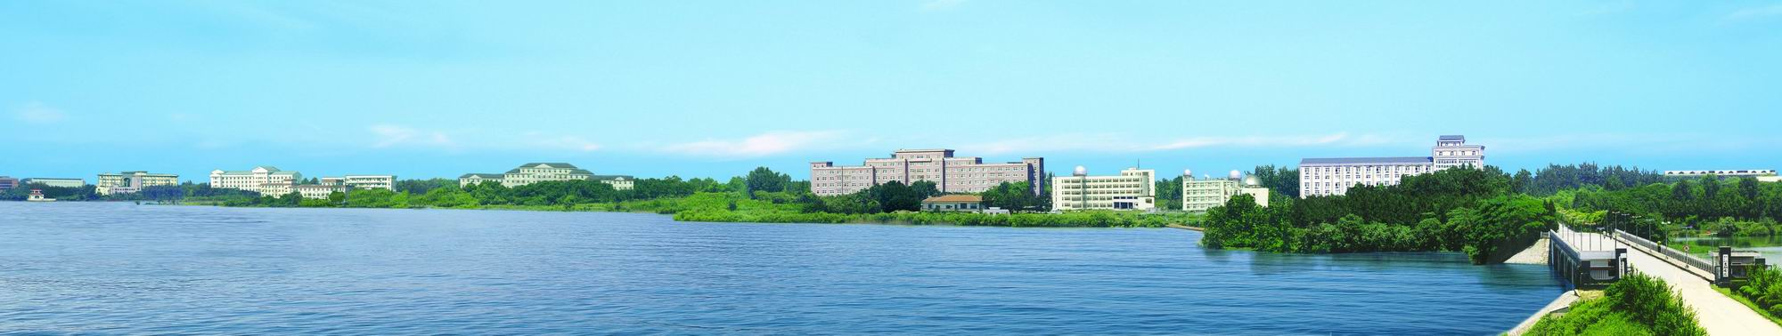
Thermohydraulic behaviour of the cryogenic system
during protected quenching of the superconducting magnet
of a hybrid magnet
Junjie LI
High Magnetic Field Lab, CAS
18/9/3

Slide 2
Contents
1. About the CHMFL
2. The helium cryogenic system
3. Thermal behavior of cryogenic system
during quenching protection
4. Conclusion

Slide 3

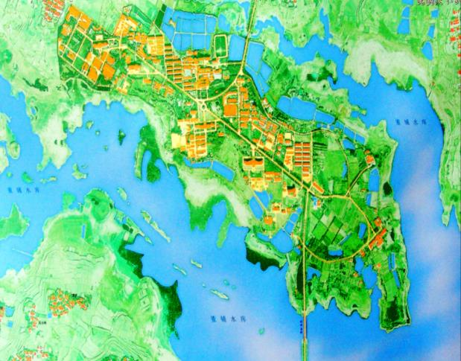
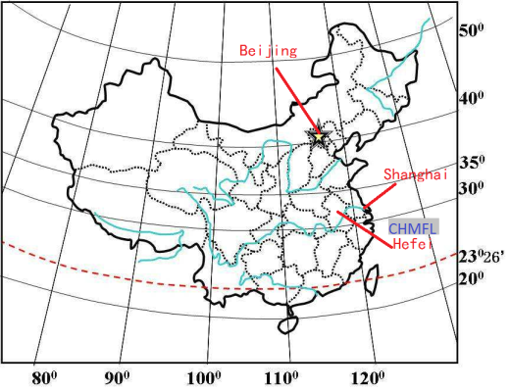
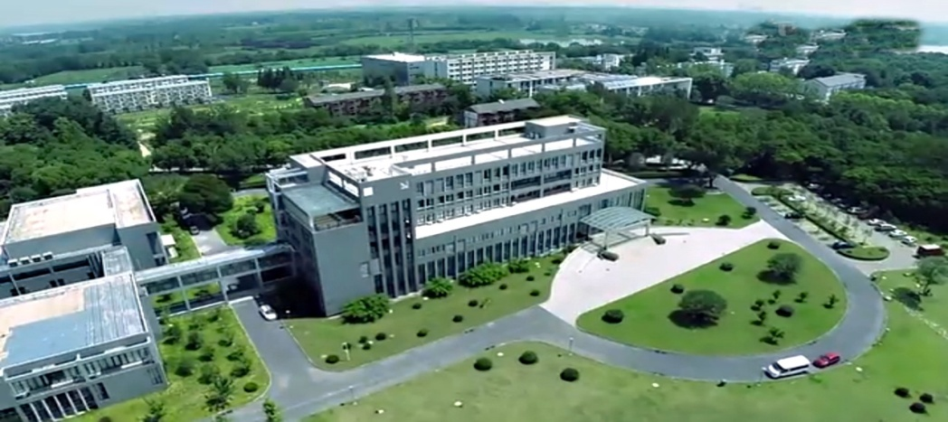

About the CHMFL
Nijmegen
the main missions of the Lab (from May 2008):
1）Develop series of high field magnets (hybrid magnets, superconducting magnets and water-cooled magnets)
Water-cooled magnets (resistant magnets) | WM1 | 38.5T@32mm
 | WM2 | 25T@50mm
 | WM3 | 20T@200mm
 | WM4 | 27.5T@32mm
 | WM5 | 35T@50mm
Superconducting magnets | SM1 | 8T@100mm
 | SM2 | 20T@50mm
 | SM3 | 18.8T@54mm
 | SM4 | 9.4T@400mm
Hybrid magnets | HM1 | 45T@32mm
Tsukuba
Tallahassee
Grenoble
Hefei
2）Research on physics, functional material, chemistry, life sciences and pharmacology in the extreme high magnetic field
TMS | Transport Measurement System @Closed Cycle Refrigerator
MPMS | Magnetic Property Measurement System
MOMS | Magneto-Optical Measurement System
SMA | STM-MFM-AFM Combo System
HPMS | High Pressure Measurement System
ULTES | Ultra Low Temperature Experiment System

Slide 4
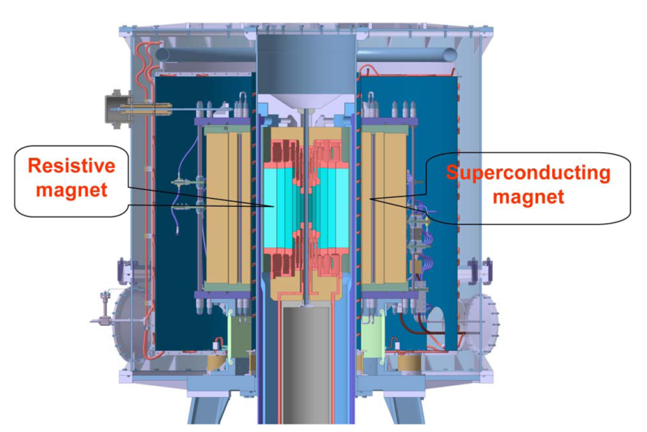
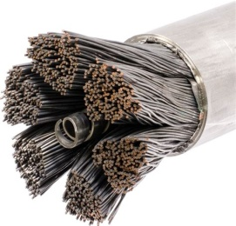
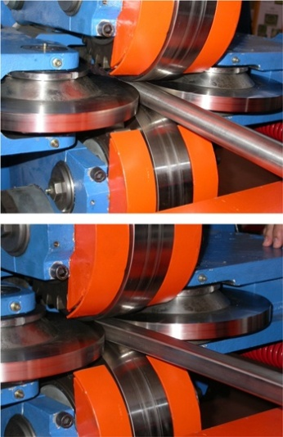

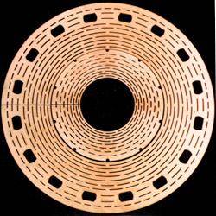
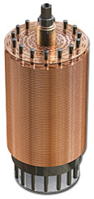
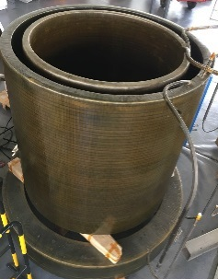
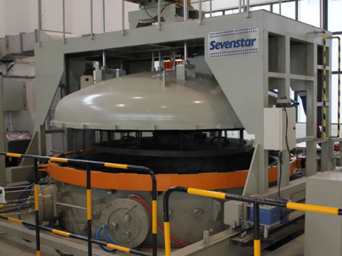
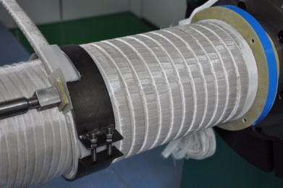
About the CHMFL
Hybrid Magnet
Combined system | Field | Operating temperature | conductors | Clear bore
Superconducting magnet (outsert) | 11T | 4.5 K | CICC | 800mm
Water-cooled magnet (insert) | 34T | Room temperature | Florida- Bitter Disc | 32mm
Superconducting coils are wound by Nb₃Sn cable-in-conduit conductors (CICC) which are cooled by 4.5K supercritical helium @ 4.2 bar.
Cooling water
10℃，850m³/h
Supercritical helium
4.5 K, 18g/s

Slide 5
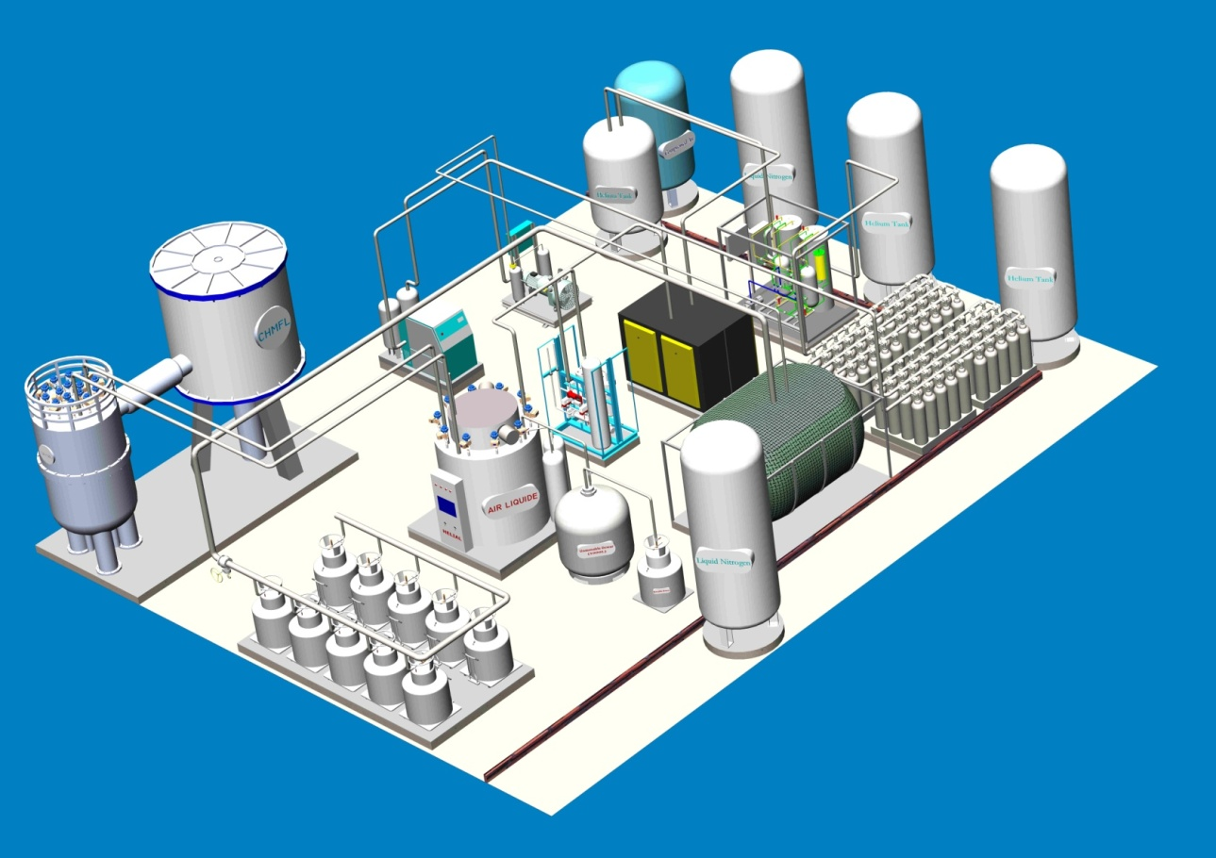

The helium cryogenic system
Requirement of cryogenics
Our team are in charge of the design, building, commissioning and operation of the helium cryogenic system with functions as follows:
Supply 4.5 K supercritical helium for the hybrid superconducting outsert .
(heat load : ~100W@4.5K)
Supply liquid helium for other superconducting magnets and cryogenic experimental facilities.
(50000 L/year)
Hybrid magnet
Helium refrigerator
Helium purifier
Recovery compressors
2,400
Million
Gasbag
Facility hall
Experimental building
Cryo-distribution box
Liquid helium station
The capacity of helium refrigerator is 360W @4.5 K.
Magnet workshop

Slide 6
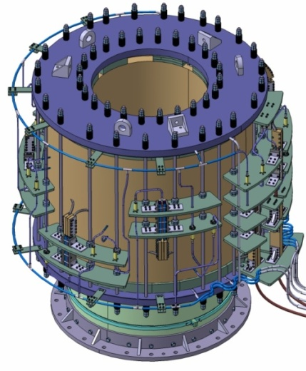
The helium cryogenic system
Cryogenic circuit for the superconducting magnet
6.2 K,4.22 bar
4.5 K,1.25 bar
6.2 K,4.2 bar
4.5 K,4.2 bar
5.4 K,3 bar
4.45 K,1.25 bar
26 cooling channels
channels | length（m）
A-1 | 154.54
A-2 | 160.11
B-1 | 181.26
B-2 | 186.79
C-1 | 208.05
C-2 | 213.58
C-3 | 219.11
C-4 | 224.64
D1-18 | 182.32

Slide 7
The helium cryogenic system
Cryogenic control and safety
object: HP
actuator: PCV280/289
measure: PT290
setpoint: 14.3 bar bas
object: LP
actuator: PCV275
measure: PT275
setpoint: 1.05 bar bas
object: Helium return
actuator: FCV460
measure: PT360
setpoint: 1.2 bar bas
object: LHe pressure
actuator: FCV608
measure: PT110
setpoint: 1.25 bar bas
object: JT valve
actuator: FCV606
measure: PT105
setpoint: 3 bar abs

Slide 8
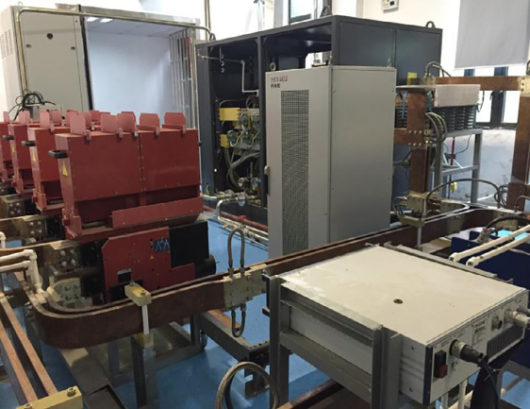
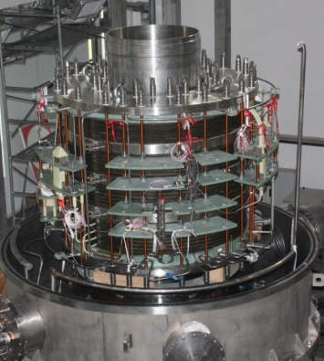
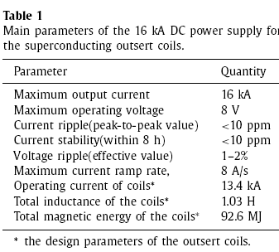
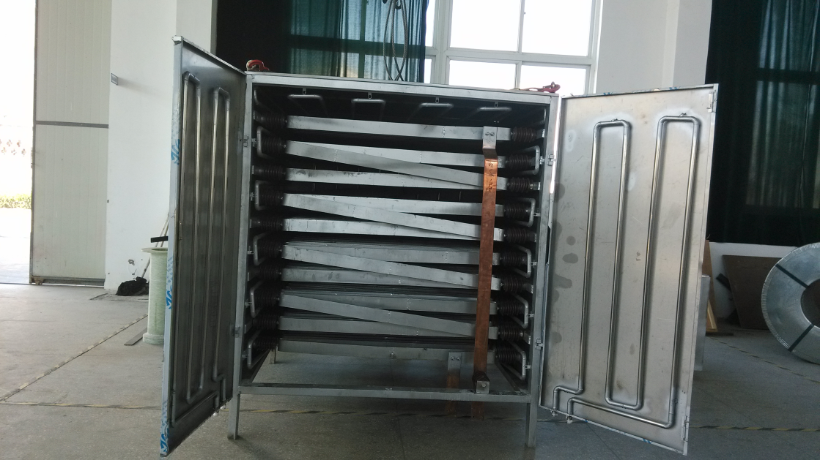
Thermal behavior during quenching protection
Configuration of the quenching protection
Energy dump resistor
Resistance: 0.284 Ω
Mass: ~1 ton
Limiting voltage: 4 kV

Slide 9
Thermal behavior during quenching protection
Process of the quenching protection
Current in the coils decreases exponentially, and reaches 36.8% of the operating current in 3.6s.
99.9% of the energy is transferred to the resistor outsides.
0.1% (~100kJ) of the energy heats the coils in the way of eddy current.

Slide 10
Thermal behavior during quenching protection
Pressure change of the cryo-distribution box
The inlet pressure increases from 4.2 bara to 12.7 bara and the outlet pressure increase from 3 bara to 10.7 bara in 30s.
The pressure of the LHe buffer increases from 1.26 bara to 1.42 bara in 2 minutes.
In the whole process, ~60 L liquid helium are evaporated.

Slide 11
Thermal behavior during quenching protection
Temperature change of the cryo-distribution box
At the first decades of seconds, the heated helium flows to the pipes connected to the both end of the coils, and makes a quick temperature raise in the pipes.
Recovery of the normal temperature distribution in the cryo-distribution box and the cryoplant need about 30 minutes.

Slide 12
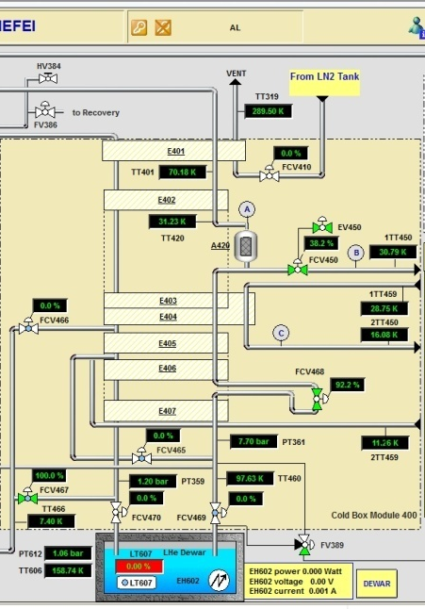
Thermal behavior during quenching protection
Situation of the coldbox
Pressure in the MLI space of the coldbox decrease about 3E-7 mbar.
so much evaporated cold helium makes the heat exchangers inside the coldbox too cold. Temperature after the adsorber decrease ~7K.

Slide 13
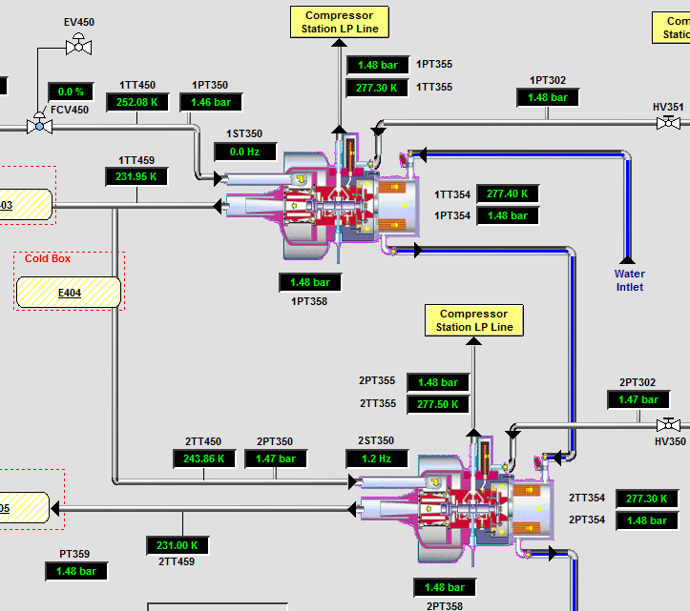
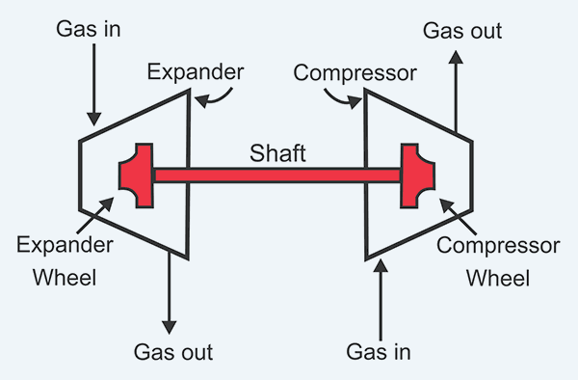
Thermal behavior during quenching protection
Situation of the turbines
T2 speed
T1 speed
T1 braker
T2 braker
Turbines inlet pressure/nozzle pressure
T2 bearings
T1 bearings

Slide 14
Thermal behavior during quenching protection
Situation of the compressor
The by-pass valve PCV275 closed ~10% to increase the discharge capacity of the compressor to recovery the gas helium caused by quenching.
The unload valve PCV289 opened ~6% to transfer the gas helium to the buffer tank.
Only small pressure fluctuations happened to the discharge side(PT290) and the charge side(PT105) of the compressor.

Slide 15
Conclusion
At CHMFL, construction of the helium cryogenic system which have the functions of liquid helium production and hybrid superconducting outsert cooling is finished.
At 4.5 K, the field of the hybrid superconducting outsert is increased to 11 T. Combined with the water-cooled magnet, 42.9 T magnetic field in a 32 mm clear bore is obtained. The field will be increased to 45 T in the future.
During quenching protection of the superconducting coils with maximum operating current, the helium cryogenic system can response successfully.

Slide 16
THANKS FOR YOUR ATTENATION

