Slide 1

Cooling Large HTS Magnet Coils using a Gas Free-convection Cooling Loop connected to Coolers
Michael A, Green
Lawrence Berkeley Laboratory, Berkeley, CA 94720, USA
International Cryogenic Engineering Conference-27

Slide 2
Factors that determine how a Cooler is Connected to the Load
Most small devices (such as electronics) can be connected to the the cooler by conduction through some sort of flexible copper strap.
The method for cooler connection to the load is dependent on a number of factors such as; 1) the distance from the cooler to the load, 2) the physical size of the load, 3) the maximum ΔT in the load, 4) required connection flexibility, and 5) the reliable operating time.
The issues above may mean that a cooler should be connected to the load using a cooling loop.

Slide 3
Why may a cooler moved away from the device?
With large devices, the cooling should be distributed. For various reasons one might want all the coolers together.
If the there is high magnetic field around the device, the coolers must be moved to a place with an acceptable magnetic field.
When distance is a factor, a two-phase He cooling loop is a good way of transmitting the refrigeration to something like large superconducting magnets.

Slide 4
Two-phase Helium Cooling in Pipes
Most large detector magnets have been cooled using forced two-phase He cooling. Three large detector magnets have been cooled using free-convection two-phase He cooling loop from a liquid He tank above the magnet. Free-convection cooling can remove hundreds of watts from a 4.5 K magnet. Cooling for detector magnets comes from a large 4.5 K refrigerators.
In the last 15 years free-convection two-phase cooling in pipes has been used conjunction with small coolers to cool magnets. The largest magnet cooled with He cooling loops is the large cyclotron gas-stopper magnet at Michigan State University.

Slide 5
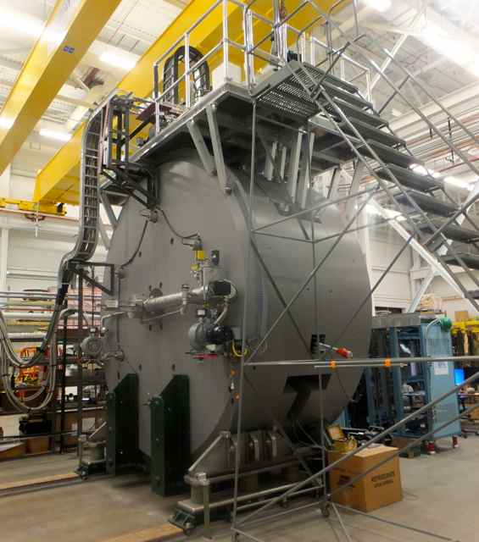
The MSU Experience with Free Convection Cooling
In 2012, MSU decided to cool-down cyclotron gas-stopper magnet using free-convection cooling from six Cryomech PT415 pulse tube coolers. The coolers also liquefy He gas going into the magnet cryostat. With a filled cryostat, the magnet was kept cold using two-phase free-convection He cooling.
When the magnet was first cooled down, the cool-down took 14-days instead of the expected 5-days. On the first try, the cryostat took 7-days to fill. Piping changes were made; the fill time was reduced to < 2 days.

Slide 6
The MSU Magnet Cool-down with Free Convection Cooling
The first MSU magnet coil cool-down using free convection cooling. The mass is 1250 kg and it was cooled using three PT415 coolers. (See the cooling system schematic on right.) Subsequent cool-down took twelve days and two days to fill the cryostat with LHe.

Slide 7
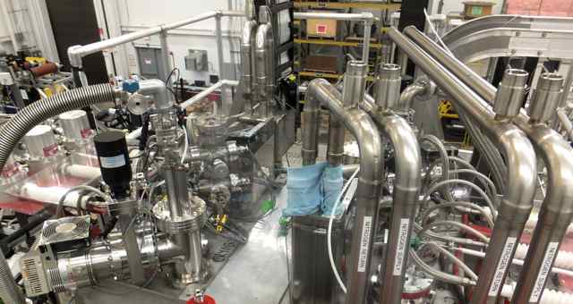
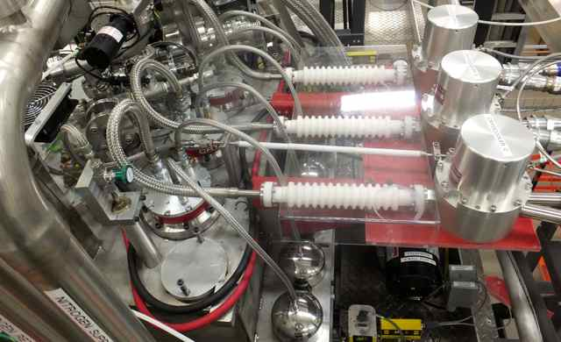
What was learned from the MSU Experience?
The flow space within the coil was too small for a short magnet cool-down.
Magnet shims between the coil and the cryostat caused momentum jumps.
The cryostat pressure was limited by the bellows in the piping. The pressure at the start of the cool-down should be > 4 bar.
There was a flow restriction from one of the coolers, which reduced the the cooling from all three coolers by about one third.
The measured cooler performance above 20 K was less than expected.

Slide 8
Cryomech PT415 Two-Stage Pulsed Tube Cooler
1st Stage
2nd Stage
Two-stage PT415 Cooler
Operating diagram for a two-stage PT415 Cooler

Slide 9
Cool-down with He, H₂ and Ne in a Cooling Loop
1250 kg cryostat cross-section. Tube area = 253 mm⁻². Tube surface are = 0.62 m². Design pressure = 8 bar.
Magnet T (K) versus time, type of gas, and cryostat P (MPa)
Cool-down temperature versus time for He, H₂ and Ne for a coil and cryostat with a mass of 1250 kg. The cryostat pressure are 0.2 MPa and 0.8 MPa. The cooler used is a single Cryomech PT415 pulse tube cooler that produces 1.5 W at 4.2 K.

Slide 10
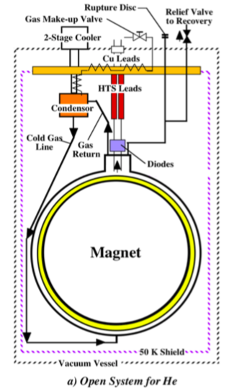
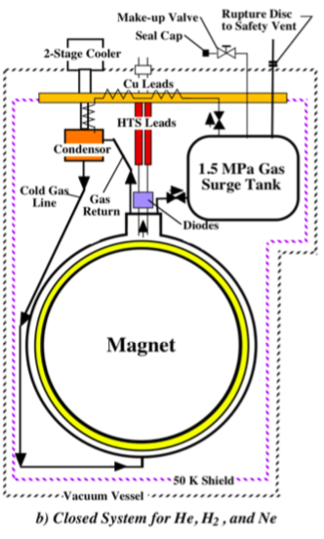
What was learned about Free-Convection Cooling?
A magnet can be cooled-down using various working fluids in the cooling loop.
A He loop can be an open loop. H₂ and Ne loops must be closed loops. H₂ has safety concerns due to flammability.
The shortest cool-down time is with H₂. The cool-down time for a He loop is a little longer. The Ne loop cool-down time is about double that of a H₂ cooling loop.
A helium loop is best from a number of perspectives. Neon is a poor gas to use in a loop.

Slide 11
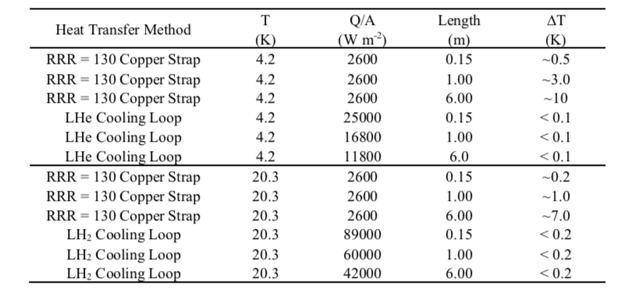
ΔT for a copper strap and cooling loops as a function Q/A and L for two-phase He and H₂ loops.

Slide 12
Gas-phase He or H₂ Cooling in Pipes
Gas cooling of an HTS magnet can be done using coolers. This requires a larger heat exchanger attached to the cooler cold head. The product of the U factor and the heat exchanger area must be an order of magnitude larger than the heat exchanger used for two-phase cooling. A larger heat exchanger will speed up the cool-down. Increasing the cryostat pressure makes single-phase cooling more efficient.
Single phase cooling will always have a larger ΔT between the hottest spot in the load and the cooler cold head than a two-phase system. Depending on the magnet design a ΔT of 5 to 7 K may be acceptable.
A Cryomech AL-325 GM cooler produces a factor of three more cooling in the range from 20 to 40 K than a PT415 two stage pulsed tube cooler. For an H₂ system the cold head must be > 15 K to avoid coolant freezing.

Slide 13

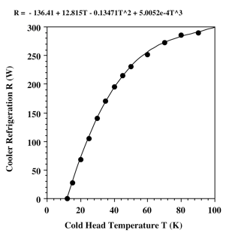
Cryomech AL-325 GM Cooler Parameters
The single stage AL325 cooler goes down to 11 K. The input power to the compressor is 11.4 kW. This cooler is about 12 % of Carnot in the range from 30 to 40 K.
This cooler can’t cool a shield or the tops of HTS leads. A shield and HTS lead intercepts must be cooled using LN₂.
This cooler should be used in a drop in mode to make maintenance easier.
AL-325 Cold Head
AL-325 Cooling as a function of Temperature

Slide 14
The consequences of gas cooling of HTS Magnets
Cooling a magnet with gas has two effects on the cooling system. The heat load into the cryostat from all sources determines the temperature of the cold head cooling the gas. An increase in the heat load into the cryostat also increases the ΔT of the gas in the gas circuit. The combination makes the magnet temperature more sensitive to the heat load into the cryostat.
The sensitivity of the magnet hottest temperature on the cryostat heat load is a factor that makes two-phase cooling with hydrogen gas more attractive. For safety reasons the hydrogen in the system must be stored in a surge tank when the magnet is warm.

Slide 15
Concluding Comments
Forced two-phase cooling has been used for forty years in large detector magnets. Free convection two-phase cooling has also been used on large detector magnets.
Two-phase free convection helium cooling loops have been used with coolers for over fifteen years.
The MSU cyclotron gas stopper magnet has demonstrated that a large magnet can be cooled down by free-convection and the helium in the loop can be liquefied by the loop coolers.
Natural convection convection cooling can be extended to other working fluids such as Hydrogen. Free convection cooling in a gas loop is possible but there are consequences for cooling this way.
This work was supported by the Office of Science, US Department of Energy under DOE contract DESC0000661.

Slide 16
Thank You

