Slide 1
Study on the heat transfer of helium cryostats following loss of insulating vacuum
C. Weber, A. Henriques (CERN), S. Grohmann
ICEC27-ICMC, 4th September 2018, Oxford, E-17:15

Slide 2

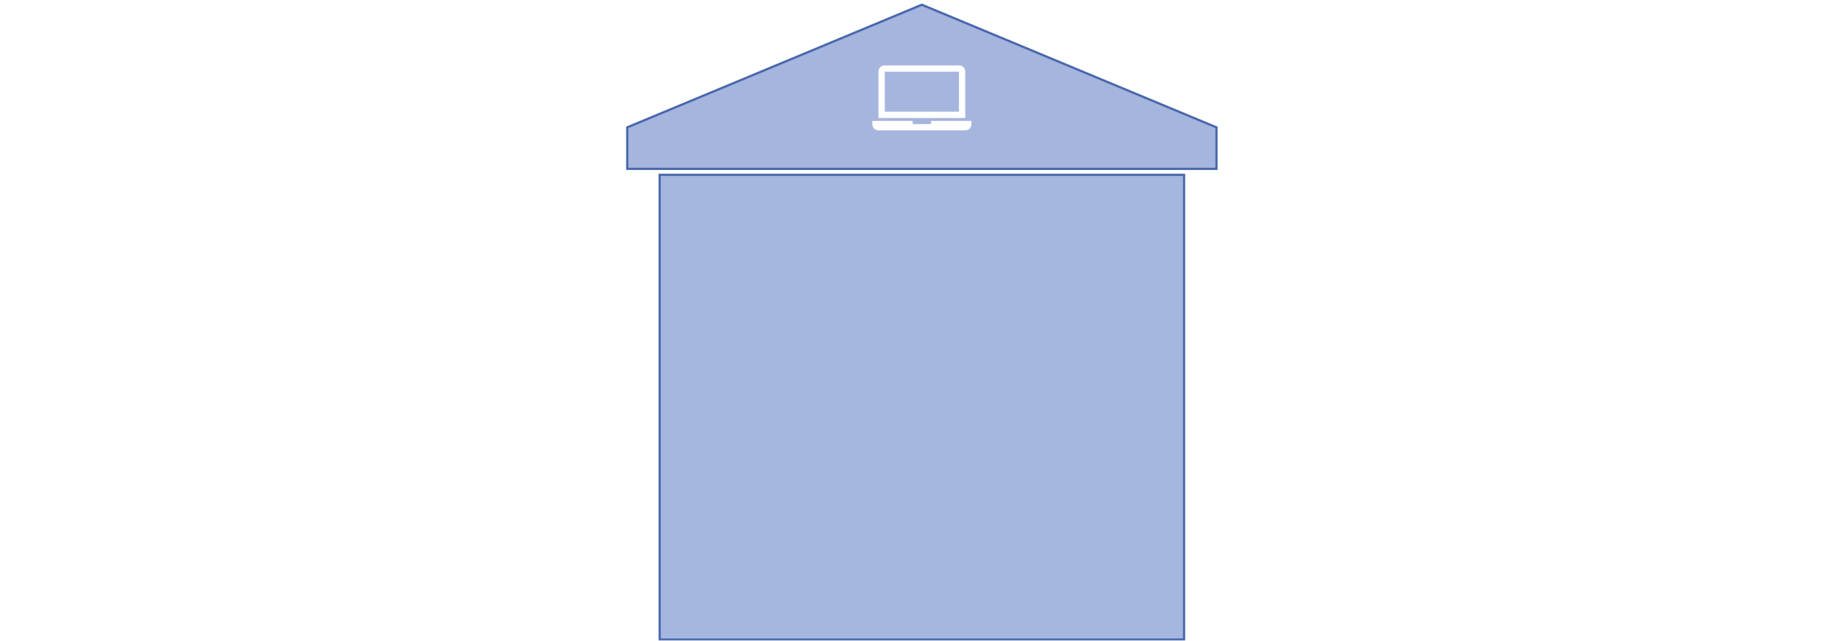


Motivation
Uniform understanding and design approach
Experimental testing on cryogenic pressure relief
Dynamic modelling of cryogenic pressure relief
EU-Standardization project in CEN TC 268 WG 6:
“Safety test facility PICARD:
Experiments of incidents”
“Consideration of process dynamics following incidents”
“Helium cryostats -
Protection against excessive pressure“
Last years [1,2,3]
This talk
Next talk
Difference in cryogenic design practice and different understanding of risk
[1] Heidt C et al. 2015 IOP CONF. SER. MATER. SCI. ENG 101 [2] Heidt C et al. S 2017 IOP CONF. SER. MATER. SCI. ENG 171 [3] Weber C et al. S 2017 IOP CONF. SER. MATER. SCI. ENG 278

Slide 3
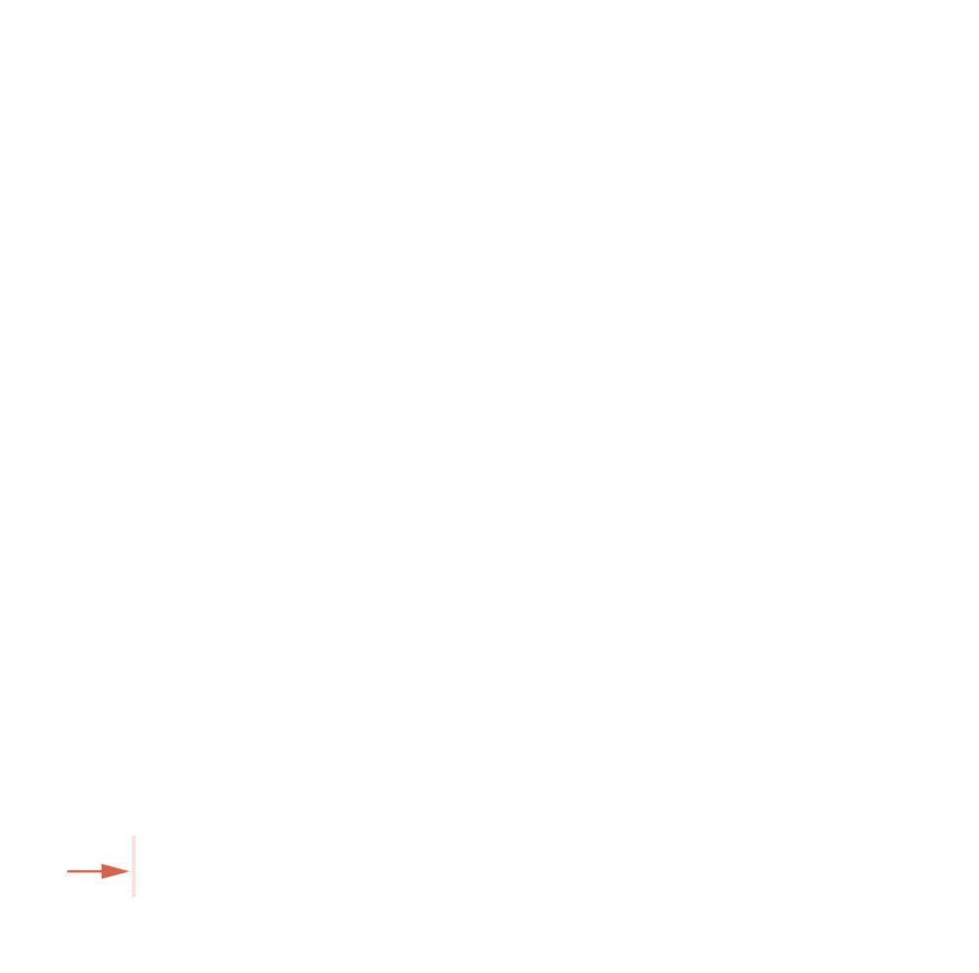
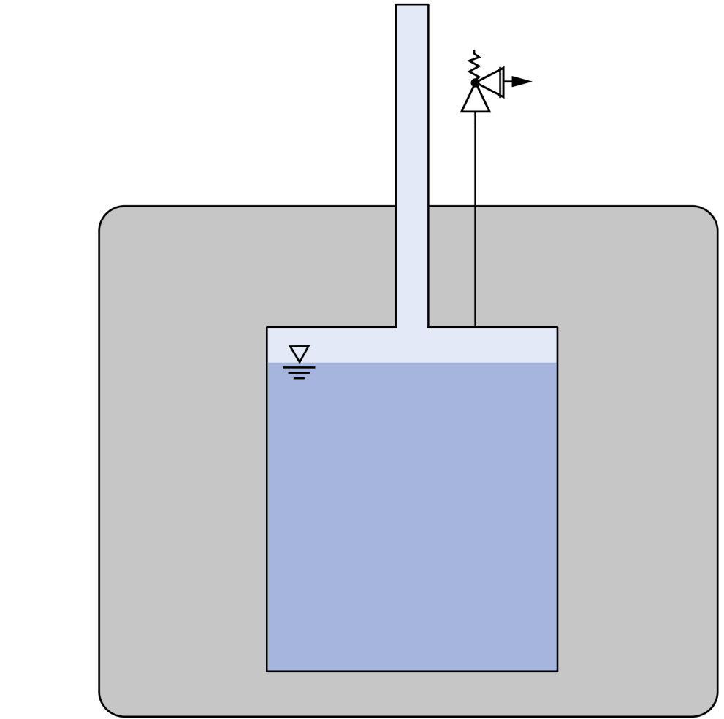
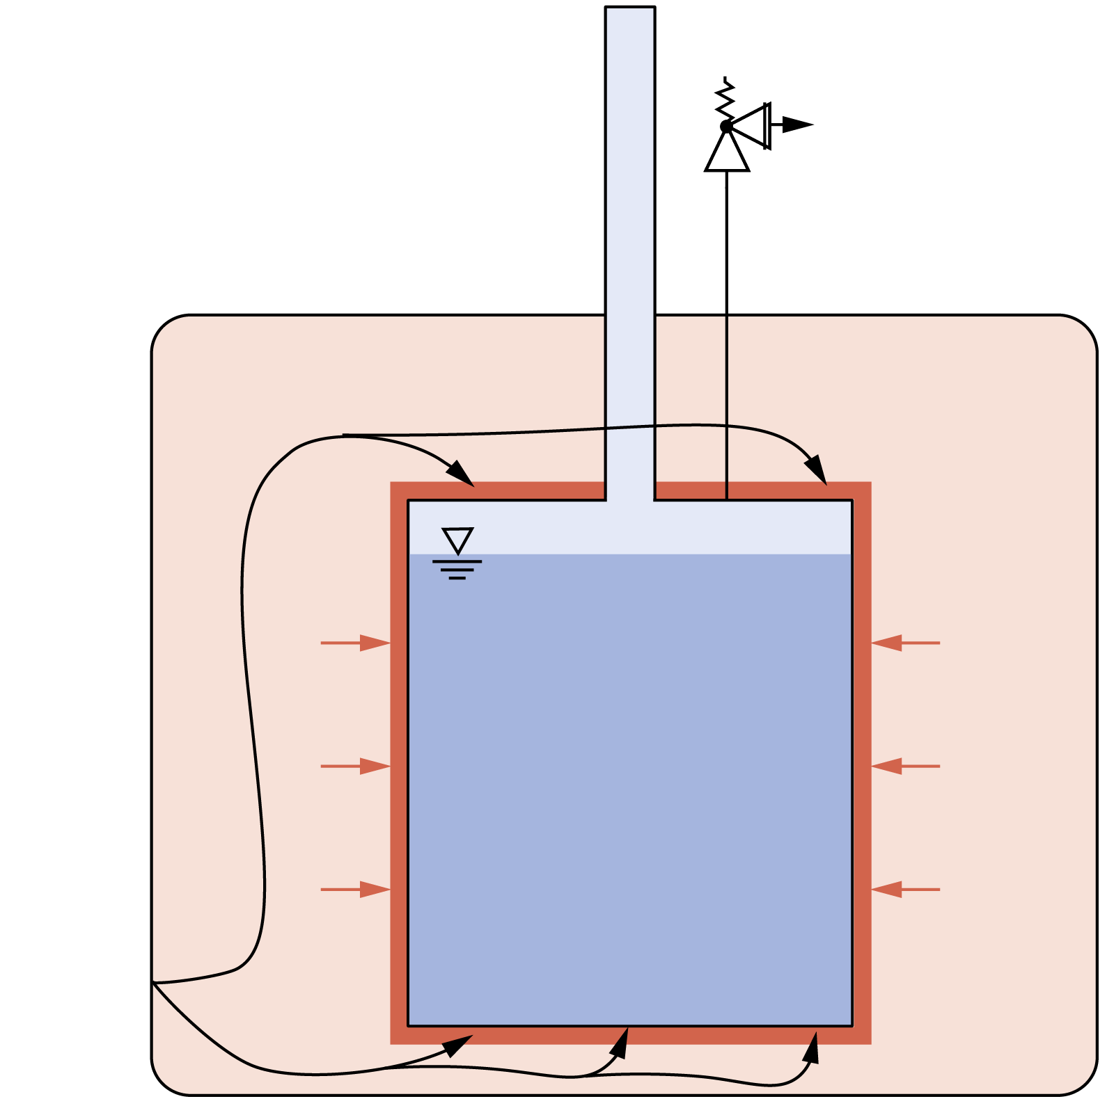
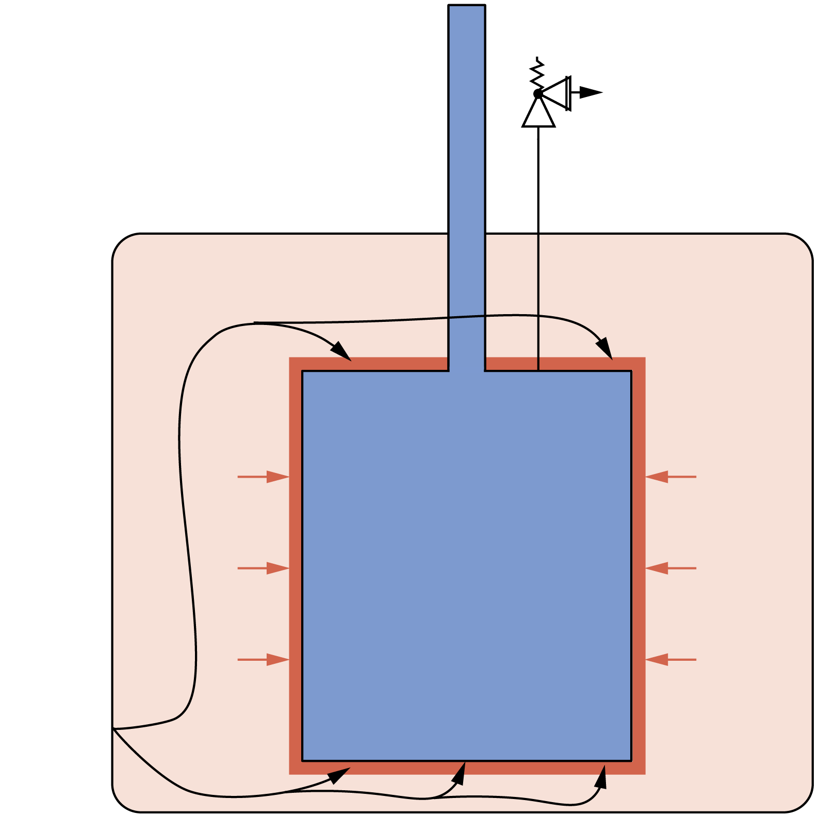
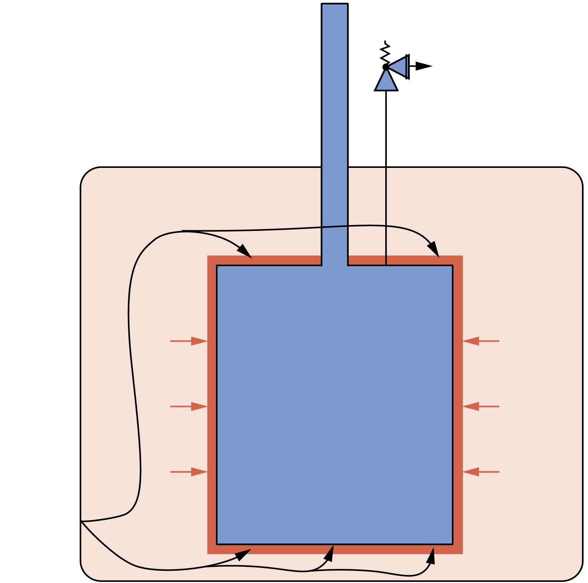




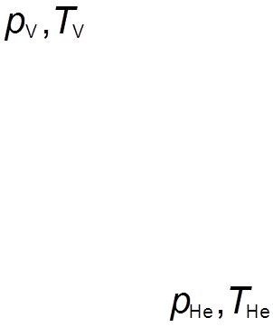
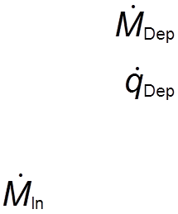



Dynamic modelling approach
Calculation of the time-dependent heat flux following Loss of Insulating Vacuum (LIV) for sizing of Pressure Relief Devices (PRD):
Ordinary first-order differential equation system [1,2,3]:
  Vacuum system: Ideal gas law and constant temperature
  Closed helium system: Isochoric, 1st law of thermodynamics
  Open helium system: Isobaric, 1st law of thermodynamics
[1] Chorowski M, Fydrych J and Polinski J 2005 Research Report Research Center Karlsruhe
[2] Chorowski M, Fydrych J, Polinski J and Süßer M 2006 PROC INT CRYOG ENG CONF 21 141-144
[3] Heidt C, Grohmann S and Süßer M 2014 Adv. Cryog. Eng. 1573 1574-1580

Slide 4
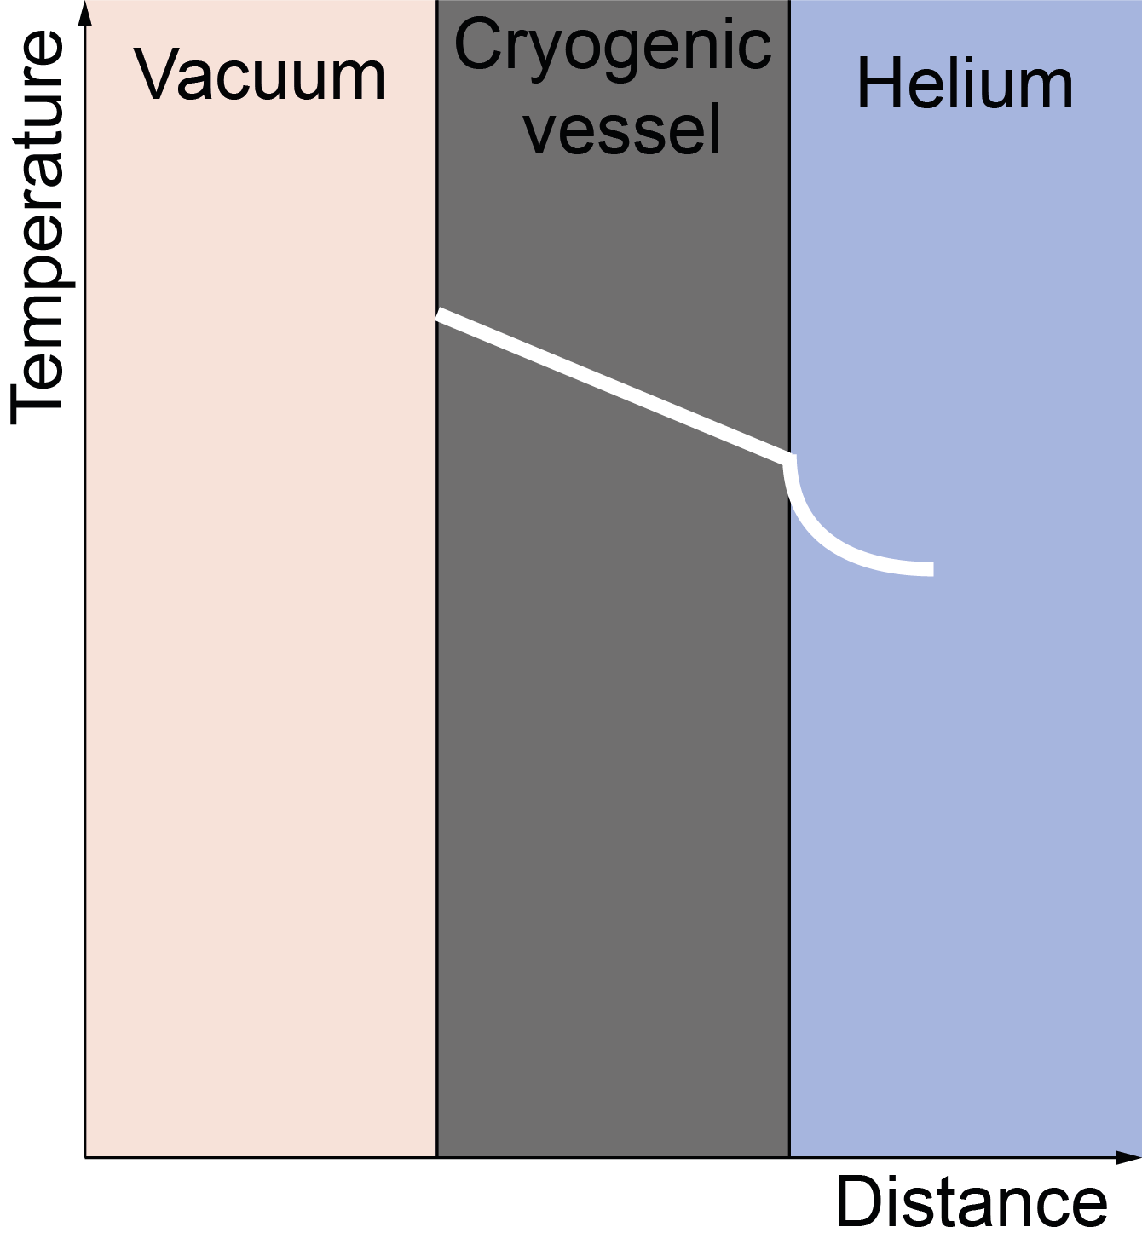

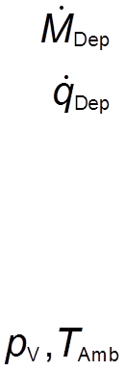
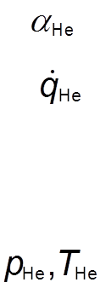


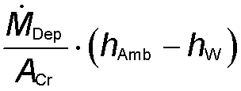





Heat Transfer
One-dimensional heat equation for T_{W} applied:
  Convective heat transfer in vacuum neglected:
  High sticking probability of molecules on the wall
  Ice-layer neglected due to uncertain property data
  Deposition : Hertz-Knudsen diffusion theory [4,5]
  : Enthalpy balance
  Thermal radiation : Stefan-Boltzmann equation
  Conduction in the wall : Fourier equation
  Convective heat transfer in helium : Fourier equation
[4] Haefer R A 1989 Cryopumping: theory and practice 1st ed Monographs on cryogenics, 4 (Clarendon Pr.)
[5] Zoller C 2018 Ph.D. Thesis. Experimental investigation and modelling of incidents in liquid helium cryostats

Slide 5
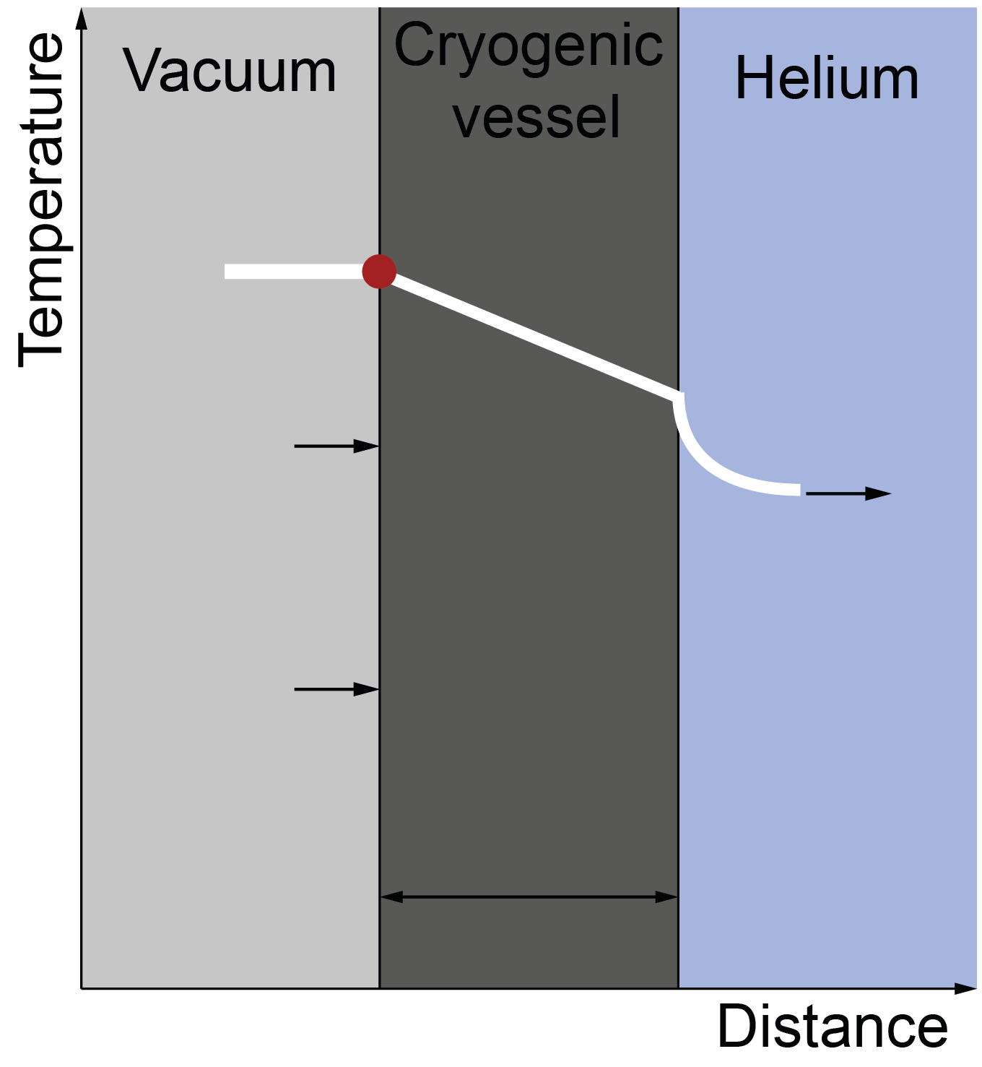
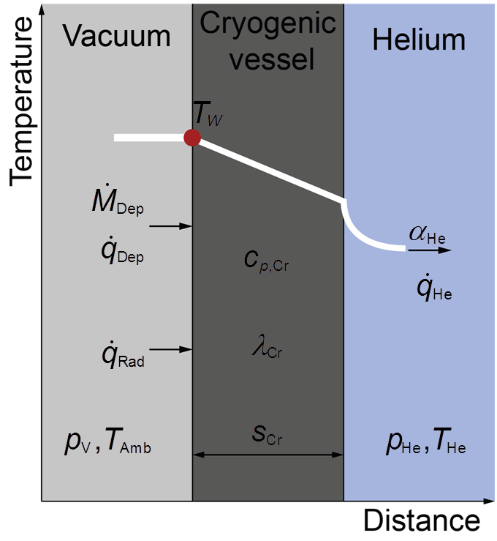

Heat Transfer
  Hertz-Knudsen diffusion theory:
    Kinetic theory to describe cryopumping
    complex dependences
  α_{T,} α_{C,} α_{E}: coefficients to describe probability that molecules Transmit to, Condensate on and Evaporate from the surface. [5]
  Convective heat transfer to helium α_{He}:
  Dependent on heat flux and pressure
  Heat transfer correlations for pool boiling [6,7] and free convection in supercritical fluid [8] implemented.
[5] Zoller C 2018 Ph.D. Thesis. Experimental investigation and modelling of incidents in liquid helium cryostats
[6] Kutateladze S S 1951 Izvestia Akademia Nauk Otdelenie Tekhnicheski Nauk 4 5297536
[7] Breen B P and Westwater J W 1962 Chem. Eng. Prog. 58 67
[8] Hilal M A and Boom R W 1979 Int. J. Heat Mass Transfer 23 697{705

Slide 6
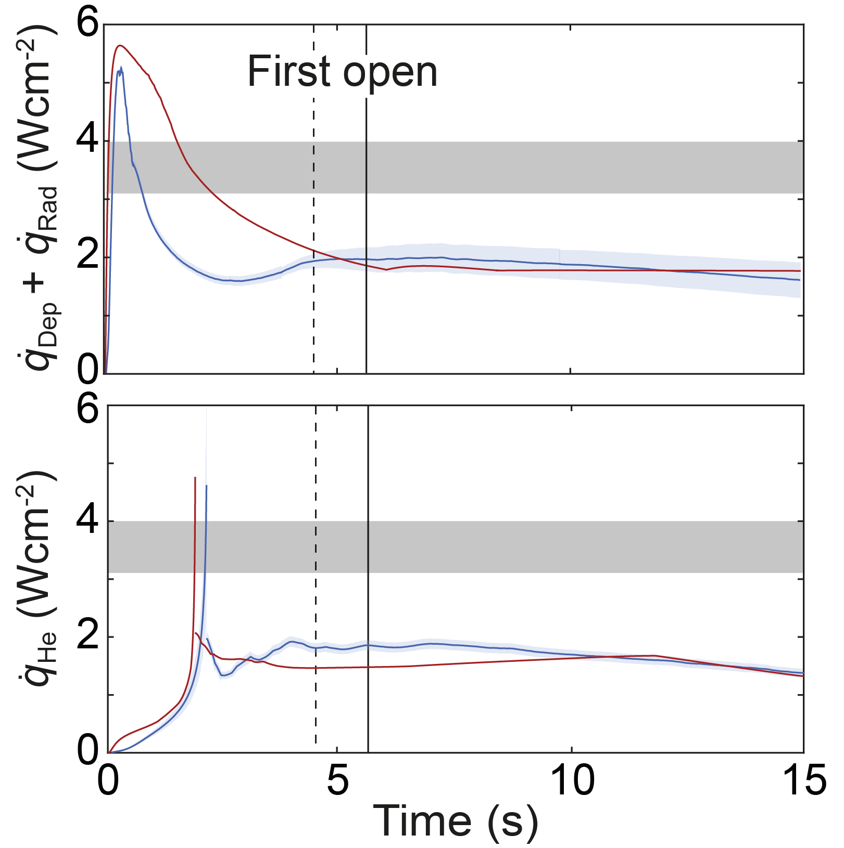
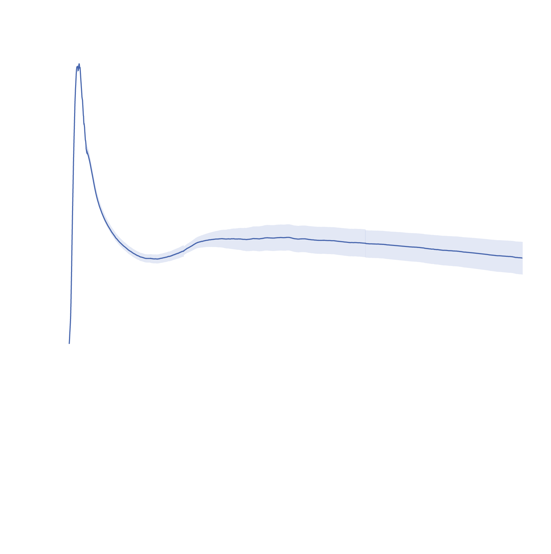
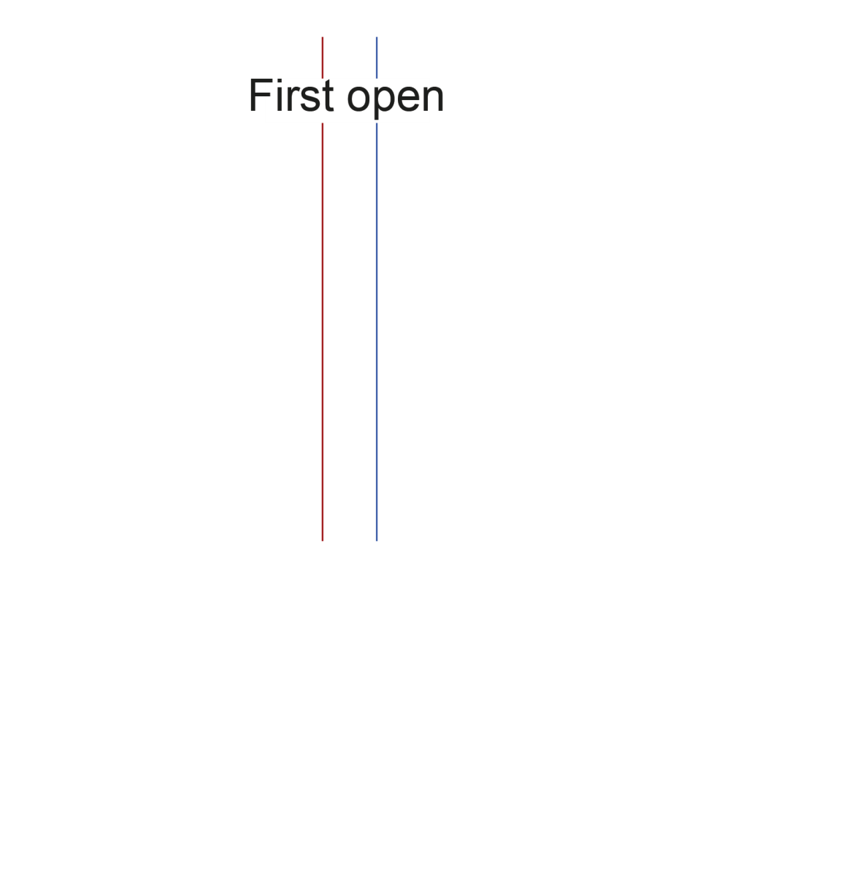
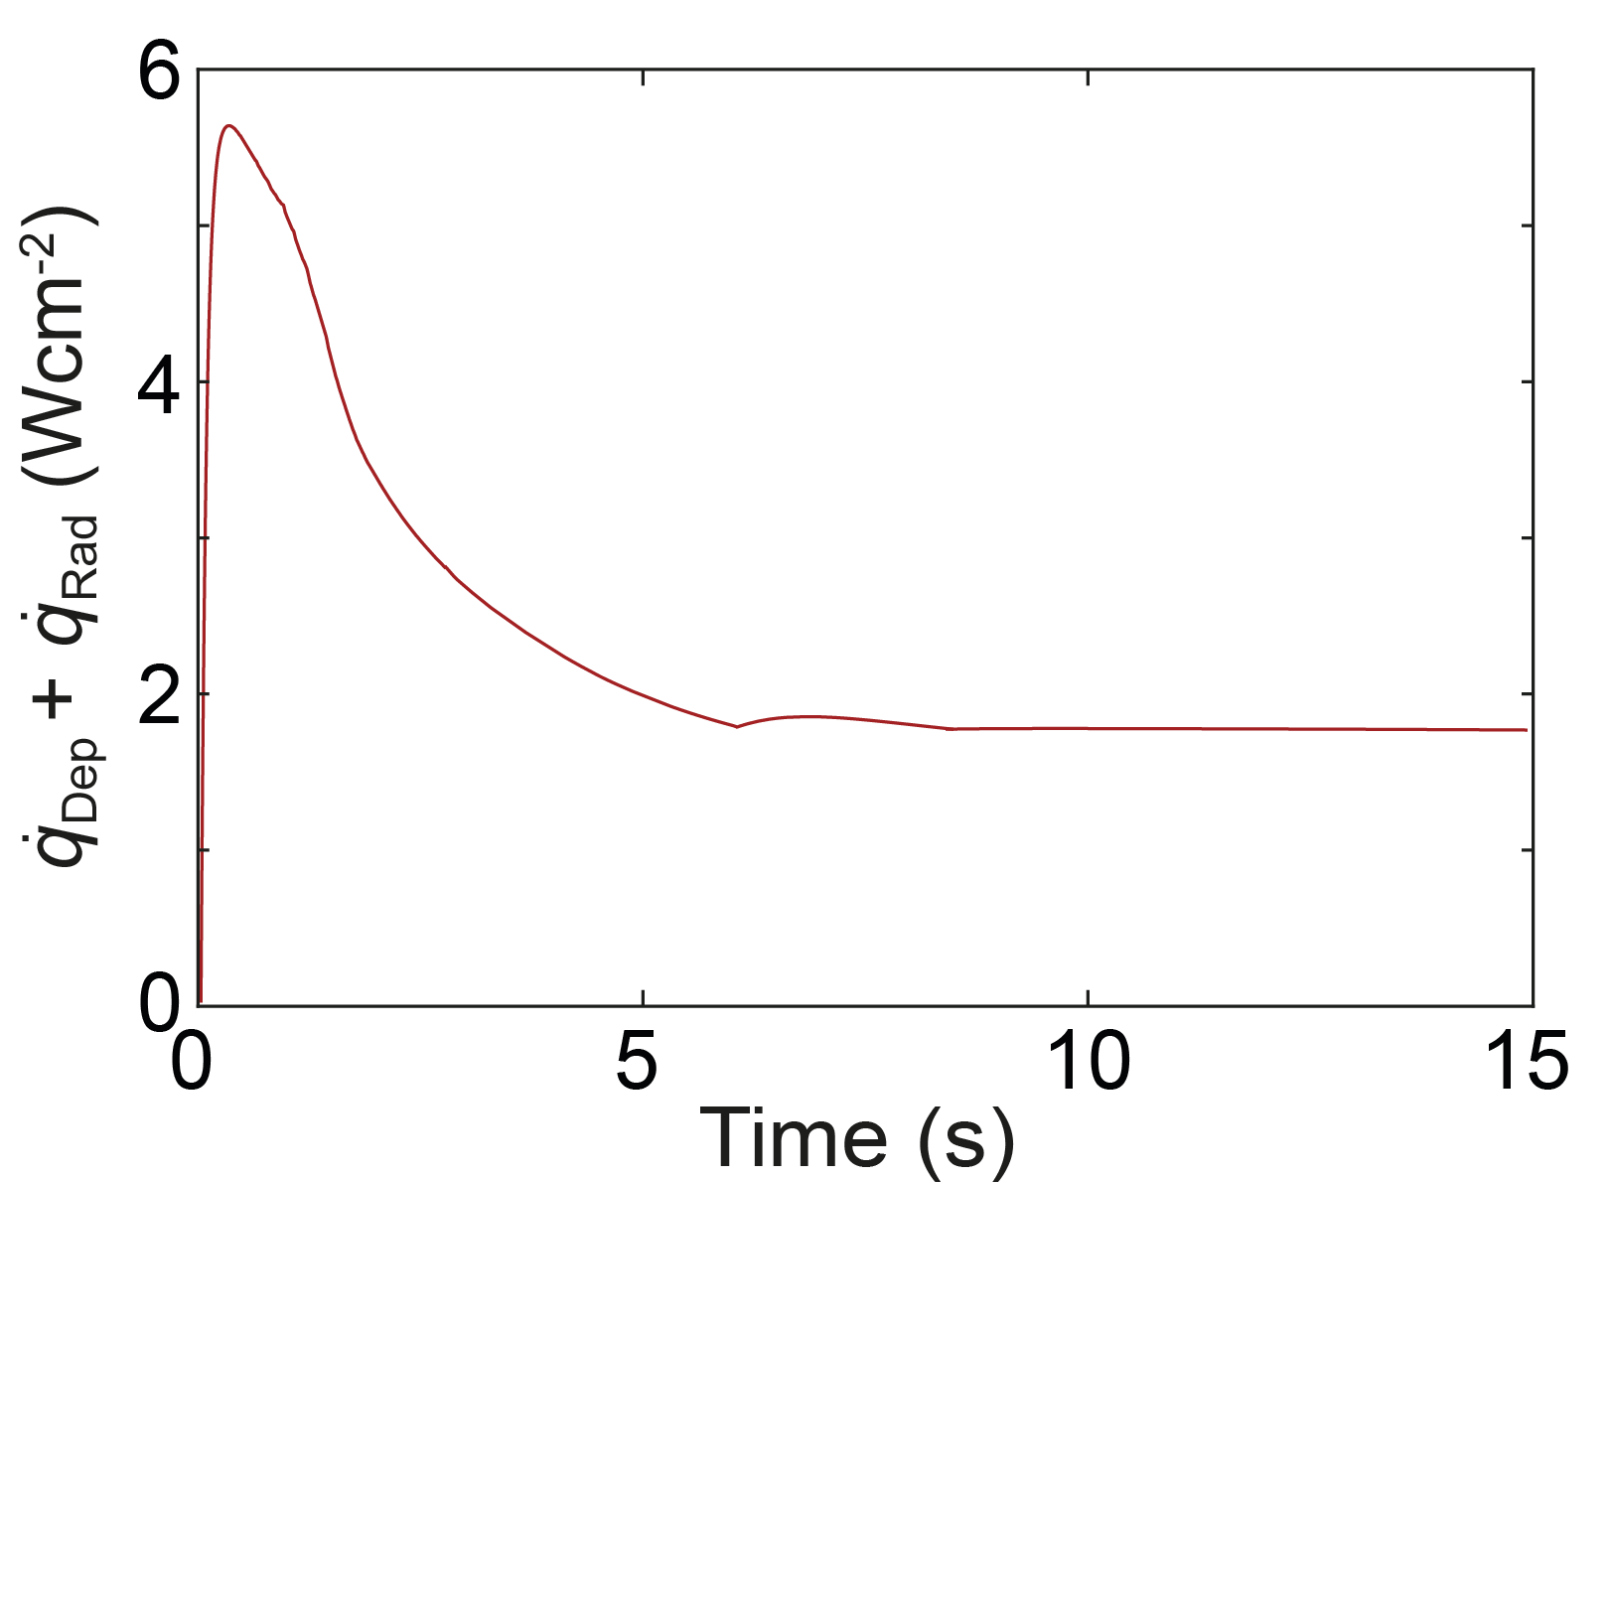
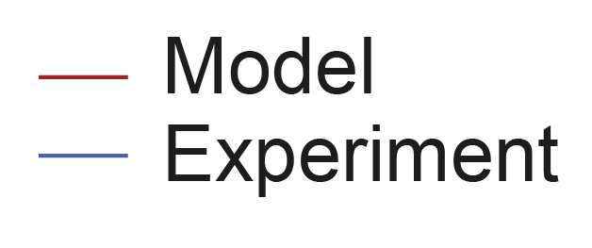
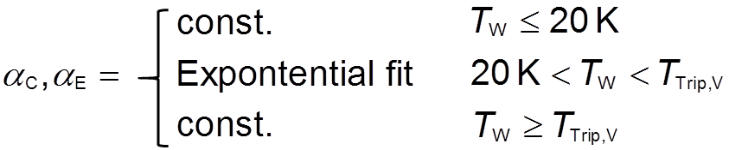

Results
Modelled heat flux on cryogenic surface:
Form due to Hertz-Knudsen coefficients
Good agreement of model and experiment:
12 % deviation at first opening PRD
8 % deviation at peak
Further investigation between 1 and 3 s
Literature data [8-10]
Free convection
Film boiling

Slide 7

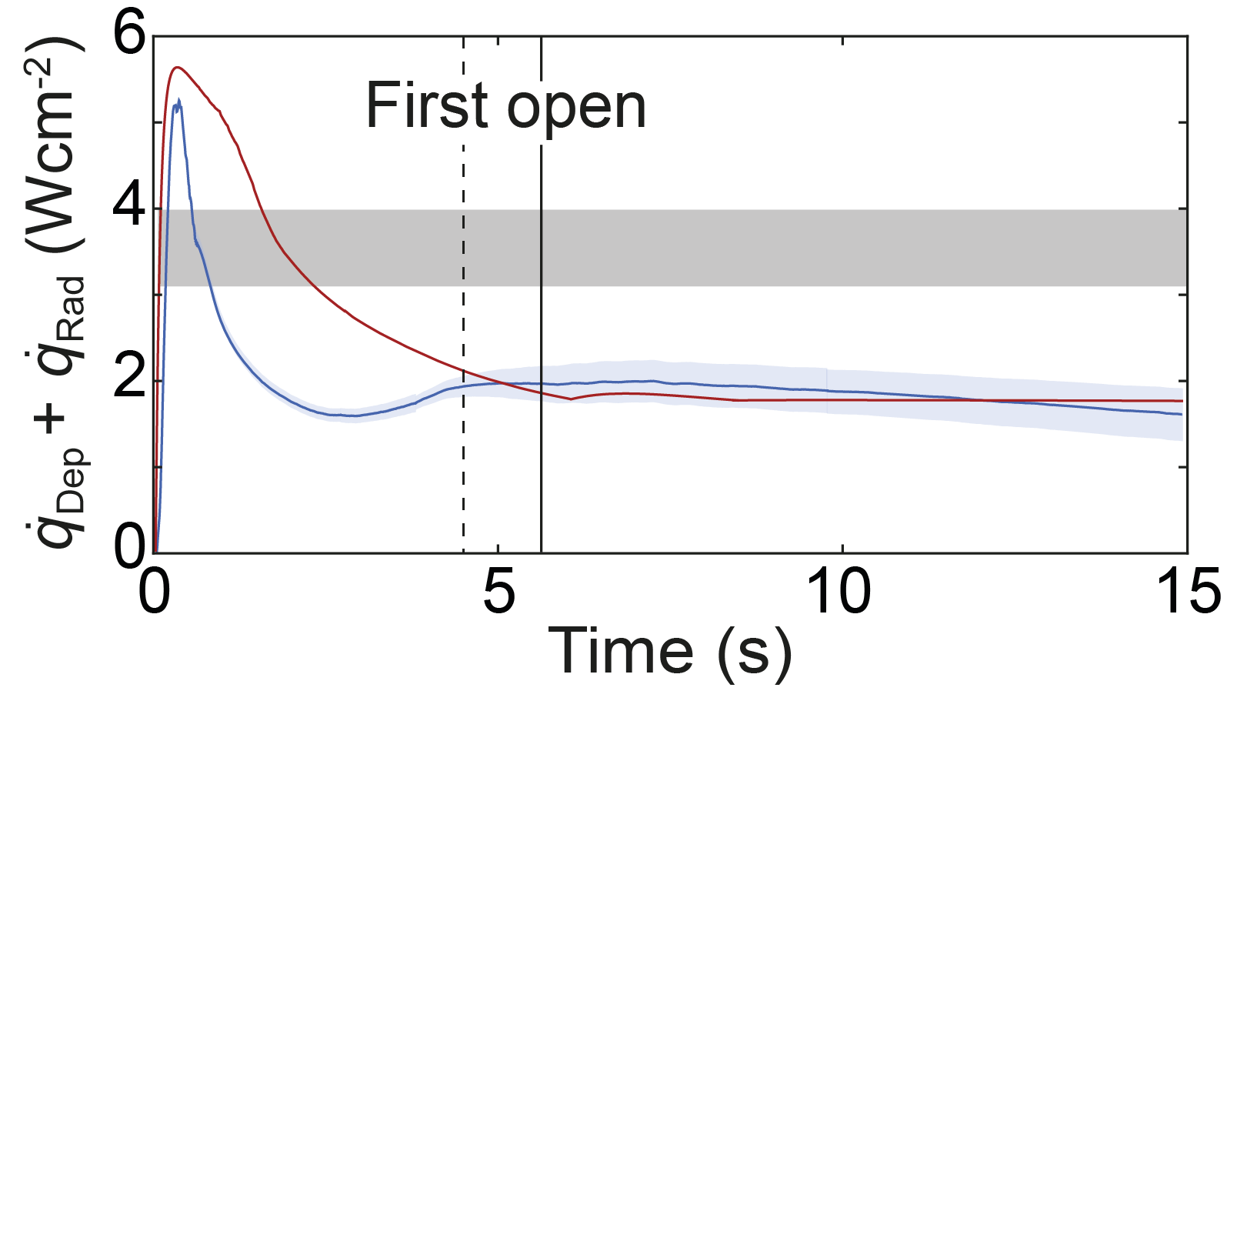
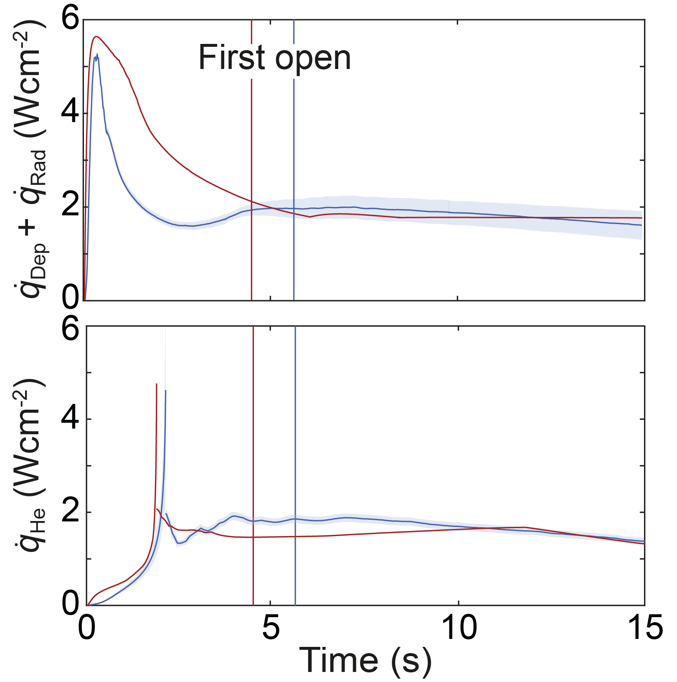


Results
Heat flux to helium:
General shape:
  small due to film boiling
  Peak due to property data in vicinity of p_{Crit}
  Free convection
Biot number: 0.1 < Bi < 1 (except for peak)
  Thermal resistance inside helium higher
  Transient wall conduction not negligible
Modelled and measured heat flux data are lower than established constant values
from literature.
Literature data [9-10]
1
2
3
Literature data [9-10]
[9] Lehmann W and Zahn G 1978 Proc. Int. Cryog. Eng. Conf 7 569-579
[10] Cavallari G et. al. 1989 Proc. 4th Workshop on RF Supercon. 1 781-803
[11] Harisson S 2002 IEEE T. Appl. Supercon. 12 12 1343-1346

Slide 8
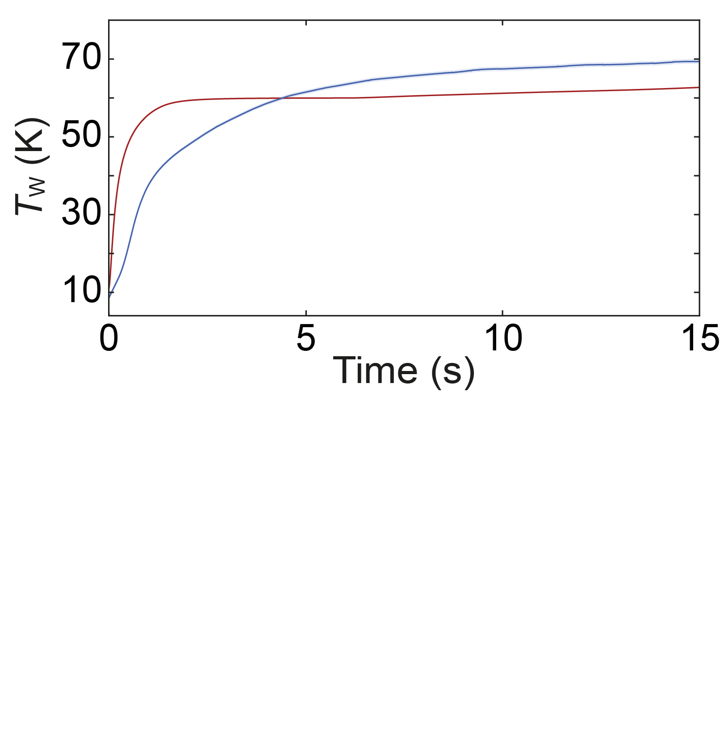
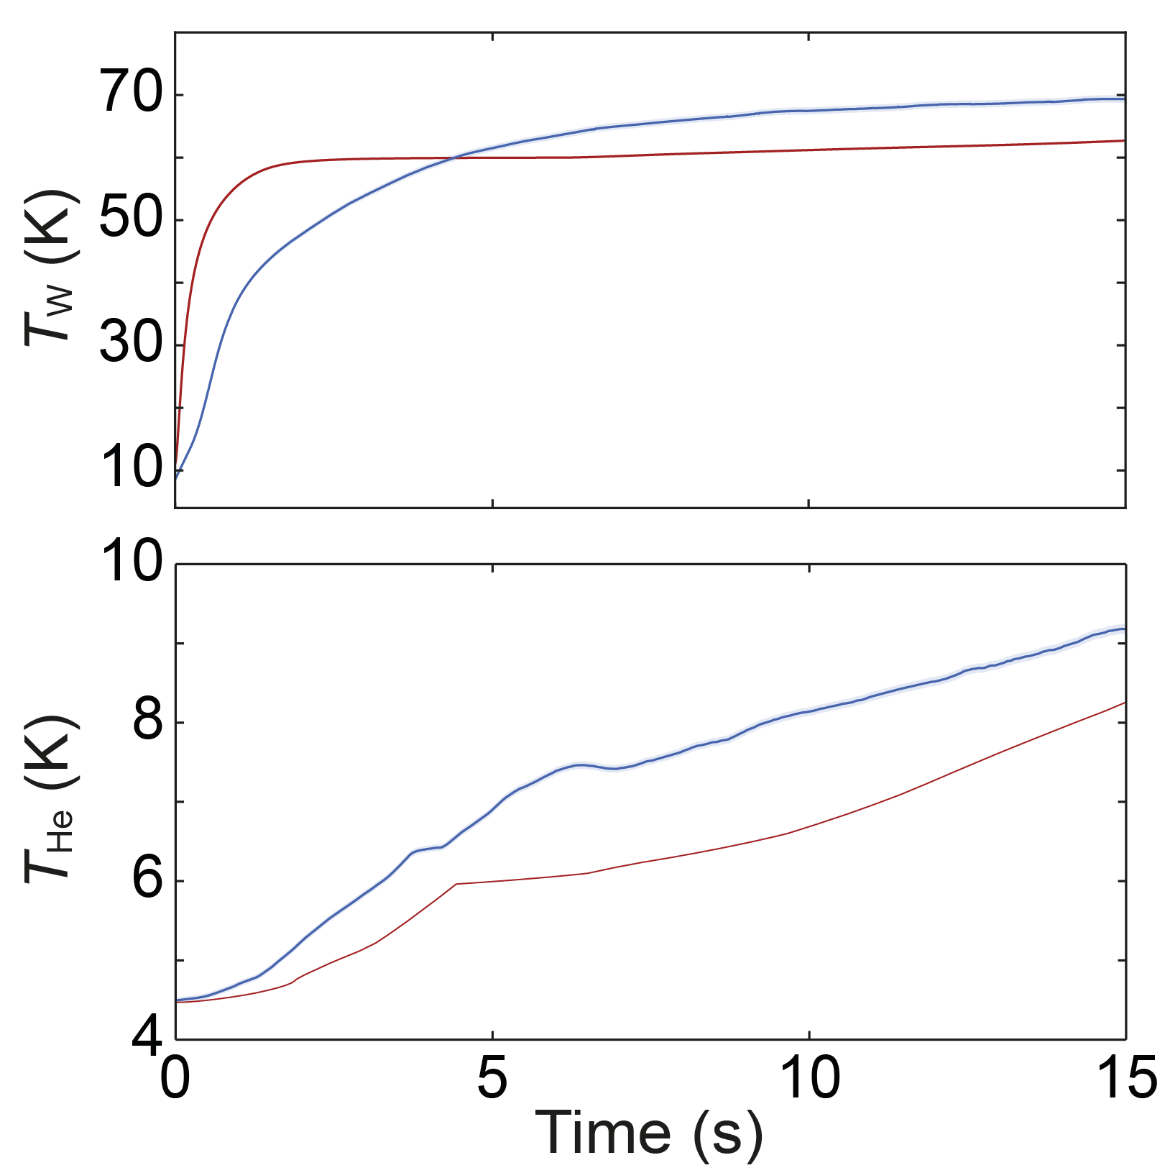
Results
Modelled wall temperature increase:
In accordance with difference between in- and outflowing heat fluxes:
  Faster increase
  Stagnation at 10 % lower value
Possible reason: Neglect of ice-layer
Modelled helium temperature increase:
Underestimation in accordance with heat flux
Pressure increase is overestimated
Possible reason: Neglect of stratification

Slide 9
Summary and Outlook
Summary:
Modelling approach on the heat transfer of cryostats following LIV successfully introduced
No empirical parametrization needed
Experimental data of PICARD well predicted
Modelled heat flux data can predict system behavior more accurately than established constant values from literature
Outlook:
Test of more heat transfer correlations
Investigation on the effect of stratification
Comparison to different experimental conditions
Evaluation of reliability and uncertainty

Slide 10
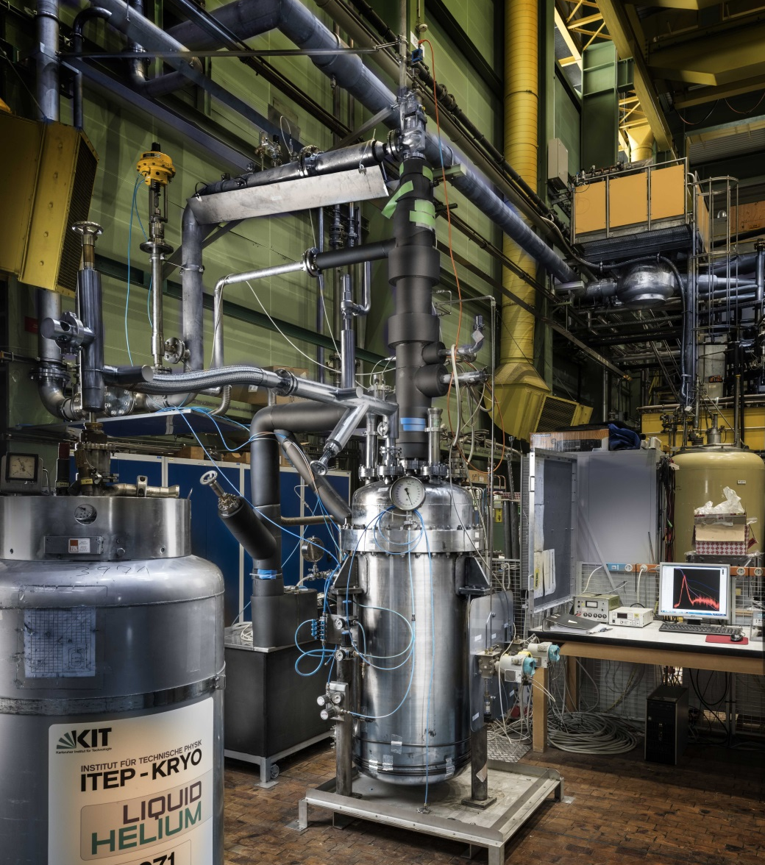
Thank you for the attention
PICARD –
Pressure Increase in Cryostats and Analysis of Relief Devices
Christina Weber
Ph.-D. student
KIT – Campus Nord
Institut für Technische Physik
Hermann-von-Helmholtz Platz 1
76344 Eggenstein-Leopoldshafen
Email: christina.weber@kit.edu
Tel.: 0721 – 608 26248

Slide 11
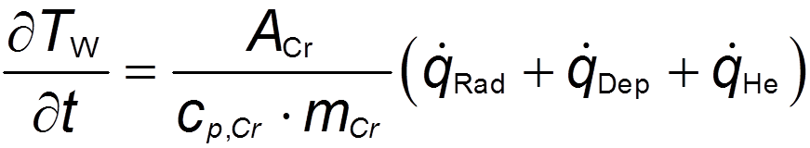
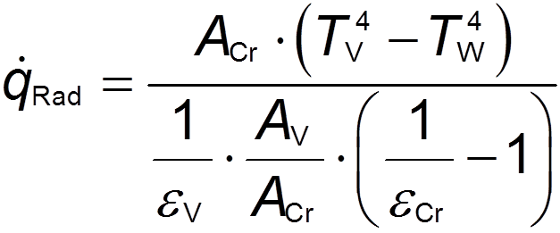
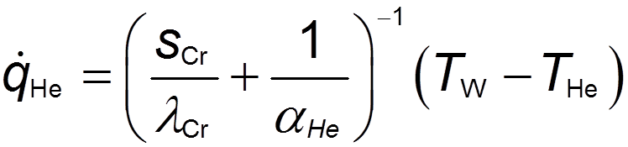
Back-up
Wall temperature:
Stefan-Boltzmann:
Fourier:

Slide 12
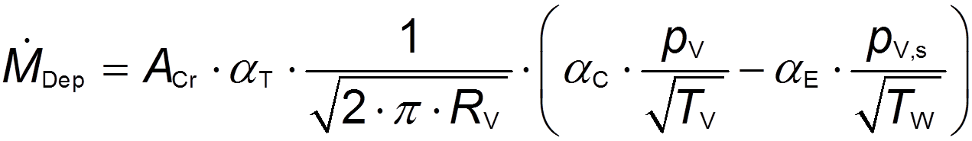
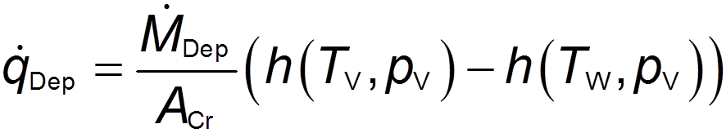
Back-up
Hertz-Knudsen:
Deposition heat flux:

