Slide 1
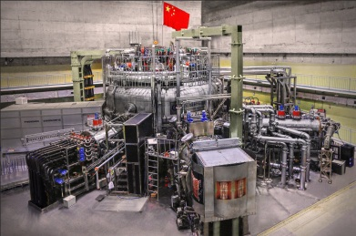
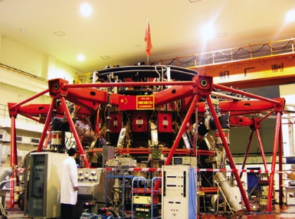
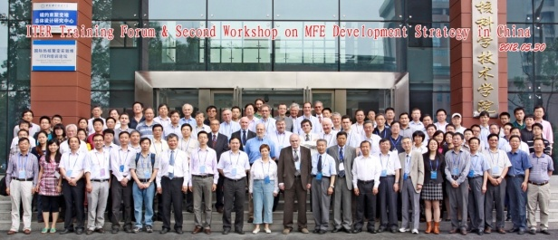
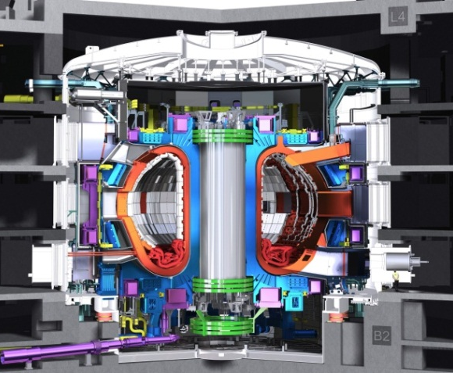
Conceptual design of the CFETR cryogenic system
Xiaogang Liu & CFETR team
Institute of Plasma Physics, CAS

Slide 2
Outline
1
Introduction of CFETR design
2
Average heat load estimation
3
Conceptual design of Cryogenic system
4
Summary

Slide 3
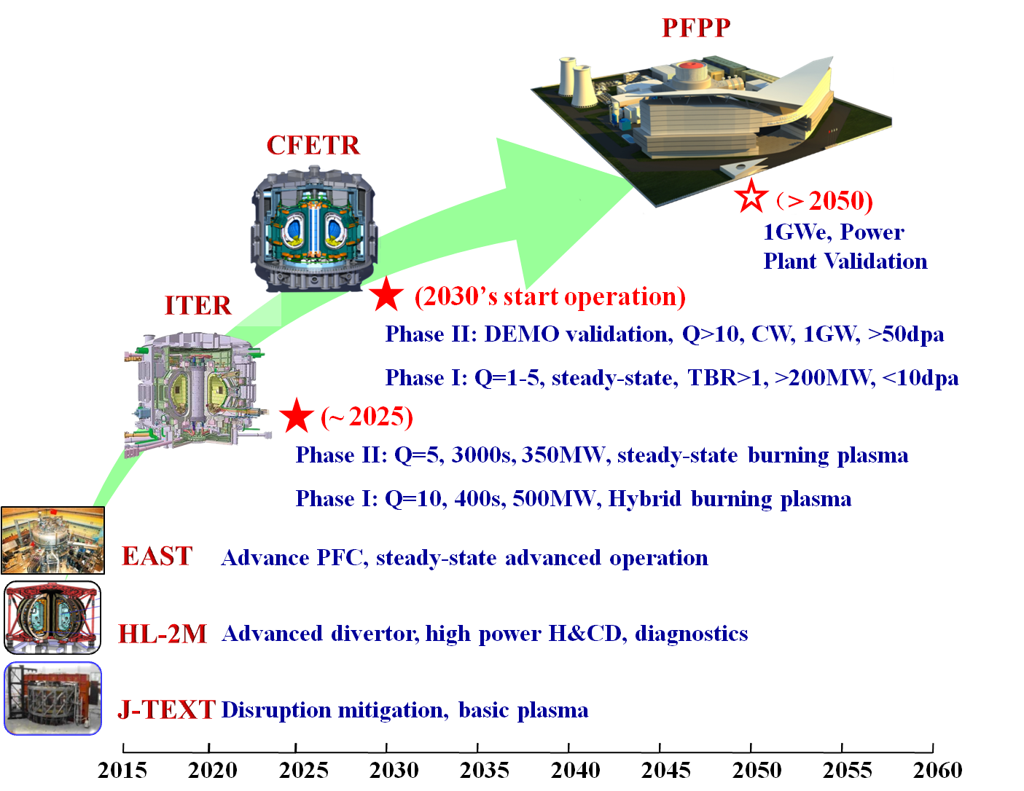
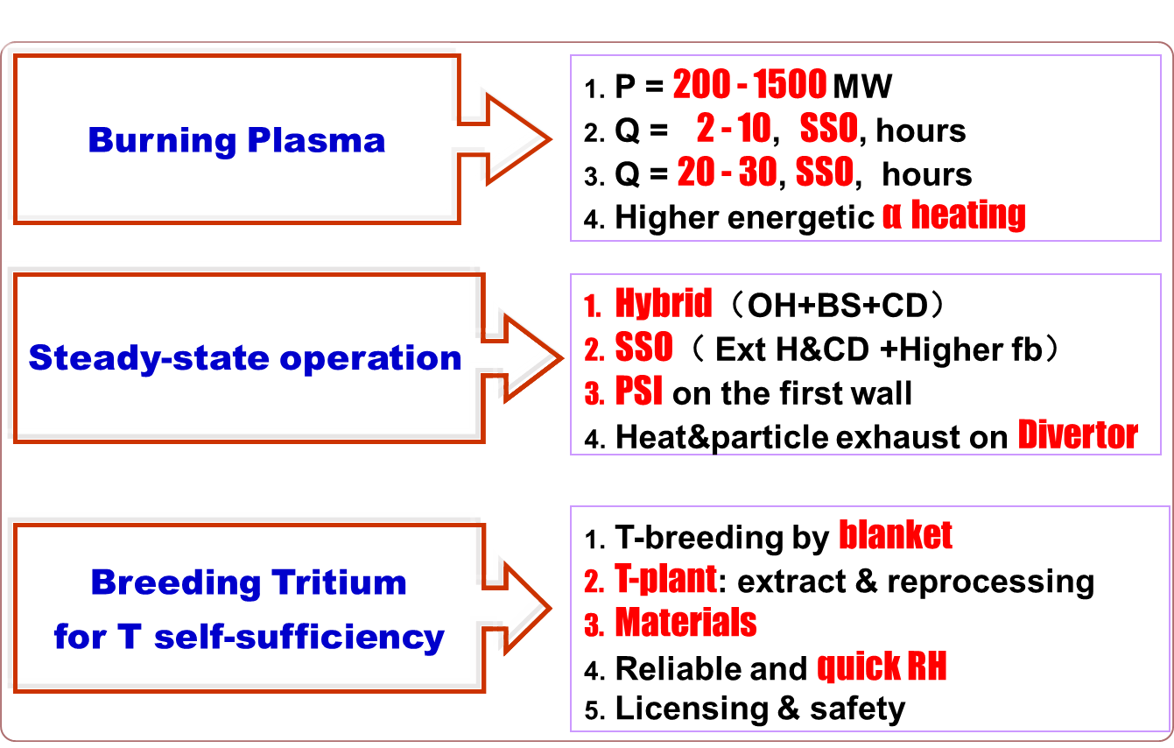
Roadmap of MCF development in China
The China Fusion Engineering Test Reactor (CFETR) is the next device in China’s roadmap for developing fusion energy. CFETR is envisioned to be constructed in the 2020s.
CFETR aims to bridge the gaps between the fusion experimental reactor ITER and the demonstration reactor (DEMO).

Slide 4
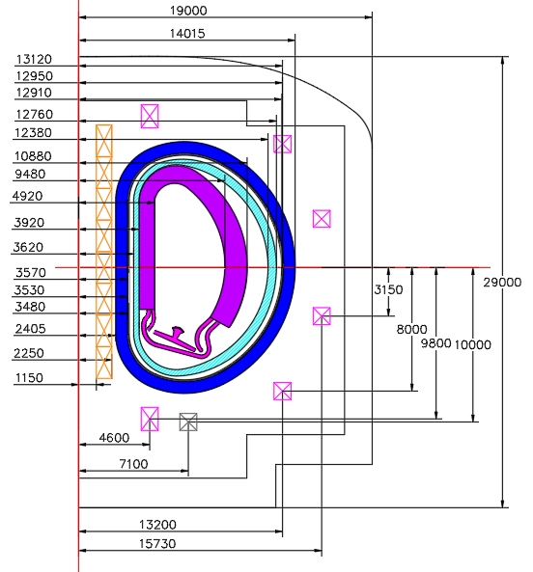
Key parameters of CFETR
R₀ = 7.2 m, a = 2.2 m
P_{fusion} = 200 MW – 1000 MW
I_{p} = 10 MA – 14 MA,
B_{t} = 6.5 T,
TBR ≥ 1
Duty time ≥ 0.5
Through physics design, the key engineering parameters of CFETR have been determined.
Input data from the cryogenic users are needed for the design of the CFETR cryogenic system.
The present conceptual design is based on an estimation of the heat loads.

Slide 5
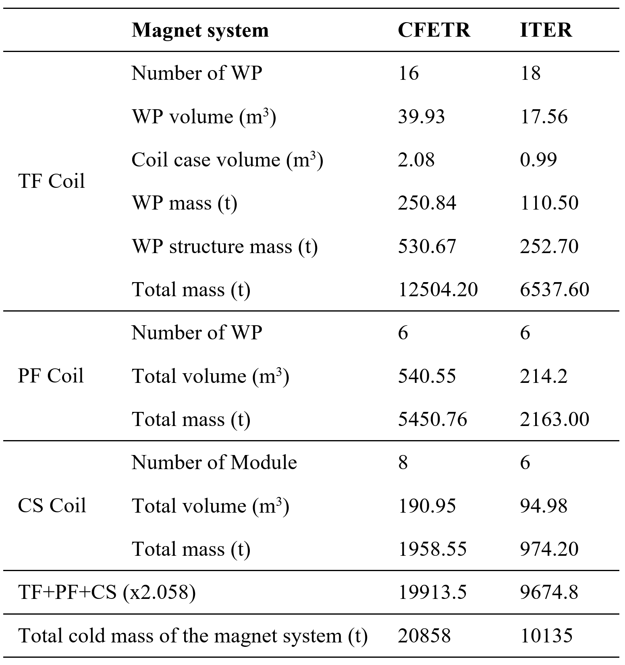
The CFETR in Phase I is an ITER-like tokamak except for the additional tritium breeding blanket.
Mass of CFETR magnet system
Mass of the magnet system of CFETR extrapolated from ITER.
Overview of structure and cross-section of CFETR magnet system.
CFETR in phase I is an ITER-like tokamak except for the additional breeding blanket.
The coils of CFETR share the similar design philosophy and use the same superconducting conductor as their ITER counterparts.
The weight of the CFETR coils can be extrapolated from the corresponding ITER coils.

Slide 6
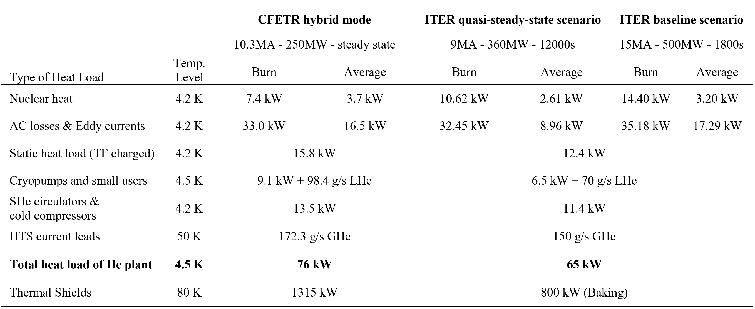
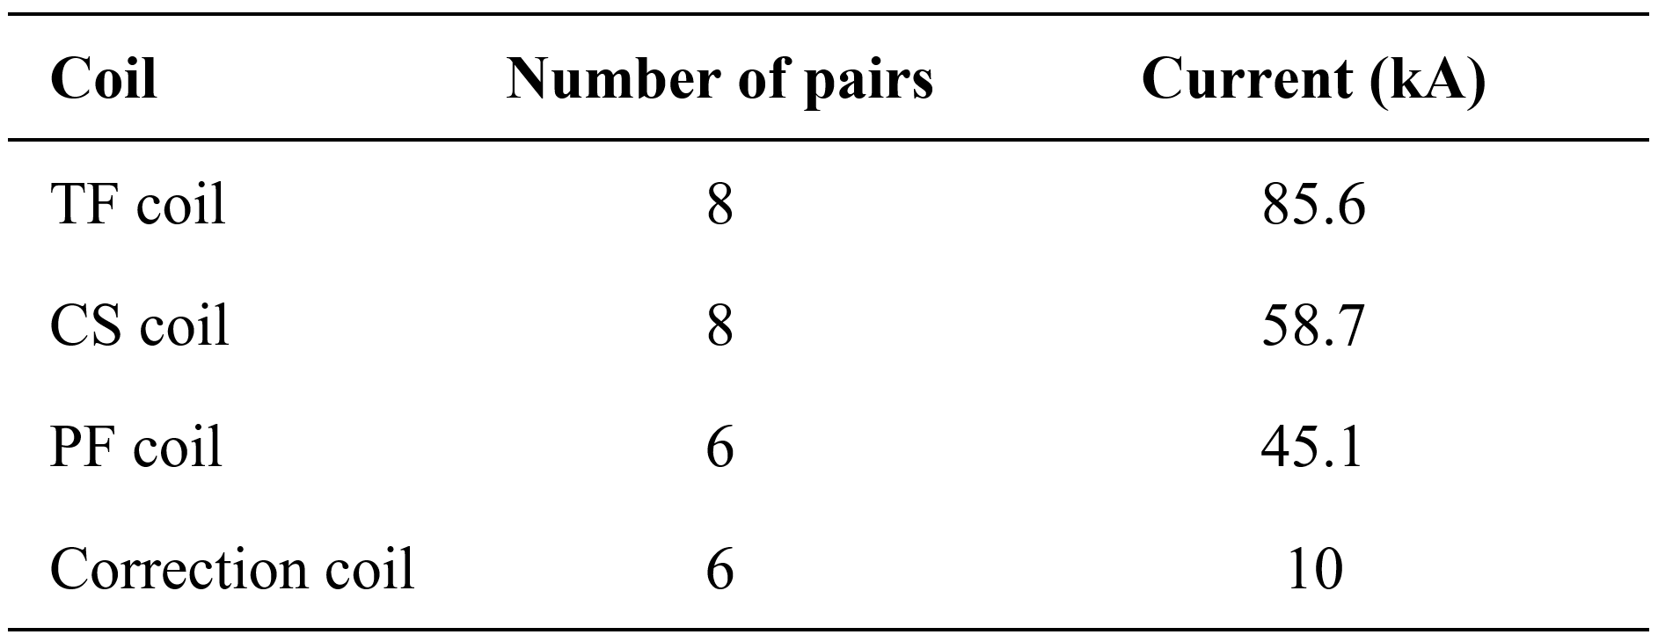
Average heat load estimation
Heat load of magnet system accounts for 55% of the overall 4.5 K load.
Notes:
Nuclear Heat ~Pfusion; dynamic load~ Ip; Static load~ R r (plasma surface area); Cryopumps~Rr²,(Vplasma); Circ&CC~磁体和低温泵的She流量，进而和磁体和低温泵的热负荷正比。CL的对数和运行电流。Thermal shields~(1+k²)Rr,(radiation surface area

Slide 7
Conceptual design of the principal PFD
Staged installation for various phases of CFETR operation will be adopted instead of margins.
According to the estimated average heat load of 76kW@4.5K, a helium plant with an average refrigeration capacity within the range of 85~90 kW@4.5K is required for CFETR (3 to 4 helium refrigerator).
This capacity range is referring to the installed capacity of the ITER helium plant, which is 75 kW to withstand an average heat load of 65 kW@4.5K.
As for the N₂ plant, in order to cooperate with the He plant and to cool the thermal shields, a maximum equivalent capacity of ~ 1900kW@80K is needed for the CFETR cryogenic system.

Slide 8
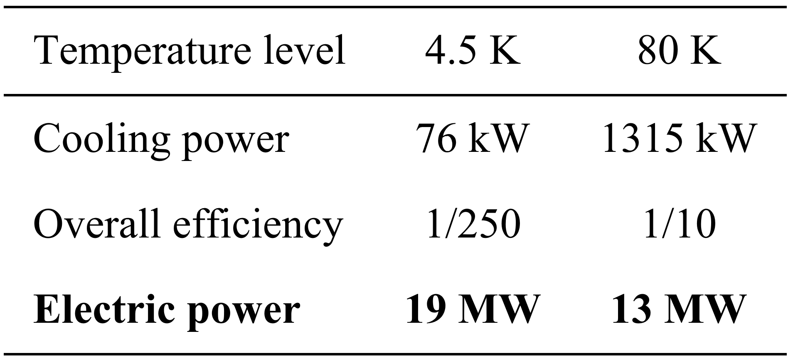
Schematic layout of CFETR cryogenic system
By referring to ITER, the CFETR cryogenic system will provide an average cooling power of 85~90 kW@4.5K and a peak power of 1900 kW@80K.
The electric power consumption of the CFETR cryogenic system is estimated to be 32 MW.
The gross building area is about 7000 m².

Slide 9
Influence of auxiliary power on Q
Schematic PFD of the power flux in CFETR
If f_{recirc} goes lower than ~40%, the required Q for CFETR must be drastically increased to balance the reactor.
It is evaluated that Q = 12 is realizable for CFETR in phase II. when Q = 12 and P_{el,aux} = 32 MW, the recirculated power fraction f_{recirc} should be about 52%.
If the P_{el,aux} is reduced, Q could be lower and the investment cost of CFETR could be reduced.
(a) The fusion power gain Q as a function of the recirculated fraction f_{recirc} and auxiliary electric power P_{el,aux}. (b) The Q and (c) f_{recirc} as a function of P_{el,aux}.
Notes:
fusion power gain

Slide 10
Summary
The heat load of the CFETR cryogenic system is estimated to be 76 kW at 4.5K and 1315 kW at 80K. The heat load of the Tritum Plant need to be addressed in the future.
A helium plant consists of 3 to 4 helium refrigerators will allow the production of an average cooling power of 85~90 kW at 4.5K.
The electric power consumption of the CFETR cryogenic system is estimated to be 32 MW. The gross building area is about 7000 m2.
The heat load of the CFETR cryogenic system still need to be detailed through the engineering design of the CFETR tokamak.

Slide 11
Thanks for your attention!

