Slide 2
Study of Thermal Diffusivity of Dielectric-Metal Interfaces at Low Temperatures
T. Koettig, P. Borges de Sousa, J. Golm, J. Liberadzka, J. Bremer
CERN, TE/CRG-CI Central Cryogenic Laboratory

Slide 3
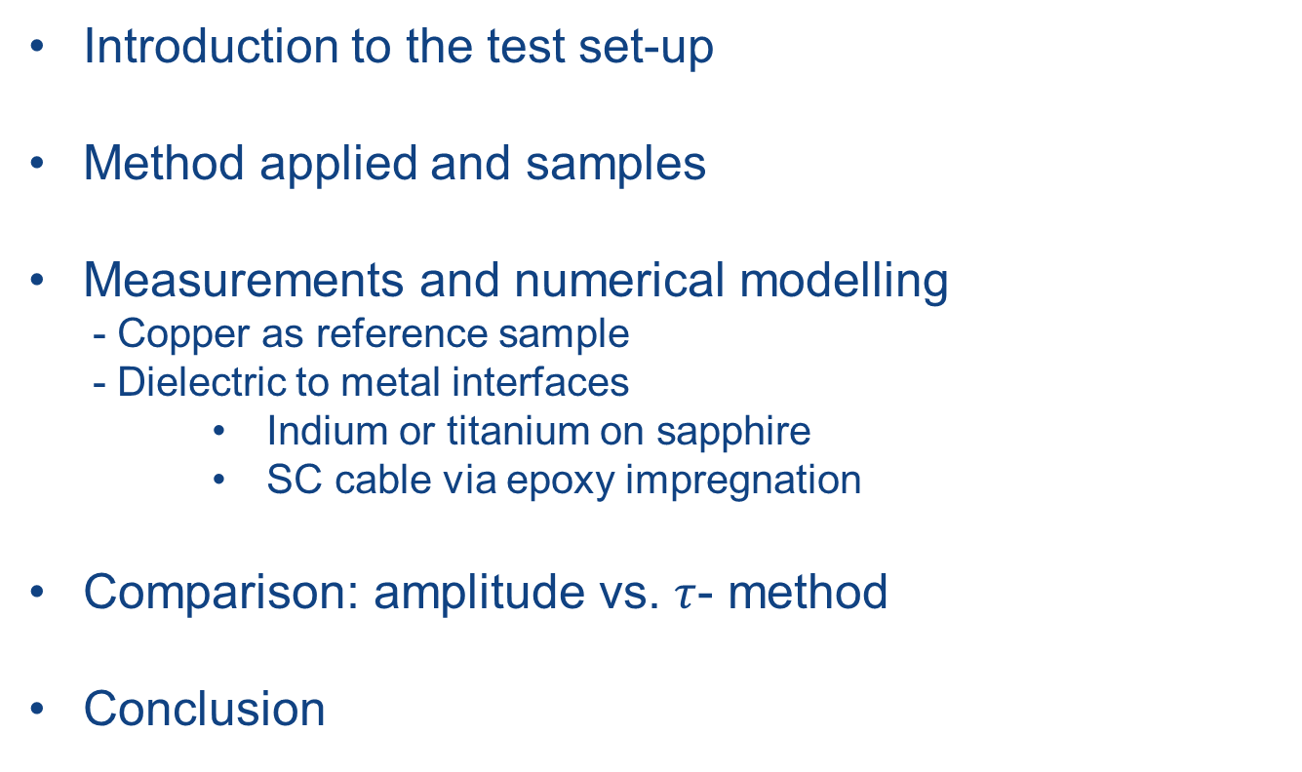
Content
Introduction to the test set-up
Method applied and samples
Measurements and numerical modelling
  - Copper as reference sample
  - Dielectric to metal interfaces
      Indium or titanium on sapphire
      SC cable via epoxy impregnation
Comparison: amplitude vs. $τ$- method
Conclusion

Slide 4
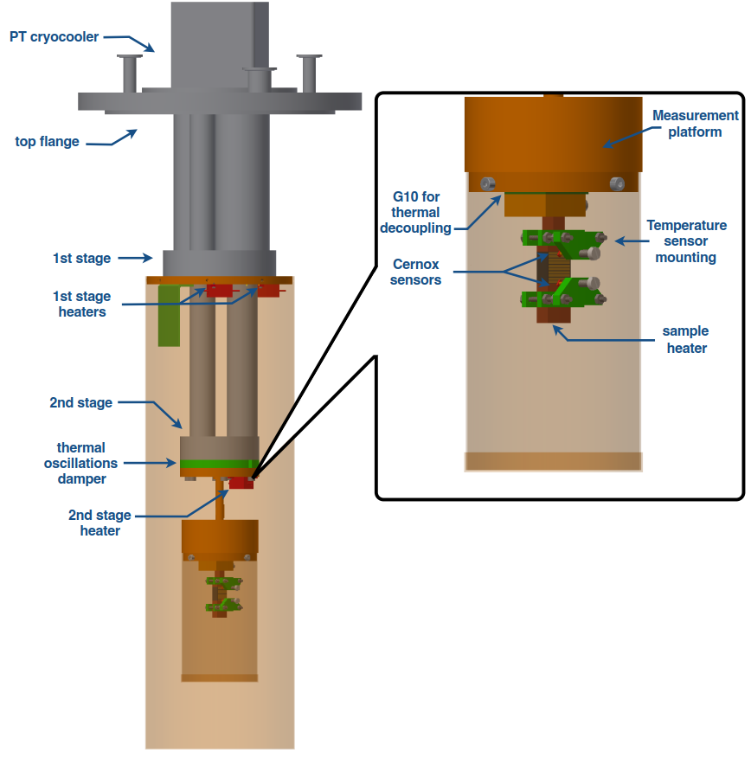
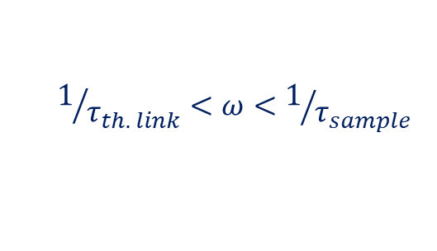

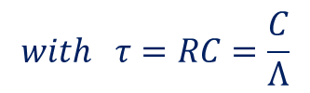
Thermal conductivity / diffusivity set-up
Features:
3 temperature sensors calibrated to each other + offset compensation
Stepwise change of platform temperature 1 K - 2 K
ΔT on sample 0.2 K to 0.3 K
Passive thermal attenuator between cryocooler and thermal platform
Threshold frequencies (Stewart et al., Rev. Sci. Instrum. 54, 1 (1983):
$$1/{τ_{th. link}}<ω<1/{τ_{sample}}$$
$$with τ=RC=\frac{C}{Λ}$$
$τ_{th. link}≫$ $τ_{sample}$

Slide 5
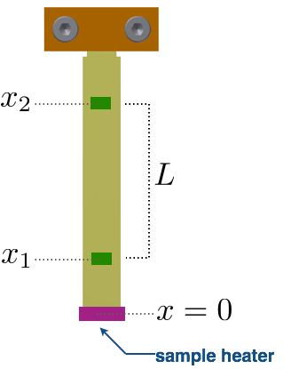
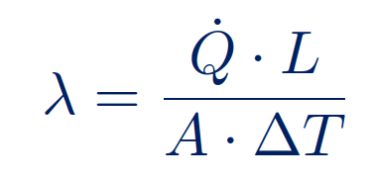
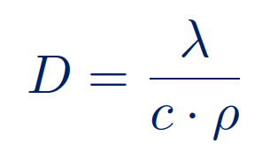
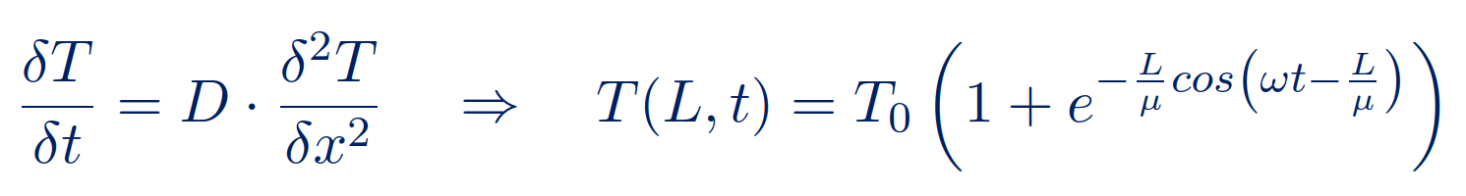
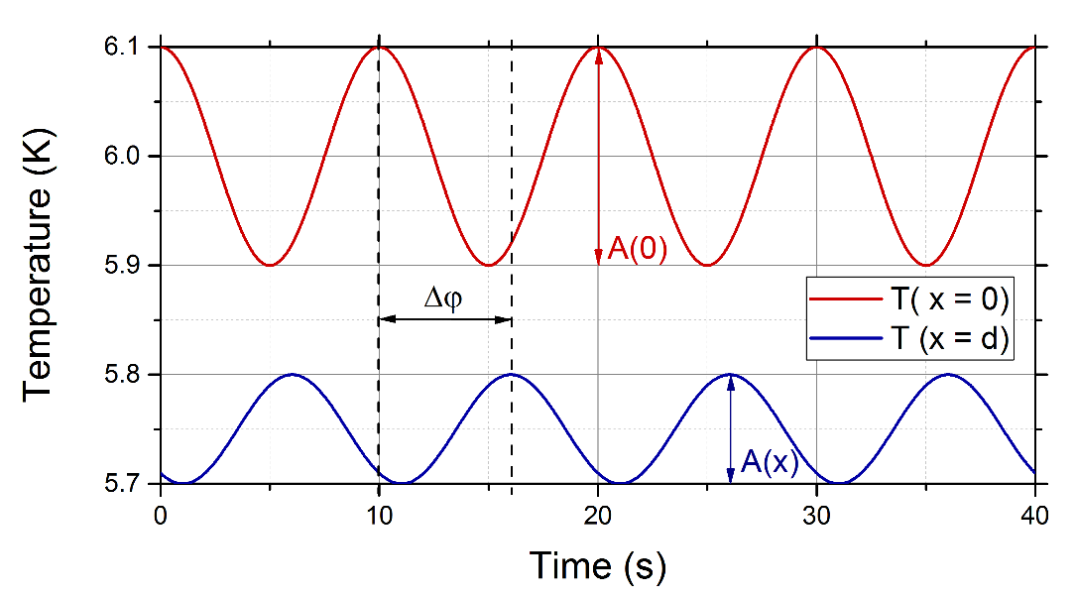

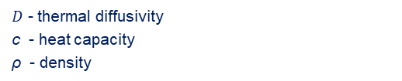
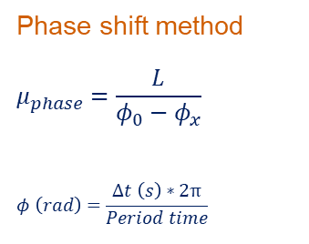
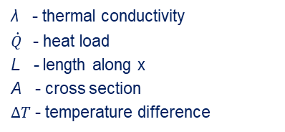
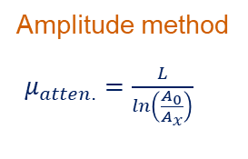
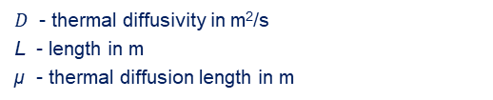
Measurement methodology I
λ - thermal conductivity
$\dot{Q}$- heat load
L - length along x
A - cross section
$ΔT$ - temperature difference
Thermal conductivity:
Thermal diffusivity:
$D$ - thermal diffusivity
c - heat capacity
ρ - density
Phase shift method
$$μ_{phase}=\frac{L}{φ_{0}−φ_{x}}$$
$$φ \left(rad\right)=\frac{Δt \left(s\right)∗2π}{Period time}$$
Amplitude method
$μ_{atten.}=\frac{L}{\ln\left(\frac{A_{0}}{A_{x}}\right)}$
$$D=\frac{μ^{2}∙ω}{2}$$
$D$ - thermal diffusivity in m²/s
L - length in m
µ - thermal diffusion length in m

Slide 6
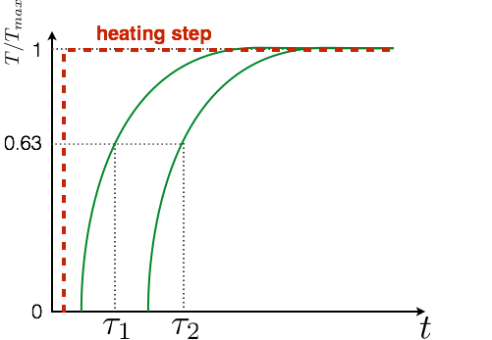
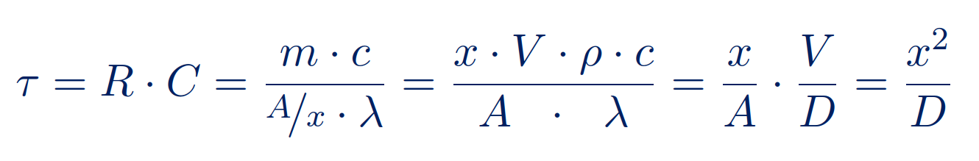
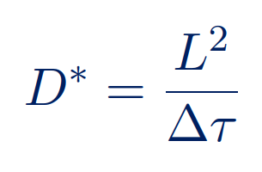

Measurement methodology II
$τ$ - method

Slide 7
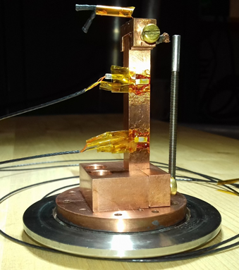
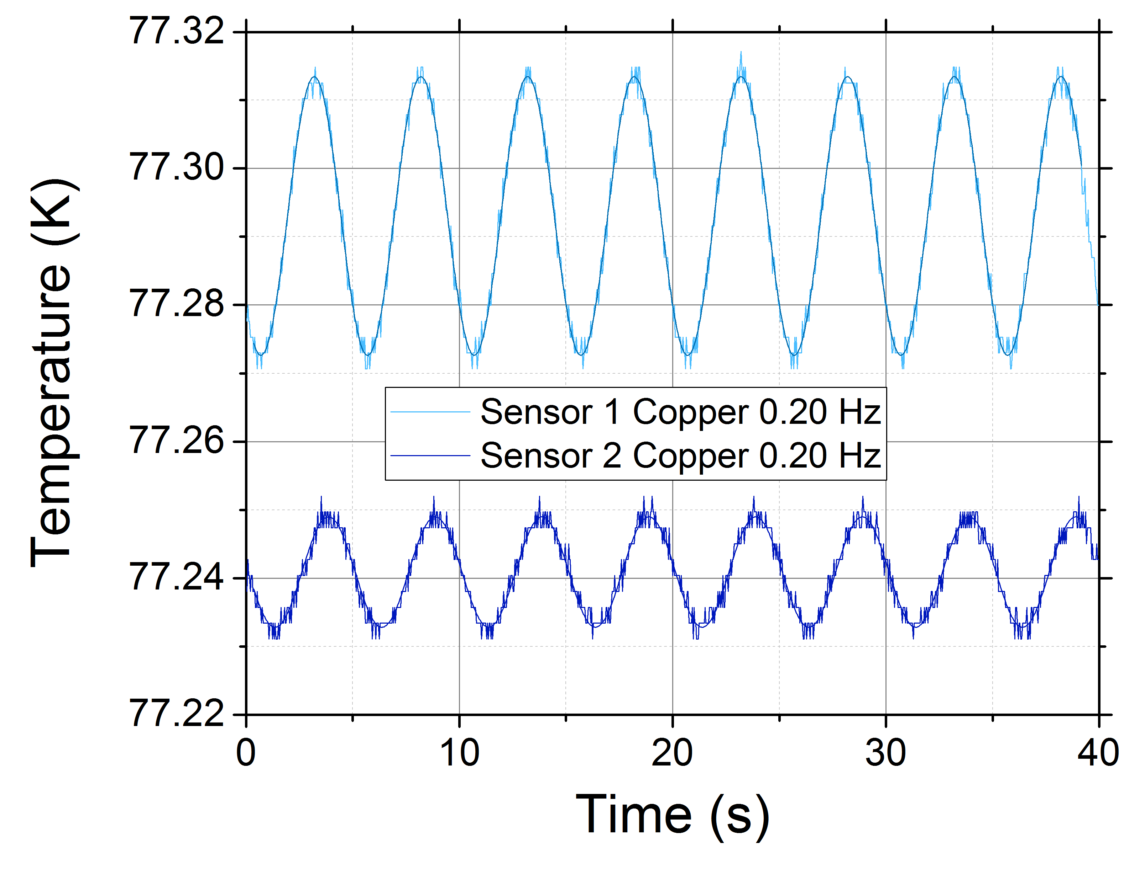
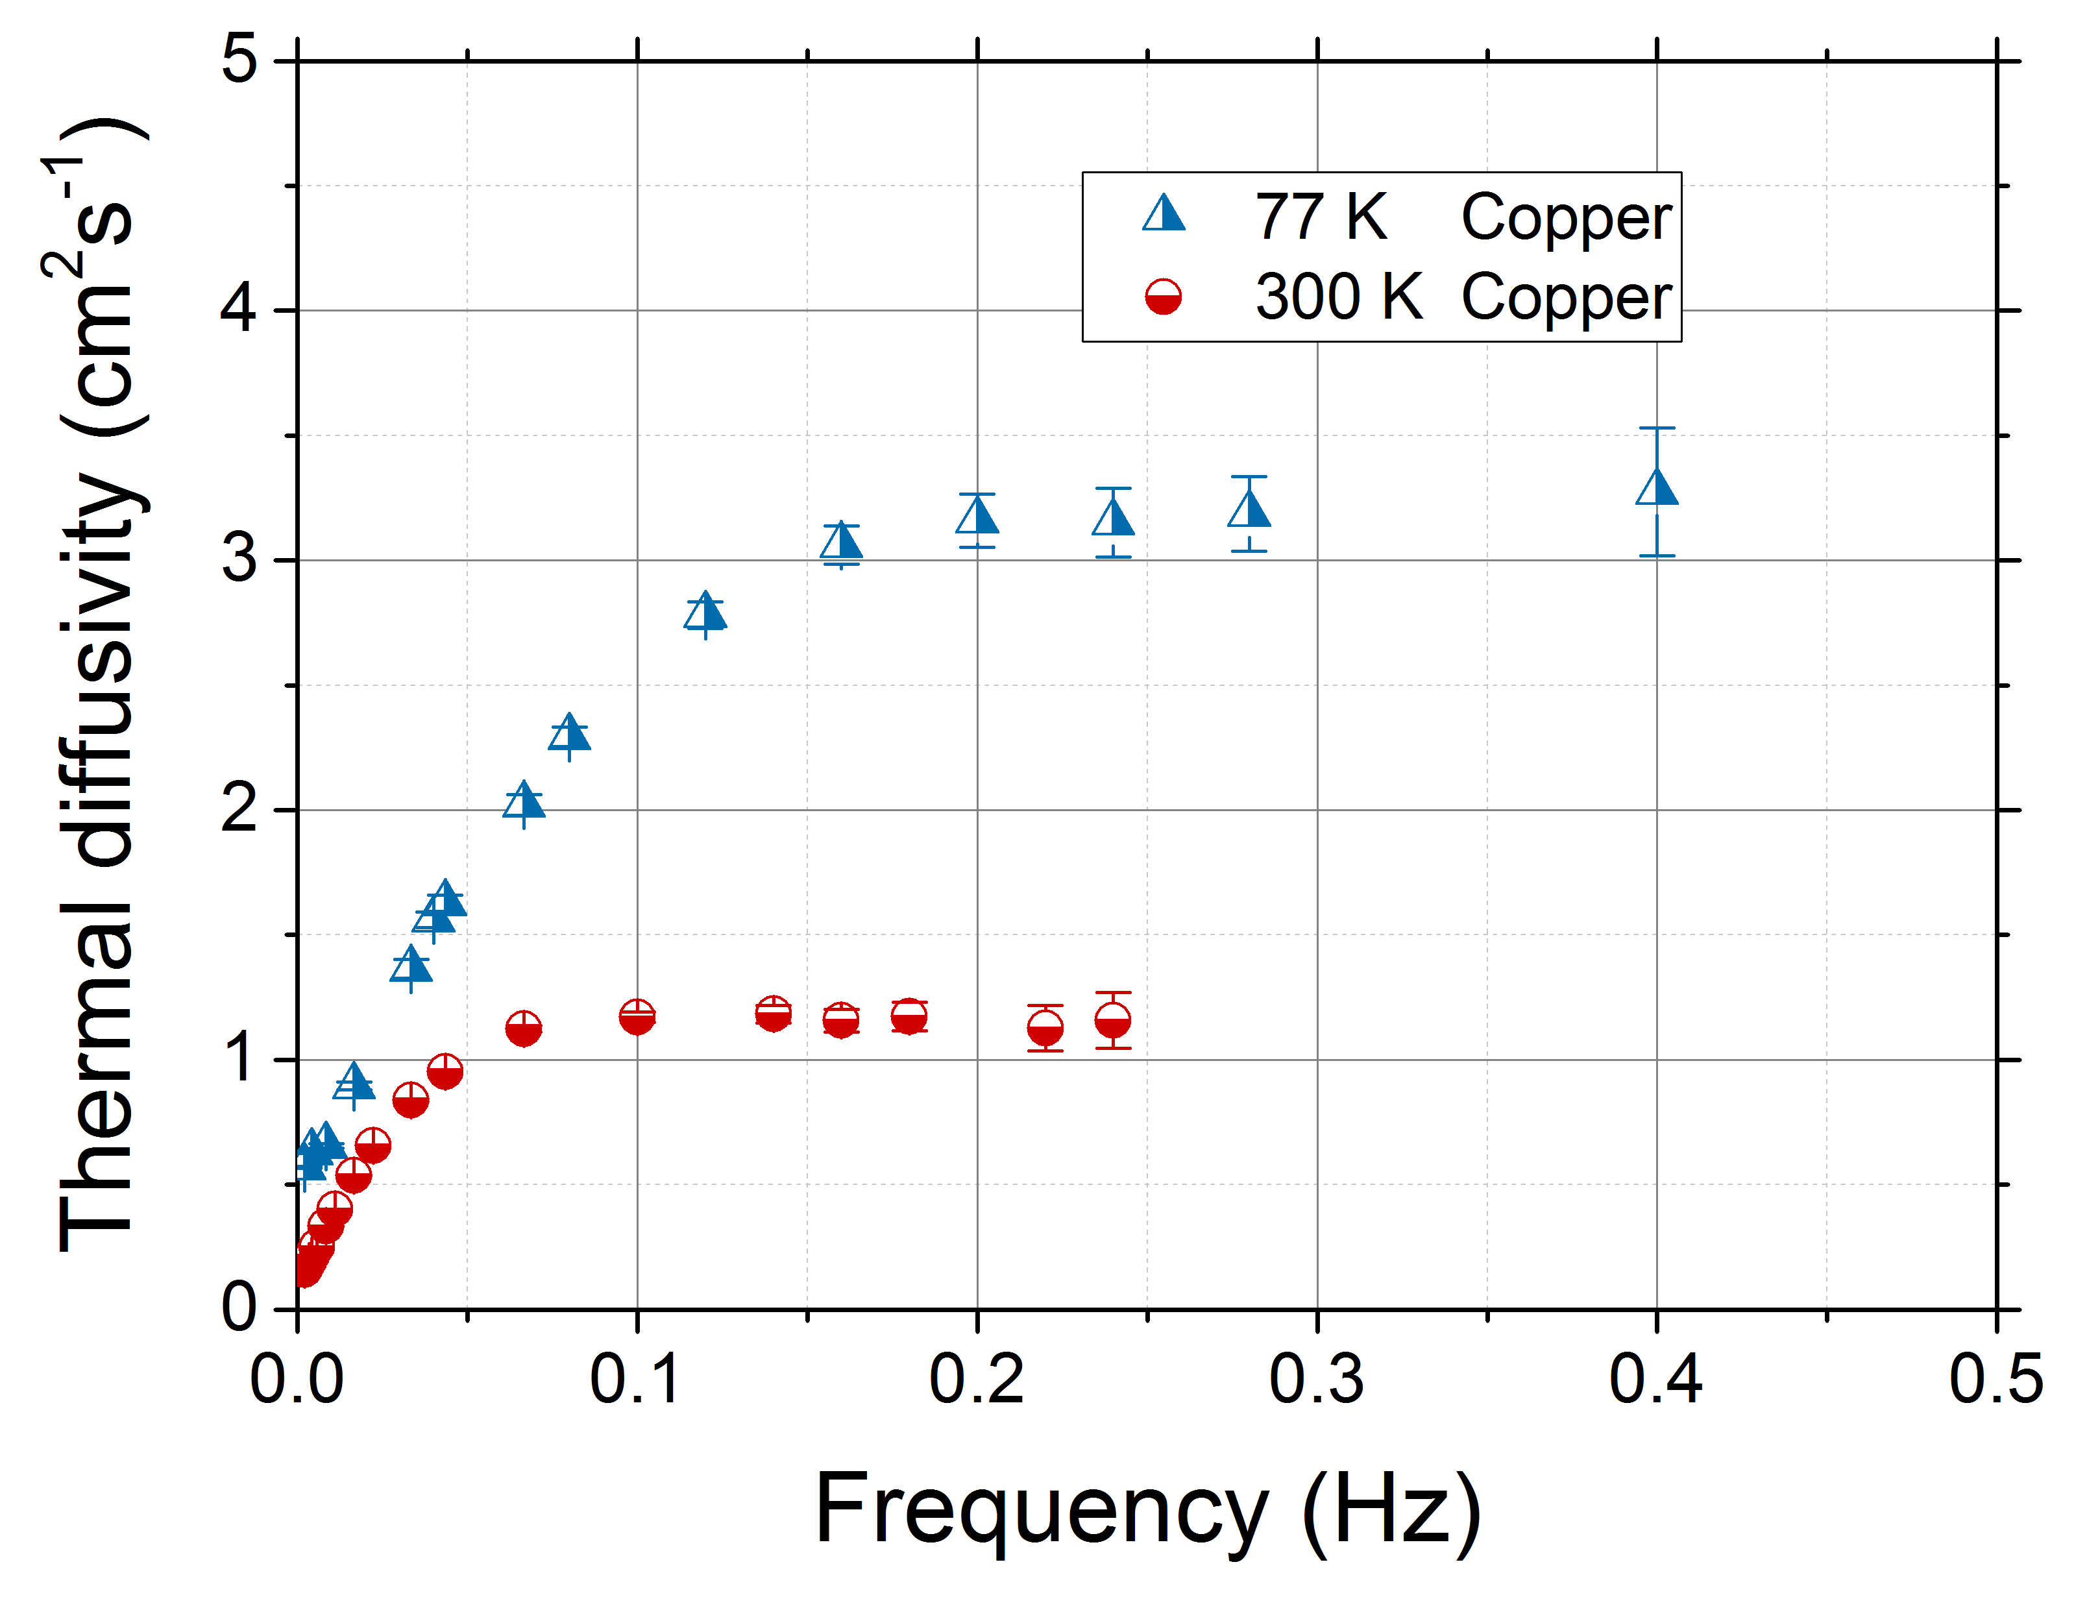
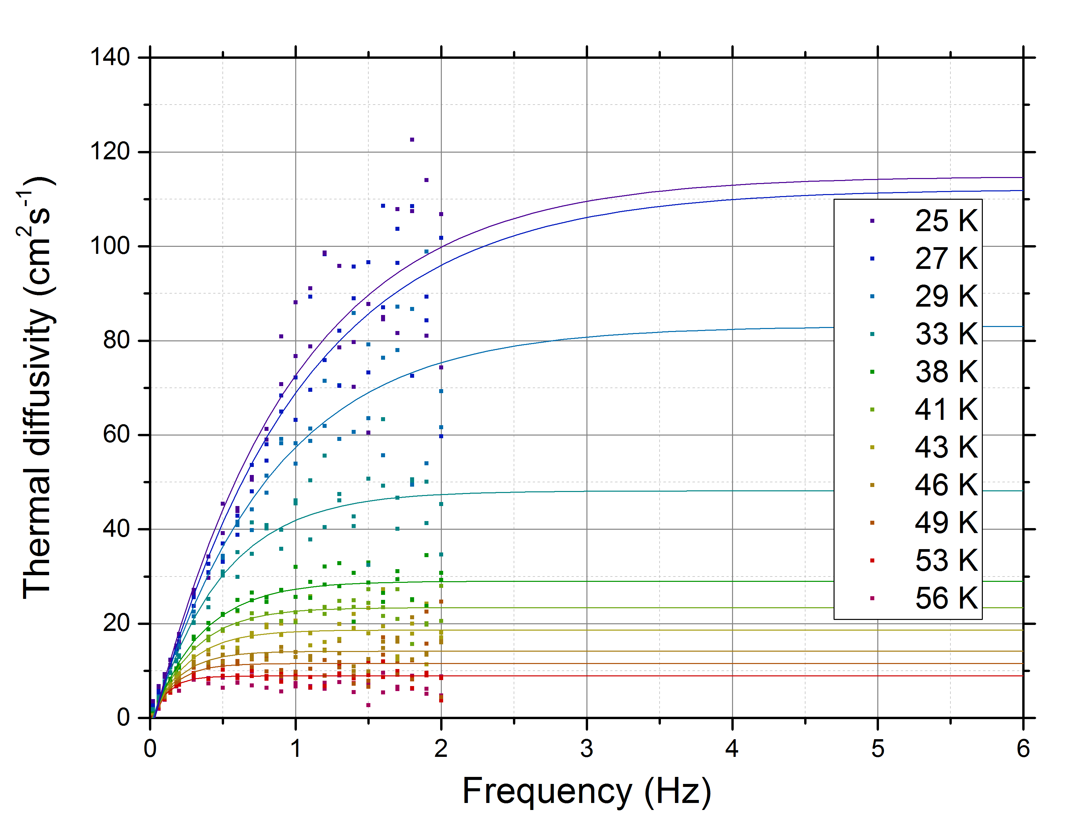
Diffusivity measurements on reference sample Cu-OFHC
Oxygen-free high-conductivity
(OFHC) copper
Dimensions:
8 x 8 x 50 mm³
Frequency dependence
At frequencies > threshold thermal diffusivity constant
Threshold frequency is higher at low temperatures

Slide 8
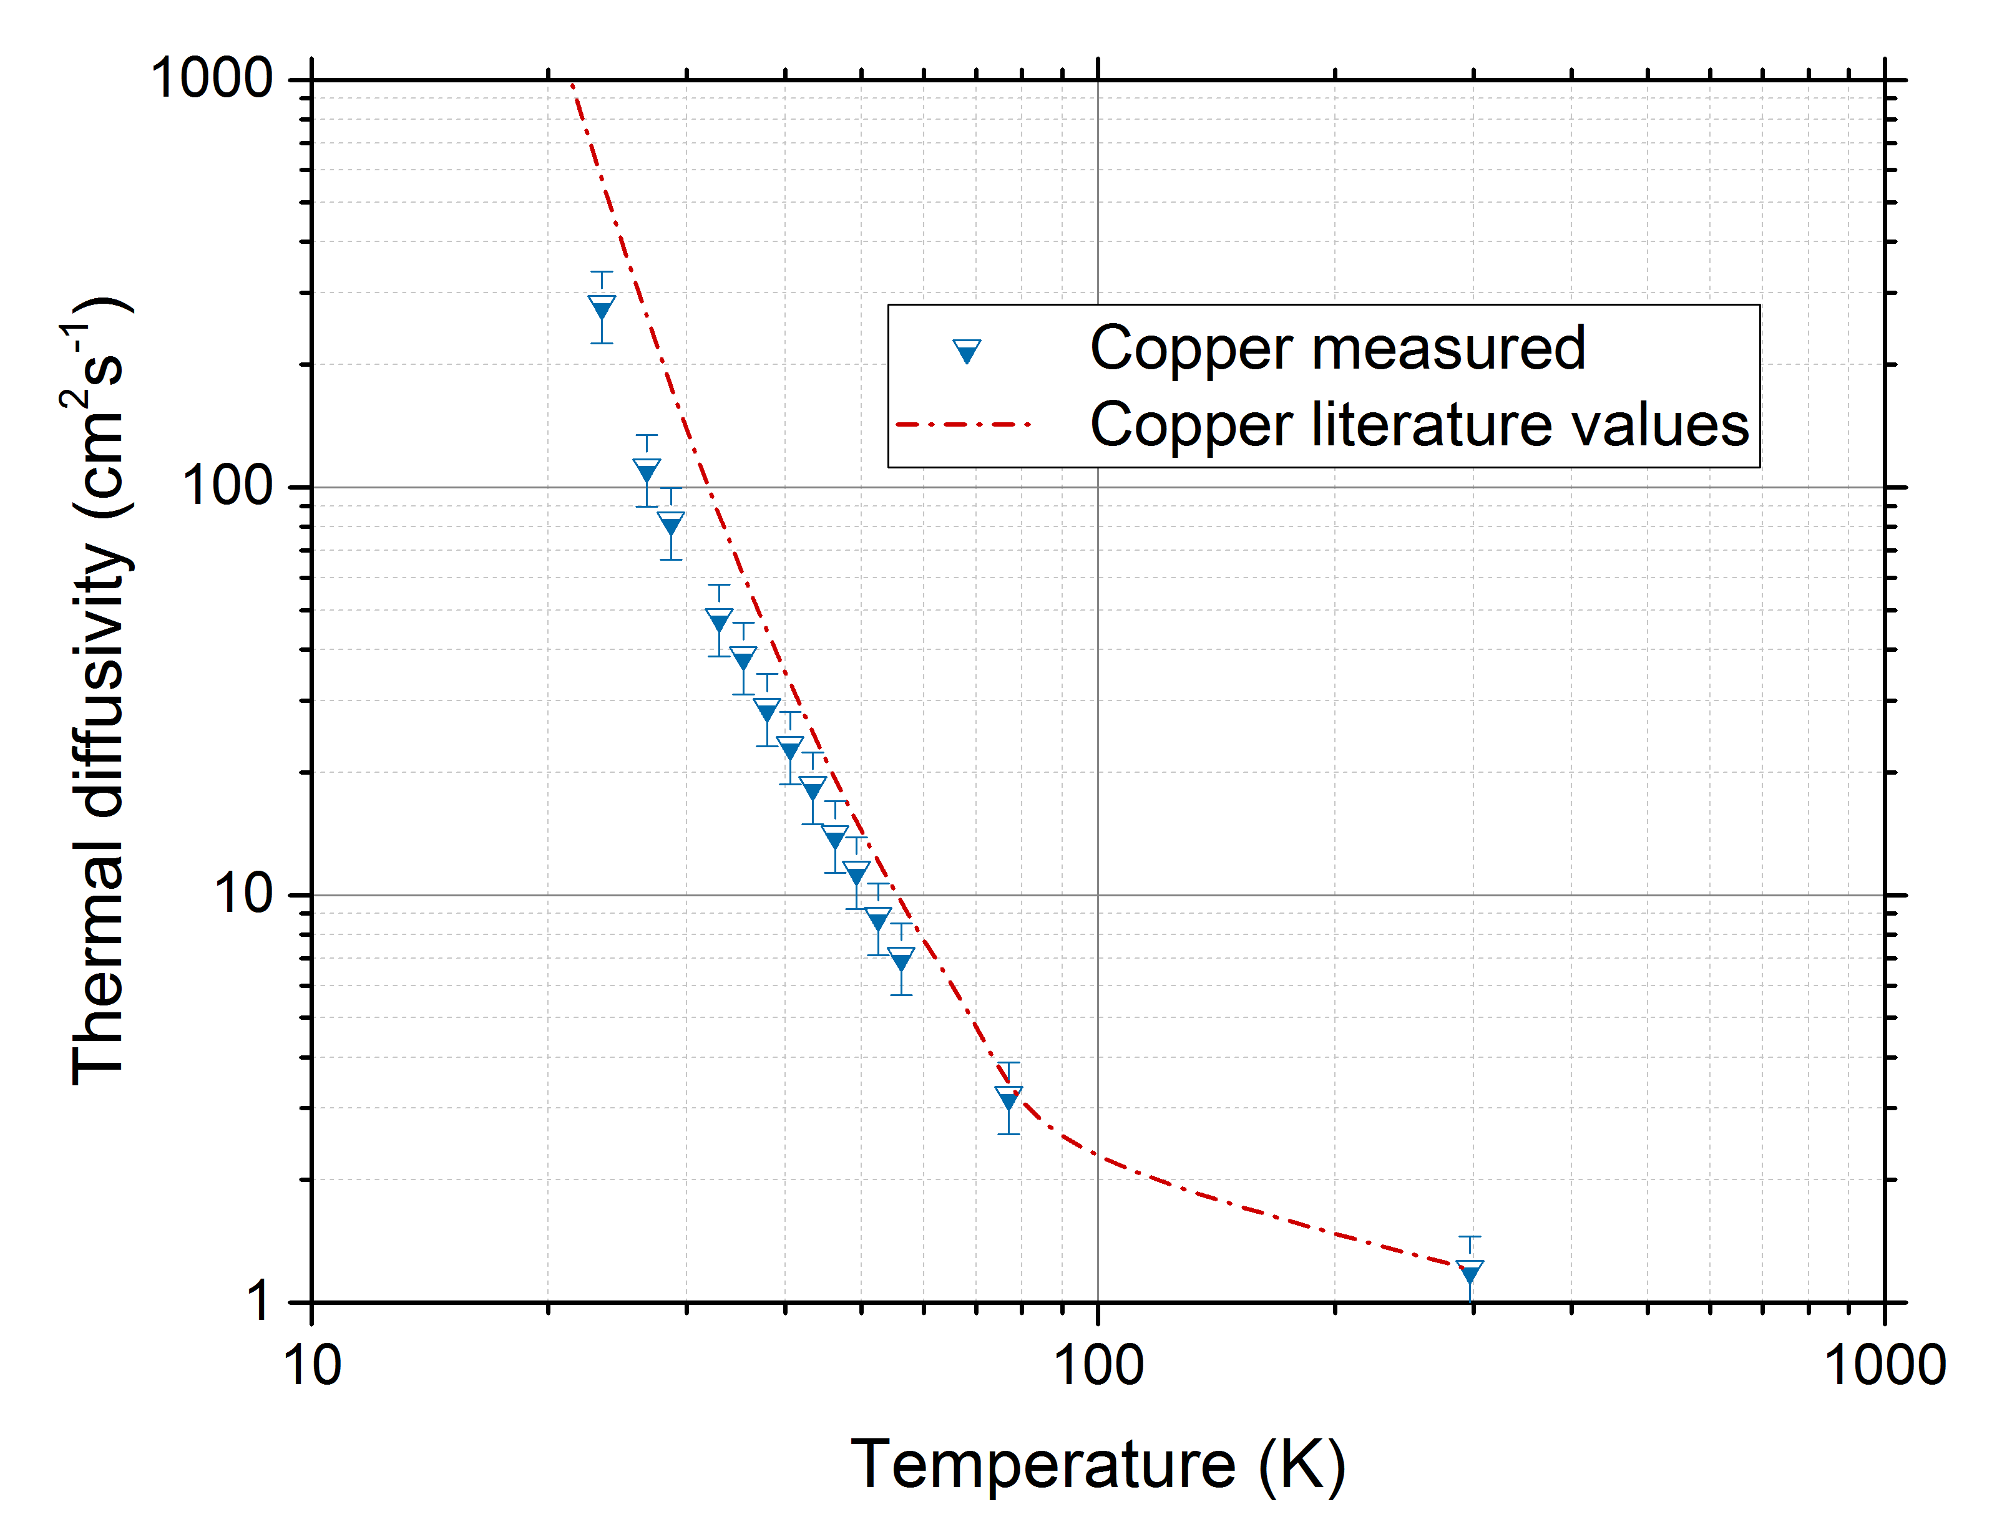
Diffusivity measurements on reference sample Cu-OFHC
D(T) measured is in good agreement with literature values.
Amplitude method can be used for more complex samples
Samples and interfaces need to be adapted
Literature data from: J. E. Jensen et al., Thermal Diﬀusivity, Brookhaven National Laboratory Selected Cryogenic Data Notebook, Brookhaven National Laboratory (1980).
OFHC copper tested RRR~100 from th. conductivity results

Slide 9
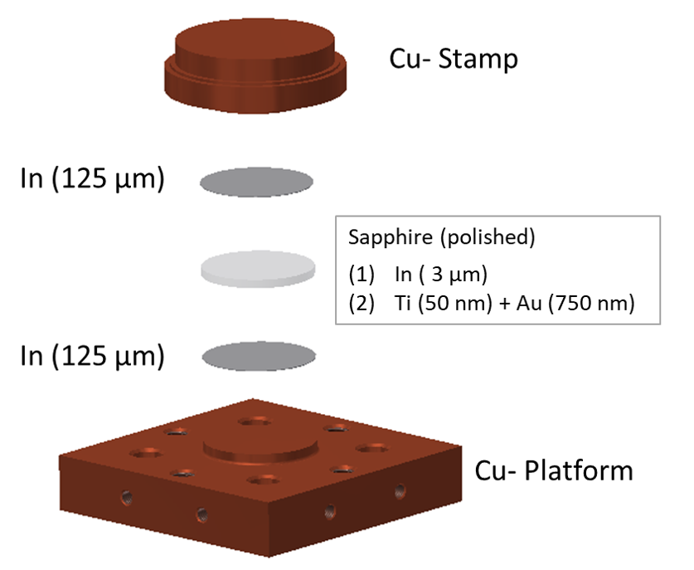
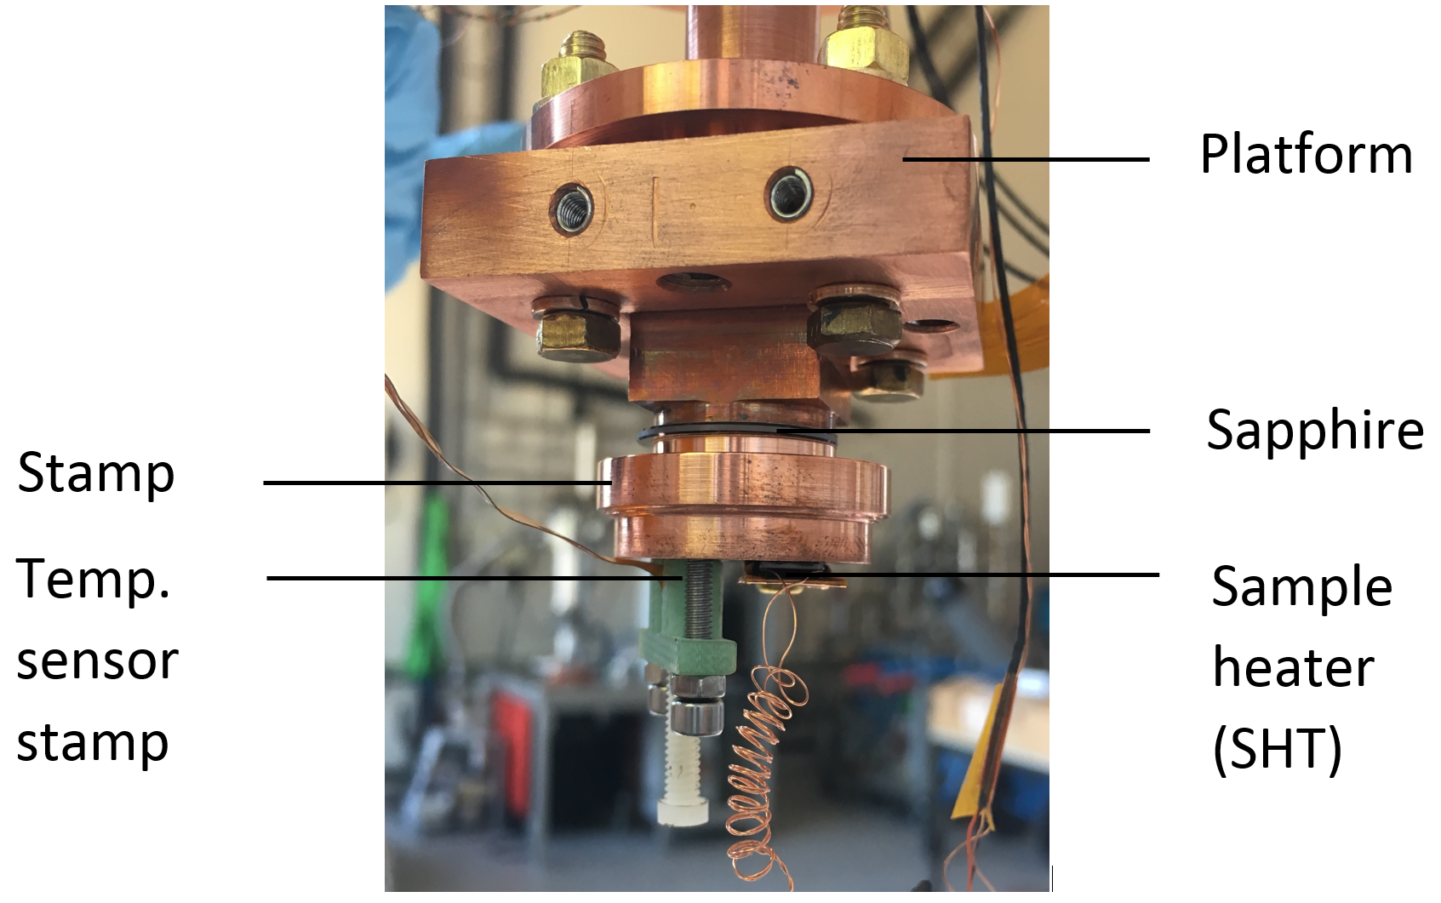
Thermal diffusivity of a Cu-In- sapphire and Cu-In-Au-Ti-sapphire sandwich
Link to
cryocooler
Indium sample : Cu-In-sapphire-In-Cu
Ti-Au sample: Cu-In-Au-Ti-sapphire-Ti-Au-In-Cu
See results presented by J. Liberadzka in her talk: E-09: 32
Definition of a diffusivity-like value (due to the presence of interfaces) => $D^{∗}$

Slide 10
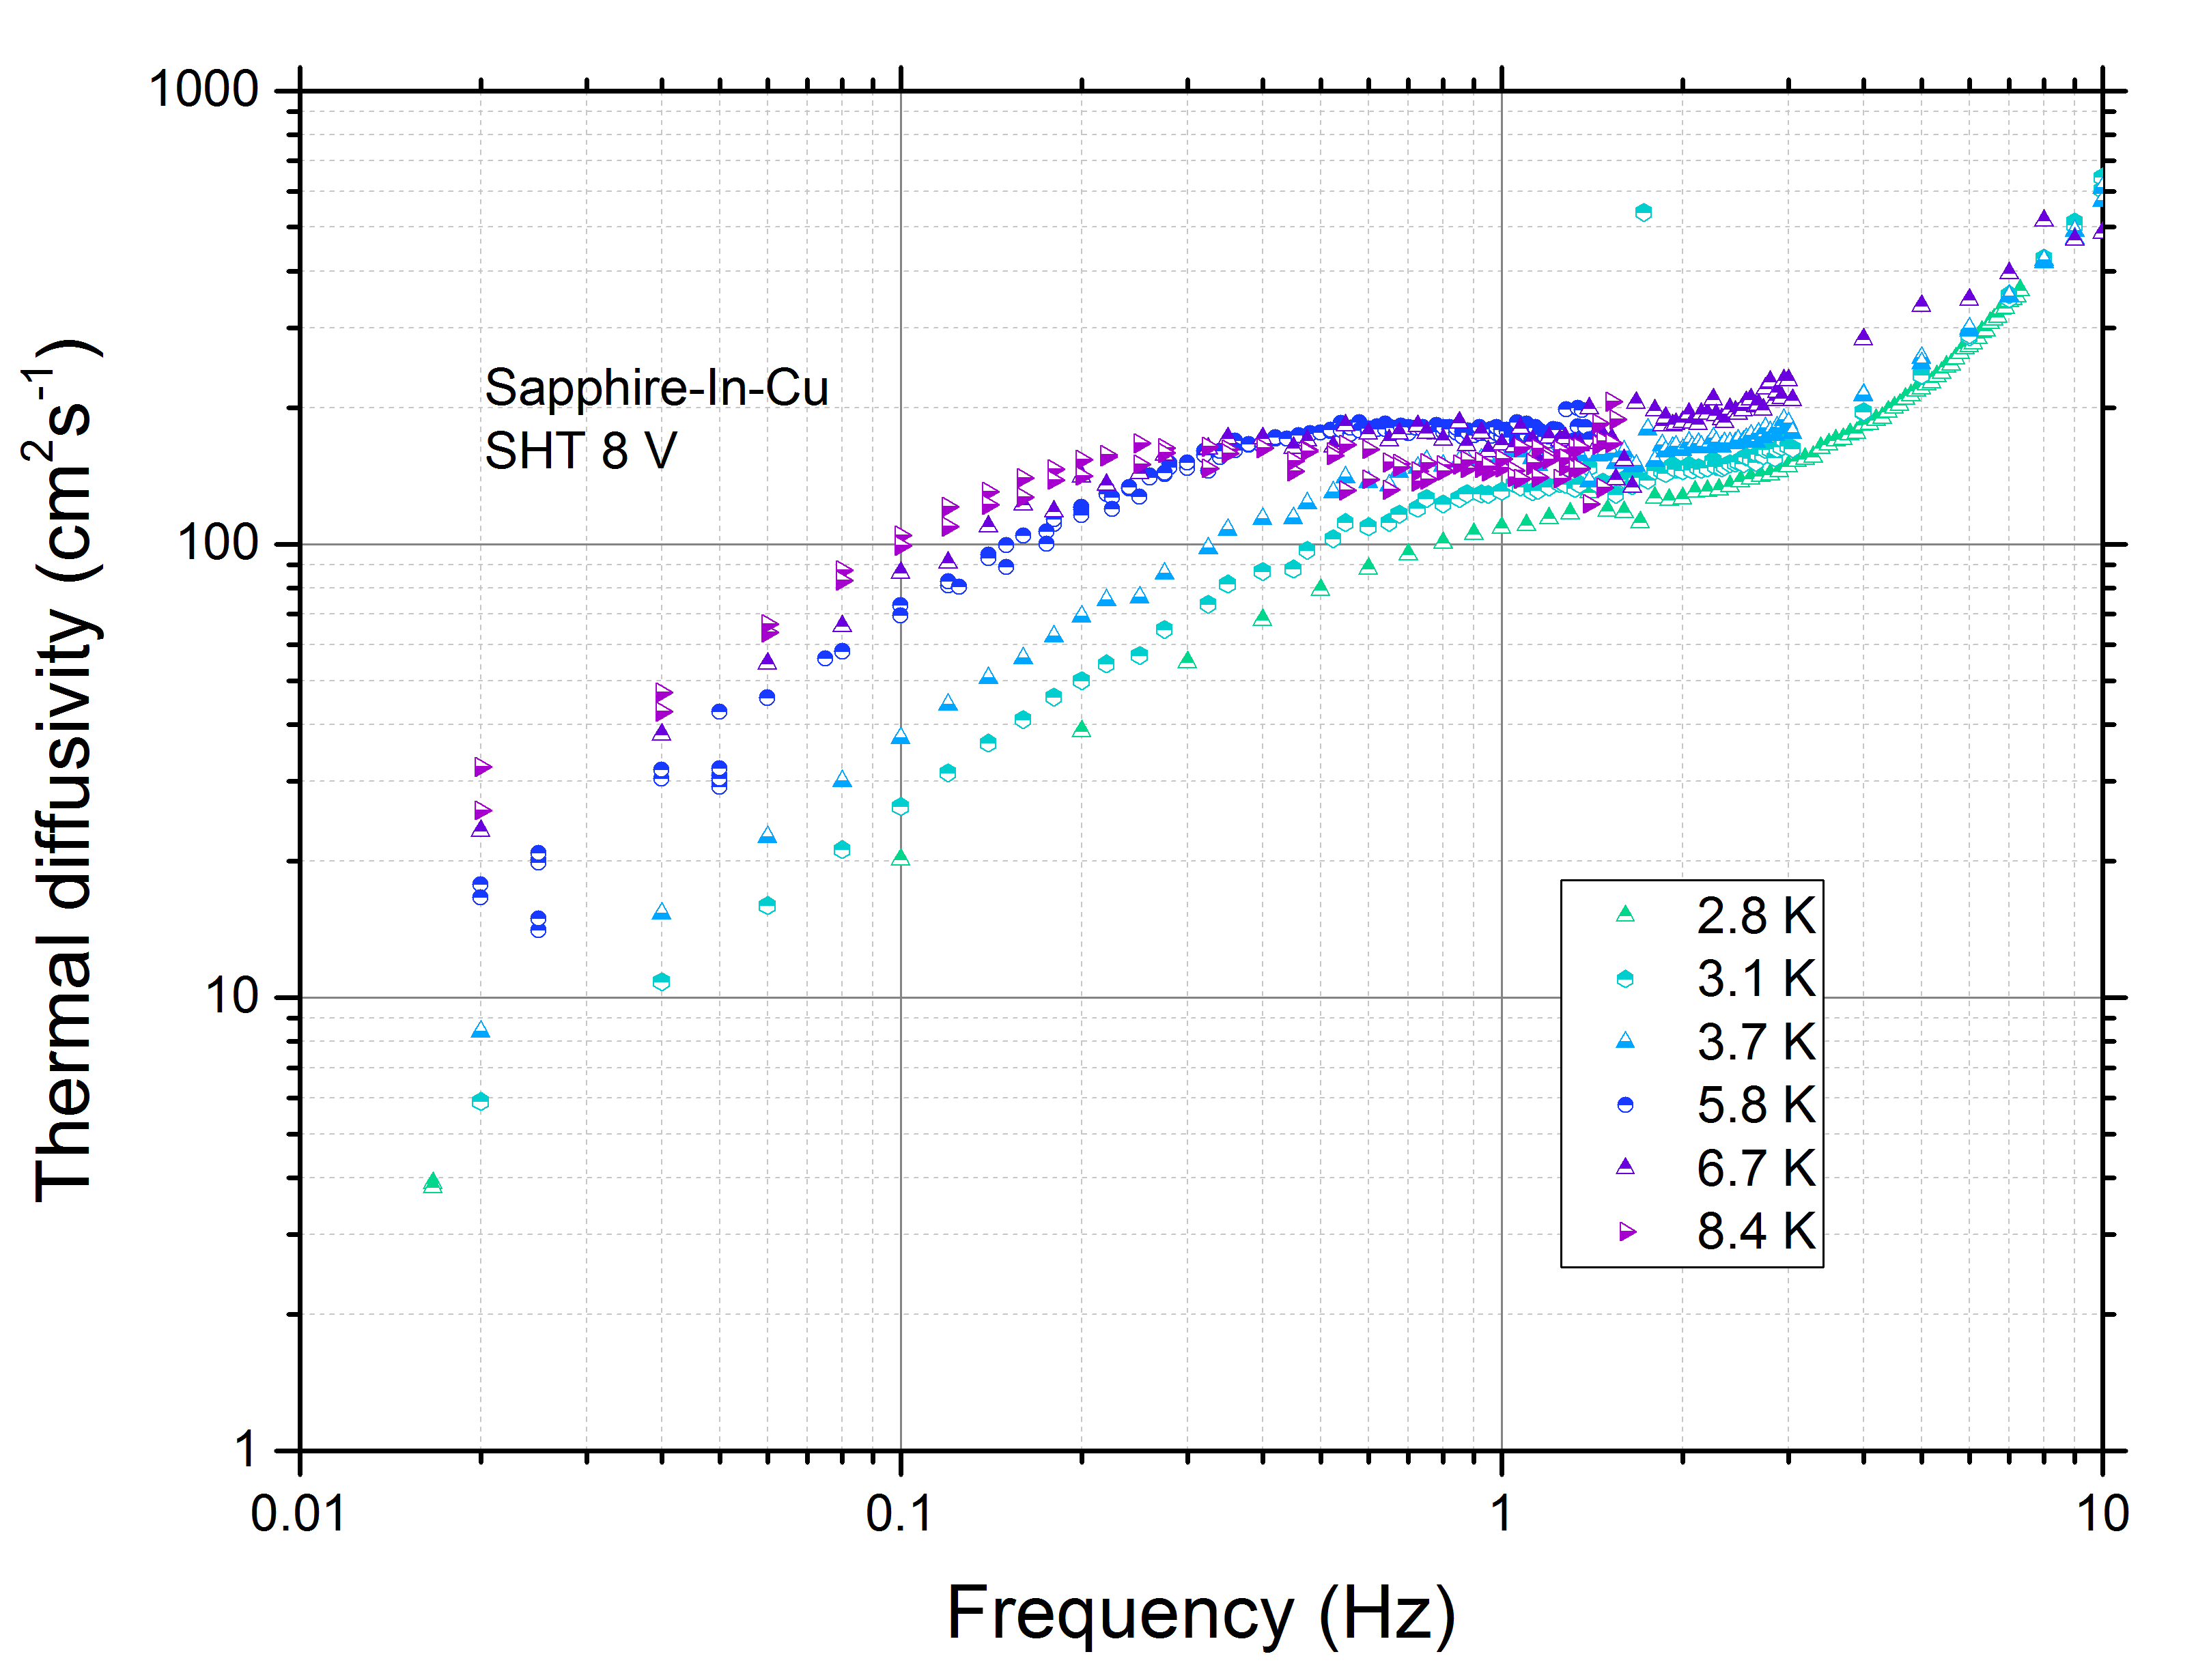
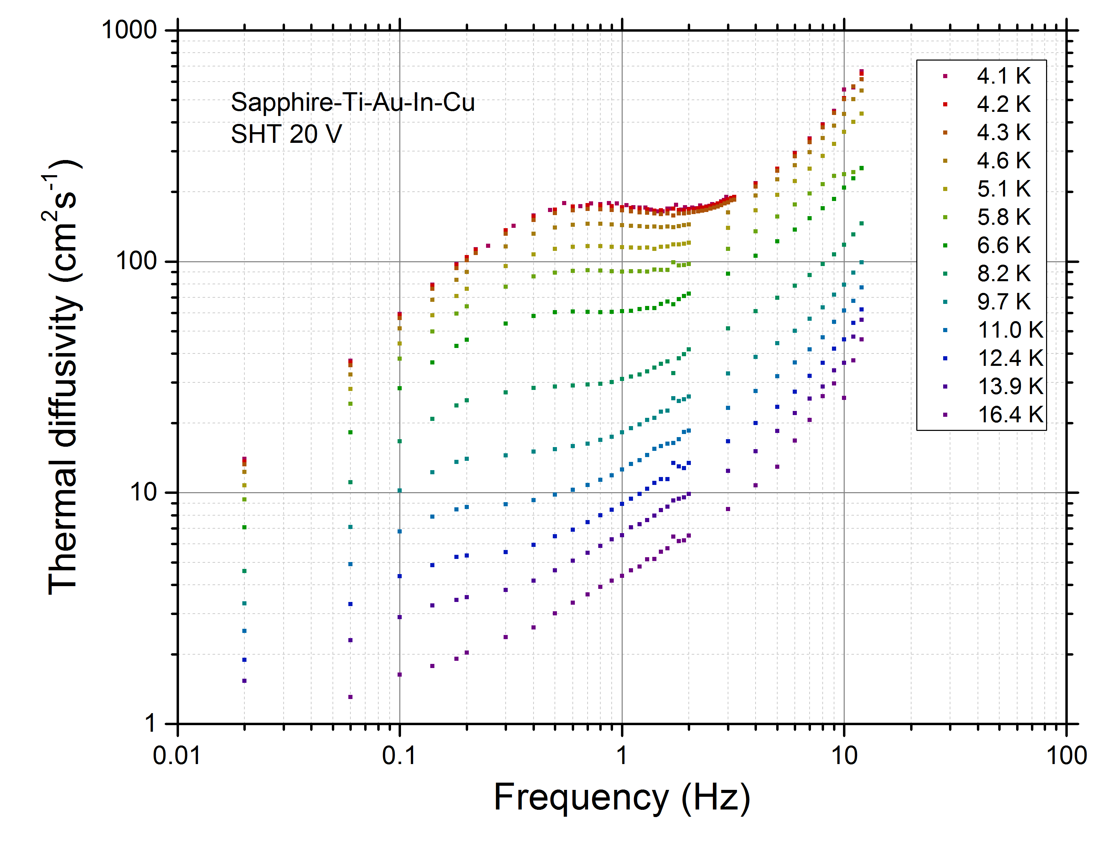
Thermal diffusivity of a Cu-In-sapphire and Cu-In-Au-Ti-sapphire sandwich
Cu-In-Sapphire
Cu-In-Au-Ti-Sapphire
Influences by the cryocooler frequency and threshold frequency are visible
There is a clever solution to attenuate the cryocooler oscillations and increase $τ_{th. link}$

Slide 11
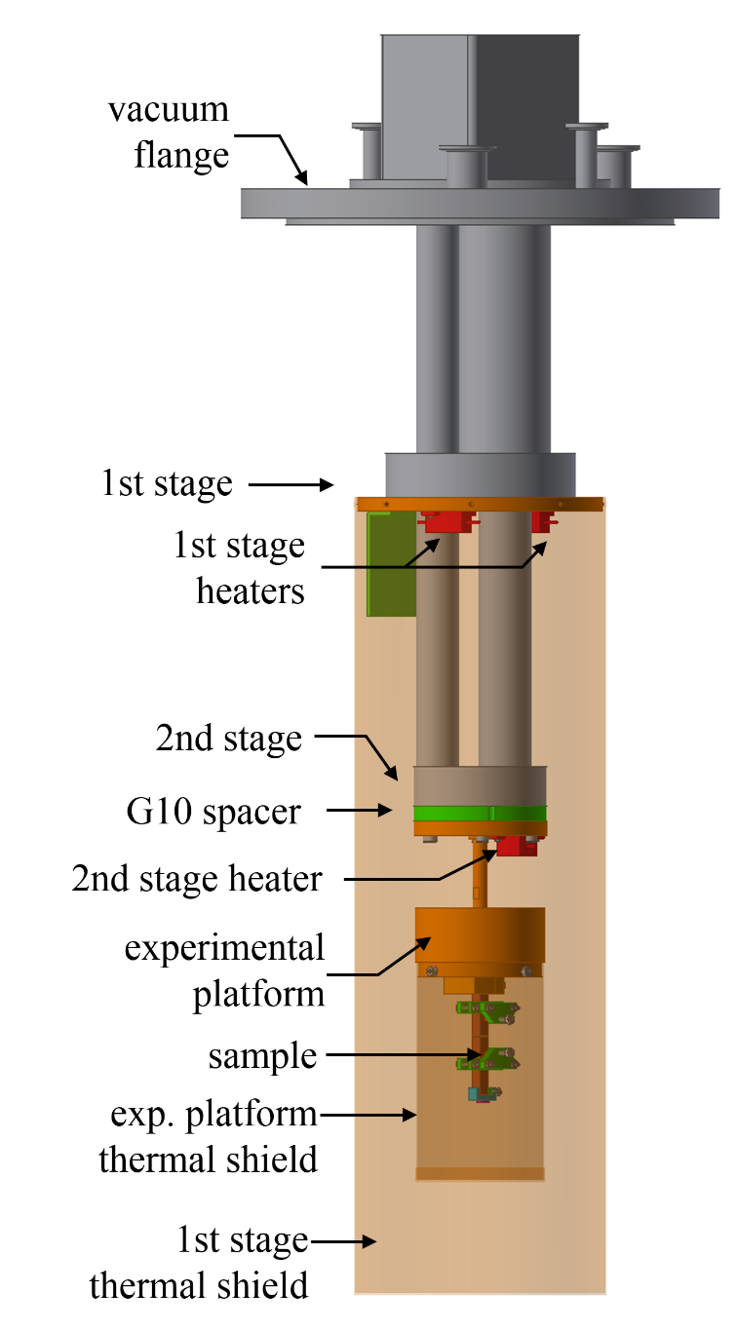
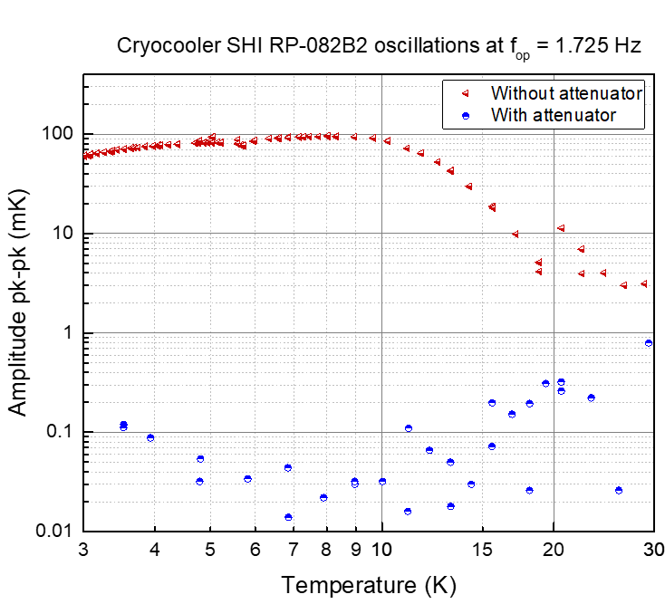
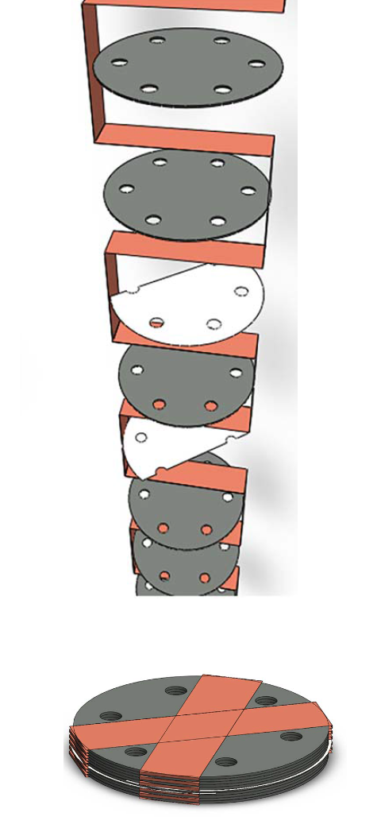
Passive thermal attenuator (G. Dubuis)
Our version CERN Cryolab with:
Pb and stainless steel disks +
Cu meander
Attenuator
No load temp. rises from 2.8 K to 3.4 K
Courtesy: G. Dubuis, X. He, and I. Božovic,
Sub-milliKelvin stabilization of a closed cycle cryocooler, Rev. Sci. Instrum. 85, 103902 (2014).

Slide 12
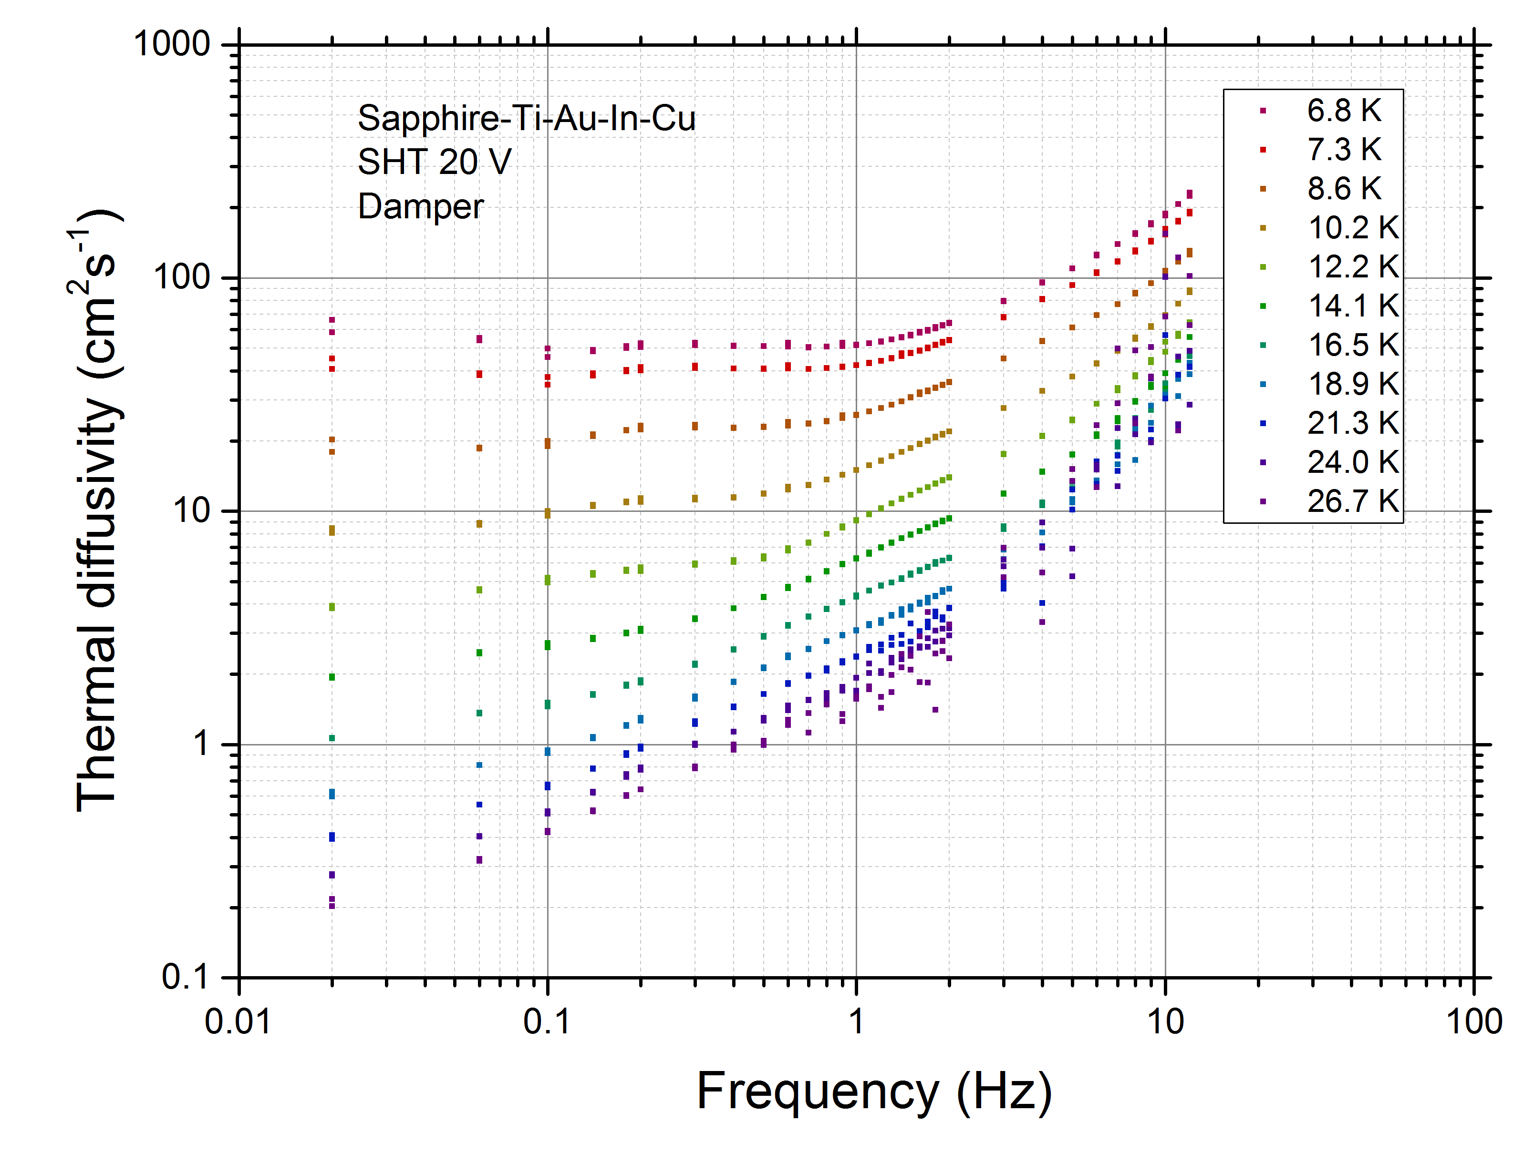
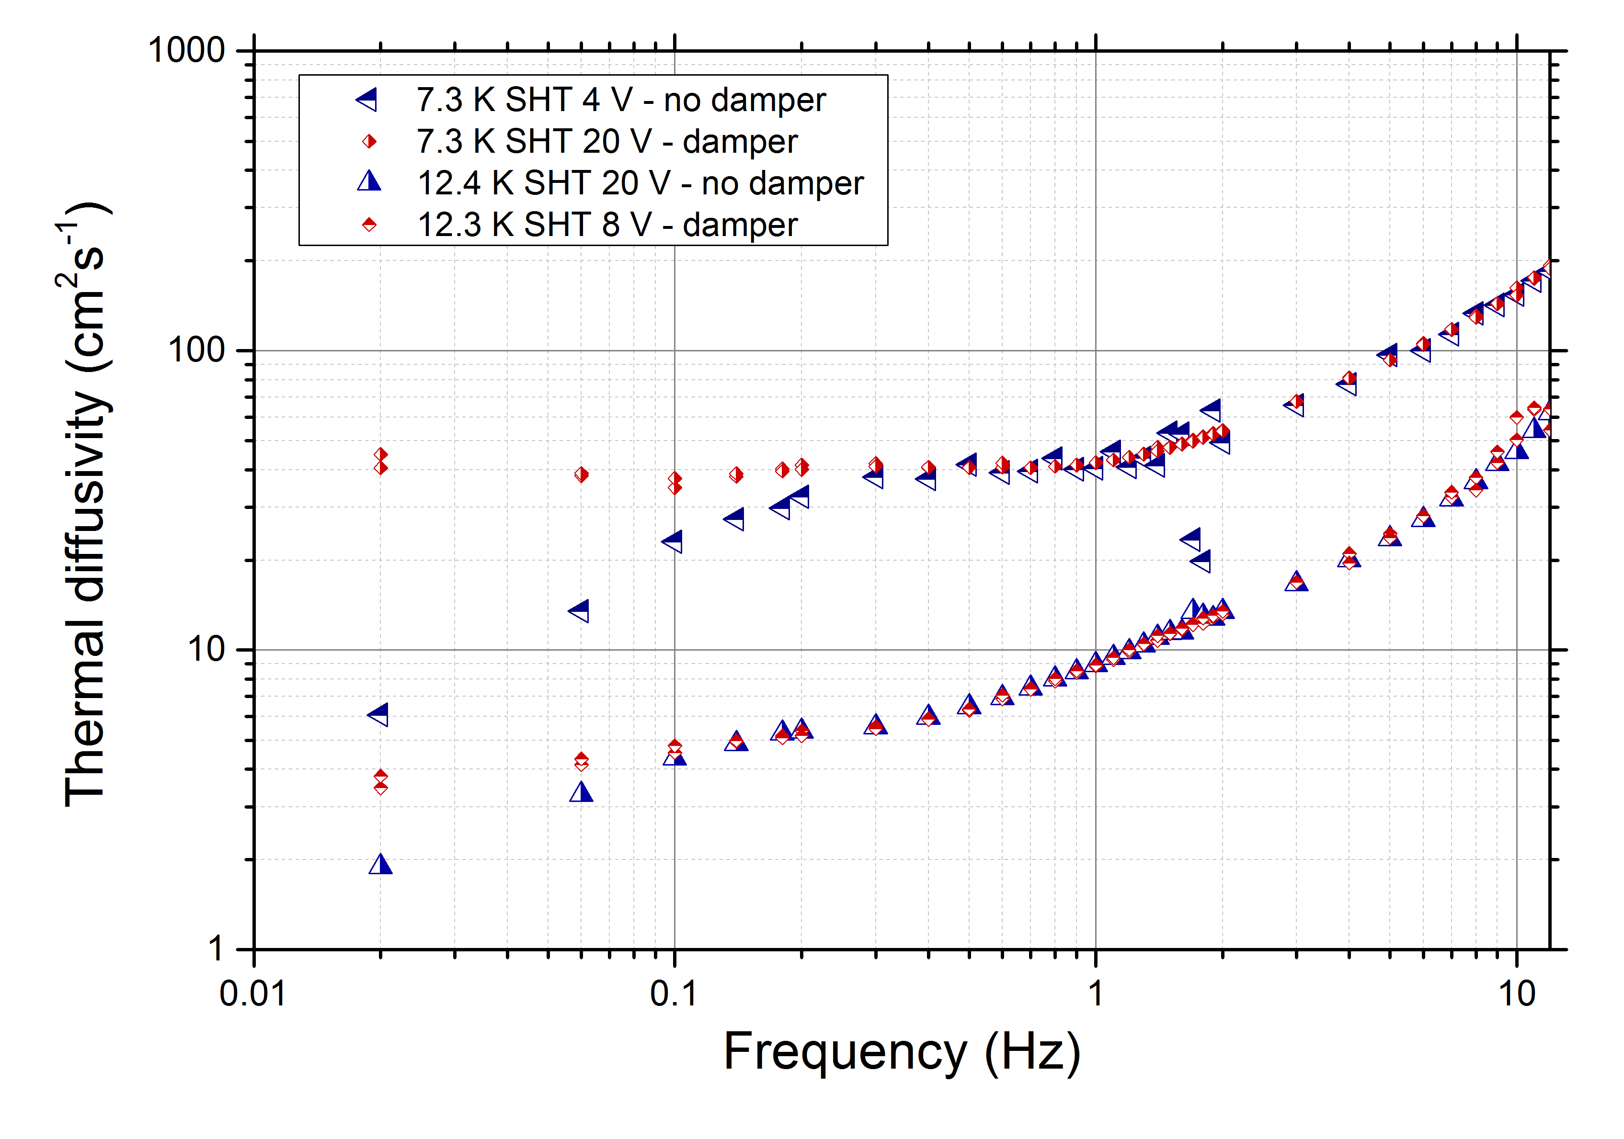
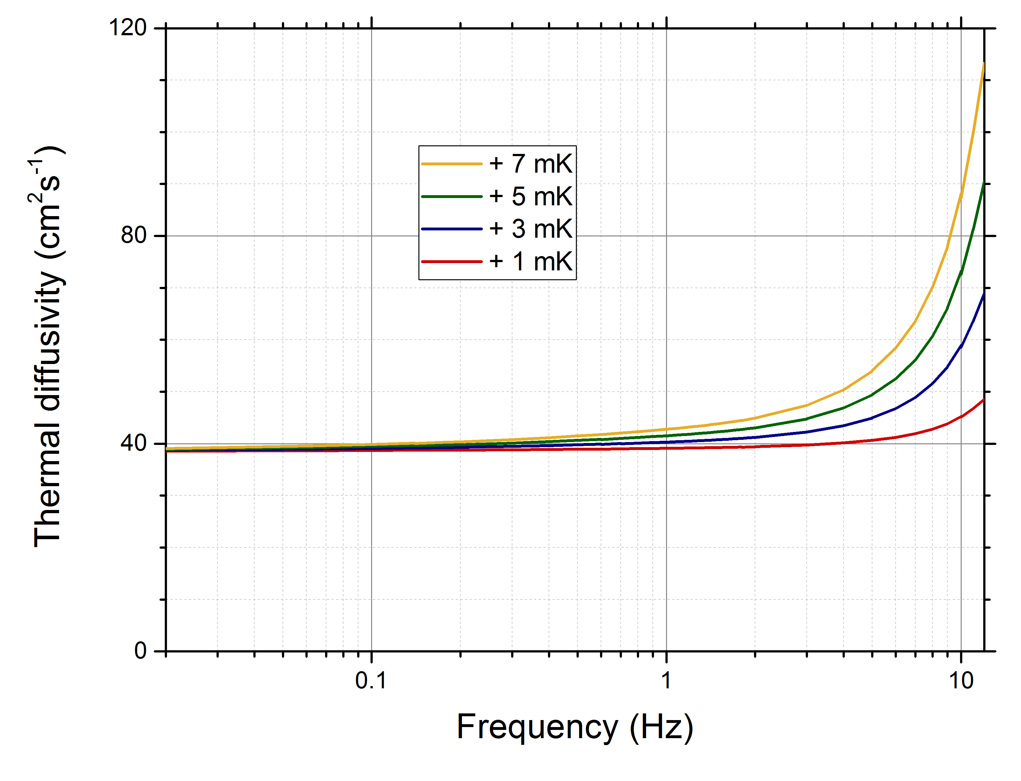
Thermal diffusivity of a Cu-In-sapphire and Cu-In-Au-Ti-sapphire sandwich
Measurement accuracy dT

Slide 13
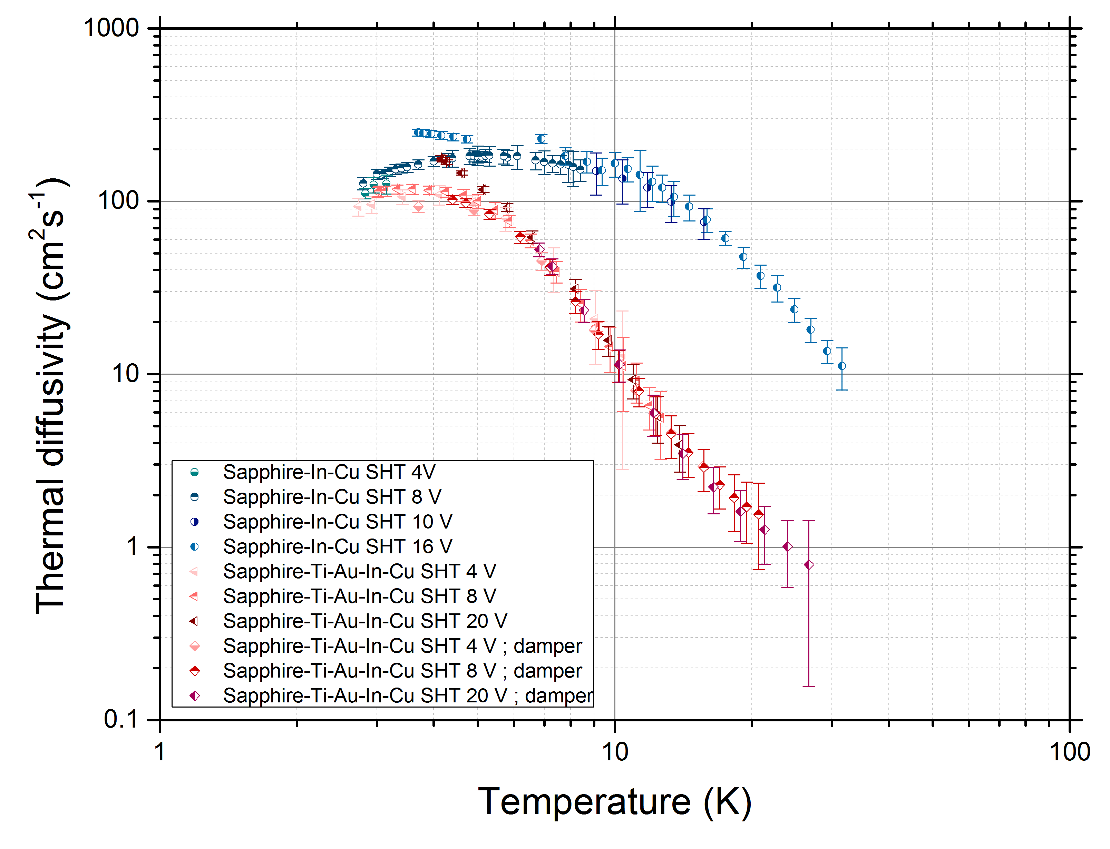
Thermal diffusivity of a Cu-In- sapphire and Cu-In-Au-Ti-sapphire sandwich
D*_{Cu-In-Sapphire} > D*_{Cu-In-Au-Ti-Sapphire}
D*_{max,Cu-In-Au-Ti-Sapphire} is at lower T
Curves almost merge at about 3 K
Cu-In-Au-Ti-Sapphire has additional interfaces → additional thermal resistance
Numerical modelling of that structure =>

Slide 14
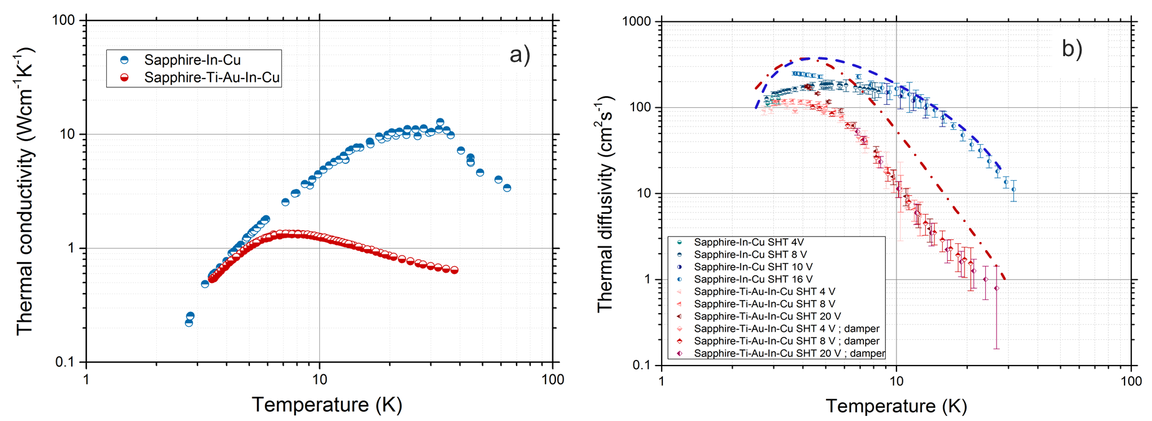
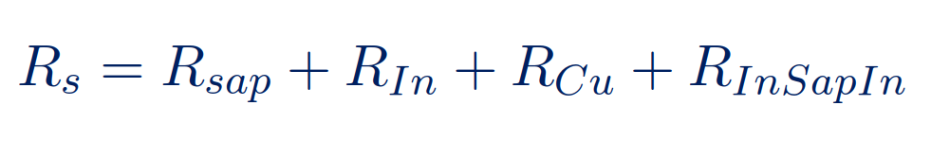
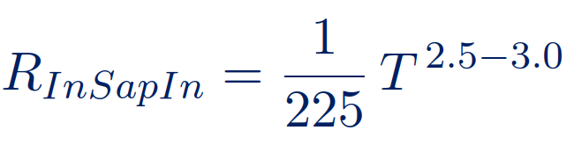
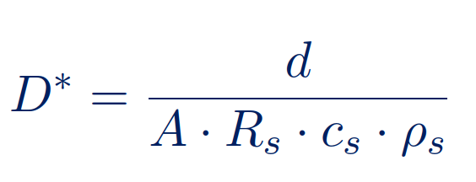
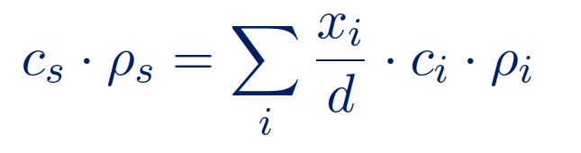
Thermal diffusivity of a Cu-In-sapphire and Cu-In-Au-Ti-sapphire sandwich
Numerical modelling =>
measured thermal conductivity
Remaining deviation for Au-Ti-sapphire sandwich is attributed to the formation add. interlayers
Geometry +

Slide 15
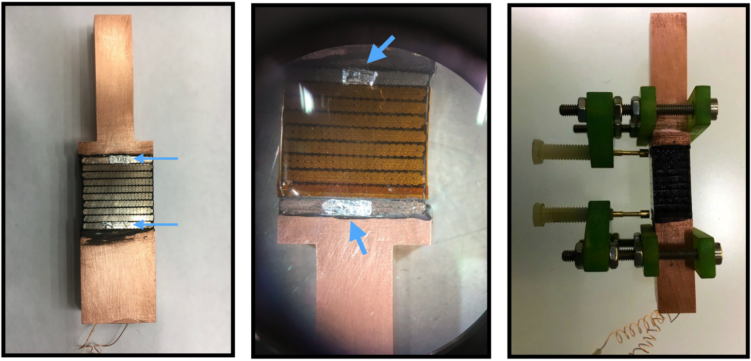
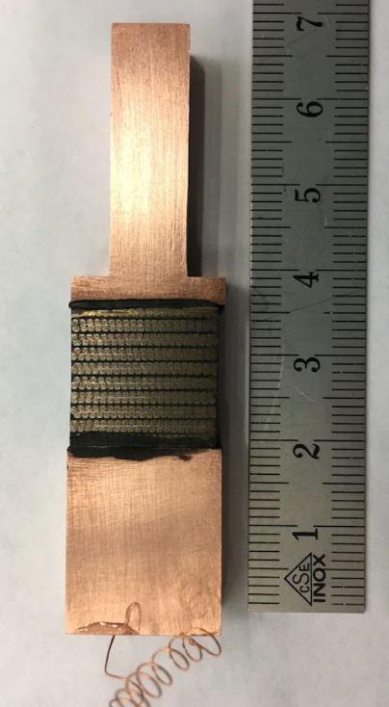
Comparing methods: amplitude attenuation vs. step function
Sample:
Nb₃Sn Rutherford type cable stack of 11 T dipole, fully impregnated
a)
b)

Slide 16
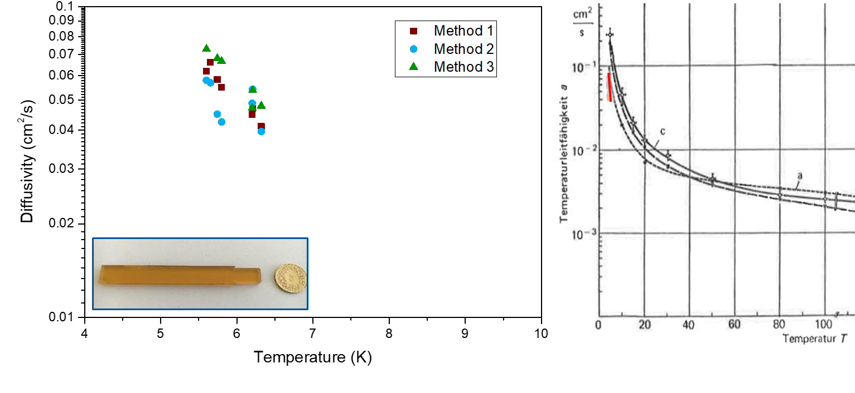
Conclusion
Evaluation of measurement methods
OFHC-copper measurement and comparison with literature values
Inhomogenous stackd with dielectric-metal interfaces
Comparison of methods for bulk samples
Amplitude attenuation and step methods seem to be complementary
CTD 101K

Slide 18
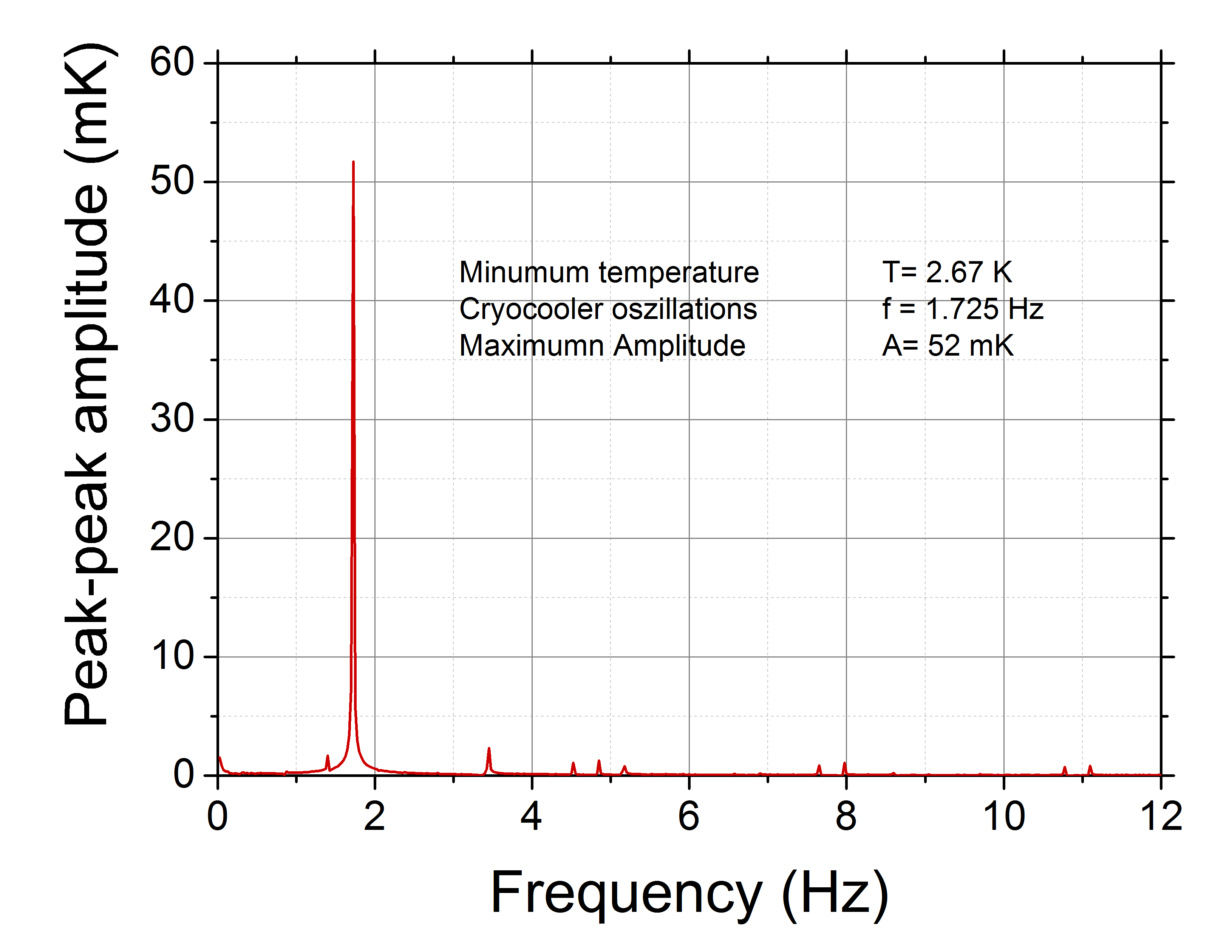
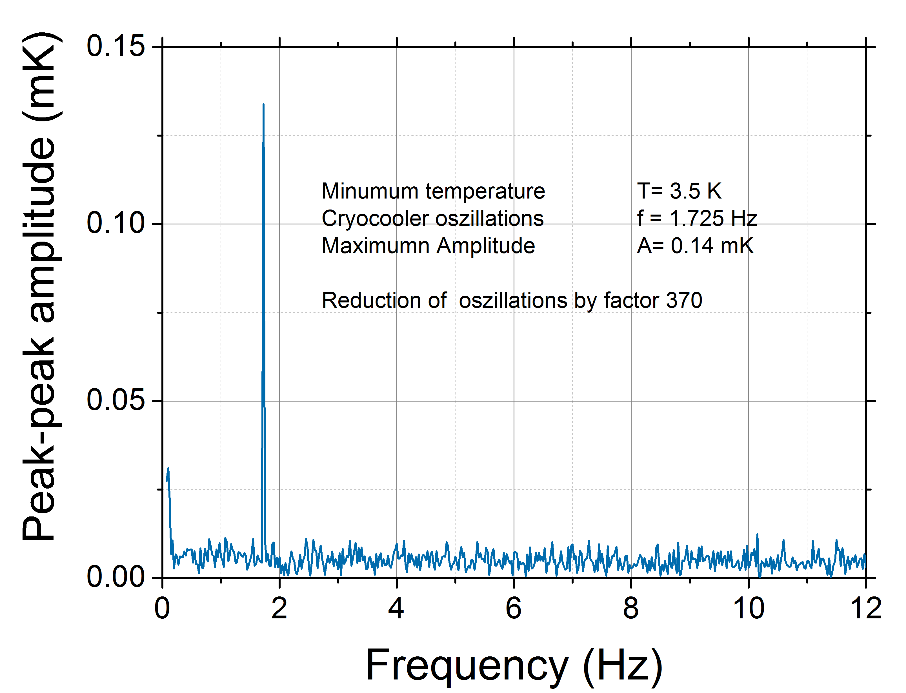
Passive thermal attenuator
Pb and stainless disks +
Cu meander
Attenuator
Courtesy: G. Dubuis, X. He, and I. Božovic,
Sub-milliKelvin stabilization of a closed cycle cryocooler, Rev. Sci. Instrum. 85, 103902 (2014).

Slide 19
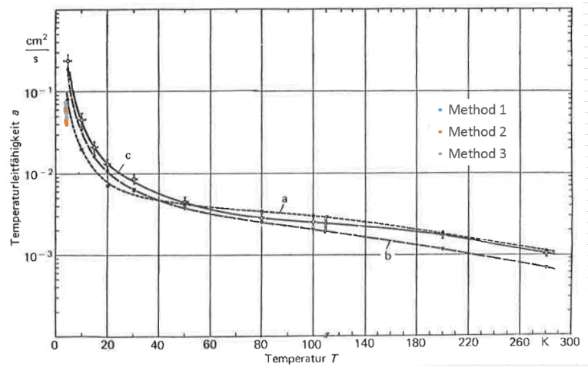
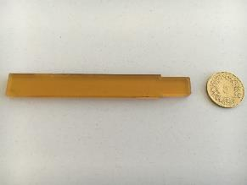
HiLumi LHC_{11 T Nb3Sn Dipole} => CTD-101K bulk epoxy sample
From: Frey, H. and Haefer, R. A., Tieftemperaturtechnologie

Slide 20
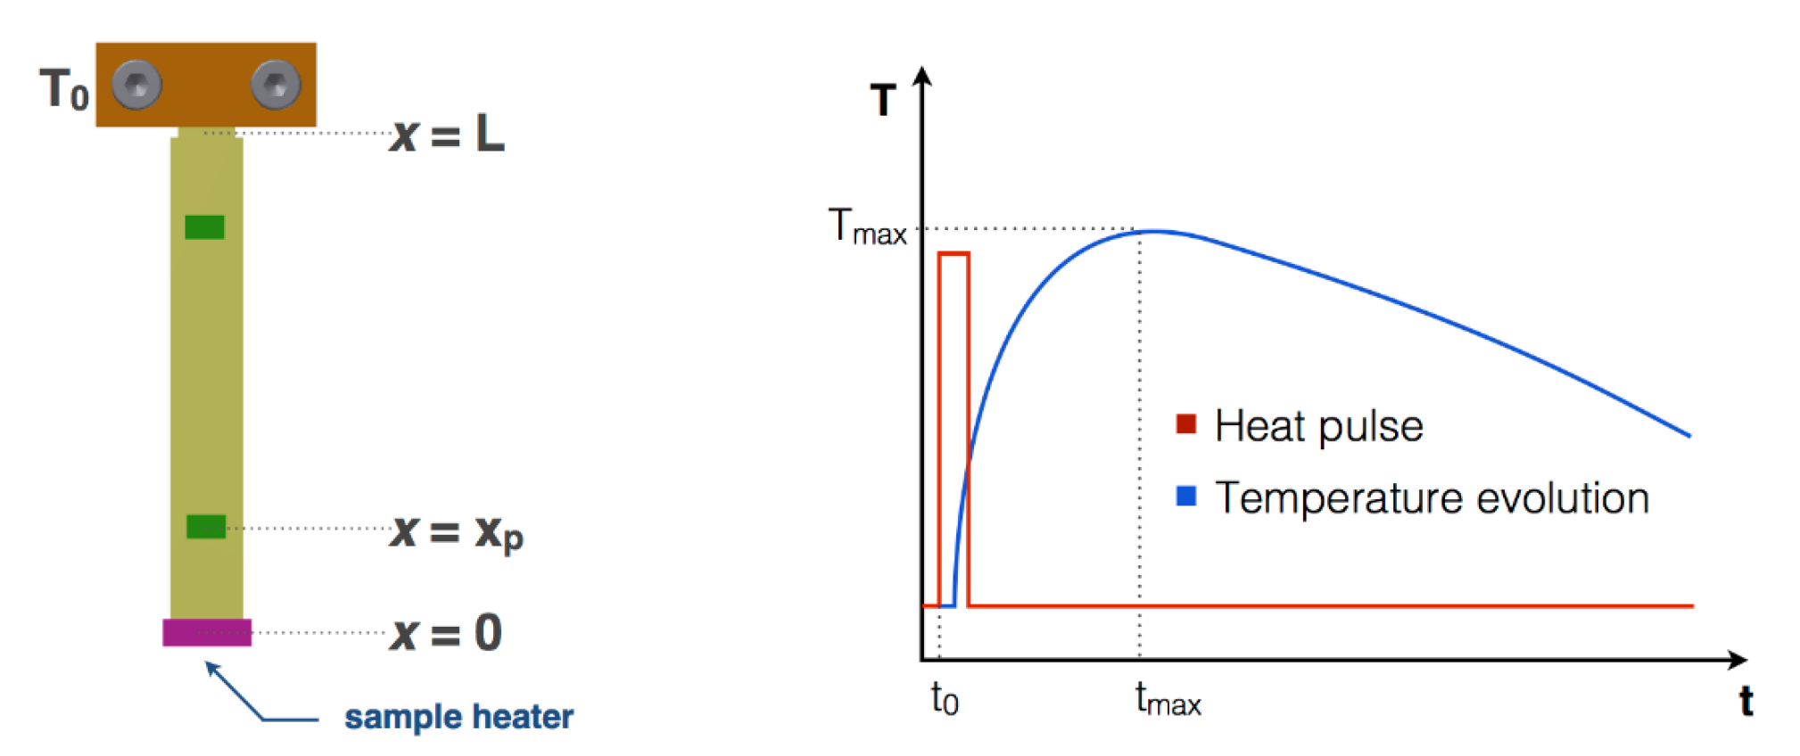
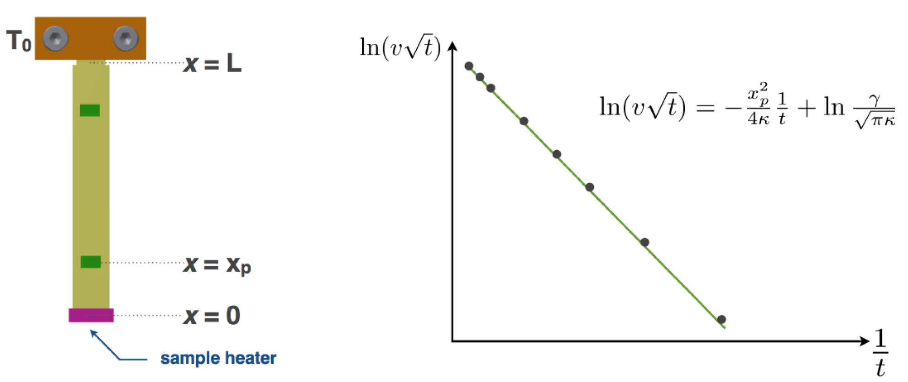
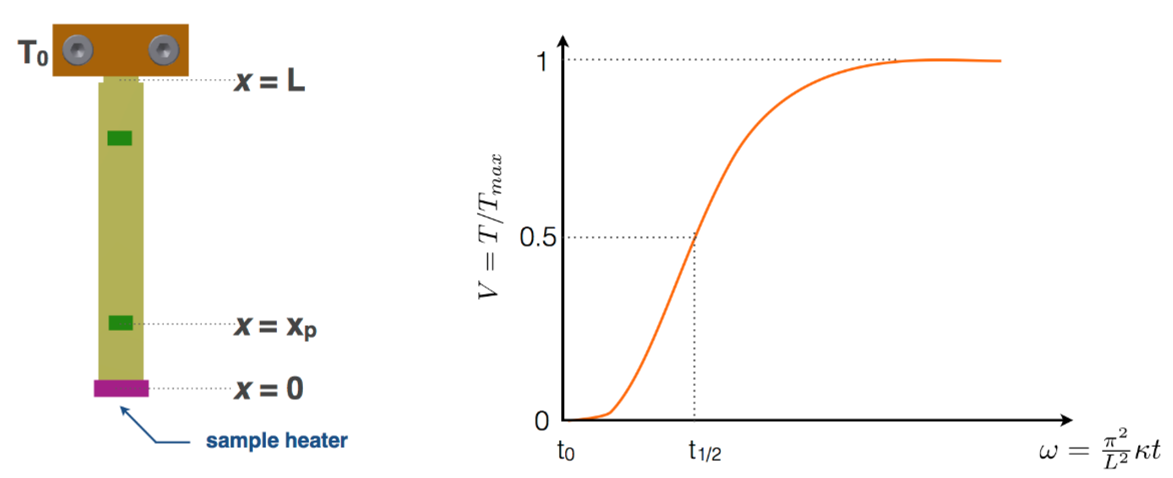
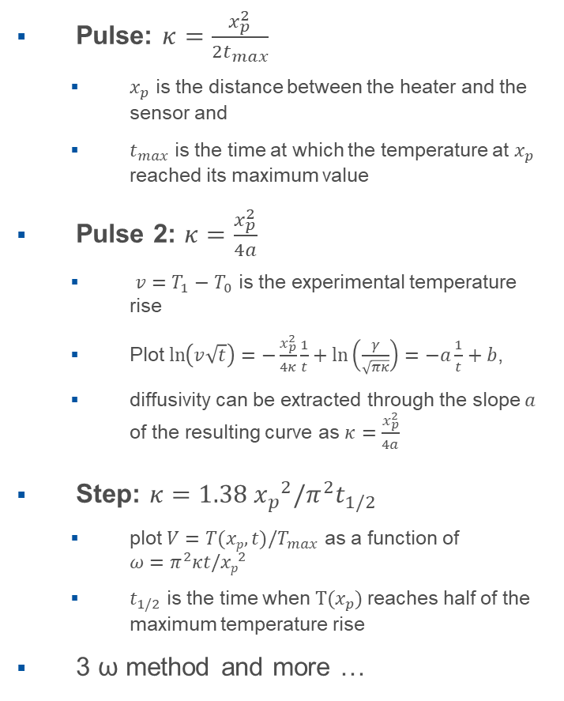
Further diffusivity measurement methods
Pulse: $κ=\frac{x_{p}^{2}}{2t_{max}}$
  $x_{p}$ is the distance between the heater and the sensor and
  $t_{max}$ is the time at which the temperature at $x_{p}$ reached its maximum value
Pulse 2: $κ=\frac{x_{p}^{2}}{4a}$
  $v=T_{1}−T_{0}$ is the experimental temperature rise
  Plot $\ln\left(v\sqrt{t}\right)=−\frac{x_{p}^{2}}{4κ}\frac{1}{t}+\ln\left(\frac{γ}{\sqrt{πκ}}\right)=−a\frac{1}{t}+b$,
  diffusivity can be extracted through the slope $a$ of the resulting curve as $κ=\frac{x_{p}^{2}}{4a}$
Step: $κ=1.38{ x_{p}}^{2}/π^{2}t_{1/2}$
  plot $V=T(xp,t)/T_{max}$ as a function of $ω=π^{2}κt/{xp}^{2}$
  $t_{1/2}$ is the time when$T(x_{p})$ reaches half of the maximum temperature rise
3 ω method and more …
Ref.: Hunklinger, S., Low Temperature Physics, Springer, 2005.
Ref.: Krüger, R. et al., Phys.
Stat. Sol. (a) 17: 471–478 (1973)
Ref.: Parker, W.J., Journal of
Applied Physics, 32, 1679-1684 (1961)

Slide 21
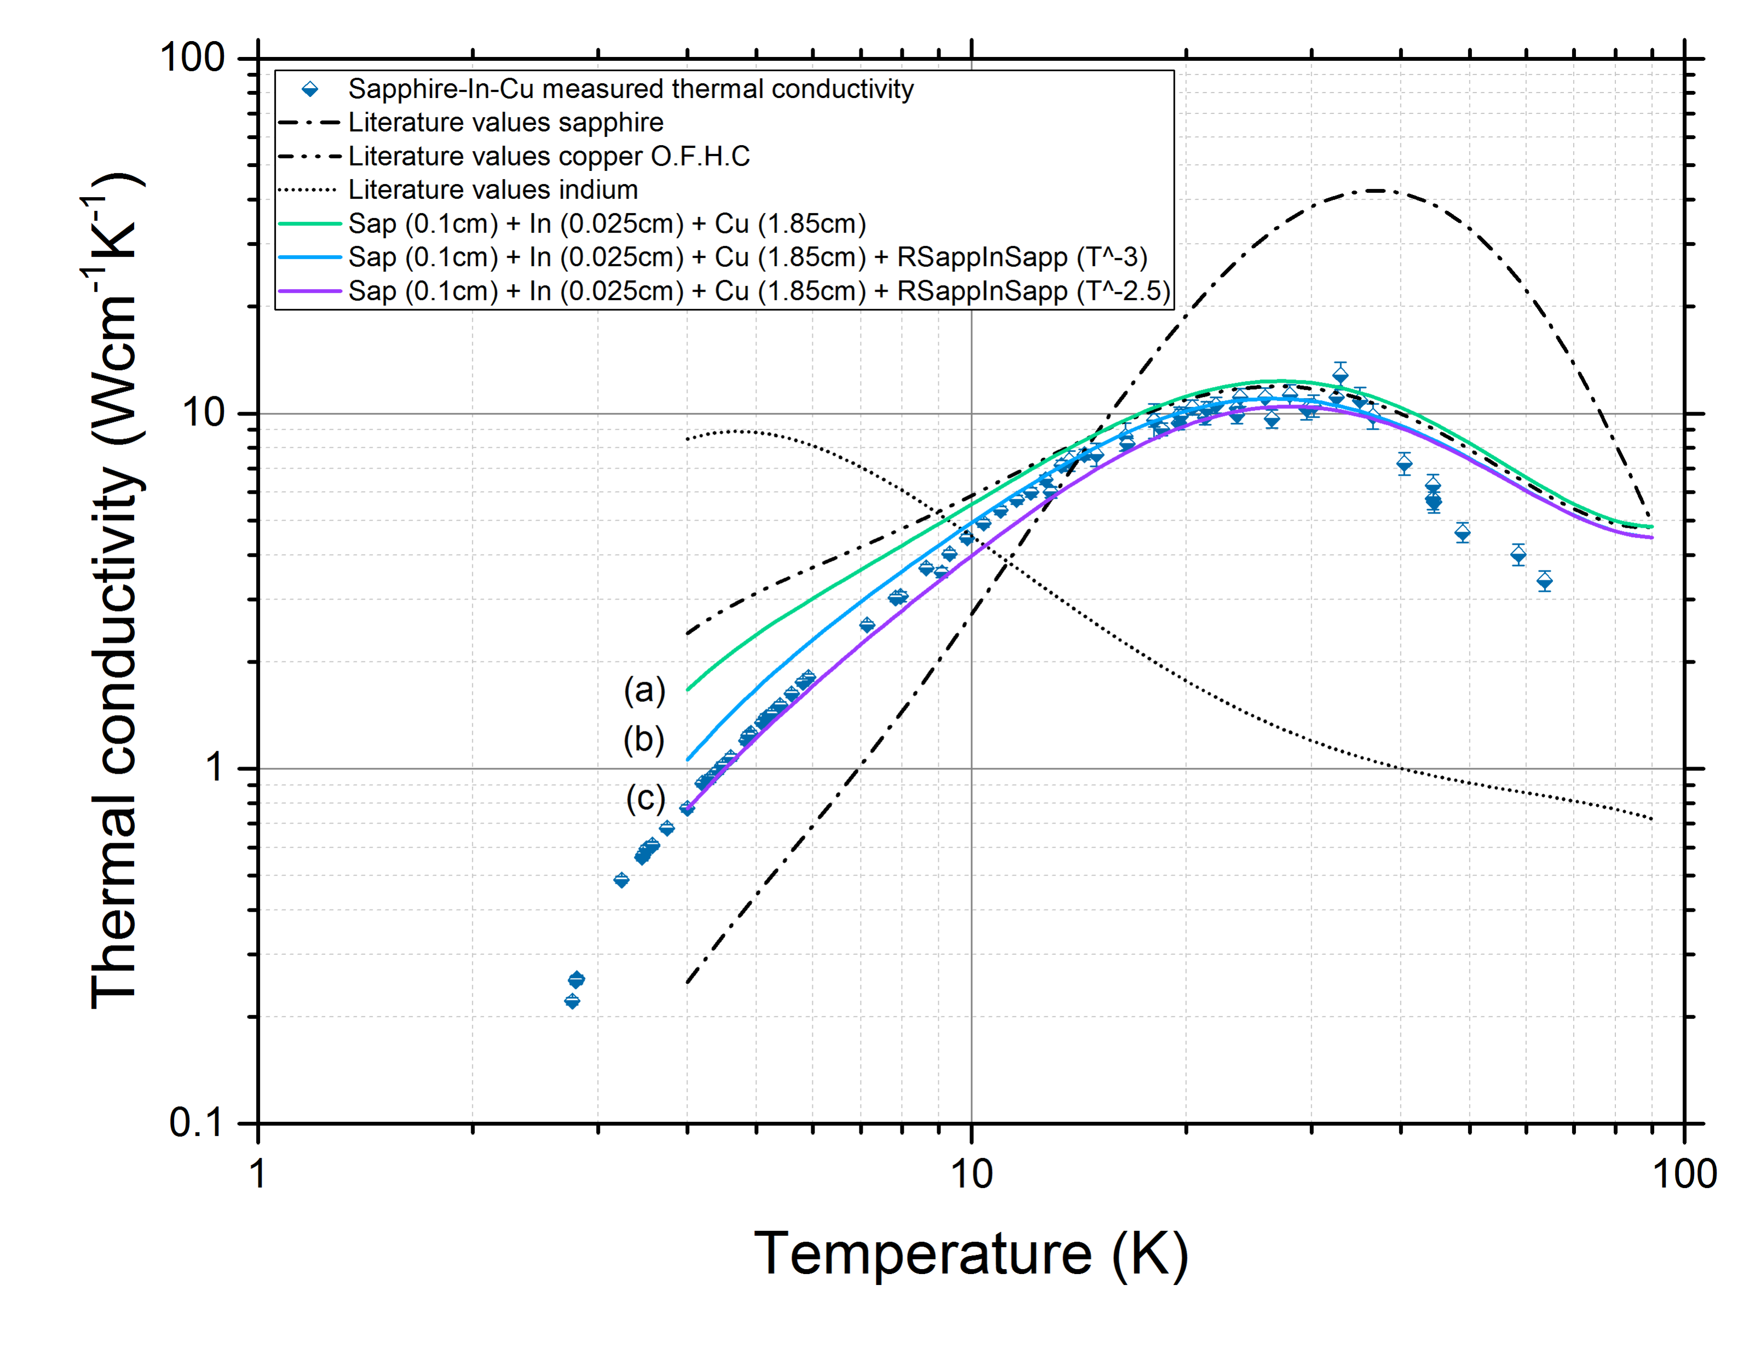


l and k* of a Cu-In-sapphire and Cu-In-Au-Ti-sapphire sandwich
Indium (SC) Indium (NC)
Modelling of thermal conductivity including the boundary resistances e.g. Cu-In-sapphire:
Modelling of diffusivity including l measured !
of Cu-In-sapphire:
Gmelin et al., J. Phys. D: Appl. Phys. 32 (1999) R19–R43.

Slide 22

l and k* of a Cu-In-sapphire and Cu-In-Au-Ti-sapphire sandwich
Remaining deviation for Au-Ti-sapphire sandwich is attributed to the formation add. interlayers
Modelling of thermal conductivity including the boundary resistances e.g. Cu-In-sapphire:
Geometry factor: static vs. transient
Cu-In-Au-Ti-sapphire = (2.7)
Gmelin et al., J. Phys. D: Appl. Phys. 32 (1999) R19–R43.

