Slide 1
Development of 10 kA current leads cooled by a cryogenic mixed-refrigerant cycle
E. Shabagin, S. Grohmann
ICEC27 – ICMC 2018 / E-10: 017

Slide 2
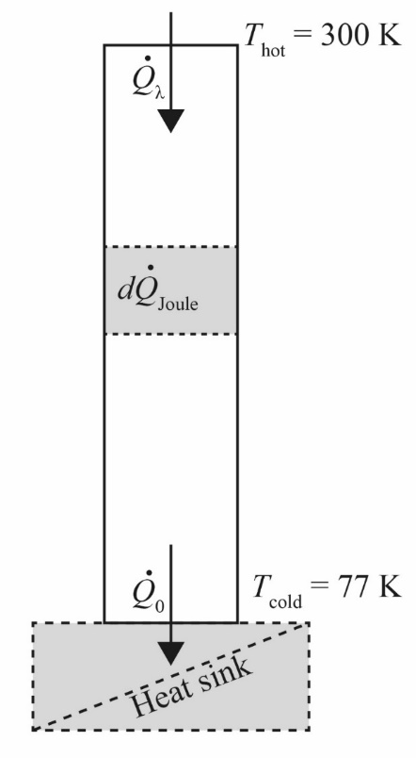
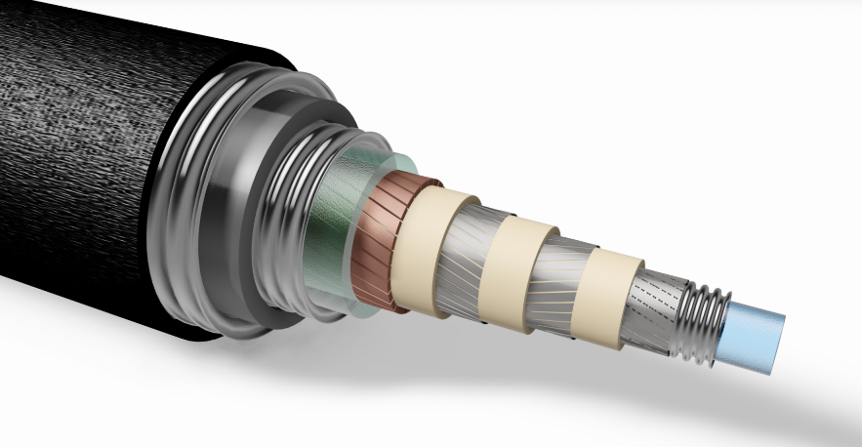
Motivation
Efficient transport of electrical energy from room-temperature to a superconducting application at the cryogenic temperature
Electrical current @ 300 K
Heat conduction
+
Joule heating
=
Thermal load @ 77 K
Current Lead
As low as possible!
Electrical current @ < 77 K

Slide 3
Technical options
Cooling solutions for 10 kA current leads in HTS applications
Type | Open cycle |  | Closed cycle
Principle | Gas-cooled | Gas-cooled
Medium | Helium | Nitrogen
State-of-the-art | Forced flow helium refrigeration | Nitrogen bath
Advantages | No limitation to the maximum heat load
Disadvan-tages | Expensive | LN₂ supply
Type | Open cycle |  | Closed cycle
Principle | Gas-cooled | Gas-cooled | Conduction-cooled
Medium | Helium | Nitrogen | -
State-of-the-art | Forced flow helium refrigeration | Nitrogen bath | Cryocooler
Advantages | No limitation to the maximum heat load |  | Simple method
 |  |  | No medium supply required
Disadvan-tages | Expensive | LN₂ supply | Limitation to max heat load | -
Type | Open cycle |  | Closed cycle
Principle | Gas-cooled | Gas-cooled | Conduction-cooled | J-T cycle heat exchanger
Medium | Helium | Nitrogen | - | Mixed refrigerant
State-of-the-art | Forced flow helium refrigeration | Nitrogen bath | Cryocooler | CMRC-CL
Advantages | No limitation to the maximum heat load |  | Simple method | Good efficiency
 |  |  | No medium supply required
Disadvan-tages | Expensive | LN₂ supply | Limitation to max heat load | -

Slide 4
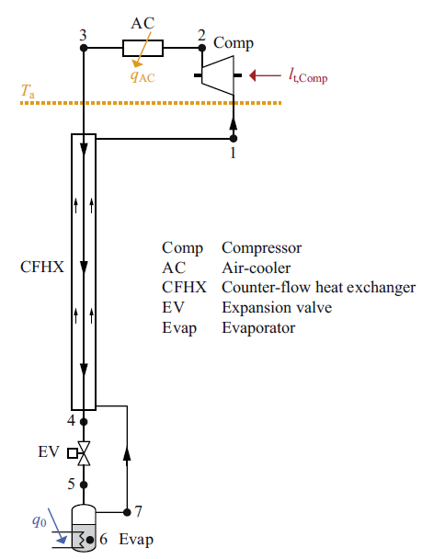
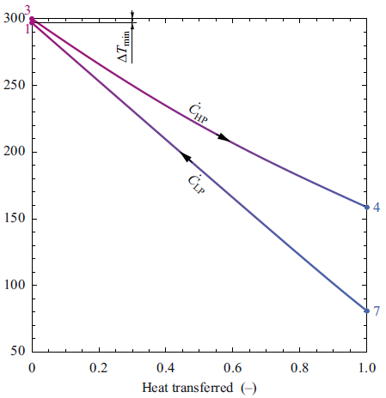
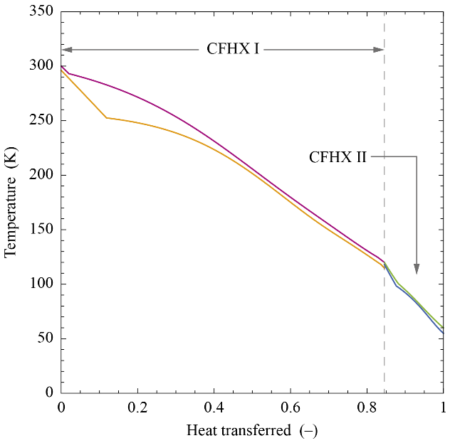
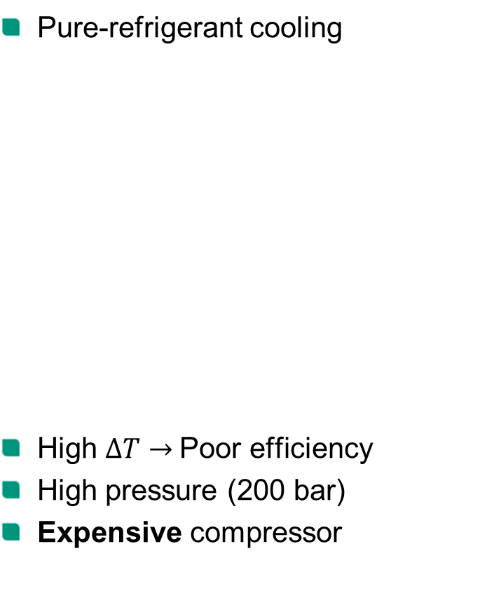
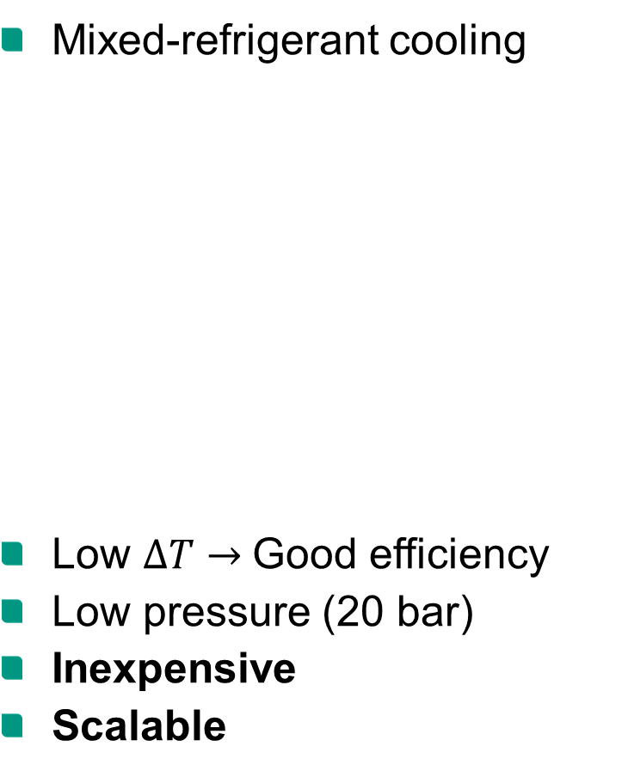


Pure- vs. mixed-refrigerant cooling
Pure-refrigerant cooling
High $∆T→$Poor efficiency
High pressure (200 bar)
Expensive compressor
Mixed-refrigerant cooling
Low $∆T→$Good efficiency
Low pressure (20 bar)
Inexpensive
Scalable
[1]
[1] Tamson J, Stamm M and Grohmann S 2018 ICEC-ICMC Proc. 27

Slide 5
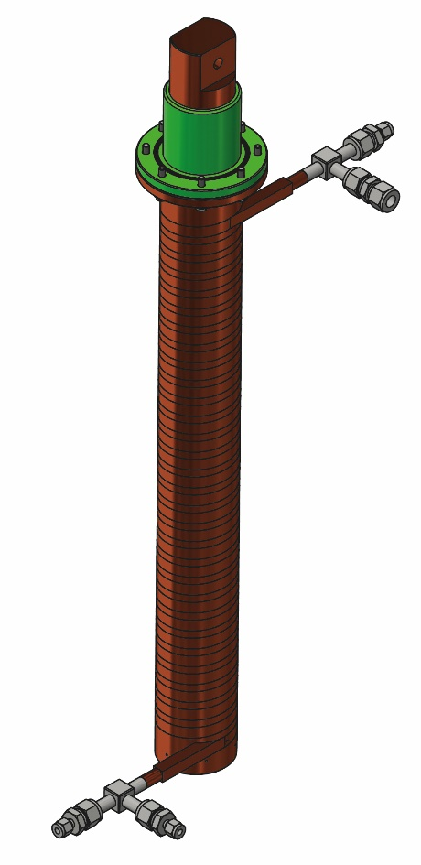
Prototype design of 10 kA CMRC-CL
Development of a pair of 10 kA current leads cooled with a cryogenic mixed refrigerant cycle (CMRC)
CMRC
CL
CMRC-CL

Slide 6
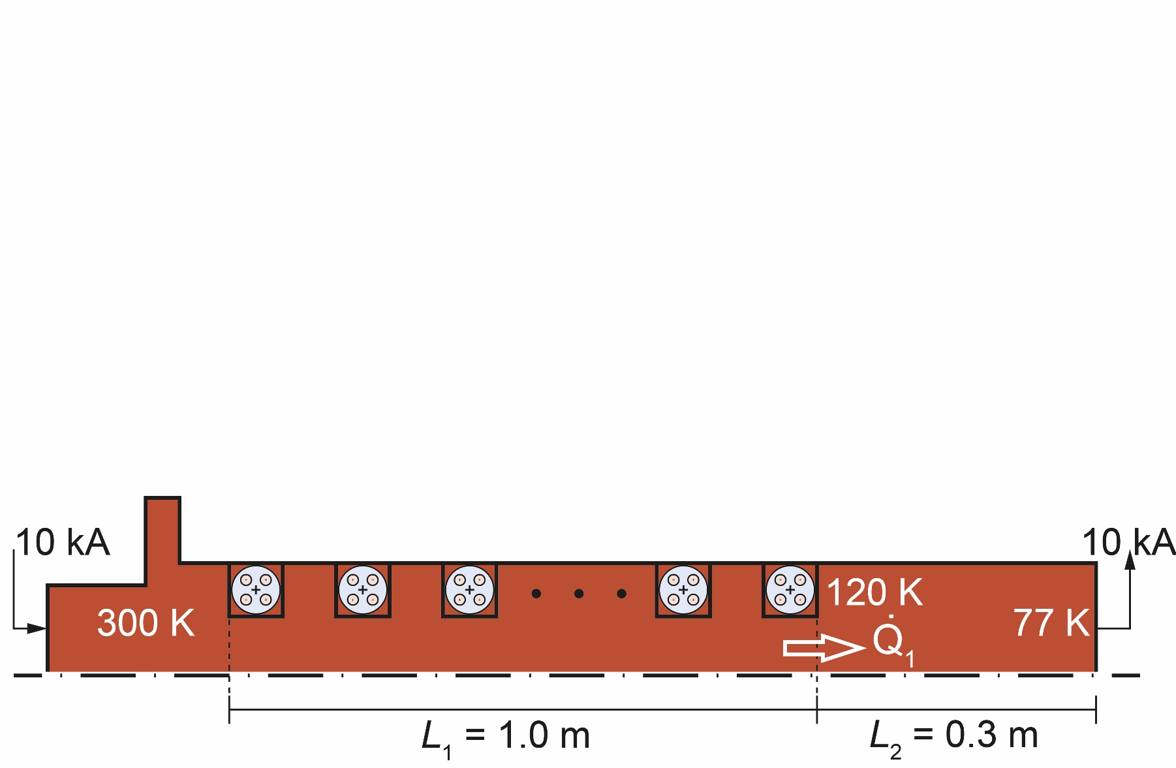
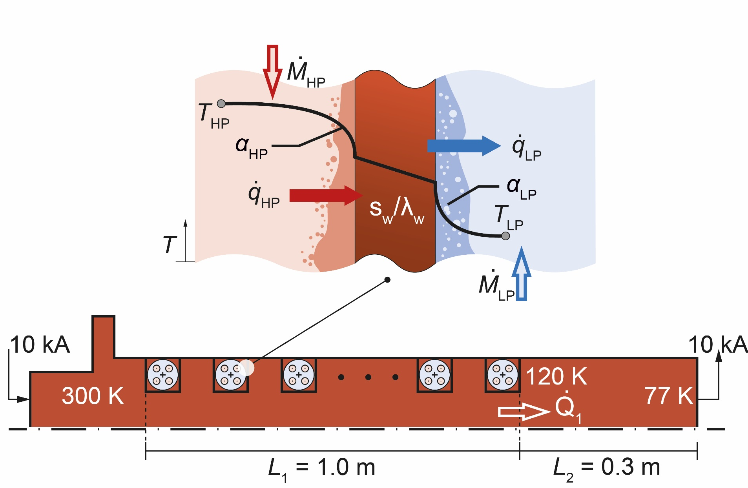
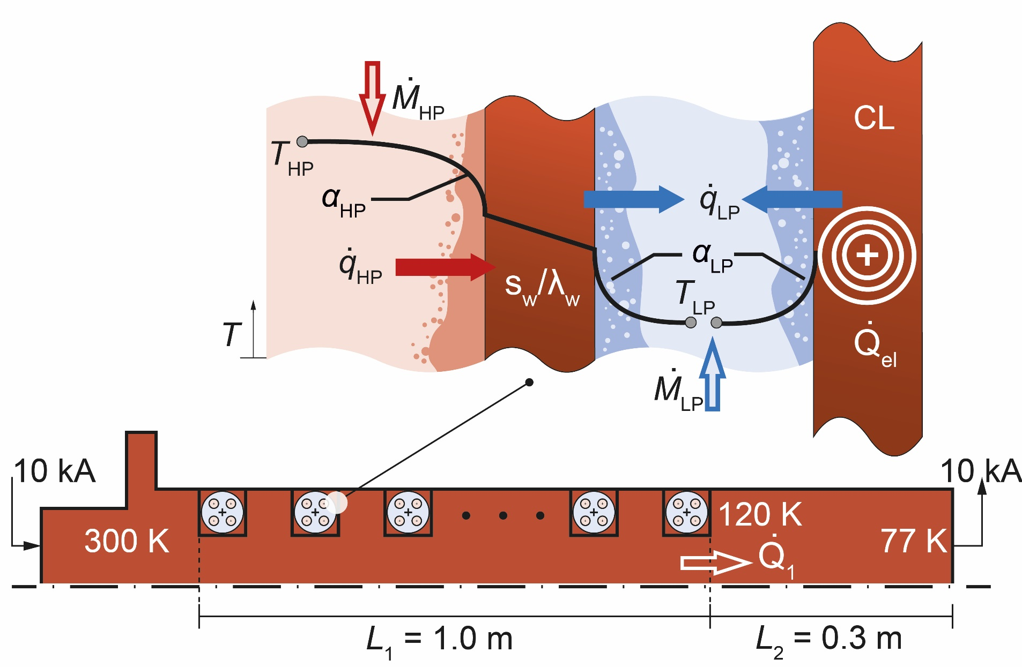

Thermal & electric model design
Temperature profile calculation with 1-dim heat equation
[2,3]
?
?
$$\frac{∂}{∂x}∙\left(λ_{Cu}\left(T\right)∙A∙\frac{∂T}{∂x}\right)+I^{2}∙\frac{ρ_{Cu}\left(T\right)}{A}−α_{LP}∙U∙\left(T−T_{LP}\right)=0, 0<x<L_{1}$$
Heat conduction
Joule heating
Forced convection
$$\left(λ_{Cu}\left(θ\right)∙A∙\frac{∂θ}{∂x}\right)=\sqrt{{\dot{Q_{1}}}^{2}+2∙I^{2}∙\int_{θ\left(x\right)}^{120 K}{λ_{Cu}\left(T\right){∙ρ}_{Cu}\left(T\right)}dT}, L_{1}<x<L_{1}+L_{2}$$
Fourier’s Law & Optimized conduction cooled CL
$$x$$
[2] Gomse D, Kochenburger T M, and Grohmann S 2018 Journal of Heat Transfer 140 051801; doi: 10.1115/1.4038852
[3] Gomse D and Grohmann S 2018 ICEC-ICMC Proc. 27

Slide 7
Thermal & electric model design
Temperature profile calculation with 1-dim heat equation
[2,3]
?
?
$$\frac{∂}{∂x}∙\left(λ_{Cu}\left(T\right)∙A∙\frac{∂T}{∂x}\right) + I^{2}∙\frac{ρ_{Cu}\left(T\right)}{A} −{ α}_{LP}∙U∙\left(T−T_{LP}\right)=0, 0<x<L_{1}$$
Heat conduction
Joule heating
Forced convection
$$x$$
[2] Gomse D, Kochenburger T M, and Grohmann S 2018 Journal of Heat Transfer 140 051801; doi: 10.1115/1.4038852
[3] Gomse D and Grohmann S 2018 ICEC-ICMC Proc. 27

Slide 8
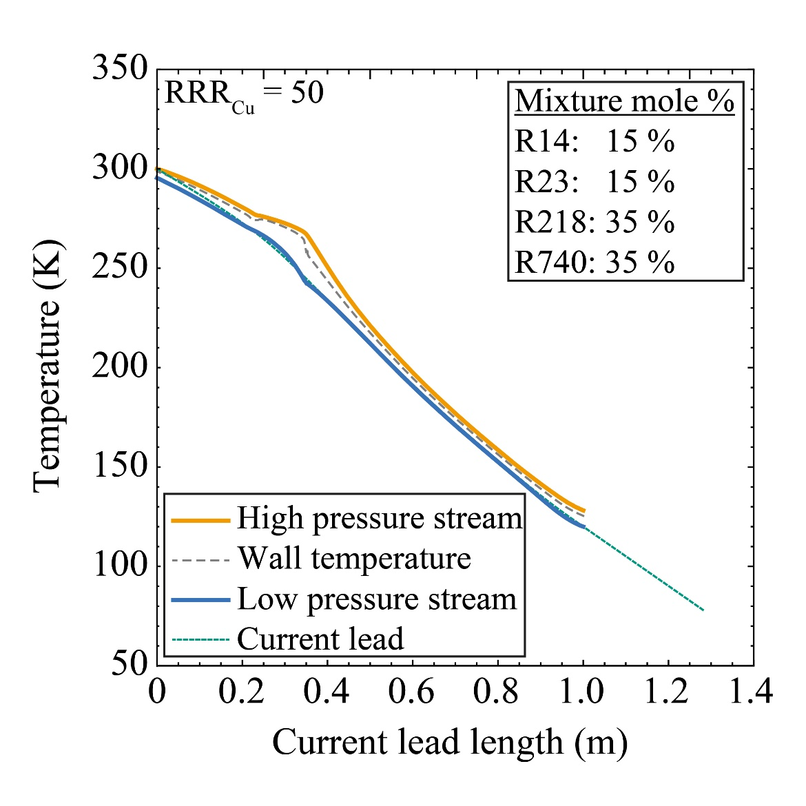
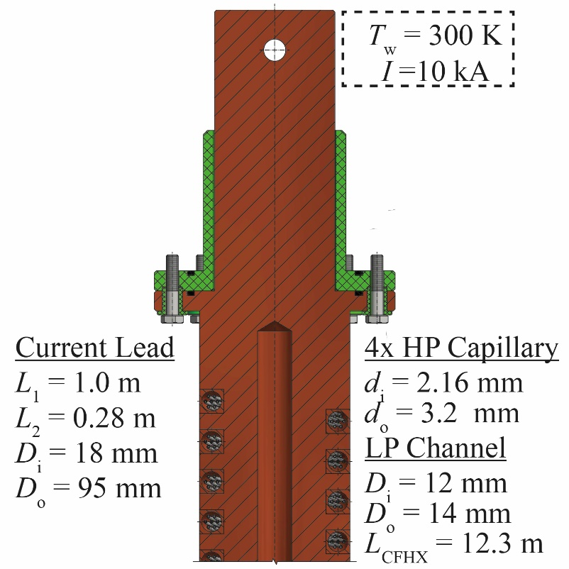
Prototype design and Temperature profile
Prototype based on classical heat exchanger design
Recess can be adapted depending on
the design amperage

Slide 9
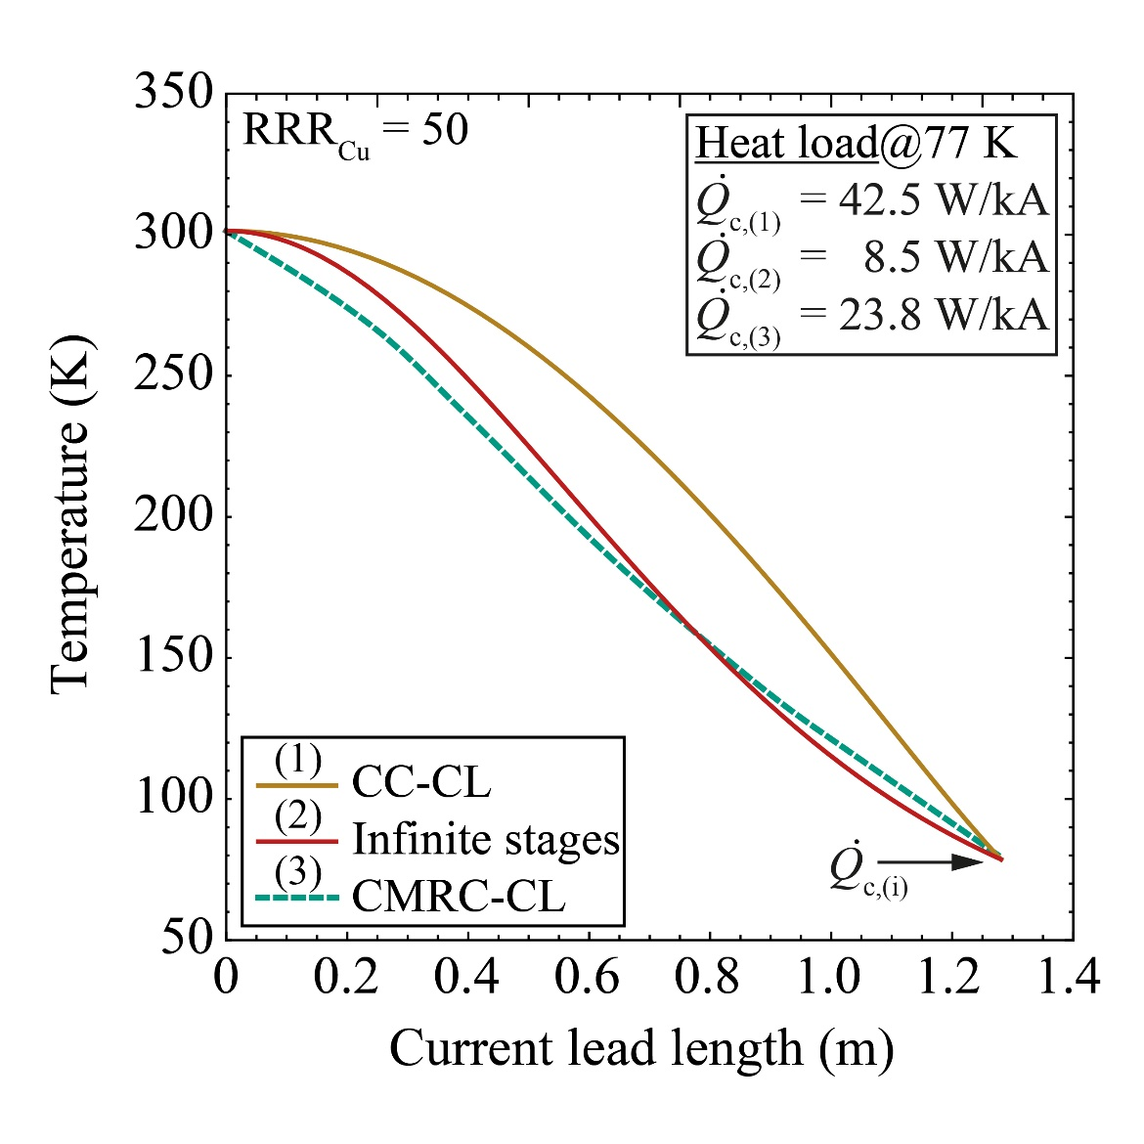
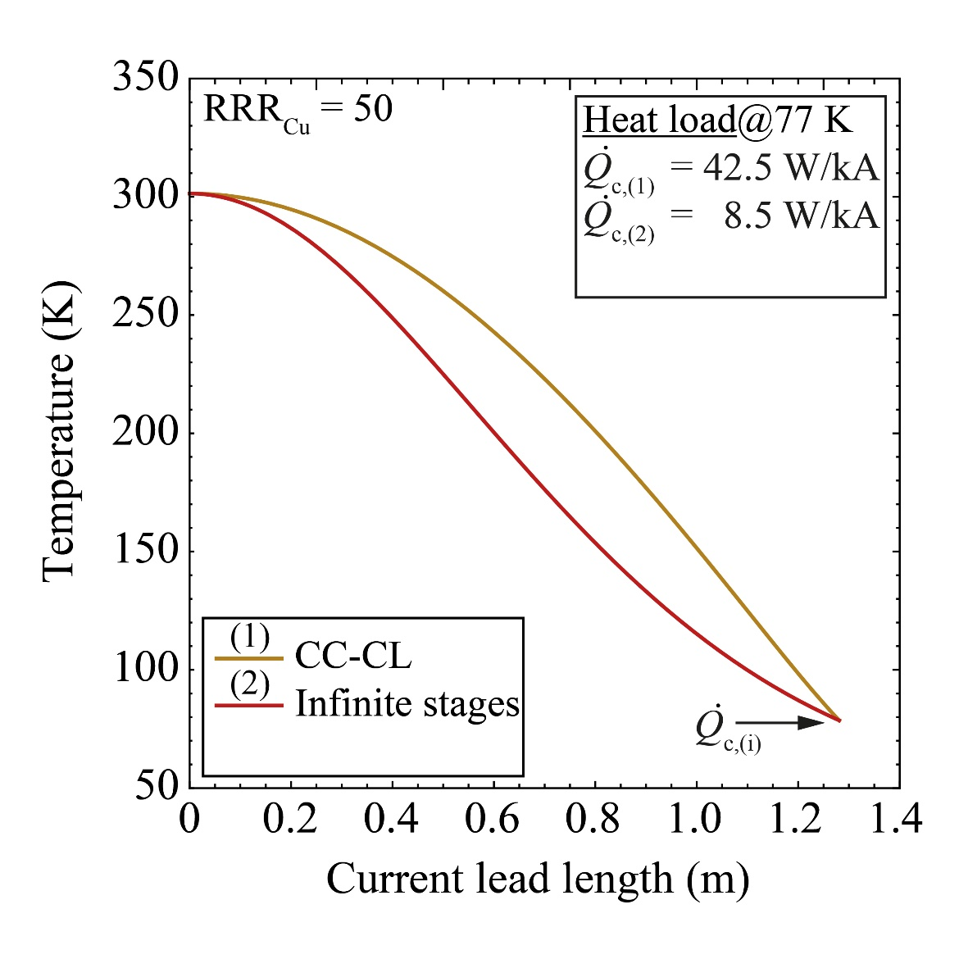
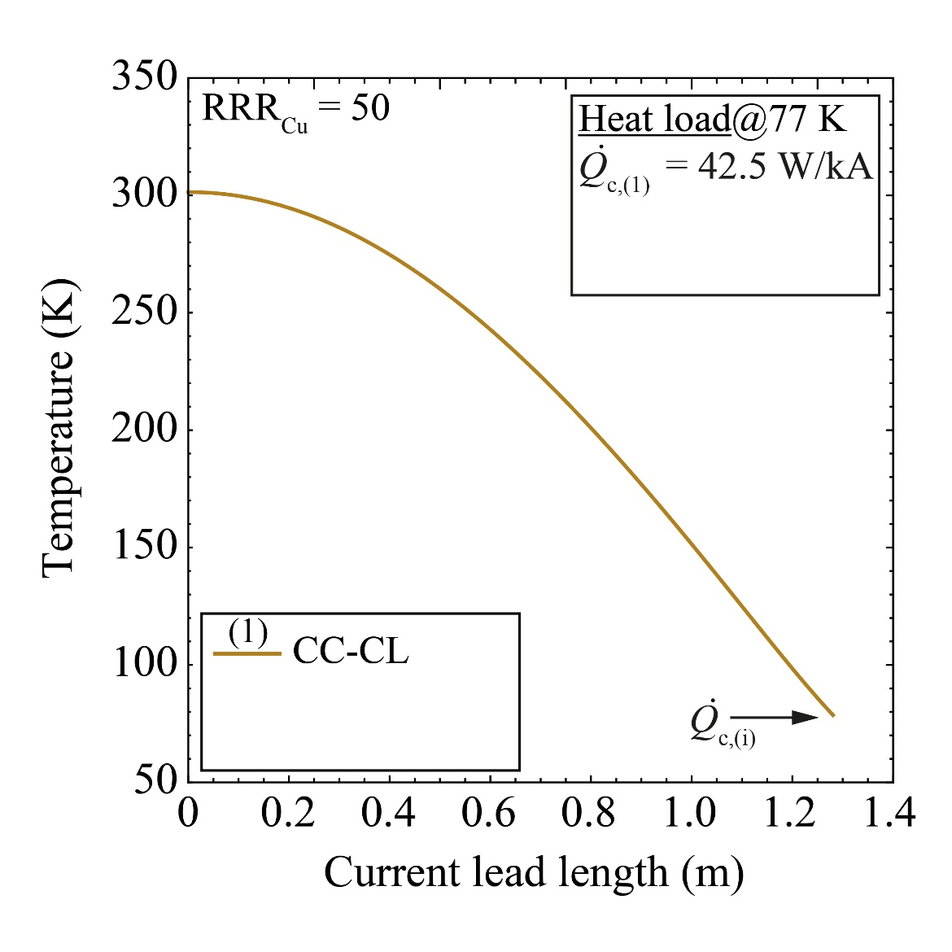

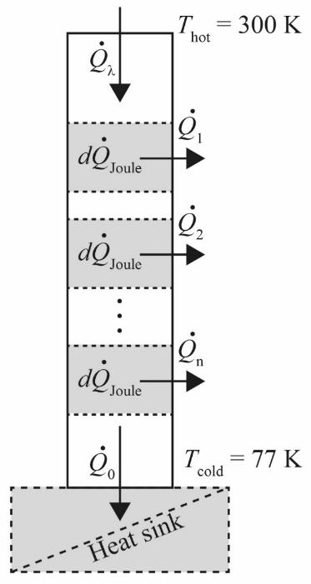
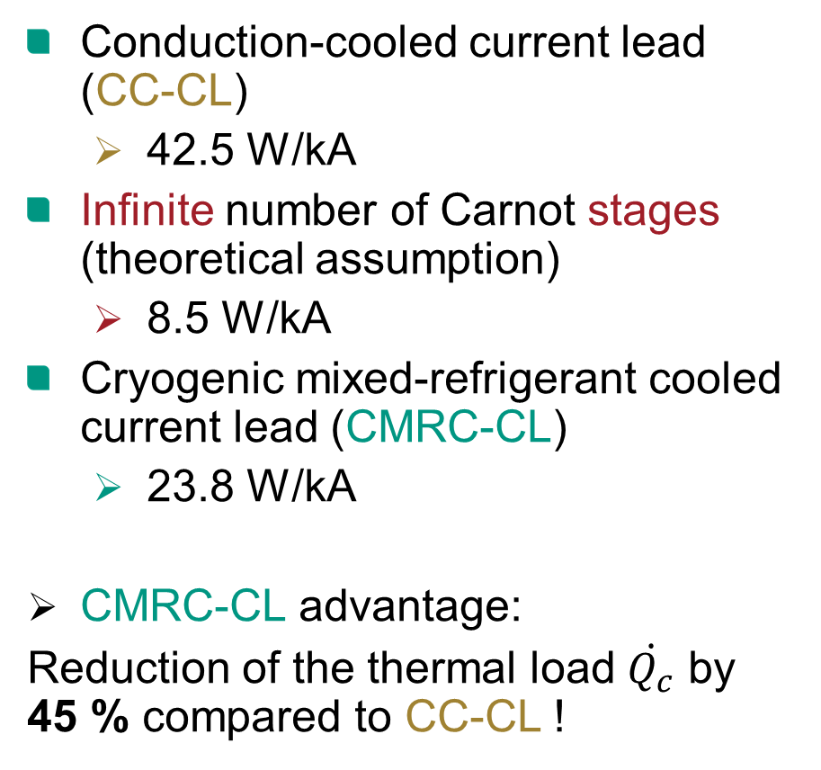
Comparison with alternative cooling methods
Conduction-cooled current lead (CC-CL)
  42.5 W/kA
Infinite number of Carnot stages (theoretical assumption)
  8.5 W/kA
Cryogenic mixed-refrigerant cooled current lead (CMRC-CL)
  23.8 W/kA
CMRC-CL advantage:
Reduction of the thermal load $\dot{Q_{c}}$ by 45 % compared to CC-CL !

Slide 10
Prototype design of 10 kA CMRC-CL
Development of a pair of 10 kA current leads cooled with a cryogenic mixed refrigerant cycle (CMRC)
  State-of-the-art solutions require multiple stages
  Numeric coupling of electric model and thermal modeling framework for integrated optimization
    Heat exchanger = current lead
  Simulation results show reduction of thermal load at cold end by 45 % compared to conventional conduction-cooled current leads
  Tubes-in-tube CFHX design makes CMRC-CL too long (>1 m)
    Development of micro-structured CFHX [4]
  Aim: Achieve Technology Readiness Level TRL 6
    Prototype in relevant environment
[4] D Gomse, Reiner A, Rabsch G et al. 2017 IOP Conf. Series: Materials Science and Engineering 278 012061; doi:10.1088/1757-899X/278/1/012061.

Slide 11
Thank you for your attention !

