Slide 1
Emissivity of black plated open honeycomb and black coatings at cryogenic temperatures
Makiko ANDO, Kosuke TANAKA, Keisuke SHINOZAKI, Hiroyuki SUGITA
(Japan Aerospace Exploration Agency)
Ikuma NISHIKAWA
(University of Tsukuba)

Slide 2
Contents
Background and motivation
Approaches for emissivity enhancement
Emissivity measurements
Conclusions

Slide 3
Background and motivation

Slide 4
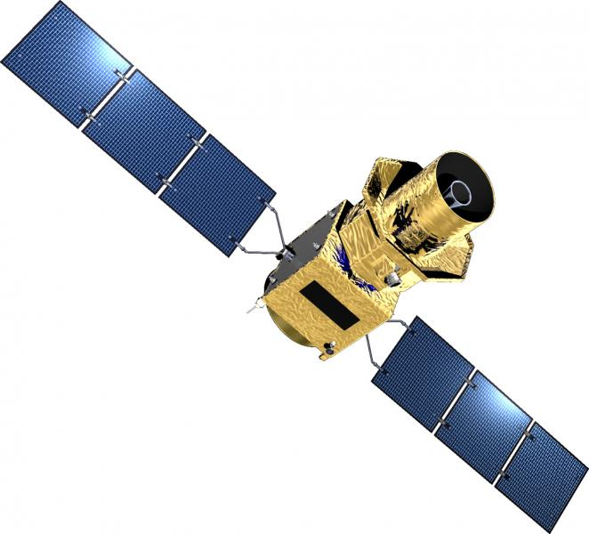
Background and motivation (1/2)
Ultra-sensitive astronomical observation missions
Optical sensors are required to be kept at cryogenic temperatures for thermal noise reduction.
Cooling system
Expendable cryogen cooling
No cryogen cooling
Huge cryogen tank
Cryocoolers + Radiative cooling
Large-scale and long-term observation
SPICA^{[1]}
Running out of cryogen
End of Mission
©JAXA/ISAS
High emissivity surface at cryogenic temperatures is required.
Cryogenic radiator surfaces of spacecraft
Deep space simulation at ground test facility (thermal vacuum test)
Lite BIRD
[1] H Ogawa, et al., ICES-2016-305 (2016)

Slide 5
Background and motivation (2/2)
Difficulty in achieving high emissivity at cryogenic temperatures
50-1000μm at 20K
High emissivity surface at room temperature
≠
High emissivity surface
at cryogenic temperature
5-100μm at 300K
Dominant wavelengths of infrared radiation differ depending on temperature.
e.g.)
5-100μm at 300K
50-1000μm at 20K
Longer and wider wavelength range should be considered.
Emissivity of candidate surfaces was experimentally evaluated at 20-80K in this study.
Several kinds of coatings
Three-dimensional structure with/without coating
Dominant wavelengths of black-body radiation at various temperatures.

Slide 6
Approaches for emissivity enhancement

Slide 7
Approach 1: Coatings
Emissivity enhancement by coating
Select a proper coating material and thickness
Candidate coatings in this study
Coating | Description
Black paint | Commonly used at room temperature to achieve high emissivity. Thickness: Usually on the order of several tens of μm.
Carbon nanotubes (CNT) | Extremely low reflectance at the wavelength range from UV to mid IR. Thickness: From submillimeter to millimeter.
Black plating | Common blackening method. Thickness: From several microns to several tens microns No organic compound Advantage of low outgassing

Slide 8
Approach 2: Three-dimensional structures (1/2)
Cavity effect
Cavity resonance
Incident light
Light at resonant wavelength is absorbed.
repeatedly reflected and trapped inside the cavity.
Increase of emissivity
at specific wavelength
2R
Increase of
apparent emissivity
Cavity
Resonant wavelength(λ)
2R = n x λ/2
(n=1,2,…..)
Wavelength < Cavity aperture size
Cavity effect can be achieved.
No dependence on wavelength
. . .
Cavity

Slide 9
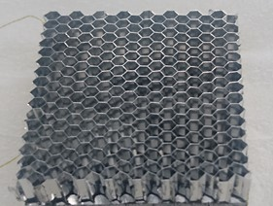
Approach 2: Three-dimensional structures (2/2)
Cavity effect
Reach a plateau
Emissivity increase rate
Depending on surface emissivity
Increase rate reaches a plateau at an aspect ratio > 6.
Candidate structure in this study
Open honeycomb
R
L
Cylindrical cavity
Emissivity enhancement by cylindrical cavity with diffuse material surface
(estimated by thermal analysis).

Slide 10
Emissivity Measurement

Slide 11
Test pieces (1/2)
Name | Structure | Coating
 |  | Category | Thickness
Desothane®-Flat | Flat surface | Black paint (PPG Aerospace, Desothane®) | 130μm
CNT100-Flat |  | Carbon nanotubes | 100μm
CNT500-Flat |  | Carbon nanotubes | 500μm
TB-Flat |  | Black plating (Ebina Denka Kogyo, Tough Black®) | 20μm
TB-OH | Open honeycomb Cell size: 1/8” Cell height: 10mm | Black plating (Ebina Denka Kogyo, Tough Black®) | 20μm
AL-OH |  | No coating | -
1/8” (=3.2mm) could almost covers the dominant wavelength range of IR radiation down to 7K.
1/8” x 10mmH Aspect ratio: 6.3 (> 6)

Slide 12
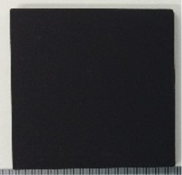
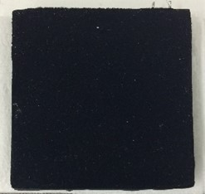
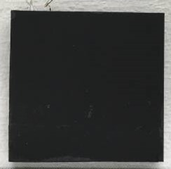
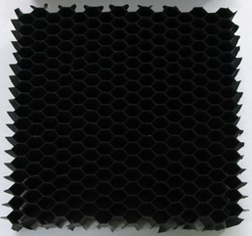
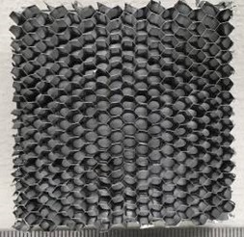
Test pieces (2/2)
Flat surface
Open honeycomb
Honeycomb core
Coating
10mm
A honeycomb core is adhered to the baseplate with STYCAST®.
Baseplate (Al or Ti)
50mm x 50mm x 3mmt
Baseplate (Al)
50mm x 50mm x 3mmt
Desothane®-Flat
CNT500-Flat
TB-Flat
TB-OH
AL-OH

Slide 13
Measurement configuration
Measurement using calorimetric method
GHP (Guard heater plate)
Ultimate vacuum:
1.8×10⁻⁶Pa
Low emissivity tape
Test sample
Test apparatus
Sample details (example of open honeycomb)

Slide 14
Defining equations
Radiation heat transfer at steady state
Symbols
A : area, m²
Q : heat transfer rate, W
T : temperature, K
ε : emissivity, -
σ : Stefan-Boltzmann constant, W/m²K⁴
Subscripts
eff : effective
H : heater
leak : leak
rad : radiation
ref : reference
s : sample
sh : shield
(1)
where,
(2)
(3)
Approximation
(4)
Major error source 1
Heat leak (measured in the heat leak test)
(5)
Test configuration and heat flow
Major error source 2

Slide 15
Defining equations – Major error source (1/2)
Error due to the approximation
Symbols
A : area, m²
ε : emissivity, -
Subscripts
eff : effective
s : sample
sh : shield
A_{s}/A_{sh} = 1/200 in this study
Error due to the approximation: not always negligible.
Error varies depending on the shield emissivity, ε_{sh}.
Emissivity of the 2nd shield, ε_{sh}
Coated with black paint (Desothane®, 130μmt)
ε_{sh} at 4K was not precisely identified.
Expected minimum value is 0.1 based on extrapolation using the emissivity measurement results above 20K.
Error due to the approximation could be +4.4% at maximum.
Error due to the approximation.

Slide 16
Defining equations – Major error source (2/2)
Heat leak (measured in the heat leak test)
Symbols
A : area, m² Q : heat transfer rate, W
T : temperature, K ε : emissivity, -
σ : Stefan-Boltzmann constant, W/m²K⁴
Subscripts
H : heater leak : leak
rad : radiation ref : reference
sh : sheild
Conduction heat transfer by residual gas
Via Kevlar® threads and lead wires
Q_{leak} is determined according to a preliminary heat leak test.
Same configuration and temperatures as for emissivity measurements.
Low emissivity reference sample is used (ε_{ref} < 0.025).
The value of ε_{ref} should be in the range from 0 to 0.025, but not identified at various cryogenic temperatures.
Q_{H,ref}
Q_{rad,ref}
Ref. sample
T_{ref}, A_{ref}, ε_{ref}
The uncertainty of ε_{ref} should be considered in the error of ε_{s}: +0.025 at maximum.
Test configuration

Slide 17
Result and discussion 1: Flat surface with coatings
Decrease with temperature
The emissivity of flat surface
Decrease significantly with temperature.
CNT500-Flat
Highest emissivity due to the large thickness of CNT coating.
Emissivity decreased at temperatures below 50K.
Sample emissivity [-]
Influence of wavelengths longer than the coating thickness.
Tough Black® had relatively high emissivity for its thickness of only 20μm.
©Ebina Denka Kogyo
Due to the complex texture at its surface.
Sample temperature [K]
Emissivity measurement results (flat surface with coatings).

Slide 18
Result and discussion 2: Open honeycomb
The emissivity of open honeycomb
Less dependent on temperature.
AL-OH (w/o black plating)
Emissivity enhanced up to 0.5 even when the material surface emissivity is very low.
w/ black plating
Sample emissivity [-]
Emissivity enhancing effect:
Specular reflection > Diffuse reflection
w/o black plating
TB-OH (w/ black plating)
Emissivity increased drastically by adding black plating.
Open honeycomb + black plating
Promising solution to achieving high emissivity!
Sample temperature [K]
Emissivity measurement results (open honeycomb).

Slide 19
Conclusions
The emissivity was measured using calorimetric methods at 20-80K.
Emissivity of flat surface with several kinds of black coatings
Strong dependence on temperature.
- Decreased significantly with temperature.
Emissivity of open honeycomb w/ or w/o black plating
Less dependent on temperature.
Enhanced up to 0.5 even without black coating, and 0.9 with black plating.
The combination of an open honeycomb and black plating
Promising solution to achieving high emissivity.

Slide 20
Thank you for your kind attention!

Slide 21
Back up slides

Slide 22
Emissivity enhancing effect - Diffuse or Specular
1.0
ε_{surface}=0.9
ε_{surface}=0.7
0.8
ε_{surface}=0.5
ε_{surface}=0.3
Apparent emissivity [-]
ε_{surface}=0.2
0.6
ε_{surface}=0.1
0.4
Diffuse
Specular
0.2
M Kiuchi, Thermal Calculation Handbook, Japan Management Association, Published in 1988 (in Japanese)
0.1
0
2
4
6
8
10
Aspect Ratio (L/R) [-]

Slide 23
Dimensions and specifications of test apparatus
Major specifications
Ultimate vacuum | 1.8×10⁻⁶Pa
2nd shield temperature | 3.3 – 4.1K
Required time to evacuation and cooling down | 24 hours
Required time to warm-up and repressurization | 13 hours
*The values above is for blank test.

Slide 24
Heat leak test results
Ratio of heat leak to radiation heat transfer rate of a sample (Q_{leak}/Q_{rad,s})
In the case of ε_{s}=0.8:
Q_{leak}/Q_{rad,s} = 4-6% at maximum
In the case of ε_{s}=0.3:
Q_{leak}/Q_{rad,s} = 11-16% at maximum
Heat leak test results

Slide 25
Test sample set up

