Slide 1






Cooling performance of Joule Thomson coolers in 300K – 50mK cryochain demonstration for ATHENA X-IFU
K.Shinozaki¹⁾, C.Tokoku²⁾, R.Yamamoto^{2)*}, Y.Minami³⁾, N.Y. Yamasaki²⁾,
K.Mitsuda²⁾, T.Nakagawa²⁾,
J.M.Duval⁴⁾, T.Prouvé⁴⁾, I.Charles⁴⁾, M.Le Du⁵⁾, J.André⁵⁾, C.Daniel⁵⁾,
M.Linder⁶⁾,
S.Tsunematsu⁷⁾, K.Kanao⁷⁾, K.Otsuka⁷⁾ and K.Narasaki⁷⁾
    JAXA / R&D, Japan
    JAXA / ISAS, Japan
    High Energy Accelerator Research Organization (KEK), Japan
    Univ. Grenoble Alpes, CEA, INAC, SBT, France
    CNES Toulouse, France
    ESA-ESTEC, Netherlands
    Sumitomo Heavy Industries, LtD., Japan
    * AIST, Japan at present
27th International Cryogenic Engineering Conference, 3-7th September 2018, Oxford, UK

Slide 2




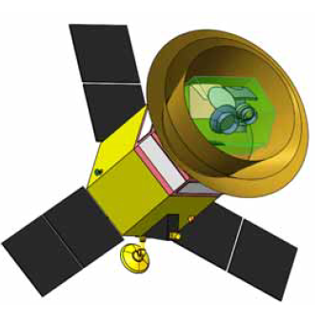
Introduction
50～100mK Cooling system for space science missions
  Athena : 2nd L-class X-ray astronomical mission by ESA cosmic vision
  SPICA : Space infrared telescope for cosmology and astrophysics by ESA / JAXA
  LiteBIRD: CMB B-mode polarization detection satellite by JAXA
Detector cooling system (ESA Core Technology Program = CTP)
  Design and develop a detector cooling system (DCS).
  Validation of cryogenics operation.
  Integration and test of a functional FPA (from SRON).
  Assess perturbation induced by microvibration and EMC.
Intermediate step: 300K – 50mK cryochain operation (Cryostat1)
  Dedicated cryostat in France (CEA Grenoble).
  Coupling of international coolers.
    50mK cooler, Joule Thomson coolers, etc..
  Validation of cryocoolers operation.
  Additional cryocoolers characterizations.
  300K – 50mK operation validated.
LiteBIRD

Slide 3
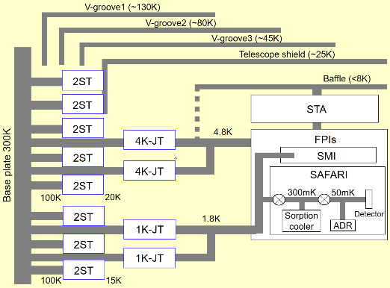
1. Cooler system developments
CTP Cryostat1: Common I/Fs in several mission’s cooler systems can be tested.
 | CTP (Athena X-IFU) | SPICA | LiteBIRD
50mK cooler | 300mK Sorption cooler + ADR (CNES/CEA)
2K cooler | 2K-JT (JAXA/SHI or RAL) | 2K-JT (JAXA/SHI)
4K cooler | 4K-JT (JAXA)
Pre-cooler | PT15K (ESA/CEA/AL/TAS) | 2ST (JAXA/SHI)
Note | Vacuum dewar | Radiative cooling
Same thermal I/F
2K-JT : 1K-class Joule Thomson cooler
4K-JT : 4K-class Joule Thomson cooler
2ST : Double-stage Stirling cooler
PT15K: 15K-class Pulse Tube cooler
ESA : European Space Agency
RAL : Rutherford Appleton Lab. (UK)
CEA : Commissariat a L’energie (FR)
AL : Air Liquide Co.
TAS : Thales Alenia Space Co.
２ST, 4K-JT and 2K-JT have been developed by JAXA.
2K-JT
50mK cooler (CEA)
2K-JT
Common I/Fs
Fig. SPICA cooler system
K.Shinozaki et al. SPIE (2016)

Slide 4
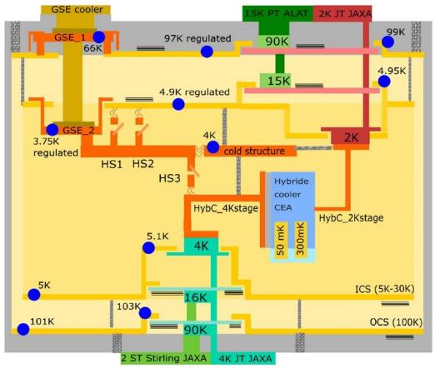
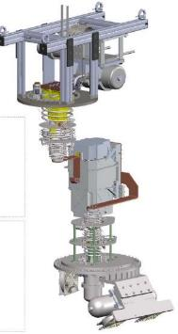
2. Cryostat1 design
CTP Cryostat1: Cooler system demonstration including trade-off study.
  The cubic vacuum vessel is used. Easy integration, open and close.
  4K commercial cooler is used to cool outer (~100K) and inner (5~30K) shield.
  PT15K developed by ESA/CEA/AL/TAS has been coupled with 2K-JT as a pre-cooler.
PT15K
(CEA)
2K-JT
(JAXA)
50mK hybrid cooler
(CEA)
4K-JT
(JAXA)
2ST
(JAXA)
T.Prouvé et al. Cryogenics (2018)

Slide 5
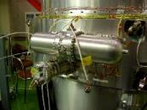



3. Mechanical coolers in JAXA / SHI
SHI: Sumitomo Heavy Industry
Double stage stirling cooler (2ST) | 4K-class Joule Thomson cooler (4K-JT) | 1K-class Joule Thomson cooler (2K-JT)
TRL8 | TRL8 | TRL5 (life time test is ongoing)
Specification: Cooling power: >200mW at 20K and >1W at 100K (EOL) Life time: >3years (5yrs as a goal) | Specification: Cooling power: 40mW at 4.5K (EOL) Life time: > 3yrs (5yrs as a goal) | Specification: Cooling power: 10mW at 1.7K (EOL) Life time: >5yrs
Operating temp: -70~+30 deg.C | Operating temp: 0~+30 deg.C | Operating temp: 0~+30 deg.C
Input power: 80W at EOL | Input power: 90W at EOL | Input power: 75W at EOL
Mass: 9.5kg | Mass: 15kg | Mass: 28kg
Driving freq.: 15Hz | Driving freq.: 52Hz | Driving freq.: 40Hz (L1, L2), 52Hz (M, H)
Mission: Akari (2006) JEM / SMILES (2009) Astro-H / SXS (2015) SPICA (late 2020s) Athena (late 2020s) LiteBIRD (mid 2020s) | Mission: JEM/SMILES (2009) Astro-H/SXS (2015) SPICA (late 2020s) Athena (late 2020s) LiteBIRD (mid 2020s) | Mission: SPICA (late 2020s) Athena (late 2020s) LiteBIRD (late 2020s)
Compressors (x4)
↓
→
Cold Head
↑
Compressor
↑
Compressors (x2)
Cold Part →
Cold →
Part

Slide 6
4. JT coolers test sequence and test items (1/2)
4K-JT with 2ST precooler
  A vacuum vessel was used for the pre / post-shipment cooling test as well as the transport from Niihama Japan to CEA France.
  The verification of the cooling performance between before and after the transport. The different condition between the vacuum vessel and the cryostat1 is also considered.
2K-JT (PT15K as a precooler, transported with PT15K dummy)
  No cooling verification was performed before the transport, since 1) diameter and total length of the heat exchanger were only updated to fit the PT15K, 2) 30~50% margin was considered in the heat exchange length design, 3) the design can be verified by gas flow rate, pressure and temperature distribution.
  2K-JT compressors performance has been verified before and after the transport.
Unit performance of each JT cooler and GSE cooler have been measured.
Feb~Mar 2017
May 2017
GSE cooler installation in to cryostat1 and cooling test
Green: CNES/CEA
(in Grenoble)
Blue: JAXA/SHI
Integration of 2K-JT with PT15K
Apr 2017
Mar~Jul 2017
Sep~Oct 2017,
Feb 2018
Feb~Mar 2017
4K-JT unit cooling test in vacuum vessel
(pre / post shipment)
4K-JT installation into cryostat1 and cooling test
2K-JT installation and cooling test (⁴He, ³He)
50mK cooler
Installation and cooling test

Slide 7
4. JT coolers test sequence and test items (2/2)
Operation methods and the JT temperature behavior during the sub-K cooler recycle.
  There are mainly 3 kinds of operation methods by taking into account the relation between driving power, temperature and cooling power.
  Passive operation (constant driving power) or active operation (active heater, or active variation of driving power) should be determined by the cooling test.
The heat load of each JT at each steady state (Observation mode, stand-by mode)
  These heat load and interface requirements determine the driving power.
40
20
0
Sorption pump temperature
Tβ K
The 50mK cooler recycling
mode
Specific
cooling power
T (K)
40
20
0
Tα K
Stand-by
mode
Dryout
4.7
4.5
4.3
4K-JT coldtip temperature
Tβ K
Constant
input power
(Method 1)
Cooling power (mW)
T (K)
Tα K
Piston
collision
Heat load into 4K-JT
40
20
0
Total
4.3 4.5 4.7 4.9
α
α mW
Temperature (K)
Total Heat load
From HybC
0 mW
0 mW
Fig. Typical 4K-JT behavior during the 50mK cooler recycle (method 1B).
0 5 10
Time (hour)

Slide 8
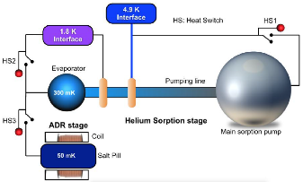
5. Coolers integration
Integration completed without any severe discrepancies.
2K-JT coupled with PT15K
Integrated
50mK hybrid cooler
Credit: CEA
4K-JT with 2ST
Cryostat and GSE
J.M.Duval et al. CEC (2015)

Slide 9
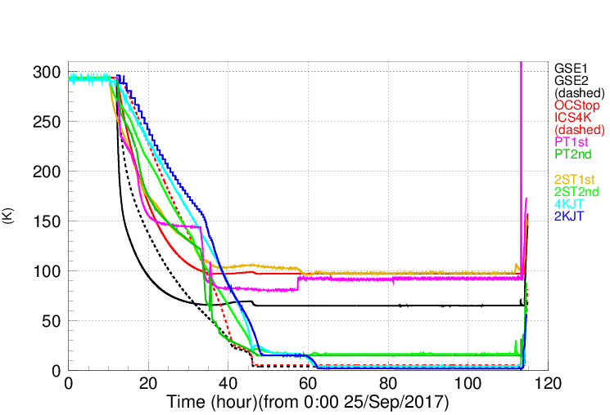
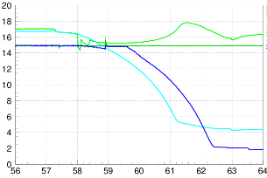
6. Cryostat1 cooling down from 300K to 1.7K
Typical cooling profile from 300K to 1.7K
2ST
GSE1
GSE2 (dashed)
OCS top
ICS 4K (dashed)
PT15K 1st stage
PT15K 2nd stage
2ST 1st stage
2ST 2nd stage
4K-JT cold finger
2K-JT cold finger
PT15K
Start GSE cooler,
Start PT15K
25→50W
Start
2ST
20W
4K-JT
2ST 60W
PT15K
100W
→150W,
Phase Optimization
2K-JT (³He)
2ST
24W
PT15K
Restarted
PT15K 300W,
T control
2ST 38W
2ST 60W
4K-JT
2K-JT (³He)
Cool down
2ST 46W

Slide 10
7. JT coolers performance
No apparent degradation in both JT coolers performances
  2ST 2nd stage temperature was slightly lower with 62W after the installation into cryostat1. In this condition, 4.3K was obtained with almost same JT driving power (different compressor balance). The gravitational effect may exists.
4K-JT | heat load | 2ST 1st | 2ST 2nd | JT coldtip | PL | PH | FL | 2ST | JTCL
Vacuum Vessel (23 Jun 2017, in Japan) | 40.1 mW | 118.2K | 18.4K | 4.29K | 100 kPa | 1628 kPa | 1.93 NL/min | 81W | 62.4W
Vacuum Vessel (30 Mar 2017, in France) | 40.2 mW | 109.3K | 18.1K | 4.28K | 100 kPa | 1652 kPa | 1.93 NL/min | 81.8W | 62.7W
Cryostat1 (14 Apl 2017) | 39.9 mW | 96.0K | 17.3K | 4.32K | 103 kPa | 1554 kPa | 1.89 NL/min | 61.6W | 61.3W
Confirmed the required cooling power.
Cooing power of 19mW at 1.77K has been measured by PT15K precooling temperature of 9.9K.
2K-JT | heat Load | PT 1st | PT 2nd | JT coldtip | PL | PH | FL | PT15K | JTC
PT 90K / 15K (6 Jul 2017) | 10.0 mW | 92.2K | 14.9K | 1.72K | 7.8 kPa | 541 kPa | 1.33 NL/min | 300W | 40.0 W
PT 90K / 10K (12 Jul 2017) | 19 mW | 92.2K | 9.9K | 1.77K | 7.2 kPa | 484 kPa | 1.26 NL/min | 300W | 37.3 W

Slide 11
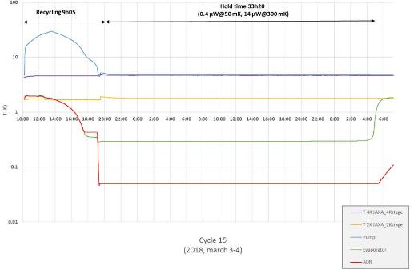
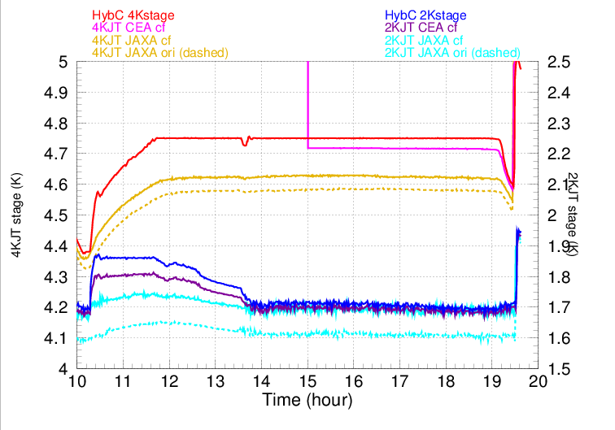
8. Hybrid cooler recycling (1/2)
Successfully obtained 50mK more than 10 cycles.
Hold time of 33hr20min obtained with the recycling time of 9hr05min (~78%) using the nominal operation.
Required cooling power demonstrated with heater.
  0.4μW at 50mK
  14μW at 300mK
Recycling
Observation
Sorption pump
4K-JT
2K-JT
300mK sorption evaporator
50mK ADR
+10mW / +3mW heat load from 50mK hybrid cooler to 4K-JT / 2K-JT.
4K-JT heat load: 30 → 40mW.
2K-JT heat load: 4 → 7mW.
Successfully operated with method 1B (max interface temperature regulation).
Recycle start
Recycle end

Slide 12
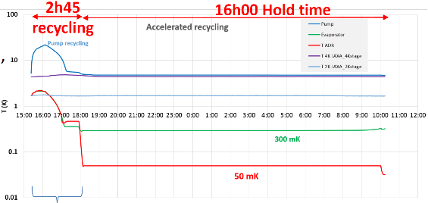
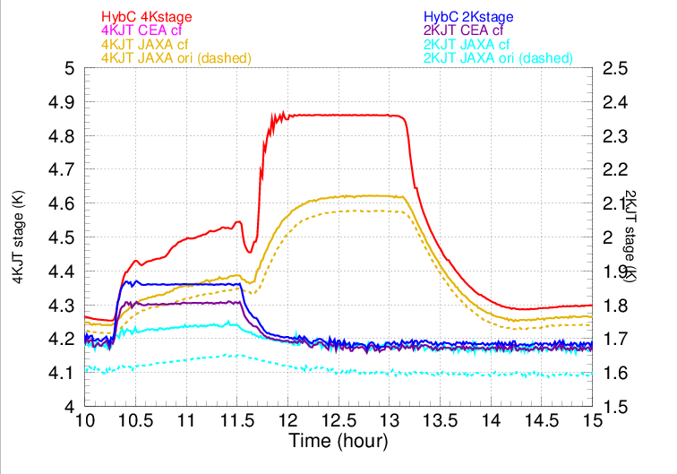
8. Hybrid cooler recycling (2/2)
Accelerated recycling.
25 Oct 2017
Shorter recycling time by higher heat load with lower max sorption temperature.
4 numbers of trials.
Duty cycle of 85% (90% possible).
Sorption pump
4K-JT
2K-JT
T(K)
300mK sorption evaporator
28 Feb 2018
50mK ADR
+20mW / +3mW heat load from 50mK hybrid cooler to 4K-JT / 2K-JT.
4K-JT heat load: 20 → 40mW.
2K-JT heat load: 4 → 7mW.
Successfully operated with method 1B (max interface temperature regulation).

Slide 13
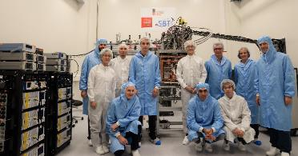
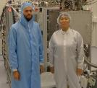
Summary
Successful design of test cryostat
  Integration validated without severe problems.
  Good heritage for DCS and flight models.
  Efficient tool for coolers characterization.
JT coolers performance
  1st time to integrate and operate two JTs.
  Many operating points measured.
  Cooling performance with different precooling temperature.
300K – 50mK cooling operation
  Successful coupling of coolers.
    2K-JT and PT15K
    Hybrid cooler and JT coolers
  Efficient operation.
    33 hours hold time measured.
    9 hours recycling time.
    Accelerated cycle

Slide 14
The transports, installations and performance tests have been performed successfully without critical schedule delay.
2017/2018 |  | Jan | Feb | Mar | Apr | May | Jun | Jul | Aug | Sep | Oct |  | Feb | Mar
4K-JT test (VV, in JP) | SHI/ JAXA
4K-JT trans. | JAXA/ SHI
4K-JT test (VV) | JAXA
4K-JT integration | CEA/ SHI/ JAXA
4K-JT test | JAXA
2K-JT trans. | JAXA/ SHI
2K-JT integration | CEA/ SHI/ JAXA
2K-JT test (⁴He) | JAXA/ SHI
3He gas purification | JAXA/ SHI
2K-JT test (³He) | JAXA/ SHI
HybC test
HybC add. test
Japan
Plan
Result
France
VV: using vacuum vessel for transport

