Slide 2
Heat transfer at dielectric – metallic interfaces in the ultra-low temperature range
J. Liberadzka^{1,2}, J. Golm¹, T. Koettig¹, J. Bremer¹, H.J.M. ter Brake²
¹ CERN TE-CRG-CI, Switzerland
² University of Twente, The Netherlands

Slide 3
Content
Motivation – AEgIS experiment
Experimental setup
Cryolab DR characteristics
Steady state measurement results
with magnetic field
without magnetic field
Conclusions

Slide 4
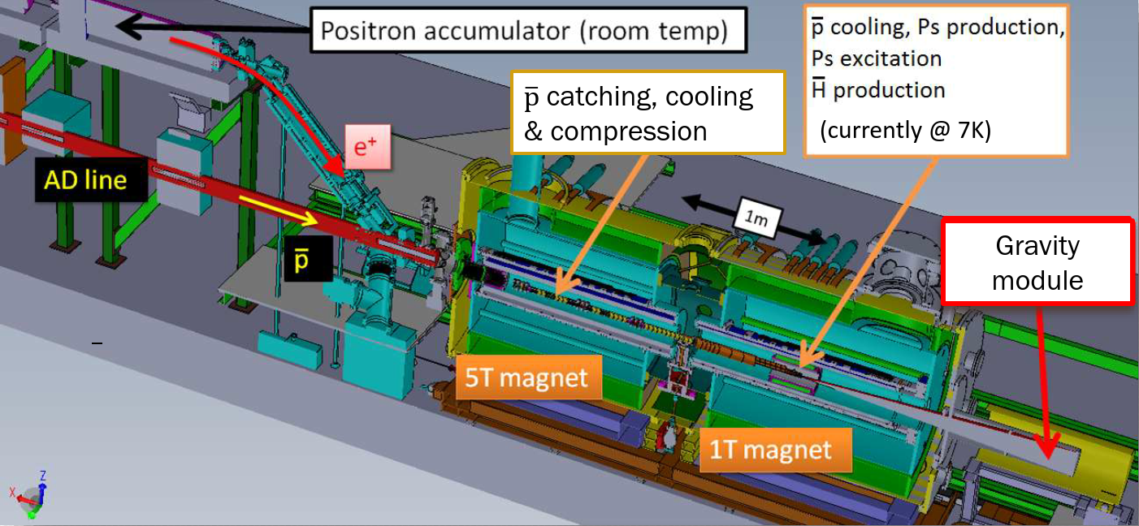
AEgIS at CERN
Antimatter Experiment:
Gravity, Interferometry, Spectroscopy
Aim: direct measurement of the Earth’s gravitational acceleration g
on antihydrogen within 1 % precision
Picture: D. Krasnicky, AEgIS collaboration, presentation for LEAP 2018 Paris

Slide 5
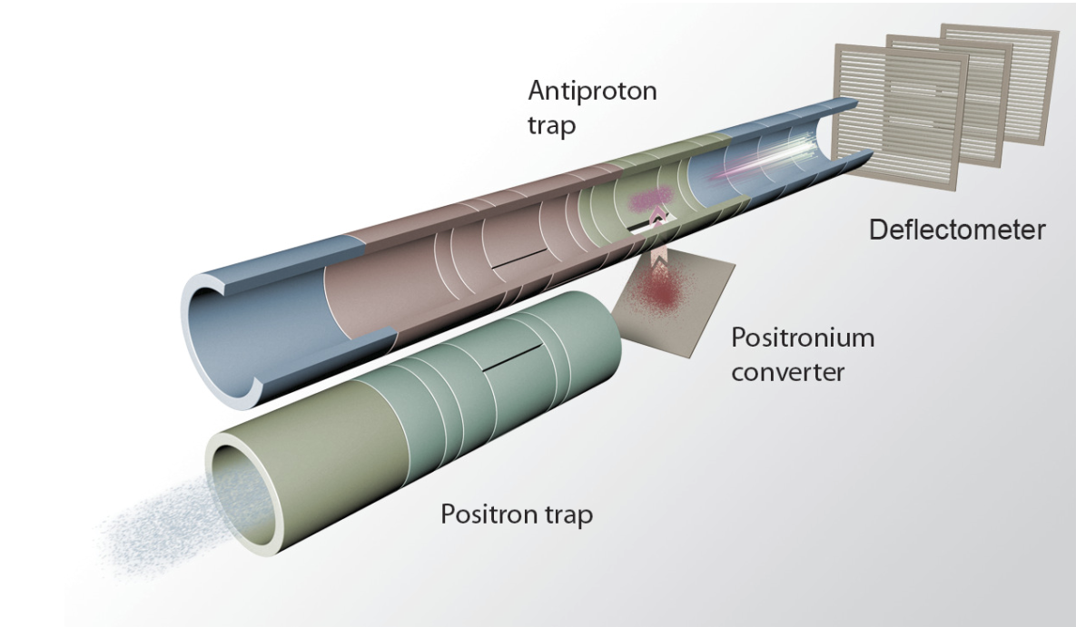
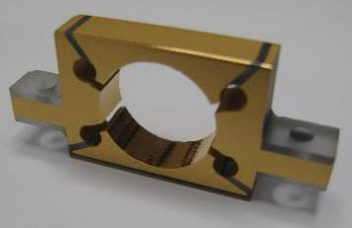
AEgIS ultra–cold electrodes
A. Kellerbauer, AEgIS collaboration,
Probing antimatter gravity – The AEgIS exeriment at CERN
Electrode requirements:
10 electrodes, some divided into 4 separate sectors,
Antimatter should „see” only golden surfaces,
Electrical insulation up to 1 kV,
Cooled below 100 mK
Compatible with ultra-high vacuum < 10⁻¹² mbar,
Radiation hard
SAPPHIRE + GOLD
24 mm
Picture by G. Burghardt

Slide 6
Experimental setup – two types of sandwich
# 2
# 1
Stamp
520 nm Au
125 μm indium foil
45 nm Ti
+3 μm of vapour
deposited indium
Optically polished 1mm thick sapphire disk
45 nm Ti
125 μm indium foil
520 nm Au
Platform

Slide 7
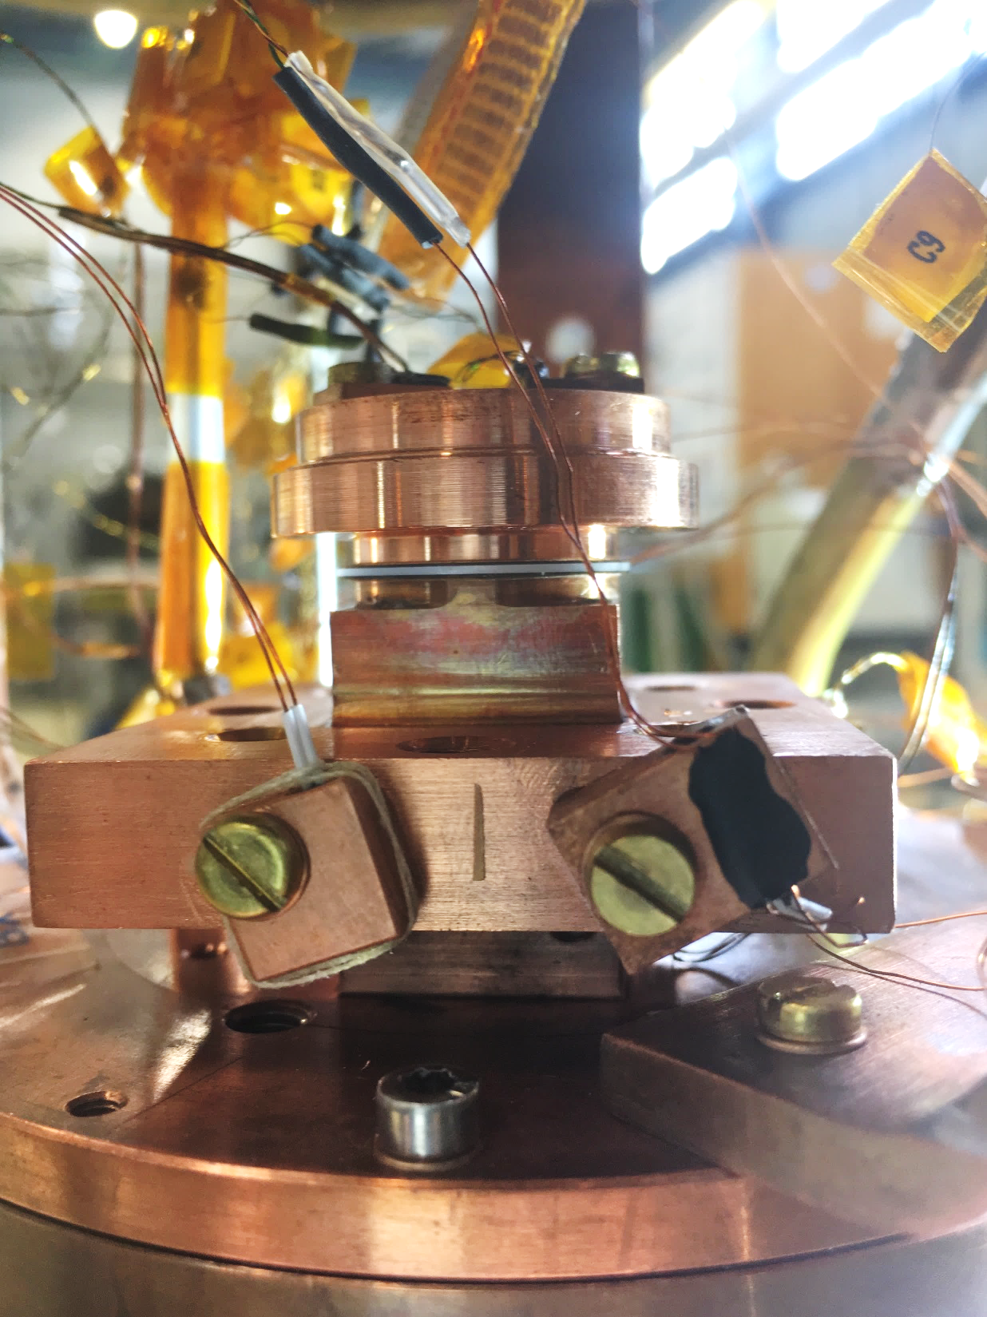
Experimental setup – preparation and measurements
Stamp
$$\dot{Q}$$
$$T_{H}$$
Sapphire disk with deposited thin layers
A
Platform
$$T_{C}$$
Thermal resistivity:
$$κ= \frac{A}{4\dot{Q}}\left({T_{H}}^{4}−{T_{C}}^{4}\right)$$
$$\left[κ\right]={{cm}^{2}K^{4}}/W$$
MC
50 mm
Clamping force can be removed!

Slide 8
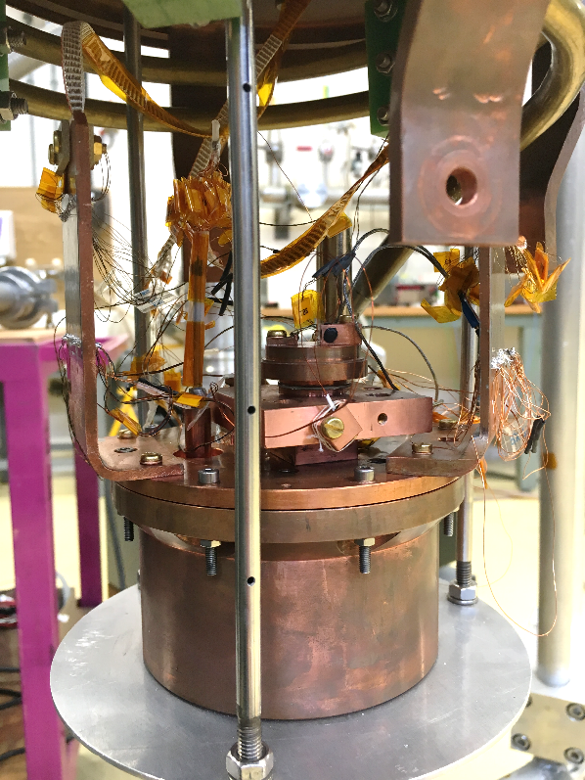
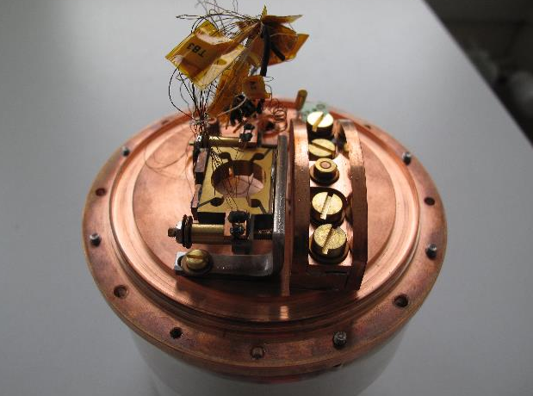
CERN Cryolab Dilution Refrigerator
Lowest recorded temperature 9.85 mK
Cooling power: 100 μW at 60 mK,
~500 μW at 90 mK
Mixing chamber of 120 mm diameter enables placing the samples in the mixture

Slide 9
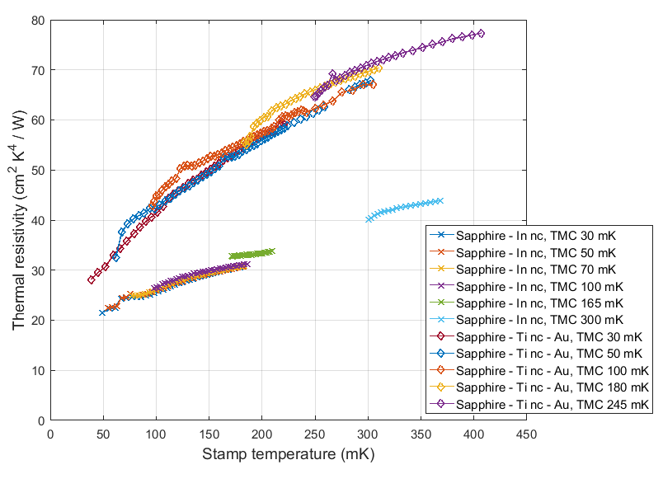
Steady state measurement results
Thermal resistivity:
$$κ= \frac{A}{4\dot{Q}}\left({T_{H}}^{4}−{T_{C}}^{4}\right)$$
$$\left[κ\right]={{cm}^{2}K^{4}}/W$$
Sapphire – Ti nc – Au
Magnetic field B=32.3 mT
↓
In and Ti nc
Sapphire – In nc
For single interface:
$$κ_{sapphire − In }=$$
$$=22.9 {cm}^{2}K^{4}/W$$
$$κ_{sapphire − Ti }=$$
=$18.3 {cm}^{2}K^{4}/W$

Slide 10
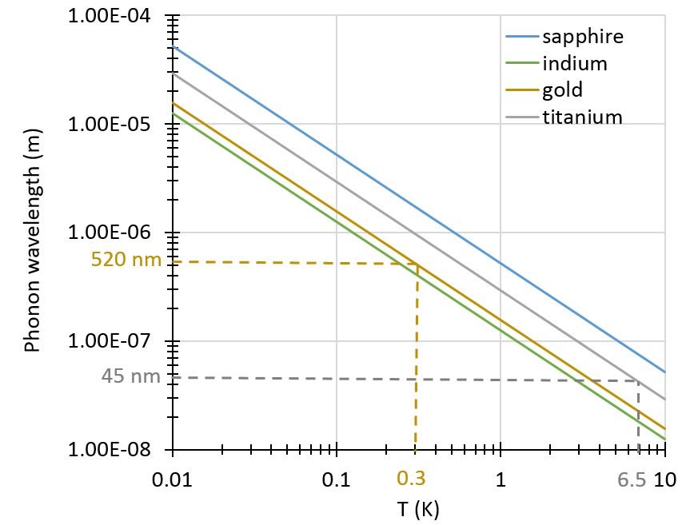
The effective thermal resistivity depends on:
1. „Parallel plates effect” observed before by Peterson, Anderson (1972)
2. Phonon mean free path – estimation for sapphire below 1 K gives ~ 2 mm
3. Phonon wavelength
4. Interface quality:
adhesion, ageing, alloying

Slide 11
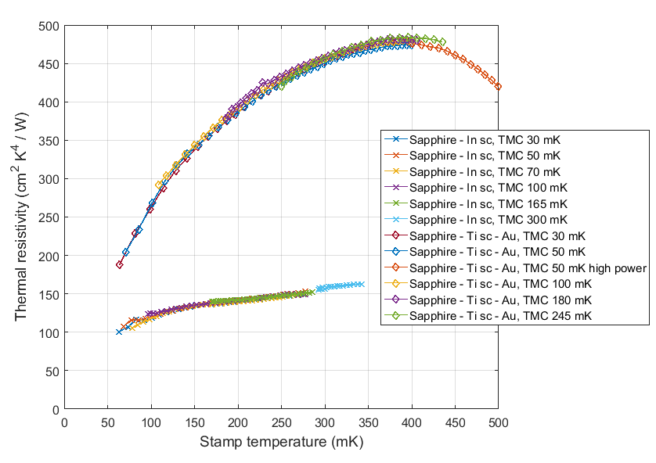
Steady state measurement results
No magnetic flux
↓
In and Ti sc
Sapphire – Ti sc – Au – In sc - Cu
Ti nc
Including parallel
plates assumption
at the sapphire
disk:
Sapphire – In sc - Cu
$$κ_{sapphire−In−Cu}=27.1 {cm}^{2}K^{4}/W$$
$κ_{sapphire−Ti−Au−In−Cu }$=
$$=26.8 {cm}^{2}K^{4}/W$$

Slide 12
Conclusions
The „parallel plates effect” observed at the sapphire disk
Thin layers significantly reduce the effective thermal conductivity, even in normal conducting titanium
Only indium deposition at the bottom of the electrode
5 times better thermal performance!

Slide 13
Thank you for your attention!

