Slide 1





A compact 4 K cooling system for superconducting nanowire single photon detectors
STFC Rutherford Appleton Laboratory - M Hills, T W Bradshaw, M Crook, B Green, T Rawlings
University of Glasgow - N R Gemmell, R H Hadfield, R M Heath, K Tsimvrakidis
Single Quantum - S Dobrovolskiy, S N Dorenbos, V Zwiller
Notes:
SNSPDs (and other technologies)
Context (other cooling systems)
Cooler design and heritage
Results
Cooldown
Detector characterisation
Application demonstrations
Future developments
Conclusions

Slide 2
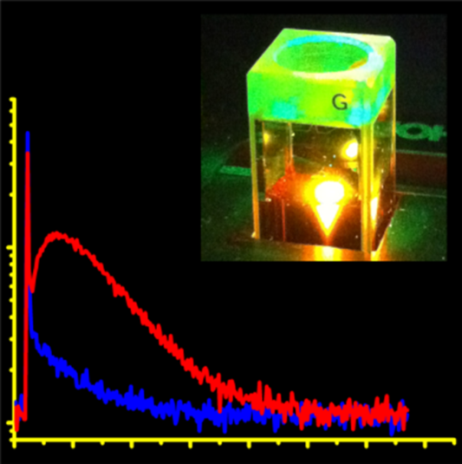
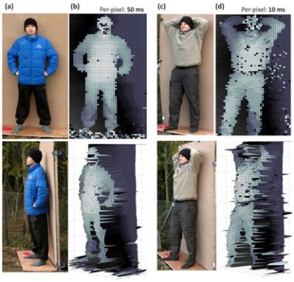
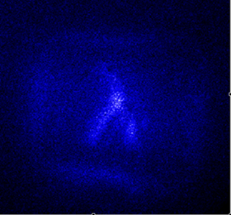
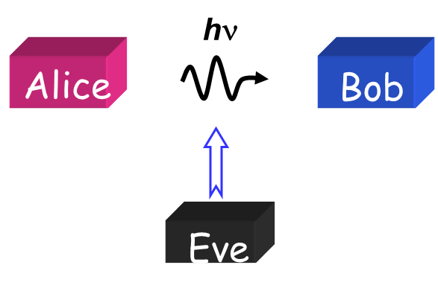
Introduction
Infrared single photon detection is an important emerging quantum technology
Various superconducting detector types are promising alternatives to conventional photomultipliers (PMTs) and semiconductor avalanche photodiodes (SPADs)
  Superconducting Tunnel Junctions (STJs)
  Transition Edge Sensors (TESs)
  Kinetic Inductance Detectors (KIDs)
  Superconducting Nanowire Single Photon Detectors (SNSPDs)
Applications for these technologies are growing
  astronomy
  space-to-ground communications
  quantum key distribution
  imaging and remote sensing
  dosimetry for laser medicine
But cooling the detectors to their operating temperature remains a challenge….
Notes:
Infrared single photon counting
Technologies are alternatives to off-the-shelf photomultipliers/photo avalanche diodes
Not achieving the operating temperatures, but doing so with a compact and portable system

Slide 3








Superconducting Nanowire Single Photon Detectors
Key properties
Operate at 4K
  not mK
Wide spectral range
  UV – mid IR
Low dark counts
Low timing jitter
Short recovery time
See: Natarajan et al Superconductor Science and Technology 25 063001 (2012) Open Access
Notes:
Highlight operating temperature – this is why we’re interested in this. Operates at a few K not mK

Slide 4
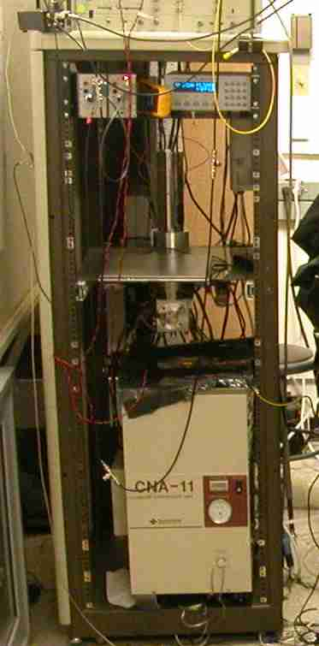


Laboratory cooling technology
Based on SHI RDK 101D cold head and CNA 11C compressor
  Cold head/compressor mass ~ 50kg
  Fits into standard 19” rack
  Air cooled
  100 mW cooling power at 4.2 K
  1 kW from 13 A plug
Several international companies are commercialising SNSPDs in systems of this type:
  Scontel (Russia)
  Single Quantum (NL)
  Quantum Opus (USA)
  Photon Technologies (China)
Notes:
List companies – Single Quantum, Quantum Opus,
NIST logo

Slide 5
Compact 4K cooling technology
Hybrid coolers
  Pulse tube & Joule-Thomson
  Stirling & Joule-Thomson
Utilise small compressors with low power consumption
Aim to minimise
  size
  mass
  input power
Systems now under development by several groups
  National Institute of Standards and Technology (NIST)
  Chinese Academy of Sciences (CAS)
4K stage
20K stage
150K stage
Joule-Thomson cooler
Stirling cooler
Notes:
Small compressors – hybrid coolers
Appropriate for use with SNSPDs
We were first!

Slide 6
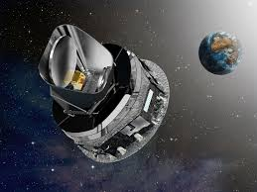
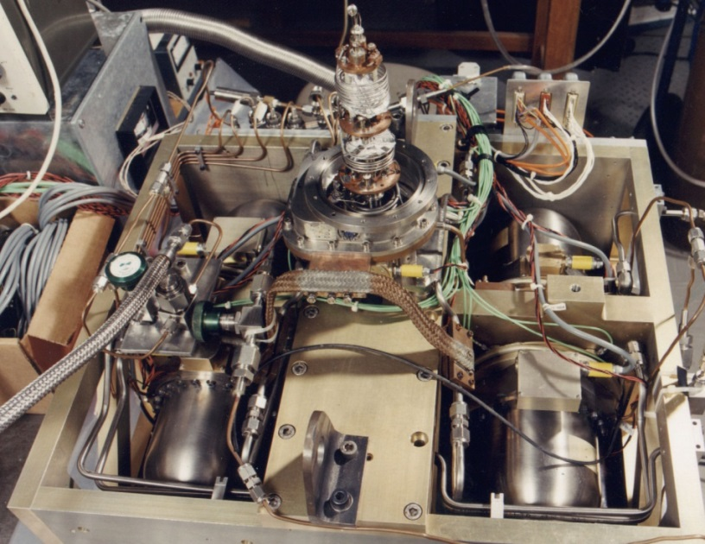
Space heritage
Cooler technology developed by Rutherford Appleton Laboratory UK for many years
  4 K cooler for Planck (~4.5 years of in-orbit operation)
Combined Stirling/Joule-Thomson mechanism
Weight of cold head/compressor 5kg
~3 mW cooling power at 4.2 K
~120 W input power to compressors
Mobile (and able to withstand a rocket launch!)
Notes:
Demonstrator re-purposed for this project

Slide 7
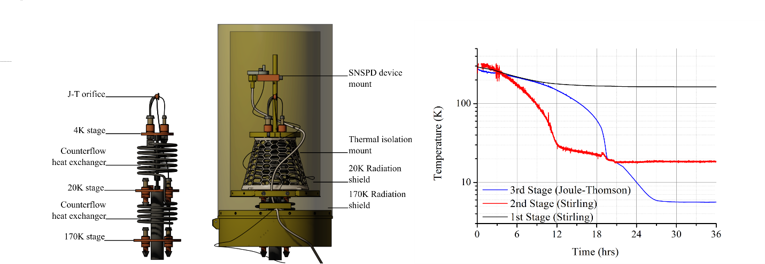
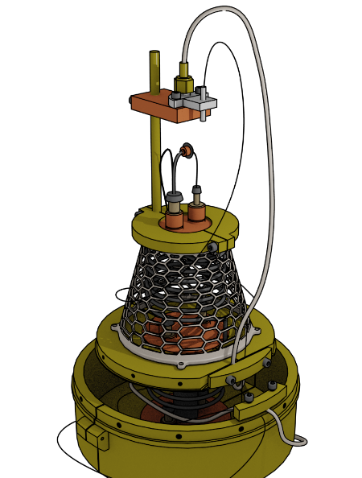
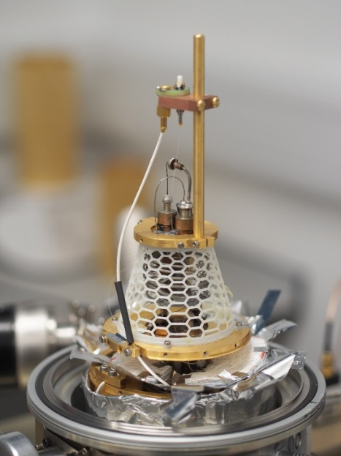
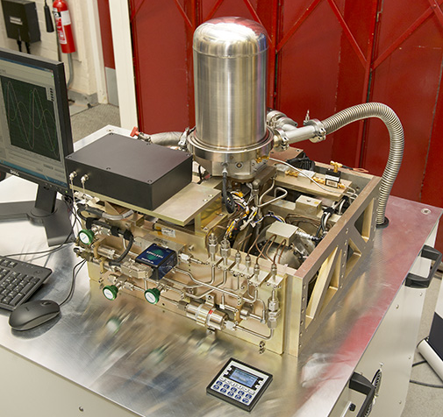
Cryogenic design
Bespoke cryostat for SNSPD integration
  Fibre optic feedthrough
  Coax feedthroughs
2-stage Stirling pre-cooler
  170K
  20K
4K JT stage for detector cooling
Controlled through LabView interface
Radiation shielding and harness heat sinking at these temperatures
Notes:
Mention ease of access,
cryostat feedthroughs and vacuum connections

Slide 8
Cryogenic performance
Base temperature ~ 4K
Measured cooling power
  4 mW at 4.7 K
Base temperature reached in less than 30 hours
  Bypass circuit employed to speed up cool-down

Slide 9
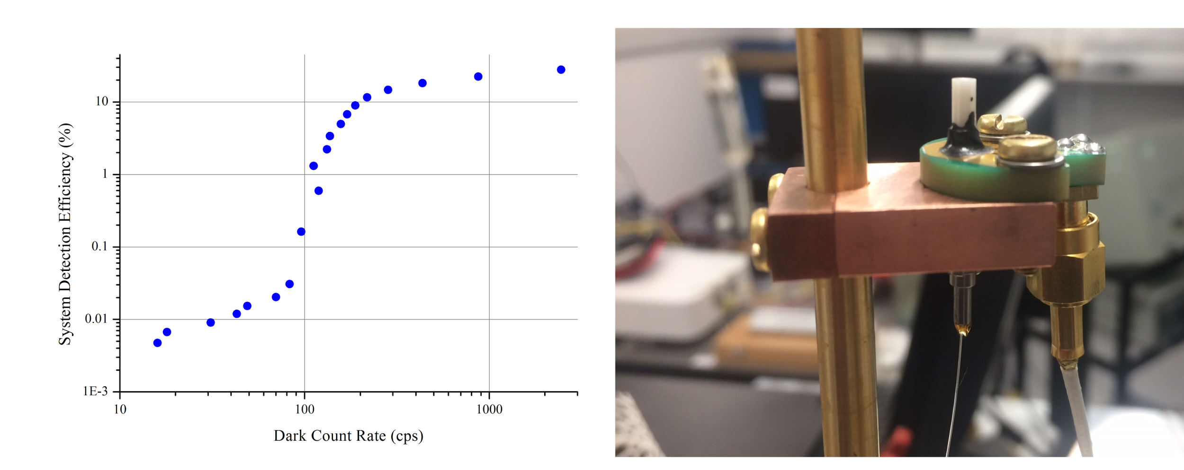
Detector performance
Single photon efficiency tests performed at 1310 nm
  peak design wavelength of the SNSPD optical cavity
Cooler operating at 4.3 K
Efficiency of > 20 % at 1 kHz dark count rate
Notes:
1 kHz in free running
Could be gated down to the timing resolution of the detector

Slide 10
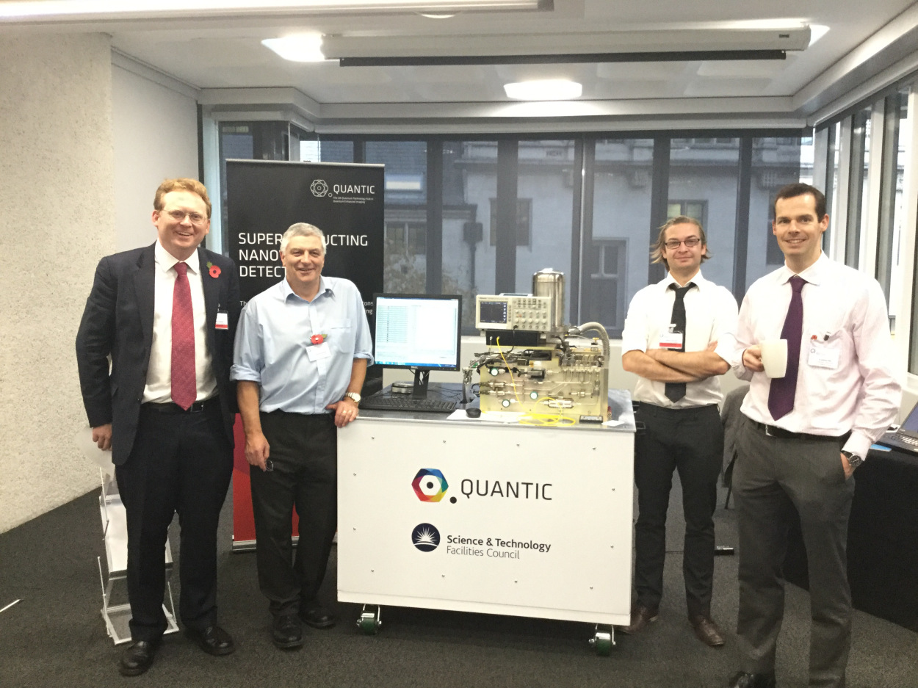
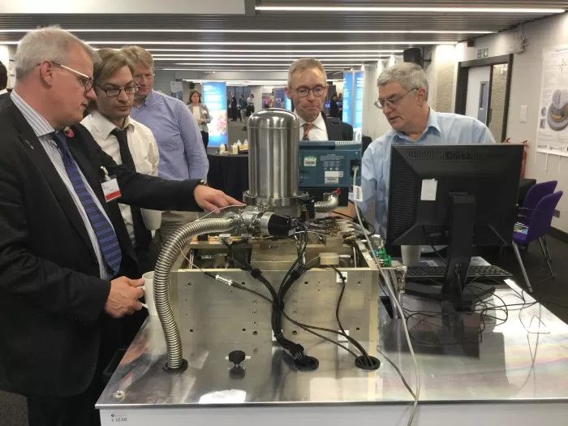

National Quantum Technologies Showcase November 2016
Entire system including ancillary equipment contained in mobile rack
Displayed at Queen Elizabeth Exhibition Centre, London
Notes:
Mention that this is an annual event.

Slide 11
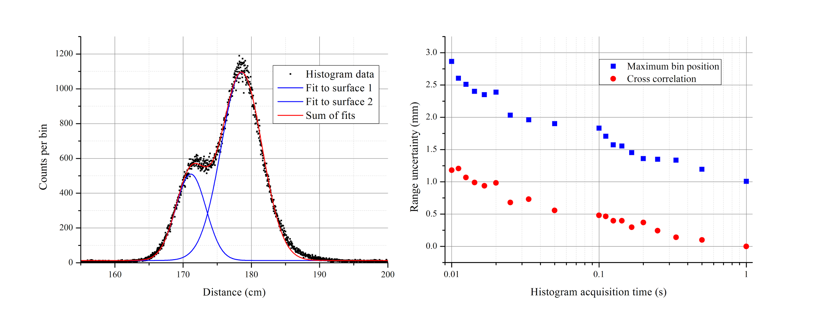
Applications: LIDAR
Discrimination of two targets at 1.5m distance
Range uncertainty reduces with acquisition time
Potential application in driverless cars

Slide 12
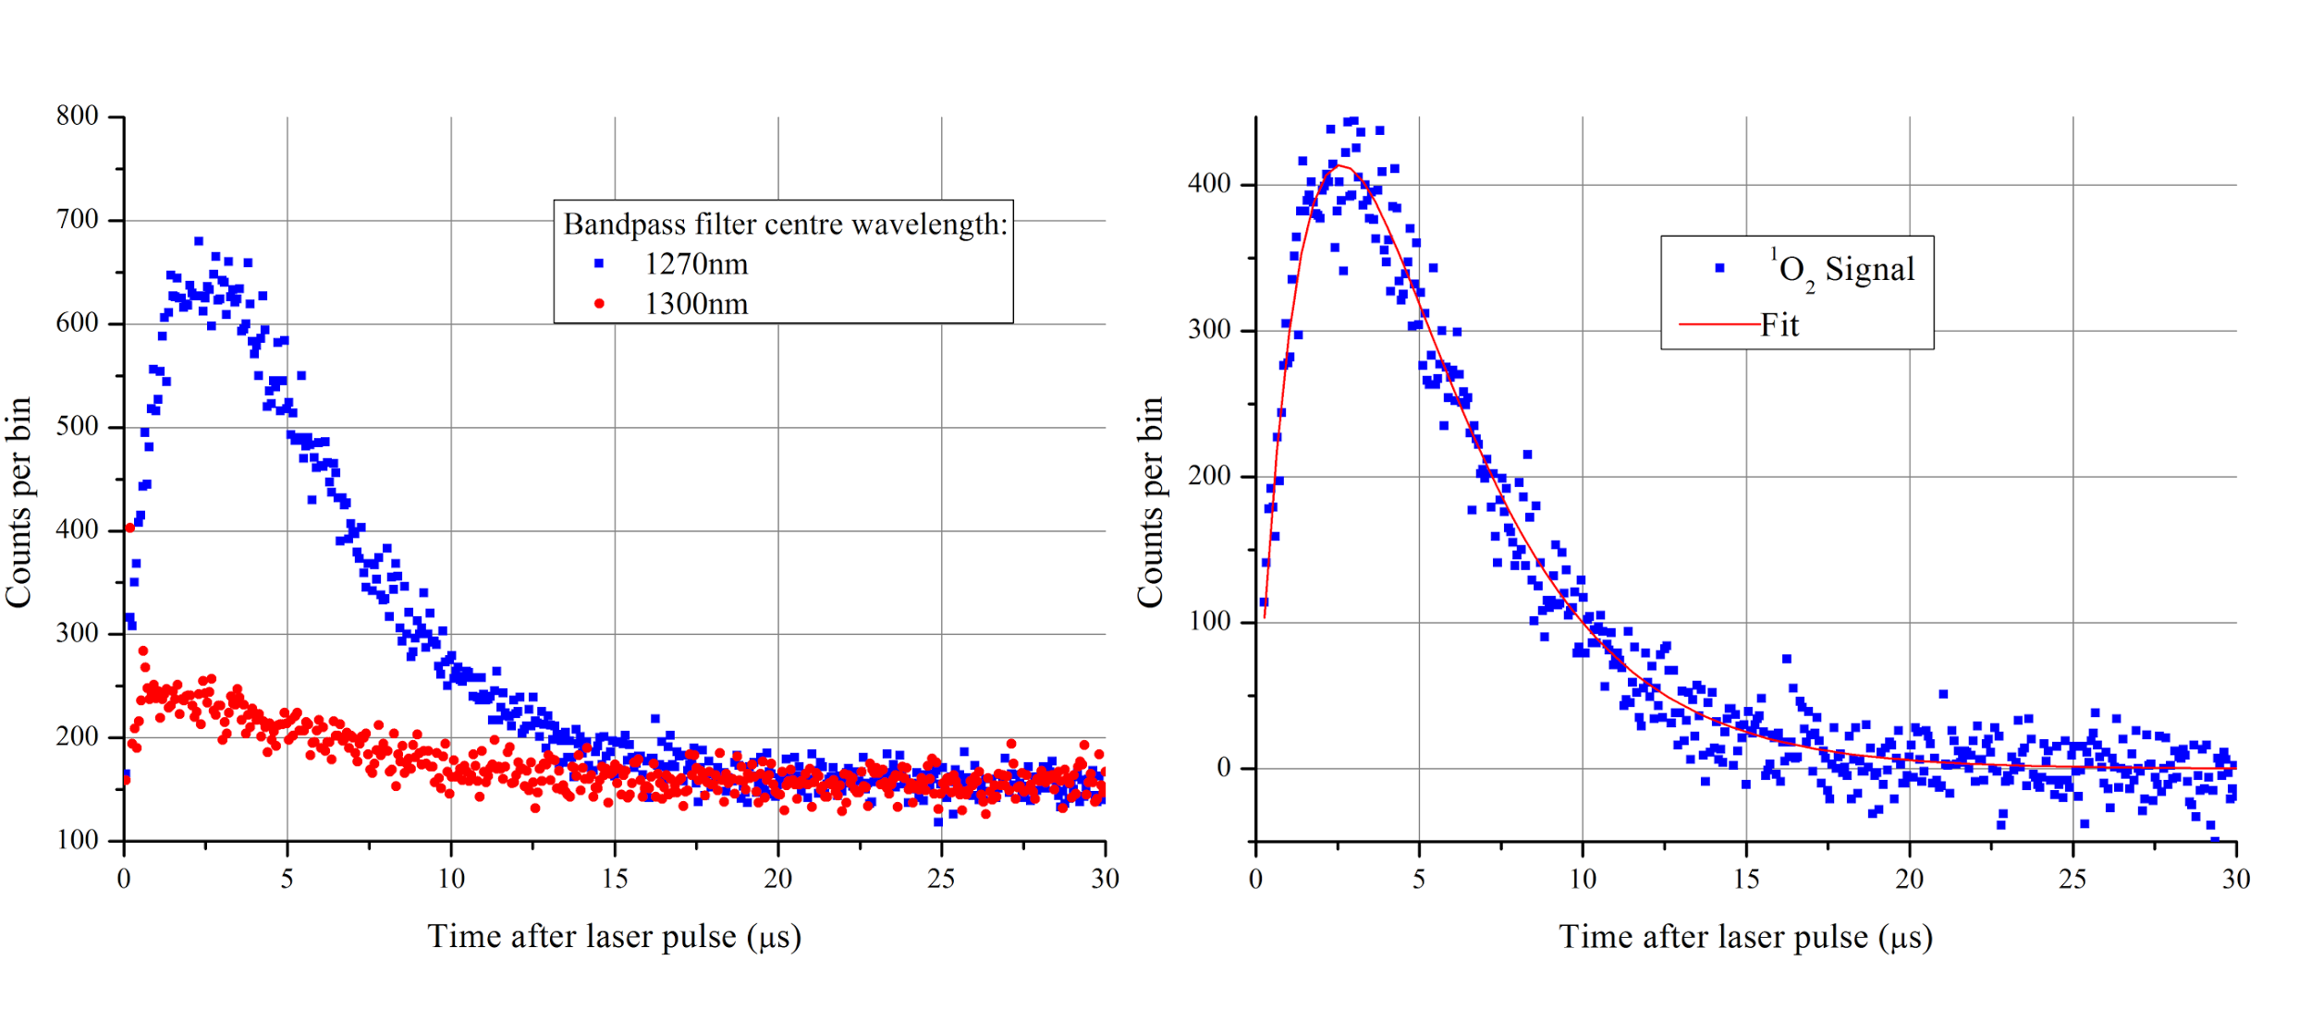
Applications: Photodynamic Therapy (PDT) in the treatment of cancer
Photosensitiser treatment drug exchanges energy with surrounding oxygen molecules on optical excitation, creating singlet oxygen radicals which kill tumour cells
Singlet oxygen detection crucial for dose monitoring
System able to detect the weak 1270 nm signal of singlet oxygen transition
Notes:
Skip through

Slide 13
See also: Nature Photonics Research Highlight, Physics World, Laser Focus World, NanoWerk etc.

Slide 14
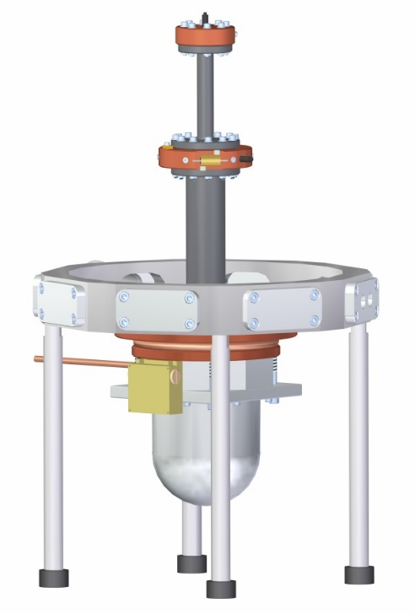
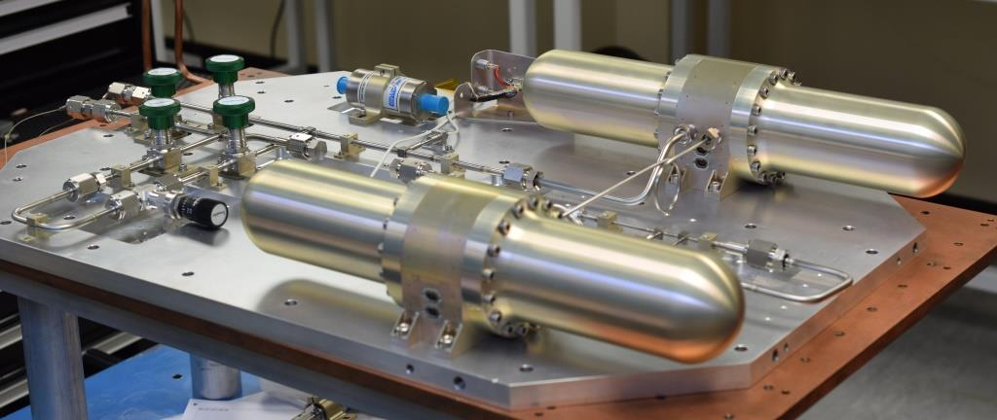
Future developments
Stirling cooler optimisation
  Temperature and heat lift tailored to SNSPD requirements
  Designed with production engineering in mind
  Prototype cooler under construction
Joule-Thomson compressor developments to achieve 2 K (and below)
  Demonstrator cooler currently under test
Cooler drive electronics miniaturisation
Reduction/elimination of ancillary equipment
  Air cooling
  Miniature/passive vacuum system
Notes:
Mass production of Stirling cooler – designed for manufacture
More cooling power could mean more detectors for bigger arrays…..
Space cooler technology is truly mobile

Slide 15
Conclusions
A Stirling–Joule-Thomson cooling system, based on proven space cooler technology, has been constructed for use with SNSPDs
The system delivers > 4 mW of cooling at 4.7 K
Detector performance in the system has been characterised
Application demonstrations have been performed
  LIDAR
  Photodynamic Therapy
Work to further optimise such systems for SNSPDs is ongoing

Slide 16
