Slide 1

Cryogenic systems for a PrFeB-based cryogenic permanent magnet undulator at TPS
Jui-Che Huang¹, Hideo Kitamura², Chin-Kang Yang¹, Chih-Sheng Yang¹, Cheng-Hsing Chang¹, Cheng-Hsiang Chang¹, Ching-Shiang Hwang¹
¹National Synchrotron Radiation Research Center, Taiwan
²RIKEN/SPring-8,Japan
ICEC27-ICMC 2018, Oxford, U.K.

Slide 2
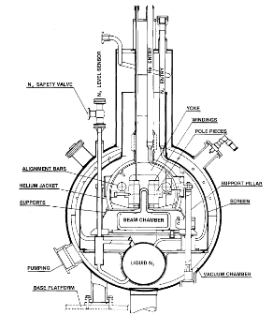
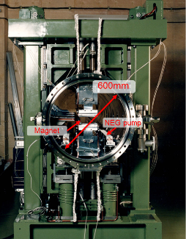
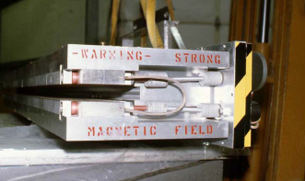
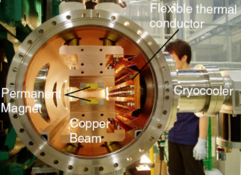
Undulators
The undulator is designed as a X-ray source from a third-generation light facility. Main features of an optimized source are;
-- the quality of the electron beam. For example, a low emittance storage ring.
-- undulator radiation from short period undulators with low phase errors:
  shorter wavelength radiation. → Hard X-ray
  more periods for a given length. → Higher Brilliance
  low degradation of SR. → Higher Harmonics can be reached
Most important is the generation of a high magnetic field
in a short period undulator.
First permanent magnet undulator
at SSRL-SLAC,1980
First Cryogenic Permanent Magnet Undulator (CPMU)
prototype SPring8 ,2004
SuperConducting Undulator
(SCU) LURE, 1980
First In-vacuum Undulator
SPring8, 1993

Slide 3
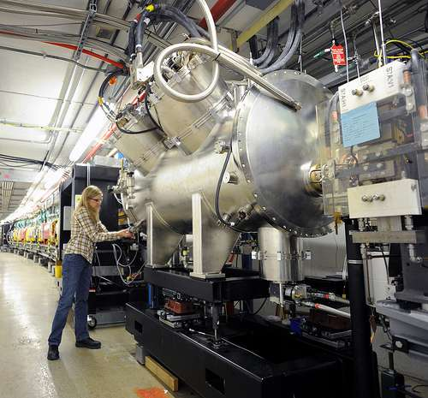
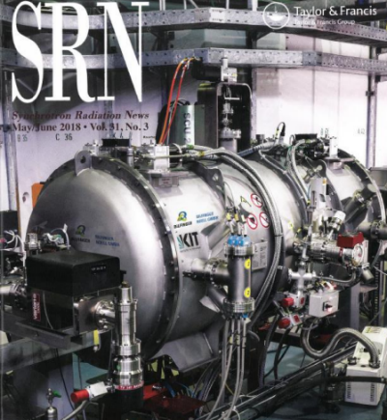
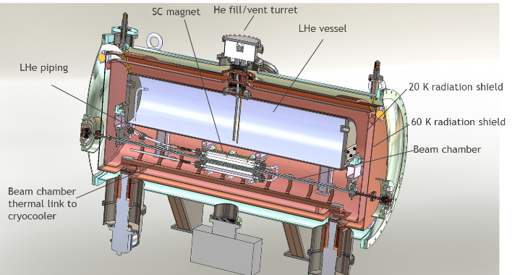
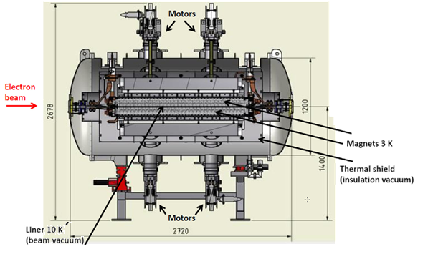
SuperConducting Undulator
APS (USA)
KARA(Germany)
Liquid Helium
indirect cooling
2x Sumitomo RDK408D2
2x Sumitomo RDK415D
SCU0 at APS with a period length of 16 mm and 20.5 periods generating a magnetic field of 0.8T at a magnetic / vacuum gap of 9.5 mm / 7.2 mm.
SCU15 at KARA with a period length of 15 mm, 100.5 periods and a magnetic field of 0.73T at a magnetic/vacuum gap of 8 mm / 7 mm.

Slide 4
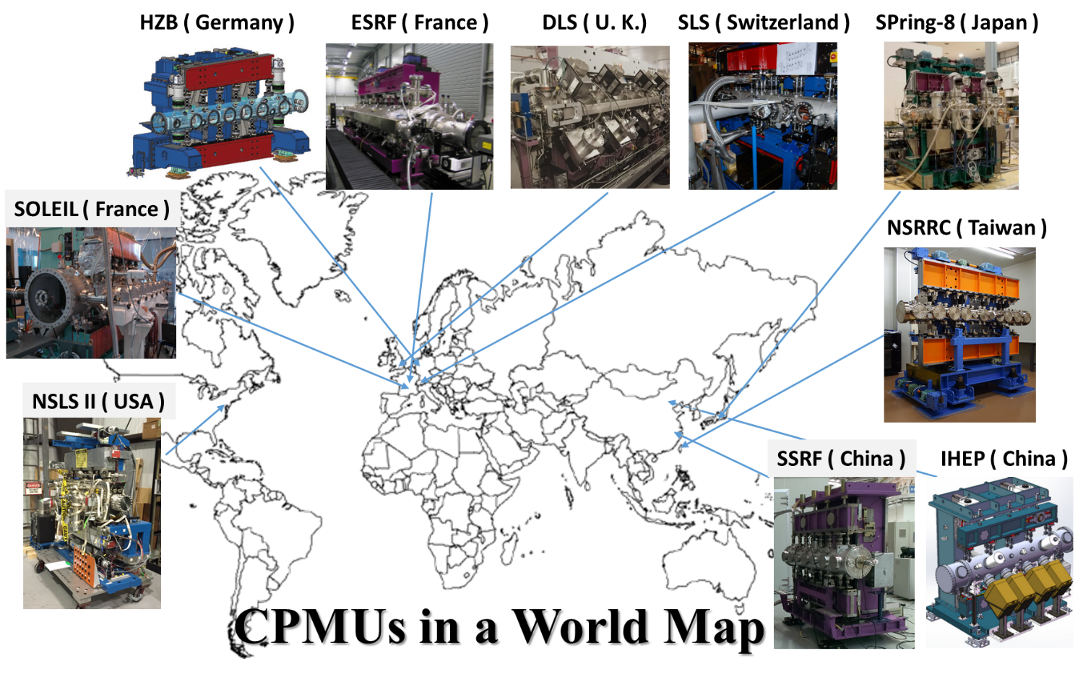
Cryogenic Permanent Magnet Undulator

Slide 5
SCU or CPMU at TPS
Several considerations: Magnetic field, Beam-induced heat load, cooling technologies, field measurement, cost …. TPS decided to adopt CPMUs as Phase-II insertion devices.
CPMU15 @
gap 4 mm→1.31T
Heatload > 25 W
SCU15 @ gap 8 mm → 0.73T
Heatload > 5.3W
The calculation is based on TPS parameters, EGeV = 3 GeV, Ib = 500 mA, number of bunches = 600, bunch length = 4.65 mm (15.5 psec), circumference = 518 m, bending radius = 8.353 m and a distance of 5 m from the dipole magnet end to the undulator entrance.

Slide 6
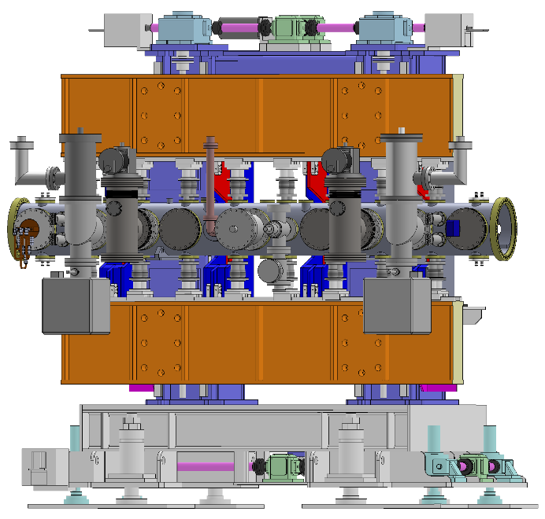
Development of the TPS CU15
Main desired features for the CU15 are low-phase-errors and high thermal stability against various heat loads.
Items | Unit | Values
Magnet structure |  | Hybrid
Magnet material |  | Pr₂Fe₁₄B (NMX-68CU)
Remanence ( Br ) | T | 1.40 at 293 K 1.67 at 77 K
Coercivity ( Hcj ) | kA/m | 1689 at 295 K 6200 at 77 K
Magnet size (x,y,z) | mm³ | 2.25 × 56 × 20
Pole material |  | Vanadium Permendur
Pole size (x,y,z) | mm³ | 3 × 46 × 16
Period | mm | 15
Min. magnetic gap ,G_{mag} | mm | 4
Min. vacuum gap , G_{vac} | mm | 3.8
Effective magnetic field | T | 1.30
Deflection parameter |  | 1.81
Number of periods |  | 133
Magnetic force | kN | 31.8
Total length | m | 2
Total cooler capacity | watts | 400 at 80K
Operating temperature | K | ~80

Slide 7
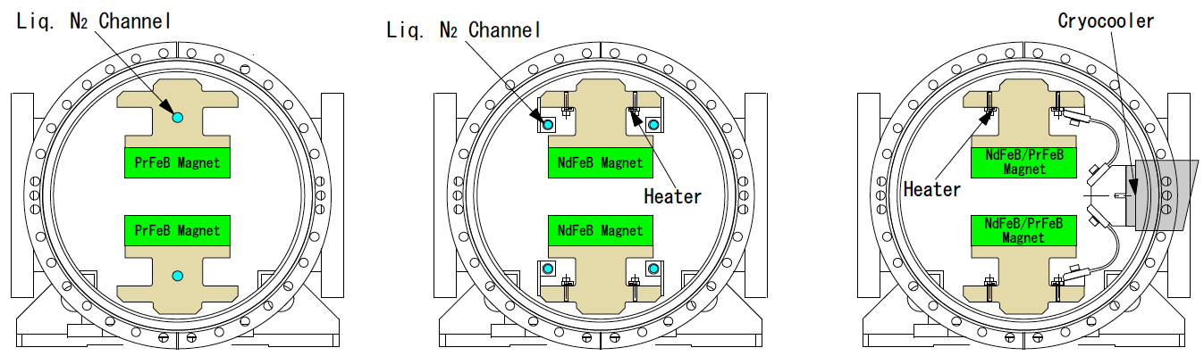
Cooling system for CPMUs
LN₂ cooling
Stable closed-loop LN₂ cooling in operation. (cooling system is used for Monochromator/ Thermosiphon cooling system)
Cryo-cooler cooling
Cryo-cooler cooling can provide a wide range of PM temperature below 77K and obtain good magnetic performance for a PrFeB / (NdPr)FeB CPMU.
SOLEIL
HZB
IHEP
ESRF
SLS
Diamond LS
NSRRC
SPring-8
Direct cooling of PMs with LN₂ without temperature control
Indirect cooling of PMs with LN₂ with temperature control
Indirect cooling of PMs with cold head and temperature control

Slide 8
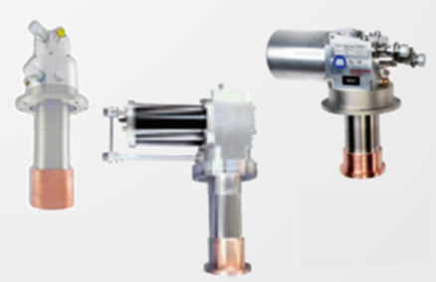


Cryo-cooler
A cryo-cooler can provide a cooling power of up to ~200 watts at 80K. Two cold-heads are necessary for a two-meter CPMU.
Advantages :
Low initial investment for the cooling system.
Suitable for a facility without LN₂ supply.
Neither welding nor pipe connections can cause a vacuum risk. Compatibility with storage ring ultra-high vacuum regulation.
Wide cooling margin, so the design of a cooling
system is relative easy compared to a LN₂
cooling system.
Disadvantages :
Operating costs are high.
Annual maintenance of cryo-coolers.
Must use a low vibration type
cryo-cooler.
Leybold
250MD
Advanced Research Systems DE110
Sumitomo
CH110
SuzukiShokan
RF90S

Slide 9
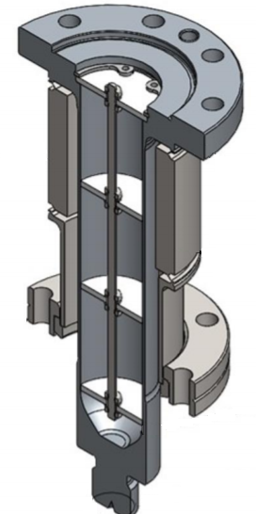
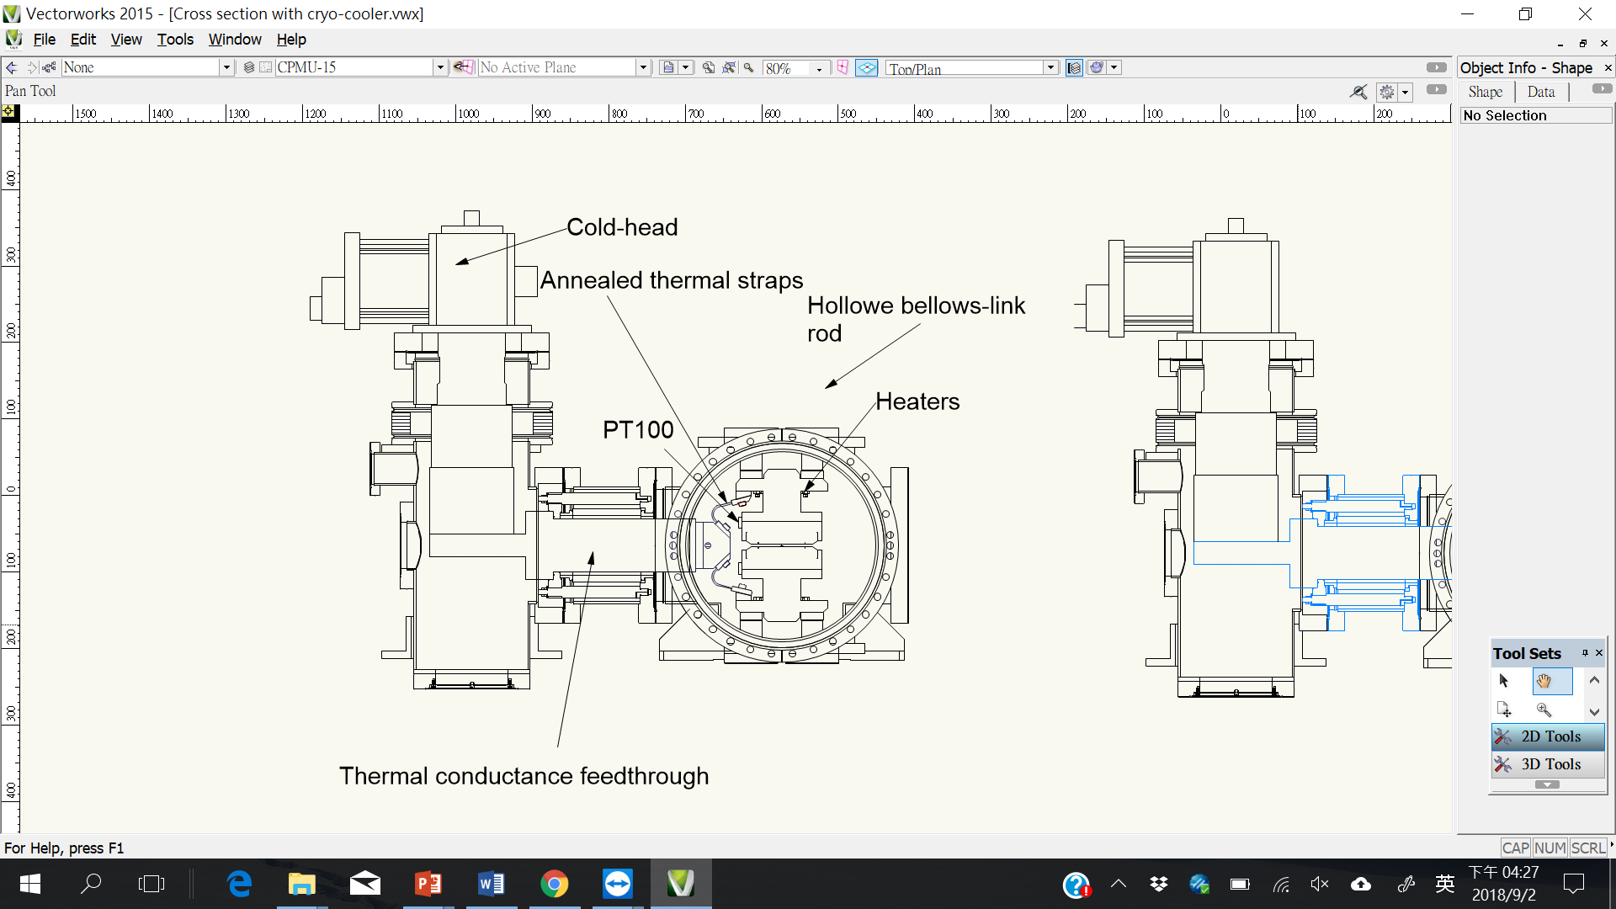
Features of TPS CPMU
Cryo-coolers to compensate for diverse sources of heat loads
Two low vibration cryo-coolers (~200Wx2 @ 80K) are used.
The vacuum of the cold-heads is separated from the storage ring vacuum making the design compatible with UHV rules for storage rings and with easy maintenance .
Thermal budget and temperature control
Hollow bellows-link rods reduce conduction heat transfer by a factor of 7. The bulkhead design is to suppress the air circulation inside the hollow space of the rods,which prevents condensation on the surface.
In-vacuum girder is made of OFHC with high thermal conductivity and low thermal contraction compared to aluminum.
Annealed flexible thermal straps increase thermal conductance by a factor of 3.5.
A 320W (40Wx8) heater is used to balance the beam-induced heat load.
RTDs (PT100) are calibrated to minimize tolerances in temperature measurements.
UHV
HV

Slide 10
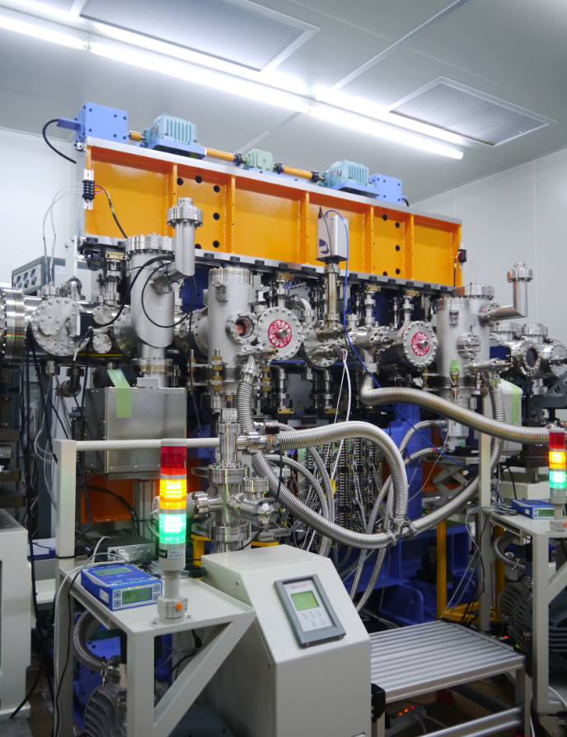
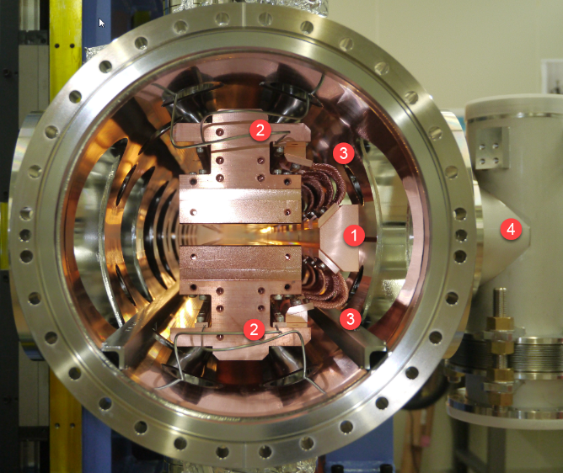
TPS CPMU, CU15
Inner structure
Connected
to a storage ring
Cold-head
Thermal conductor bar
Heaters
Flexible thermal straps
Separated and Insulated vacuum
for cold-heads
Overall structure

Slide 11
Temperature Control System
A temperature control system is mandatory for a NdFeB-CPMU operating at 140~150K. But, temperature control is optional for a PrFeB-CPMU, the reason we use it is because:
We can obtain a reproducible energy spectrum under various beam conditions
Compensate any residual temperature gradient to minimize field errors.
Heaters are installed along the side of the magnet arrays with high speed PID temperature controllers .
An optimum PID parameters of the temperature control is important to minimize the temperature fluctuation of magnets.
Temperature distribution of CU15 at various input of heater power
Magnet [K] | 140 | 120 | 100 | 80 | 55
Cooling bar [K] | 111~122 | 103~108 | 82~89 | 68~73 | 51~54
Cold-head[K] | 60.9 / 61.3 | 56.0 / 57.9 | 52.7 / 53.1 | 49.6 / 50.3 | 44.7 / 45.9
Estimated Heater power [W] | ~100 | ~80 | ~60 | ~40 | 0

Slide 12
Cooling performance
The lowest achievable temperature of PMs is ~ 55 K in 48 hours.
(cold-head : 45 K, thermal conductor bar: 52 K)
If the temperature of PMs is controlled to ~ 80 K, the cold head is 50 K, thermal conductor bar is 70 K.
In magnet arrays, the temperature variation within ± 0.4 K with temperature control system. (PT100 is calibrated , the tolerance is within ± 0.1 K).
At ~ 80 K, the magnet gap is 0.99 mm wider.
Total shrinkage of a 2m-copper-magnet-array is 5.65 mm.

Slide 13
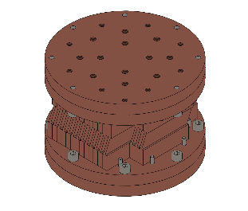
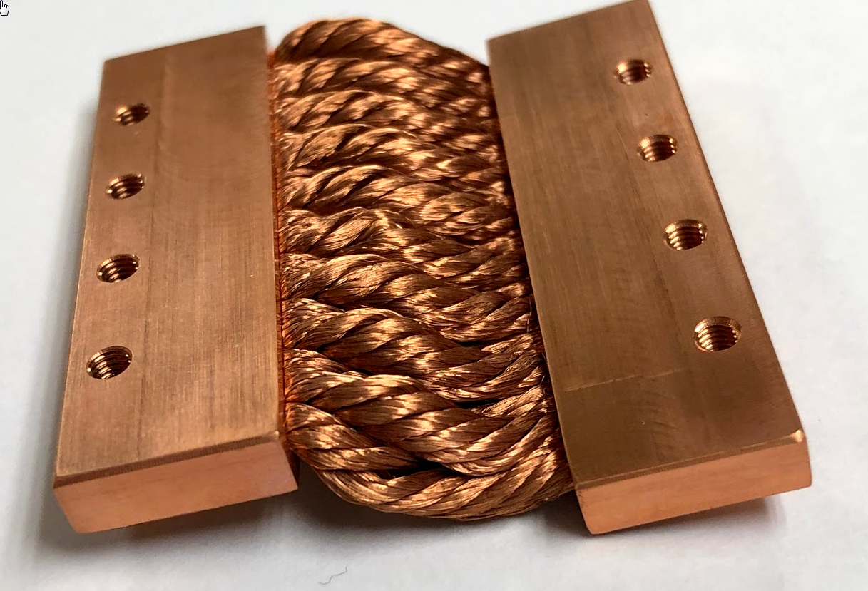
Reduction of vibration of chambers
Using Gifford-McMahon cryo-coolers, instead of solvary cryo-coolers.
Using a flexible-straps-adapter between cold
heads and thermal conductance feedthroughs.
5 cm
Flexible-straps-adapter
solvary cryo-coolers
G-M cryo-coolers
Original Design
New Design
Advantages
Avoid vibrations from cold-heads to inner structure of CPMUs.
No inner stress between cold-heads and thermal conductance feedthroughs .
Disadvantages
Reduced thermal conductance.
Increased thermal contact resistance due to many components.
A temperature
rise on magnets

Slide 14
Summary
  A 2m-CPMU has been tested at NSRRC with a vacuum compatibly in-situ measurement system.
  The PMs can reach 55K with two cold-heads (200W x2 @ 80 K). The heatload of TPS-2m-CPMU is estimated around 240 W.
  The temperature control can reduce the residual temperature gradient to a variation along the 2m-magnet-array to less than ± 0.4K.
  Using Gifford-McMahon cryo-cooler and flexible-straps-adapters can obtain lower vibration. But, the temperature of magnet may increase 5 K.
  Current design can be easily extended to LN₂ cooling methods and the system is compatible with storage ring ultra-high vacuum regulations.
NdFeB

Slide 15
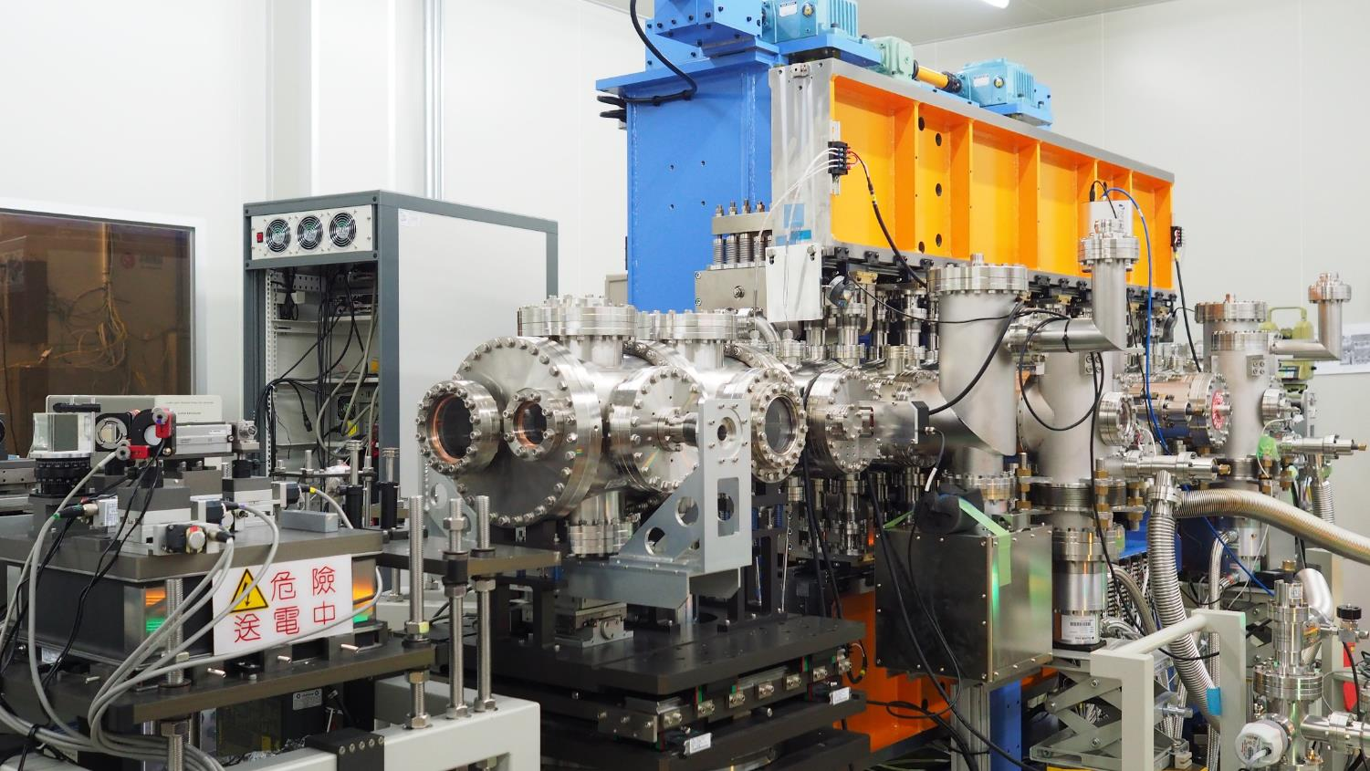
Thank you very much.

