Slide 1
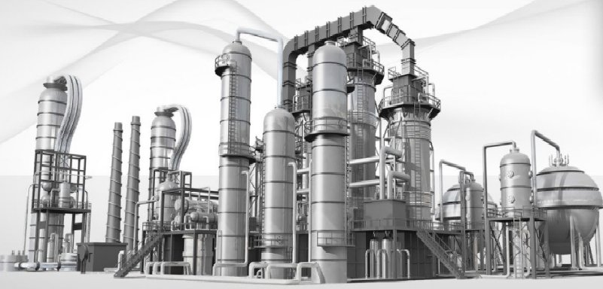
Measurements of Pressure Oscillations and Mechanical Vibrations
Dr. Sergiy Putselyk *
FERCHAU Engineering GmbH, Butzweilerhof-allee 4, 50829 Köln, Germany
E-Mail: sergiy.putselyk@gmail.com
* Present address: Fraunhofer Institute for High Frequency Physics and Radar Technique (FHR), Fraunhoferstr. 20, 53343, Wachtberg, Germany

Slide 2
Overview
Introduction
Mechanical Vibrations and Measurements
Pressure Oscillations and Measurements
Data Analysis
Conclusion

Slide 3
Introduction
Dynamic Pressure Measurements can help to:
detect and identify sources of pressure variations
Vibration Measurements can help to:
detect and identify sources of mechanical variations, e.g. small warm (cold) machinery, building, etc.
to identify a malfunction time-onset of mechanical components, e.g. screw compressors, pumps, electrical motors, and possible sources inside them, e. g. misalignment, unbalance, bearing defects, etc.
To improve cryogenic system operation and to reduce wear & tear!

Slide 4
Mechanical Vibrations and Measur. (I)
Applications in Cryogenic Engineering and Low Temperature Physics:
Cryostats for Ultra-Low Temperature Physics (dilution units with nuclear demagnetization stage).
Experiments in Low Temperature Physics, e.g. Josephson Effect in 3He or 4He.
Occasional measurement of vibrational equipment, e.g. “small” mechanical pumps (vacuum, turbo, roots, rotating vane, etc.) with mobile detectors (typically in Low Temperature Physics, but also in small till medium Cryogenic facilities)
Permanent monitoring of large mechanical equipment at large Cryogenic facilities, e.g. screw compressors, electrical motors, pumps, turbines, cold circulators).

Slide 5
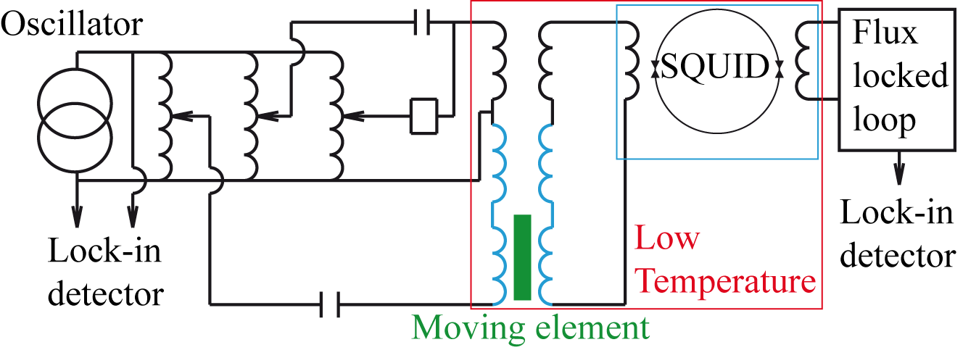
Mechanical Vibrations and Measur. (II)
An Example of Vibration Measurements of Experimental Cell or Membrane (Low Temperature Physics):
Cell or membrane is metallized, so during movement induced voltage in coil is measured.
Voltage is amplified by ac/dc-SQUID working in phased-locked loop.
Local oscillator with Lock-in detector allows to lock in the desired vibrational frequency or to perform frequency sweep.
Frequency range is typically few Hz but could be extended up to 100 kHz.
Signal-to-noise ratio is poor, i.e. signal is (well-)below the noise floor.
Vibration source (sometimes is needed for calibration): i) Calibration at cold state! ii) Use piezo-resistive elements,
iii) Measurement set-up includes: piezo sensor, Lock-in amplifier, high-voltage amplifier (piezo needs 100-200 V excitation voltage).

Slide 6
Mechanical Vibrations and Measur. (III)
Vibration Measurements of Large Machinery (screw compressors, pumps, electrical motors):
Apply norms! (ISO 20816/10816, VDI 3836, VDI 3839 …).
Consult machinery experts on possible faults and corresponding mechanical vibrations, e.g. due to unbalance, misalignment, soft foot, bearing faults, etc.
Use permanently installed sensors and track histories.
For occasional measurements, use standard hardware/software, e.g. Emerson Machinery Health Analyzer
Other norms:
[1] VDI 3842: Vibrations in piping systems.
[2] DIN ISO 7919 – Mechanical vibrations of non-reciprocating machines
[3] ISO 13373 – Condition monitoring and diagnostics of machines – Vibration condition monitoring, and ISO 17359 – for general guidelines
[4] ISO 14694 – Industrial fans – Specifications for balance quality and vibration levels, , ISO 14695 – Industrial fans – Methods of measurement of fan vibrations
References:
[1] O. Pirotte, Vibrational Monitoring of the Rotating Machines of the CERN cryogenic systems, Cryogenic Operational Workshop, 2016, Fermi National Laboratory, USA.
[2] D. Pflueckhahn, Vibration Measurement Analysis on Helium Cycling Compressor, Cryogenic Operational Workshop, 2014, Daresbury, UK

Slide 7
Mechanical Vibrations and Measur. (IV)
Vibration Measurements of small Machinery (cryogenic turbines, compressors, circulators):
Near no norms
Accelerometer-type, 3-axis, sensor is typically sufficient

Slide 8
Pressure Oscillations and Measurem. (I)
Sources:
Thermo-acoustics oscillations: f=1-50 Hz (typical)
Density-wave oscillations: f<10 Hz (typical)
Standing wave oscillations: f<10Hz, but strongly depends on geometry
Oscillations due to limitation of free flow area during heat transfer (single or two phase): f< 10 Hz
rotating equipment and cold check valves: frequency could be different (1Hz-5 kHz) but strongly depends on design
Set-ups:
warm piping system: i) slow (mHz) oscillation – standard industrial sensors, e.g. Siemens Sitrans, ABB, Rosemount pressure transducers, ii) fast (up to few kHz) – KPY-Series of Siemens/Infineon, or industrial, e.g. 113B-Serie of PCB Piezotronics
Cold piping system and warm pressure sensor: see above. Note: measurement capillary must be DN20 or larger to avoid thermo-acoustic oscillation and damping of pressure oscillations in small capillaries.

Slide 9
Pressure Oscillations and Measurem. (II)
Set-ups:
cold piping system with cold pressure sensor:
No universal pressure sensor for dynamic measurements exists.
Some sensors were applied, e.g.:
KPY-Series: good performance characteristics with response time below 1 ms
102A10 (PCV Piezotronics): good sensor properties for dynamic measurements. Sensor is also available on the market.
Other sensors found on market:
Kulite: CCQ-062, 093, Series (ultraminiatur) and CTL-190(M), 312(M), 375(M) till LN2 temperatures
Omega: PX1005 sensor till LN2 temperatures
GP:50: 311-QX (response time <4 ms), 7710, 7720, 7730- Series (response time <4 ms). LN2 temperatures
Omicron: CP6700-Serie, (response time <4 ms). LN2 temperatures

Slide 10
Data Analysis (I)
Signal/Noise (S/N) ratio above 1: → Apply standard devices available on market
Signal/Noise (S/N) ratio below 1: → Customized solution
Improvement of S/N ratio by “analogue” methods,
Using Lock-in amplifiers: the noise bandwidth is significantly reduced to single frequency. For wide frequency range measurements, frequency sweep will be needed.
Application of SQUID amplifiers with Lock-in technique further increases S/N ratio.
Improvement of S/N ratio by “software” methods
Perform Analog-Digital-Conversion as soon as possible (use rough data!),
Signal processing in time domain:
Assuming different forms of periodic signals, spectral decomposition on single harmonics is possible. So autocorrelation function using harmonics sinus-function could be applied. For “known” or “expected” signal, cross-correlation function could be considered.
The coherence function of two (un)known signal is calculated. It is possible to consider one signal as simplified one, e.g. sinus, while other as unknown. By trying different forms of simplified signal, it is possible to find other possible correlations or similarities of signals. Using frequency sweep, it is possible to test the frequency range of interest.
If (piezo)actuator is present, it is possible to sweep it over frequency range. In this case, detection of system response or system resonance frequencies is significantly enhanced.
Signal processing in frequency domain (FFT transformation of original signal): this case is similar to previous one with main difference - calculations need less time.

Slide 11
Summary
Short overview of vibration measurements is presented.
Dynamic pressure measurements with different cryogenic sensors are outlined
Possible sources of pressure variations/oscillations are mentioned
Signal processing for case of low signal-to-noise ratio is shortly discussed.
Thank you for your attention!

