Slide 1


Experimental investigations on bubble behavior of methane and ethane at saturated nucleate pool boiling condition
Chen Gaofei, Gong Maoqiong, Yao Yuan
Technical Institute of Physics and Chemistry,
Chinese Academy of Sciences, China
Sep 4, 2018
Notes:
Good morning, everyone. It’s my great honor to be here to attend the meeting. Today I’d like to present my study about Experimental investigation on Experimental investigations on bubble rising process of methane and ethane at saturated nucleate pool boiling condition.

Slide 2
Main Content
Research background
Measurement
Results and Discussion
Conclusion
Notes:
Next, I will present them from the following aspects. First of all, the research background.

Slide 3
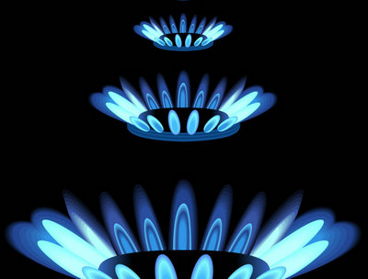
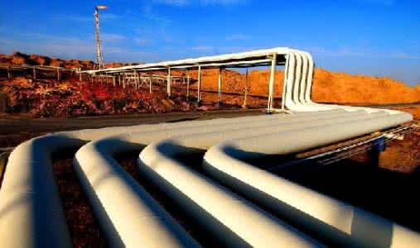
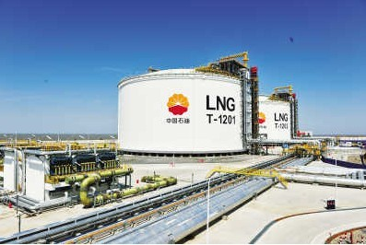
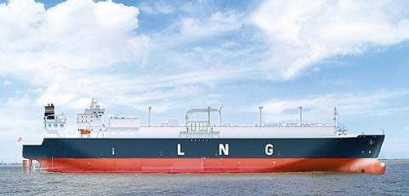
Research background
Natural Gas area
Methane and Ethane are the main components
Clean
Energy
As the cleanest fossil energy, natural gas plays an important role in the world energy construction
NG
Benefited from its higher density, liquefied natural gas (LNG) contributes great in the NG trade (volume reduced about 600 times)

Slide 4
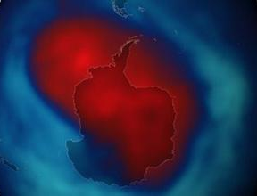
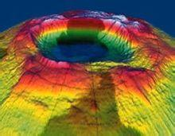
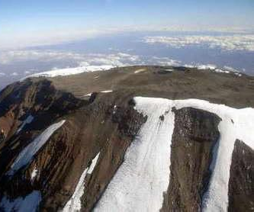
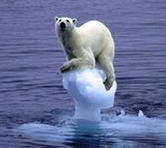
Research background
Refrigerants alternatives area
Traditional refrigerants have serious environmental problems：
Ozone depletion
Greenhouse effect
Hydrocarbons, Methane & Ethane included, are good alternatives to replace the traditional refrigerants：
zero ozone depletion potential
low global warming potential
high thermodynamic properties
······
Notes:
Traditional refrigerants have serious environmental problems like ozone depletion and greenhouse effect. Some researchers proposed that hydrocarbons are good alternatives for zero ozone depletion potential, low global warming potential, and high thermodynamic properties.

Slide 5
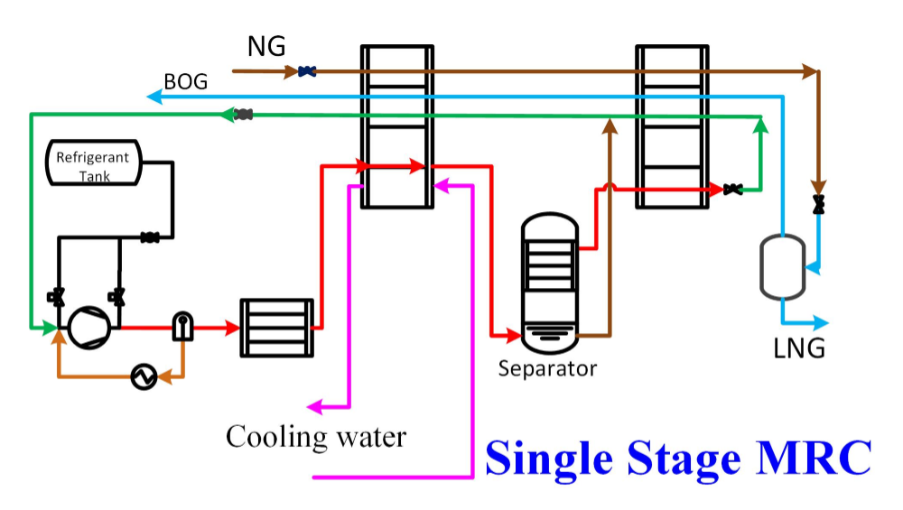
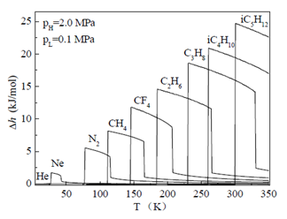
Research background
MJTR Tech. area
Mixed-refrigerants Joule-Thomson Refrigeration (MJTR) is one of the major technologies in low temperature refrigeration and also the major liquefaction tech. in LNG industry
HCs are essential components in the mix-refrigerants.
Heat exchangers
Mixed-refrigerants
R170
R50
5/35

Slide 6
Research background
Refrigerant alternative component
Nature gas component
Major components in mix-refrigerants for natural gas liquefaction applications
Methane
Ethane
Effective mode of heat transfer
Studied physical phenomena in resaerch
Bubble behavior reflect heat transfer situation partly
Nucleate
boiling
Investigate the bubble behavior of methane & ethane in saturated nucleate pool boiling is good for:
studying refrigerant alternative
improving natural gas liquefaction technology
researching characteristics of heat transfer and multiphase flow
6/35
Notes:
Ethane was suggested as one of the components of the refrigerant alternative. And as one of the essential components of nature gas, the study of heat transfer properties makes an important supplement in natural gas liquefaction applications.
At the same time, nucleate boiling is an effective mode of heat transfer, as well as the most studied physical phenomena in science and engineering. While, bubble behavior reflect heat transfer situation partly.

Slide 7
Research background
Researchers | Date | Fluid | Test section | Type
Kosky and Lyon | 1968 | R50 |  | Nucleate pool boiling
von Hoffmann | 1978 | R50,R170,R50+R170
Bier and Lambert | 1990 | R50,R170
Gorenflo | 1990 | R50,R170
Chen | 2013 | LNG | 8mm and 14 mm vertical tube | Flow boiling
Chen | 2013 | LNG | 8mm horizontal tube
Maråk | 2009 | R50,R50+R170 | 0.25, 0.5 and 1 mm vertical tube | Flow condensation
Macdonald | 2016 | R170,R170+R290 | 7.75 - 14.45 mm horizontal tube
Directly measured bubble behaviors of hydrocarbons is NOT sufficient
Researchers | Date | Fluid | Heater | Observations
Yuming et al. | 2004 | propane iso-butane | horizontal tubes | bubble growth rate, departure diameter, frequency, active site density, rise velocity and latent heat transfer
Siedel et al. | 2008 | pentane | copper plate | detachment volume, growth time, bubble growth rates, bubble frequency and bubble coalescence
Gong et al. | 2013 | ethane Iso-butane | copper plate | departure diameter and frequency
Chen et al. | 2017 | methane | copper plate | departure diameter and frequency
This presentation aims to present the experimental studies on bubble behaviors of Methane & Ethane during saturated nucleate pool boiling
7/35
Notes:
Though there are some published boiling heat transfer data for hydrocarbons, there are little data published for ethane, especially bubble behaviors. Therefore, this presentation aims to present the bubble behaviors on saturated nucleate pool boiling heat transfer in ICCR.

Slide 8
Main Content
Introduction
Measurement
Results and Discussion
Conclusion
8/35
Notes:
Next, the experimental.

Slide 9
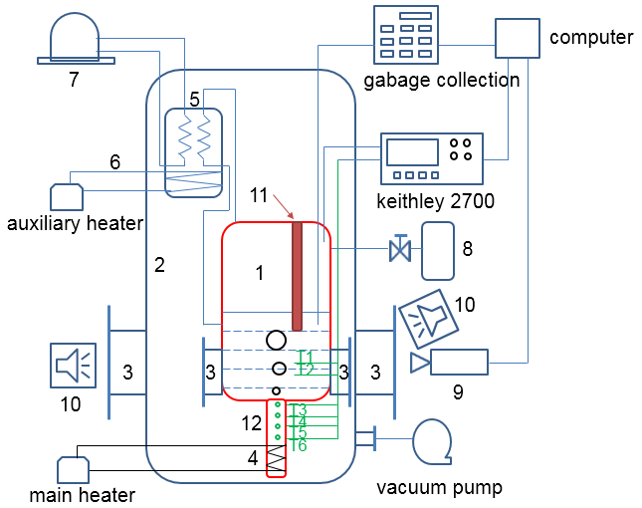
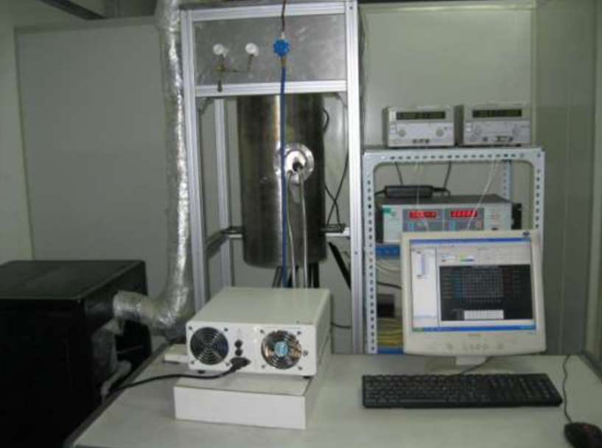
Measurement
Test facility
Visual pool boiling experimental apparatus:
1. Visualization boiling vessel; 2. Vacuum hood; 3. Visual windows (split into the inner and the outer windows); 4. Main electric heater; 5. Condenser; 6. Auxiliary electric heater; 7. Cryocooler; 8. Refrigerant tank; 9. High speed camera; 10. Cold illuminant (the front and the rear);
11. calibrated ruler; 12. Copper cylinder.
9/35
Notes:
The experiments were conducted in the facility.
Boiling occurred on the upward facing side of a smooth vertical copper cylinder. High-speed camera was used to observe and record bubble behaviors. A steel ruler inside the pool is regarded as the reference length to measure the bubble size.

Slide 10
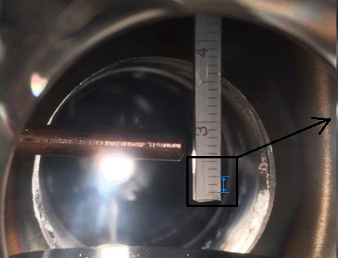
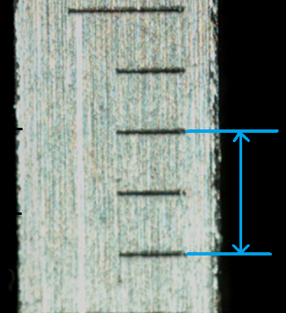
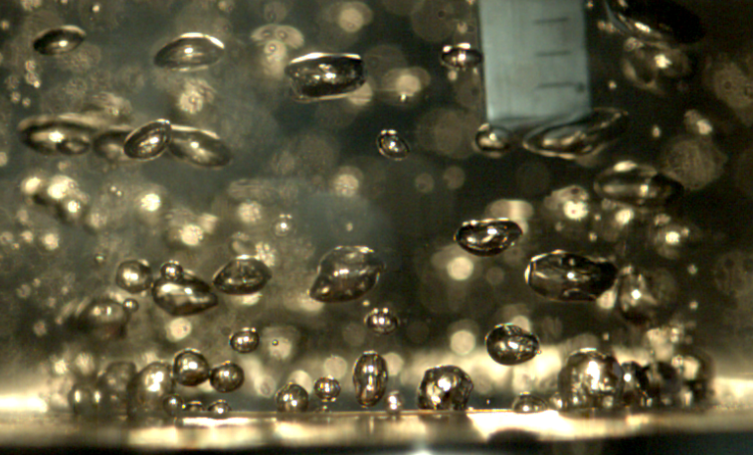
Measurement
Dimension measurement
Measurement for bubble size A stainless steel ruler was used
Calibration Length - 2.007 mm Uncertainty - 0.06 mm
Photo of the boiling pool
Average linear thermal expansion coefficient of the ruler
10/35

Slide 11
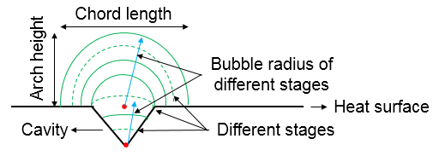
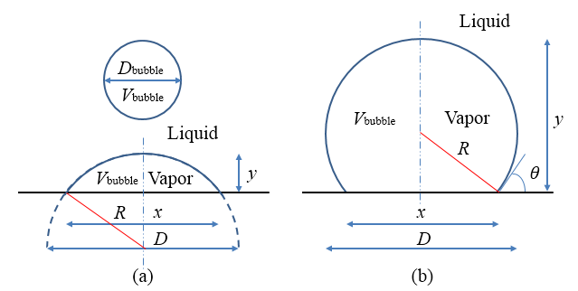
Measurement
For Bubble Growth
Bubble growth model:
Bubble grows at three different stages: bubbles formation in the surface cavity, bubbles reaching at the mouth of the cavity and bubbles further expansion.
Bubble shape: Spherical
geometric principle——
two equations:
[1] Marko M, Boˇstjan K. Science and Technology of Nuclear Installations. 2012, 1-7.
[2] Griffith P, JD Wallis. Massachusetts: Massachusetts Institute of Technology. 1958.
[3] Seyed A A F, Seyed B S. Journal of Heat Transfer. 132: 0815021-0815027.
11/35
Notes:
To interpret these data, a model were used to analyze the bubbles. From the first picture, the bubble growth on the boiling surface were divided into three different stages. It was distinguished by dashed lines: bubbles formation in the surface cavity, bubbles reaching at the mouth of the cavity and bubbles further expansion, respectively.
After simplification, the bubbles shape in the heated wall are also divided into two types. Due to geometric principle, we could obtain 2 equations.

Slide 12
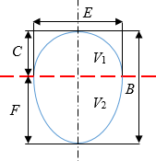
Measurement
For Bubble Departure
The definition of the bubble diameter
Calculation method of D_{d}
Bubble volume
Sphere
volume
其中：
Assumption
Combination of two
symmetry ellipsoid
12/35

Slide 13
Measurement
For Bubble rising
Assumption
Rising in a straight line
Despite the irregularity of the bubble shape
Rising distance
End speed
Average speed
Acceleration
13/35

Slide 14
Measurement
Parameter | model | range | uncertainty
temperature | PT100 transducer | 80-373 K | ±0.1 K
pressure | UNIK 5000 transducer | 0-4 MPa | 0.04%
voltage | Keithley 2700 | 0-300 V | 0.005%
length | SS ruler | 0-300 mm | ±0.02 mm
Uncertainty analyze on the bubble size
Thermal expansion
Pixels count
Camera distance
Relative Combined Uncertainty - 9.8%
Relative Uncertainty of bubble growth time
or 6.9%
14/35

Slide 15
Main Content
Introduction
Measurement
Results and Discussion
Conclusion
15/35
Notes:
Next, the results and discussion.

Slide 16
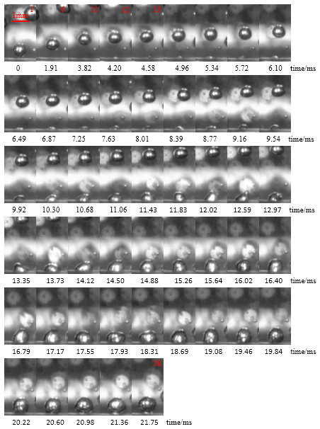
Results and Discussion
Typical bubble growth process
Complicated
Disorganized
0 ms, previous bubble detached 21.75 ms, the bubble detached
waiting time is 3.82 ms
growth period is 21.75 ms
departure frequency is 46 Hz
Bubble growth cycles in ethane, q=21.02 kW·m⁻²
16/35
Notes:
The behaviors of abundant bubbles were studied. Although the behavior of the bubbles was complicated and disorganized, most bubbles obey the same rules.
This is a bubble cycles. At 0 millisecond, previous bubble detached from heater surface; there was no bubble existing until 3.82 millisecond; and at 21.75 millisecond, the bubble detached from surface again. The waiting time is 3.82 millisecond; growth period is 21.75 millisecond; and departure frequency is about 46 Hertz.
From such figures, chord length, arch height parameter data, and the bubble diameter can be obtained.

Slide 17
Results and Discussion
Typical bubble growth process
Bubble diameter:
increasing in the whole growth cycle
the early growth rate is fast, and the latter tends to be gentle.
a short-term decline and a certain waiting time.
(a) diameter changes with time;
(b) chord length changes with time on heat wall;
the bubble growth period is divided into three stages
(c) arch height changes with time.
Bubble-growth cycle curve
17/35
Notes:
The bubble diameter is increasing in the whole growth cycle, and the early growth rate is fast, and the latter tends to be gentle. There is a short-term decline and a certain waiting time. In this paper, the bubble growth period is divided into three stages.

Slide 18
Results and Discussion
Typical bubble growth process
The first stage: rapid growth (0 ~ 6.48 ms)
Bubble grew in the cavity, the center angle remained unchanged, and the radius increased along the wall until it was visible.
At t=3.82 ms, the bubble was emitted from the cavity and the visible part was flat.
During the early growth period of the bubble, bubble diameter, chord length and arch height were growing rapidly.
18/35

Slide 19
Results and Discussion
Typical bubble growth process
The first stage: rapid growth (0 ~ 6.48 ms)
The fitting equations obtained from three bubbles:
and slope range is from 0.15 to 0.3 in rapid growth stage without the waiting time.
Close growth-cycle time do not equal to waiting time and growth rates.
By extending the fitting formula to obtain the intersection with the time axis, it is possible to counter the real bubble formation time.
19/35
Notes:
Based on the experimental data, the fitting parameters can be obtained from 3 bubbles.
The bubble diameter is in direct proportion to time. Because the cavities are invisible, previous experiments made it difficult to capture the moment of bubble nucleation. By extending the fitting formula to obtain the intersection with the time axis, it is possible to counter the real time when bubble begin to grow up, as well as the waiting cycle and the growth cycle.

Slide 20
Results and Discussion
Typical bubble growth process
The third stage: stable growth (14.11 ~ 21.75 ms)
At t=14.11 ms, the bubble was hemispherical. The bubble began to complete the transition from hemispherical to spherical.
During the later growth period of the bubble, the diameter was basically no longer change. Chord length reached the peak and started to decrease. And arch height and the volume remained increasing.
At t=21.75 ms, the bubble detached from the heating wall.
20/35
Notes:
The third stage: stable growth. At 14.11 millisecond, the bubble was hemispherical. Bubble size has been determined and the bubble began to complete the transition from hemispherical to spherical.
During the later growth period of the bubble, the diameter was basically no longer change. Chord length reached the peak and started to decrease. While the bubble continued to grow, arch height and the volume increased.

Slide 21
Results and Discussion
Typical bubble growth process
The third stage: stable growth
a power function relationship with time
The fitting equations obtained from three bubbles
and exponent range of the power function is from -1.4 to -1.2 without the waiting time.
21/35
Notes:
Based on the experimental data, the fitting parameters can be obtained from 3 bubbles.
In both of the latter second and the third stage, the bubble diameter is a power function relationship with time.

Slide 22
Results and Discussion
Bubble departure process
Photos for methane
@ different pressure & heat flux
0.15MPa
Bubble diameter & number increase with the heat flux
Bubble decrease with the pressure
0.2 MPa
0.3 MPa
0.4 MPa
22/35

Slide 23
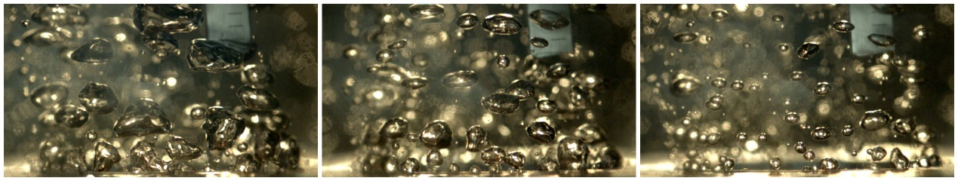
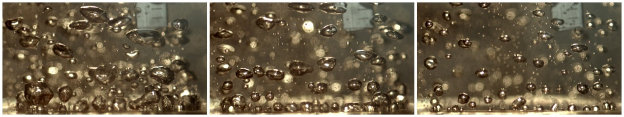
Results and Discussion
Bubble departure process
Photos for ethane
@ different pressure & heat flux
Bubble diameter & number increase with the heat flux
Bubble decrease with the pressure
23/35

Slide 24
Results and Discussion
Bubble departure process
How to choose the sample size for the measurement of bubble diameter?
statistical analysis
on the sensitivity of bubble sample size
For 5 bubbles, MRD ≈ 14%; for 15 bubbles, MRD ≈ 5%; for 30 bubbles, MRD ≈ 2%;
For 245 bubbles, MRD reach to 0.3%, 300 bubbles were chosen for analysis in present work.
24/35

Slide 25
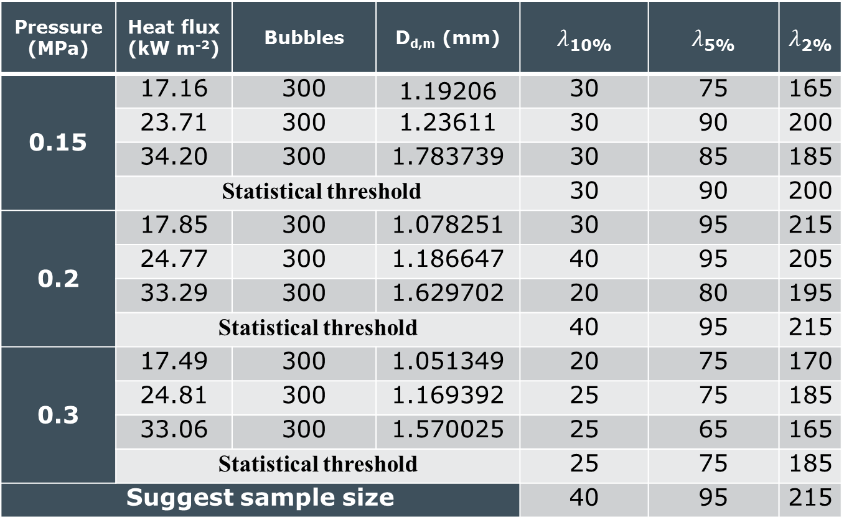
Results and Discussion
Bubble departure process
Table for sample size choose with MRD ±10%, ±5%, ±2%
Pressure (MPa) | Heat flux (kW m⁻²) | Bubbles | D_{d,m} (mm) | $λ$_{10%} | $λ$_{5%} | $λ$_{2%}
0.15 | 17.16 | 300 | 1.19206 | 30 | 75 | 165
 | 23.71 | 300 | 1.23611 | 30 | 90 | 200
 | 34.20 | 300 | 1.783739 | 30 | 85 | 185
 | Statistical threshold |  |  | 30 | 90 | 200
0.2 | 17.85 | 300 | 1.078251 | 30 | 95 | 215
 | 24.77 | 300 | 1.186647 | 40 | 95 | 205
 | 33.29 | 300 | 1.629702 | 20 | 80 | 195
 | Statistical threshold |  |  | 40 | 95 | 215
0.3 | 17.49 | 300 | 1.051349 | 20 | 75 | 170
 | 24.81 | 300 | 1.169392 | 25 | 75 | 185
 | 33.06 | 300 | 1.570025 | 25 | 65 | 165
 | Statistical threshold |  |  | 25 | 75 | 185
Suggest sample size |  |  |  | 40 | 95 | 215
For random sampling, the relative deviation is suggested to be
within 10% for a sample size of 40
within 5% for a sample size of 95
within 2% for a sample size of 215
Notes:
表2展示了9个工况下，当平均气泡脱离直径的相对偏差小于10%，5%，2%的样本容量阈值。由表可知，相对偏差10%，样本容量的阈值为40个气泡；5%，95个气泡；2%，215个气泡。

Slide 26
Results and Discussion
Bubble departure process
Gaussian function for bubble diameter
Y₀ - offset
A - area
W - wide
D_{d} – bubble diameter
D_{d,m} – average bubble diameter
Fitting parameters for the function
参数 |  | P/MPa | q/kW·m⁻² | y₀ | D_{d,m} | w | A | Adj. R-Square
组别 | 1 | 0.15 | 17.16 | 0.01423 | 1.11554 | 0.32337 | 0.08043 | 0.91712
 | 2 |  | 23.71 | 0.01249 | 1.14383 | 0.48499 | 0.08099 | 0.86033
 | 3 |  | 34.20 | -0.01199 | 1.79253 | 0.81276 | 0.12502 | 0.92453
 | 4 | 0.2 | 17.85 | 0.02469 | 0.99271 | 0.25052 | 0.06794 | 0.94480
 | 5 |  | 24.77 | 0.00265 | 1.14508 | 0.55814 | 0.09849 | 0.95855
 | 6 |  | 33.29 | 0.00548 | 1.65722 | 0.65124 | 0.09148 | 0.85013
 | 7 | 0.3 | 17.49 | -0.00003 | 1.04065 | 0.32246 | 0.10032 | 0.95026
 | 8 |  | 24.81 | 0.00806 | 1.13693 | 0.38871 | 0.09057 | 0.96455
 | 9 |  | 33.06 | 0.00693 | 1.57853 | 0.48214 | 0.08983 | 0.95266
Both D_{d} & W increase with the heat flux
26/35

Slide 27
Results and Discussion
Bubble departure process
Distribution characteristics of bubble diameter
(a) q=17.85 kW m⁻² (b) q=24.77 kW m⁻²(c) q=33.29 kW m⁻²
Deviation and Peak exist in the distribution
Higher heat flux, greater dispersion
Wider distribution, lower peak
27/35
Notes:
这是同一压力不同热流密度下的气泡频率分布图，由图可知，气泡脱离直径数据分布在平均值附近，测量值存在一定的偏差和峰值。对于平均气泡脱离直径，直径随热流密度增加而增加。对于直径数据的分散性，低热流密度数据相对集中，高热流密度则相对分散。一方面，气泡脱离直径的区间范围随热流密度增加而增加，另一方面，峰值随热流密度增加而降低。

Slide 28
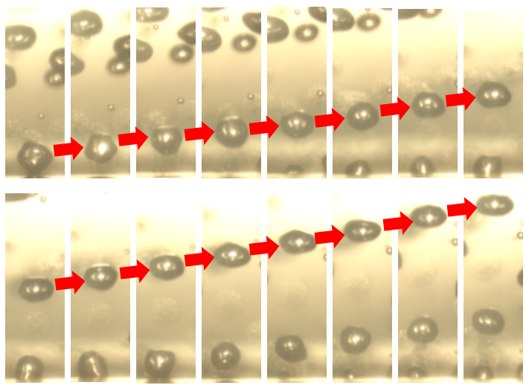
Results and Discussion
Typical bubble rising process
Methane
Rising close to a straight line
near-spheroidal to ellipsoid
28/35

Slide 29
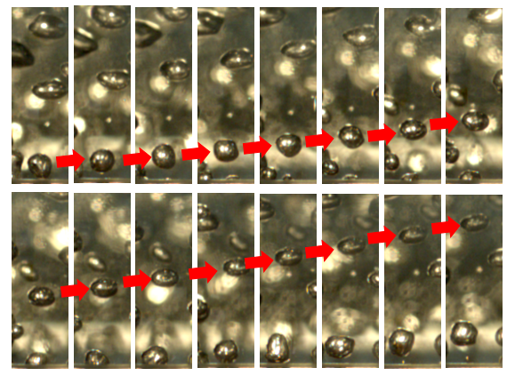
Results and Discussion
Typical bubble rising process
Ethane
Rising close to a straight line
near-spheroidal to ellipsoid
29/35

Slide 30
Results and Discussion
Typical bubble rising process
Methane
Ethane
Rising distance / mm
Rising distance / mm
Time / ms
Time / ms
Rising distance
Quadratic polynomials are suitable for the curves
30/35

Slide 31
Results and Discussion
Typical bubble rising process
Rising speed / mm/ms⁻¹
Rising speed / mm/ms⁻¹
Methane
Ethane
Time / ms
Time / ms
Rising speed versus time
Rapid fluctuations observed for both methane & ethane
Methane - Up to 0.1643 mm·ms⁻¹ after departure; Reach 0.2895 mm·ms⁻¹ at the end
Ethane - Up to 0.1252 mm·ms⁻¹ after departure; Reach 0.2739 mm·ms⁻¹ at the end
31/35

Slide 32
Results and Discussion
Typical bubble rising process
Methane
Ethane
Acceleration / mm/ms⁻²
Acceleration / mm/ms⁻²
Time / ms
Time / ms
Acceleration versus time
Acceleration fluctuate rapidly at beginning and achieve stability at the end
Methane – up to 0.0861 mm·ms⁻²
Ethane – up to 0.0656 mm·ms⁻²
32/35

Slide 33
Main Content
Introduction
Measurement
Results and Discussion
Conclusion
33/35
Notes:
Finally, let me make the conclusion.

Slide 34
Conclusion
The bubble growth process, departure process and rising process were filmed by camera. This study try to understand the whole process of the bubble during pool boiling.
For the bubble growth process - bubble diameter is a power function of time
1st stage b = 1; c =1
3rd stage -1.4 ＜ c ＜ -1.2
A diameter calculation method was proposed. The decrease in diameter caused by the changes of the center of bubbles was observed.
34/35
Notes:
(1) Side view images of bubble growth of ethane were obtained, as well as time-resolved data for bubble diameter, chord length and arch height. Although the growth periods of some bubbles are close, there are still some differences in waiting time and growth rates.
(2) According to the change in diameter with time, the bubble growth is divided into three stages: fast, slow and stable growth.
(3) The bubble growth process has obvious segmentation characteristics, and the bubble diameter is a power function of time in the whole cycle, so the segment function prediction models were recommended.
(4) A diameter calculation method was proposed. The decrease in diameter caused by the changes of the center of bubbles was observed.

Slide 35
Conclusion
For bubble departure process
Bubble diameter distributions were analyzed by statistical method
The sensitivity of bubble sample size was studied and related sample sizes were recommended
A fitted Gaussian function was proposed for bubble diameter predicting
For bubble rising process
Rising distance
Rising speed of the bubbles versus time were discussed
Acceleration
35/35

Slide 36
Thanks for your attention！

