Slide 1


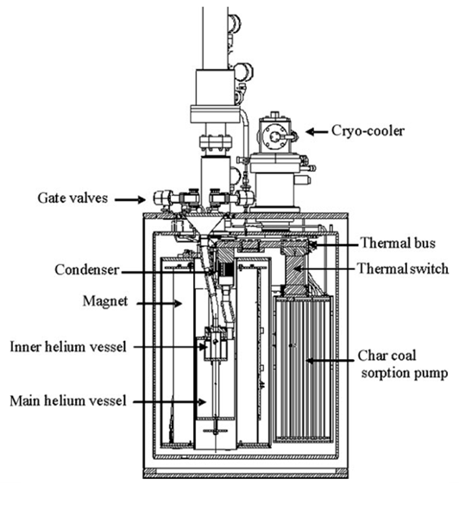
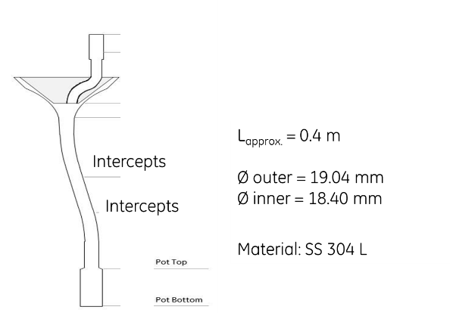
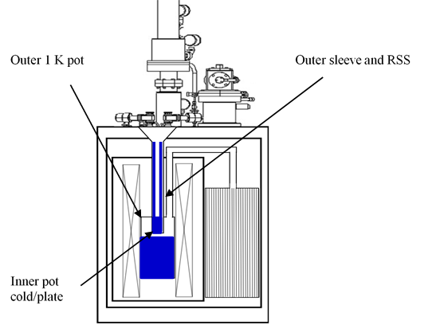
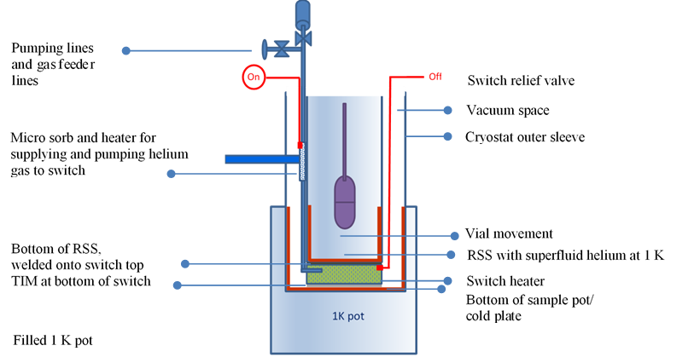
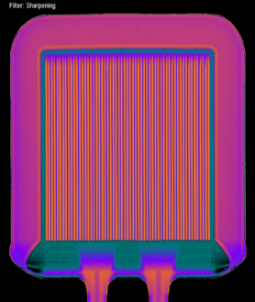
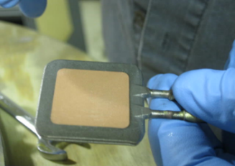
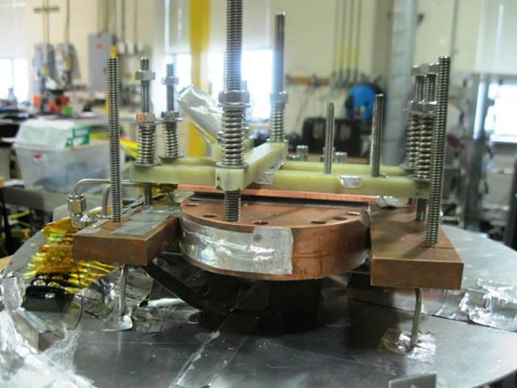
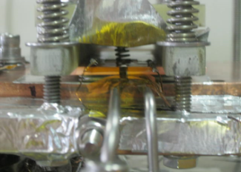
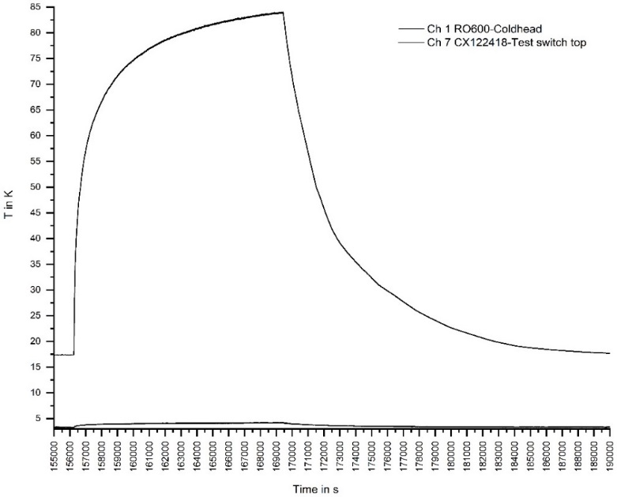
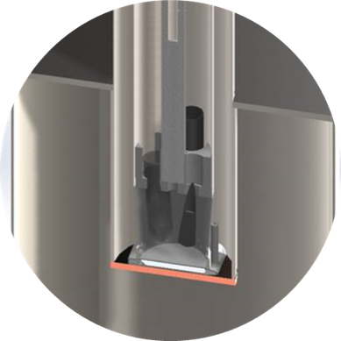
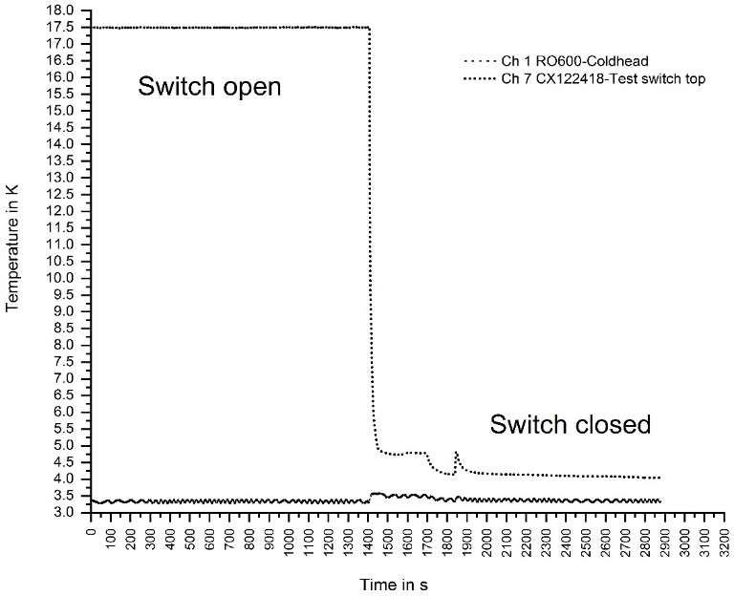
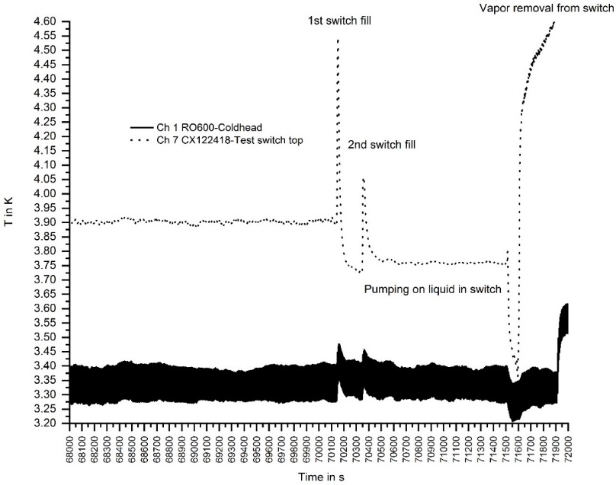
An efficient liquid helium gas-gap switch allowing rapidly servicing low-temperature dynamic nuclear polarisation systems
W. Stautner¹, R. Chen¹, A. Comment² and E Budesheim¹
¹GE Global Research, Biology and Applied Physics, Niskayuna, NY 12309, USA
²GE Research Circle Technology Inc, Healthcare Imaging, Cambridge, UK
Abstract
Variable temperature inserts are usually deeply integrated into a cryostat structure and cannot be warmed up or extracted for service purpose while the system is cold. We herein present a novel removable sample sleeve designed for dynamic nuclear polarization experiments below 4 K that can be rapidly serviced even when a large amount of water ice has contaminated the system. Our experimental results show that the performance of a liquid helium / gas-gap switch that will be used together with a sample space insert that is in direct contact to a cold plate. The sample space sleeve can be serviced by thermally disconnecting the switch from the cold plate. Furthermore, the additively manufactured heat switch features a novel cold plate interposer for heat transfer that allows the physical separation of the sample sleeve tube from the cold plate enabling a room temperature warm up or complete sleeve removal, if required.
I. Introduction
Hyperpolarised MRI is a new molecular imaging method that allows monitoring of bodily enzymatic and metabolic changes through biochemical methods. The GE Healthcare SPINlabTM C¹³ hyperpolarising MRI system developed by GE Global Research is an essential, high-end tool for cancer diagnostic research on animals and humans, targeting different types of cancers. SPINlabTM has in particular been developed to serve as a complete stand-alone clinical system using hyperpolarization MRI technology for polarizing pyruvic acid and urea samples for detecting early stages of cancer. Operating this 4-channel hyperpolarizing system involves lowering a small vial into a dedicated polarizing space within the bore of a 5 Tesla magnet. The vials are initially filled with 1-¹³C pyruvic acid and dissolved at 0.77 K by injecting hot water into it at a temperature of 130 °C. In an effort to further improve serviceability of the cryogenic fluid path design, the design steps introduced were as follows: straightened vs a curved sample path -> introduce new, removable sleeve -> develop/test a thermal switch for sleeve servicing-> find/select and validate novel appropriate interposing material between switch and cold plate.
II. Challenges
Operational system requirements:
• ∆T between two mating surfaces should be
≤ 0.1 K (that is 0.77 to 0.87 K) at no thermal load
• Time for thermal equilibrium across the interface max > 1 to 2 hours
• Thermal contact conductance between interfaces not to change during thermal cycling
• No or very little contact pressure should
be applied to the interface and mating parts
• Thermal contact between parts should be maintained during cooldown to 0.7 K and remain intact even after multiple warmup/cooldown cycles
• Thermal contact surfaces need to recover
from “hot” temperature shocks w/o degradation, shocks can occur over 30 minutes, below RT
• Occasionally, make sure surface contacts
are detachable without exceeding RT at the contact after a cryostat insert warmup and disengage the RSS from the cold plate
Fig. 1 Curved sample path (4 vial system)
Fig. 2 Modified, straight sample path with RSS vial guide stick)
III. Test switch design
The test switch that was found to be closest to cope with our challenges is an additively manufactured Inconel 718 switch based on the much larger TiAl6V4 Vanapalli switch design for higher temperature use.
Switch design requirements
• Use flat panel structure for given space constraints in cold sleeve (fitted to tube)
• Robustness of switch during pressurization / evacuation cycles
• Pre-pressure bearing capable at initial cool-down, without cracking top/bottom plate deflection or fins touching each other
• Leak-tightness < 1.10⁻¹⁰ mbar l/s, no microcracking when cycling from RT to 4 K
• Switch needs to cool down quickly to 1 K from room temperature, requires high fin efficiency
• Switch needs an OFF ratio of ~100 or higher with a 1 W heat load
Fig. 3 Schematic view of RSS in outer sleeve with attached switch in 1 K pot
Cryogenic design requirements
• Optimized RSS temperature profile to minimize stationary heat burden to 1 K pot (requires a high strength tube material with small wall thickness)
• Allow fast transient switch operation (e.g. recool, cooldown after service, e.g. at temperatures > 200 K)
• Thermal contact at bottom of RSS tube to 1 K sample pot cold plate -> find/implement simple, easy to use
TIM (Thermal Interface Material)
Fig. 4 Test switch diagnostics and test setup
V. Summary
Thermal conductance in OFF state equals to 0.011 W / K
This is a low enough value that meets our design target.
The ON resistance state cannot be evaluated since no gas phase is present in the switch and no heat load can be applied to liquid in switch without phase change
Research purpose was to develop a new type of RSS insert that engages to a cold plate, easily removable and serviceable using an additively manufactured Inconel 718 flat-panel gas-gap heat switch
Additive process for switch proved to work reliably in vacuum / cryogenic environment below 4 K.
The high thermal switch OFF state gives the end user the opportunity to service the sample path without magnet ramp down or system warm up.
Thermal test switch | Parameter | Unit
Overall dimensions | 3.25 x 37.5 x 37.5 (H x W x L) | mm
Bottom/top plate thickness | 0.5 | mm
Thermal OFF state length | 23 | mm
Inner square length | 26.35 | mm
Fin gap | 200 | µm
Fin thickness | 250 | µm
Material | Inconel 718 + copper | -
Liquid helium volume | 1.43 | ml
Vertical force on switch | 300 | N
A suitable, high conductance, Rohs compliant TIM (Galinstan) has been developed for the chosen interface for safe/simple separation of RSS from switch/ cold plate at RT, if needed.
Table 1 Test switch parameters
IV. Test switch results
The switch was mounted onto a cold bus in close contact with a cryocooler. Helium was admitted from a gas bottle with the results as shown in the figures below
Acknowledgments
The authors wish to thank S Vanapalli and the 3D systems team for their insight on switch design and additive manufacturing, as well as the GE Global Research Center material’s testing and characterization labs. Many thanks also to the technicians working on the tedious cryogenic test setup and to Oxford Instruments (OION). Last but not least, we would like to thank Jonathan Murray of GE Healthcare, Research Circle Technology, for his generous support of this effort.
Fig. 7 Temperature profile of empty test switch with 1 W applied
heat load (T-rise on cold plate), Inset: RSS model with vials (black) and future switch design (round, welded on RSS tube with vertical fill tubes
Fig. 5 Switch helium fill (partial) and condensation (40 seconds from 17.5 to 5 K)
Fig. 6 Switch helium fill (partial) and helium condensation

