Slide 1
Thermal performance of the new superfluid helium vertical test cryostats for magnet tests at CERN
A Vande Craen, M Bajko, V Benda, J-B Deschamps, C Giloux, A Lees, V Parma, F Pasdeloup, O Pirotte
CERN, European Organisation for Nuclear Research, Geneva, Switzerland
ICEC27-ICMC 2018, Oxford, UK
6th of Septembre 2018 E-05:272

Slide 2
Outline
Introduction
Thermal performances measurements
  Calorimetric measurement in 1.9 K superfluid helium
  Boil-off measurement of 4.5 K saturated helium
Results and discussion
Conclusion

Slide 3
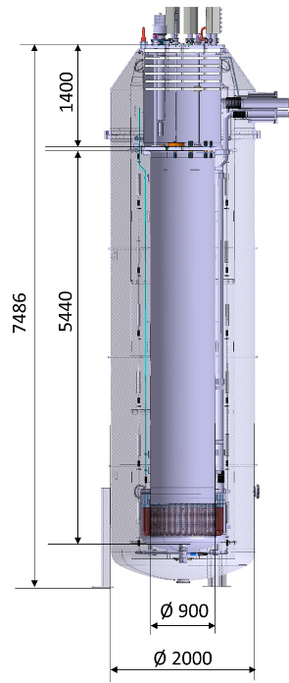
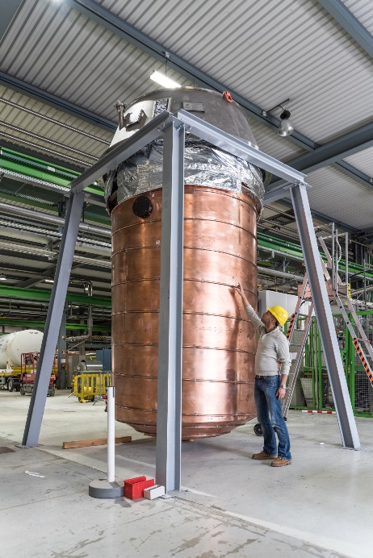
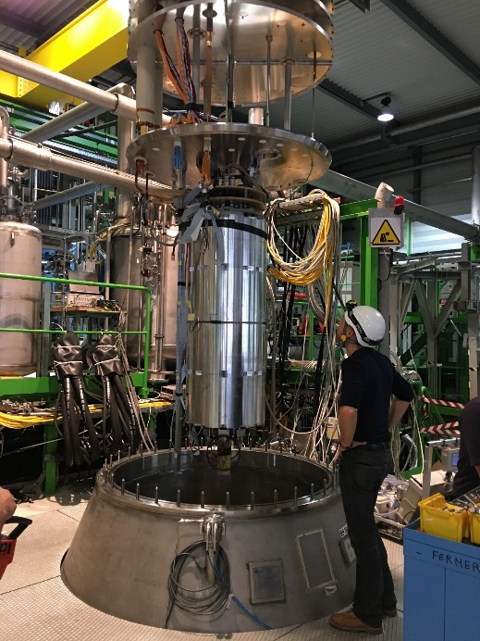
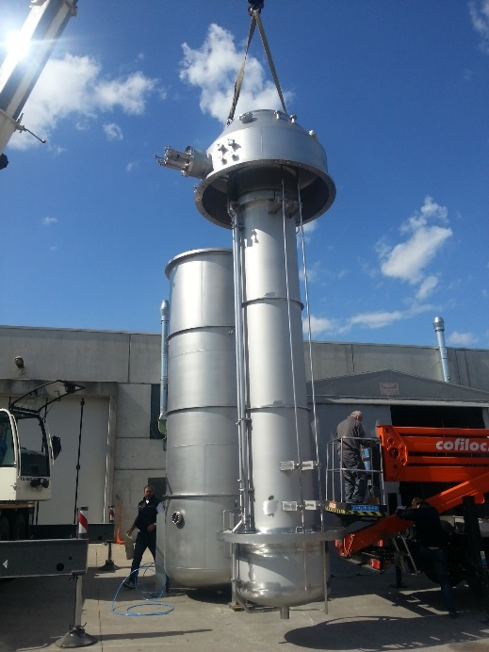
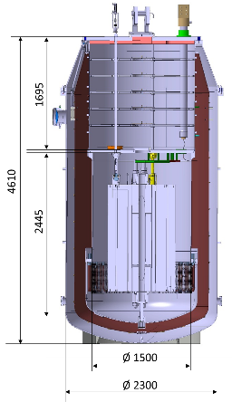
Cryostats
Two new vertical test cryostats installed and commissioned recently
  Vertical Magnet Test Facility of SM18 hall at CERN
  For magnet testing
    HFM: Fresca 2 demonstrator (L: 2.35 m, D:1.03 m, W: 8 tons)
    Cluster D: HL-LHC injection quadrupoles (L: 4.5 m, D: 0.6 m, W: 8 tons)
  Versatile, for future magnets
Maximum magnet weight
HFM : 15 tons
Cluster D : 18 tons

Slide 4
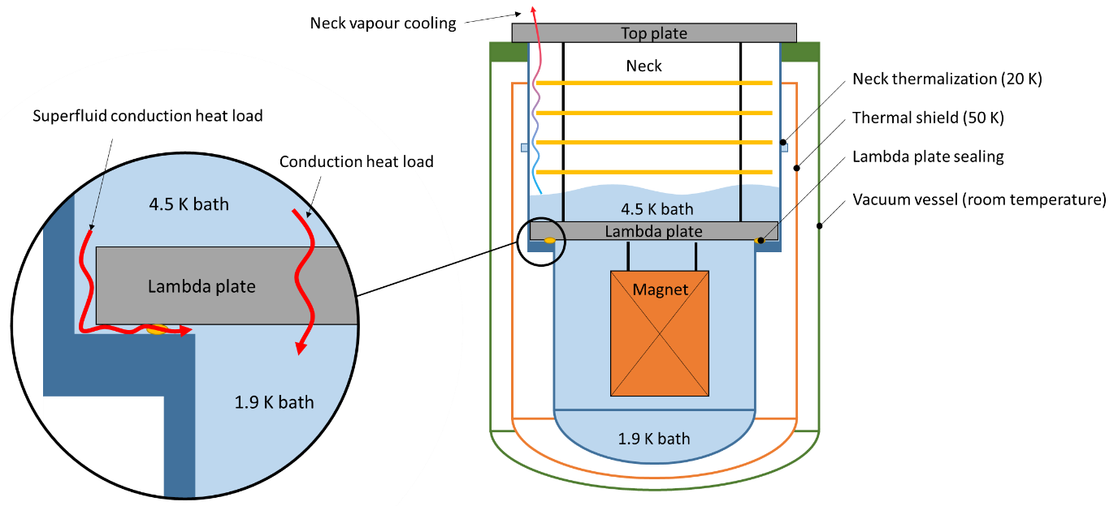
Cryostats description
Claudet bath principle
  4.5 K helium bath on top of 1.9 K superfluid helium bath
  Lambda plate for thermal insulation between baths
Design features
  20 K Thermalization and vapour cooling to reduce heat loads to 4.5 K
  Stainless steel lambda plate (instead of G10 usually used)
  Metal to metal contact for leak tightness between baths

Slide 5
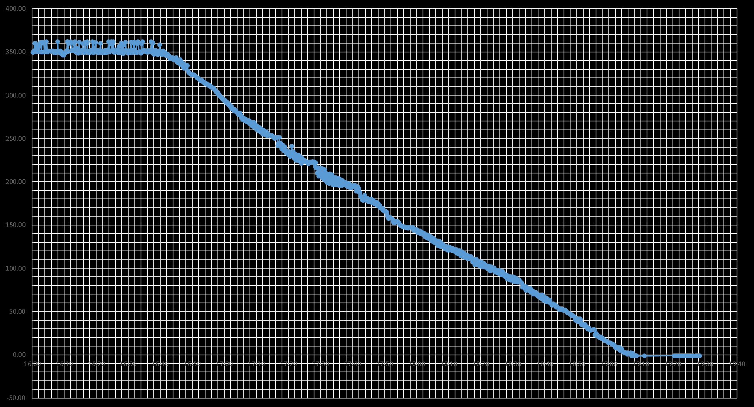
Heat load to the 4.5 K saturated helium
Level decrease rate to calculate boil-off
 | $$Q= \dot{m}×L_{v}=\frac{dL}{dt}×A_{He}×ρ_{He,L}×L_{v}$$ | (4)
Helium level [mm]
Time

Slide 6
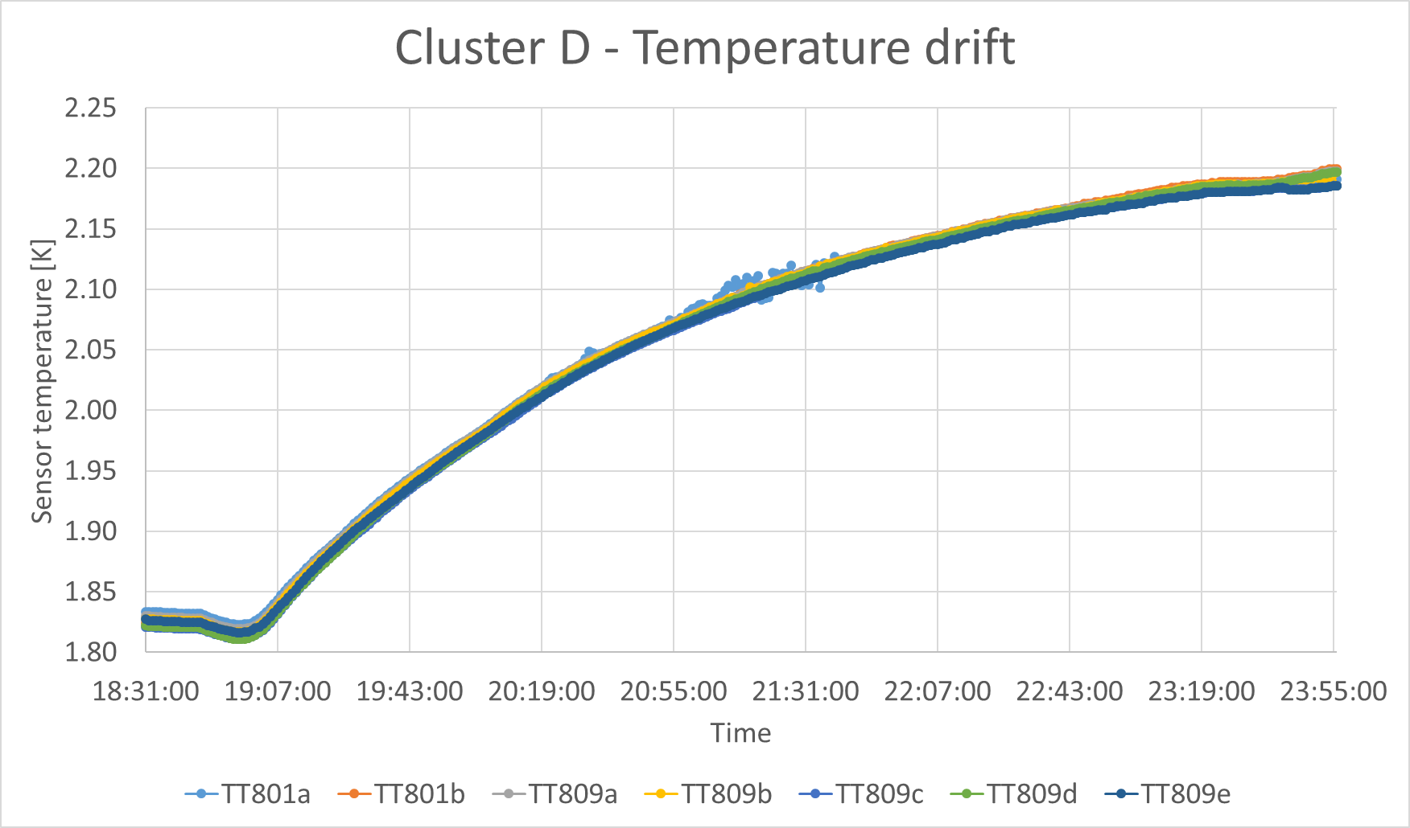

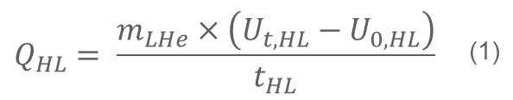
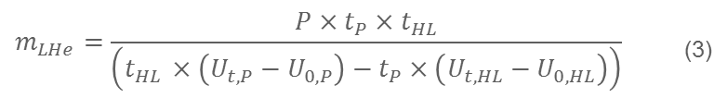
Calorimetric measurement in superfluid helium
Based on internal energy balance
Isothermal bath thanks to high thermal conductivity of superfluid helium
$$Q_{HL}= \frac{m_{LHe}×\left(U_{t,HL}−U_{0,HL}\right)}{t_{HL}}$$ | (1)
Helium mass measurement
Precisely known injected power
$$Q_{P}=Q_{HL}+P= \frac{m_{LHe}×\left(U_{t,P}−U_{0,P}\right)}{t_{P}}$$ | (2)
Combine (1) and (2)
$$m_{LHe}=\frac{P×t_{P}×t_{HL}}{\left(t_{HL }×\left(U_{t,P}−U_{0,P}\right)−t_{P}×\left(U_{t,HL}−U_{0,HL}\right)\right)}$$ | (3)

Slide 7
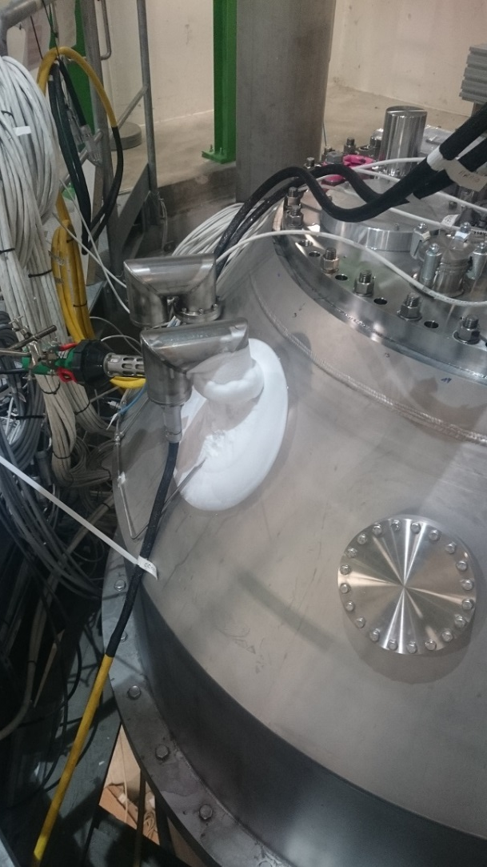
Heat loads to 4.5 K
Performances better than specified
  Better vapour cooling than expected
Cluster D
High heat load during first cool-down
Instrumentation support create thermal bridge (300 K – 4.5 K)
After removal back to nominal (instrumentation in cryostat)
HFM Heat load [W] |  | Cluster D Heat load [W]
Measured | Specified | Measured | Specified
8 | 26.5 | 16 | 35
Frost due to thermal bridge to 4.5 K in an instrumentation support

Slide 8
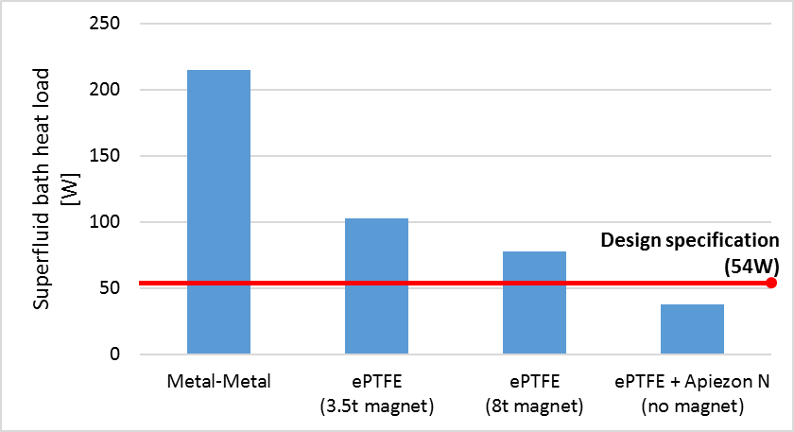
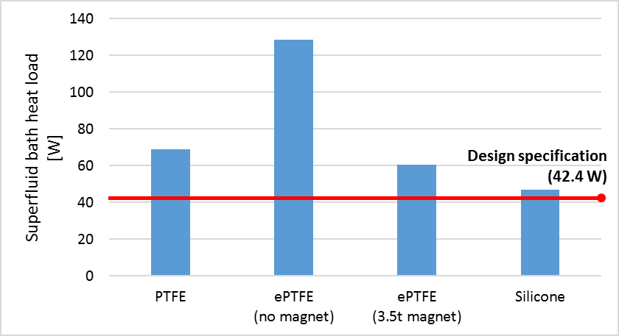
Heat loads to 1.9 K – Very first tests
HFM
Cluster D
Poor thermal performance
Incorrect insertion
Differential thermal contractions
Non conformities of helium vessel
Gaps on lambda plate to cryostat interface (up to 1.6 mm)
Metal to metal: impossible to reach specification (due to large dimensions of cryostats)
Flexible sealing needed
Poor thermal performance
All modification of HFM imported to Cluster D
Use of solid PTFE ring as sealing element
➔ Solid PTFE not flexible enough

Slide 9
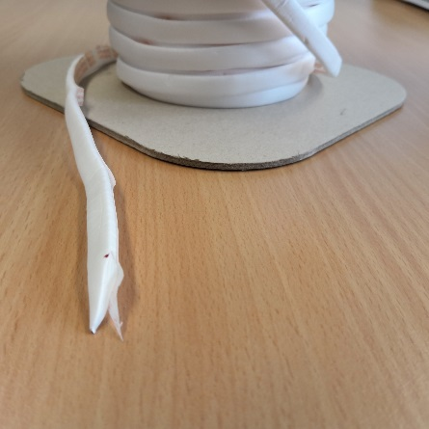
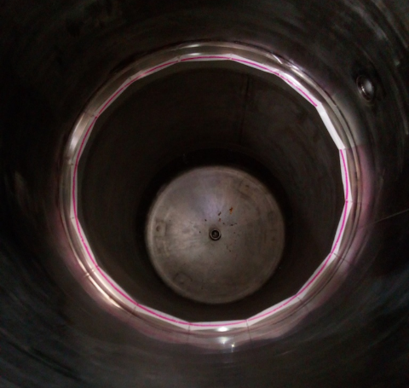
Heat loads to 1.9 K – ePTFE gasket tape
HFM
Cluster D
Improved performance
Expanded PTFE gasket tape (Gore® DF)
Leak tight to gaseous helium under low compressive force
Depend on magnet weight

Slide 10
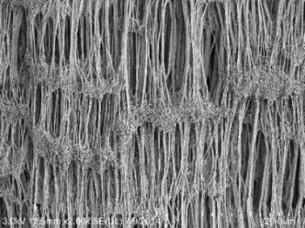
Heat loads to 1.9 K – ePTFE with grease
Better than specified
Apiezon-N vacuum grease to improve leak tightness
➔ Drastic reduction of heat loads
Superfluid helium permeate inside gasket
Grease not acceptable for long term operation at CERN
Other solution needed:
Conforming to cryostats irregularities
Large range of magnet weight
➔ Shall be flexible and strong
HFM
Microstructure of ePTFE (Gore®)

Slide 11
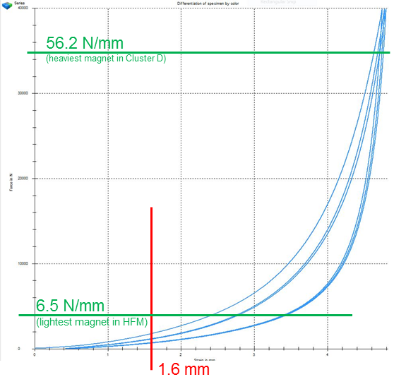
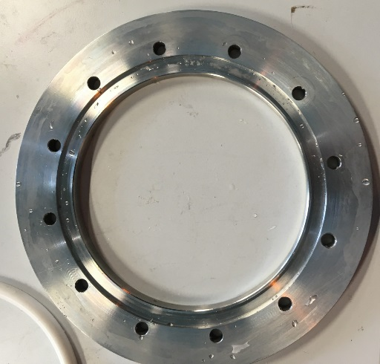
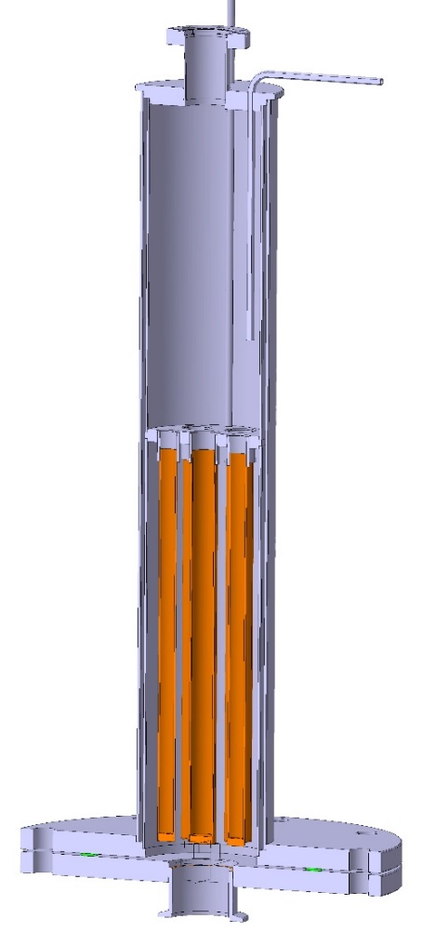
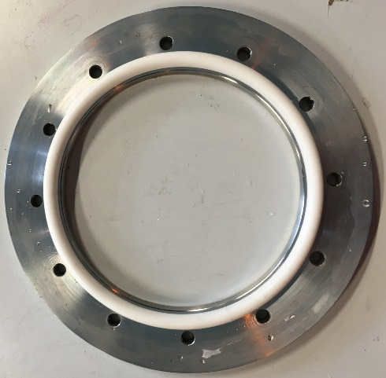
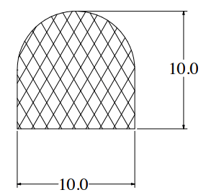
Heat loads to 1.9 K – Silicone seal
Cluster D
Silicone seal
Good mechanical properties
Cost-effective
Very promising results on small scale
  Mechanical (if in a groove)
  Thermal
➔ Heat loads close to specification in Cluster D
Seal broken after thermal cycle
Groove in lambda plate needed (machining ongoing)

Slide 12
Conclusion
Developed and successfully applied test procedure for validating thermal performance of vertical cryostats
After learning curve, HFM and Cluster D now fully operational close to specification
New cost effective sealing solution for superfluid helium developed
R&D effort still ongoing to further reduce power consumption

Slide 13
Thank you for your attention !

Slide 15
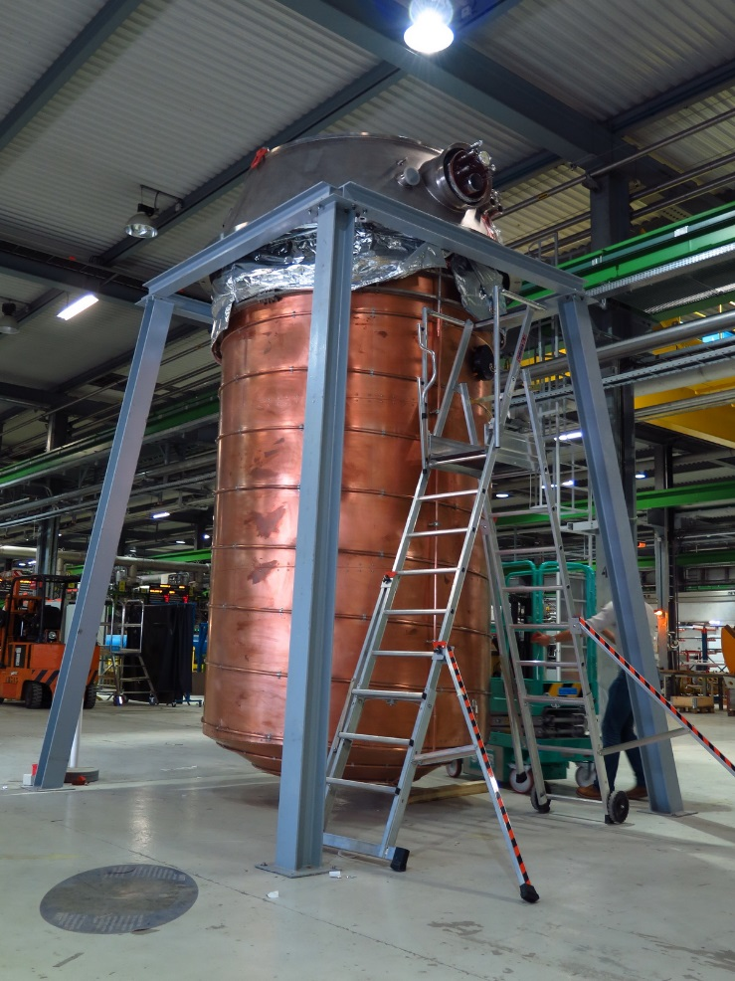
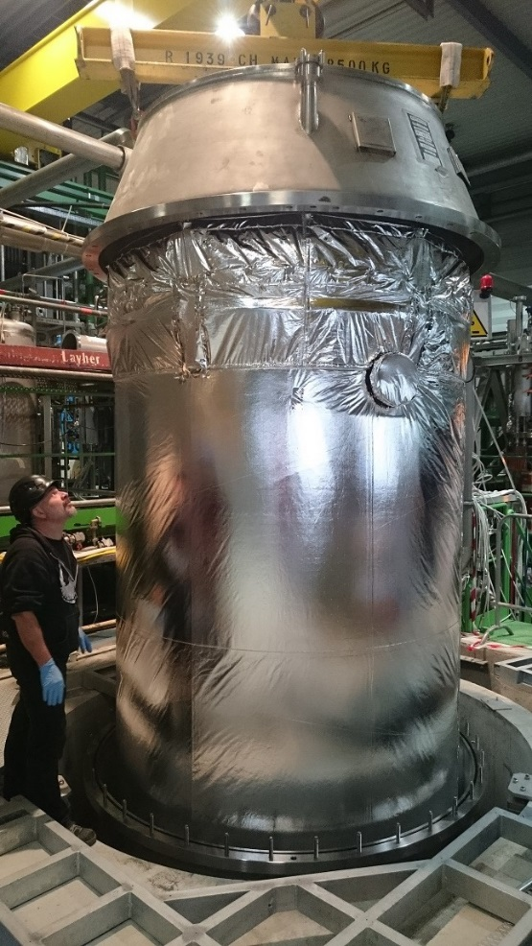
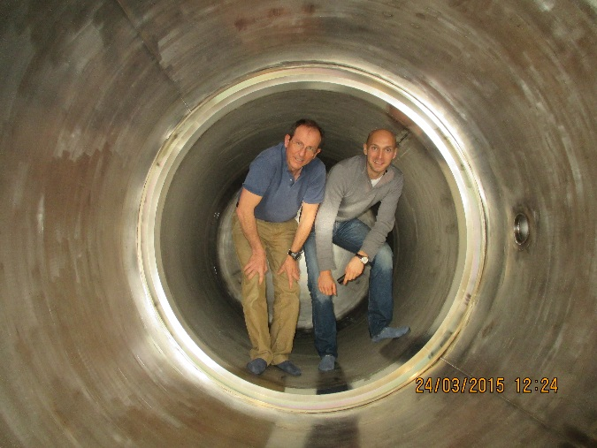
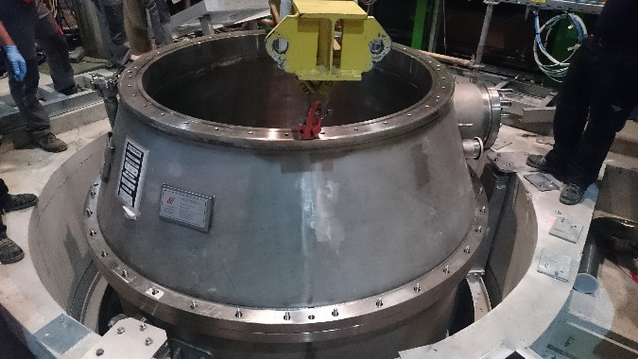
Spare slides

Slide 16
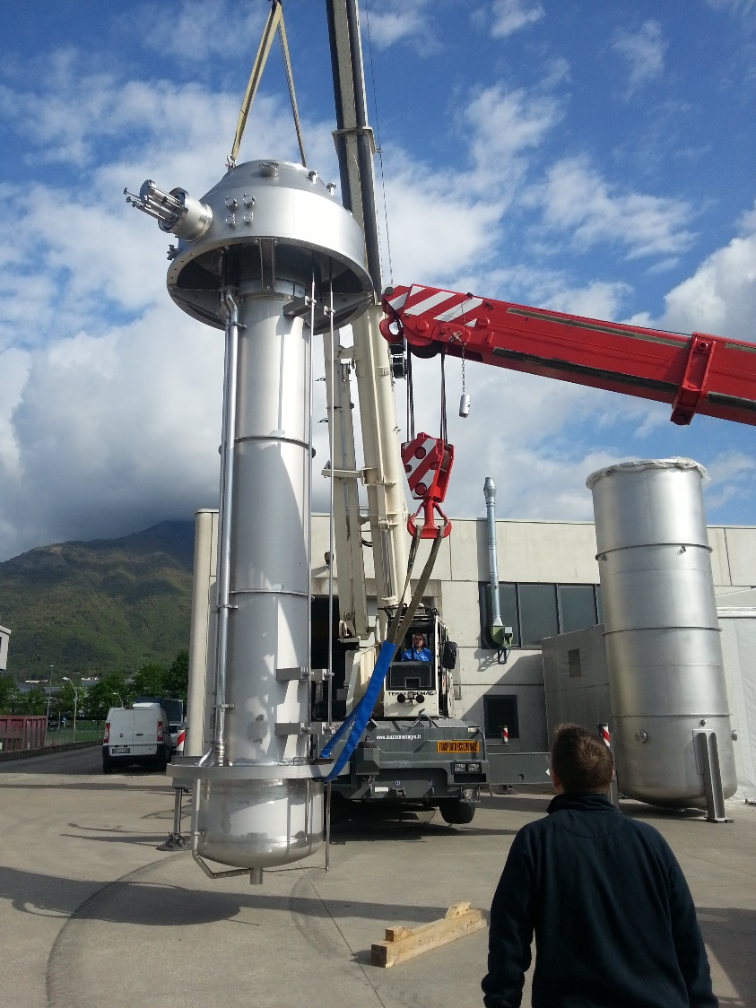
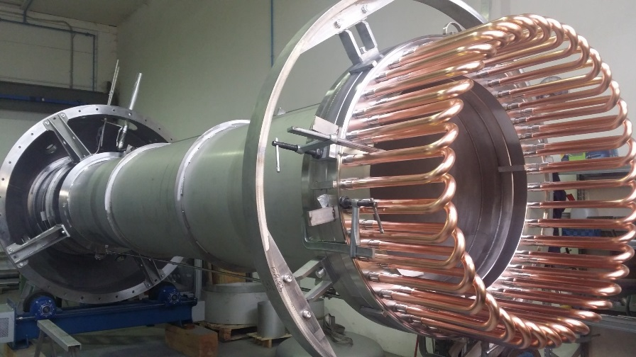
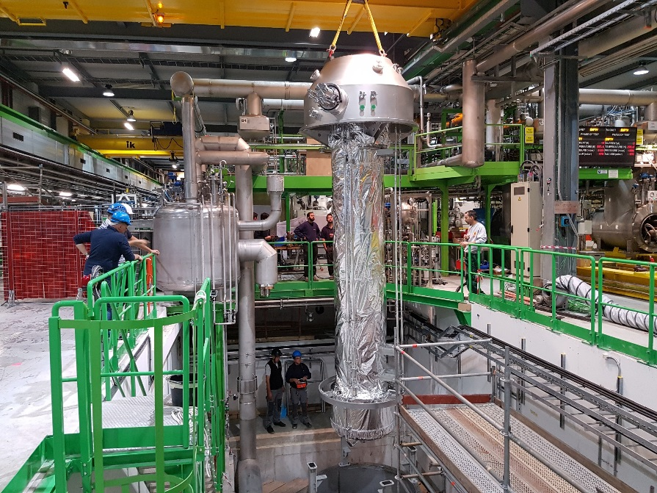
Spare slides

