Slide 1
Study on Irradiation Effect of Insulating Materials for Fusion Superconducting Magnet -Change in Electric Insulation Performance by Irradiation-
4th September 2018
27th International Cryogenic Engineering Conference
International Cryogenic Materials Conference 2018
M-10:16
Graduate school of Engineering, Osaka University
Shunsuke Kito, Yoko Akiyama
Faculty of Engineering, Fukui University of Technology
Shigehiro Nishijima
Notes:
Thank you for introduction.
Today, I’d like to talk about irradiation effect on dielectric insulating material.

Slide 2
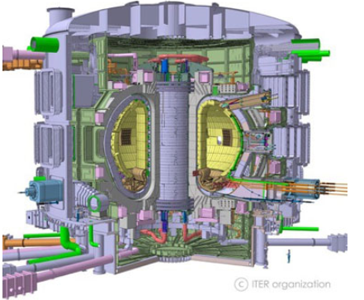
Background
ITER (fusion experimental reactor): the plasma is controlled with superconducting magnets
TF coil：the closest to plasma
⇒ most influenced by radiation
environment
○ neutron beam / γ-ray（10 MGy）
○ magnetic force (43 MPa shear stress)
○ cryogenic temperature(LHe : 4.2 K)
○ 15 kV(TF coil) voltage
Superconducting material
Construction material
Insulating material
http://www.fusion.qst.go.jp/ITER/iter/index.php
Superconducting cables
・Resin：Mixed resin prepared by mixing epoxy resin and
cyanate ester at a weight ratio of 4: 6
⇒ the most sensitive to radiation
・Glass cloth：Improve mechanical strength
(Boron free to prevent n-α reaction)
・Polyimide film：Improve insulation performance
on the pathway vertical to layers
Insulating material
Polyimide film
Glass cloth
Superconducting cables
Matrix(mixed resin)
Parallel to layers
⇒High radiation sensitivity
Vertical to layers
Notes:
In the Fusion Experimental Reactor ITER, the plasma is controlled with superconducting magnets, and they are used under severe environments such as high radiation, large electromagnetic force, cryogenic temperature, and a large voltage. Therefore, materials used for superconducting magnets must be durable in such environments.
In the magnet system of ITER, toroidal field coil is most influenced by the radiation emitted from the plasma. The insulating material is composed of the glass cloth for reinforcement and the polyimide film for insulation. They are alternately laminated, and the resin is impregnated into the gap and cured. Polyimide has high radiation resistance by numerous cyclic structures. Besides, S-glass cloth, which is boron free, is used for glass cloth to prevent n-α reaction. However, the resin has high radiation sensitivity that may cause deterioration of insulating material. So, we focused on the insulating material of the toroidal field coil, which is the most affected by radiation among the magnet components.

Slide 3
Objective of this study
Previous study irradiation effect was evaluated by interlaminar shear stress（ILSS).
⇒ The insulating material can maintain the insulation performance with polyimide film until film fracture.
On the pathway parallel to layers, insulation with films cannot be expected and only resin can insulate the voltage.
It is important to investigate the change in insulation performance with degradation.
Degradation factors
Stress
Scission of
molecular chain
Degradation
embrittlement
pathway parallel to layers
pathway vertical to layers
Irradiation
cryogenic
It is necessary to investigate complex effect.
Objective ： To investigate complex effect of stress, irradiation and
cryogenic temperature on the insulation performance
Notes:
In the previous study, irradiation effect on insulating material was generally evaluated by interlaminar shear stress. It is because the insulating material was presumed to maintain the insulation performance with polyimide film until film fracture. However, on the pathway parallel to layers, insulation with film cannot be expected. In this case, only resin can insulate voltage. On the pathway parallel to layers, it is important to investigate the change in insulation performance with degradation.
Main degradation factors of the insulating material are mechanical stress, irradiation and cryogenic temperature. Since they are interactive with each other, it is necessary to investigate not only each effect but also complex effect of them.
So the Objective of this study is to investigate complex effect of mechanical stress, irradiation and cryogenic temperature on the insulation performance.

Slide 4
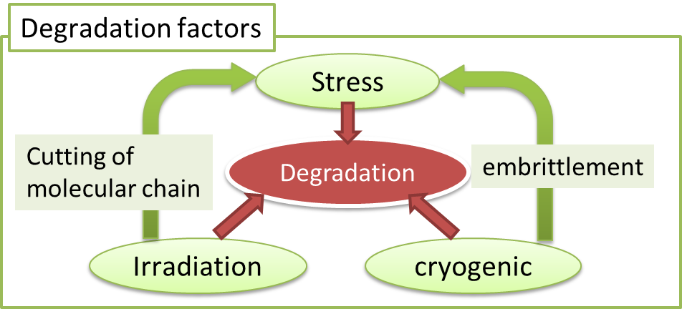
Outline of Experiments
Objective ： To investigate complex effect of stress, irradiation
and cryogenic temperature on the insulation performance
Experiment 1：Dielectric breakdown test
on irradiated insulating materials
Experiment 2 ：Dielectric breakdown test
under shear stress on non-irradiated materials
irradiation effect
mechanical stress effect
Experiment 3：Dielectric breakdown test under shear stress in LN₂
on irradiated materials
complex effect of stress, irradiation and cryogenic temperature
Notes:
This slide shows the outline of experiments in this study. We conducted three experiments. In experiment 1, dielectric breakdown test was conducted on irradiated insulating materials to investigate irradiation effect on the insulation performance. In experiment 2, dielectric breakdown test was conducted under shear stress on non-irradiated materials to investigate the effect of mechanical stress. In experiment 3, which is our main experiment, dielectric breakdown test was conducted under shear stress in liquid nitrogen on irradiated materials to investigate complex effect of three factors.

Slide 5
Outline of Experiments
Objective ： To investigate complex effect of stress, irradiation
and cryogenic temperature on the insulation performance
Experiment 1：Dielectric breakdown test
on irradiated insulating materials
Experiment 2 ：Dielectric breakdown test
under shear stress on non-irradiated materials
irradiation effect
mechanical stress effect
Experiment 3：Dielectric breakdown test under shear stress in LN₂
on irradiated materials
complex effect of stress, irradiation and cryogenic temperature
Notes:
First, I’ll talk about experiment 1.

Slide 6
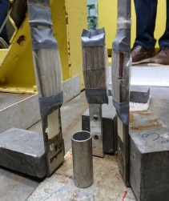
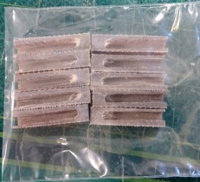
Sample preparation method (almost the same in three experiments)
① (GFRP)laminate 45 glass cloth
① (Hybrid)laminate 29 glass cloth
and 28 polyimide films
⑤ machining material
100 mm
glass cloth
60 mm
6 mm
GFRP
Hybrid
test direction
(parallel)
polyimide film
cutting
6 mm
② dried in oven (100℃-24h)
5.5 mm
30 mm
⇒The groove lengthen creeping distance to prevent creeping discharge.
1mm
Epoxy resin and hardener were deformed under vacuum.
Epoxy resin: Epikote 828
Hardner : Jeffamine D230
③ Impregnation with resin
under vacuum
⑥ γ-ray irradiation
⁶⁰Co source
in ISIR, Osaka Univ.
at RT, in the air atmosphere
Dose : 5 MGy / 10 MGy
Dose rate : 42 kGy/h
④ Curing in oven (70℃-3h, 110℃-2h)
Notes:
Let me move to preparation method. The method is almost the same in three experiments. In this study, two materials were prepared. One is glass fiber reinforced plastic, GFRP, composed of epoxy resin and S-glass cloth. The other is Hybrid composite of GFRP and polyimide films. Firstly, glass cloth and polyimide film are laminated and dried in oven. After that, they are impregnated with epoxy resin and hardener, which are mixed under vacuum. Finally, they are heat treated to cure.
The obtained material were machined into this shape. In the dielectric breakdown test, it is necessary to prevent creeping discharge. The geometry of specimen was designed to prevent creeping discharge. After manufacturing, the specimens are irradiated with gamma ray from cobalt sixty at room temperature in the air atmosphere.
After irradiation, dielectric breakdown test was conducted.

Slide 7
Experiment 1. Dielectric breakdown test on irradiated insulating materials
Test condition
・electrode
shape：needle(φ1.8 mm) - disc(φ25 mm, t = 5mm)
material：stainless steel (SUS304)
・ high voltage tester
7474, KEISOKU GIKEN, JAPAN
DC voltage
voltage rising rate ：0.5 kV/s (max 20 kV)
When the current flowed, the voltage was stopped.
⇒ Confirming breakdown trace of the specimen,
the voltage was recorded as breakdown voltage.
6 mm
5.5 mm
30 mm
1mm
Breakdown trace
＜test system of dielectric breakdown test＞
0.2 mm
＜breakdown trace of hybrid composite＞
Notes:
This is the test system of breakdown test. A needle and a disc electrodes made of stainless steel was used. Applied voltage was DC voltage and raised at 0.5 kV per second. When the current flowed, the voltage was stopped. Confirming breakdown trace of the specimen, the voltage was recorded as breakdown voltage.

Slide 8
Experiment 1. result and discussion (GFRP)
Breakdown voltage per 1 mm(Dielectric Breakdown Strength, DBS) on parallel path
GFRP・・・the DBS increased
① The shrinking of irradiated specimen
due to release of radiolysis gas
As the absorbed dose increased,
the thickness of the specimen decreased.
⇒ The density of specimen was enhanced.
vertical path
glass cloth
Polyimide film
② Crosslinking reaction of
unreacted epoxy group was accelerated.
resin
Parallel path
Increase density prevented breakdown.
GFRP
Hybrid
Notes:
This is the result of Experiment 1. The horizontal axis is absorbed dose and the vertical axis is dielectric breakdown strength. The dielectric strength was calculated by dividing the breakdown voltage by the distance between the electrodes. The blue graphs shows the result of GFRP. As the dose increased, the dielectric breakdown strength also increased. There are two possible causes. One is shrinking of the irradiated specimen due to release of radiolysis gas. This graph shows relation between dose and thickness of specimen. As the dose increased, the thickness of the specimen decreased slightly. It indicate that the density of specimen was enhanced by shrinkage. In addition, Crosslinking reaction of unreacted epoxy group was accelerated by gamma radiation. The two effect cause increase in density and prevented breakdown.

Slide 9
Experiment 1. result and discussion (Hybrid)
Breakdown voltage per 1 mm(Dielectric Breakdown Strength, DBS) on parallel path
Hybrid・・・the DBS decreased.
Since DBS of GFRP increased,
the reason for decrease was effect of films.
・ Discharge of radiolysis gas
The films inhibited the release of radiolysis gas.
The accumulated gas caused partial discharge,
resulting on dielectric breakdown.
The thickness hardly changed
vertical path
glass cloth
Polyimide film
resin
At the film-resin interface there was no reaction target of the epoxy group, so the crosslinking reaction was not promoted
Parallel path
GFRP
Hybrid
Notes:
On the other hand, dielectric breakdown strength of hybrid composite shown by red decreased. Since the strength of GFRP increased, the reason for decrease was effect of films. This graph shows the relation between the dose and the thickness of hybrid composite. The thickness hardly changed. From the result, it is assumed that the films inhibit the release of radiolysis gas and the accumulated gas cause partial discharge, resulting on dielectric breakdown.

Slide 10
Outline of Experiments
Objective ： To investigate complex effect of stress, irradiation
and cryogenic temperature on the insulation performance
Experiment 1：Dielectric breakdown test
on irradiated insulating materials
Experiment 2 ：Dielectric breakdown test
under shear stress on non-irradiated materials
irradiation effect
mechanical stress effect
Experiment 3：Dielectric breakdown test under shear stress in LN₂
on irradiated materials
complex effect of stress, irradiation and cryogenic temperature
Notes:
Next, dielectric breakdown test was conducted under shear stress on non-irradiated materials, in order to investigate the effect of mechanical stress.

Slide 11
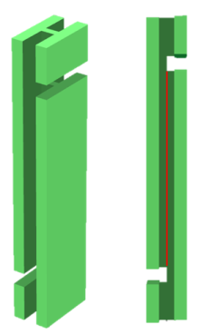
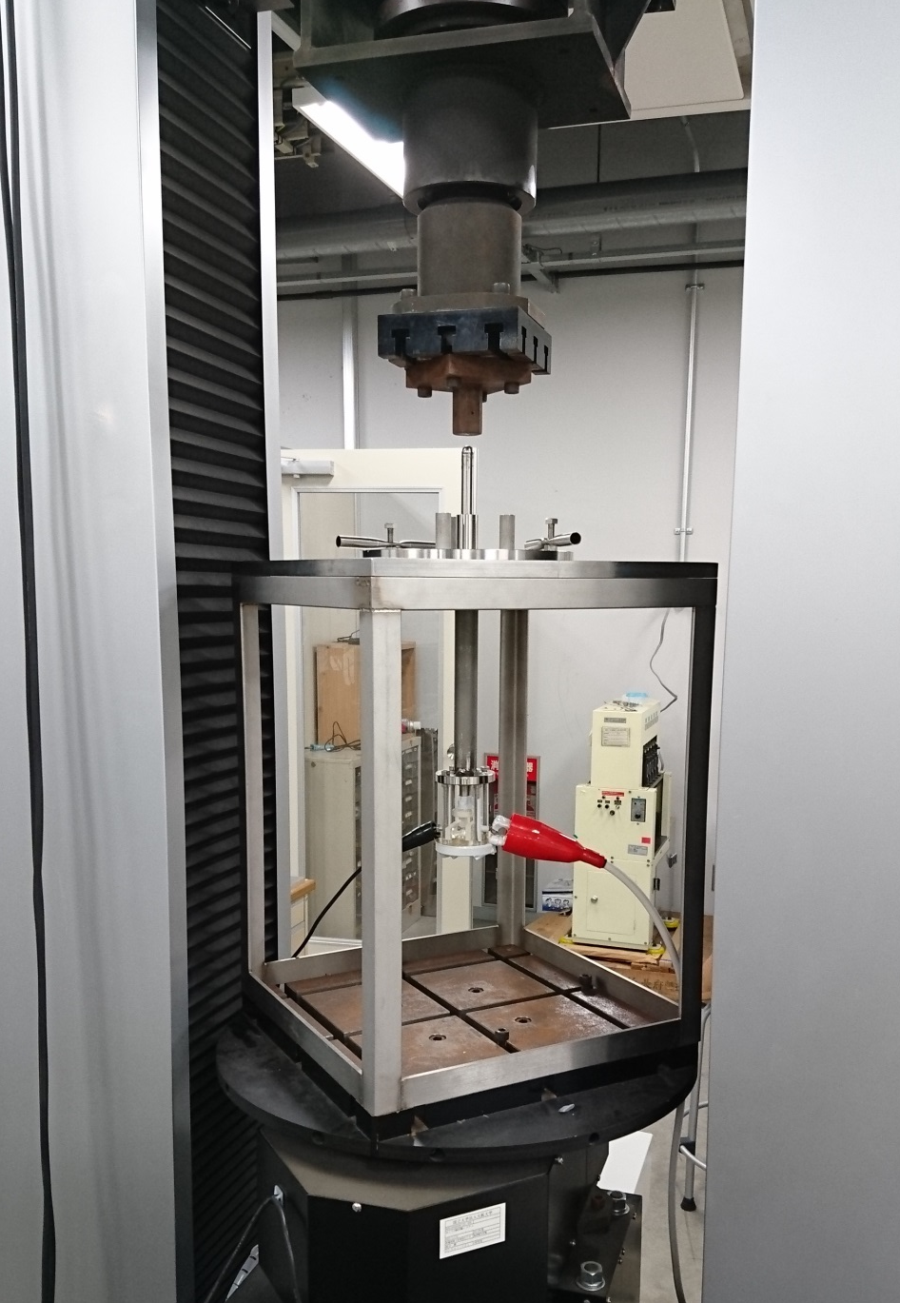
Experiment 2 ：Dielectric breakdown test under shear stress on non-irradiated materials
The system of dielectric breakdown test under shear stress
electrode
(SUS304,φ1.8)
load
Shear stress is
applied to this area
High voltage
ground
30 mm
electrode
specimen
1 mm
Test condition
At RT, in the air atmosphere, with constant shear stress
・High voltage tester：7474, KEISOKU GIKEN, JAPAN
DC voltage
voltage rising rate ：0.5 kV/s (max 20 kV)
・Universal tester：Shimadzu, JAPAN AG-X 10kN
shear stress : 0 - 40 MPa
Notes:
This is the test system of experiment 2. After preparing the materials as in experiment 1, the test specimen was fabricated as shown here and installed it in the test system. By applying a load from upper side, shear stress is applied to the center part of the specimen. By inserting the electrode into the groove, the voltage was applied in the direction parallel to the layers. The test was conducted at room temperature with applying a constant shear stress, and the voltage was raised at 0.5 kV/s to breakdown. The shear stress was varied from 0 to 40 MPa for each specimen.

Slide 12
Experiment 2. Result and Discussion
shear strength
of GFRP (34 MPa)
shear strength
of Hybrid(19 MPa)
Insulation performance was degraded under the stress lower than the shear fracture strength.
Insulation performance can be affected by even microcracks.
At cryogenic temperature, the material may become brittle.
After irradiation, mechanical strength decrease.
Notes:
Here is the result. The horizontal axis is the shear stress, and the vertical axis is the dielectric breakdown strength. Blue line is the data of GFRP, and red line is the data of hybrid composite material including polyimide film. In addition, the shear fracture strength is shown by the dashed line. From these results, insulation performance was degraded under the stress lower than the shear fracture strength. It can be said that insulation performance was affected by even microscopic cracks. At cryogenic temperature or after irradiation, the deterioration is expected to be promoted by embrittlement or mechanical degradation.

Slide 13
Outline of Experiments
Objective ： To investigate complex effect of stress, irradiation
and cryogenic temperature on the insulation performance
Experiment 1：Dielectric breakdown test
on irradiated insulating materials
Experiment 2 ：Dielectric breakdown test
under shear stress on non-irradiated materials
irradiation effect
Mechanical stress effect
Experiment 3：Dielectric breakdown test under shear stress in LN₂
on irradiated materials
complex effect of stress, irradiation and cryogenic temperature
Notes:
Lastly, dielectric breakdown test was conducted under shear stress in liquid nitrogen on irradiated material, in order to investigate complex effect.

Slide 14
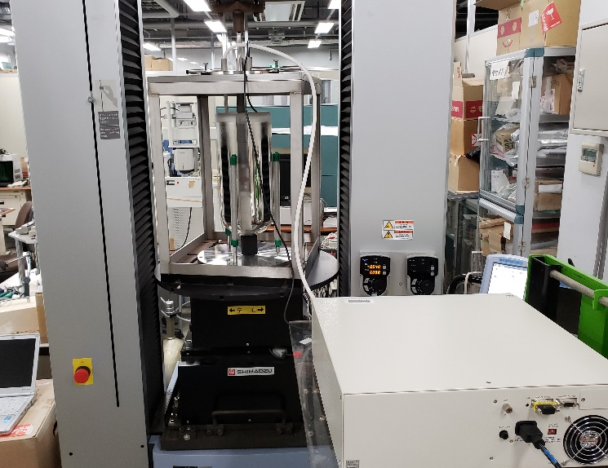
Experiment 3：Dielectric breakdown test under shear stress in LN₂ on irradiated materials
load
Test condition
・Universal tester：Shimadzu, AG-X 10kN
・High voltage tester：KEISOKU GIKEN, 7474
DC voltage
voltage rising rate ：0.5 kV/s (max 20 kV)
Voltage taster
LN₂
High voltage
ground
Notes:
This is the test system of experiment 3. It was almost the same as one of experiment 2, but the test part was placed in liquid nitrogen.

Slide 15
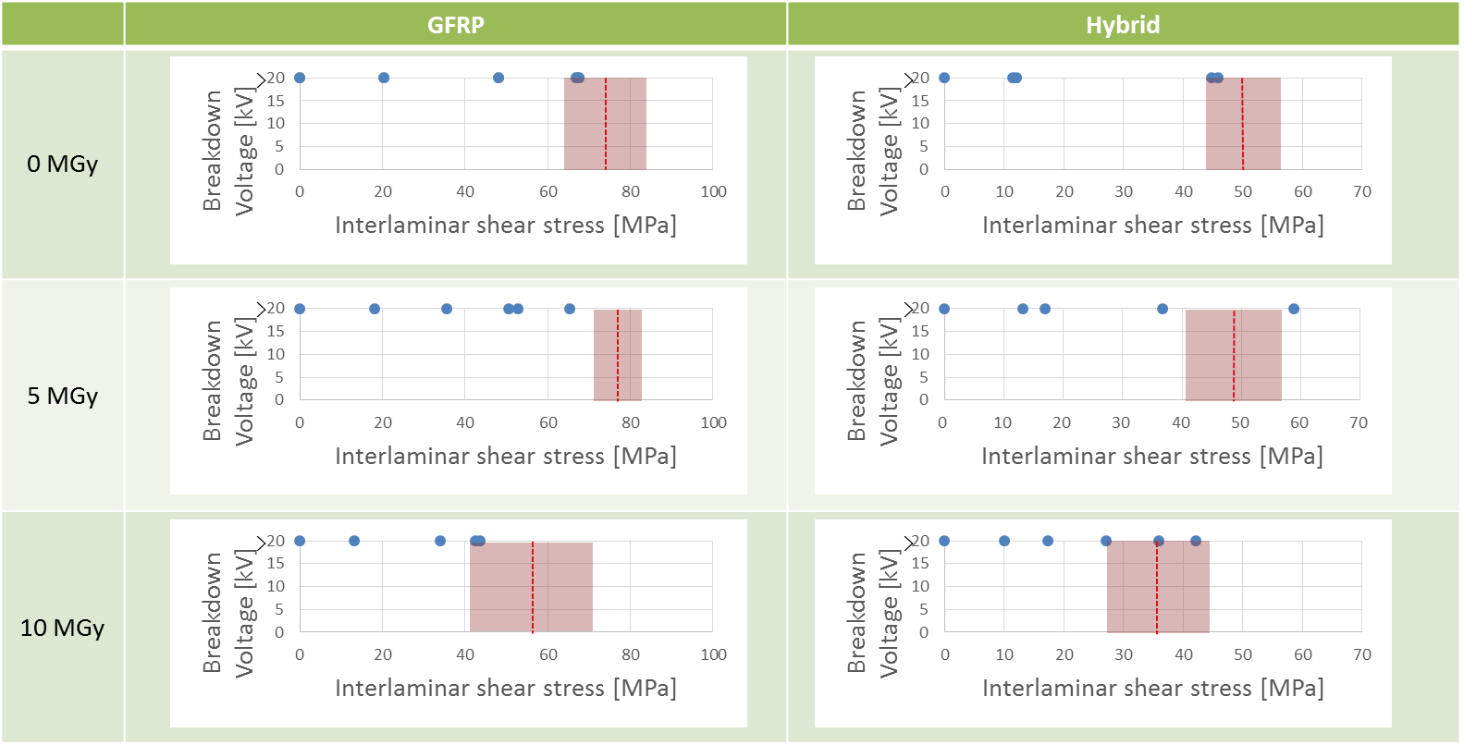
Experiment 3. result and discussion
All the samples did not breakdown up to the 20 kV, that is the maximum voltage of the tester
① Insulation with liquid nitrogen immersed in sample
② Suppression of electron motion by cryogenic temperature
We are planning the breakdown test in cryogenic gas, in order to exclude LN₂ insulation effect.
Notes:
Here is the result of experiment 3. The horizontal axis is the shear stress, and the vertical axis is the dielectric breakdown voltage. In each graph, the shear fracture strength is shown by the dashed line and the error range is shown by colored area. As a result, all the samples did not breakdown up to the 20 kV, that is the maximum voltage of the tester. Two reasons are considered; one is insulation with liquid nitrogen, the other is suppression of electron motion by cryogenic temperature. To confirm the reason, we are planning the breakdown test in cryogenic gas, in order to exclude LN₂ insulation effect.

Slide 16
Future Experiment：Dielectric breakdown test under shear stress in cryogenic gas on irradiated materials
Load
Based on the test system of Experiment 3 ;
・The test section is filled with helium gas
⇒exclude the insulation effect of liquid nitrogen
・ The outside of the gas container is filled with liquid nitrogen
⇒Maintain test specimen at cryogenic temperature
and investigate only temperature effect
GHe
Voltage tester
LN₂
H.V.
Ground
Notes:
This is the test system of the experiment we are planning. Based on the test system of Experiment 3, the test section is filled with helium gas (at liquid nitrogen temperature), to exclude the insulation effect of liquid nitrogen.
In addition, the outside of the gas container is filled with liquid nitrogen to investigate only temperature effect.

Slide 17
Summary
Objective ： To investigate complex effect of stress, irradiation and
cryogenic temperature on the insulation performance
Experiment 1：Dielectric breakdown test on irradiated insulating materials
⇒In hybrid composite, partial discharge can occur due to radiolysis gas.
Experiment 2 ：Dielectric breakdown test under shear stress on non-irradiated materials
⇒Insulation performance can be affected by even microcracks.
Experiment 3 ：Dielectric breakdown test under shear stress in LN₂ on irradiated materials
⇒Insulation performance remarkably improved in liquid nitrogen.
when cracks generated
In the atmosphere, the air enters into the cracks.
⇒ the breakdown was triggered by the partial discharge.
In LN₂, liquid nitrogen enters into the cracks.
⇒ Insulation with liquid nitrogen raises the withstand voltage.
Future plan
Breakdown test in cryogenic gas, in order to exclude LN₂ insulation effect.
Notes:
Now let me summarize my presentation. Experiment 1 indicate that in hybrid composite, partial discharge can occur due to radiolysis gas. Experiment 2 revealed that insulation performance can be affected by even microcracks. In experiment 3, it was found that insulation performance remarkably improved in liquid nitrogen. Considering the results of Experiment 2 and 3, when cracks generated, in the atmosphere the air enters into the cracks and the specimen breakdown triggered by the partial discharge. On the other hand in experiment 3, liquid nitrogen enters into the cracks and insulation with liquid nitrogen raises the withstand voltage.
In the future, we are planning breakdown test in cryogenic gas, in order to exclude LN₂ insulation effect.

Slide 18
Acknowledgments
This research was partly supported by NIFS Collaboration Research program (NIFS16KERA010)
Notes:
That’s all for my presentation. Thank you for your kind attention.

Slide 19
Supplement
The variation of complex effects
Degradation factors
No degradation(negative control)
⇒ Experiment 2 (0MPa)
Stress
Single effect
Mechanical stress ⇒experiment 2
Irradiation ⇒experiment 1
Cryogenic temperature
⇒ Experiment 3 (0 MGy, 0MPa)
Cutting of
molecular chain
Degradation
embrittlement
Irradiation
cryogenic
Complex effect of two factors
Irradiation and Cryogenic
⇒ experiment 3 (irradiated, 0 MPa)
Stress and Cryogenic
⇒ experiment 3 (0 MGy, under shear stress)
Stress and Irradiation
⇒ Uninvestigated
It is also necessary
to conduct the breakdown test
under shear stress on irradiated materials
Complex effect of three factors
⇒ experiment 3 and future experiment

Slide 20
Supplement
The composition ratio measured on a test piece
different from the material used for the breakdown test
GFRP
Volume fiber content$;V_{f}≈40\%$
Porosity ; $<3\%$
Hybrid composite
Volume fiber content$;V_{f}≈28\%$
Volume film content$;V_{k}≈12\%$
Porosity ; $<3\%$
The volume fiber content differs between GFRP and hybrid.
It is considered that there is no problem in evaluating relative to each of GFRP and hybrid composite material.

Slide 21
Supplement
The required breakdown strength
was roughly calculated by following formula.
$$\left(DBS\right)=(withstand volatage)/(Path length)$$
$$\left(Path length\right)=\frac{(tape width,25 mm)}{2}×(No. of layers)$$
According to the above formula,
the required strength is 140 V/mm or less.
As DBS tends to decrease as the distance increases,
higher DBS may be required.
TEION KOUGAKU (J. Cryo. Super. Soc. Jpn.) Vol.47 No.3 (2012)「Insulation and Impregnation Test for ITER Toroidal Field Coil」

Slide 22
Supplement
Stress distribution
of the specimen
The values in the graph was average stress.
However, stress concentration was found
in the simulation.
Stress
concentration
The fracture strength could be underestimated.

Slide 23
Supplement

Slide 25
層間せん断応力(ILSS)とγ線吸収線量の相関

Slide 26
Others
How is the effect of the kind of radiation.
Gamma ray acts on electrons, and cut the molecular chain of the material.
On the other hand, neutrons act on protons in the material. When the protons are re-combined, hydrogen gas was more generated than in the case of gamma irradiation.
→ So it is possible that the deterioration of insulation performance is promoted when the material is irradiated with neutron than when it is irradiated with gamma ray.
What is the size of microcracks
The size of microcracks was not measured. In this study, microcracks was defined as cracks before fracture. So the size of the microcracke is assumed to be not so large.

