Slide 1
Conceptual design of the Divertor Tokamak Test (DTT) magnet cooling loops
L. Savoldi¹, R. Bonifetto¹, A. Di Zenobio², L. Muzzi², R. Zanino¹, A. Zappatore¹
¹ NEMO Group, Dipartimento Energia, Politecnico di Torino, Italy
² ENEA, Frascati, Italy

Slide 2
Outline
The DTT facility
DTT magnets & cooling loops
Aim of the work
He loop dimensioning
Estimation of cooling power:
  Average
  Peak (via simulation of a plasma pulse)
Conclusions and perspective

Slide 3
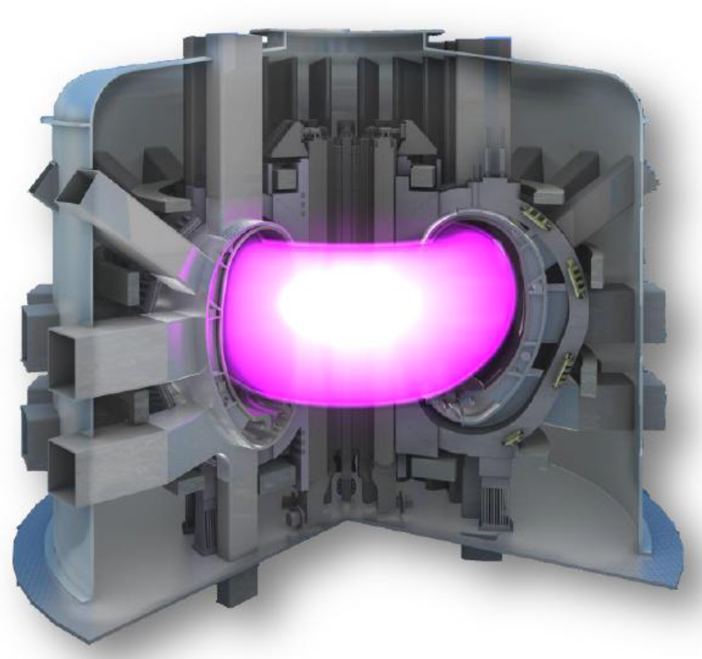
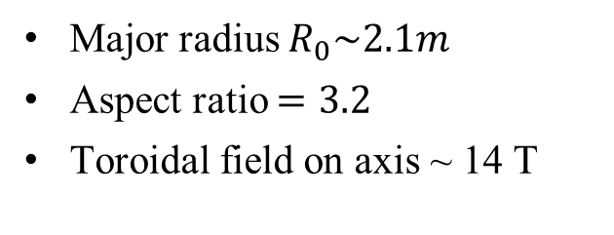
The DTT
DTT = Divertor Tokamak Test facility, currently under design, to be built in Italy
Critical issue to be addressed = power exhaust (towards the EU DEMO) → need of flexibility to realize different plasma configurations (single null, double null, snowflake…)
Plasma confinement based on LTS superconducting magnets
[Fus. Eng. Des. Special Issue, vol 122, 2017]
Major radius $R_{0}\sim 2.1m$
Aspect ratio $=3.2$
Toroidal field on axis ~ 14 T
Notes:
ITER: R0 = 6 m, aspect ratio

Slide 4
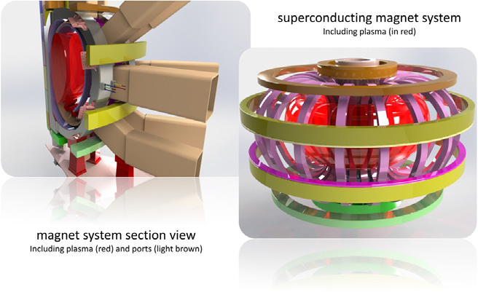
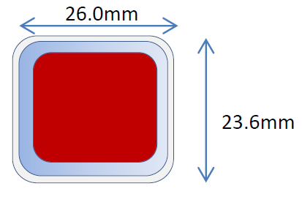
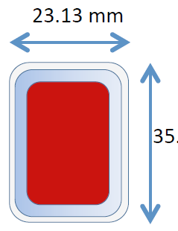
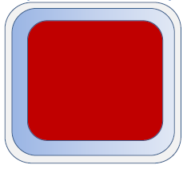
DTT SC magnets
18 Nb₃Sn TF coils (12 channels/ coil, pancake-wound, in SS casing)
6 Nb₃Sn CS modules (layer-wound, 3 sub-coils/module)
6 NbTi PF coils (pancake-wound)
[A. Di Zenobio, et al., FED 2017]
Jacket
Turn insulation
Bundle
Jacket
Turn insulation
Bundle
36 mm
Jacket
Turn insulation
Bundle
Hole

Slide 5
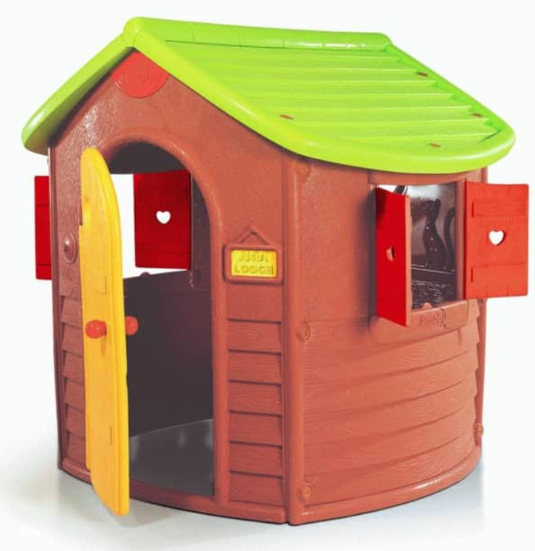
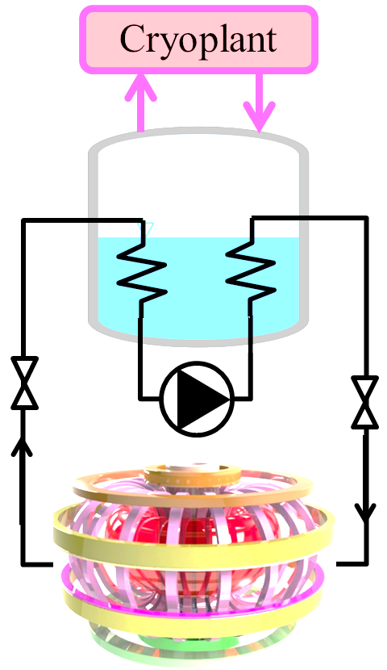

Magnet cooling loops
    4 cooling loops (TF winding, TF casing, CS, PF)
AIM of the work
First dimensioning of the He loops for the DTT magnet system (single null configuration)
Cooling power requested by the SC magnets
Feedback on the magnet design
Cryoplant building
~ 20 m apart

Slide 6
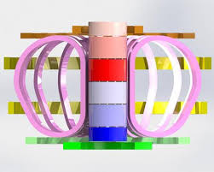
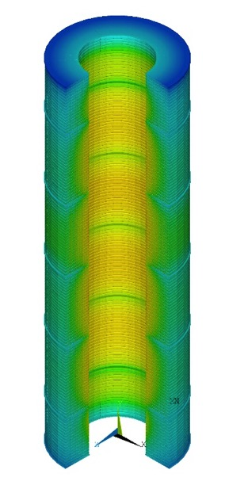
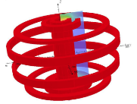
He loop dimensioning
SN configuration: plasma burn = 66 s, total pulse duration = 1800 s
  Cryolines lengths (~ 25 m) from facility layout, diameter to limit pressure drop below ~ 0.1 bar
  First estimate of average power to the thermal buffer from estimated loads
[* R. Villari]
 | Deposited energy / cycle [kJ] (AC losses + nuclear *+ static + pumping)
TF | ~ 1300 (WINDING)
 | ~ 450 (CASING)
CS | ~ 950
PF | ~ 2500
Isobaric estimation gives thermal buffer volume of ~0.5 m³ to ~2.5 m³ to operate in the range 50% - 90% of liquid filling#
Average cooling power = 5200 kJ / 1800 s ~ 3 kW
[# ITER cryodistribution plant Design Report, 2011] ]

Slide 7
Peak cooling power
 | Nuclear + pumping load during a plasma burn[kW]
TF | ~ 4.2 (WINDING)
 | ~ 3.7 (CASING)
CS | ~ 0.5
PF | ~ 2.7
Over-conservative estimation of peak power
to thermal buffers ~ 11 kW
  To get more realistic estimation of the peak cooling power requested to the refrigerator (only SC magnets client considered here - no cryopumps, no thermal shields, no current leads)
  → model a periodic pulse with the 4C code
[* R. Villari]

Slide 8
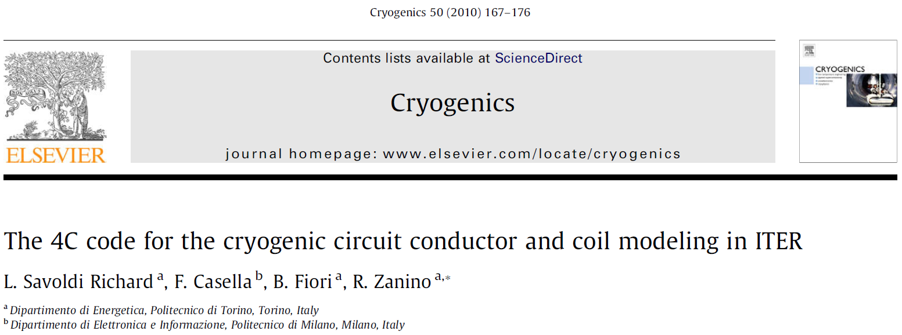
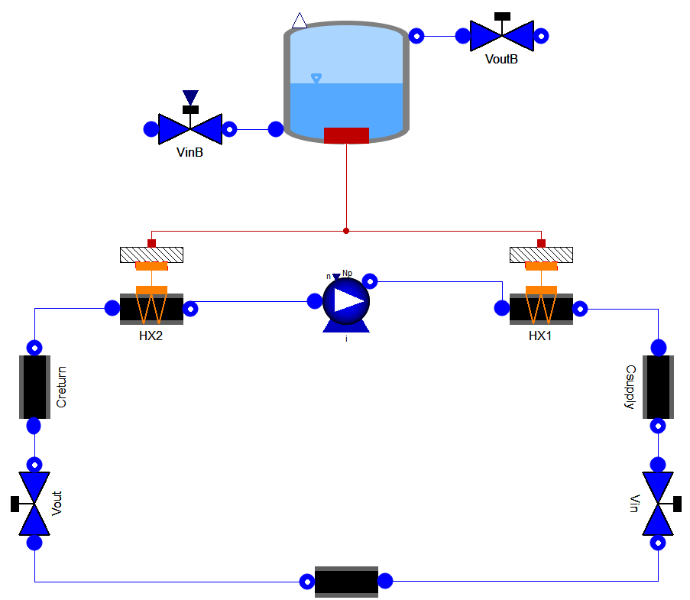
4C model of the He loops
To refrigerator
From refrigerator
LHe
Thermal buffer volume
to limit level oscillations within a range (50-90%)
Heat
SHe
Cold circulator
Simplified model of the coils / casing preserving:
Pressure drop
Conduit length and number
He and solids volume
Account for heat load deposition
Static load on cryolines accounted for

Slide 9
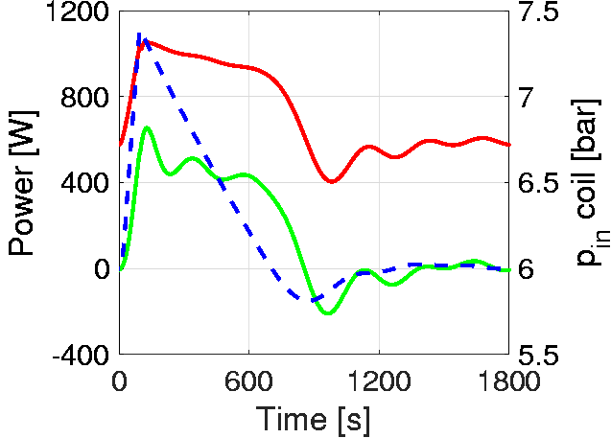
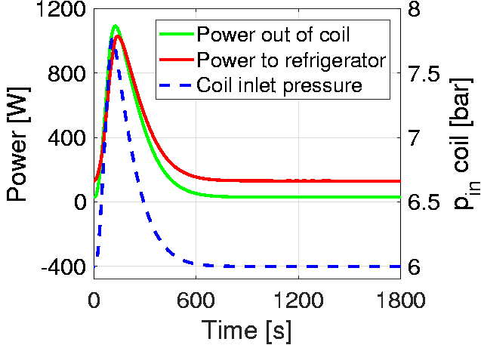
Results: cooling loops of TF coils
Peak power to the LHe bath ~ 1 kW
WINDING
V_{TB} = 0.4 m³ for WINDING and CASING loops
p_{peak} ~ 7 – 8 bar
Circulator
(+ static load on cryolines)
Peak power to the LHe bath ~ 1 kW
CASING

Slide 10
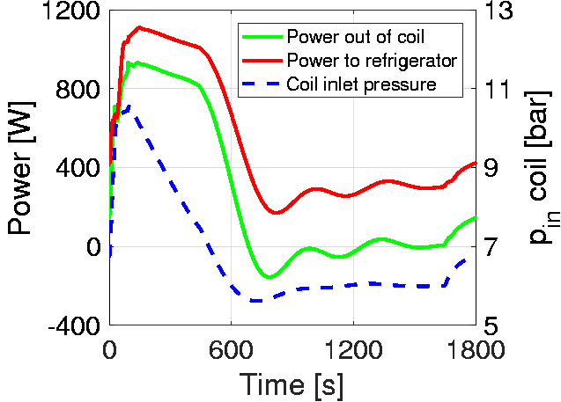
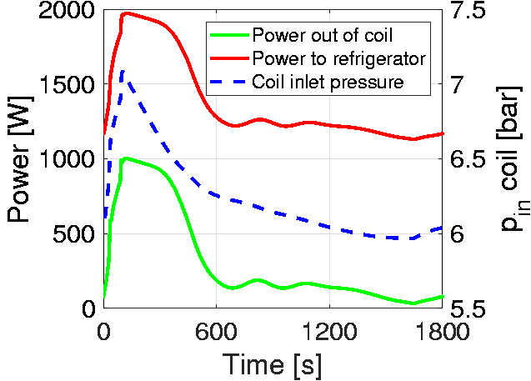
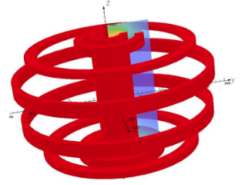
Results: cooling loops of CS and PF coils
Peak power ~ 1.1 kW
p_{peak} ~ 10 bar
Pumping power for PF coils ~1 kW) → need for design optimization
Model features:
V_{TB} = 0.5 m³
Peak power ~ 2kW

Slide 11
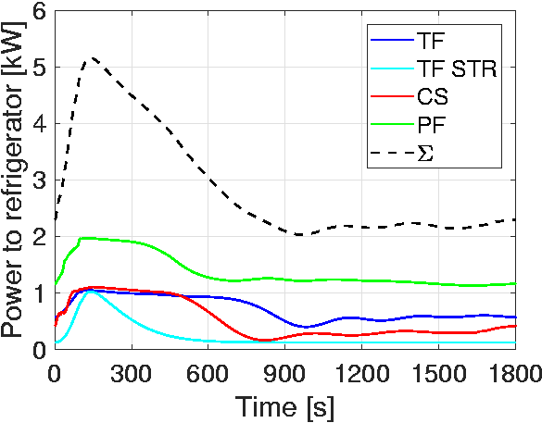
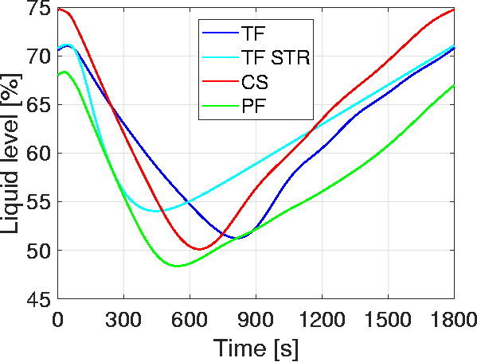
Summary of the results
Cooling power
LHe baths of ~0.4-0.5 m³ allows operation with
~ 50% < liquid level < 90%
Volume
Peak / average power ~ 5 kW / 3 kW (Peak / average ~1.2 in ITER [Chang, IEEE TAS 2012] and ~2 in JT-60SA [Hoa, IOP Conf. Ser. 2017] ) → room for heat load smoothing
Pumping power of PF coils ~ 1 kW

Slide 12
Conclusions and perspective
Preliminary dimensioning of the SHe cooling loops and thermal buffers of the DTT performed for single null configuration
Cryolines diameters and lengths, and volume of thermal buffers have been proposed
Computed peak / average cooling power for SC magnets ~5 kW / 3 kW
Large pumping power for PF coils → design revision needed
In perspective: consider double null and snowflake configuration, to assess which is the most demanding in terms of cooling power

Slide 13
Backup

Slide 14
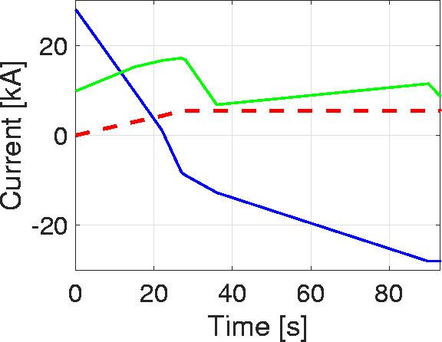
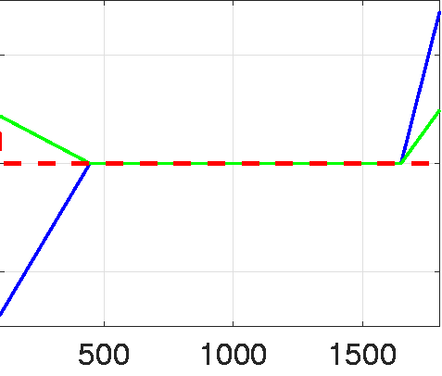
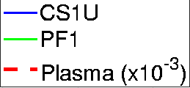
Operating scenario
  Single null configuration (SN)
[R. Albanese, et al., «DTT reference PF scenarios», 2018]
Initial charge time for CS and PF coils (150 s)
Shutdown time for CS and PF coils (350 s)
Plasma current ramp-up time (27 s)
SoF
EoF
Premag.
Burn time (66 s)
Time between pulses (1207 s)
Premag. of next shot
27
93
443
CAVEAT: Non-linear scale
Dwell (1707 s)
Notes:
Me la fai tipo la timeline della standard pulse di ITER?

Slide 15
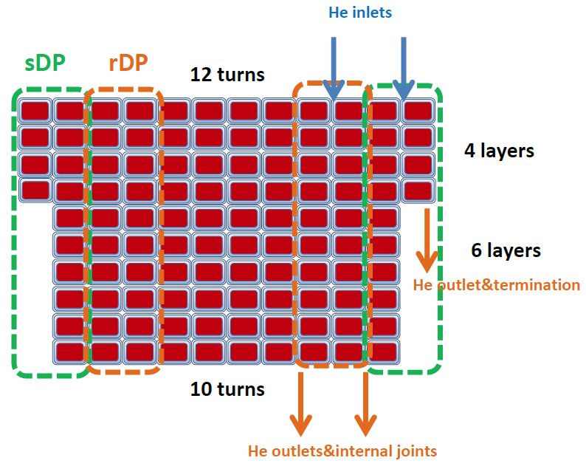
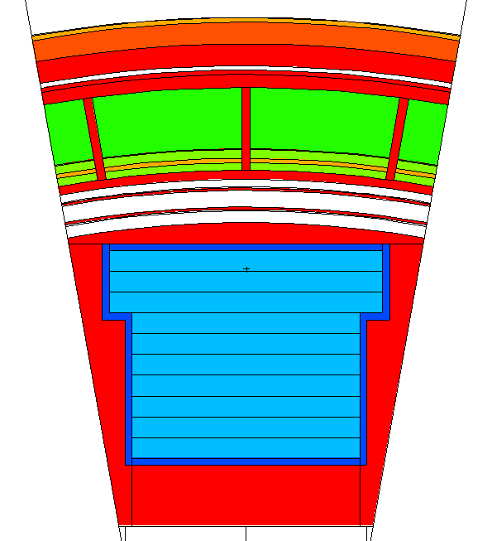
TF coils model assumptions
Plasma
WINDING PACK
Double-pancake WP
All 12 channels of each coil considered to have the same length (112 m)
Average power deposited uniformly in all 18 coils and along their entire length
He
CASING:
Casing cooling layout not defined yet: HERE we assume per each coil: 20 parallel smooth pipes, D = 8 mm, 10 m long, 1 g/s each
Average power deposited uniformly + static load (well-educated guess from ITER TF)

Slide 16
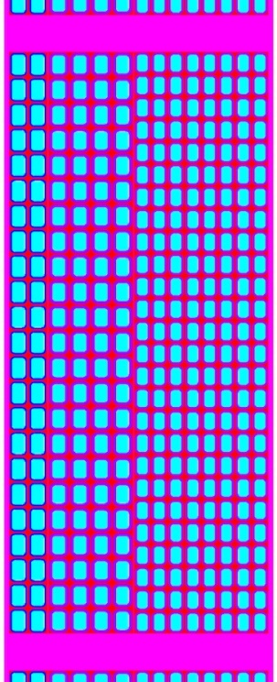
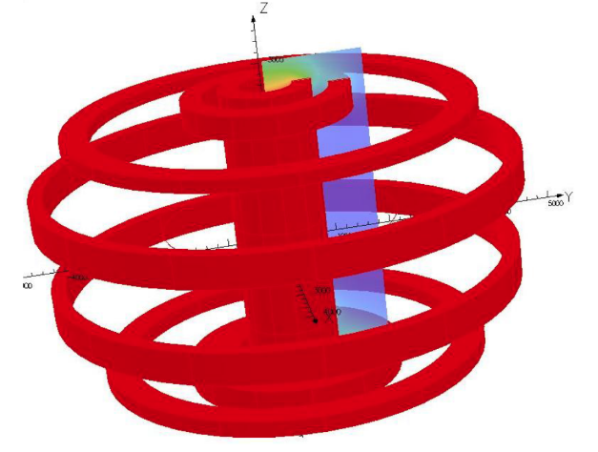
CS and PF model assumptions
Pancake-wound WP
  PF1&6: 18 channels
  PF2&5: 16 channels
  PF3&4: 14 channels
All channels of each coil considered to have the same (average) length
He
Plasma
Detailed design to be presented at SOFT
High field
Medium field
Low field
Layer-wound WP
Each module composed by 3 sub-coils (high, medium and low field) with 14 channels each, with same average length (94 m)
For both CS and PF average power deposited uniformly along all channels of each module/coil

Slide 17
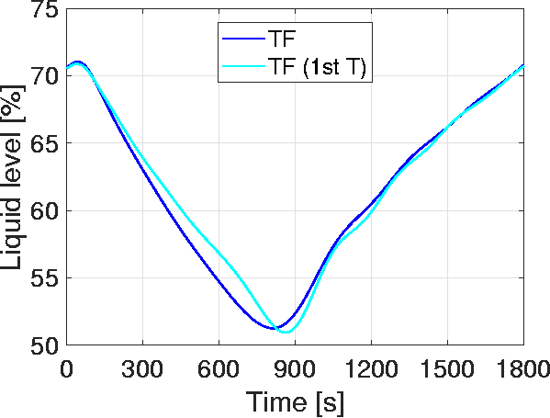
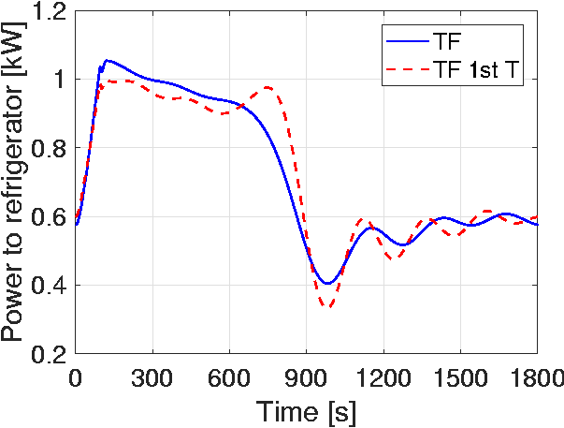
TF test with non-uniform power distribution
TF = uniform power distribution
TF 1st T = ~20% of the power in 1st Turn and the remaining 80% uniformly distributed in the other turns (comparable to real situation)
Computed results with uniform distribution are absolutely relevant, considering also the preliminary stage of the available data
Notes:
Ovviamente se metto TUTTA la potenza nel primo turn, l’effetto è MOLTO diverso, ma questo lo sapevamo già dai testo di HELIOS. Ed è assolutamente irrealistico.

