Slide 1


Outgassing characteristics analysis of mechanical cryocooler materials
Kenichiro SAWADA, Takamasa Itahashi, Tomoyuki Urabe,
Yoichi Sato, Keisuke Shinozaki, Hiroyuki Sugita
Japan Aerospace Exploration Agency
Kenichi Kanao, Shoji Tsunematsu, Kiyomi Otsuka, Katsuhiro Narasaki
Sumitomo Heavy Industries, Ltd.
Notes:
Thank you for your introduction.
I’ll talking about Outgassing characteristics analysis of mechanical cryocooler materials

Slide 2

Table of contents
Background and objectives in this research
3 types of outgas measurement method
  Outgas measurement in general
  Outgassing rate measurement by using QCM * Quartz Crystal Microbalance
  Outgassing rate measurement by using API-MS * Atmospheric Pressure Ionization Mass Spectrometer
Estimate method for both outgassing rate and adsorption energy
Results & Discussion :
  Adsorption energy
  Atmospheric exposure time effect
  Outgassing comparison
  Additional baking effect
3. Summary and future study
Notes:
Here is the contents in this presentation.
Firstly, I’m gonna talk about ~
Secondly, I will show ~
Thirdly, I will show ~
Then, I will show ~
Finally, I will make a brief summary

Slide 3
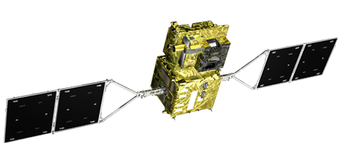
Motivation
Mechanical cryocooler require for higher reliability to achieve long-term operation of over 5 years on orbit for next generation astronomy missions
  20K class two stage Stirling (2ST) cooler
  1K/4K class Joule Thomson (JT) cooler
Reliability and lifetime of the mechanical cryocoolers depend on two factors,
  mechanical wear of the piston seal and the valve seal
  contaminated He working gas by impurity outgases mainly H₂O and CO₂
Depend on contaminated He working gas by impurity outgases mainly H₂O and CO₂
  Blockage in the JT heat exchanger plumbing and the JT orifice
  → mainly concern : 1K/4K-class Joule Thomson cooler
  Stuck and degradation of the Stirling displacer/regenerator
  → mainly concern : 20K class double-stage Stirling Cooler (H₂O and CO₂)
  → mainly concern : 50K-80K class single-stage Stirling Cooler (H₂O)
  → 1ST cooler is used for GCOM-C1 spacecraft
Outgas reduction and prediction of total amount in the cryocooler is required
SPICA
Athena
*Global Change Observation Mission- Climate 1
GCOM-C1
Notes:
First let me mention briefly why we decided to conduct the present investigation.
① such as, SPICA~ We use ②③
④
⑤は読まない
The second factor could be critical relative to causing ⑥, ⑦
so that, Outgas reduction and prediction of total amount in the cryocooler is needed.

Slide 4
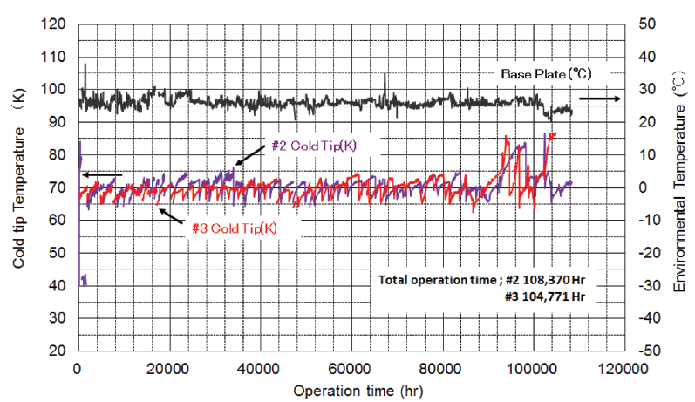
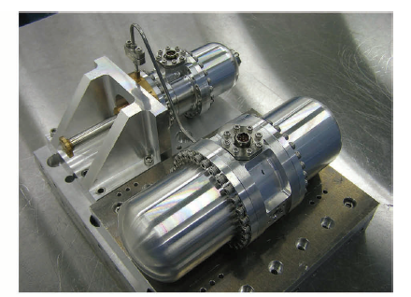
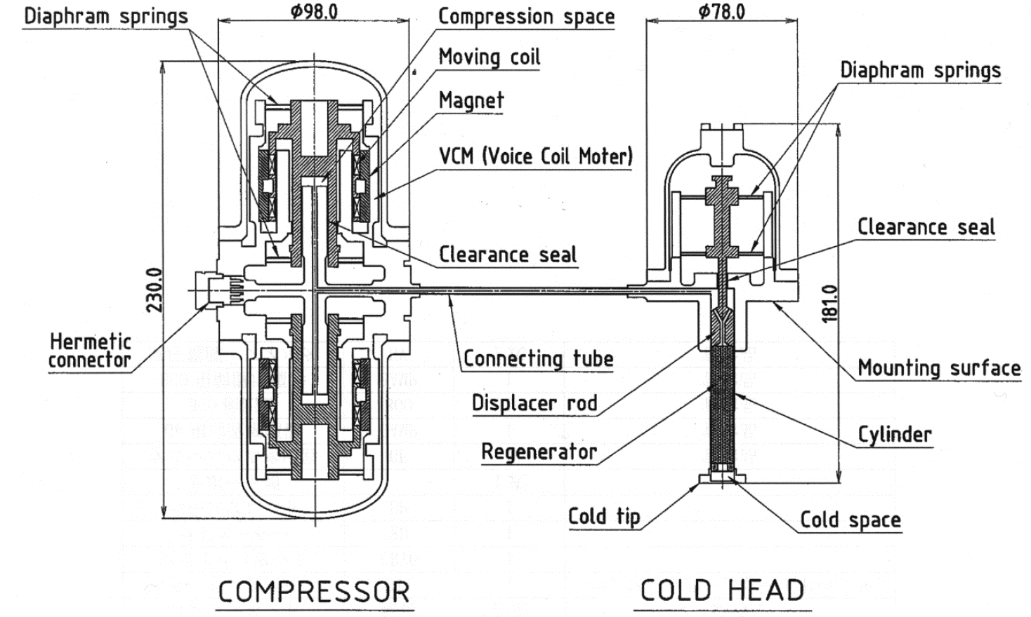
Background
Outgas reduction and prediction for Single-stage Stirling (1ST) cooler
GCOM-C1 spacecraft target lifetime : 5years
1ST lifetime test record: 5 years or more
50K-class cooling is need for the GCOM-C1, Lower temperature
Ensure reliable lifetime for the 1ST cooler
Nominal
Cooling capacity 2W@80K
Power consumption 50W
Ground lifetime test result of the 1ST cooler *1
■Activity1 (not included in this presentation)
Cryocooler accelerated test with increase the temperature
-Acceleration factor estimated from adsorption energy
Equivalent adsorption energy
Compared measured adsorption energy between cooler level and parts level
■Activity2 ( in this investigation)
Cryocooler materials and components outgassing rate measurement
*1 K. Narasaki et al., “Lifetime test and heritage on-orbit of SHI coolers for space use”, crocoolers19,2016
*2 K. Narasaki et al., “Development of Single Stage Stirling Cooler for Space Use”, AIP Conf. Proc. 823 1505–12, 2006
Schematic diagram of 1ST cooler *2
Notes:
Here, I will show background in this investigation
Outgas reduction and prediction for Single-stage Stirling (1ST) cooler is need for GCOM-C1
upside of Right figure shows lifetime test result in the ground
It has record of over 10 years driving
To ensure reliable lifetime for
We proceeded two activities. One is ~ another is ~
downside of Right figure shows schematic~
You can see Constituent material of the cooler~, here is ~

Slide 5
Objectives
1. To understand the difference in results due to differences in outgassing methods
→ Measure the outgas with 3 types of outgas measurement method
Each test pieces is equivalent to parts of comprised of 1 unit of 1ST cooler
2. To clarify outgassing rate for the materials and components of the 1ST cooler
→ Measure the outgas of the several non-metallic materials and components
3. To evaluate the effect on both atmospheric exposure and baking
Comparison of difference for measurement method
Comparison of difference for exposure time
Test pieces of the outgas measurement test
3types of outgas measurement
(1) Outgas measurement in general ---Test A
(2) Outgassing rate measurement by QCM ---Test B
* QCM = Quartz Crystal Microbalance
(3) Outgassing rate measurement by API-MS ---Test C
* Atmospheric Pressure Ionization Mass Spectrometer

Slide 6
Table of contents
Background and objectives in this research
3 types of outgas measurement method
  Outgas measurement in general
  Outgassing rate measurement by using QCM
  Outgassing rate measurement by using API-MS
Estimate method for both outgassing rate and adsorption energy
Results & Discussion :
  Adsorption energy
  Atmospheric exposure time effect
  Outgassing comparison
  Additional baking effect
3. Summary and future study

Slide 7
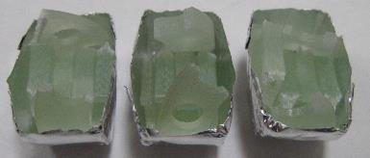
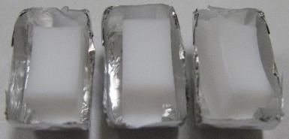
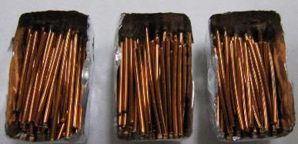
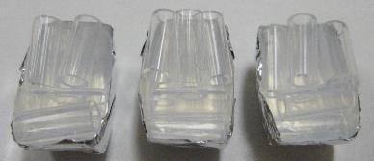
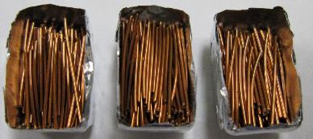
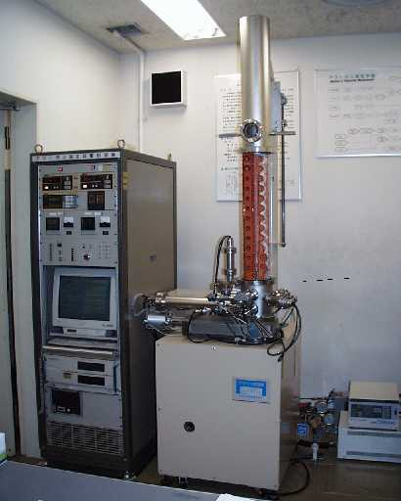
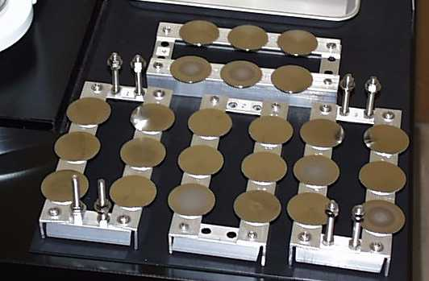
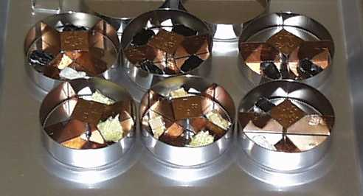
Test method – Outgas measurement in general – Test A
Outgas measurement by total mass loss in a vacuum environment (standard method, ASTM E595-07)
5 pieces of the 1ST cooler constituent materials
Low cost, 5 samples measure at on time, size restricted, measure the change amount before and after the test
GFRP parts is highest TML (~outgas rate) than other resin materials
Heating temperature : 125±1 ºC
Cooling temperature : 23±2 ºC
Measurement time : 24 hours
Vacuum condition : below 7.0×10⁻³ Pa
GFRP parts
PTFE parts
Polyamide-imide covering
Teflon parts
Polyimide covering
Picture of test pieces
Test A outgas measurement result
Picture of condensable collect plate
Picture of measurement apparatus
Picture of vessel with test sample
TML : Total Mass Loss CVCM : Collected Condensable Materials
WVR : Water Vapor Regained

Slide 8
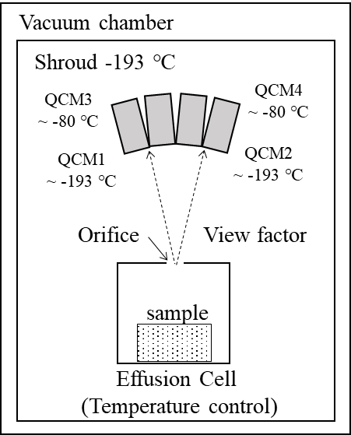
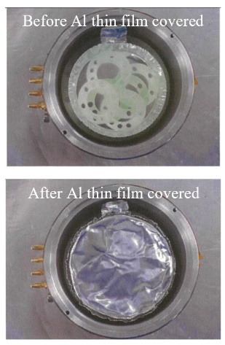
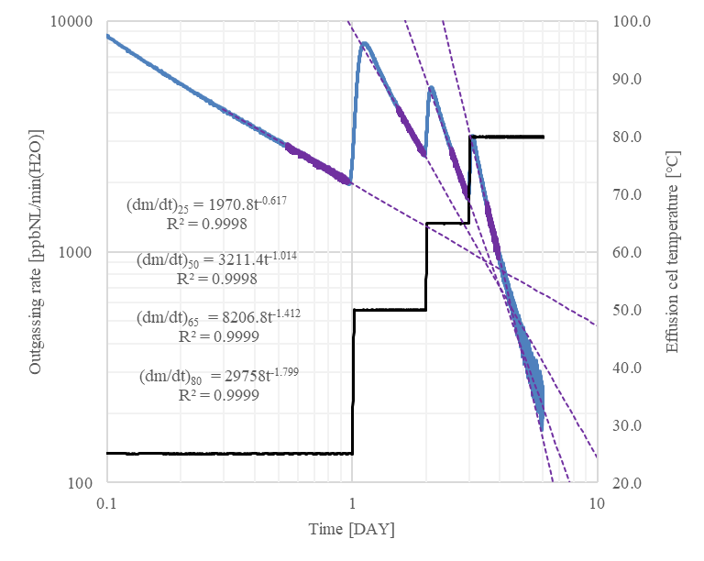
Test method – Outgassing rate measurement by QCM – Test B
Outgas measurement using the QCM in a vacuum environment (like as standard method, ASTM E1559-09 and ECSS-Q-TM-70-52A)
The periphery of the path from the orifice to the QCM is surrounded by a cooled shroud, so no influence of gas discharge from the wall surface.
Calculate the TML in consideration of the increment of the frequency, mass and surface area of samples, view factor between Orifice and QCM
Low cost in comparison with API-MS , Real-time outgassing
Estimate the Influence of the air exposure time from the results
QCM1 &QCM2 temperature : -193 ºC
QCM3 &QCM4 temperature : -80 ºC
Effusion cell temperature : 25 ºC→ 50ºC → 65 ºC → 80 ºC
Vacuum condition : ~10⁻⁷Pa
Outline of measurement apparatus
Sample setup view
Typical measured outgassing rate
( in case of GFRP parts measurement)

Slide 9
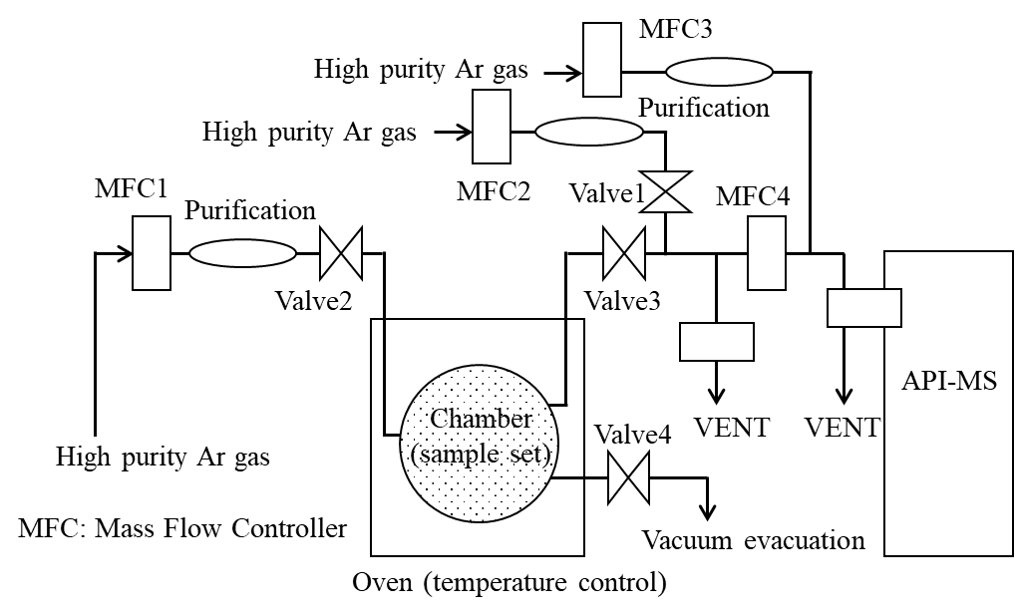
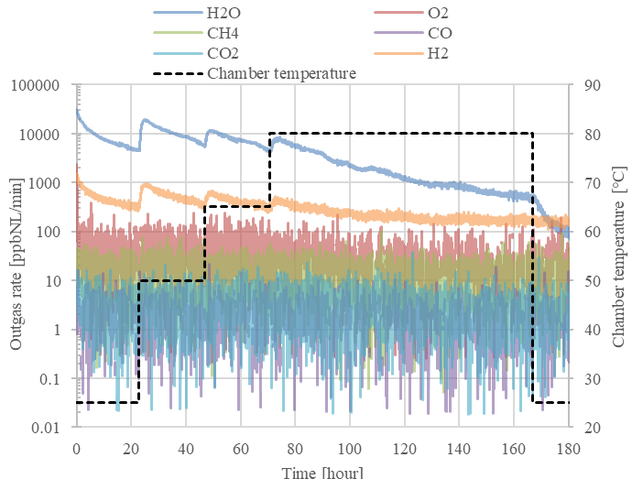
Test method – Outgassing rate measurement by API-MS – Test C
Outgas measurement using API-MS in a argon gas flowing environment
Highly accurate measurement on the order of ppb is possible while circulating helium gas as the material to be measured.
High cost, High accuracy (1ppbNL/min), Real-time outgassing at flow condition, classify measured gas type
Several gases other than outgassing rate is 1 order or less small than water
Sample setup view
Outline of measurement apparatus
Typical measured outgassing rate( in case of GFRP parts measurement)
Notes:
It is important to ①
This figure shows the gas analysis system fabricated for the assembled cryocooler that consists of the He gas purification system with the 4K-GM (Gifford-McMahon) cooler, getter, circulation compressor, and the API-MS.
The purified He gas flows into the cryocooler and carries the impurity gas molecules. Part of the He gas flow from the cryocooler is provided to the API-MS and residual He gas flows back to the gas purification loop. The He tank provides lost He gas consumed at the API-MS to maintain a constant flow rate.
Gas pressure in the loop was maintained at 1.0 MPa (G) and the He flow rate was controlled with 0.2 and 1 NL/min. Room temperature and 50 C were selected as the environmental temperatures of the 2ST cooler.

Slide 10
Table of contents
Background and objectives in this research
3 types of outgas measurement method
  Outgas measurement in general
  Outgassing rate measurement by using QCM
  Outgassing rate measurement by using API-MS
Estimate method for both outgassing rate and adsorption energy
Results & Discussion :
  Adsorption energy
  Atmospheric exposure time effect
  Outgassing comparison
  Additional baking effect
3. Summary and future study

Slide 11

Estimate method for both outgassing rate and adsorption energy
Approximate expressions are obtained by fitting data of 10 hours after 13 hours of temperature change
The adsorption energy is calculated within the temperature range at the time of measurement and it is extended and used for estimating outgas rate at a temperature outside the measurement temperature range
The outgassing rate is expressed by equation (1) in general
$\frac{dm}{dt}∝exp\left(−\frac{E}{RT}\right)$ (1)
$E_{T_{1}T_{2}}=R\left(\frac{{T_{1}T}_{2}}{T_{1}−T_{2}}\right)ln\left(k\right)$ where, $k=\frac{ORG1}{ORG2}=\frac{{\left(\frac{dm}{dt}\right)}_{T1}}{{\left(\frac{dm}{dt}\right)}_{T2}}$ (2)
$\frac{dm}{dt}={α\left(t+t_{0}\right)}^{−β}$ (3)
The adsorption energy is calculated from the outgas rate
at different temperatures using equation (2)
The outgassing rate is expressed by equation (3) in this investigation to predict long-term outgassing trend by approximate expression from the data
Calculate coefficients α and β by fitting outgas rate measurement data
Typical measured outgassing rate
( in case of GFRP parts measurement)

Slide 12
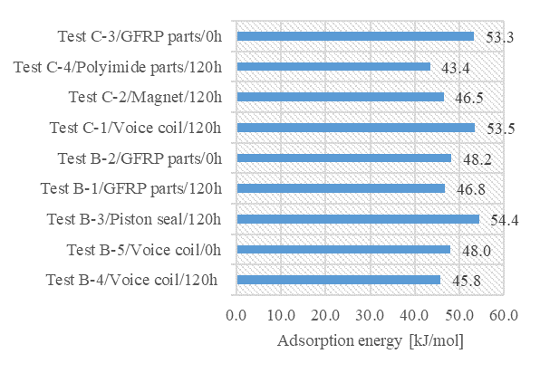
Adsorption energy
Estimated adsorption energy from 25 ºC to 75 ºC by the results of outgassing measurement
The adsorption energy of the measured cooler constituent material was in the range of 43.4 kJ/mol to 54.4 kJ/mol.
Typical outgassing rate trend (in case of Test B-2, QCM-test)
Estimated adsorption energy from 25 ºC to 75 ºC
Estimated adsorption energy from the result of Test B-2
When baking temperature changes from 25 ºC to 75 ºC ,
acceleration factor varies from 12.9 to 22.5.
- E = 43.4kJ/mol → Outgassing acceleration factor is about 12.9
- E = 54.4kJ/mol → Outgassing acceleration factor is about 22.5

Slide 13
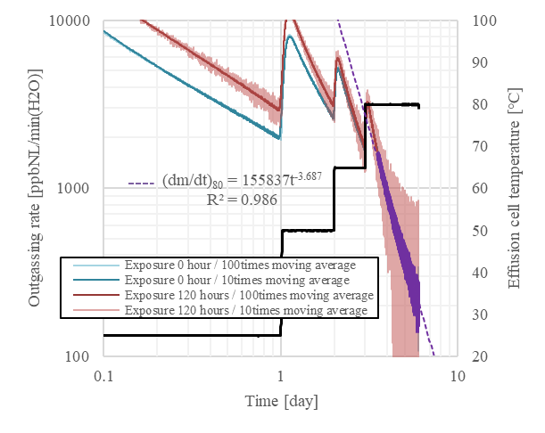
Atmospheric exposure time effect on the outgassing rate
Outgassing rate measurement results after 120 hours air exposure of GFRP parts and without exposure.
* GFRP parts is dominant outgassing source
Although the initial outgassing rate is different, the difference between two outgassing lines at 80 ºC has almost no change.
The influence of exposure can be neglected in case of conducting baking more than a certain amount.
Even if it is exposed to the atmospheric environment at the manufacturing and assembly process.
There is no problem if sufficient baking is carried out after assembly.
Atmospheric exposure effects on outgassing rate can be neglected within 120 hours exposure in manufacturing

Slide 14
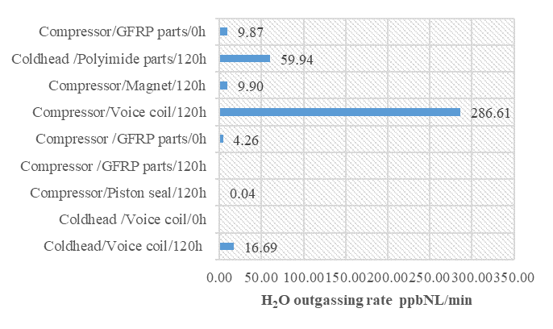
Outgassing rate comparison after cooler level baking simulated
Prediction result of outgassing rate when performing up to baking after assembly
The difference between QCM test and the API-MS test was about 2.3 times as large as that of GFRP, which is likely to be affected by the difference in air ambient environment at the time of measurement
Outgassing rate of the cold head polyimide part and compressor voice coil was dominant. In addition, outgassing rate exceed an acceptable outgassing rate level (about 1 ppb NL/min) for almost materials. *GFRP material is used for voice coil
Outgassing can be reduced by gas purification after assembly, additional baking is needed for more efficient gas purification.
API-MS test
QCM test

Slide 15
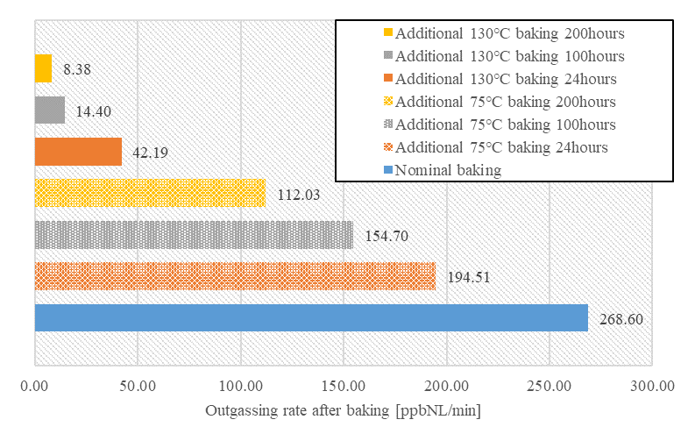
Additional baking effect on the outgassing rate
Additional baking at 130 ºC , it is expected that the outgassing rate will be greatly reduced
- decrease by 2 orders from nominal to additional 200hours
Additional baking at 75 ºC , it is expected that the outgassing rate will be slightly reduced
- approximately halved by nominal to additional 200hours
Materials with low heat resistance are used, and for materials that are difficult to raise the temperature above 75 ºC , baking time is increased
Additional baking to shorten the gas purification period after assembly of the cooler was effective.
As another method, H₂O content can be reduced by Tayler discharge cleaning method or gas substitution by discharge cleaning with inert gas such as argon
Additional baking effect on compressor voice coil
Possible to reduce the outgassing rate of 2 orders when the baking temperature can be set to 130 ºC or more.

Slide 16
Summary
Three types of outgas measurement test were carried out for constituent materials of single-stage Stirling cooler, then the adsorption energy and the outgassing rate relative comparisons were carried out.
1. To understand the difference in results due to differences in outgassing methods
The difference between QCM test and the API-MS test was about 2.3 times as large as that of GFRP, which is likely to be affected by the difference in air ambient environment at the time of measurement
The inside of the cooler is an environment filled with helium gas, API-MS test is good, accurate measurement with high accuracy is possible. On the other hand, the QCM test is inferior in accuracy with compare to API-MS, but it is confirmed that effective data including relative evaluation can be acquired.
2. To clarify outgassing rate for the materials and components of the 1ST cooler
High outgassing rate materials and components such as compressor voice coil and cold head Polyimide parts are clarified.
*GFRP material is used for voice coil
The adsorption energy of the measured cooler constituent material was in the range of 43.4 kJ/mol to 54.4 kJ/mol, when material temperature changes from 25 ºC to 75 ºC
3. To evaluate the effect on both atmospheric exposure and baking
Atmospheric exposure effects on outgassing rate can be neglected within 120 hours exposure in manufacturing.
Based on the measurement results of the main outgassing materials (compressor voice coil), it became clear that it is possible to reduce the outgassing rate of 2 orders when the baking temperature can be set to 130 ºC or more. Additional baking to shorten the gas purification period after assembly of the cooler was effective.

